Slide 1

Digital Design
With an Introduction to the Verilog HDL, VHDL, and SystemVerilog
6th Edition
Chapter 03
Gate-Level Minimization

Slide 2
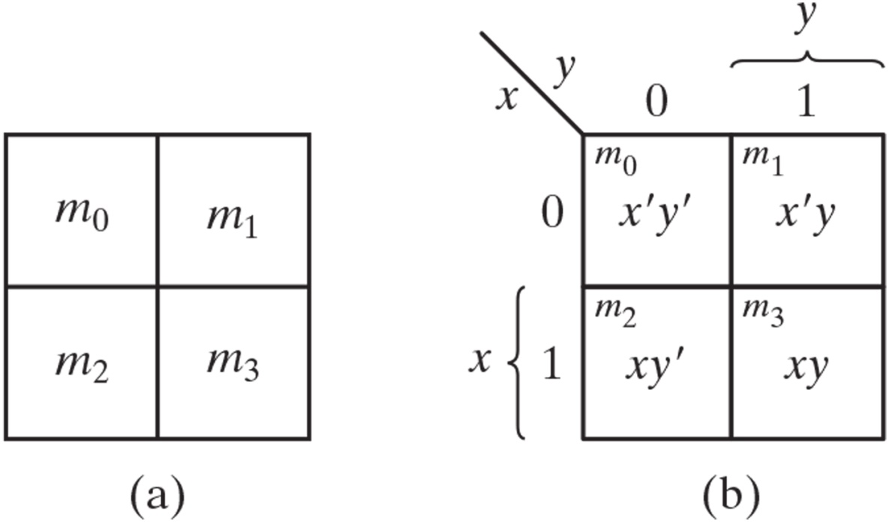
Figure 3.1 Two-variable K-map.

Slide 3
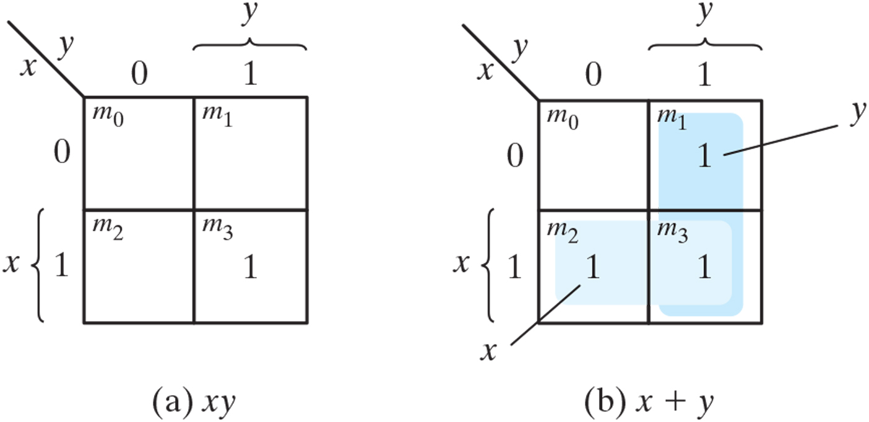
Figure 3.2 Representation of functions in the K-map.

Slide 4
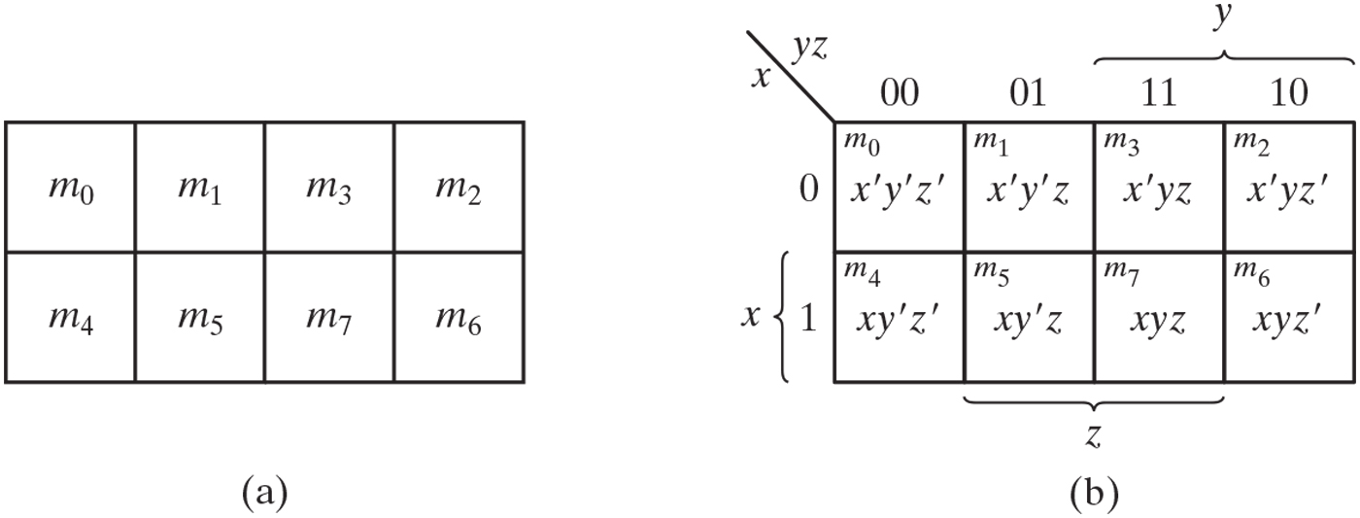
Figure 3.3 Three-variable K-map.

Slide 5
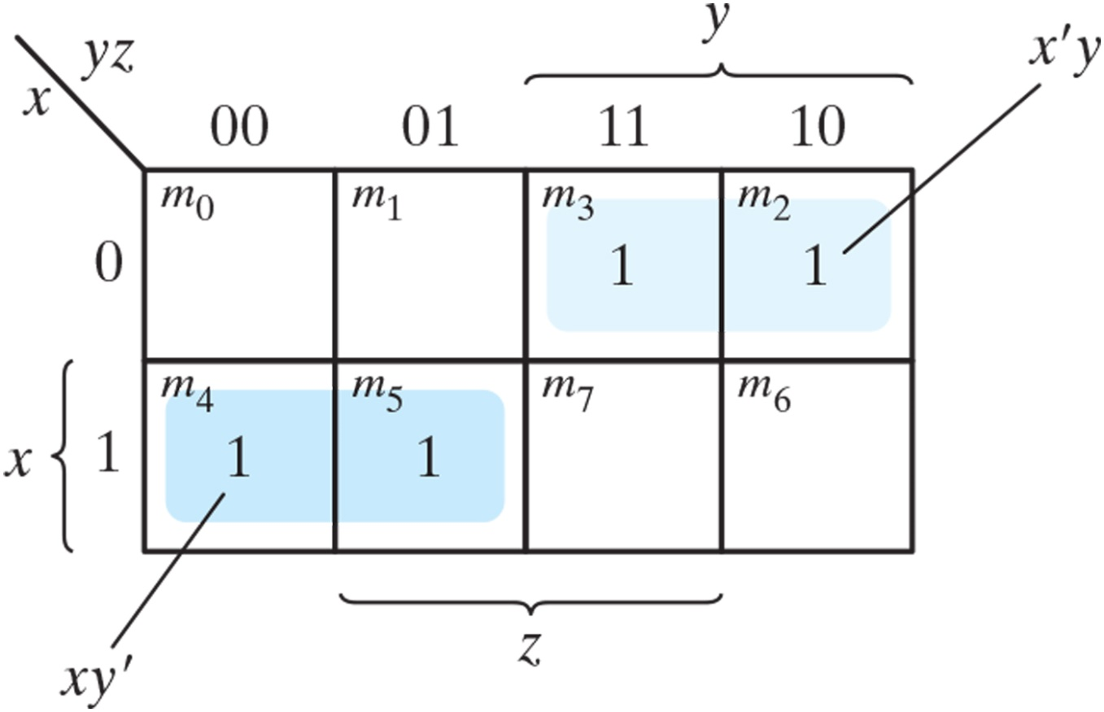
Figure 3.4 Map for Example 3.1, F(x, y, z) = 𝚺(2, 3, 4, 5) = x’y + xy’.

Slide 6
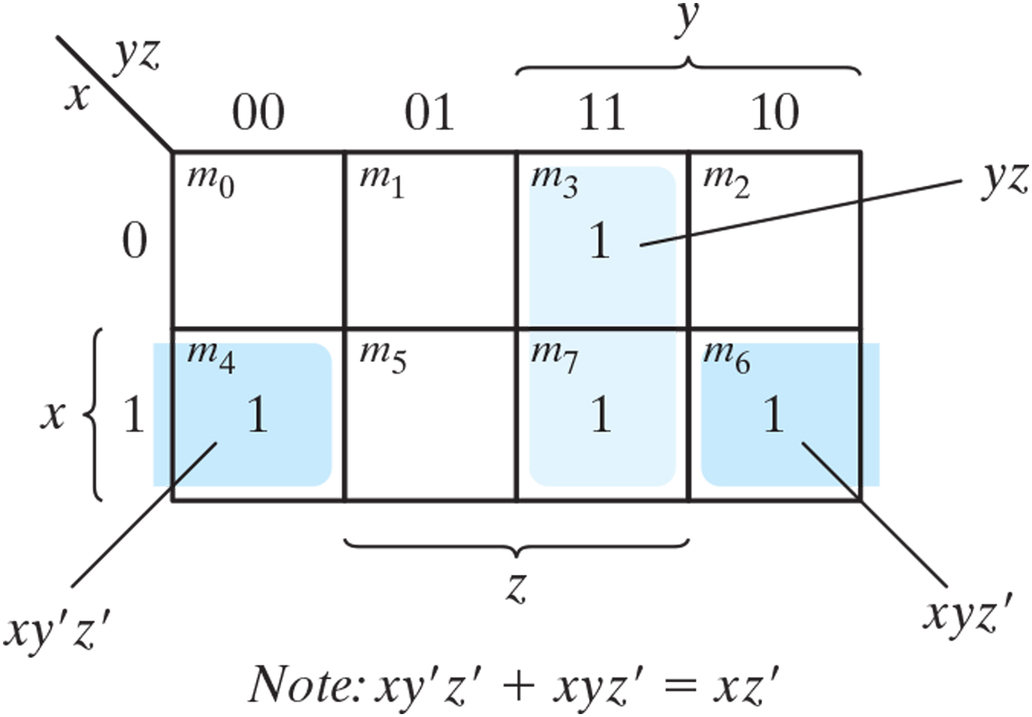
Figure 3.5 Map for Example 3.2, F(x, y, z) = 𝚺(3, 4, 6, 7) = yz + xz’.

Slide 7
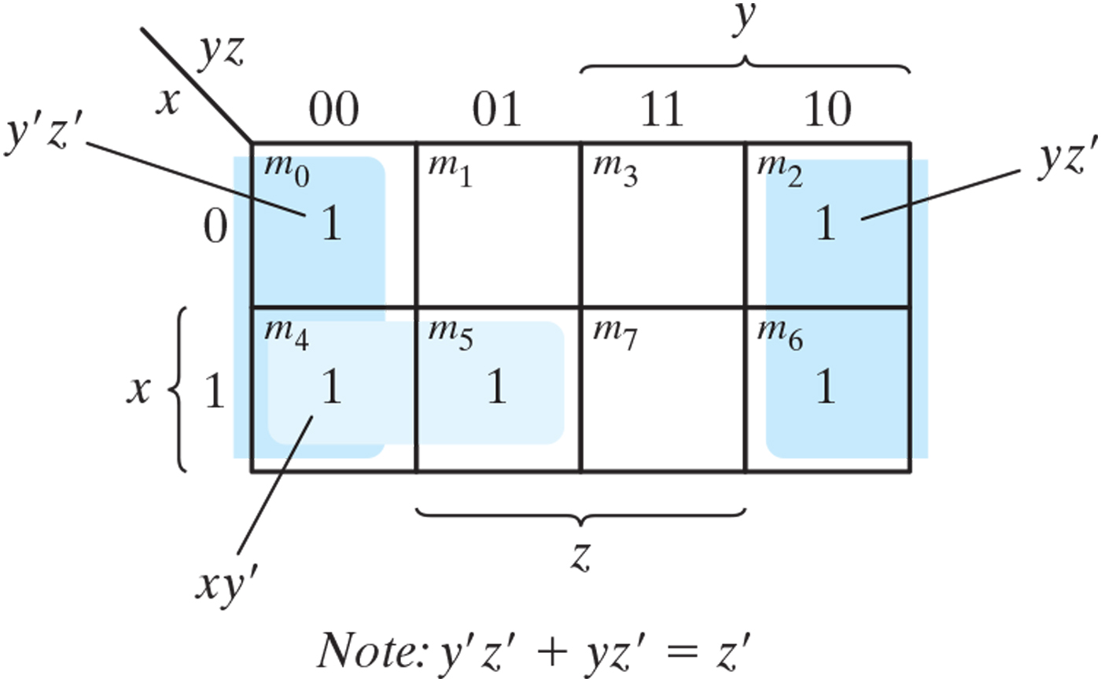
Figure 3.6 Map for Example 3.3, F(x, y, z) = 𝚺(0, 2, 4, 5, 6) = z’ + xy’.

Slide 8
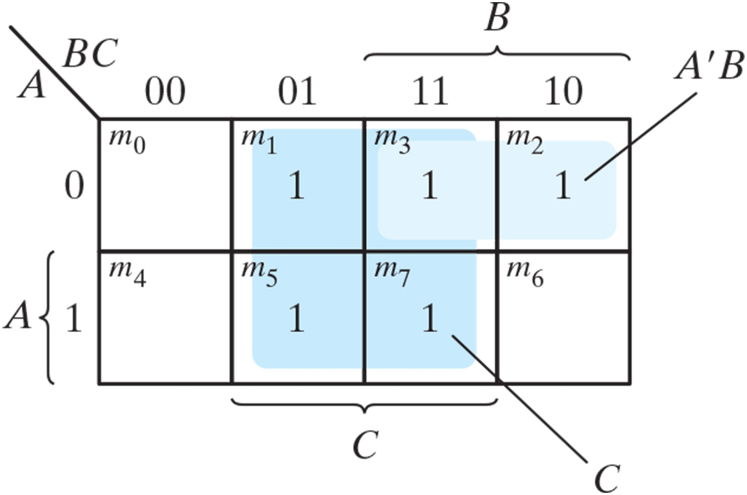
Figure 3.7 Map of Example 3.4, A’C + A’B + AB’C + BC = C + A’B.

Slide 9
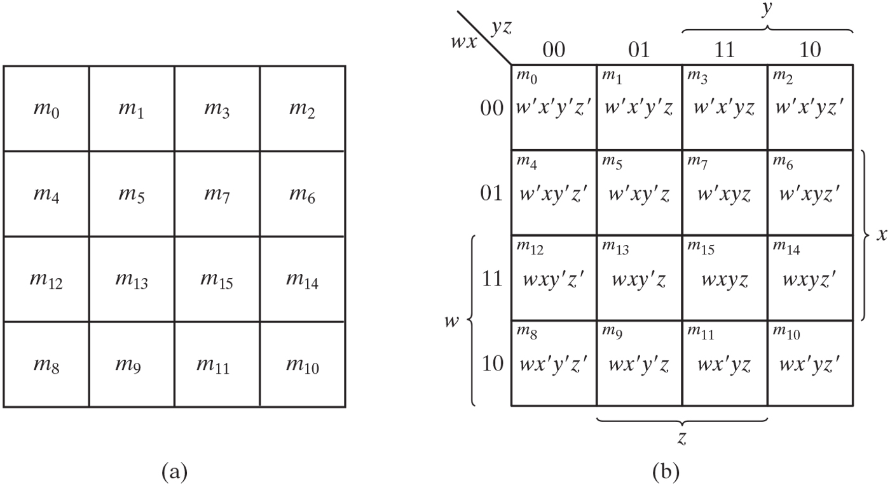
Figure 3.8 Four-variable map.

Slide 10
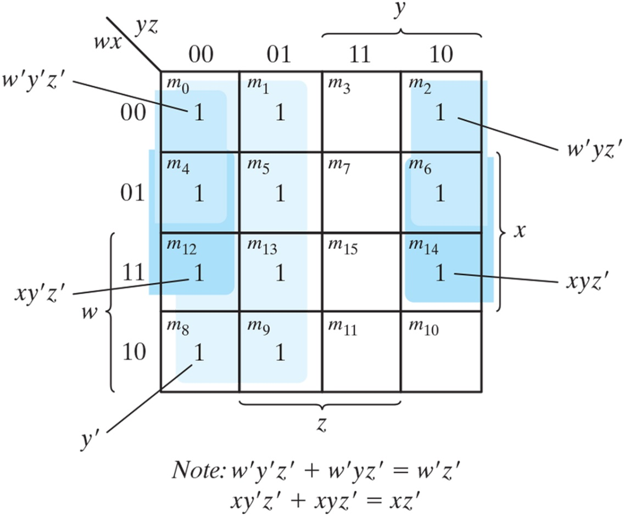
Figure 3.9 Map for Example 3.5, F(w, x, y, z) = 𝚺(0, 1, 2, 4, 5, 6, 8, 9, 12, 13, 14) = y’ + w’z’ + xz’.

Slide 11
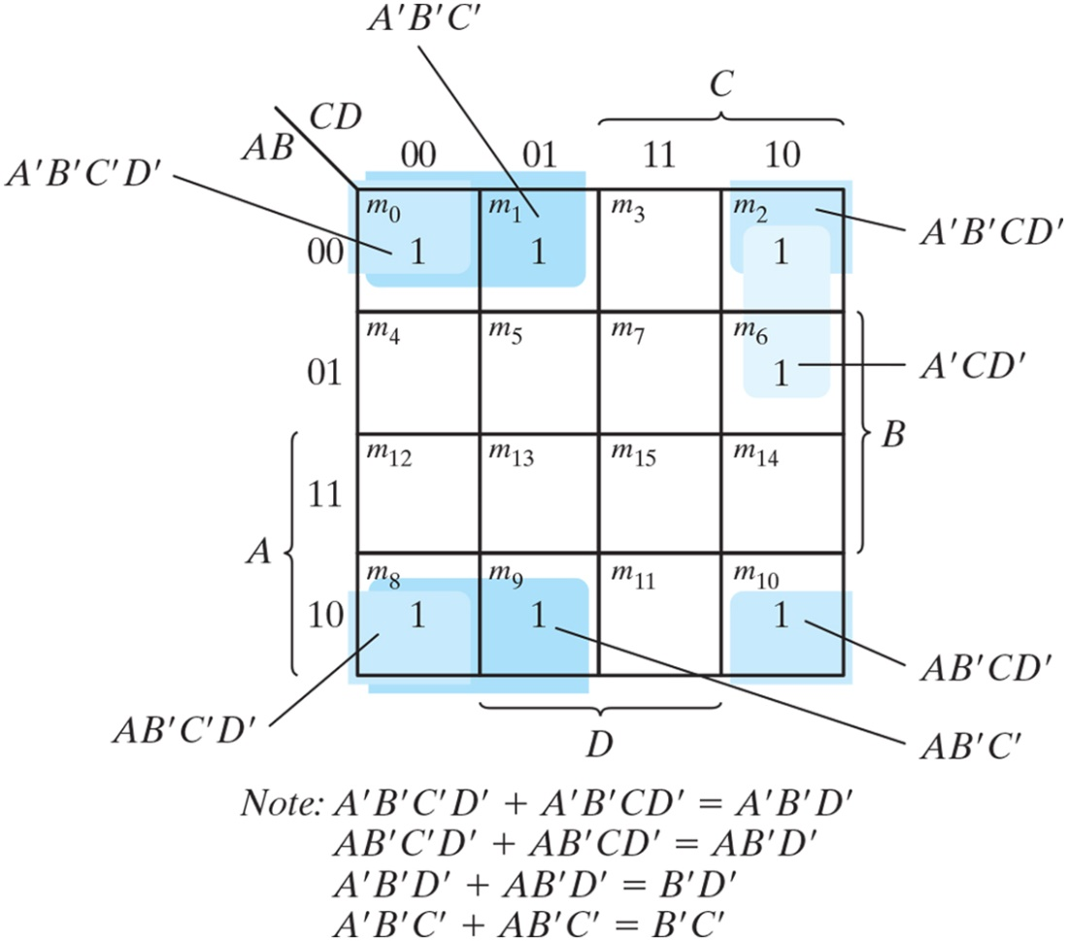
Figure 3.10 Map for Example 3.6, A’B’C’ + B’CD’ + A’BCD’ + AB’C = B’D’ + B’C’ + A’CD’.

Slide 12
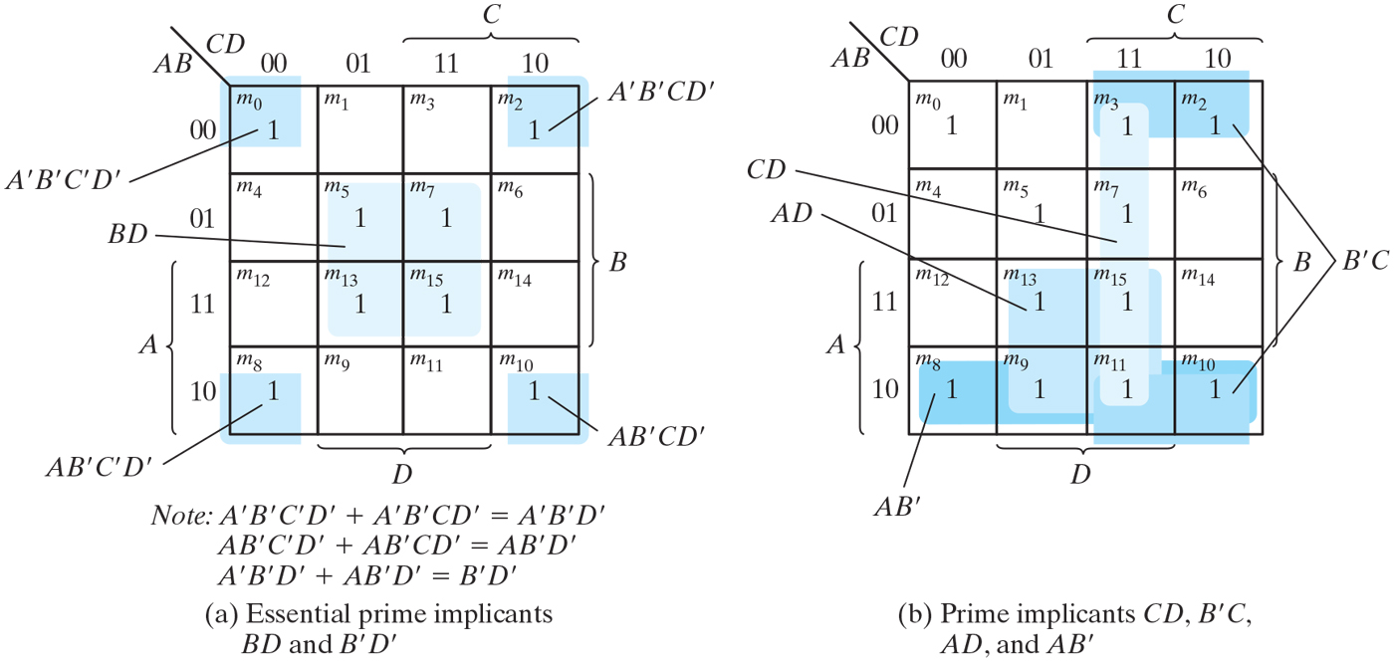
Figure 3.11 Simplification using prime implicants.

Slide 13
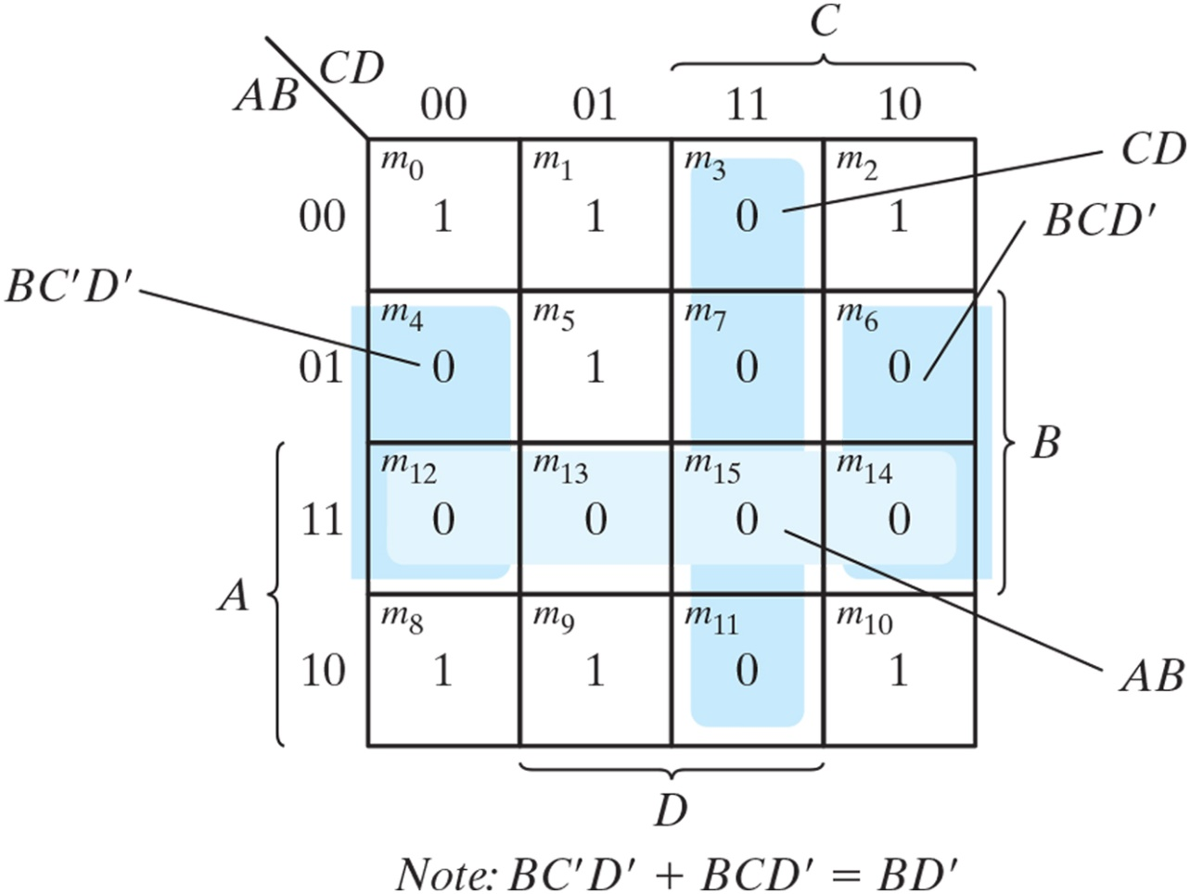
Figure 3.12 Map for Example 3.7, F(A, B, C, D) = 𝚺(0, 1, 2, 5, 8, 9, 10) = BD + BC + ACD = (A’ + B’)(C’ + D’)(B’ + D).

Slide 14
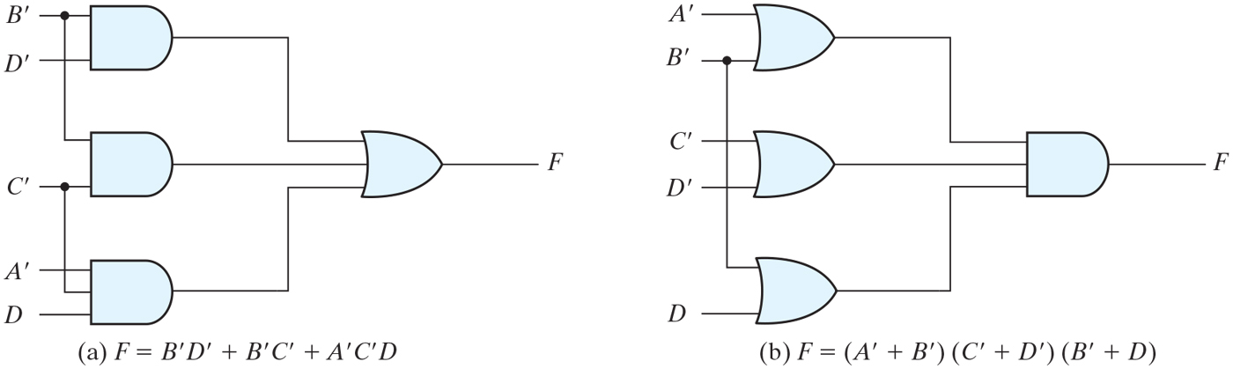
Figure 3.13 Gate implementations of the function of Example 3.7.

Slide 15
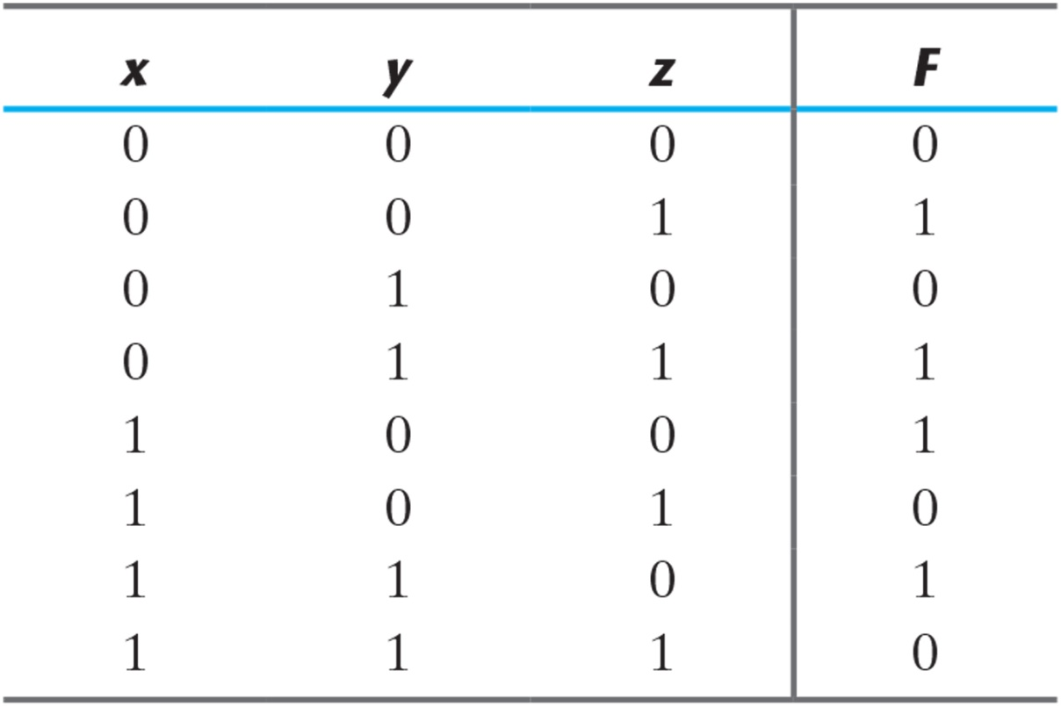
Table 3.1 Truth Table of Function F.

Slide 16
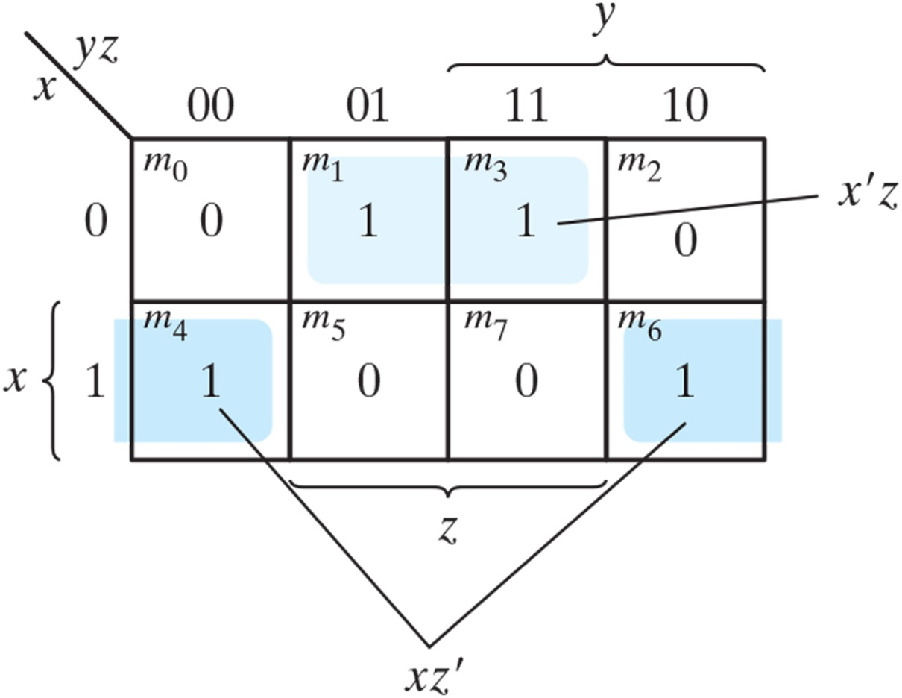
Figure 3.14 Map for the function of Table 3.1.

Slide 17
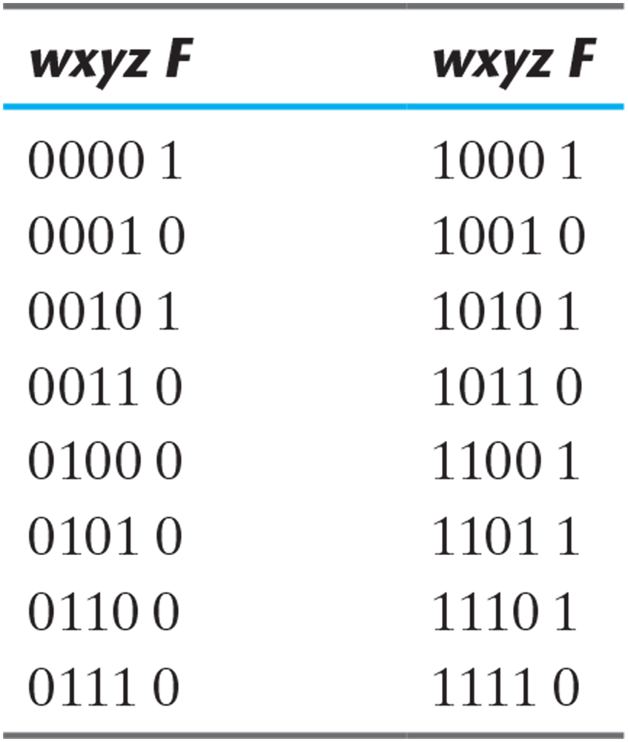
Practice Exercise 3.8

Slide 18
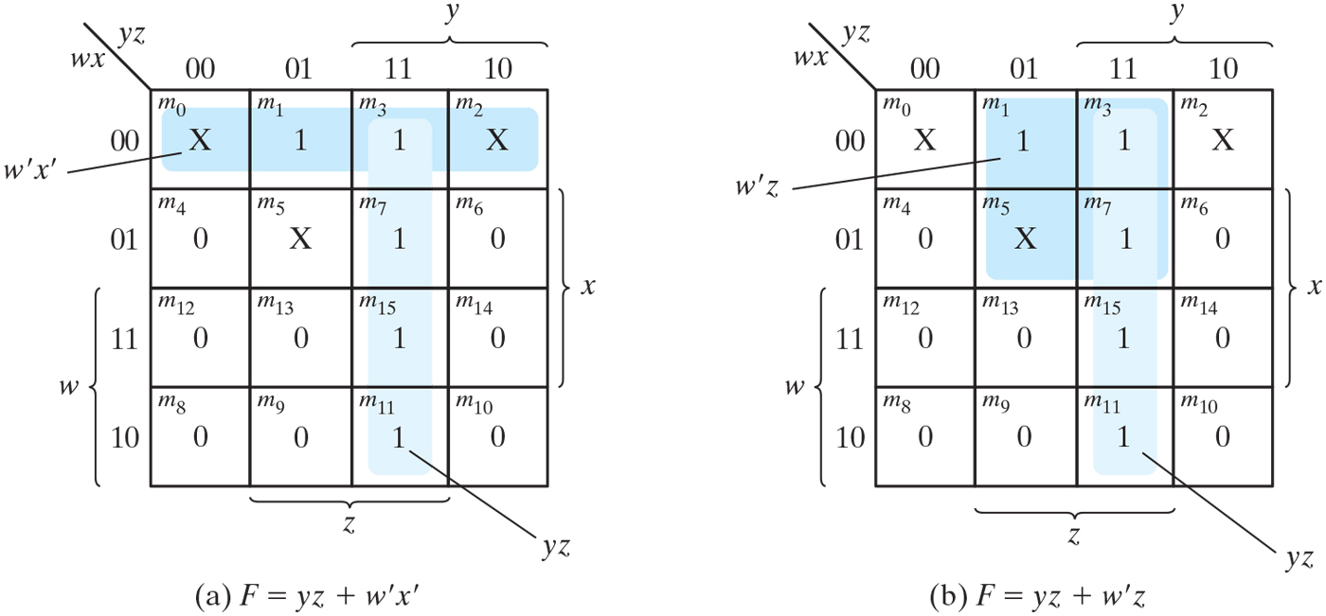
Figure 3.15 Example with don’t-care conditions.

Slide 19
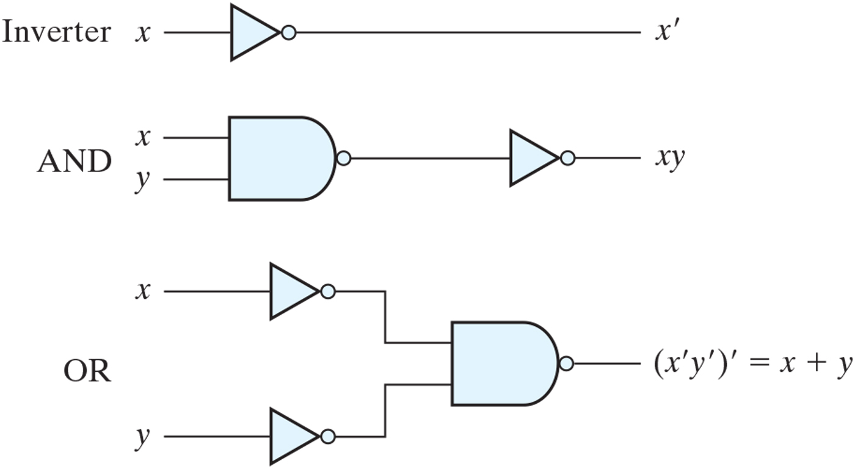
Figure 3.16 Logic operations with NAND gates.

Slide 20
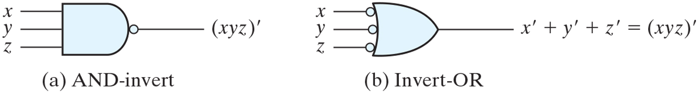
Figure 3.17 Two graphic symbols for a three-input NAND gate.

Slide 21
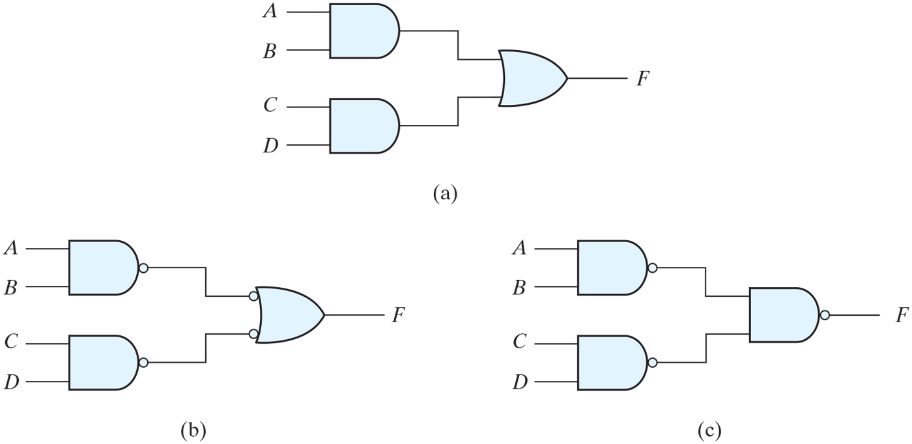
Figure 3.18 Three ways to implement F = AB + CD.

Slide 22
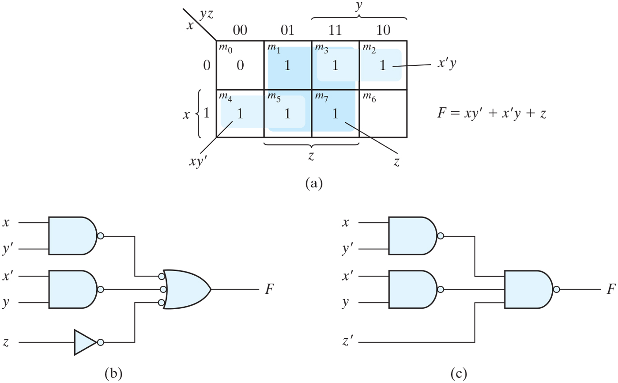
Figure 3.19 Solution to Example 3.9.

Slide 23
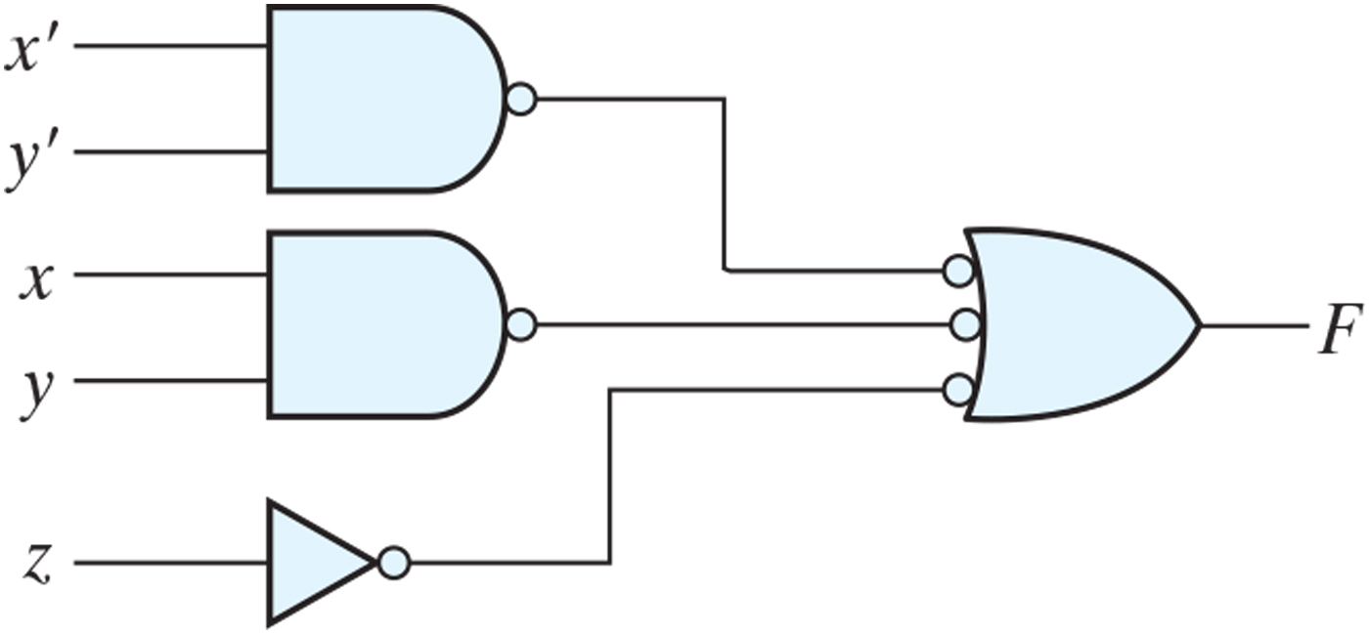
Practice Exercise 3.10

Slide 24
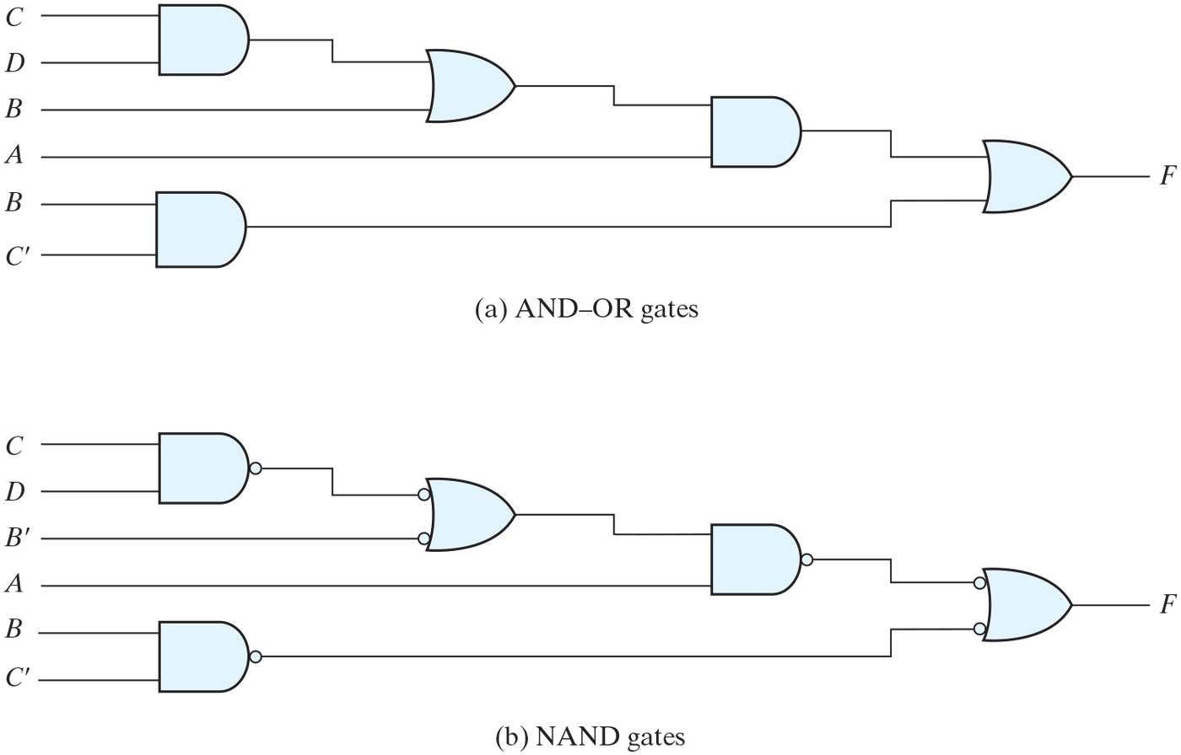
Figure 3.20 Implementing F = A(CD + B) + BC’.

Slide 25
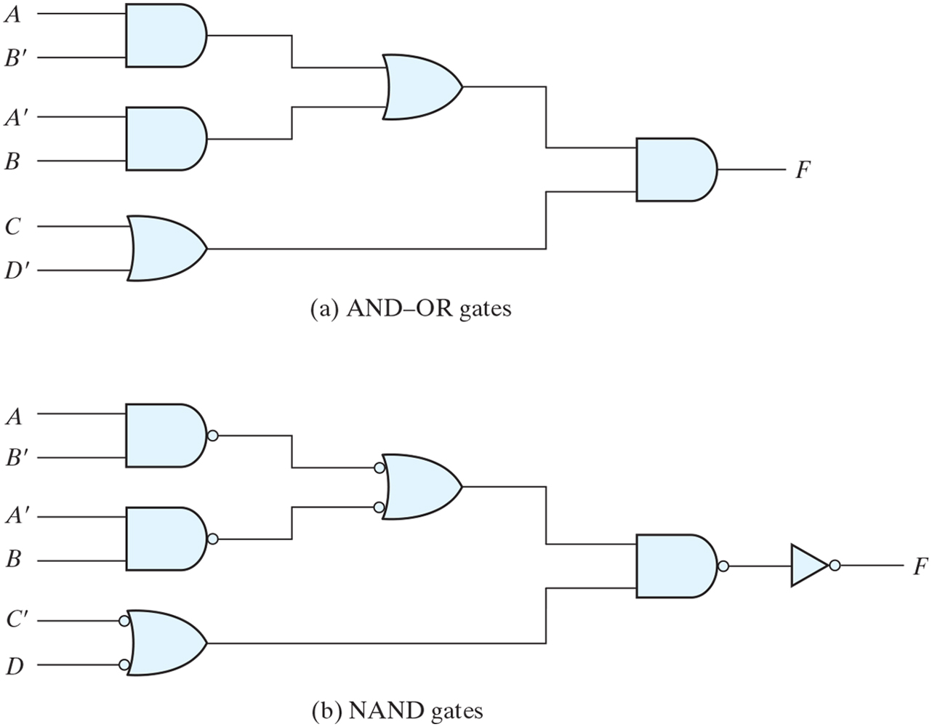
Figure 3.21 Implementing F = (AB’ + A’B)(C + D’).

Slide 26
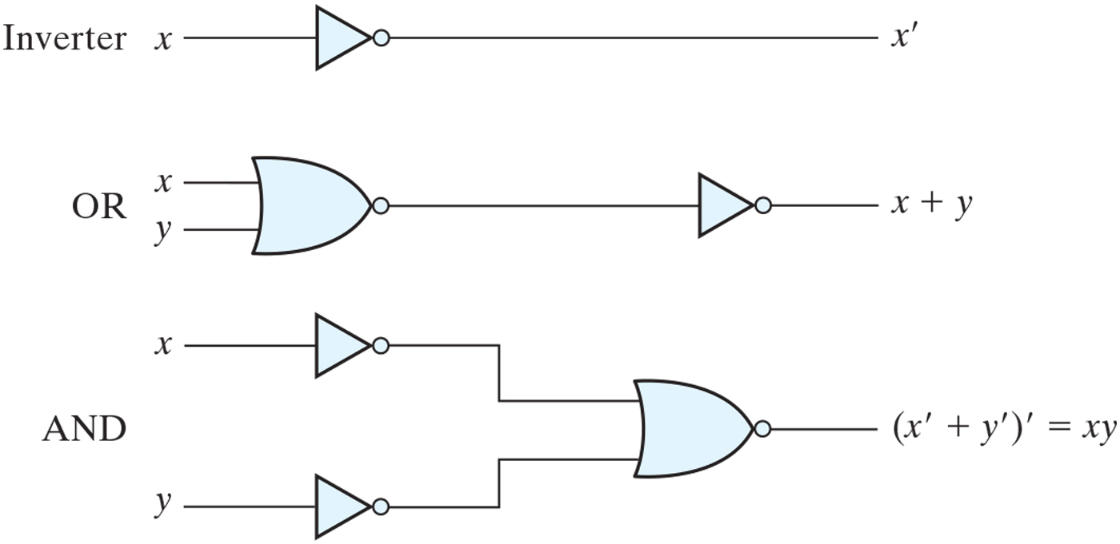
Figure 3.22 Logic operations with NOR gates.

Slide 27
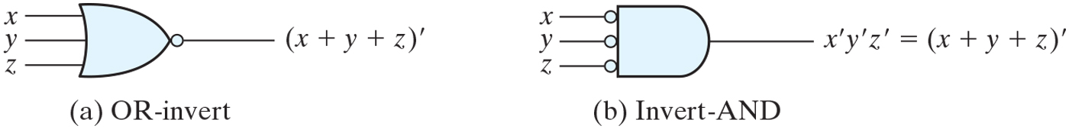
Figure 3.23 Two graphic symbols for the NOR gate.

Slide 28
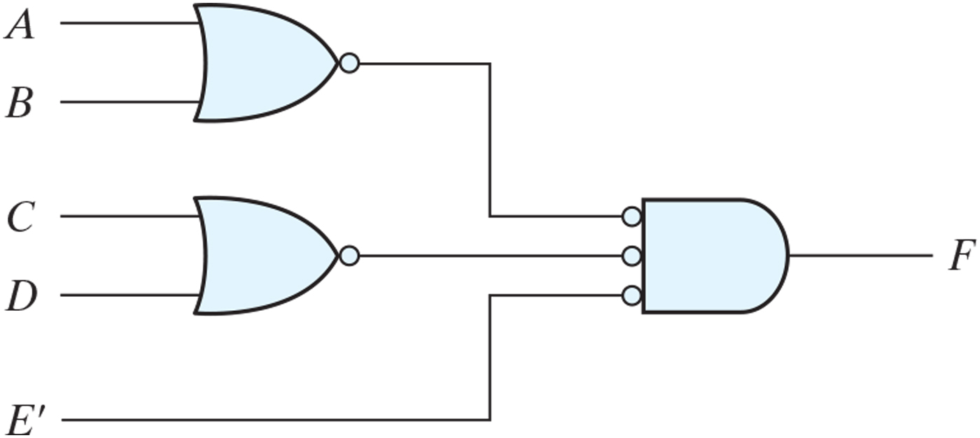
Figure 3.24 Implementing F = (A + B)(C + D)E.

Slide 29
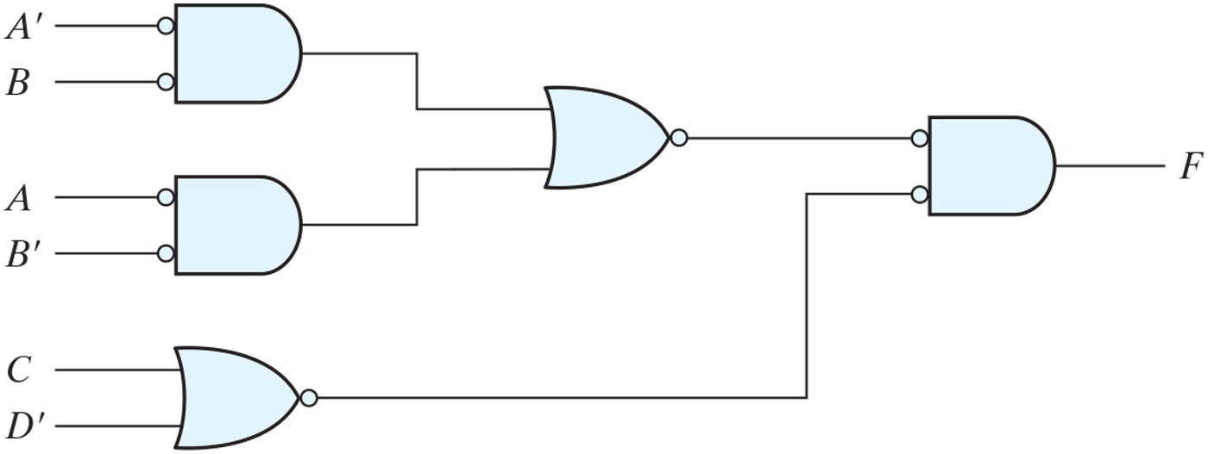
Figure 3.25 Implementing F = (AB’ + A’B)(C + D’) with NOR gates.

Slide 30
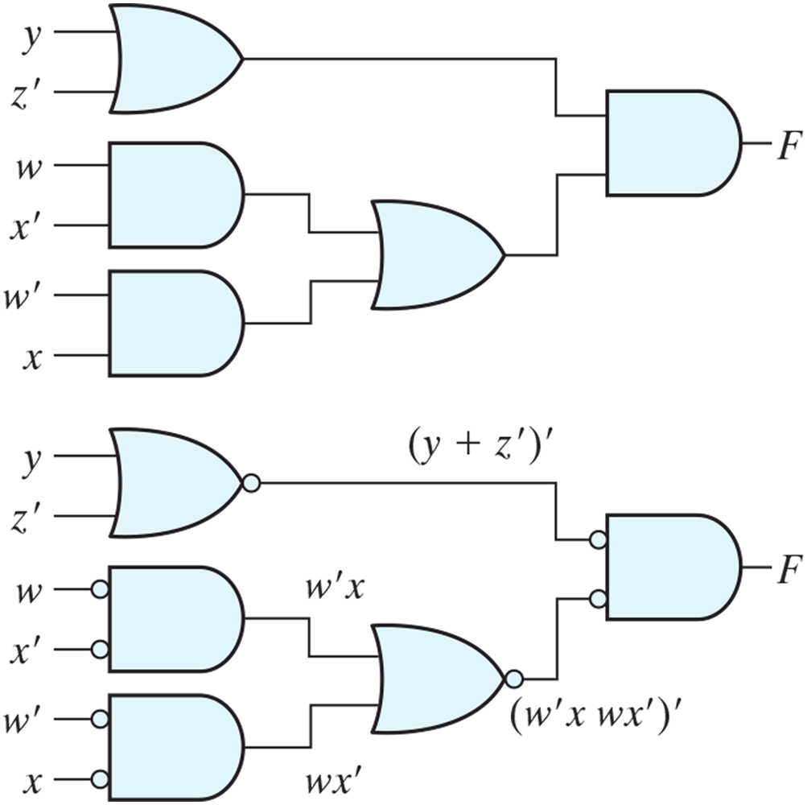
Practice Exercise 3.11

Slide 31
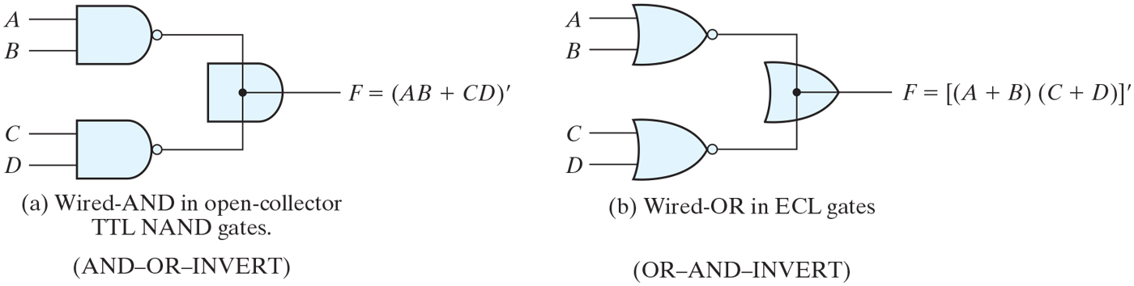
Figure 3.26 Wired logic (a) Wired-AND logic with two NAND gates (b) Wired-OR in emitter-coupled logic (ECL) gates.

Slide 32
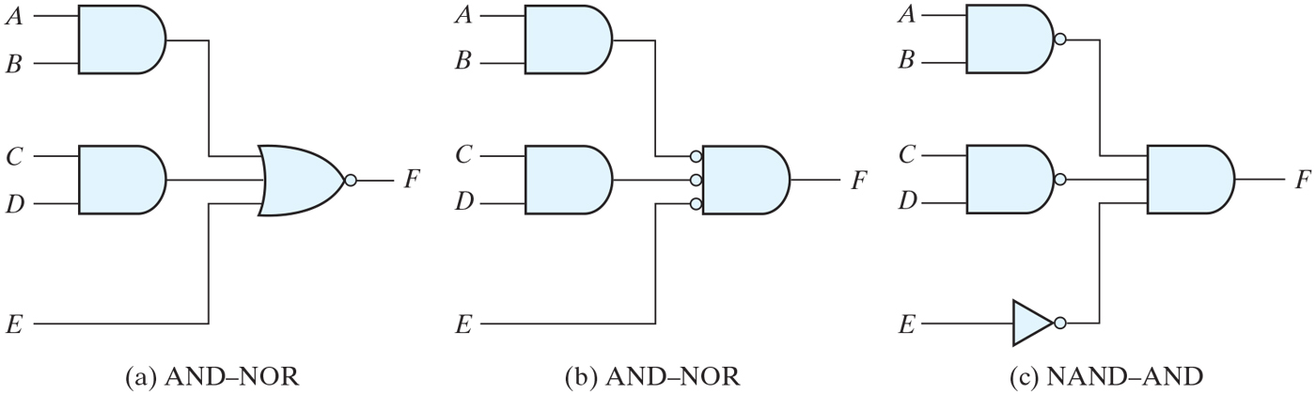
Figure 3.27 AND–OR–INVERT circuits, F = (AB + CD + E)’.

Slide 33
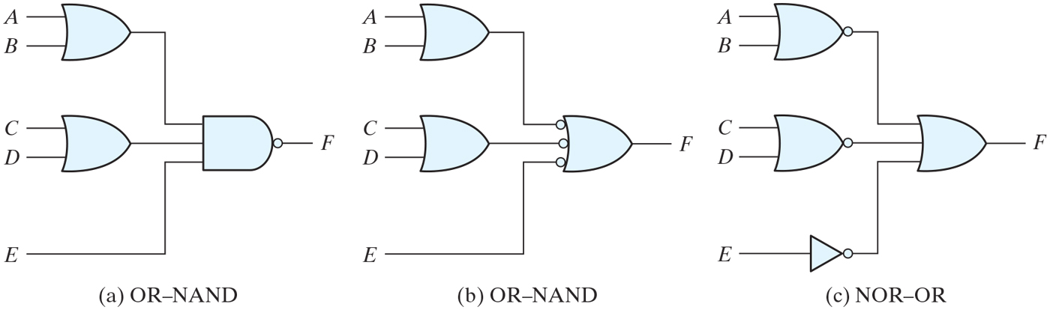
Figure 3.28 OR–AND–INVERT circuits, F = [(A + B)(C + D)E]’.

Slide 34
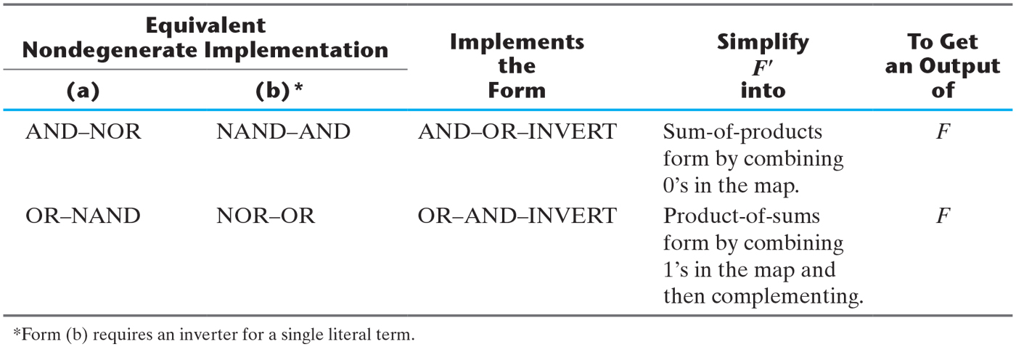
Table 3.2 Implementation with Other Two-Level Forms.

Slide 35
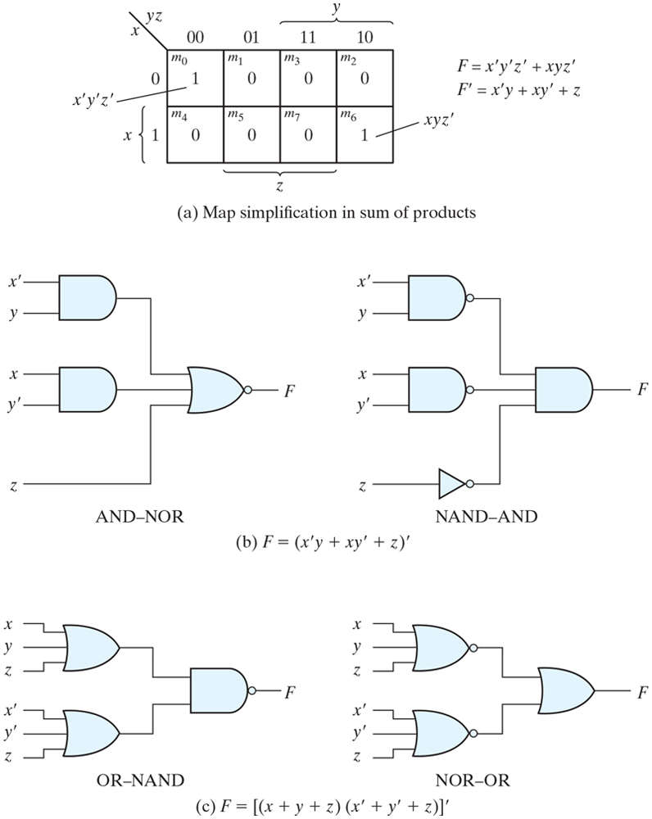
Figure 3.29 Other two-level implementations.

Slide 36
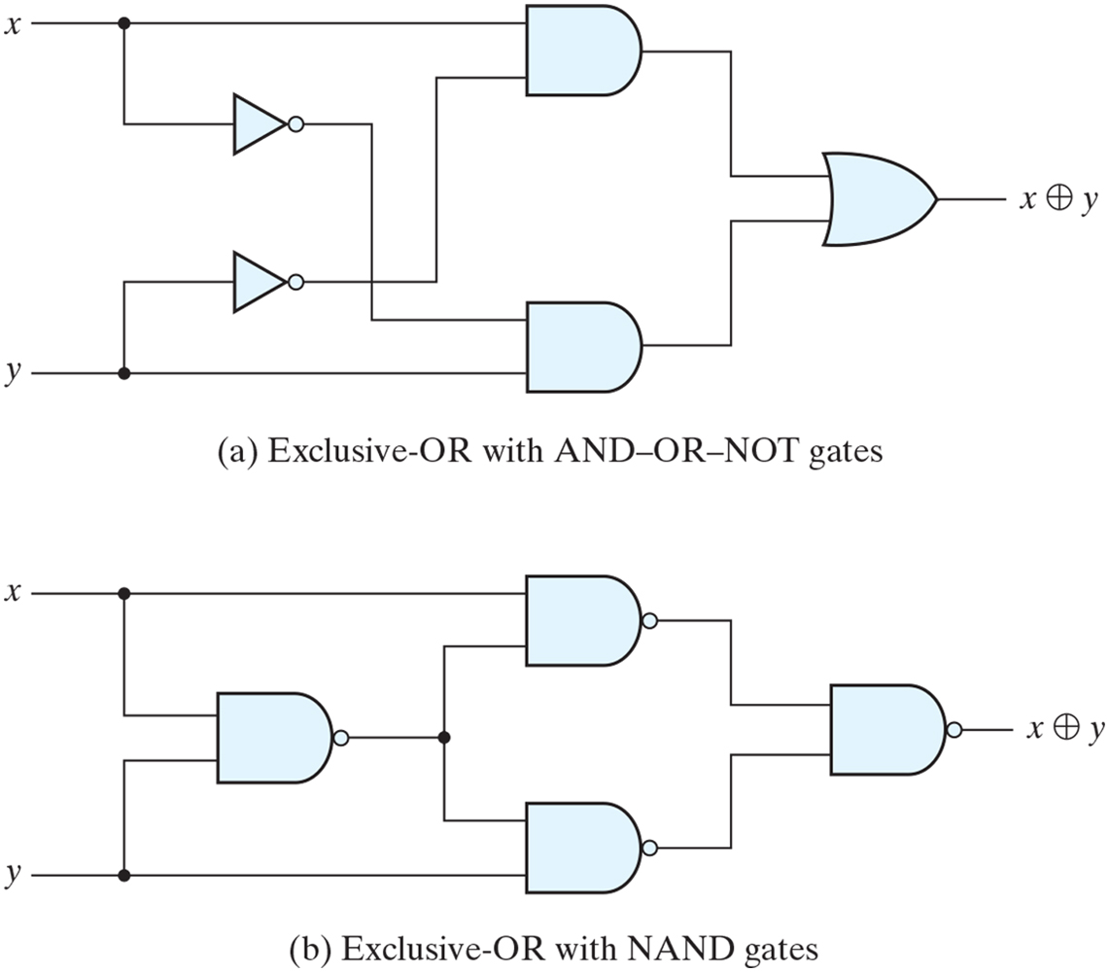
Figure 3.30 Logic diagrams for exclusive-OR implementations.

Slide 37
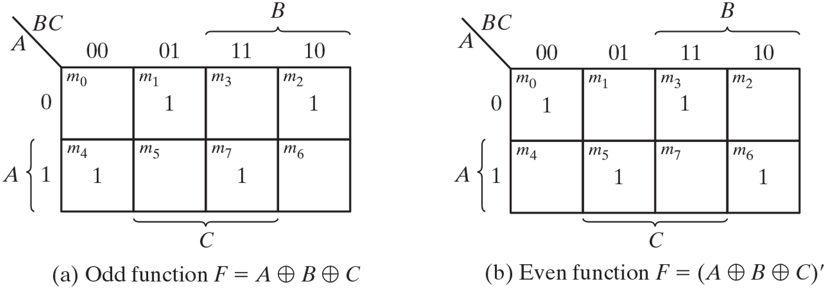
Figure 3.31 Map for a three-variable exclusive-OR function.

Slide 38
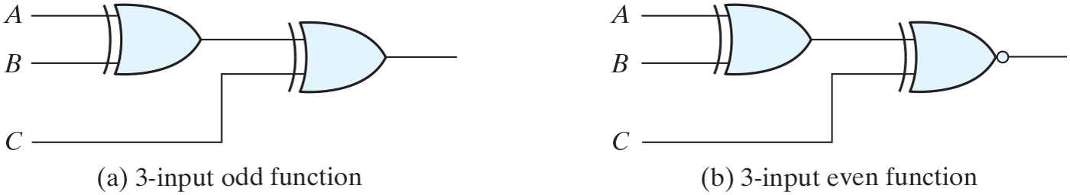
Figure 3.32 Logic diagram of odd and even functions.

Slide 39
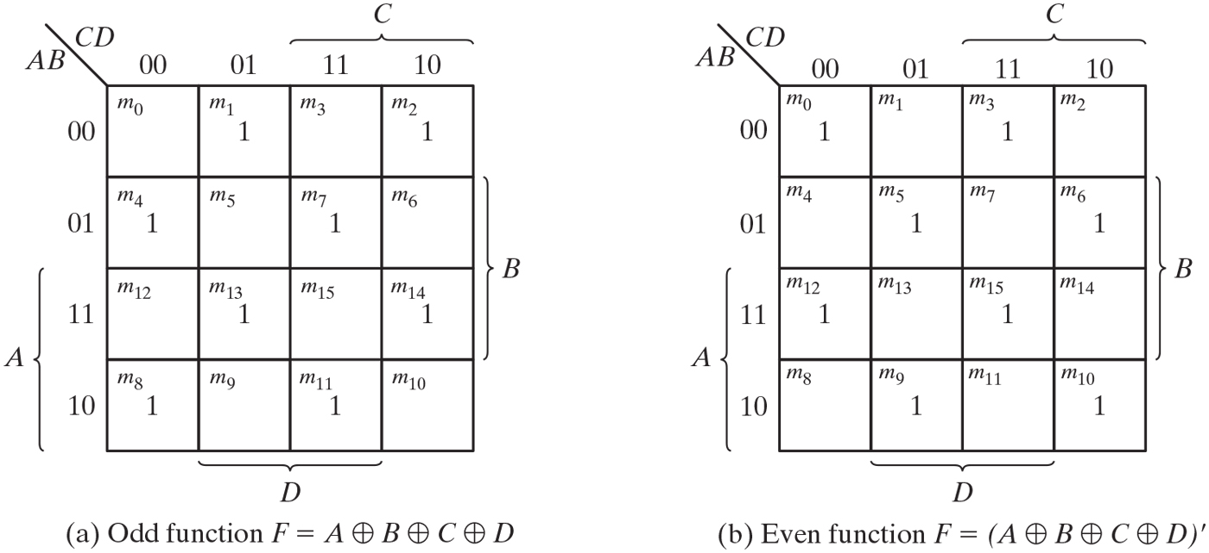
Figure 3.33 Map for a four-variable exclusive-OR function.

Slide 40
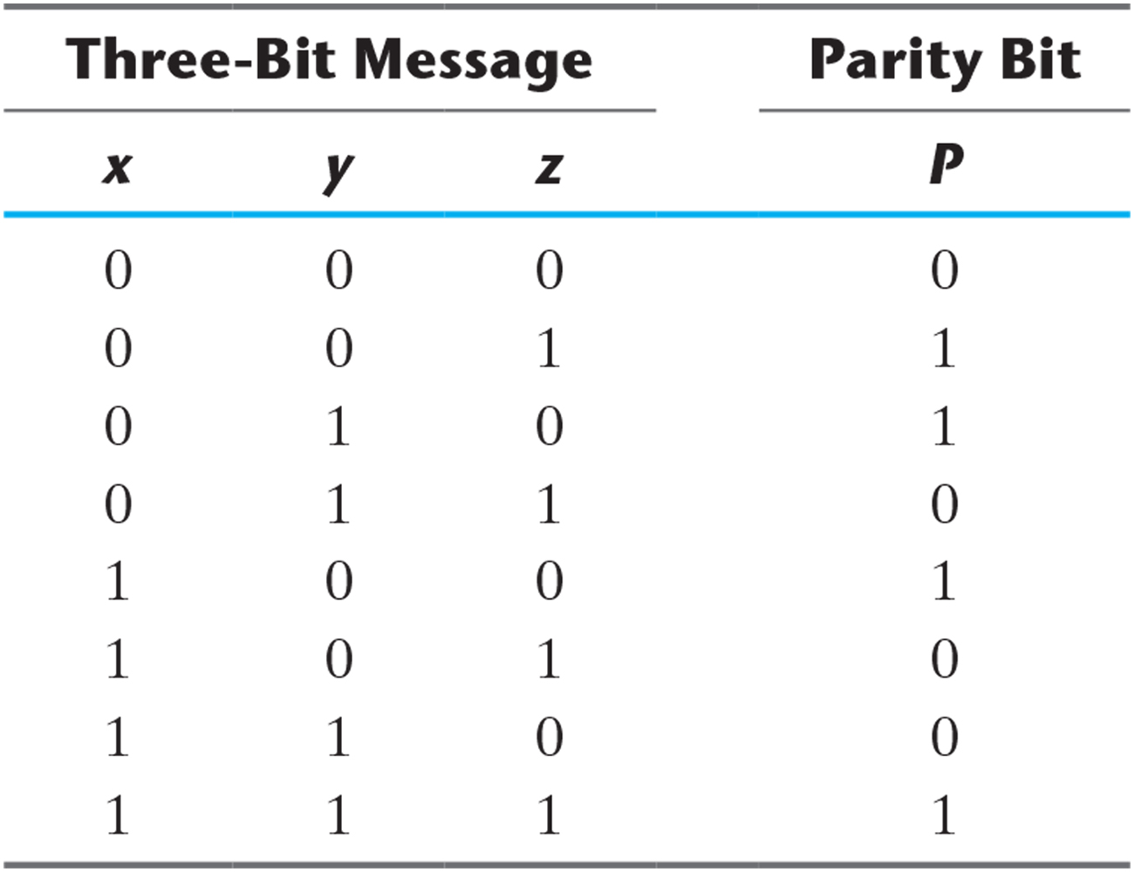
Table 3.3 Even-Parity-Generator Truth Table.

Slide 41
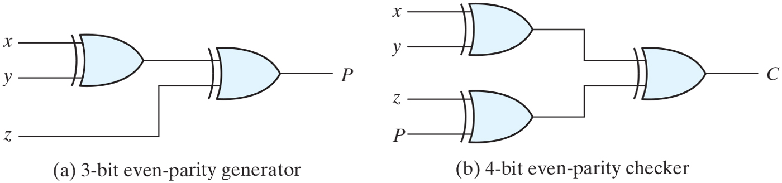
Figure 3.34 Logic diagram of a parity generator and checker.

Slide 42
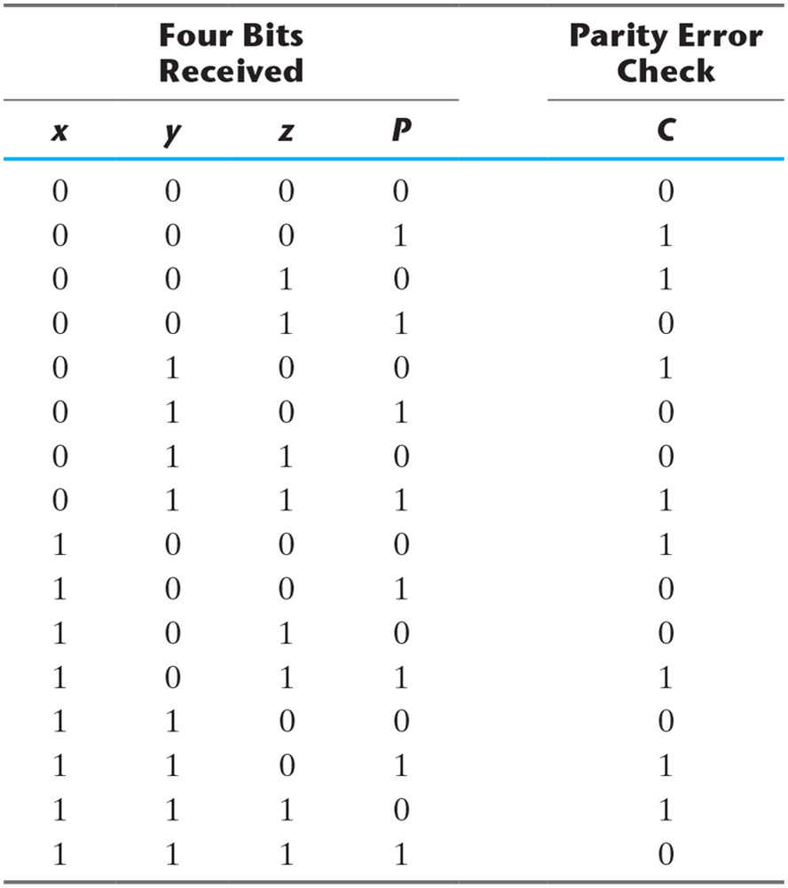
Table 3.4 Even-Parity-Checker Truth Table.

Slide 43
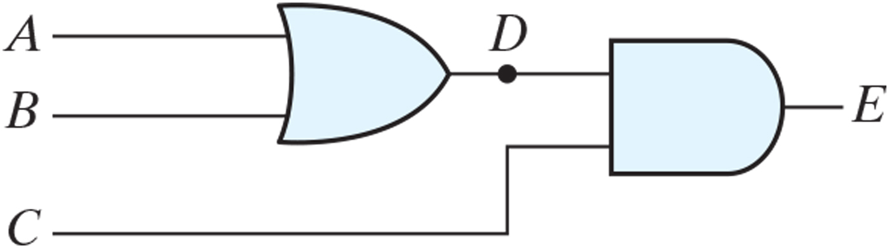
Figure 3.35 A logic diagram (schematic) for the Boolean equations D = A + B E = CD.

Slide 44
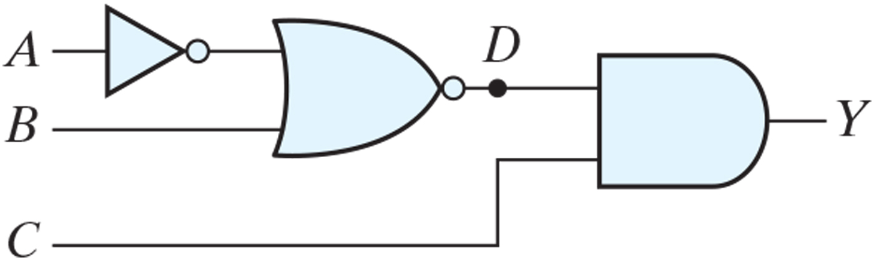
Figure PE3.12

Slide 45
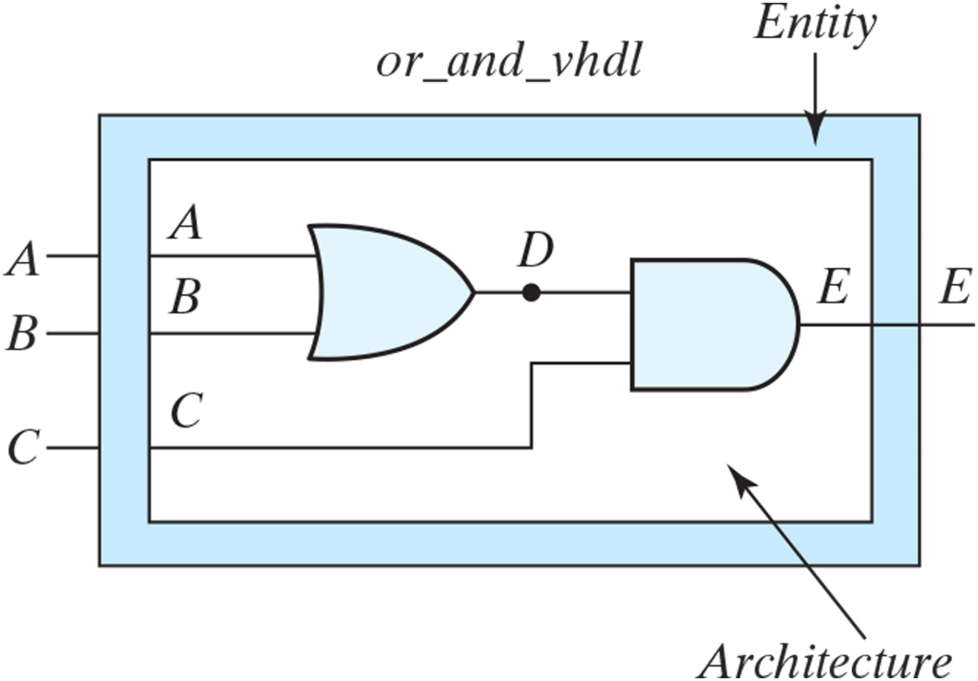
Figure 3.36 Entity-Architecture pair for or_and_vhdl.

Slide 46
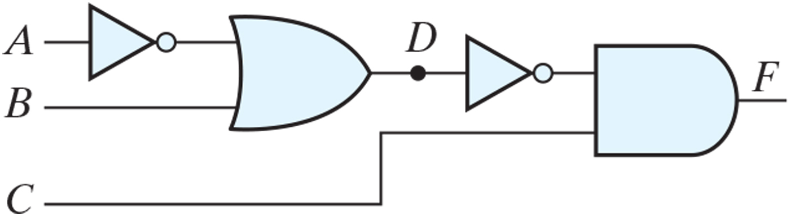
Figure PE3.13

Slide 47
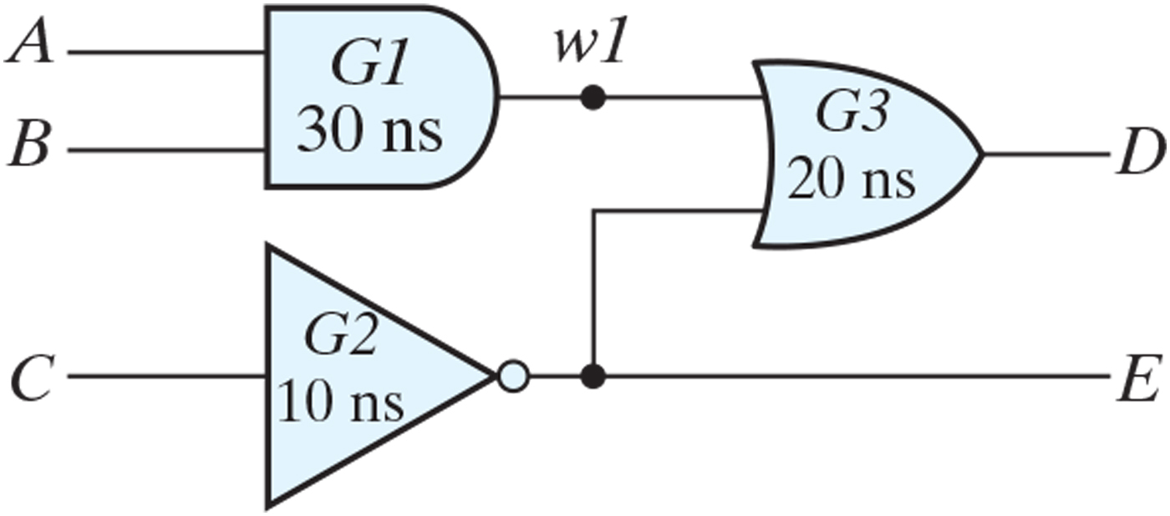
Figure 3.37 Schematic for and_or_prop_delay.

Slide 48
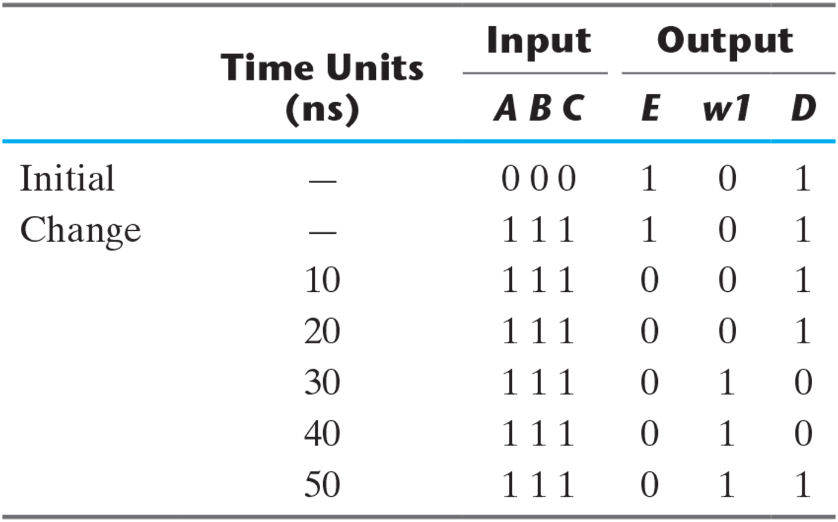
Table 3.5 Output of Gates after Delay.

Slide 49
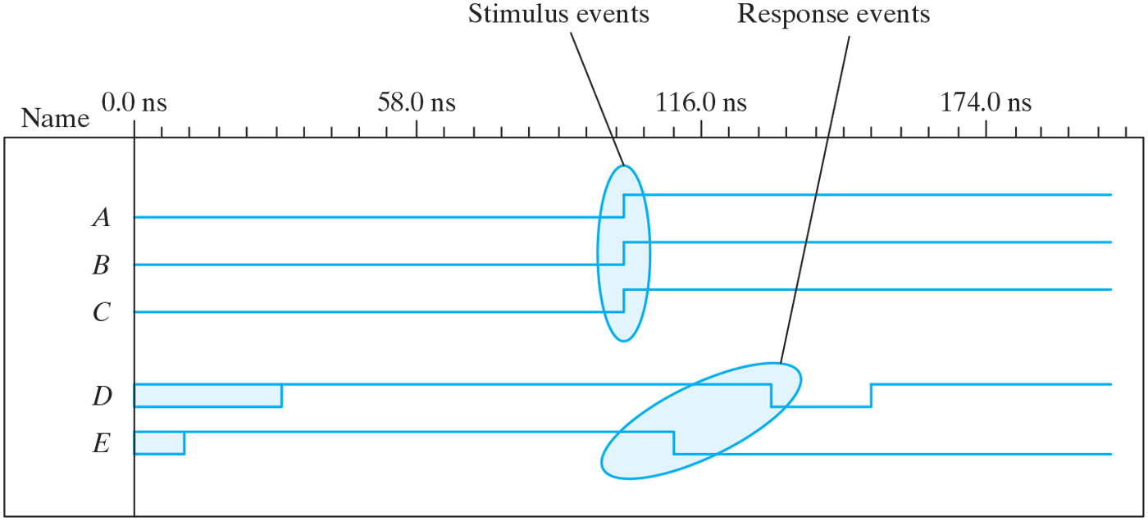
Figure 3.38 Simulation waveforms of and_or_prop_delay.

Slide 50
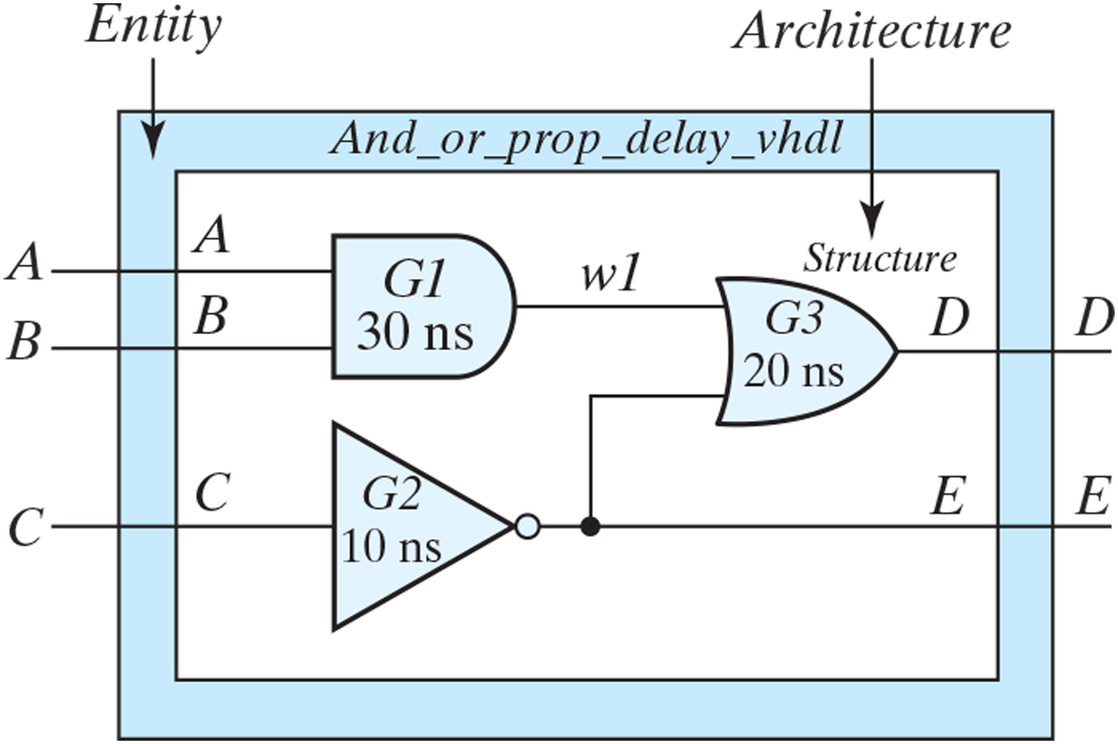
Figure 3.39 Entity-architecture for a structural model of and_or_prop_delay_vhdl.

Slide 51
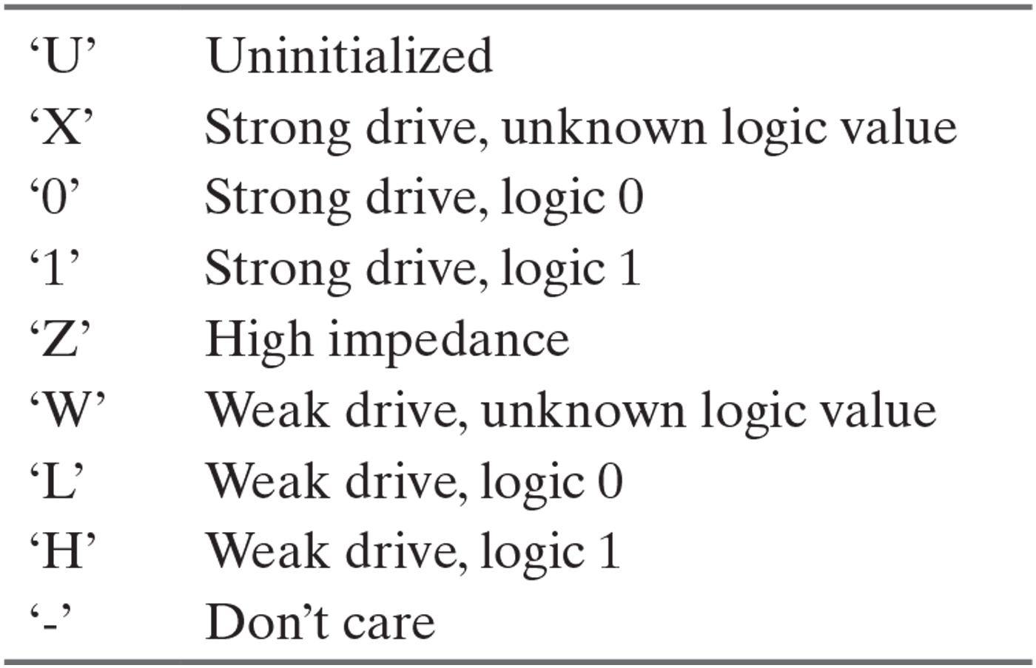
Table 3.6 Logic Symbols of the IEEE_std_logic_1164 Package.

Slide 52

Figure 3.40 Schematic for Circuit with_UDP_02467.

Slide 53

Figure P3.38

