Slide 1

Digital Design
With an Introduction to the Verilog HDL, VHDL, and SystemVerilog
6th Edition
Chapter 04
Combinational Logic

Slide 2
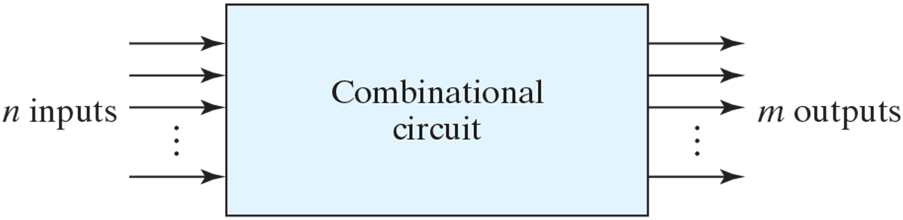
Figure 4.1 Block diagram of combinational circuit.

Slide 3
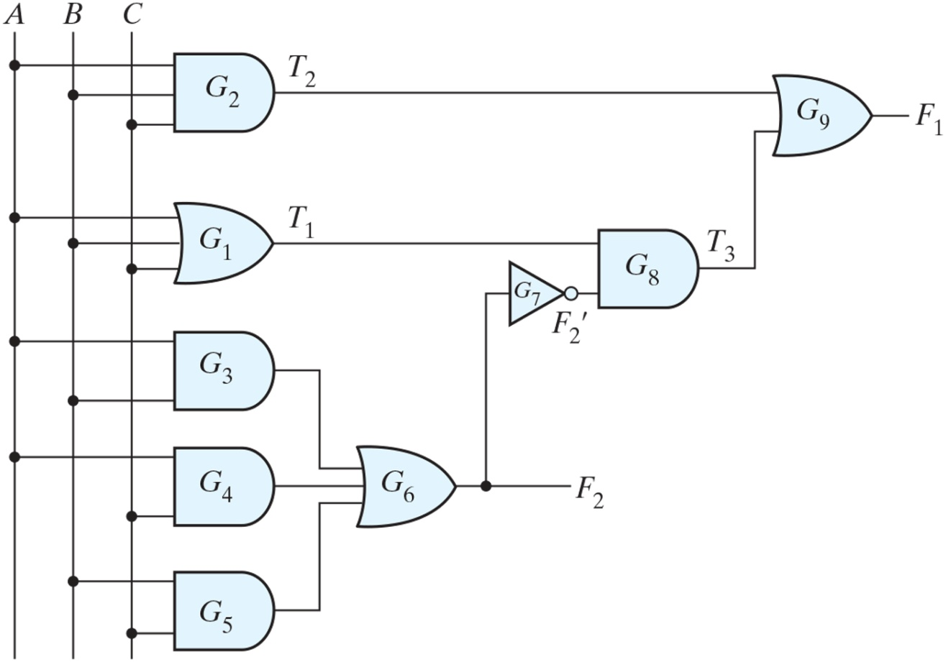
Figure 4.2 Logic diagram for analysis example.

Slide 4
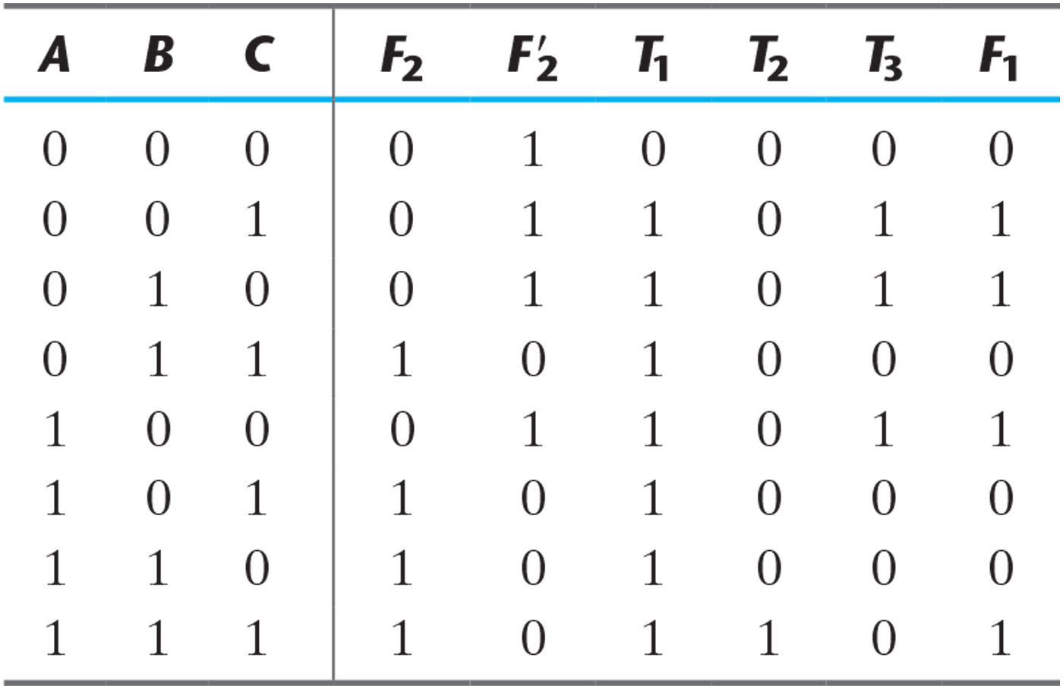
Table 4.1 Truth Table for the Logic Diagram of Fig. 4.2.

Slide 5
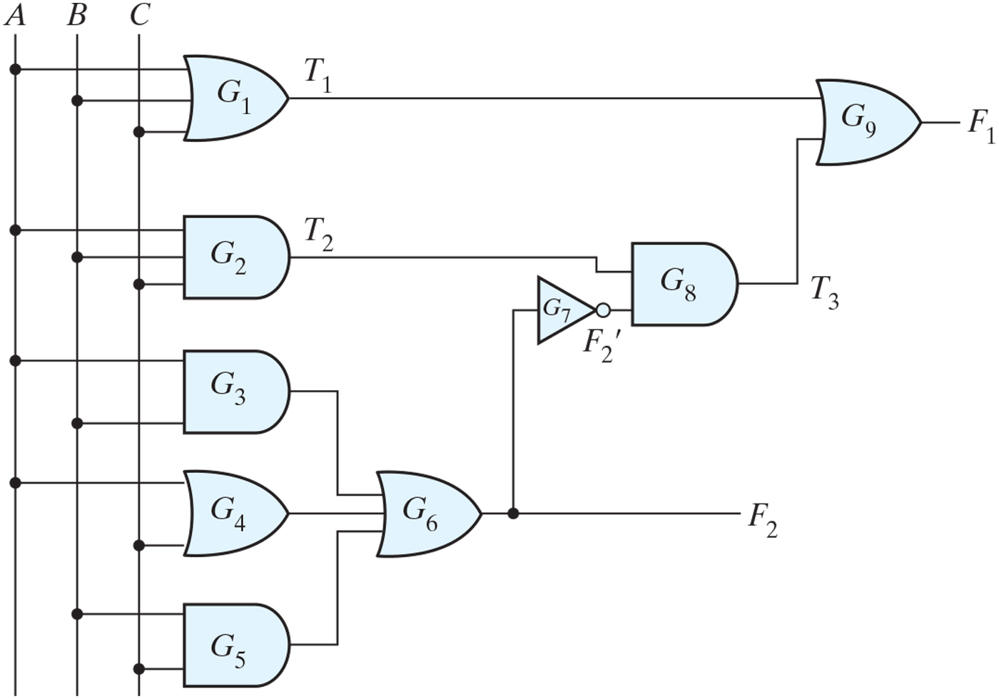
Figure PE4.1

Slide 6
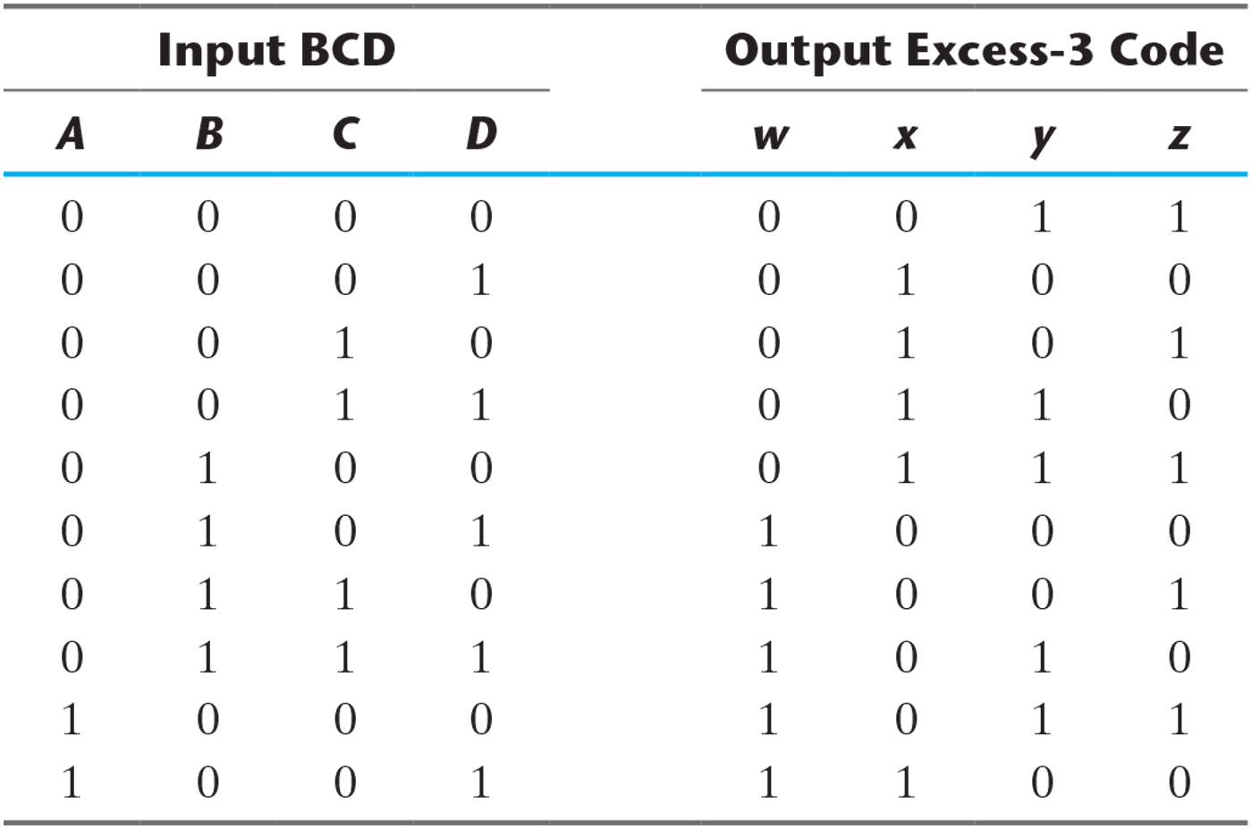
Table 4.2 Truth Table for Code Conversion Example.

Slide 7
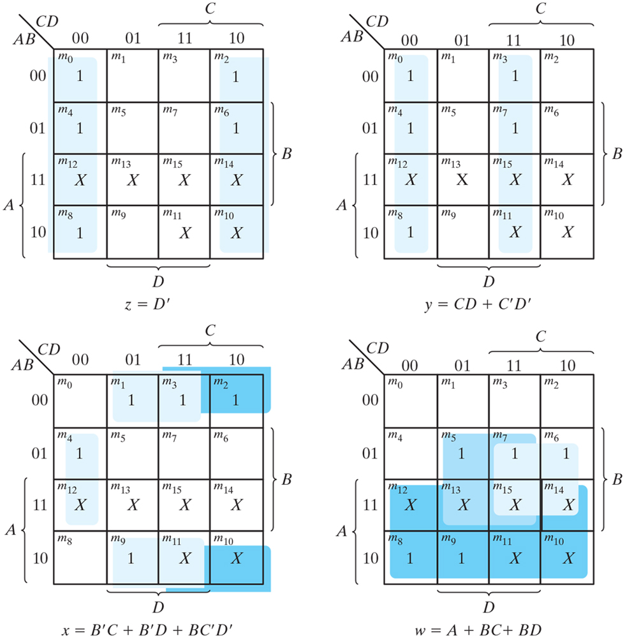
Figure 4.3 Maps for BCD-to-excess-3 code converter.

Slide 8
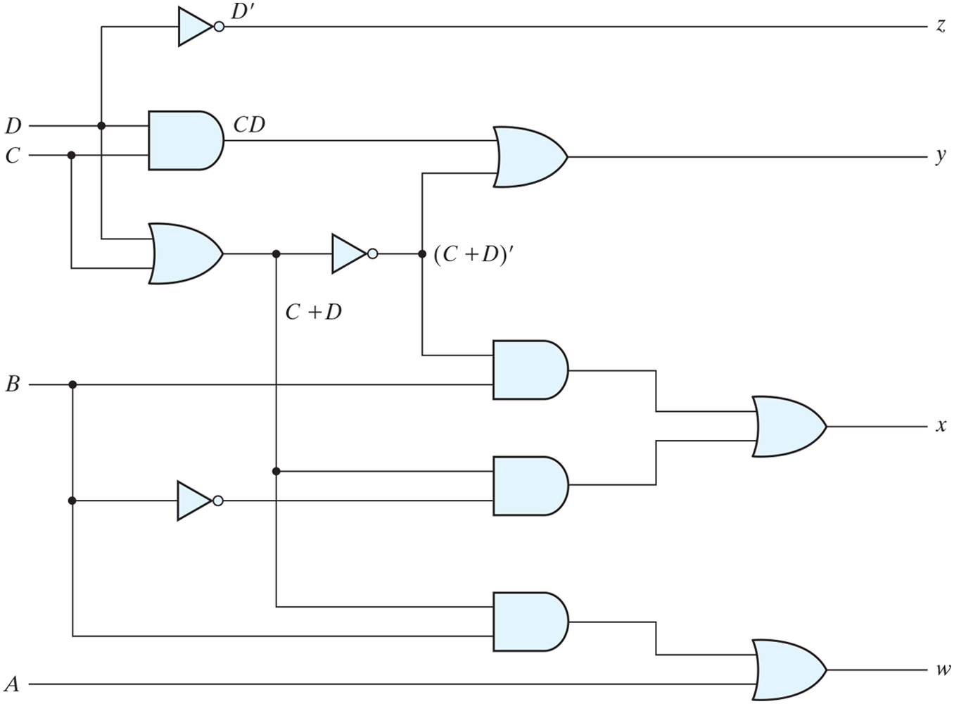
Figure 4.4 Logic diagram for BCD-to-excess-3 code converter.

Slide 9
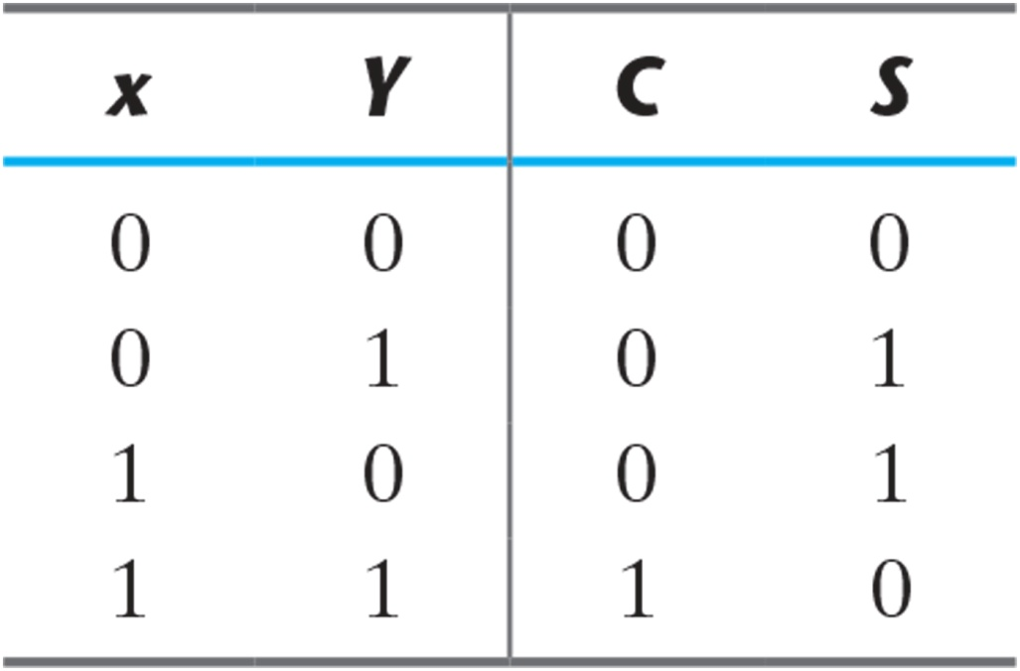
Table 4.3 Half Adder.

Slide 10
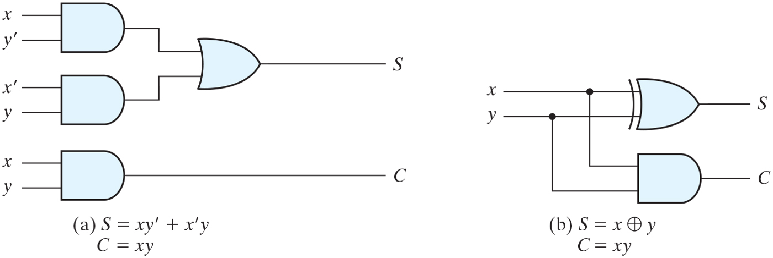
Figure 4.5 Implementation of half adder.

Slide 11
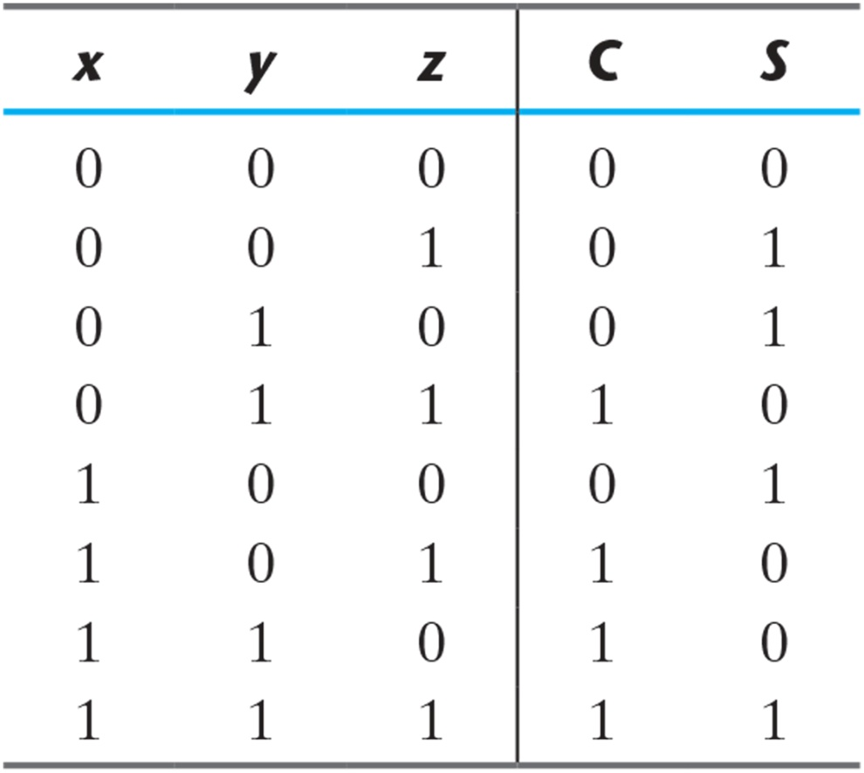
Table 4.4 Full Adder.

Slide 12
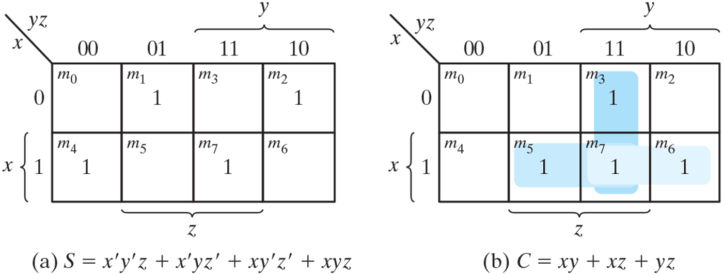
Figure 4.6 K-Maps for full adder.

Slide 13
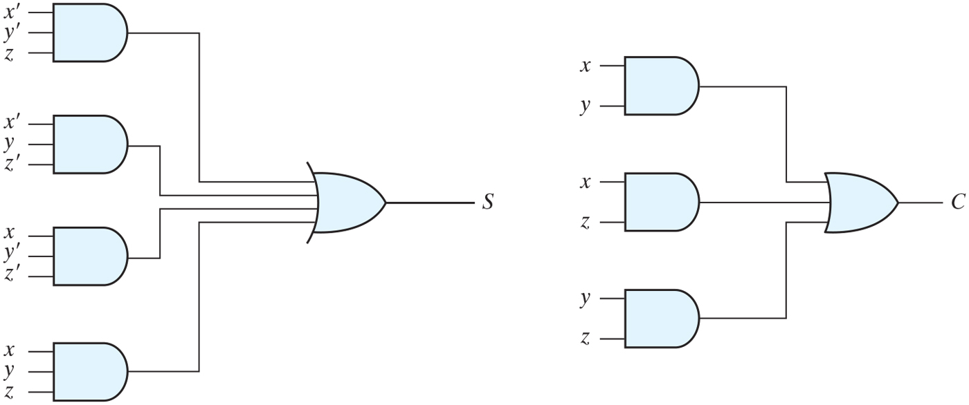
Figure 4.7 Implementation of full adder in sum-of-products form.

Slide 14
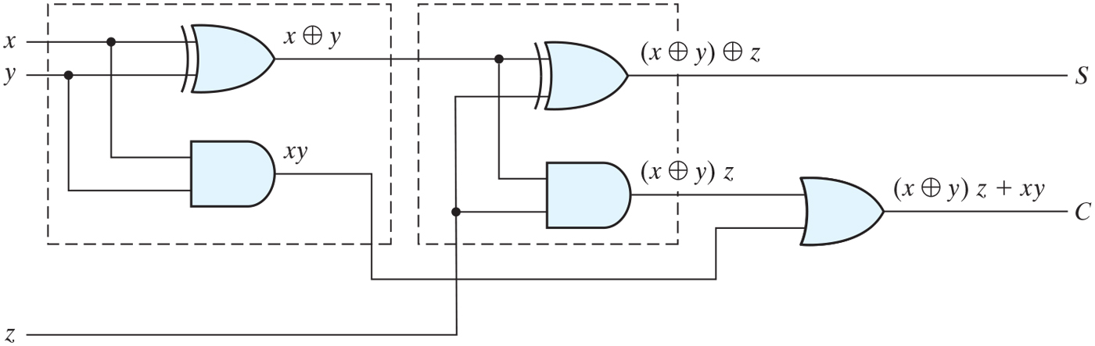
Figure 4.8 Implementation of full adder with two half adders and an OR gate.

Slide 15
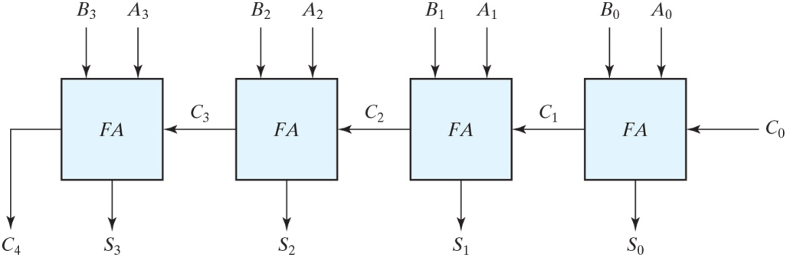
Figure 4.9 Four-bit adder.

Slide 16
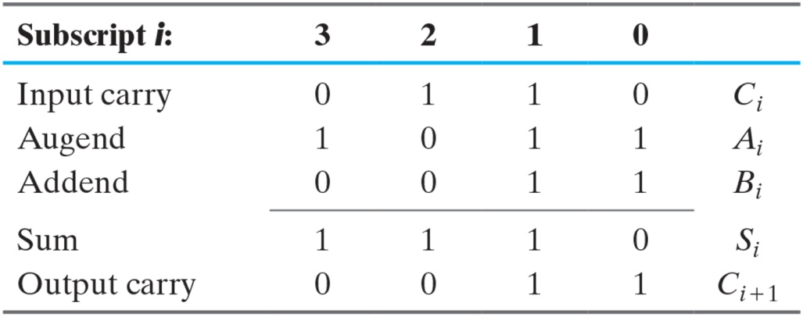
Binary Adder

Slide 17
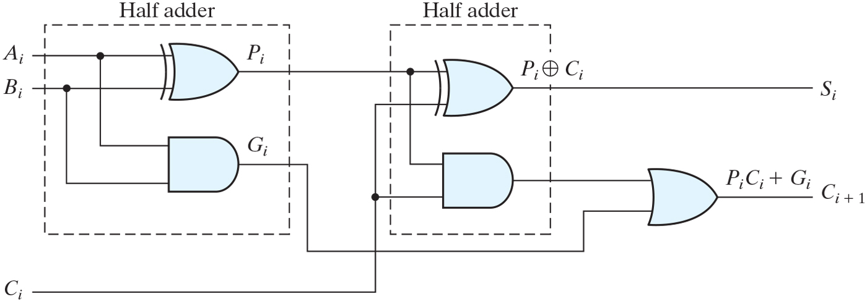
Figure 4.10 Full adder with P and G shown.

Slide 18
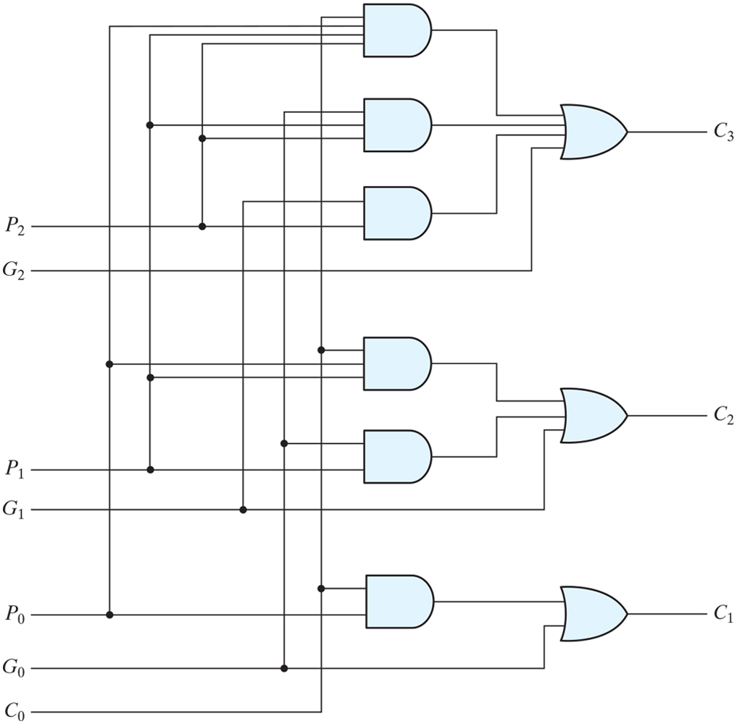
Figure 4.11 Logic diagram of carry lookahead generator.

Slide 19
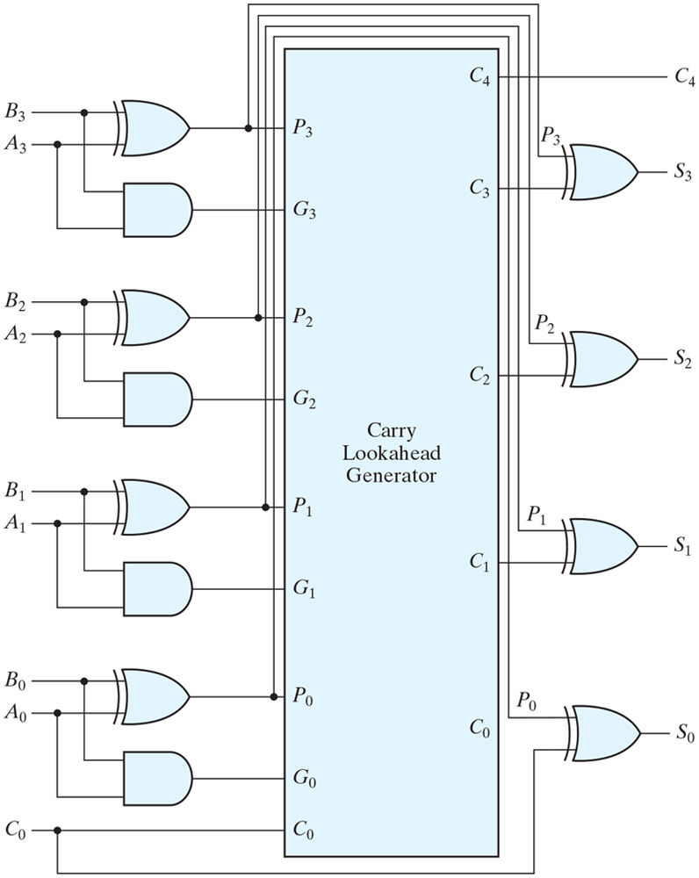
Figure 4.12 Four-bit adder with carry lookahead.

Slide 20
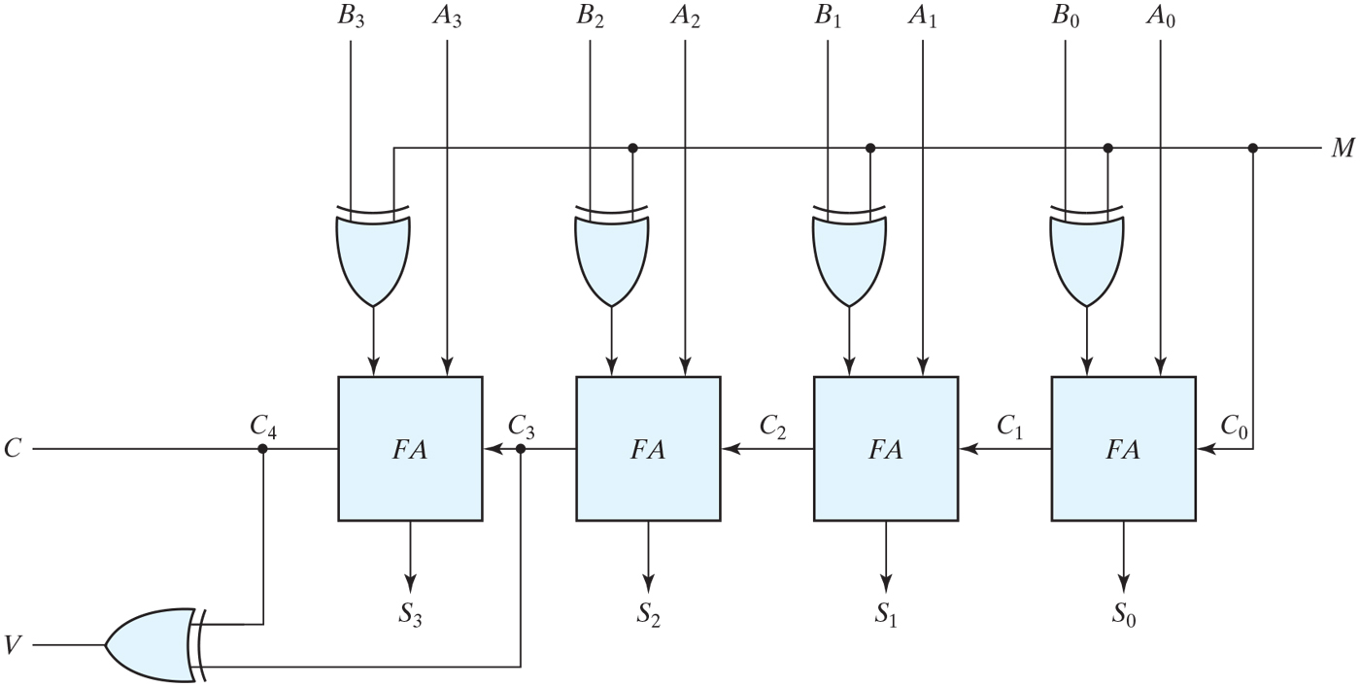
Figure 4.13 Four-bit adder–subtractor (with overflow detection).

Slide 21
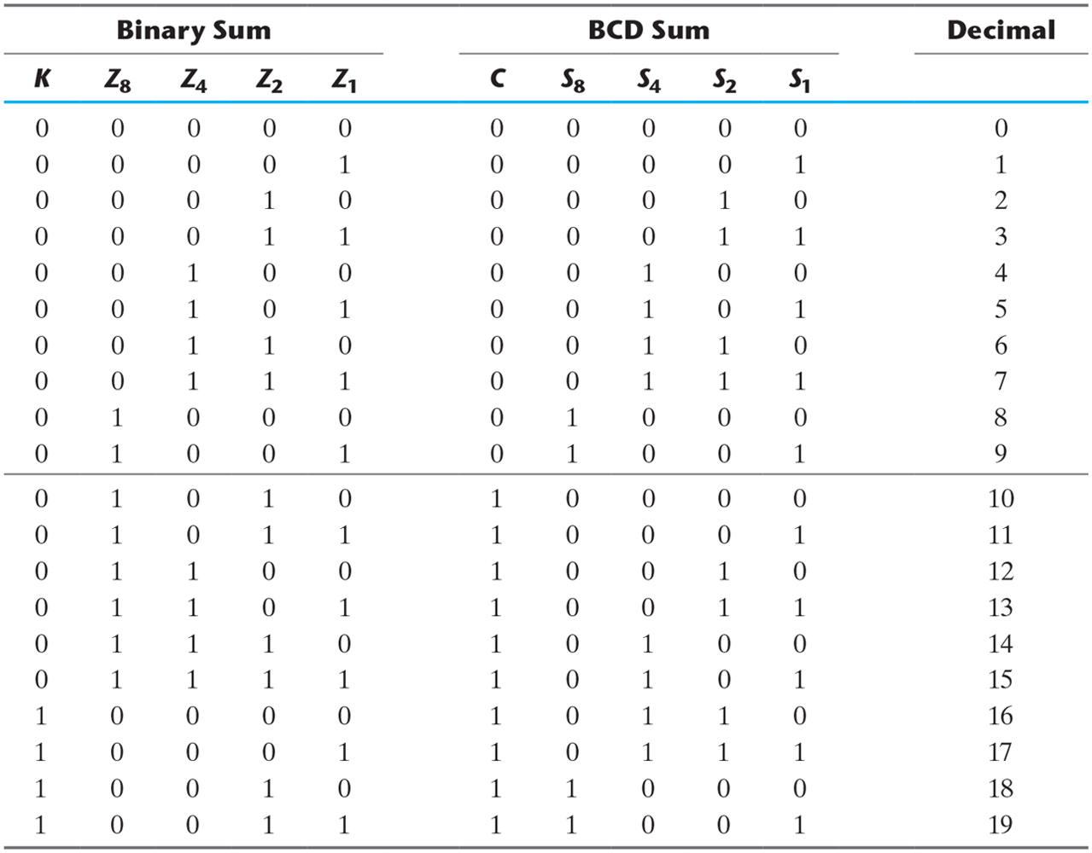
Table 4.5 Derivation of BCD Adder.

Slide 22
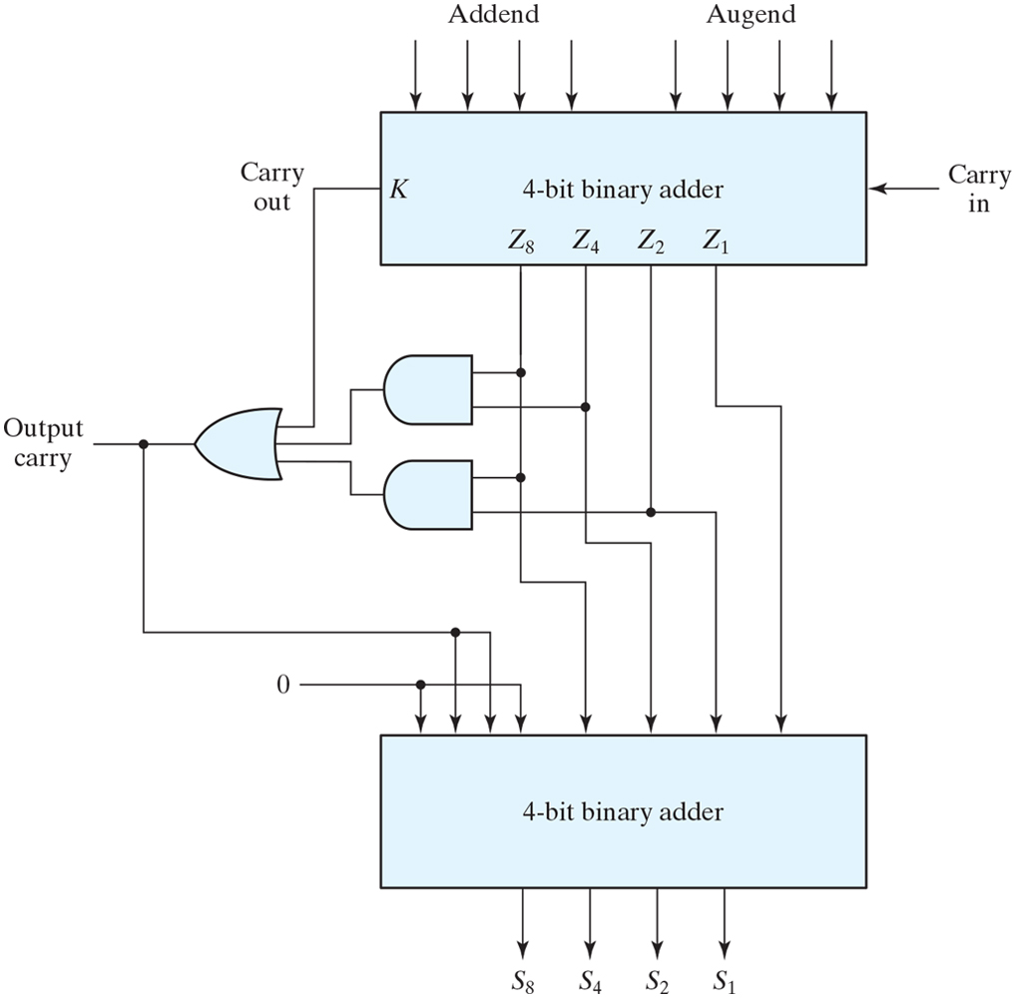
Figure 4.14 Block diagram of a BCD adder.

Slide 23
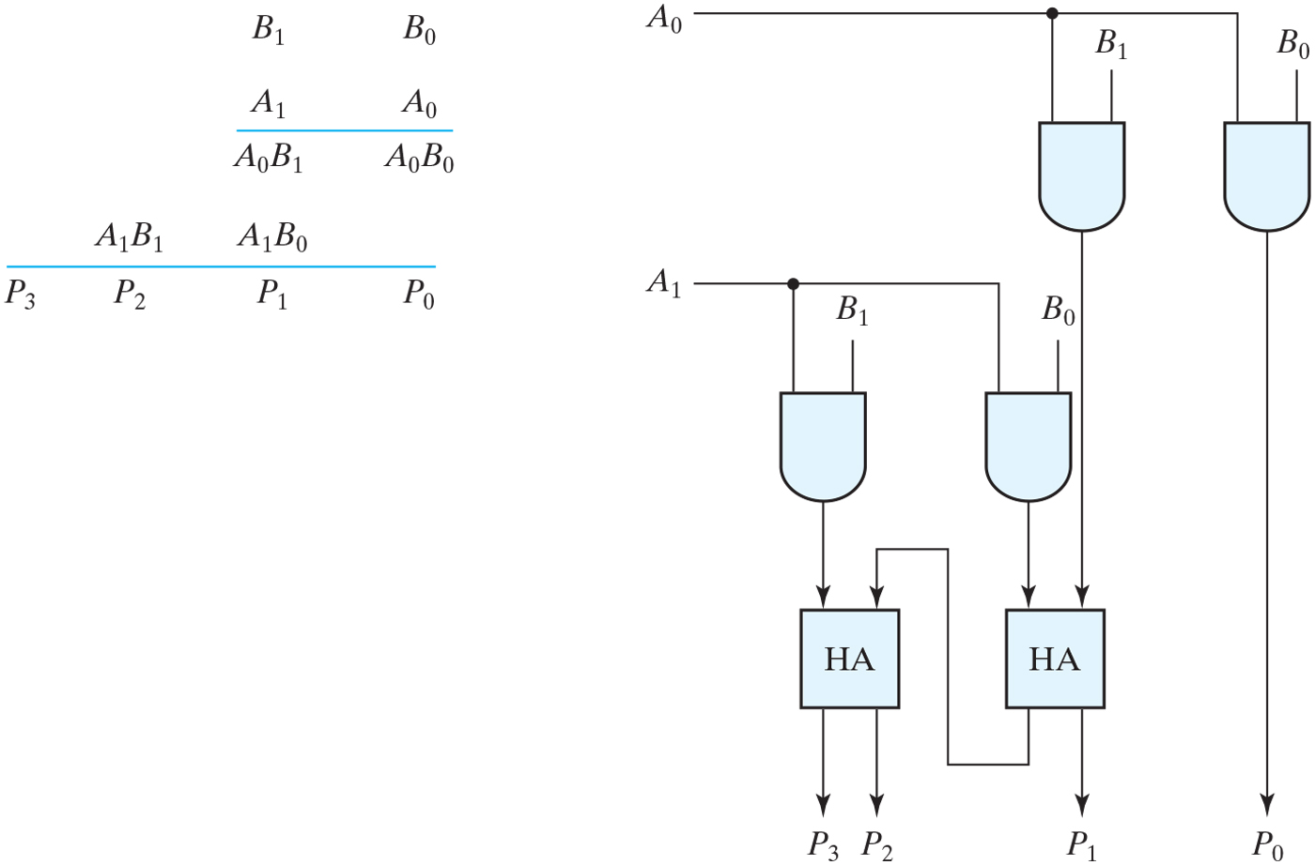
Figure 4.15 Two-bit by two-bit binary multiplier.

Slide 24
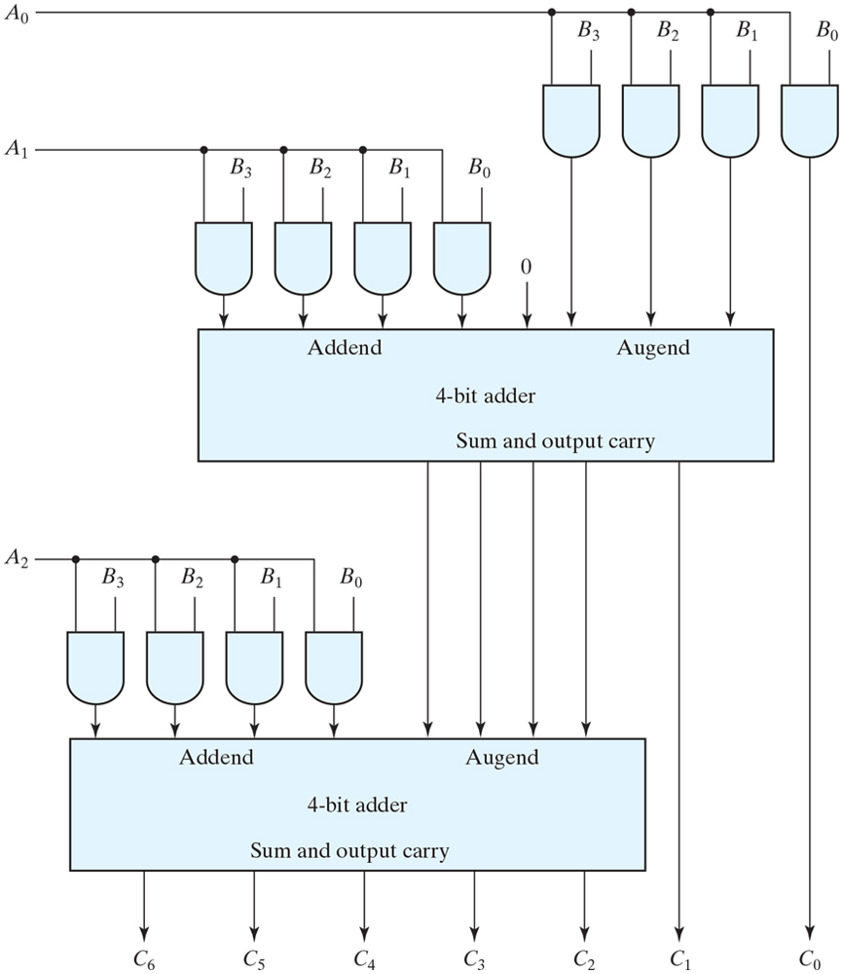
Figure 4.16 Four-bit by three-bit binary multiplier.

Slide 25
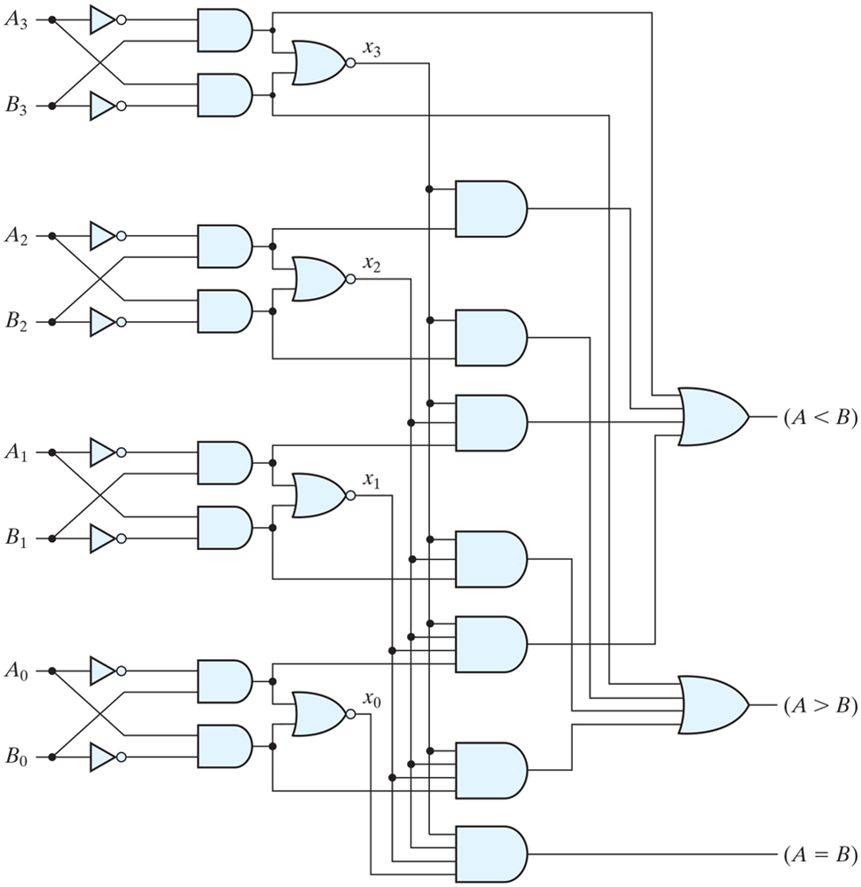
Figure 4.17 Four-bit magnitude comparator.

Slide 26
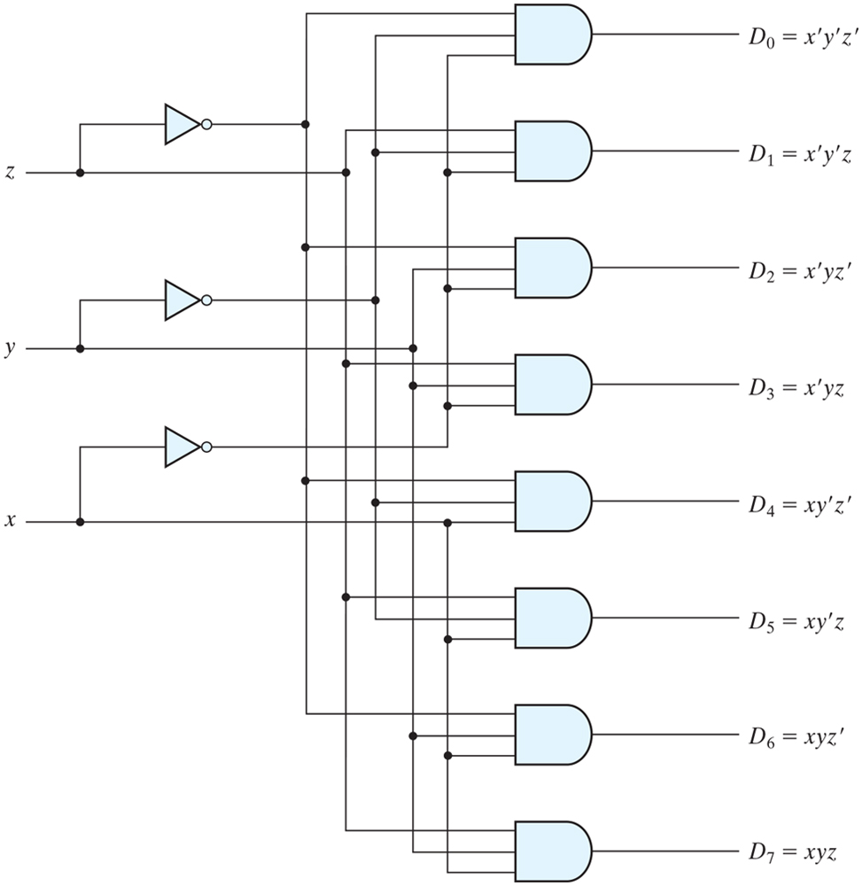
Figure 4.18 Three-to-eight-line decoder.

Slide 27
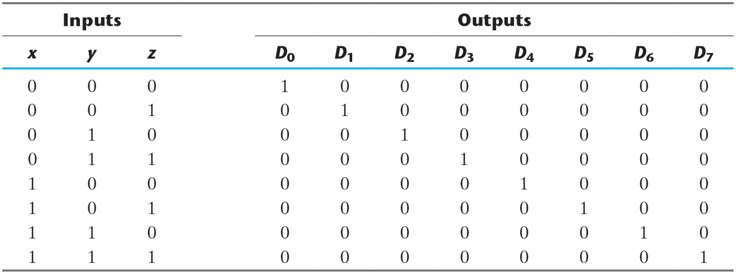
Table 4.6 Truth Table of a Three-to-Eight-Line Decoder.

Slide 28
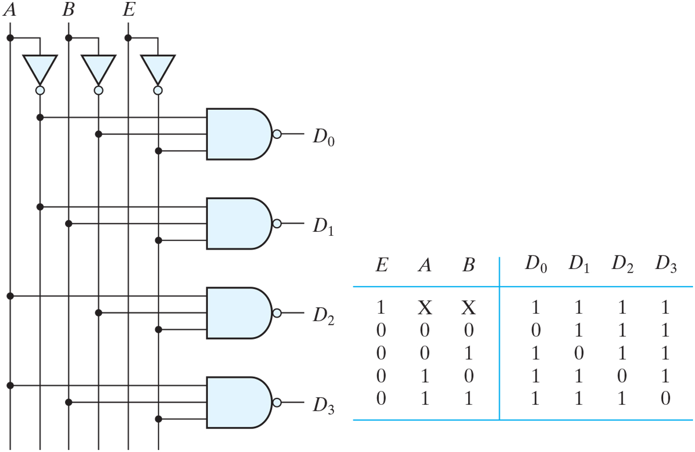
Figure 4.19 Two-to-four-line decoder with enable input.

Slide 29
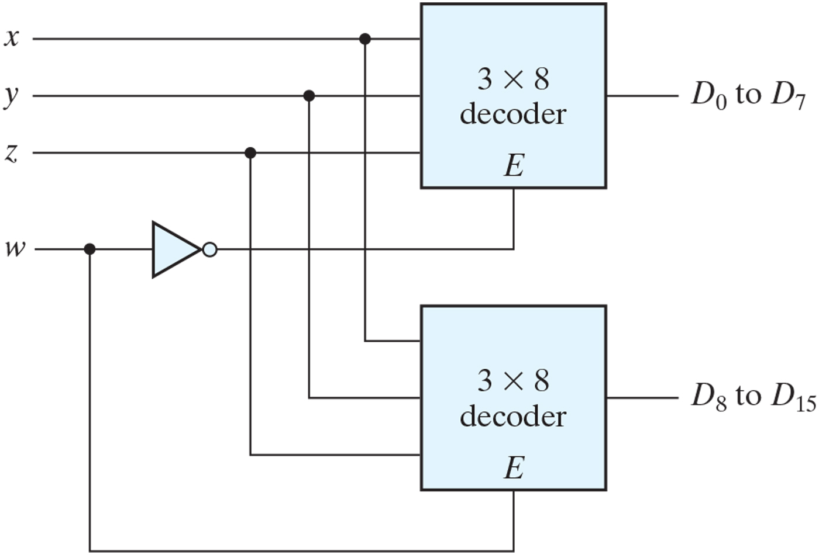
Figure 4.20 4 x 16 decoder constructed with two 3 x 8 decoders.

Slide 30
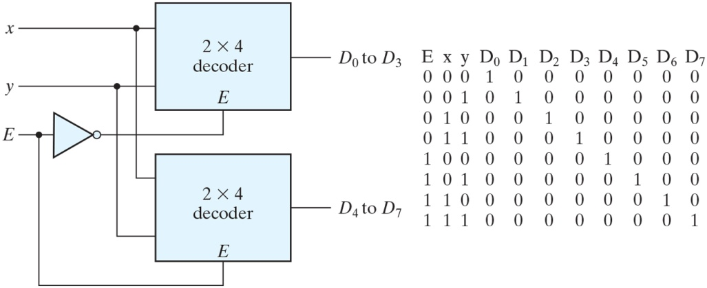
Figure PE4.8

Slide 31
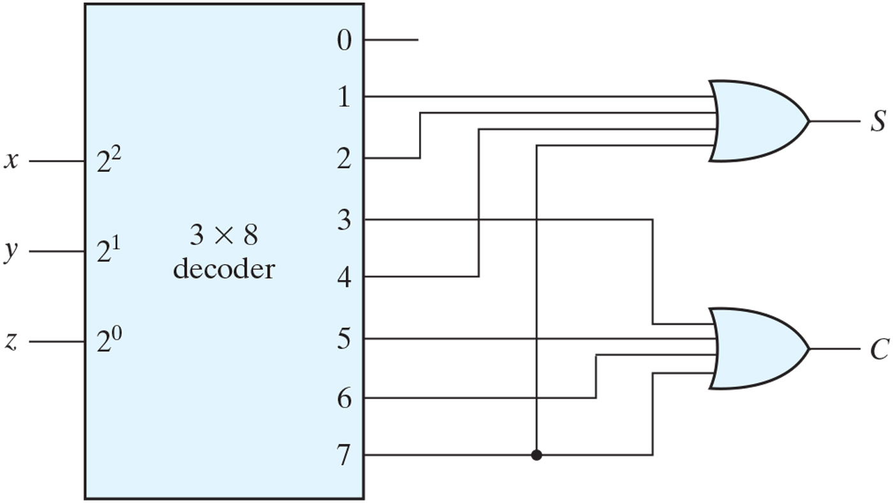
Figure 4.21 Implementation of a full adder with a decoder.

Slide 32
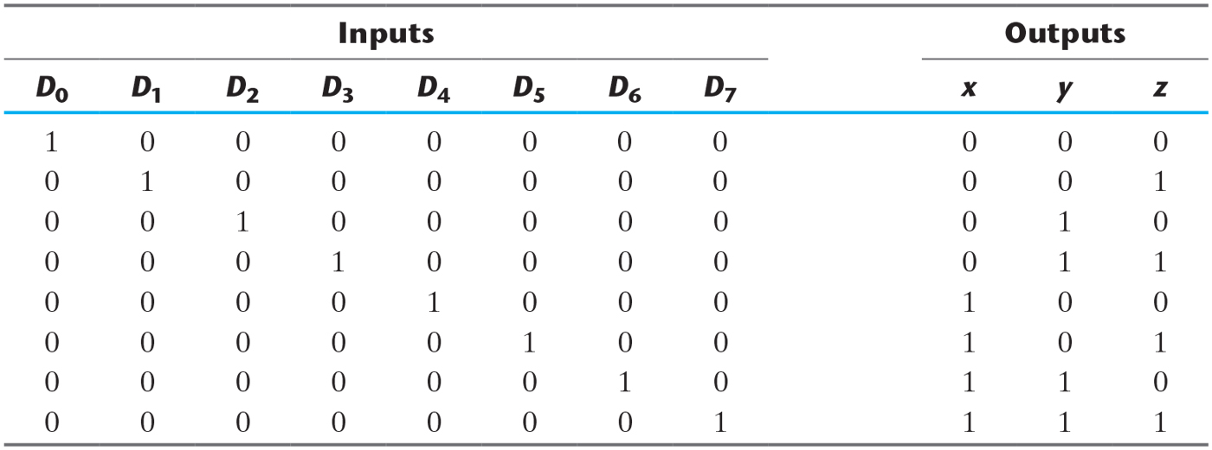
Table 4.7 Truth Table of an Octal-to-Binary Encoder.

Slide 33
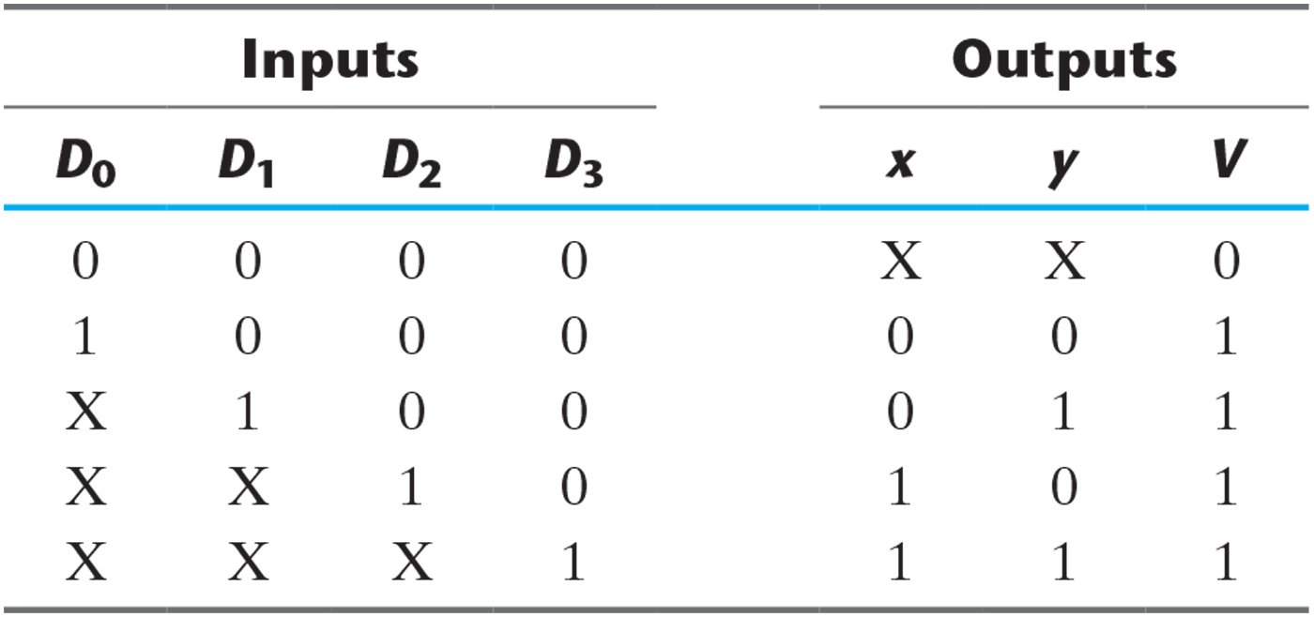
Table 4.8 Truth Table of a Priority Encoder.

Slide 34
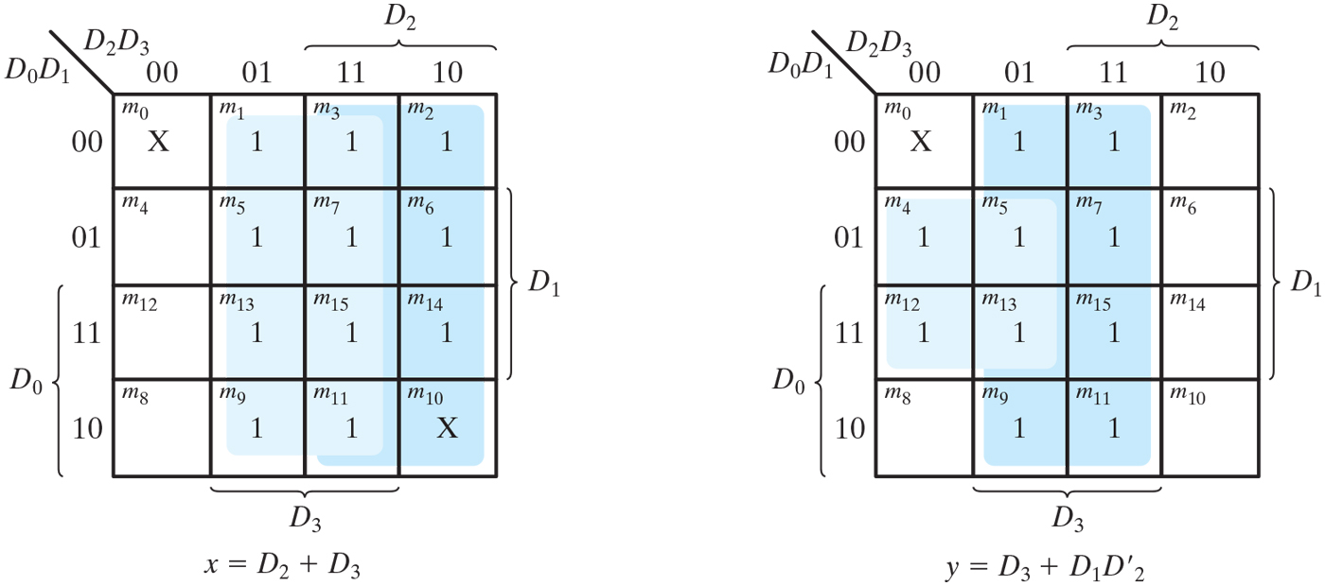
Figure 4.22 Maps for a priority encoder.

Slide 35
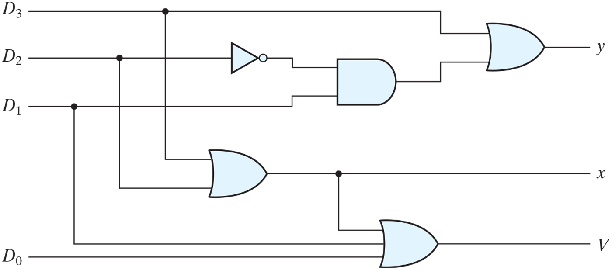
Figure 4.23 Four-input priority encoder.

Slide 36
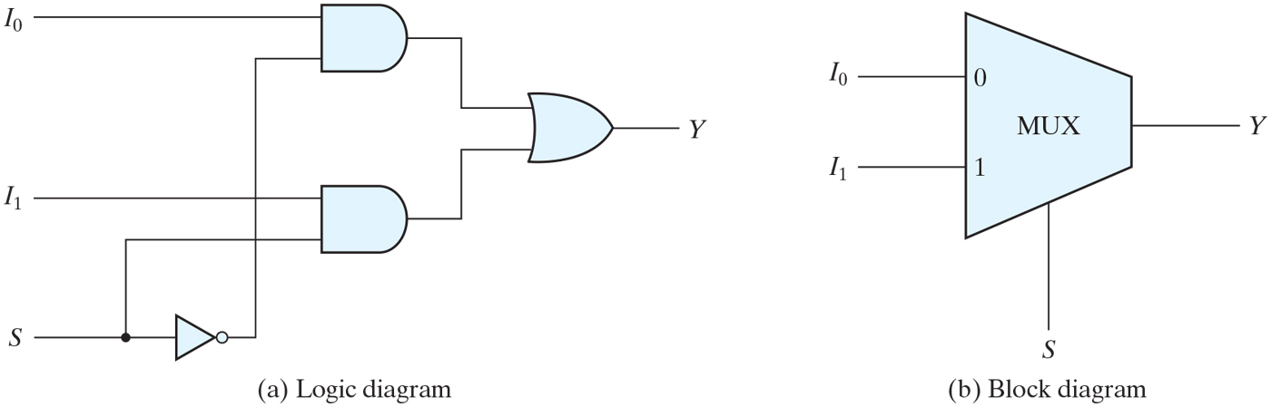
Figure 4.24 Two-to-one-line multiplexer.

Slide 37
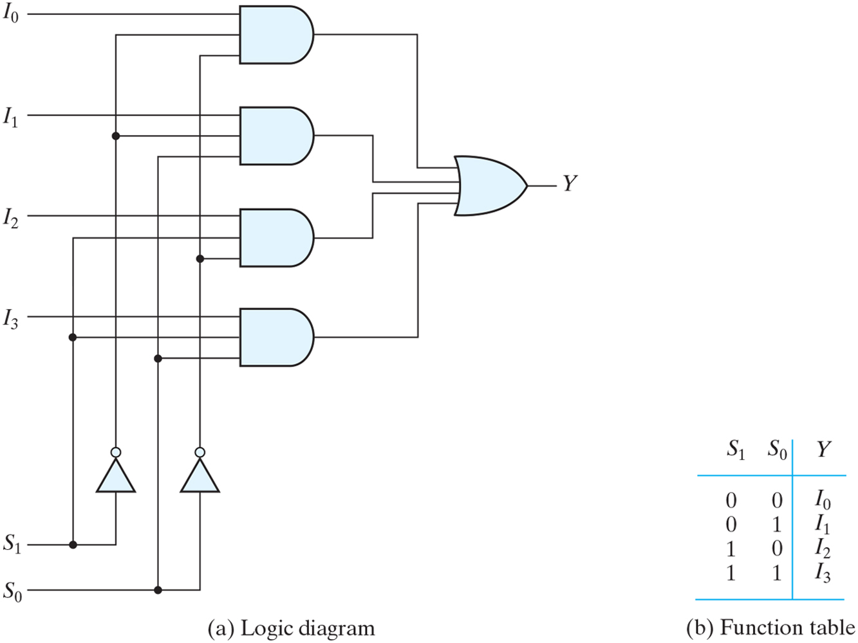
Figure 4.25 Four-to-one-line multiplexer.

Slide 38
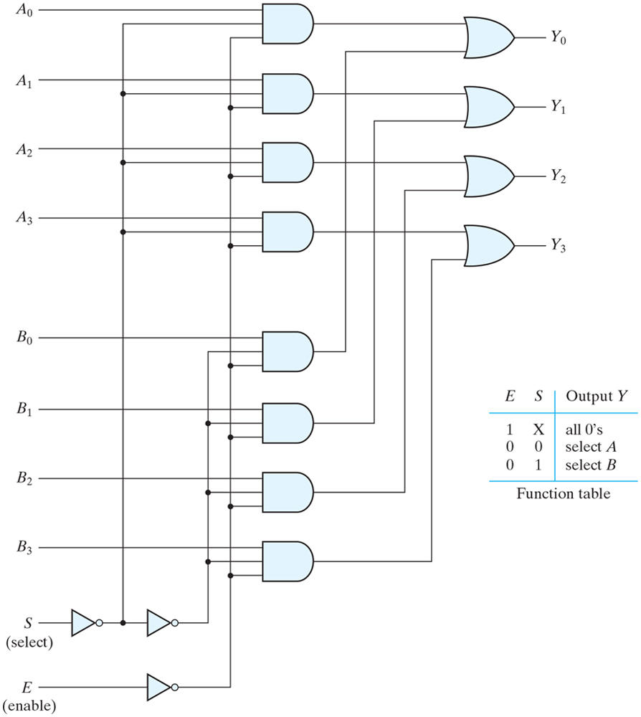
Figure 4.26 Quadruple two-to-one-line multiplexer.

Slide 39
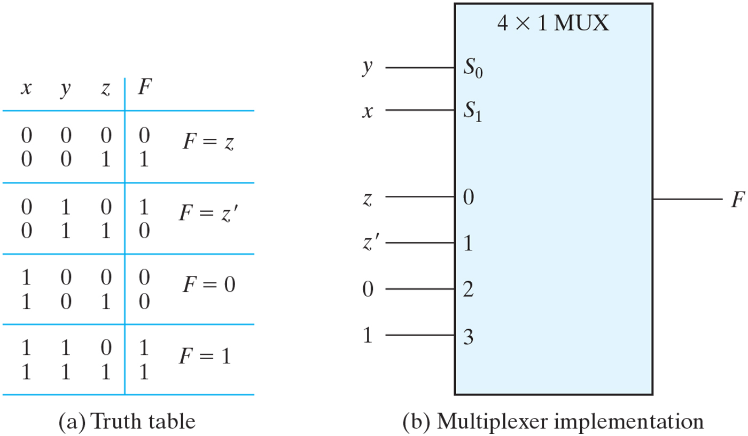
Figure 4.27 Implementing a Boolean function with a multiplexer.

Slide 40
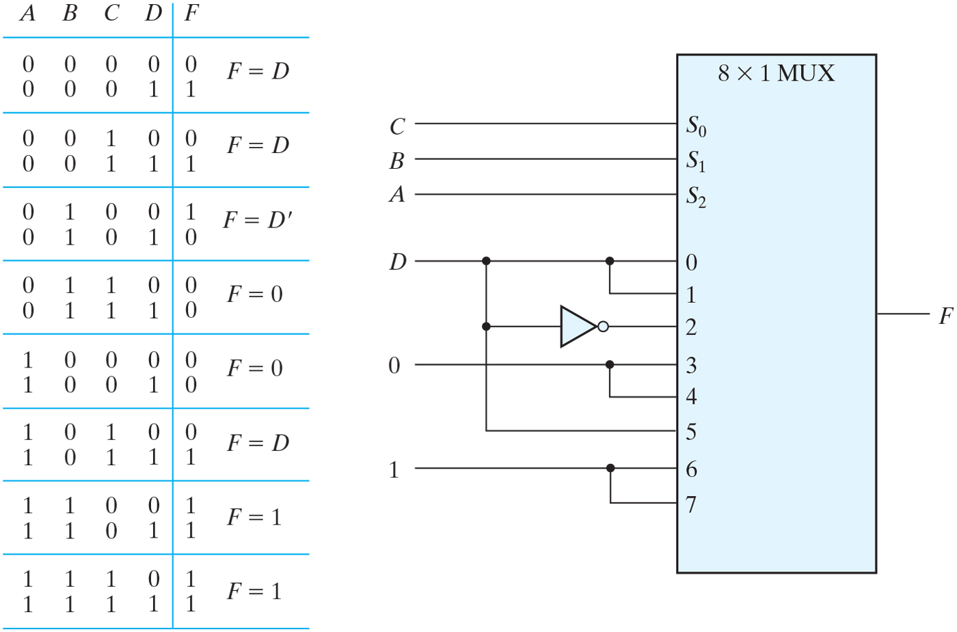
Figure 4.28 Implementing a four-input function with a multiplexer.

Slide 41
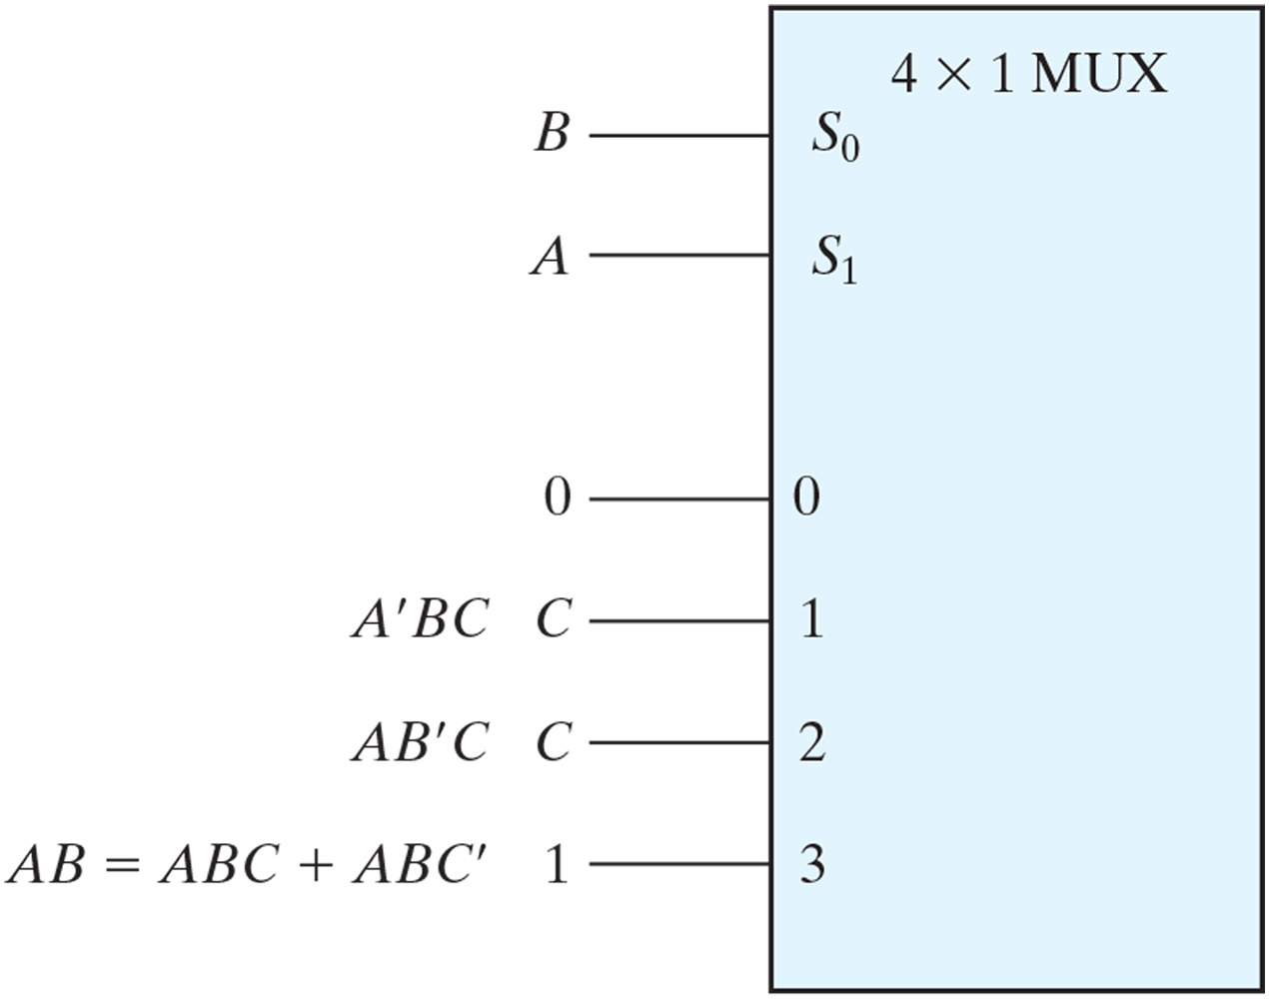
Figure PE4.9

Slide 42
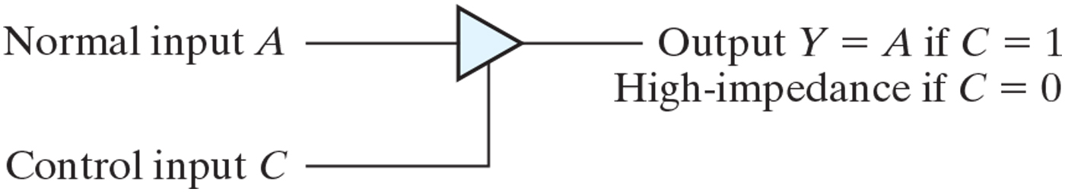
Figure 4.29 Graphic symbol for a three-state buffer.

Slide 43
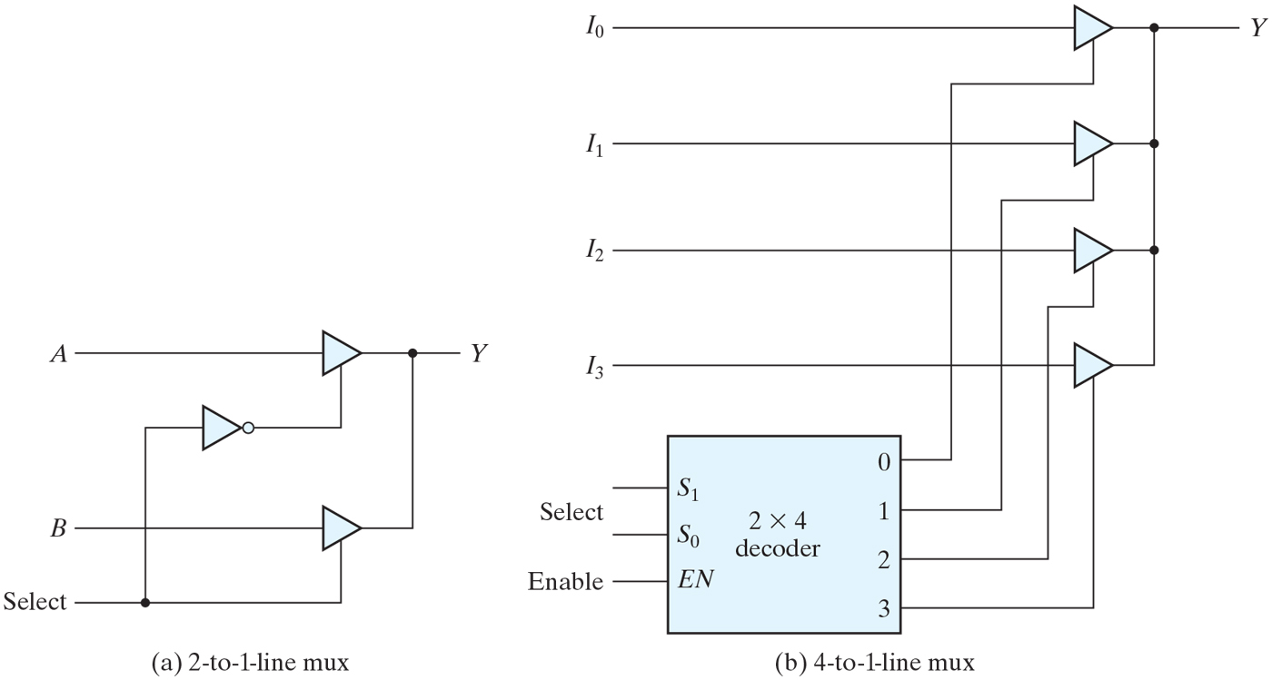
Figure 4.30 Multiplexers with three-state gates.

Slide 44
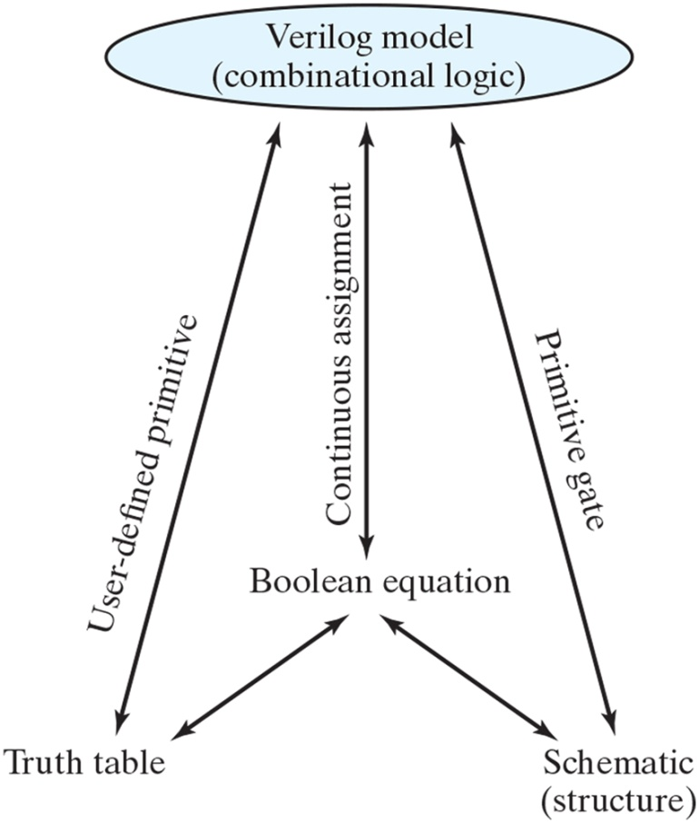
Figure 4.31 Relationship of Verilog constructs to truth tables, Boolean equations, and schematics.

Slide 45
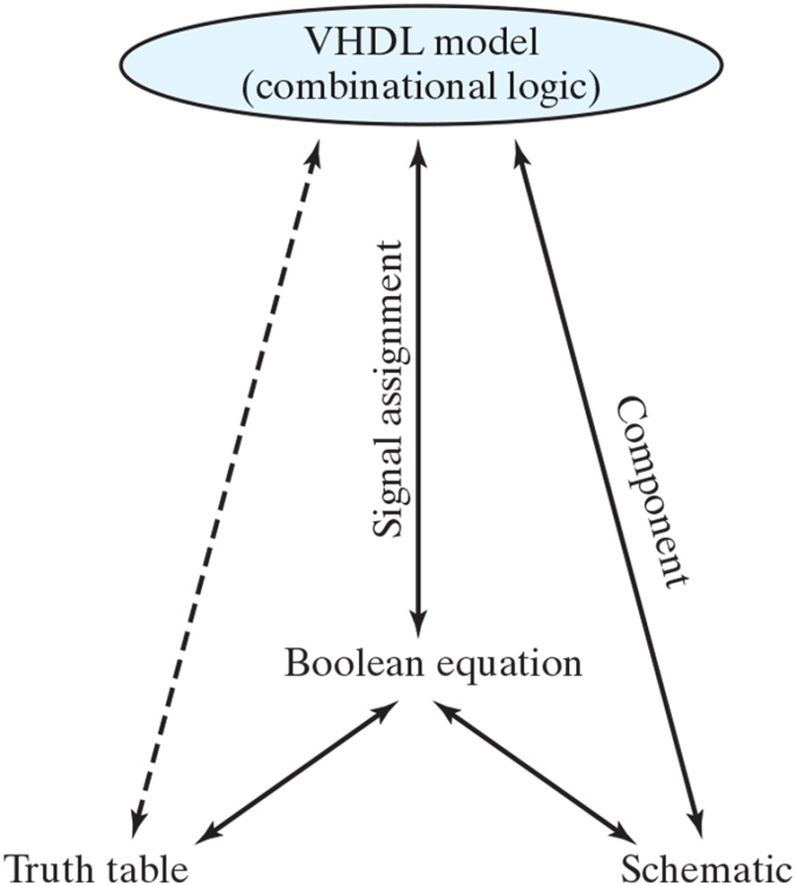
Figure 4.32 Relationship of VHDL constructs to truth tables, Boolean equations, and schematics three-state gates.

Slide 46
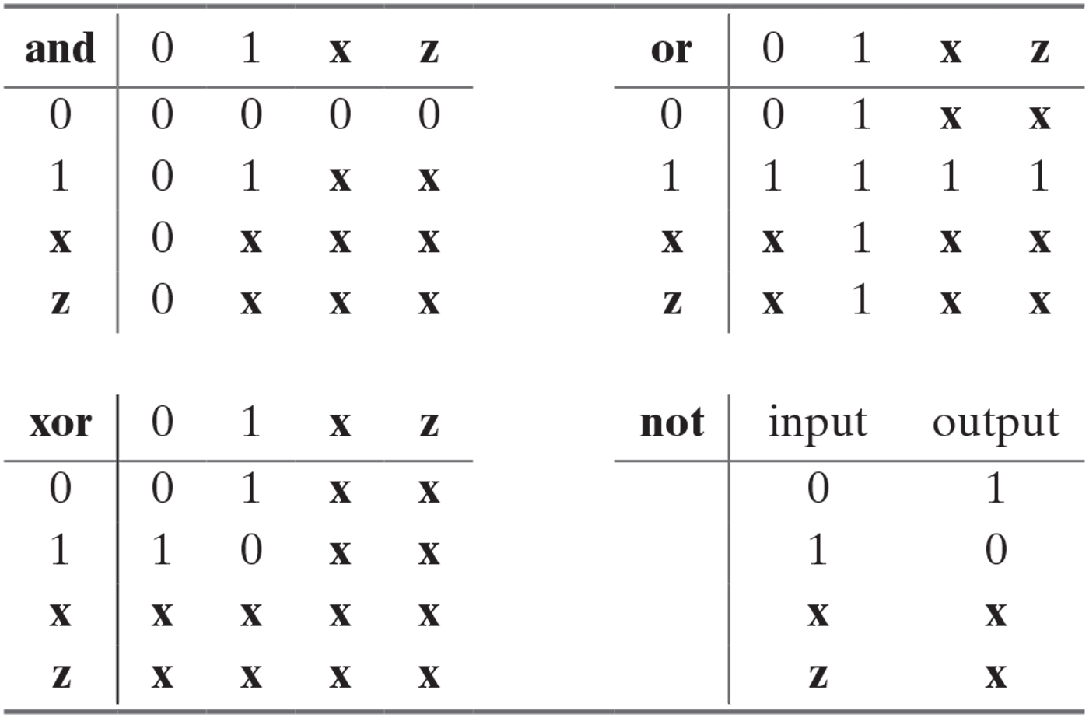
Table 4.9 Truth Table for Predefined Primitive Gates.

Slide 47
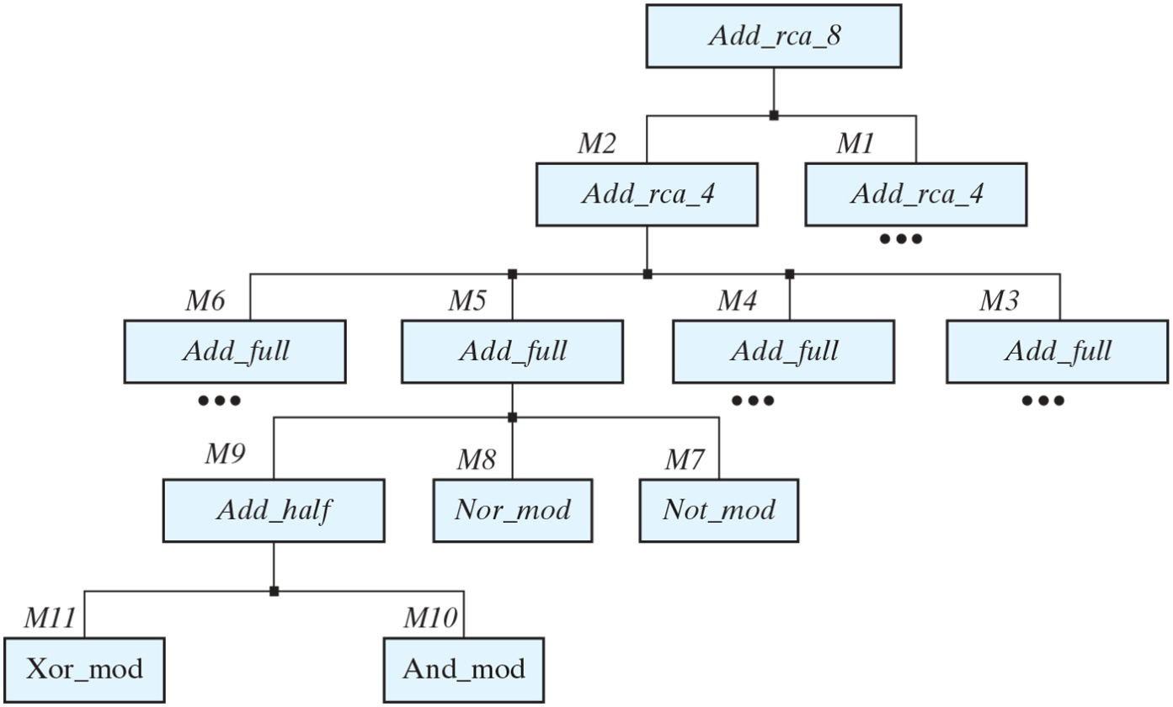
Figure 4.33 Design hierarchy of an 8-bit ripple-carry adder. For simplicity, some blocks are omitted where they replicate what is already shown.

Slide 48
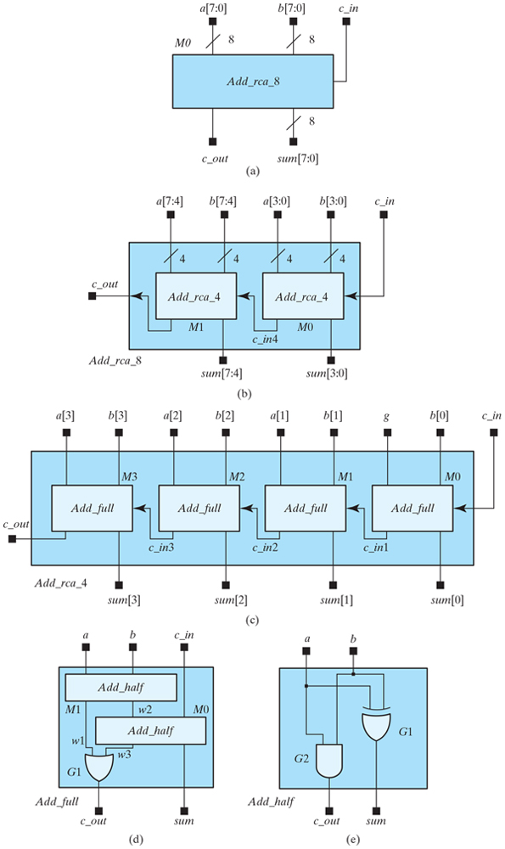
Figure 4.34 Decomposition of an 8-bit ripple carry adder into a chain of two 4-bit adders;⁹ each 4-bit adder consists of a chain of four full adders. The full adders are composed of half adders and one OR gate; the half adders are composed of logic gates.

Slide 49
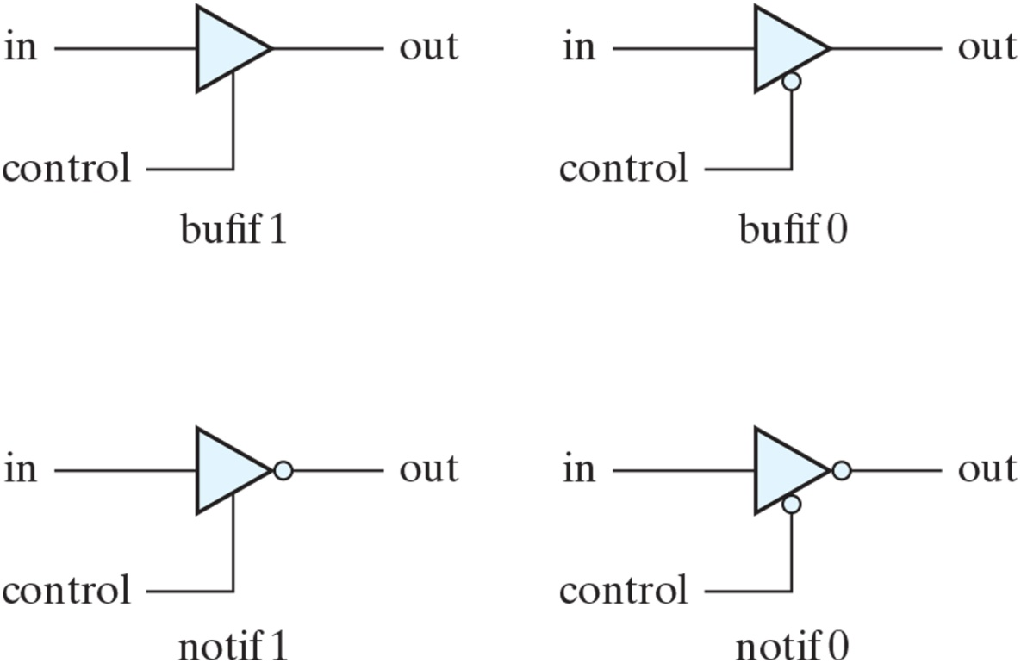
Figure 4.35 Three-state gates.

Slide 50
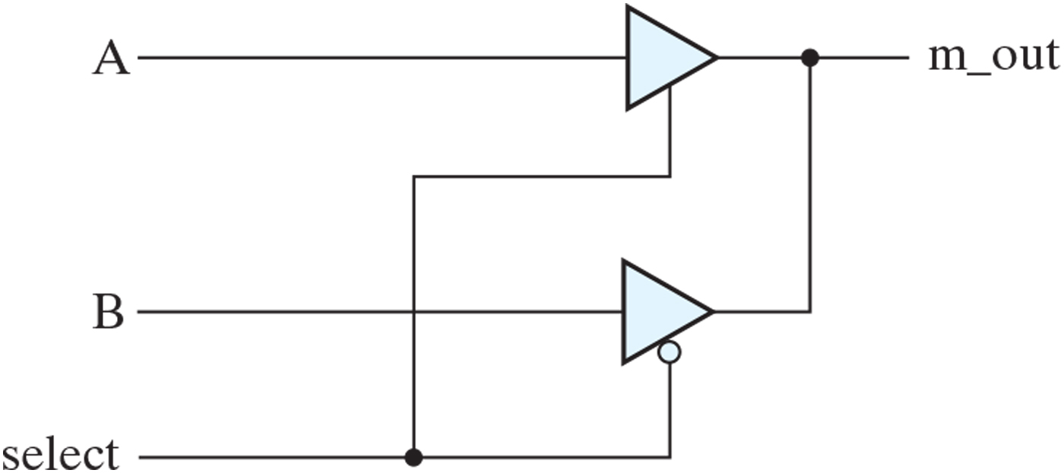
Figure 4.36 Two-to-one-line multiplexer with three-state buffers.

Slide 51
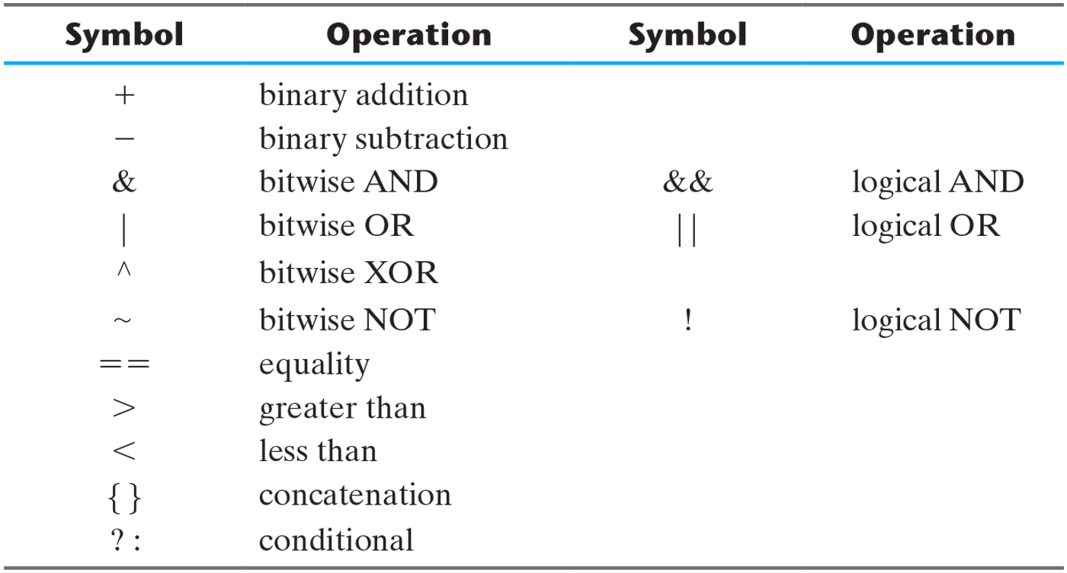
Table 4.10 Some Verilog Operators.

Slide 52

Table 4.11a SystemVerilog Assignment Operators¹⁵.

Slide 53

Table 4.11b SystemVerilog Increment/Decrement Operators.

Slide 54

Table 4.12 Predefined VHDL Data Types.

Slide 55

Table 4.13 VHDL Operators.

Slide 56

Figure 4.37 Interaction between testbench and Verilog design unit.

Slide 57

Figure 4.38 Interaction between testbench and VHDL design unit.

Slide 58

Figure 4.39 Circuit for event-driven simulation.

Slide 59

Figure 4.40 Representation of event-driven simulation (with zero delay).

Slide 60

Figure 4.41 Representation of event-driven simulation (with propagation delay).

Slide 61

FIGURE P4.1

Slide 62

FIGURE P4.2

Slide 63

FIGURE P4.9

Slide 64

FIGURE P4.16

