Slide 1

Digital Design
With an Introduction to the Verilog HDL, VHDL, and SystemVerilog
6th Edition
Chapter 05
Synchronous Sequential Logic

Slide 2
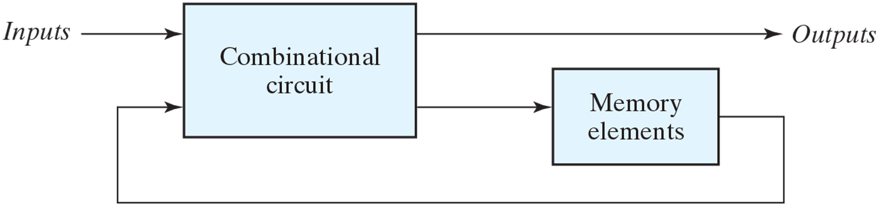
Figure 5.1 Block diagram of sequential circuit.

Slide 3
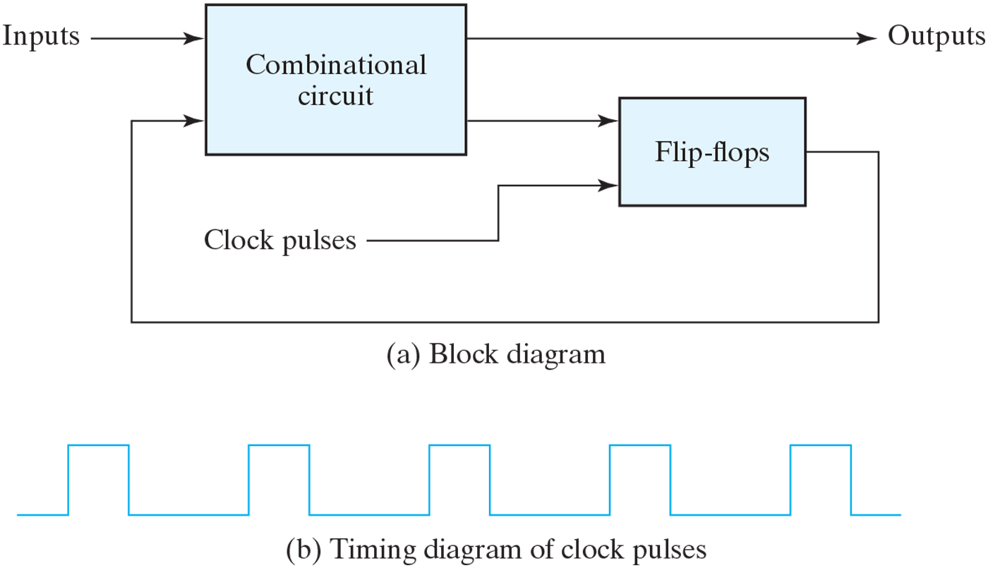
Figure 5.2 Synchronous clocked sequential circuit.

Slide 4
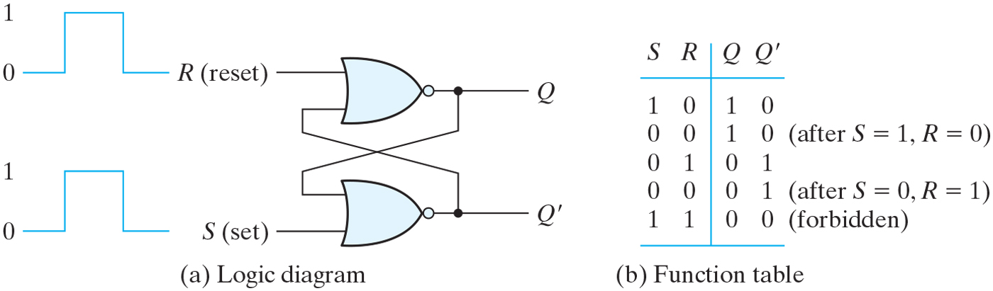
Figure 5.3 SR latch with NOR gates.

Slide 5
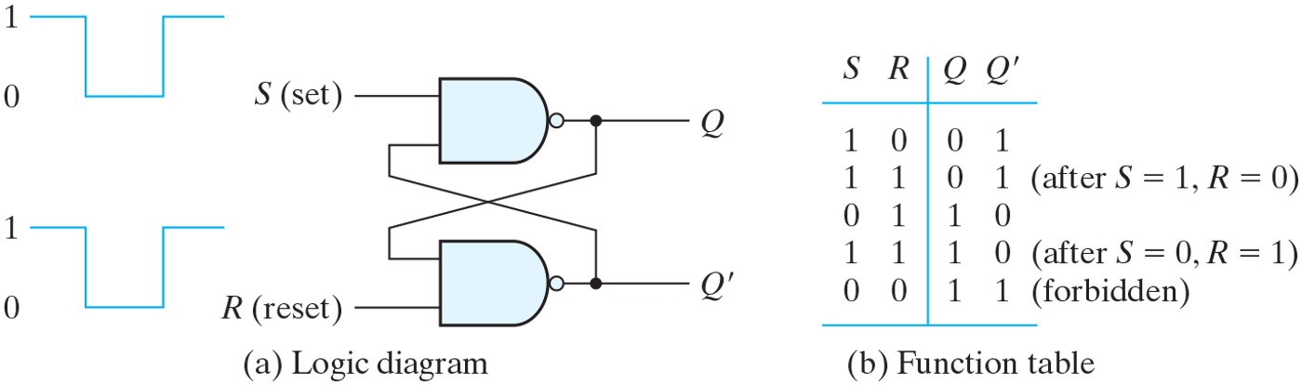
Figure 5.4 SR latch with NAND gates.

Slide 6
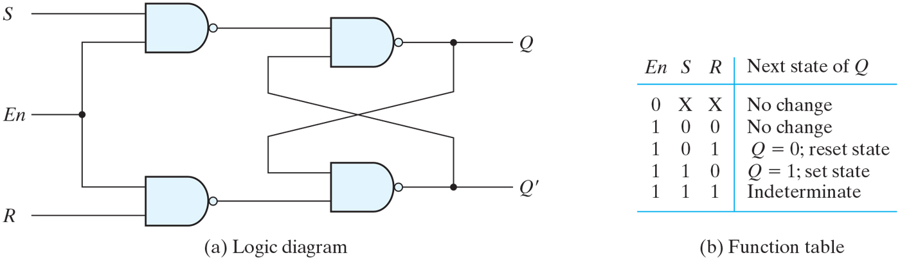
Figure 5.5 SR latch with control input.

Slide 7
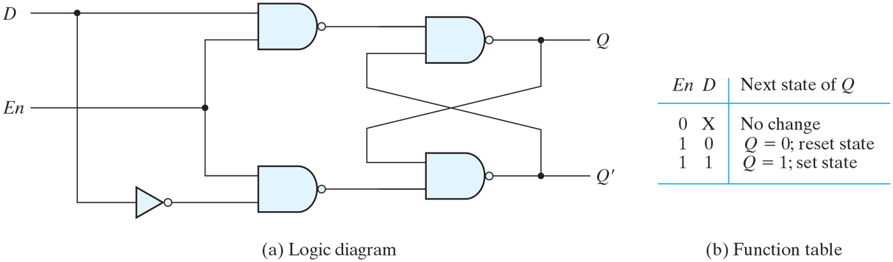
Figure 5.6 D latch.

Slide 8
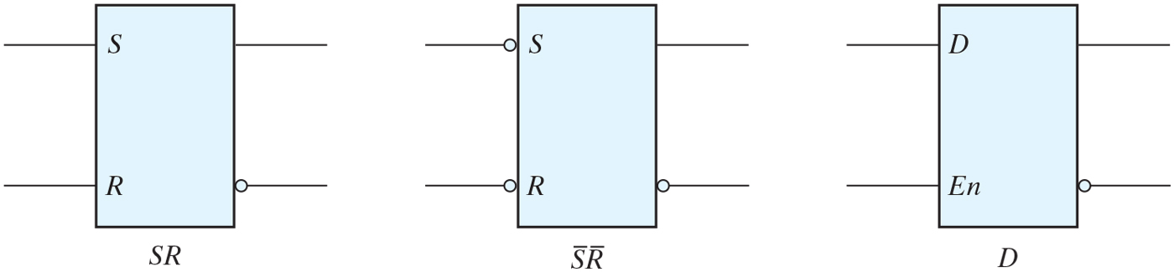
Figure 5.7 Graphic symbols for latches.

Slide 9
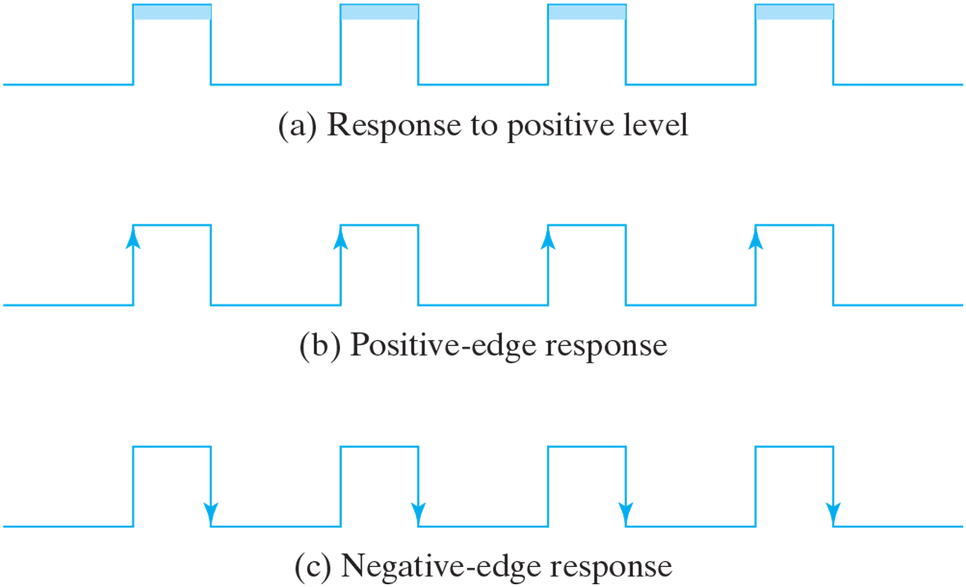
Figure 5.8 Clock response in latch and flip-flop.

Slide 10
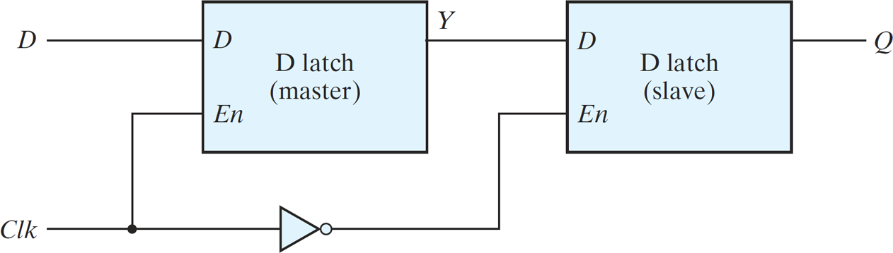
Figure 5.9 Master–slave D flip-flop.

Slide 11
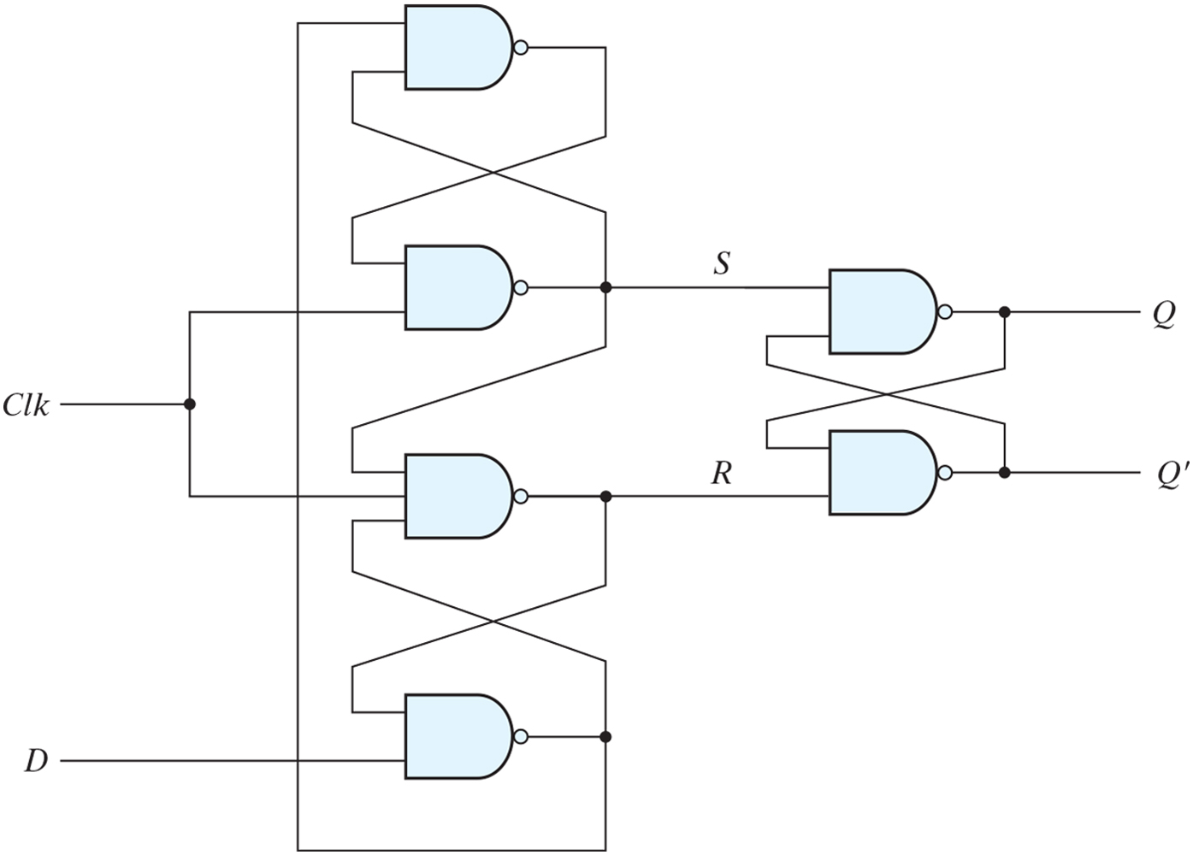
Figure 5.10 D-type positive-edge-triggered flip-flop.

Slide 12
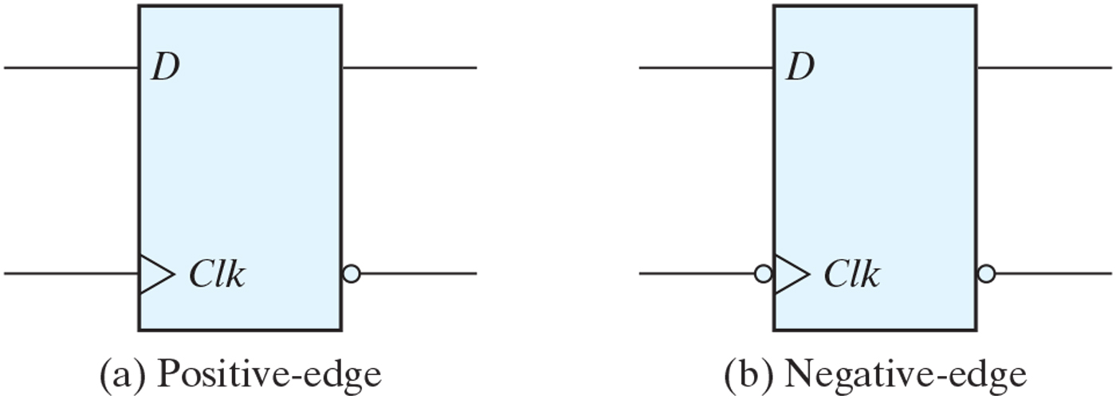
Figure 5.11 Graphic symbol for edge-triggered D flip-flop.

Slide 13
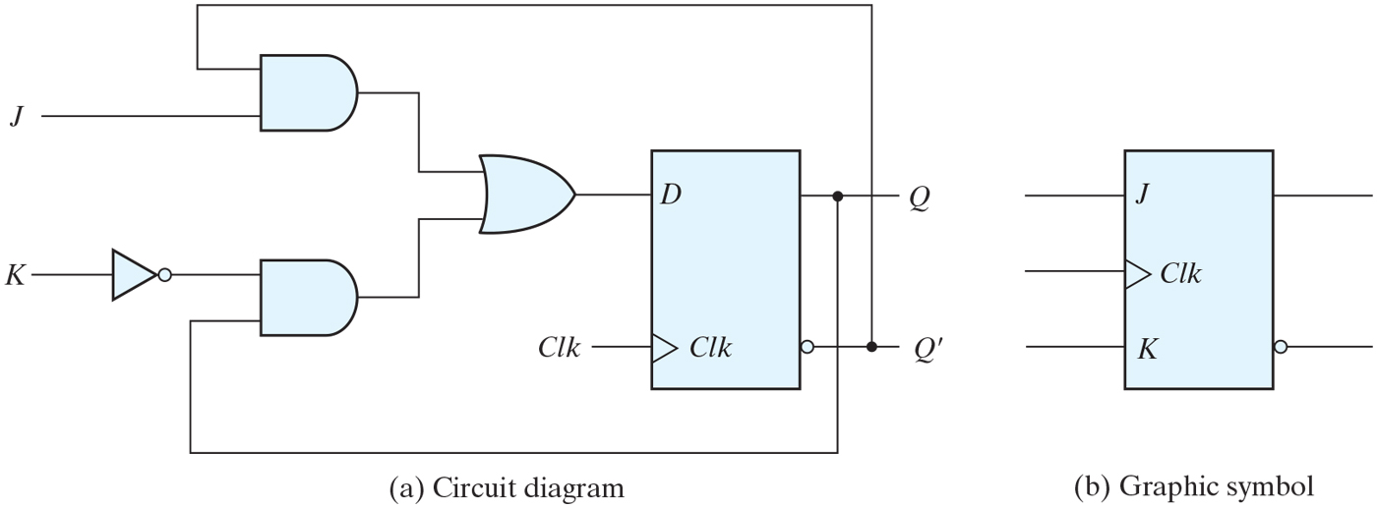
Figure 5.12 JK flip-flop.

Slide 14
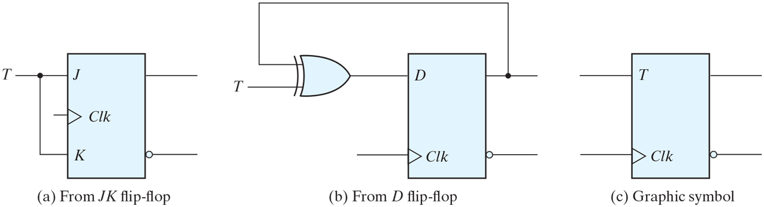
Figure 5.13 T flip-flop.

Slide 15
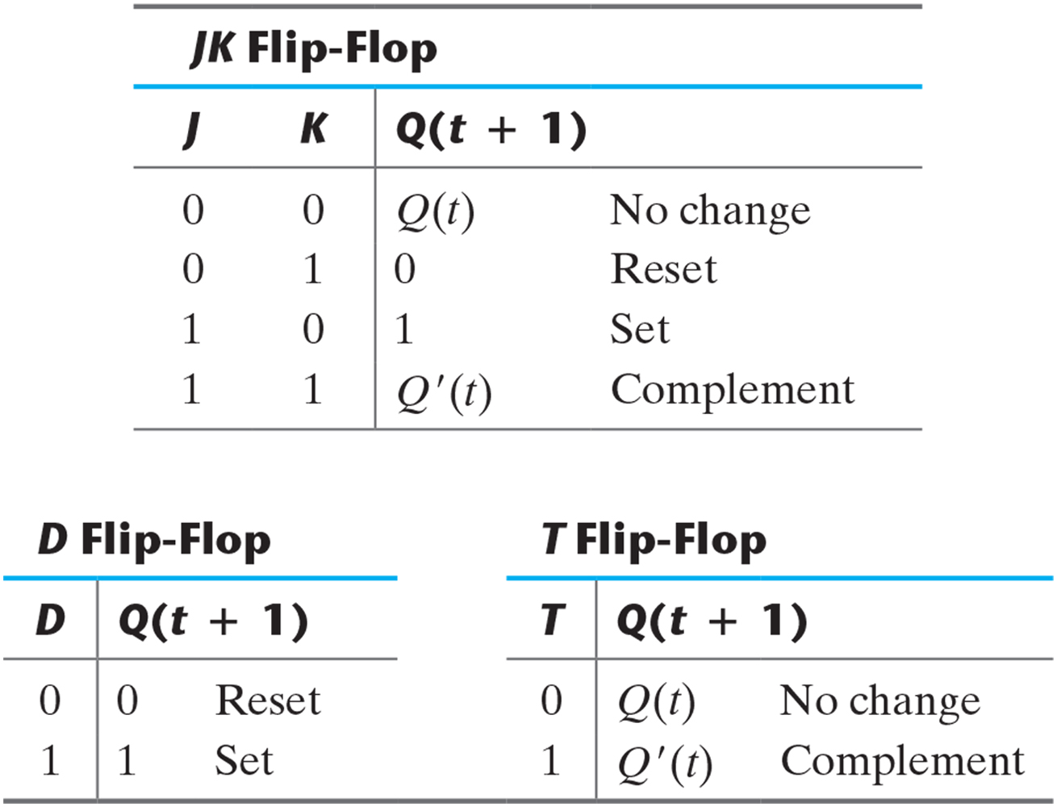
Table 5.1 Flip-Flop Characteristic Tables.

Slide 16
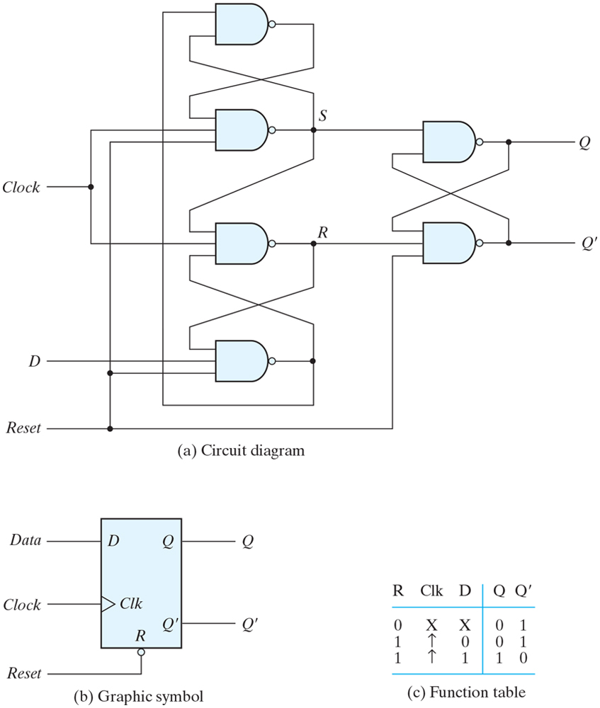
Figure 5.14 D flip-flop with asynchronous reset.

Slide 17
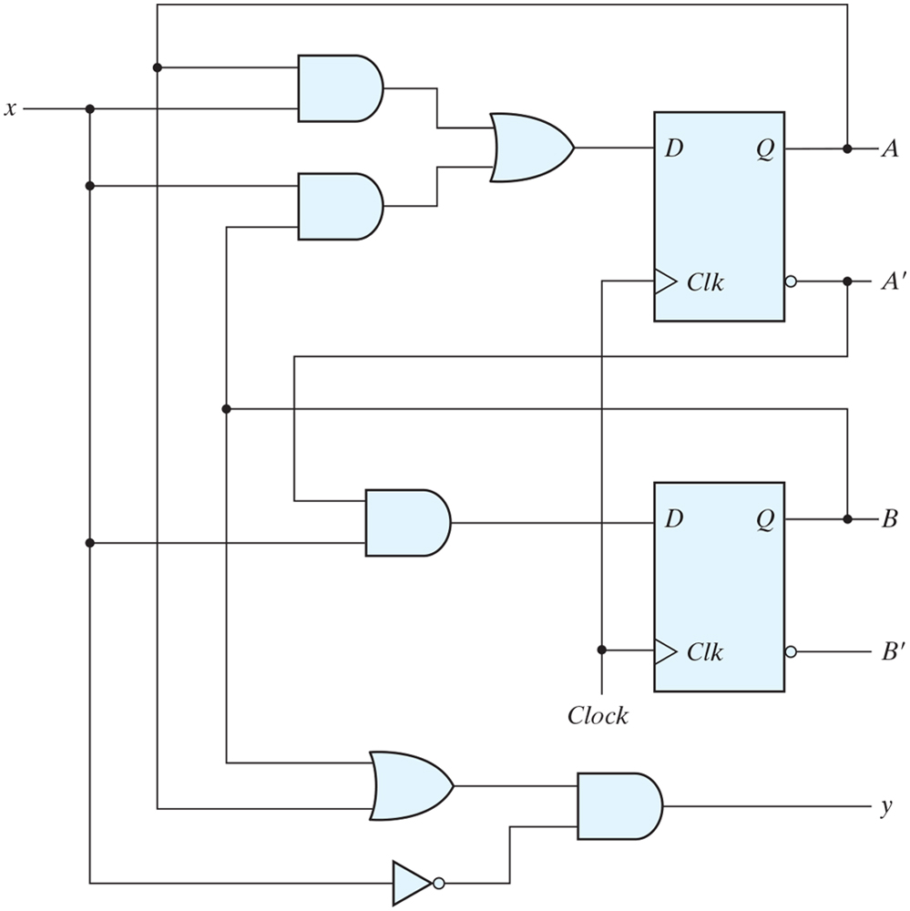
Figure 5.15 Example of sequential circuit.

Slide 18
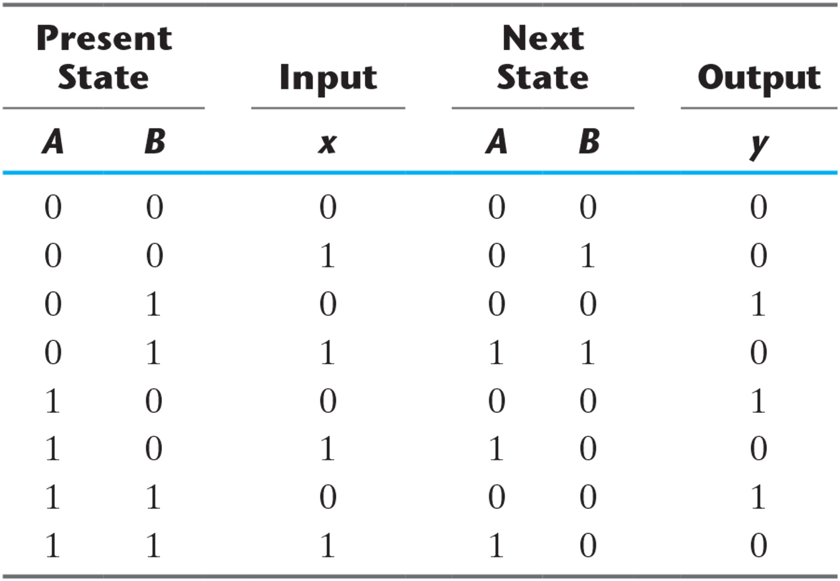
Table 5.2 State Table for the Circuit of Fig. 5.15.

Slide 19
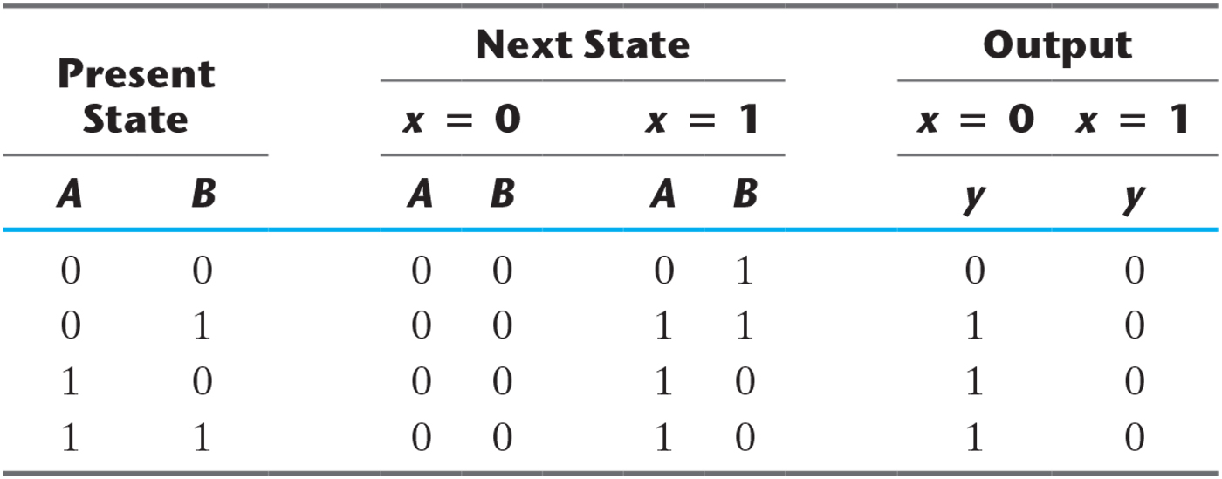
Table 5.3 Second Form of the State Table.

Slide 20
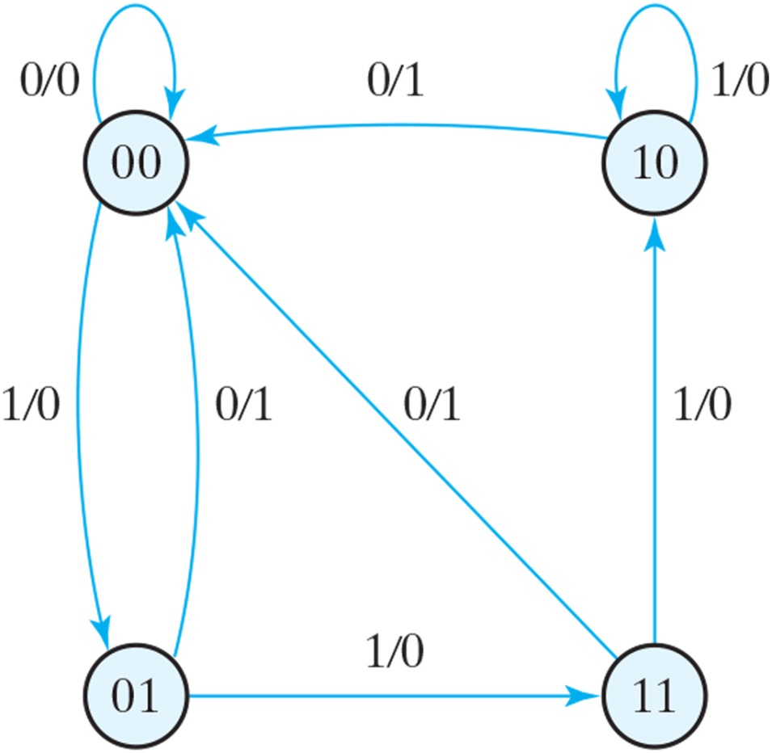
Figure 5.16 State diagram of the circuit of Fig. 5.15.

Slide 21
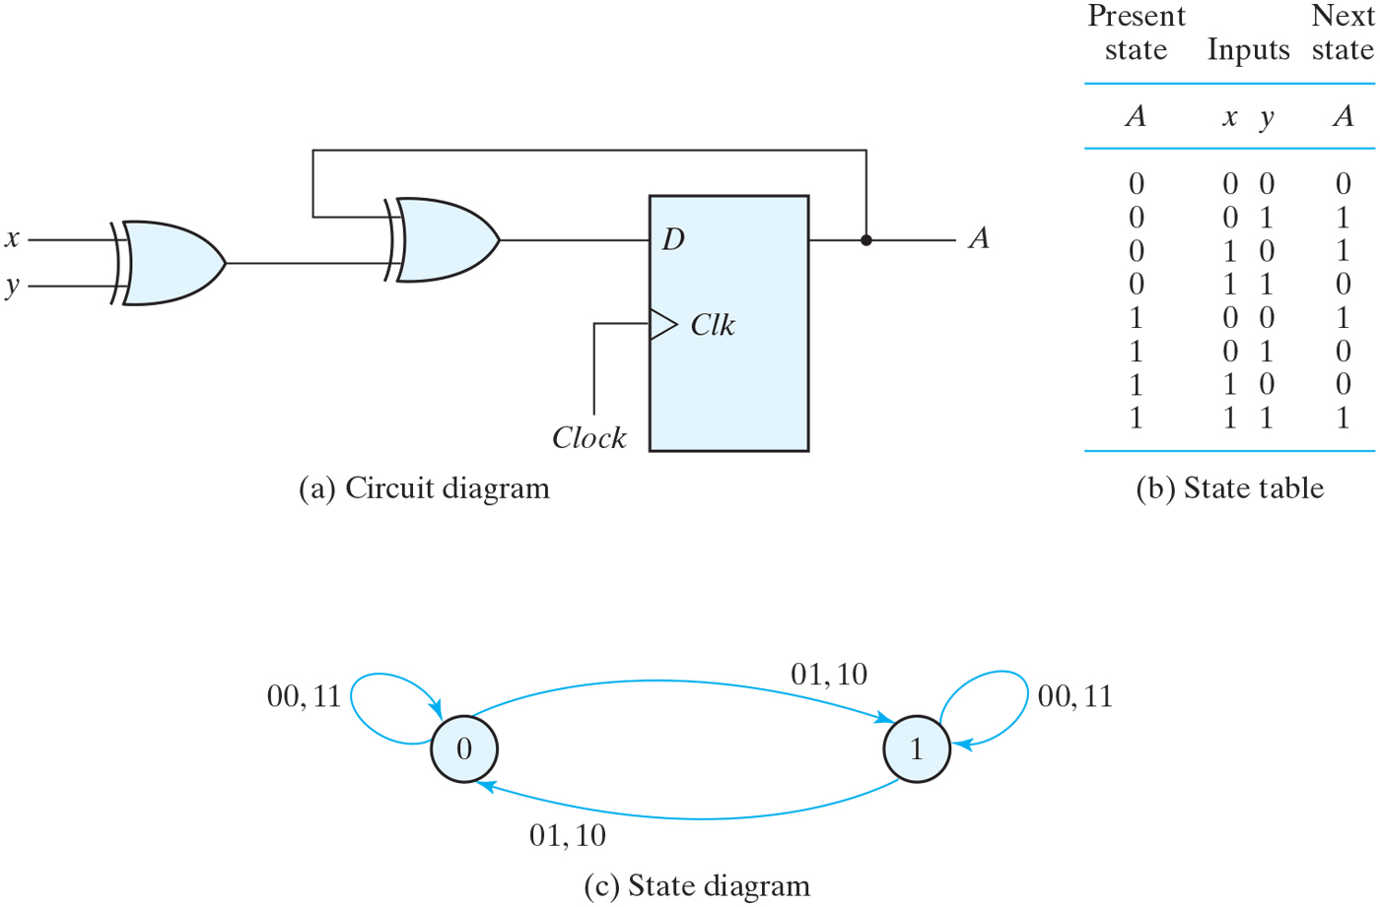
Figure 5.17 Sequential circuit with D flip-flop.

Slide 22
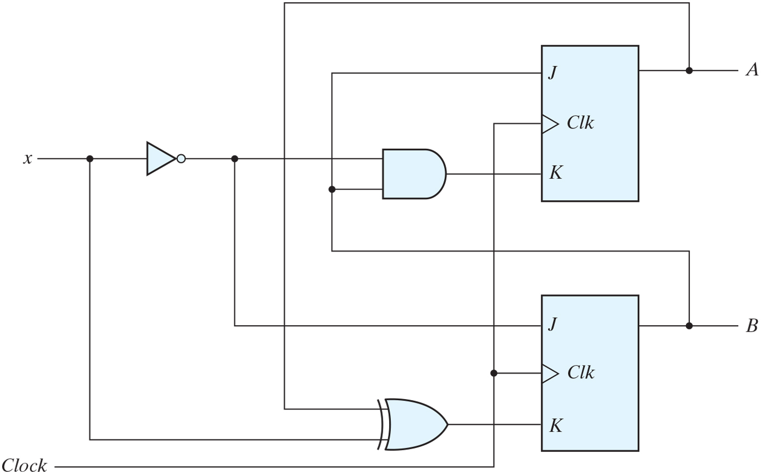
Figure 5.18 Sequential circuit with JK flip-flop.

Slide 23
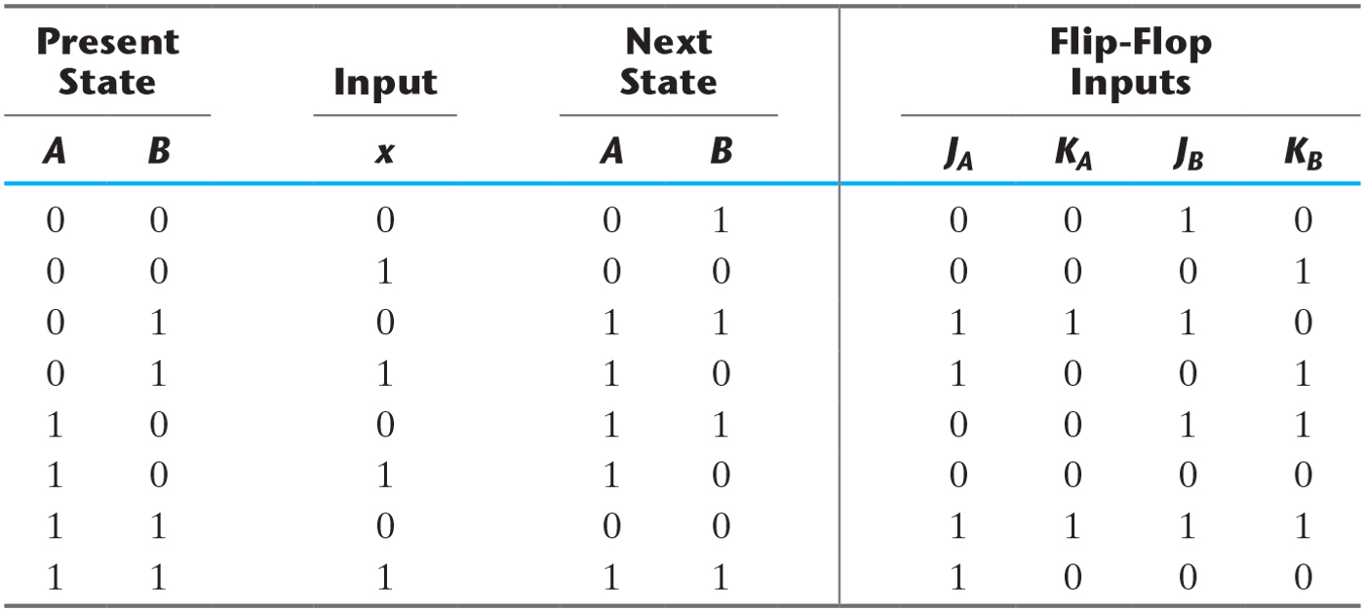
Table 5.4 State Table for Sequential Circuit with JK Flip-Flops.

Slide 24
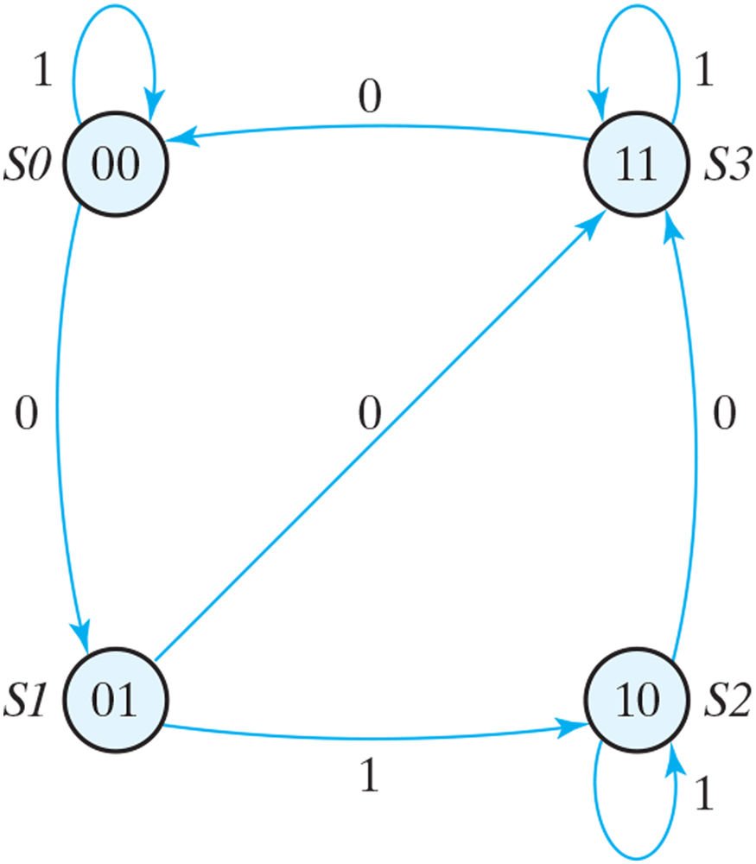
Figure 5.19 State diagram of the circuit of Fig. 5.18.

Slide 25
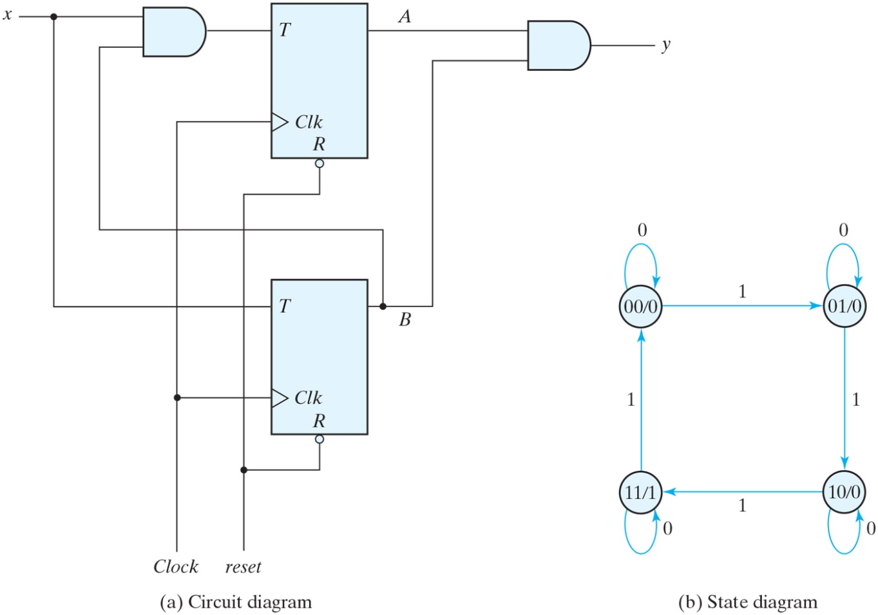
Figure 5.20 Sequential circuit with T flip-flops (Binary Counter).

Slide 26
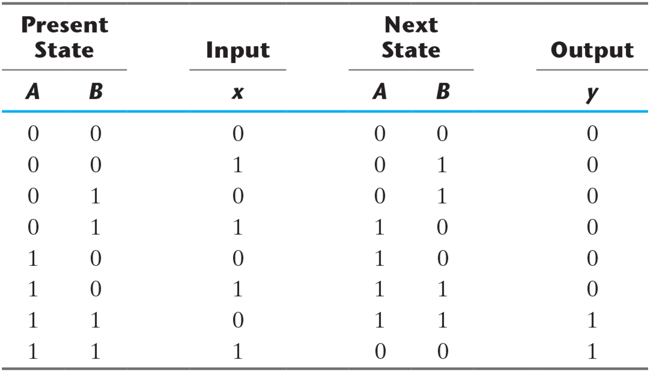
Table 5.5 State Table for Sequential Circuit with T Flip-Flops.

Slide 27
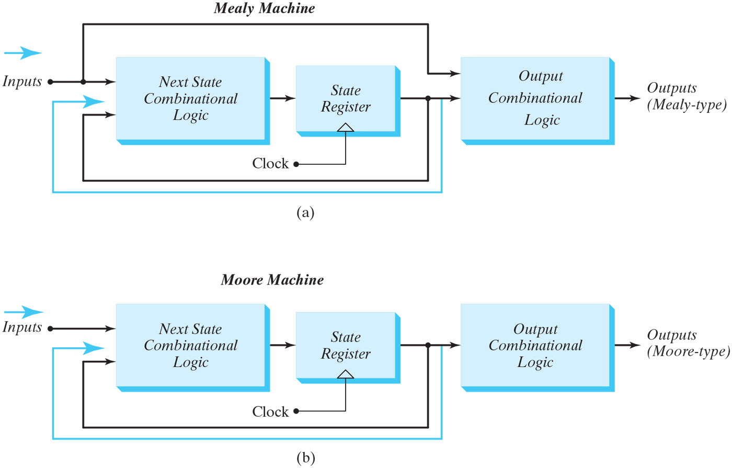
Figure 5.21 Block diagrams of Mealy and Moore state machines.

Slide 28
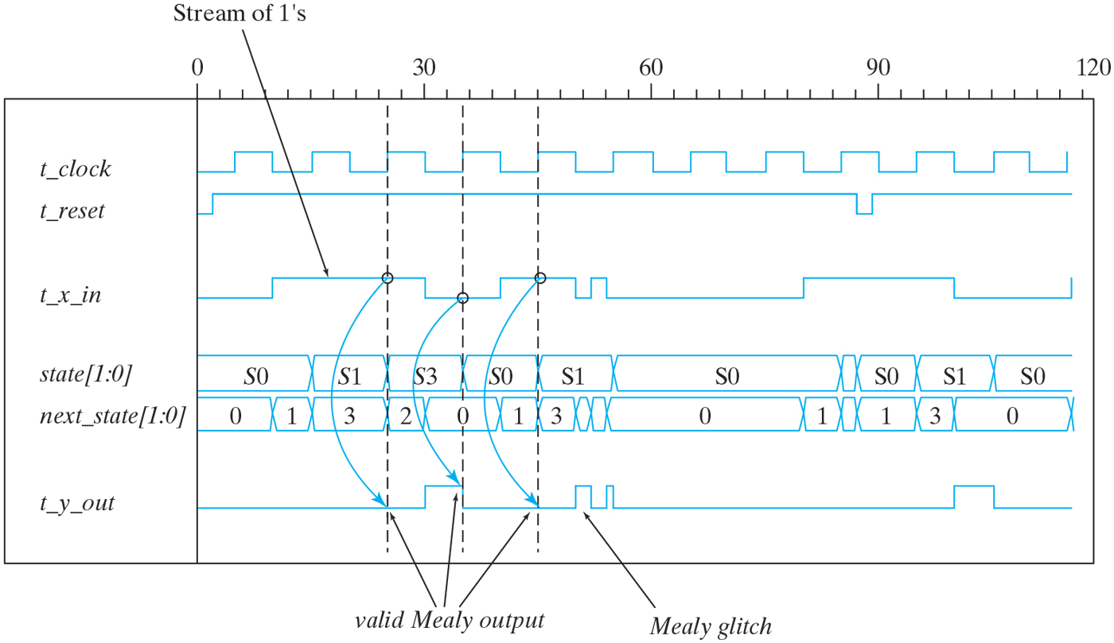
Figure 5.22 Simulation output of Mealy_Zero_Detector.

Slide 29
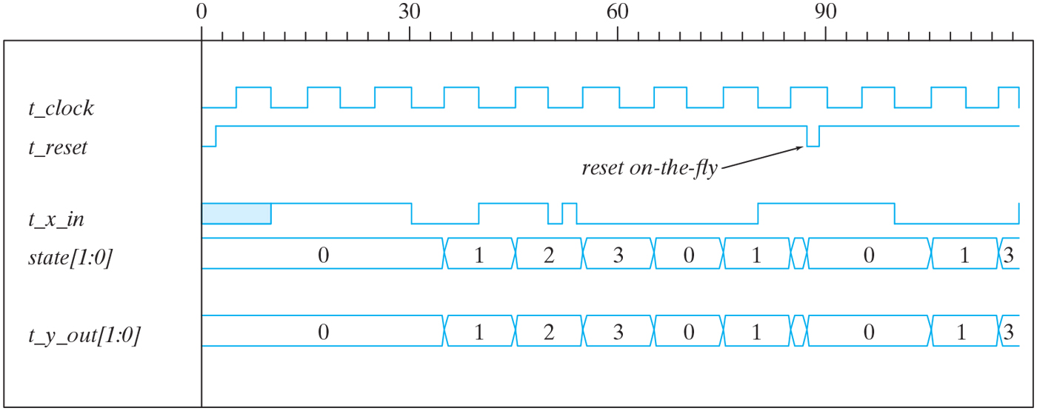
Figure 5.23 Simulation output of HDL Example 5.6.

Slide 30
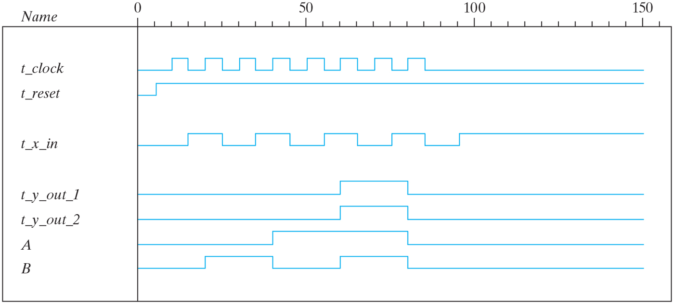
Figure 5.24 Simulation output of HDL Example 5.7.

Slide 31
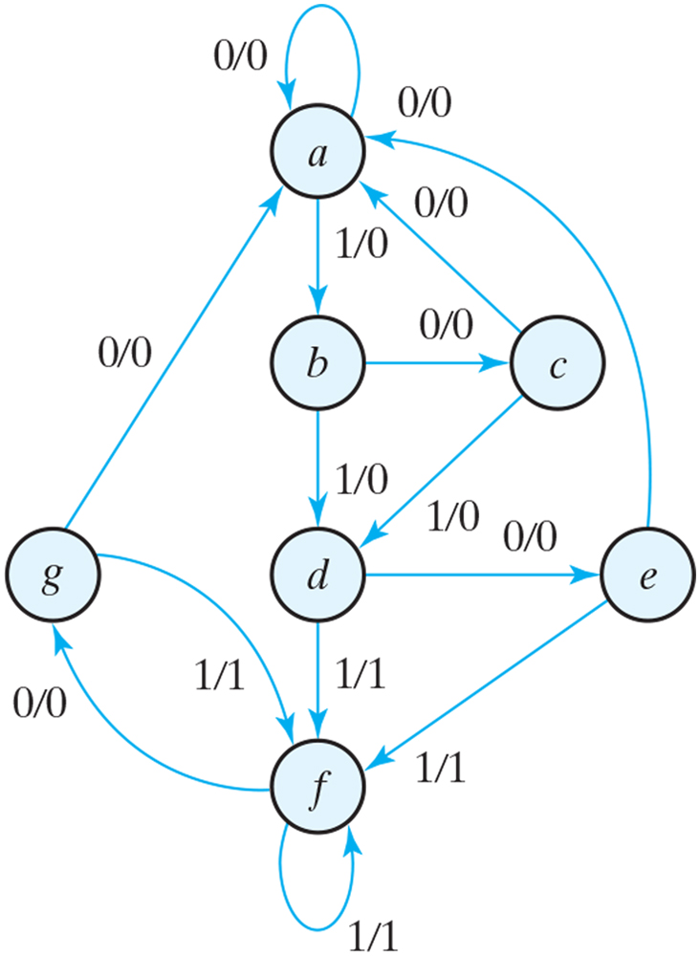
Figure 5.25 State diagram.

Slide 32
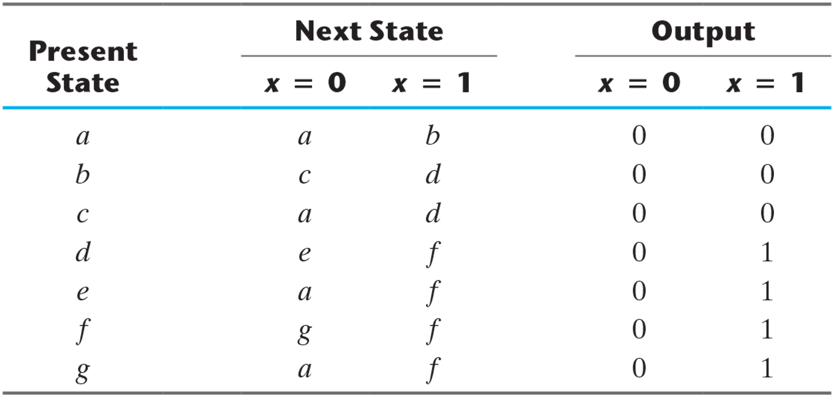
Table 5.6 State Table.

Slide 33
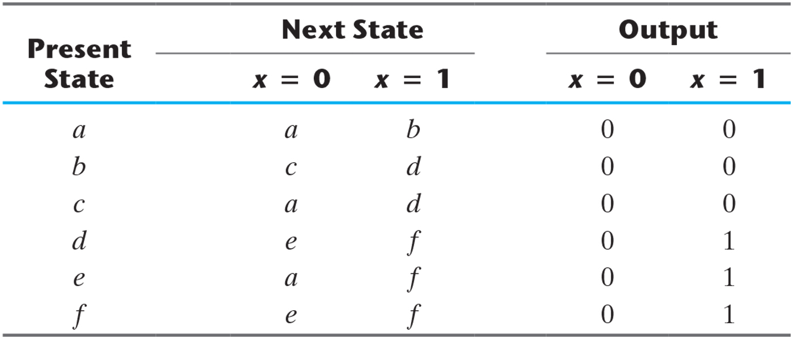
Table 5.7 Reducing the State Table.

Slide 34
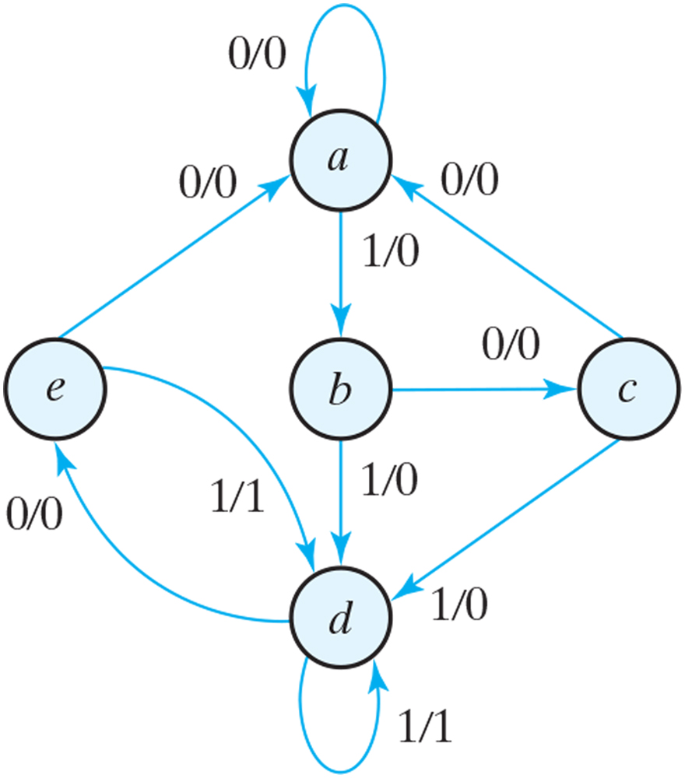
Figure 5.26 Reduced State diagram.

Slide 35
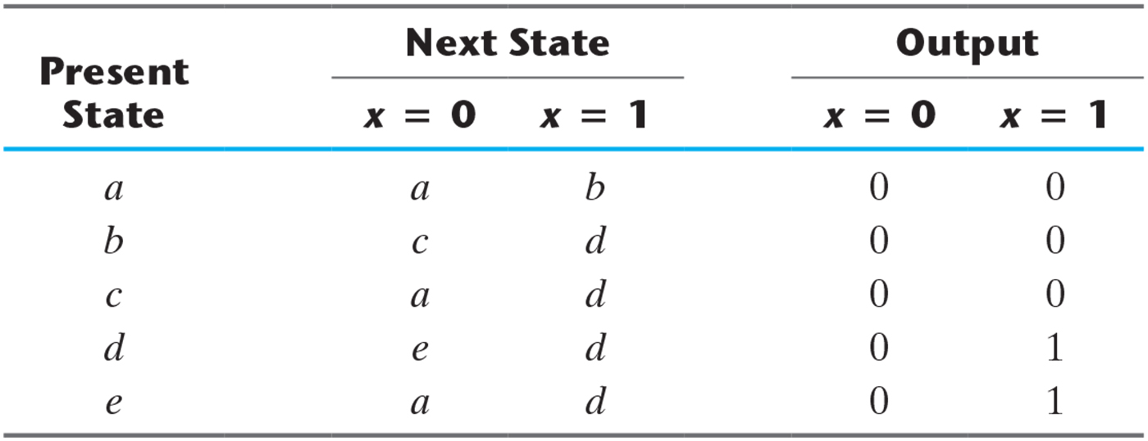
Table 5.8 Reduced the State Table.

Slide 36
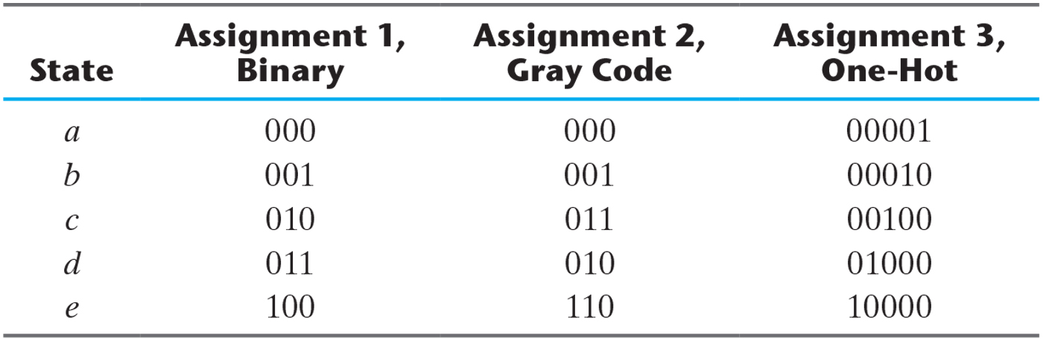
Table 5.9 Three Possible Binary State Assignments.

Slide 37
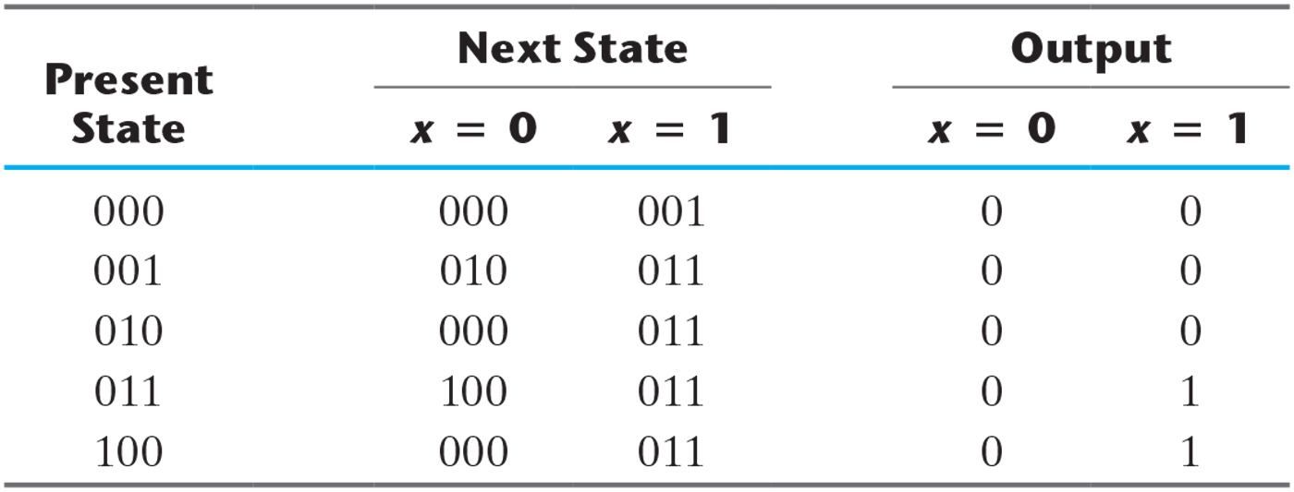
Table 5.10 Reduced State Table with Binary Assignment 1.

Slide 38
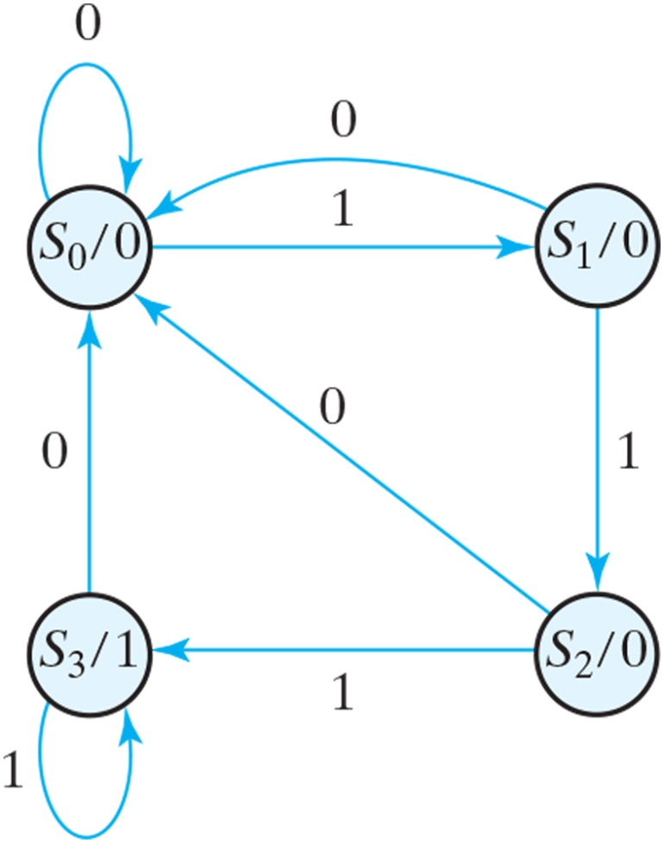
Figure 5.27 State diagram for sequence detector.

Slide 39
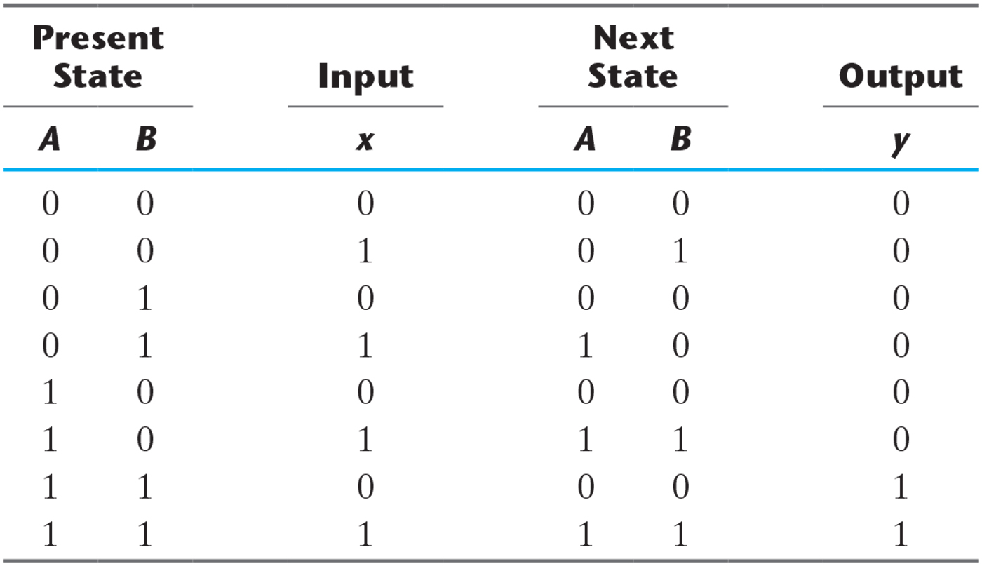
Table 5.11 State Table for Sequence Detector.

Slide 40
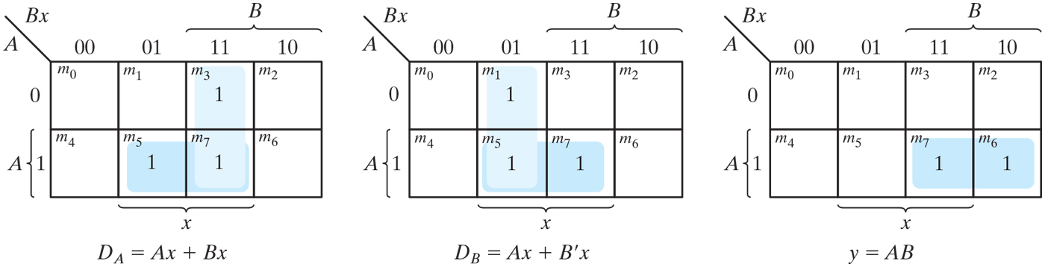
Figure 5.28 K-Maps for sequence detector.

Slide 41
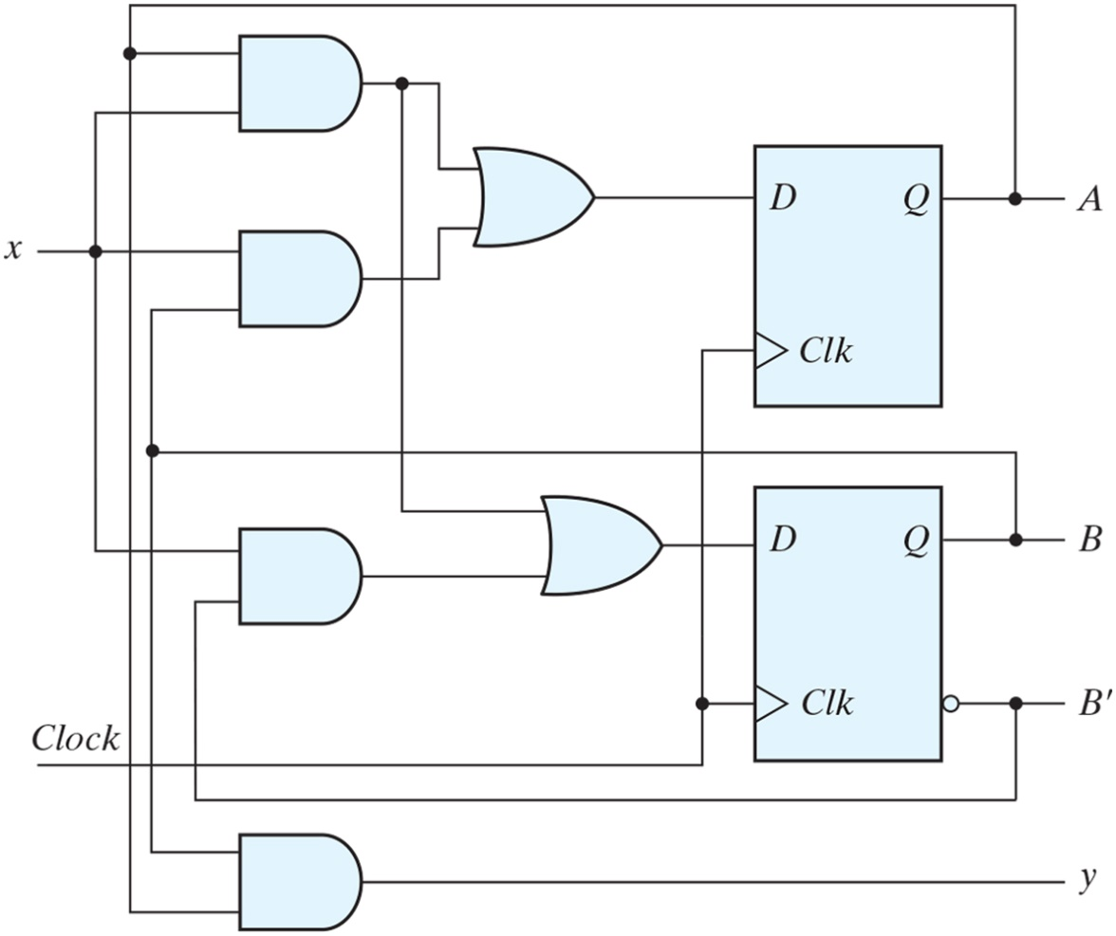
Figure 5.29 Logic diagram of a Moore-type sequence detector.

Slide 42
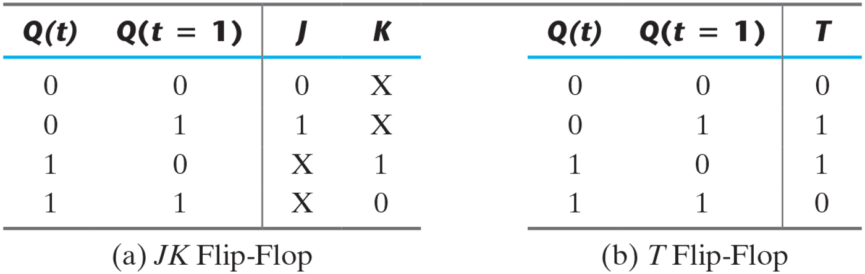
Table 5.12 Flip-Flop Excitation Tables.

Slide 43
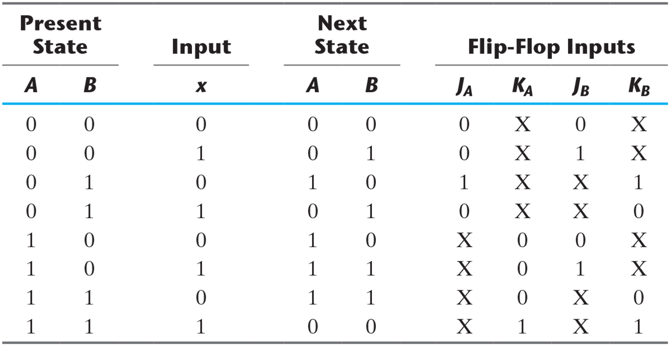
Table 5.13 State Table and JK Flip-Flop Inputs.

Slide 44
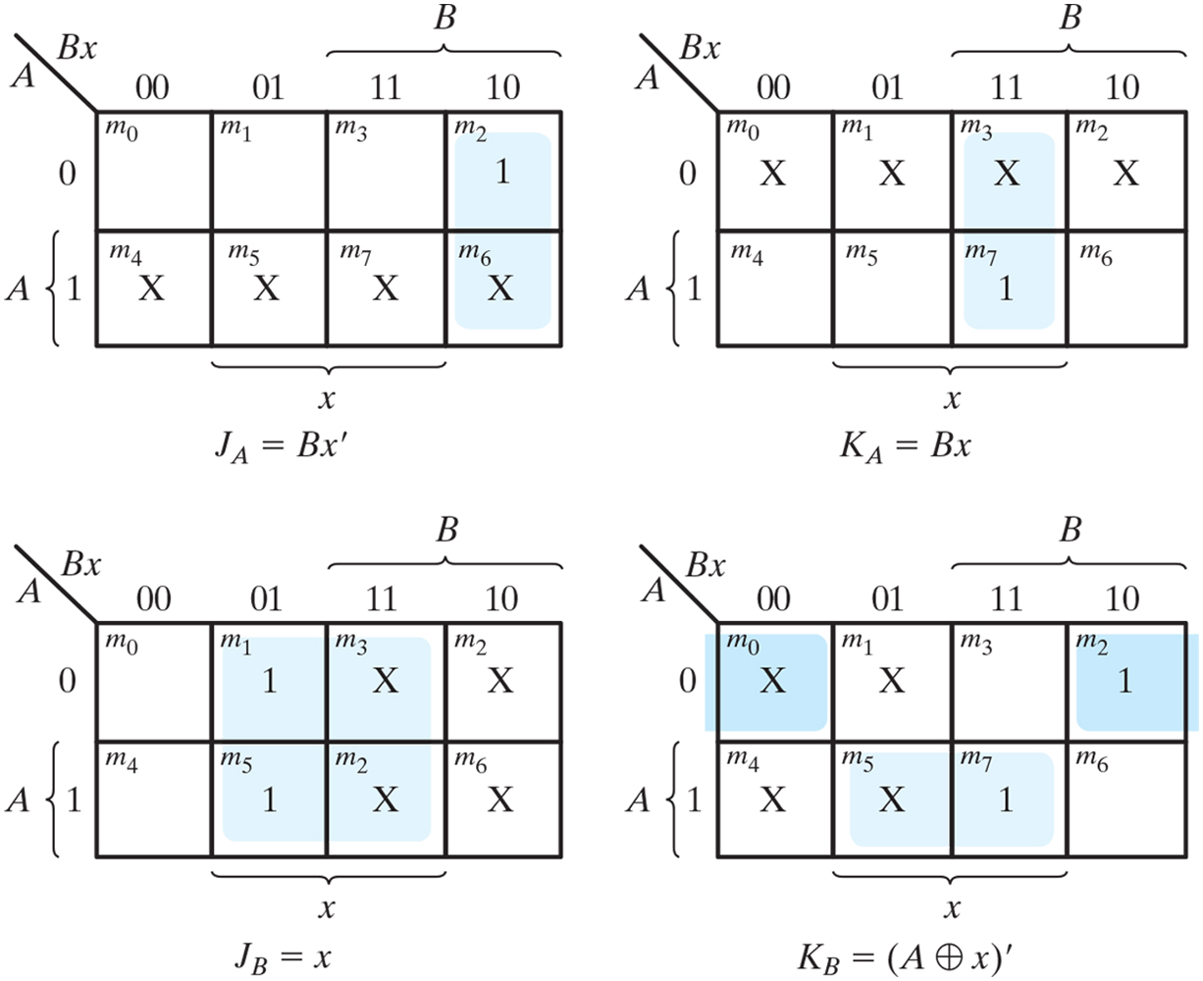
Figure 5.30 Maps for J and K input equations.

Slide 45
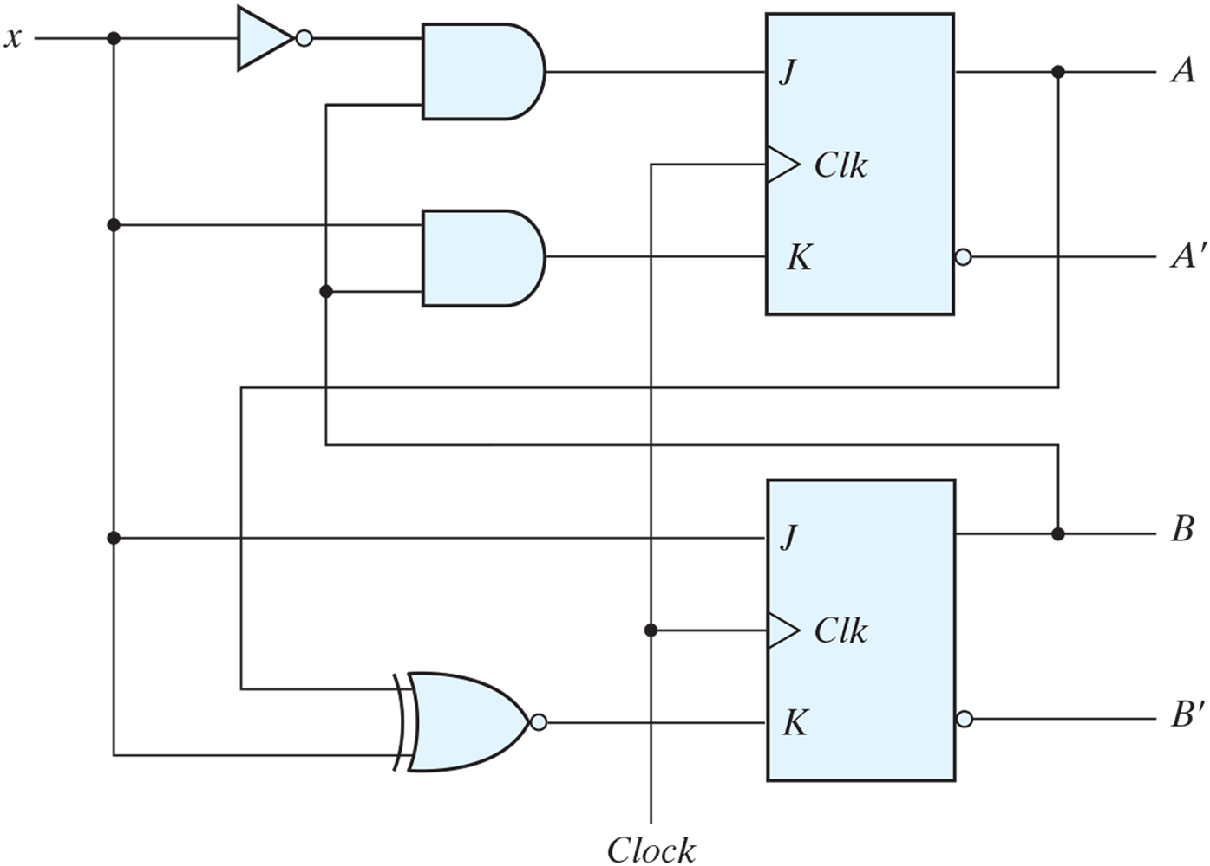
Figure 5.31 Logic diagram for sequential circuit with JK flip-flops.

Slide 46
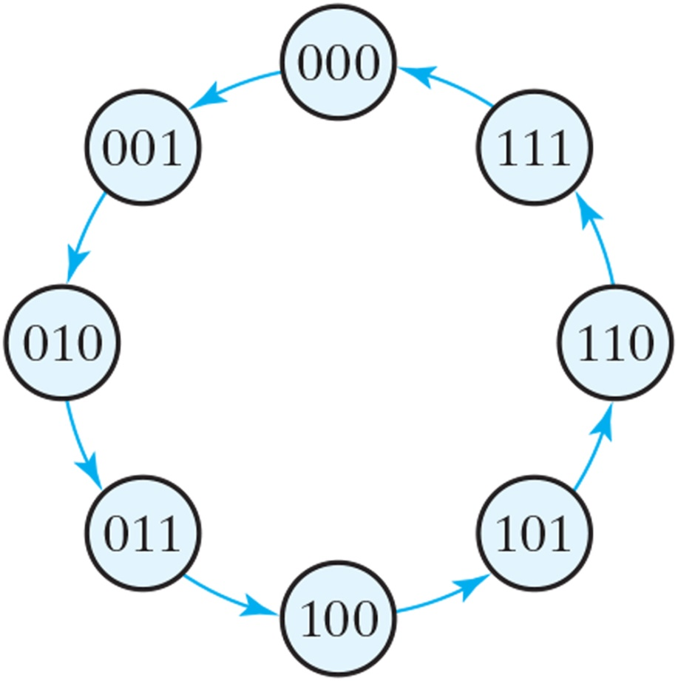
Figure 5.32 State diagram of three-bit binary counter.

Slide 47
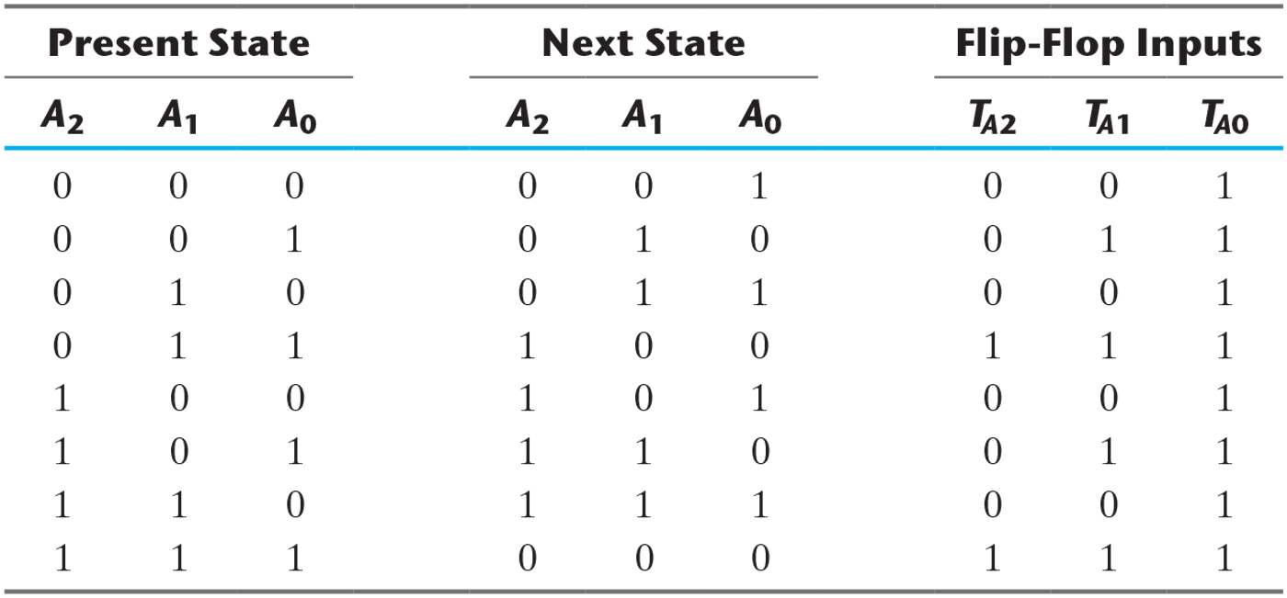
Table 5.14 State Table for Three-Bit Counter.

Slide 48
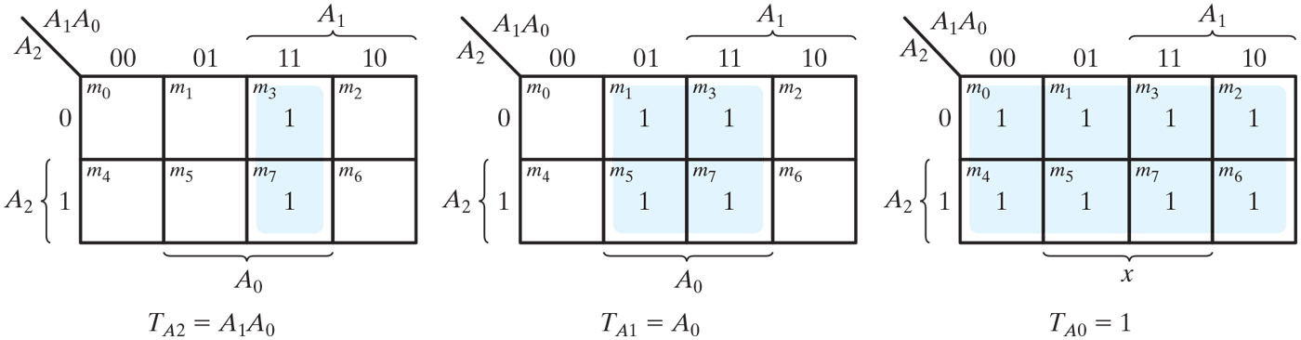
Figure 5.33 Maps for three-bit binary counter.

Slide 49
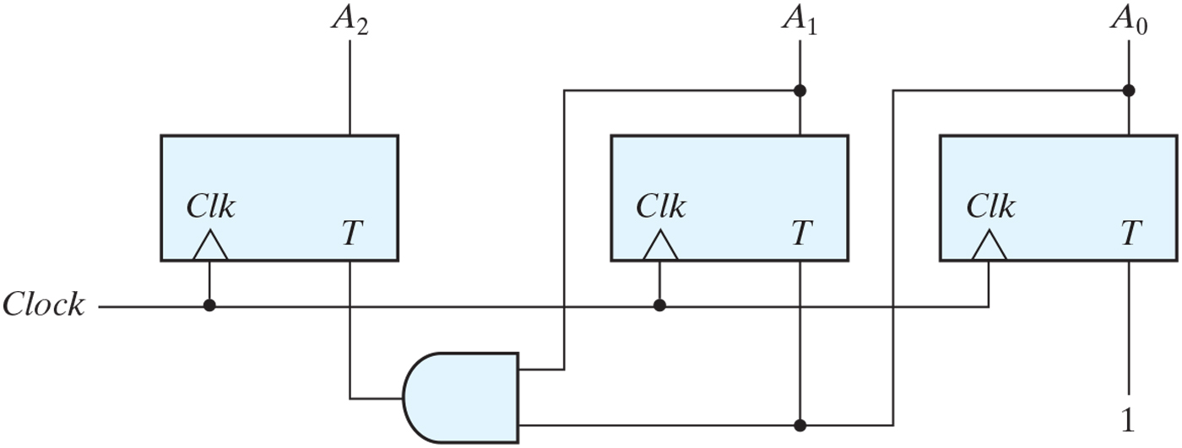
Figure 5.34 Logic diagram of three-bit binary counter.

Slide 50
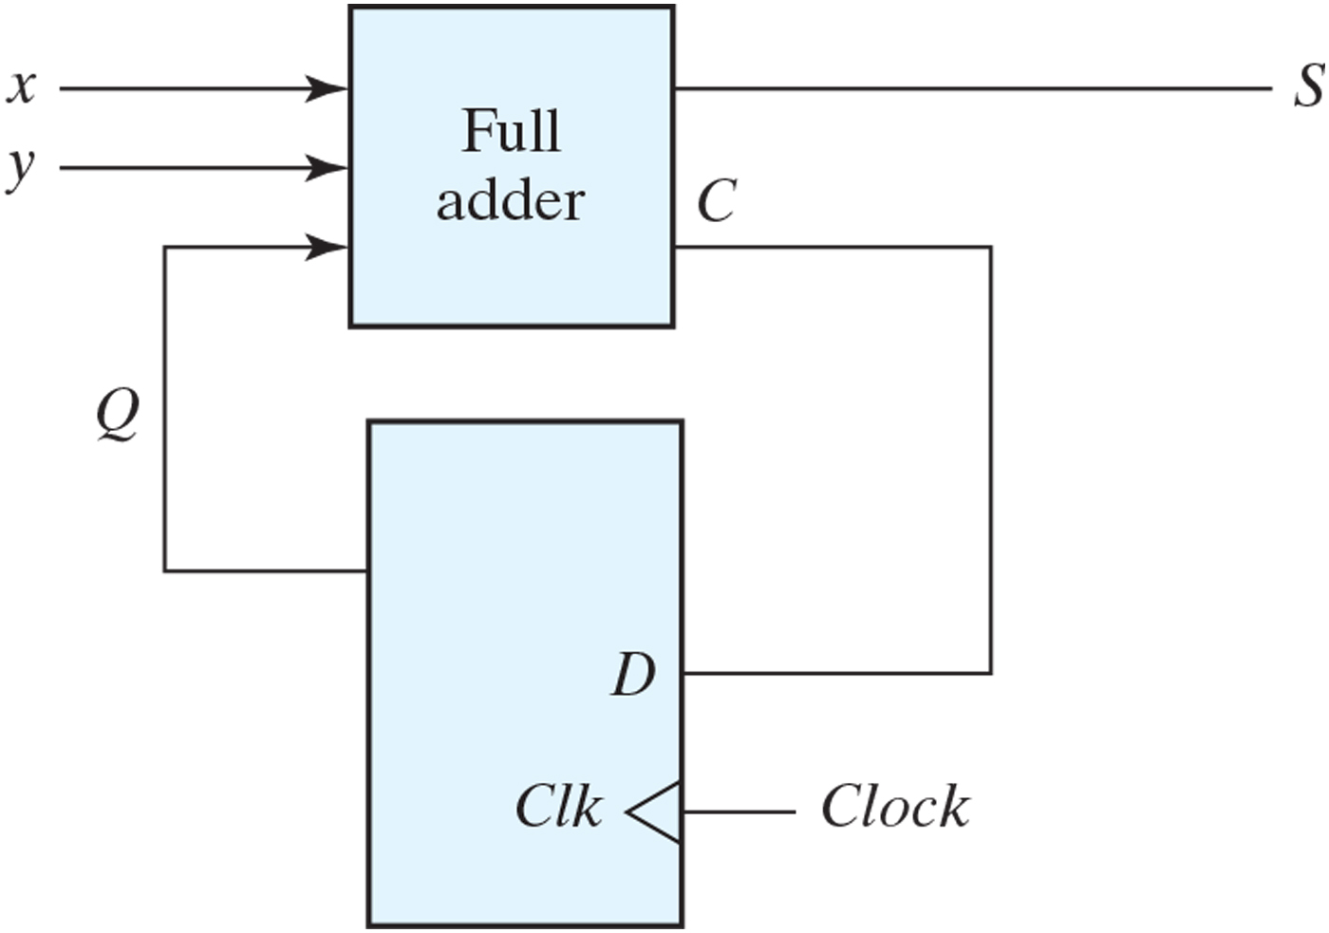
Figure P5.7

Slide 51
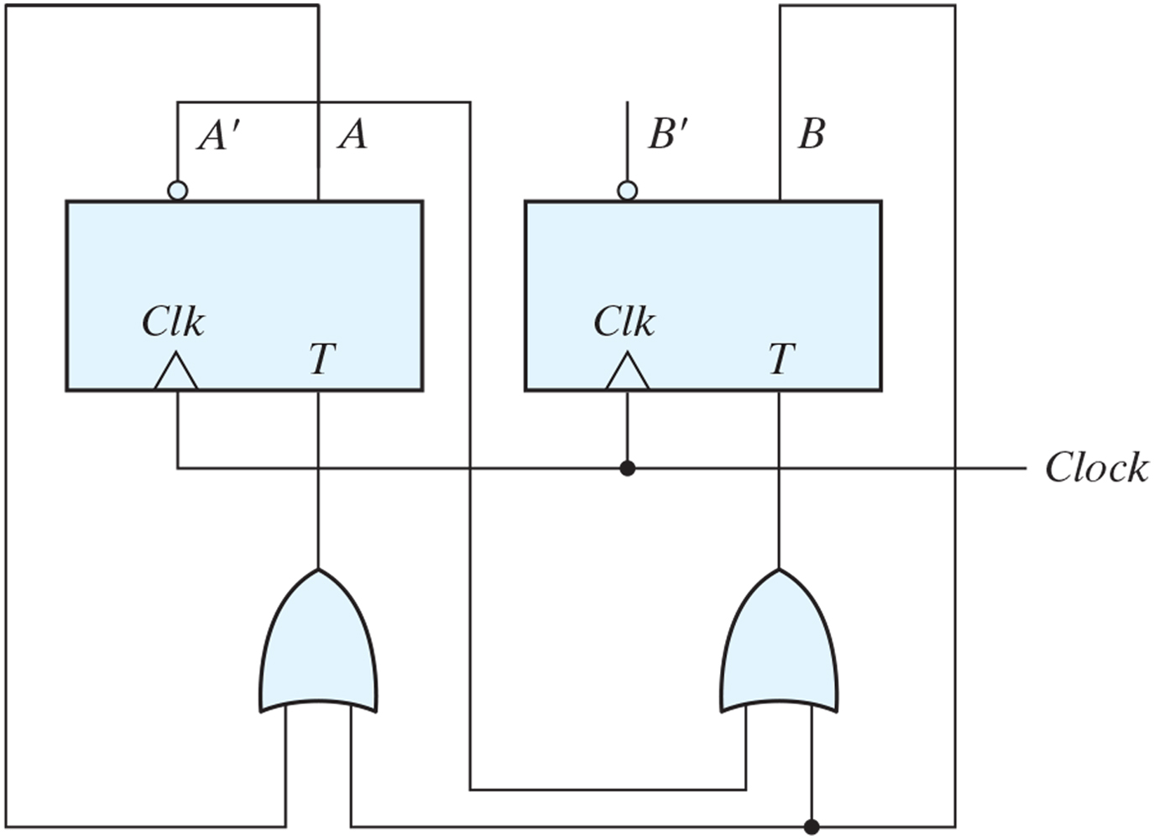
Figure P5.8

Slide 52

Problem 5.12

Slide 53

Figure P5.19

Slide 54

Figure P5.32 Waveforms for Problem 5.32.

Slide 55

Figure P5.48

Slide 56

Figure P5.49

