Slide 1

Digital Design
With an Introduction to the Verilog HDL, VHDL, and SystemVerilog
6th Edition
Chapter 06
Registers and Counters

Slide 2
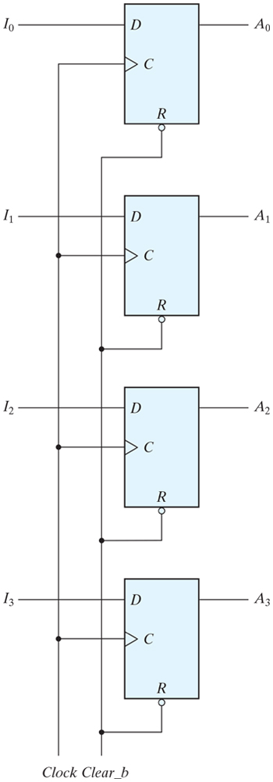
Figure 6.1 Four-bit register.

Slide 3
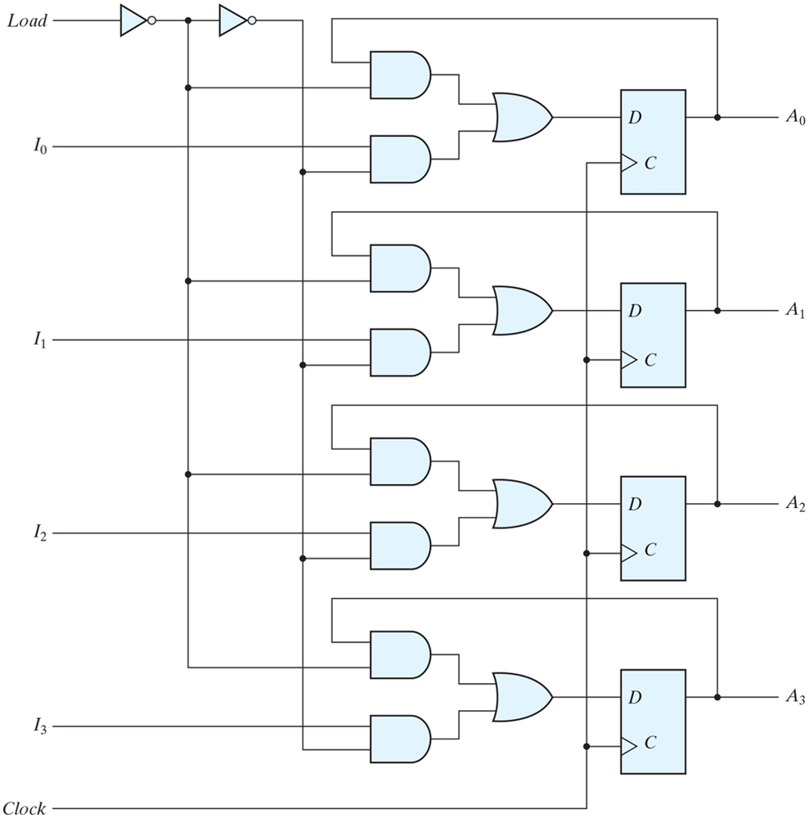
Figure 6.2 Four-bit register with parallel load.

Slide 4
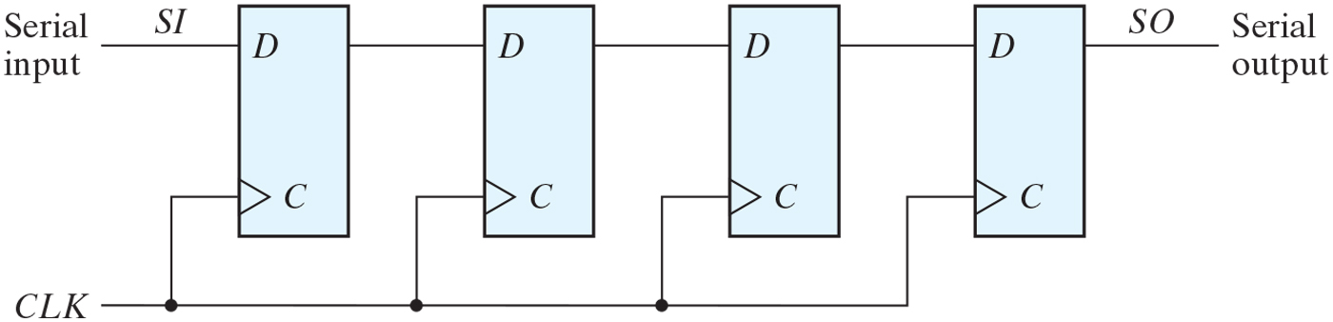
Figure 6.3 Four-bit shift register.

Slide 5
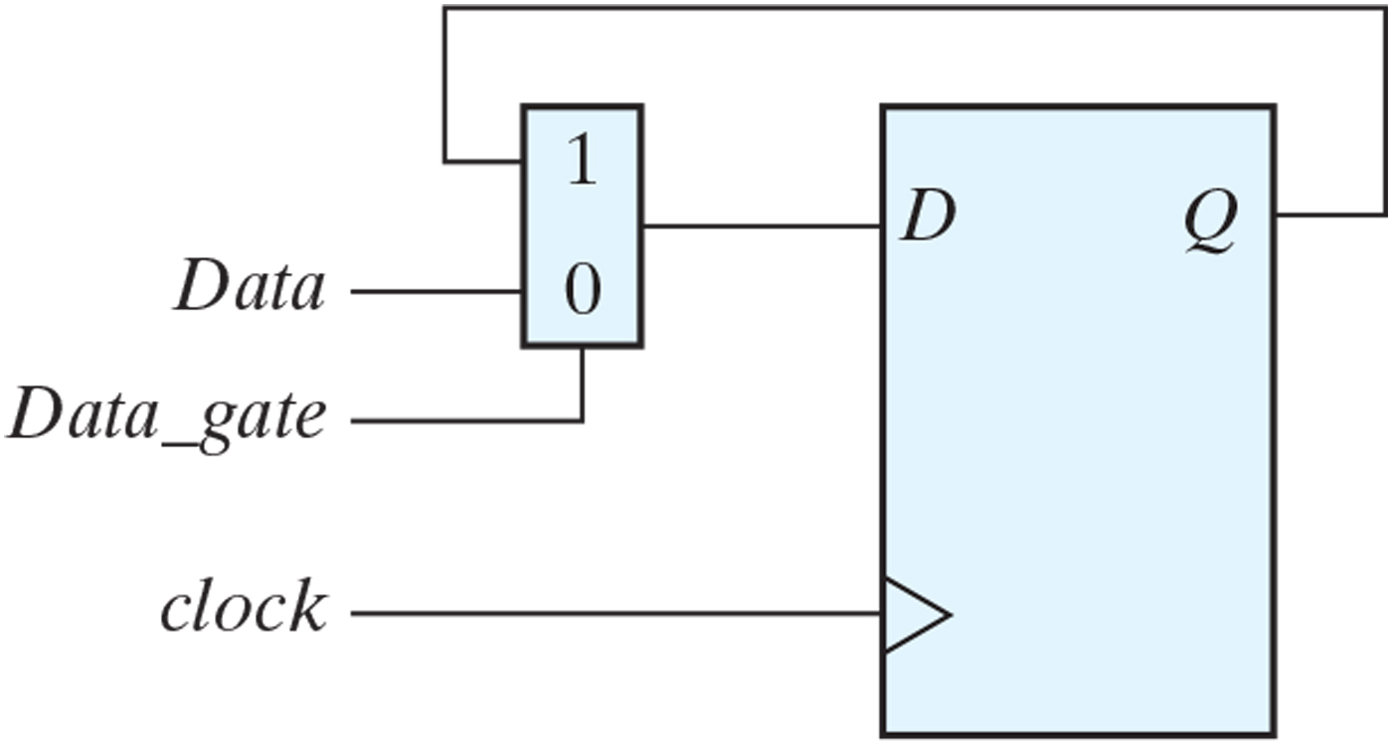
Figure PE6.1

Slide 6
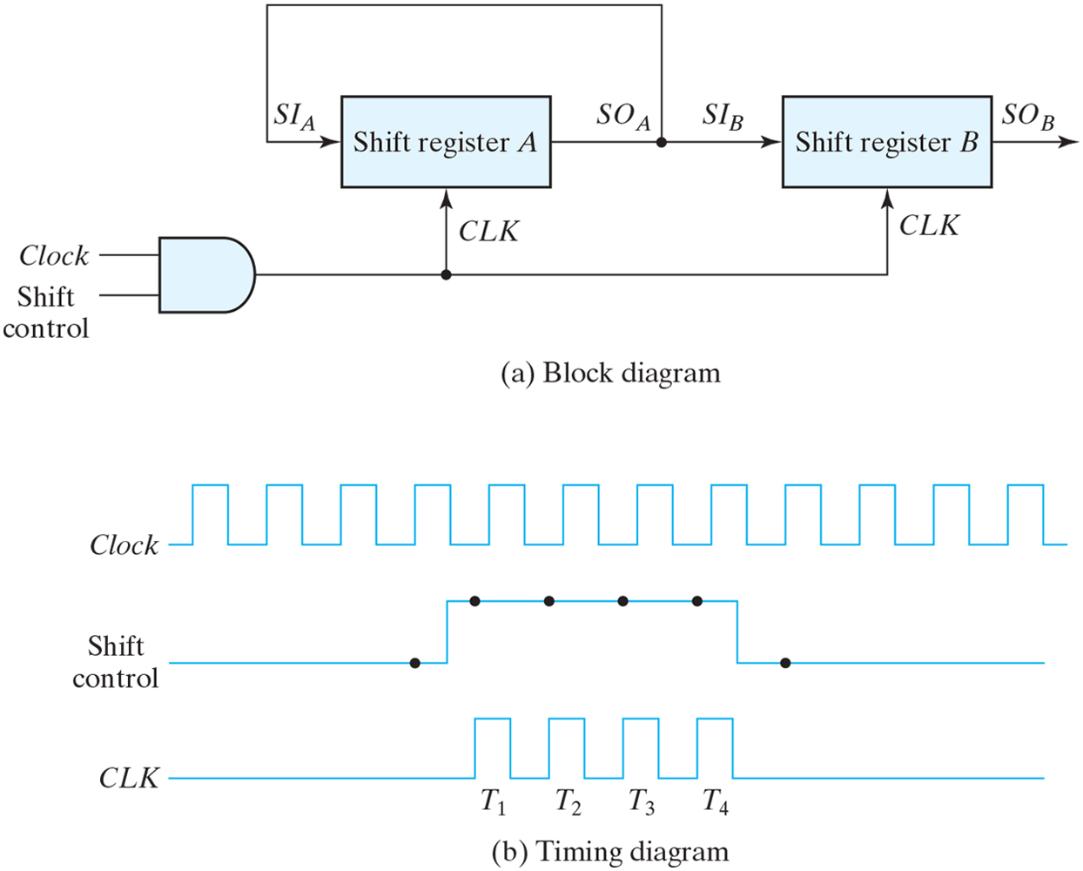
Figure 6.4 Serial transfer from register A to register B.

Slide 7
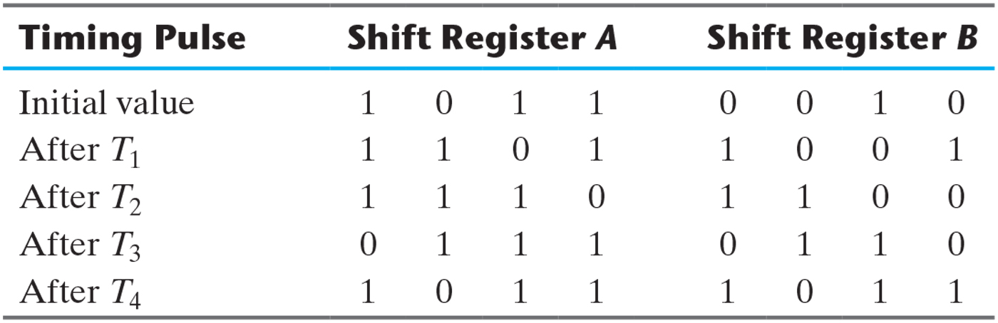
Table 6.1 Serial-Transfer Example.

Slide 8
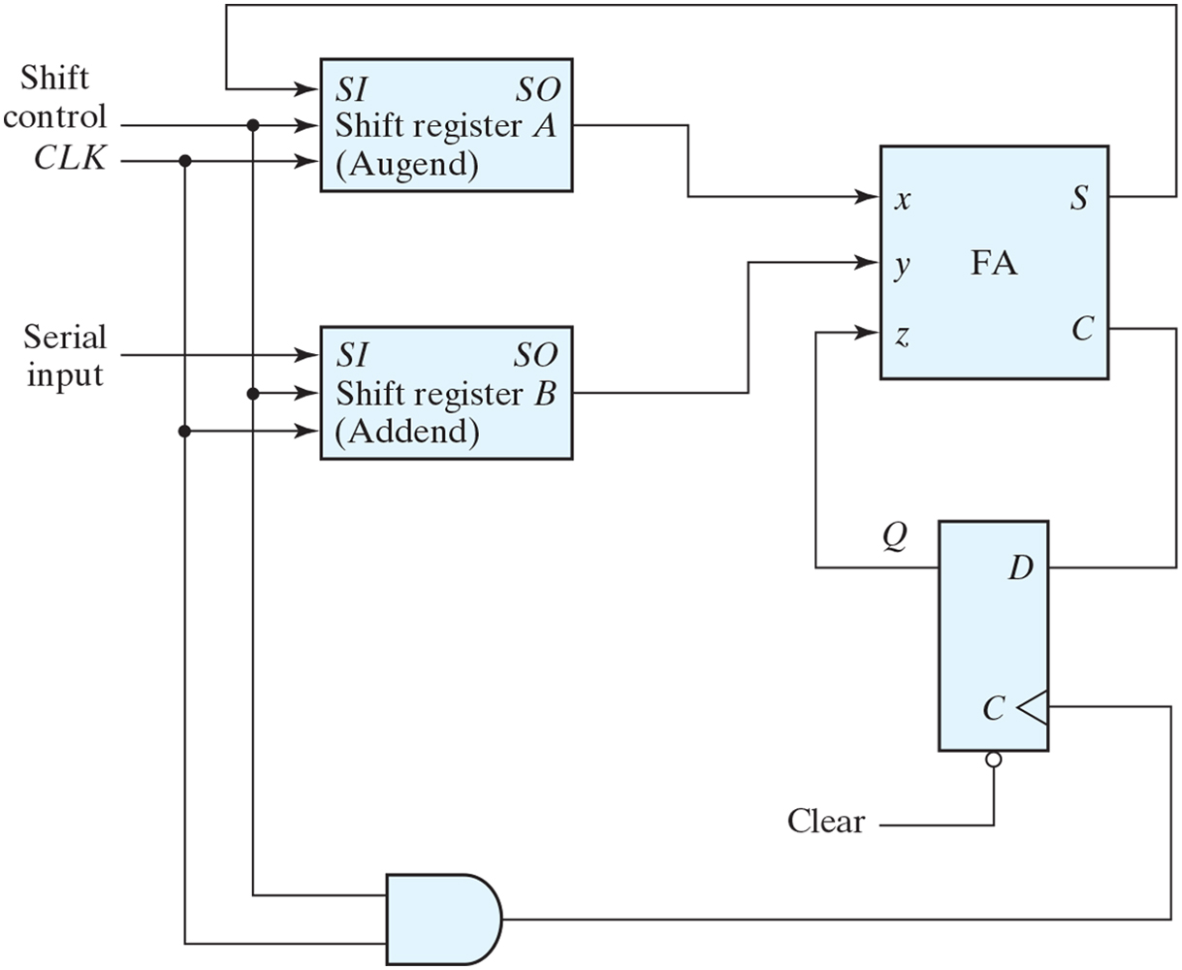
Figure 6.5 Serial adder.

Slide 9
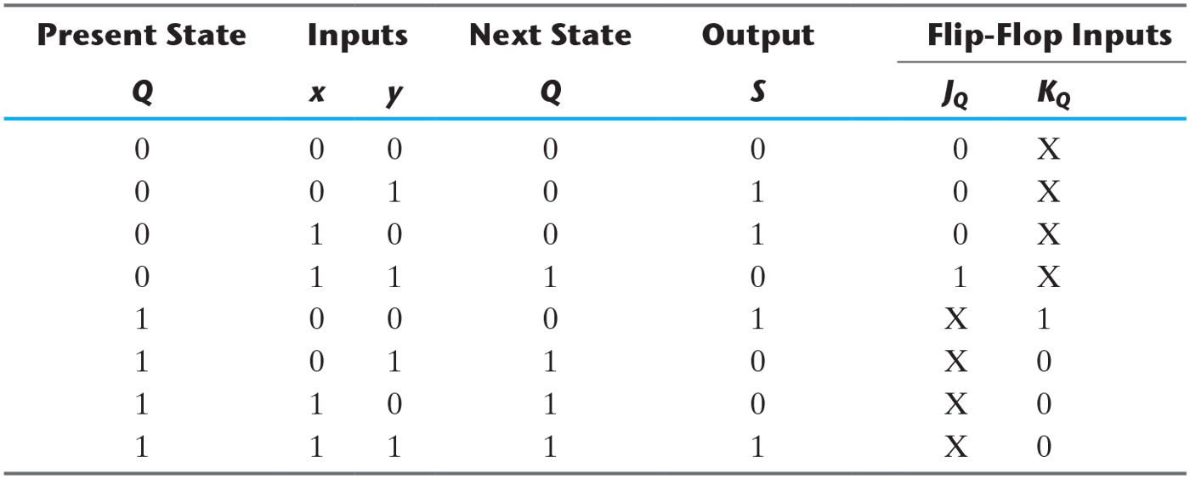
Table 6.2 State Table for Serial Adder.

Slide 10
Figure 6.6 Second form of serial adder.

Slide 11
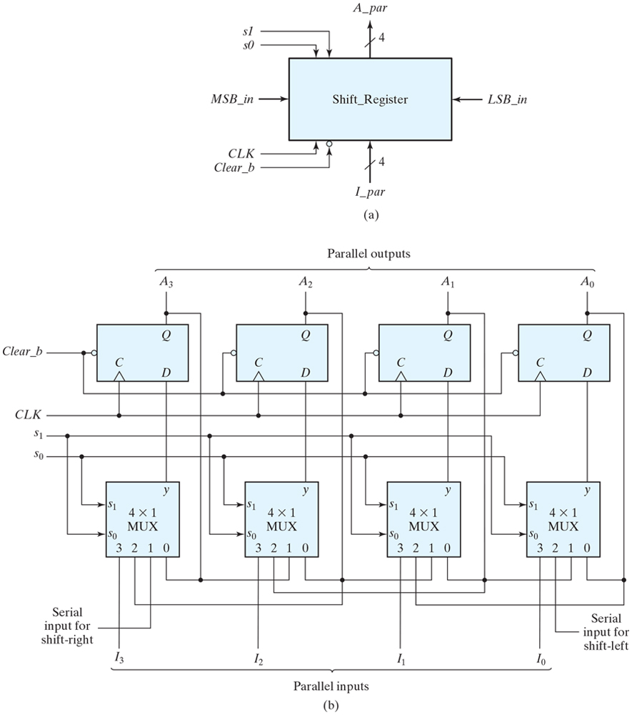
Figure 6.7 Four-bit universal shift register.

Slide 12
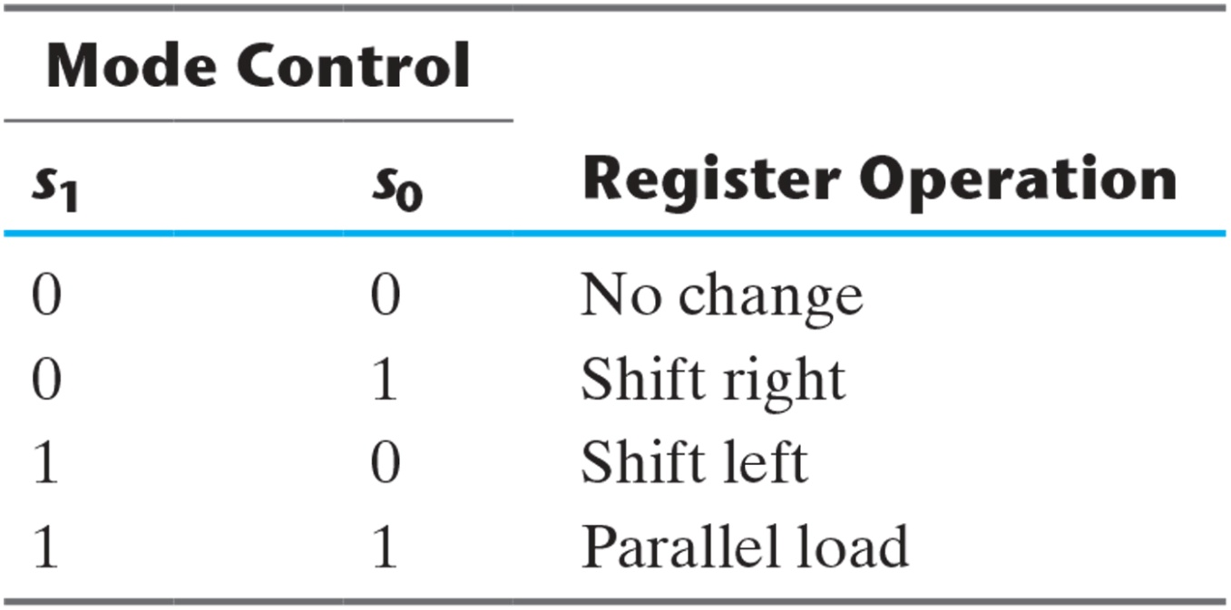
Table 6.3 Function Table for the Register of Fig. 6.7.

Slide 13
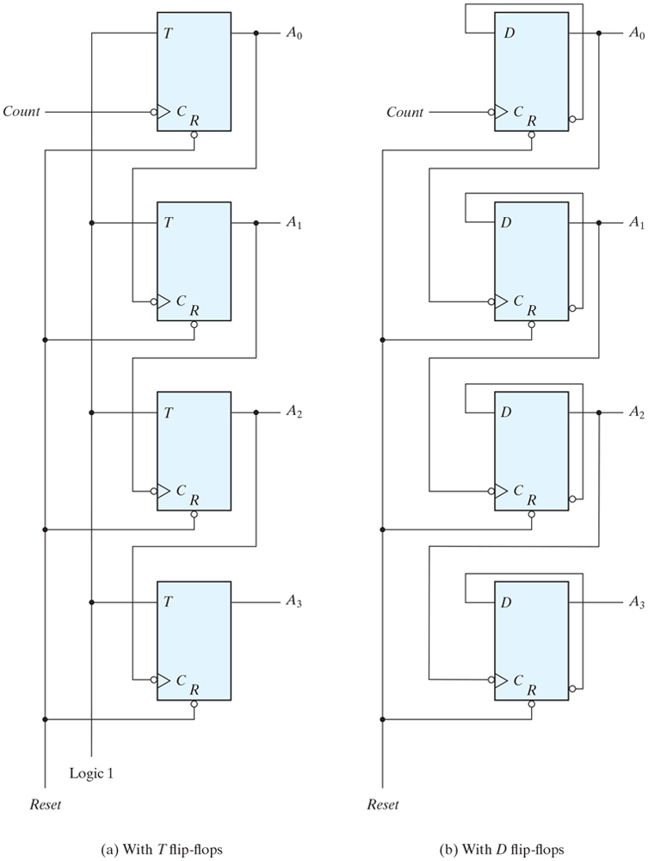
Figure 6.8 Four-bit binary ripple counter.

Slide 14
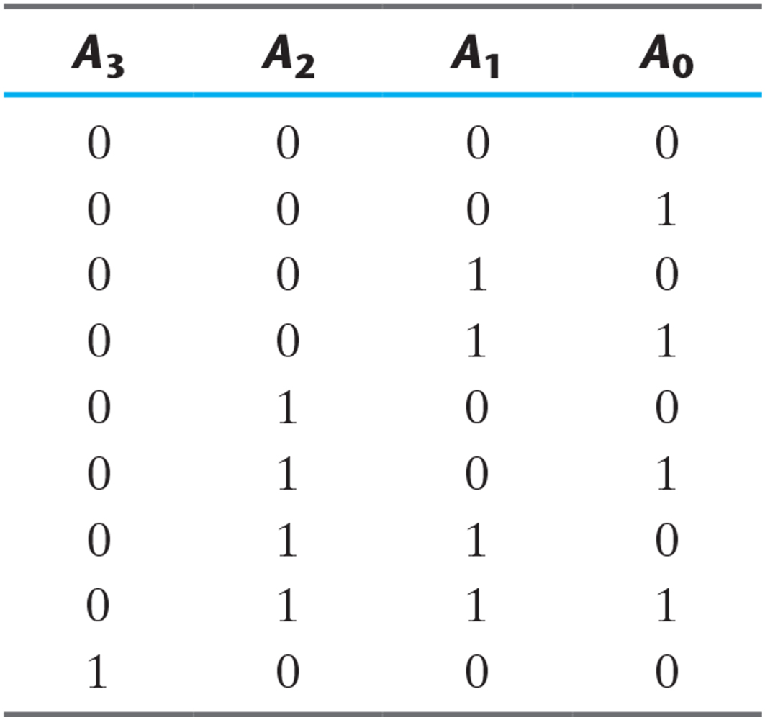
Table 6.4 Binary Count Sequence.

Slide 15
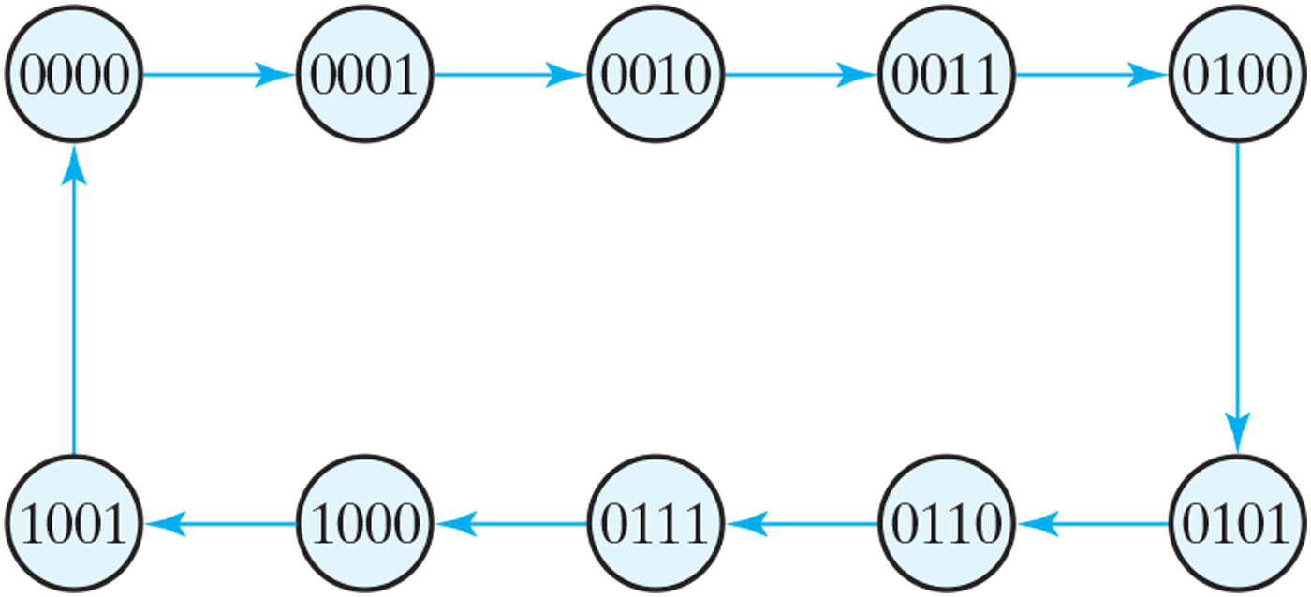
Figure 6.9 State diagram of a decimal BCD counter.

Slide 16
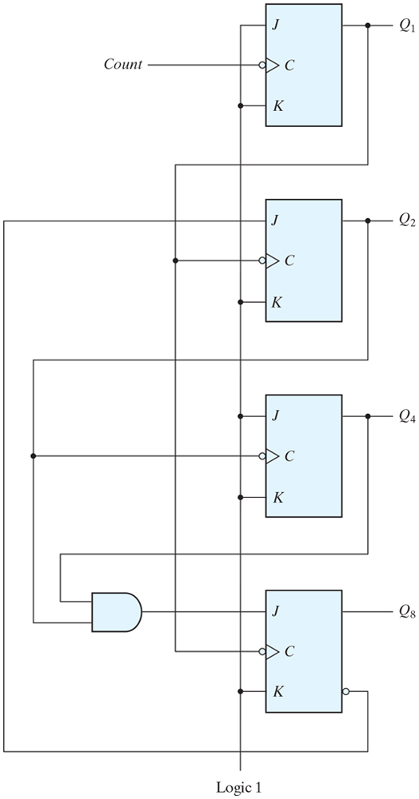
Figure 6.10 BCD ripple counter.

Slide 17
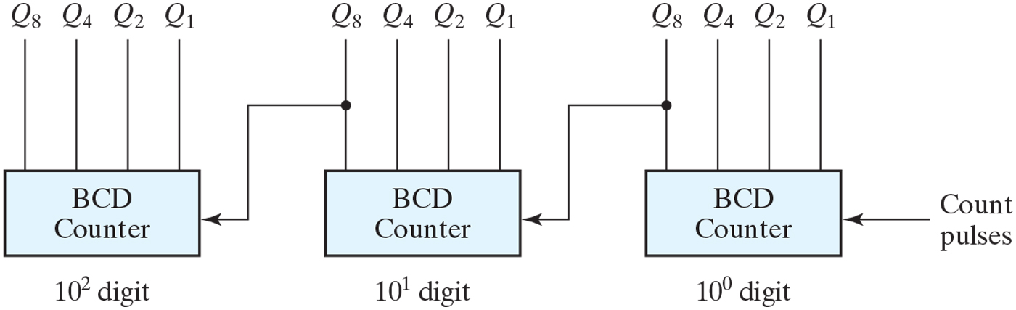
Figure 6.11 Block diagram of a three-decade decimal BCD counter.

Slide 18
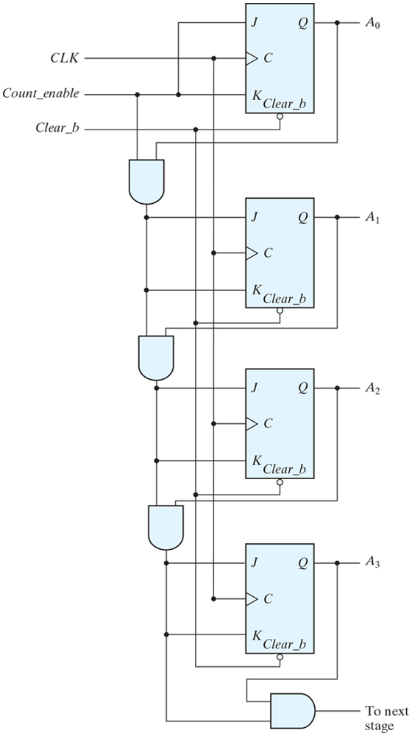
Figure 6.12 Four-bit synchronous binary counter.

Slide 19
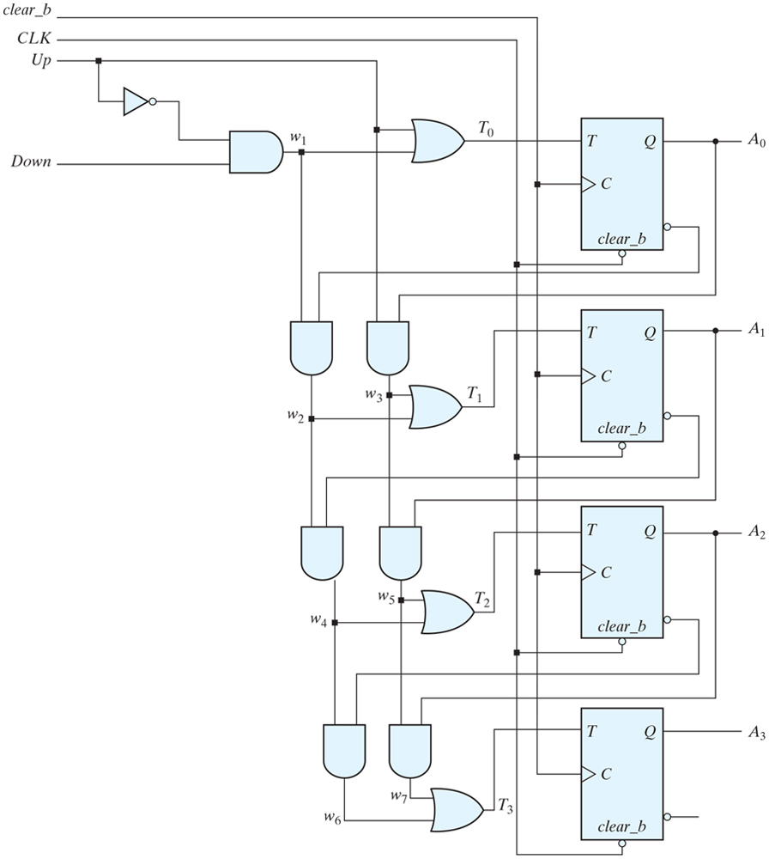
Figure 6.13 Four-bit up–down binary counter.

Slide 20
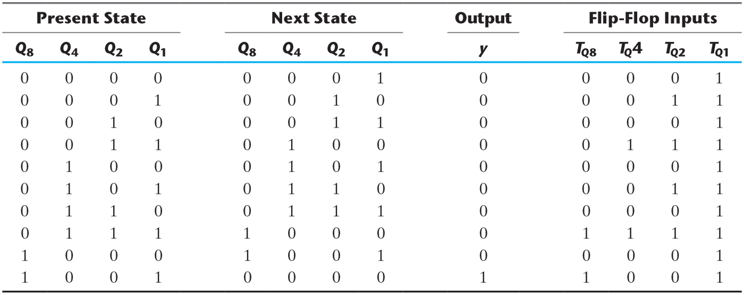
Table 6.5 State Table for BCD Counter.

Slide 21
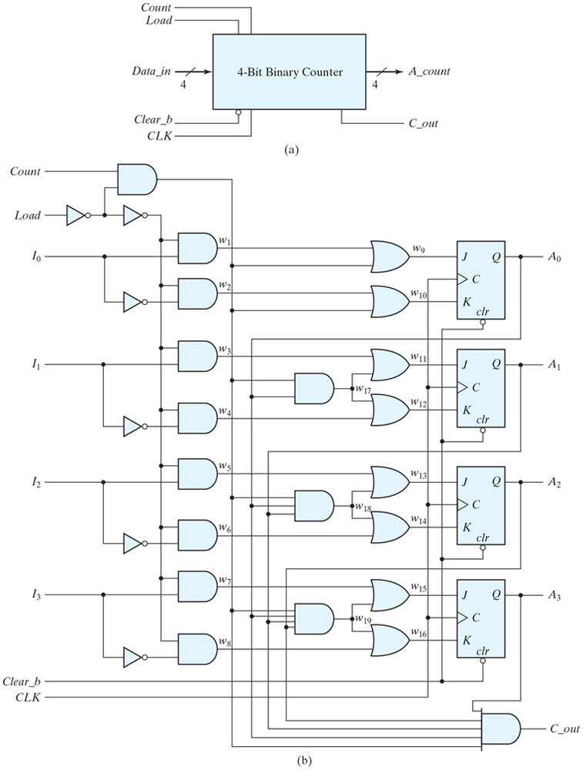
Figure 6.14 Four-bit binary counter with parallel load.

Slide 22
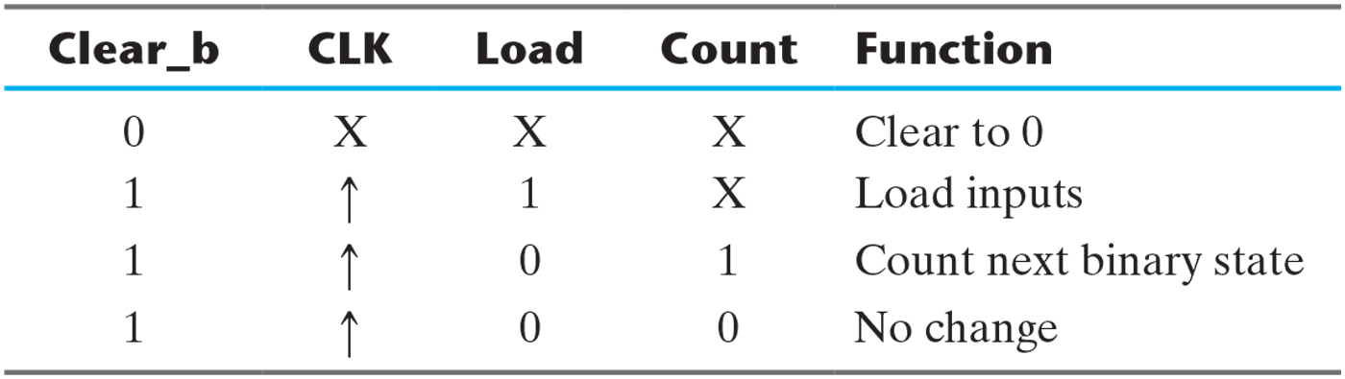
Table 6.6 Function Table for the Counter of Fig. 6.14.

Slide 23
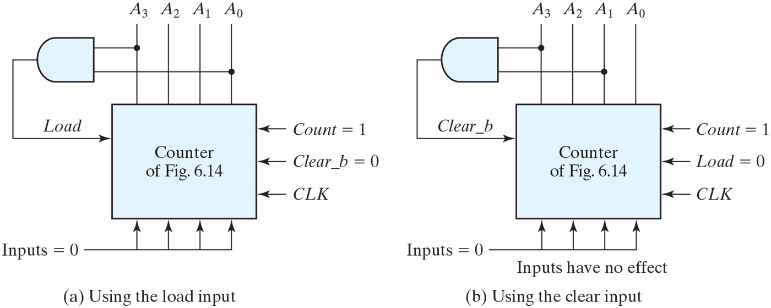
Figure 6.15 Two ways to achieve a BCD counter using a counter with parallel load.

Slide 24
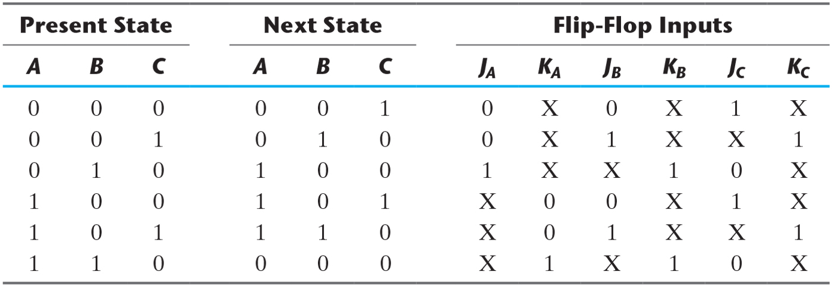
Table 6.7 State Table for Counter.

Slide 25
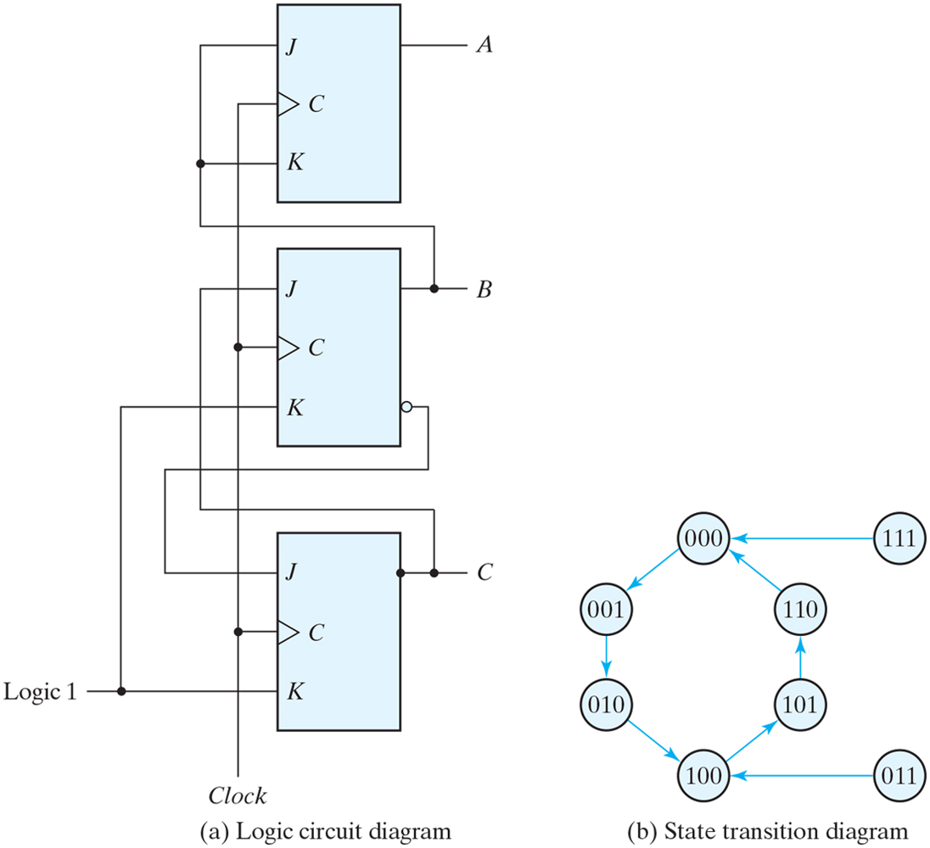
Figure 6.16 Counter with unused states.

Slide 26
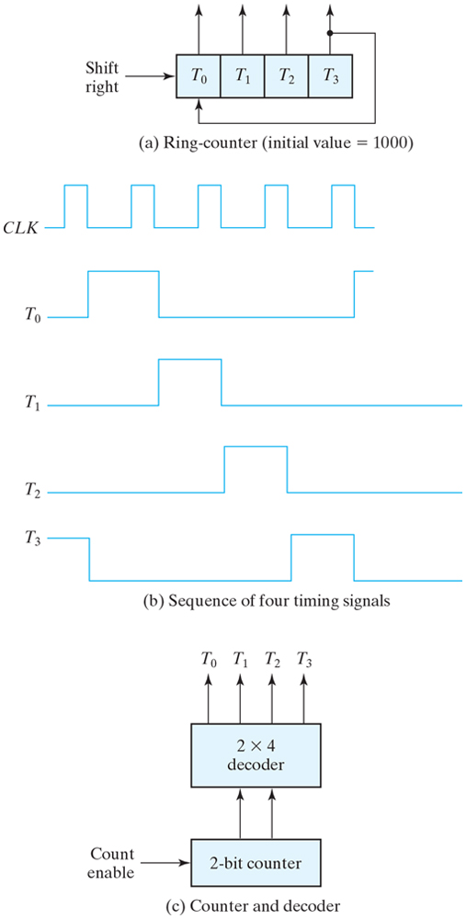
Figure 6.17 Generation of timing signals.

Slide 27
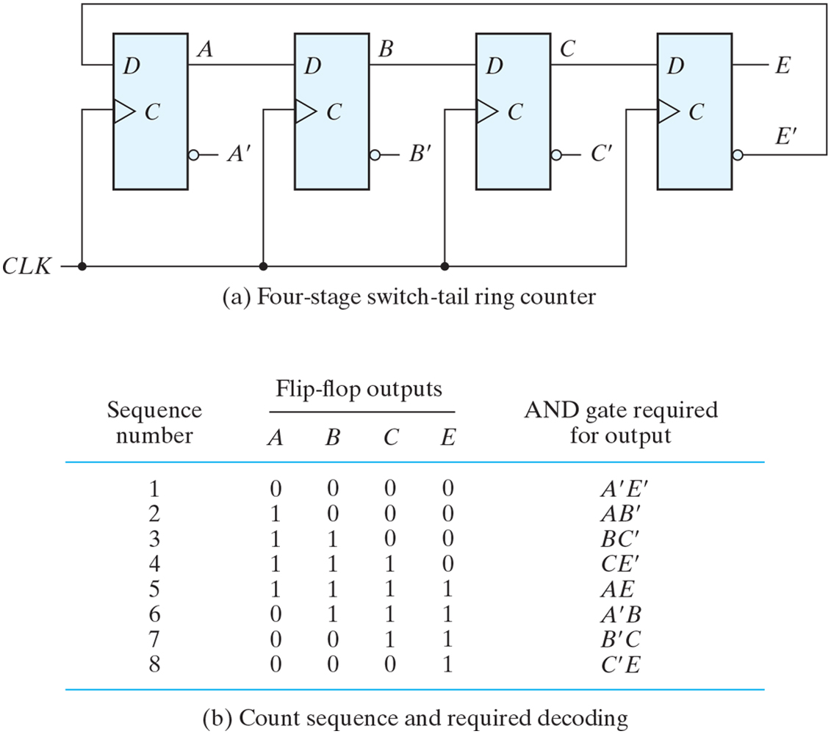
Figure 6.18 Construction of a Johnson counter.

Slide 28
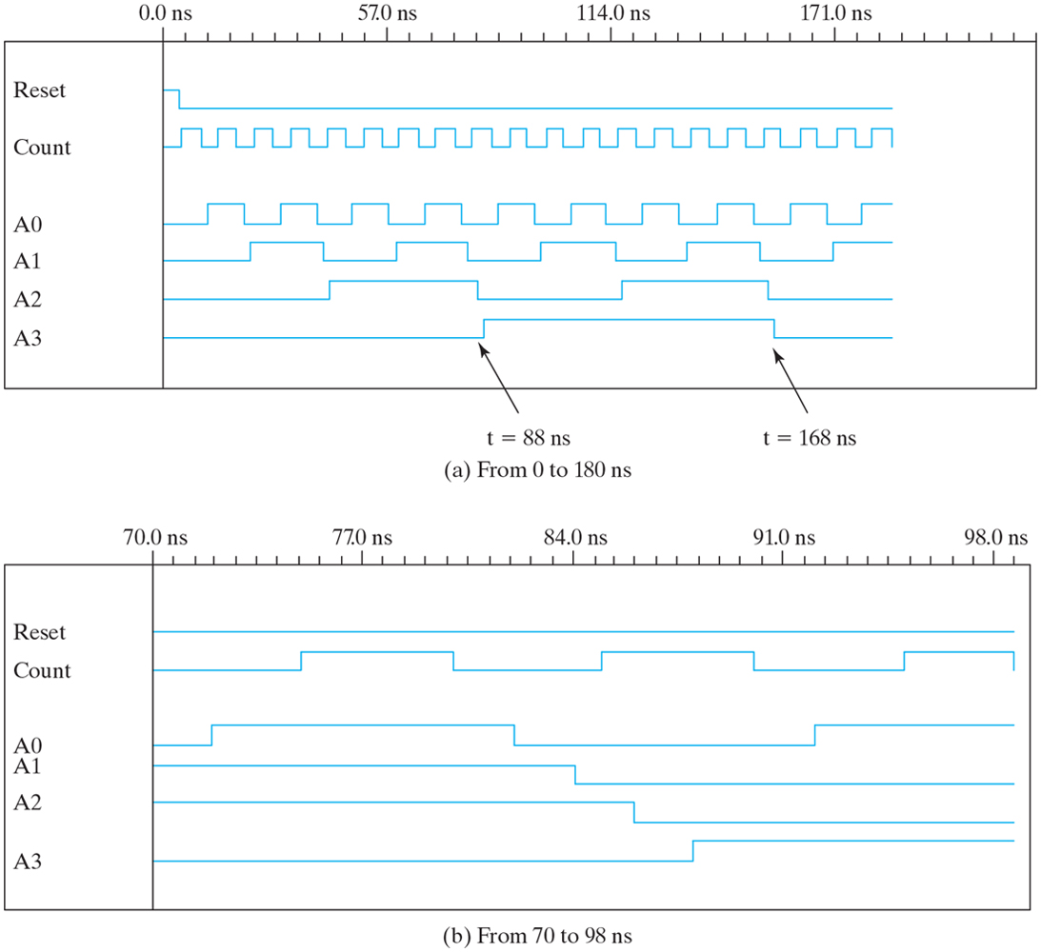
Figure 6.19 Simulation output of HDL Example 6.4.

Slide 29
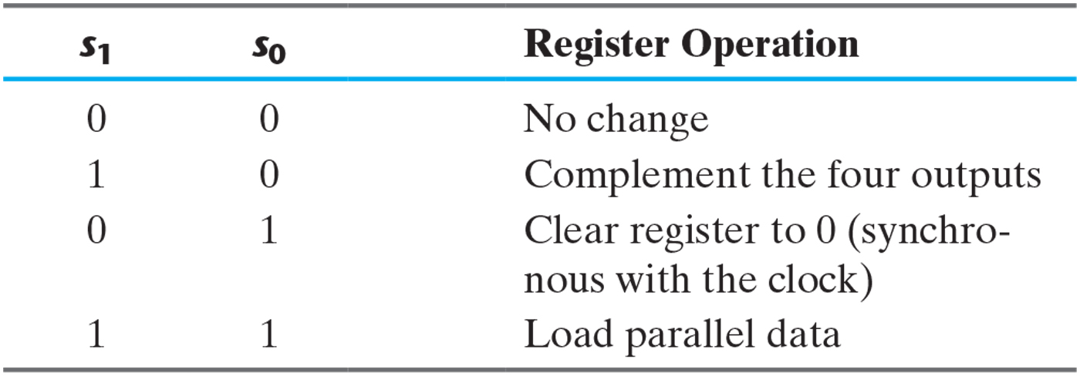
Problem 6.7

Slide 30
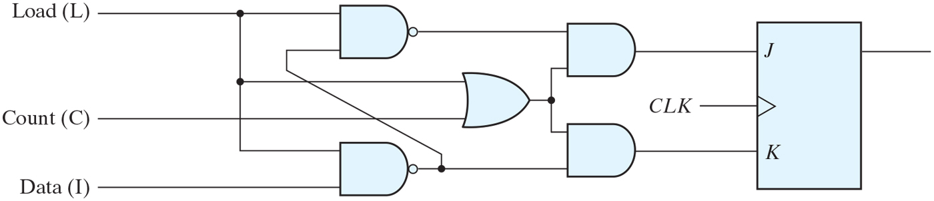
Figure P6.21

Slide 31
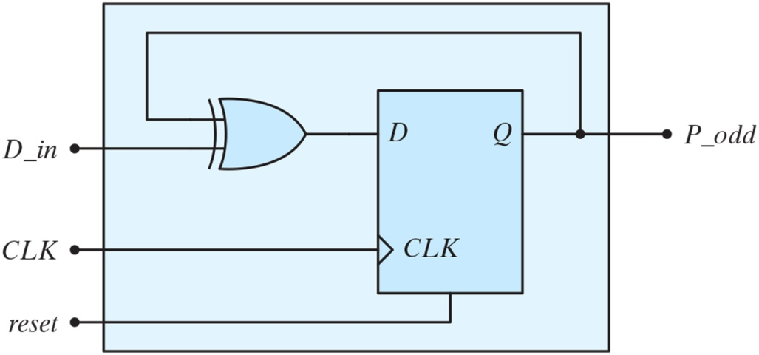
Figure P6.47 Circuit for Problem 6.47.

Slide 32
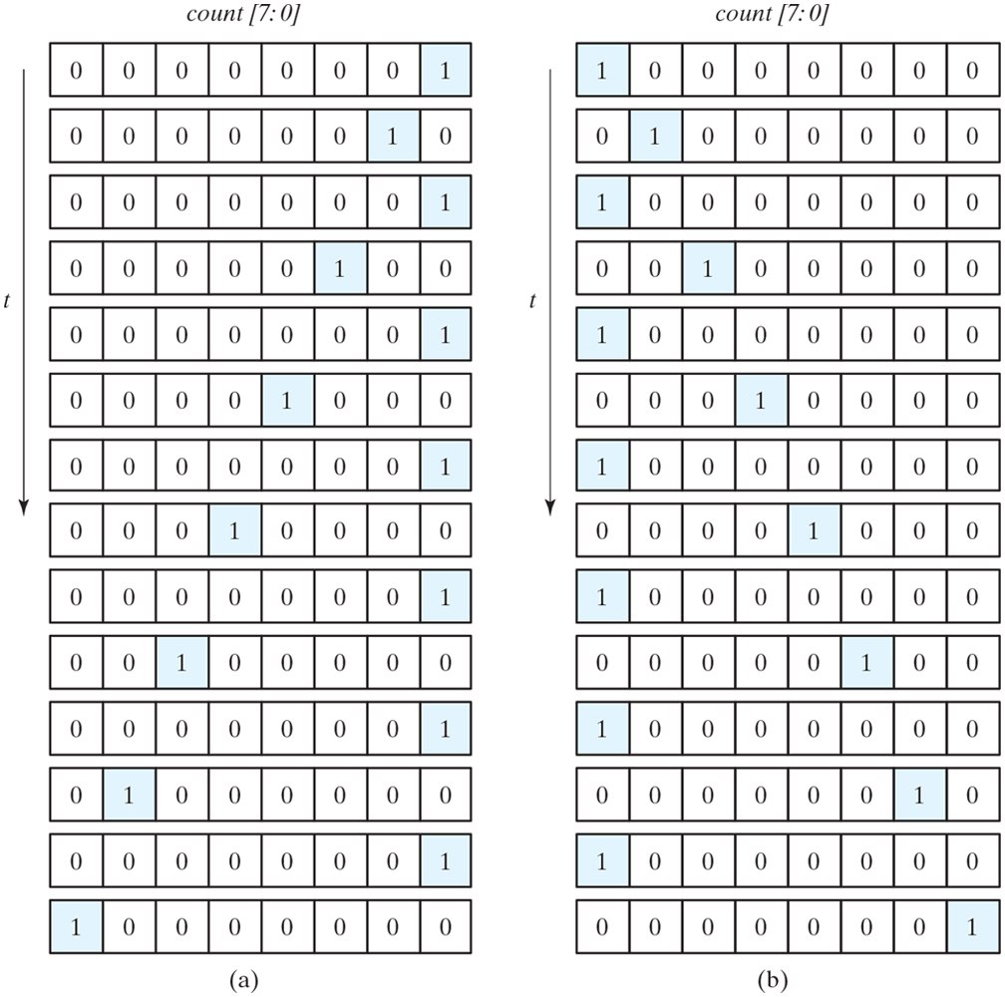
Figure P6.48 Circuit for Problem 6.48.

