Slide 1

Digital Design
With an Introduction to the Verilog HDL, VHDL, and SystemVerilog
6th Edition
Chapter 07
Memory and Programmable Logic

Slide 2

Figure 7.1 Conventional and array logic diagrams for OR gate.

Slide 3
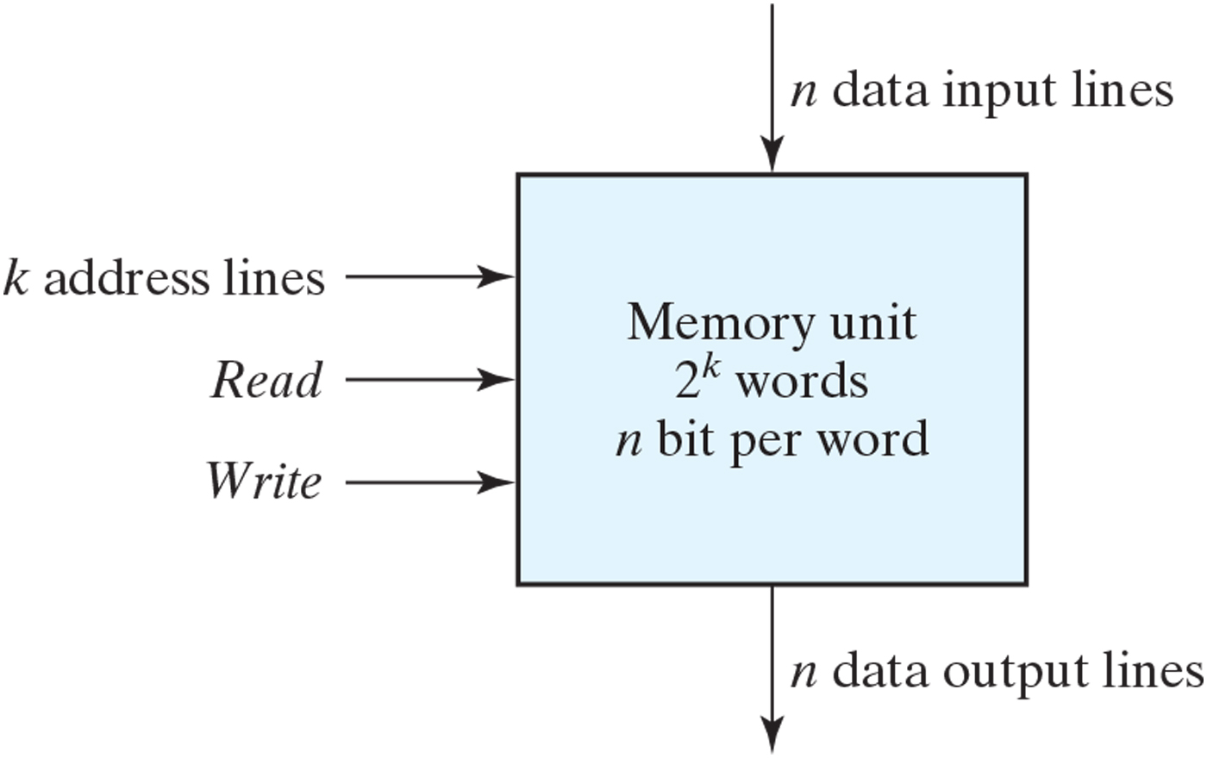
Figure 7.2 Block diagram of a memory unit.

Slide 4
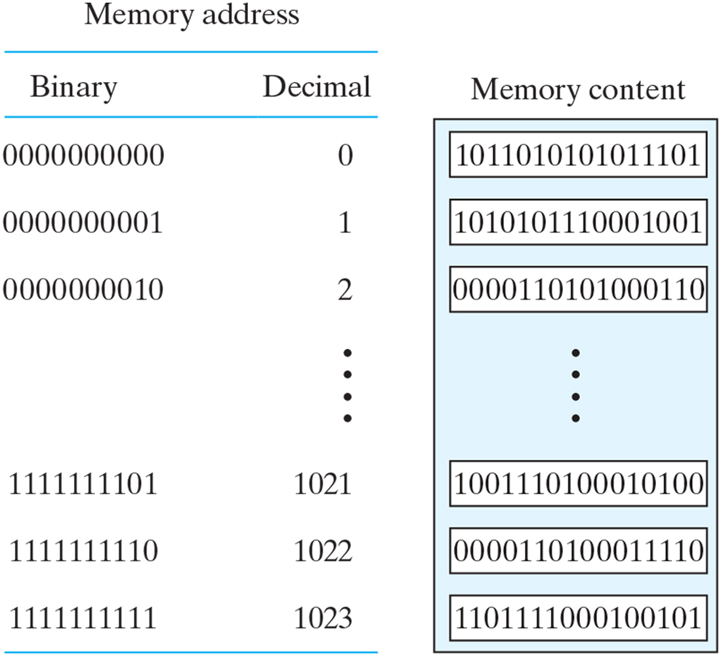
Figure 7.3 Contents of a 1024 × 16 memory.

Slide 5
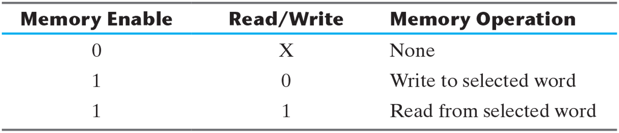
Table 7.1 Control Inputs to Memory Chip.

Slide 6
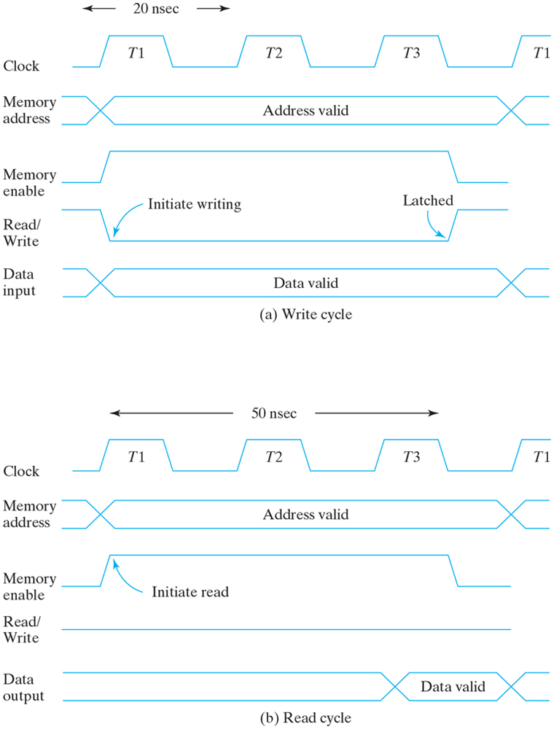
Figure 7.4 Memory cycle timing waveforms.

Slide 7
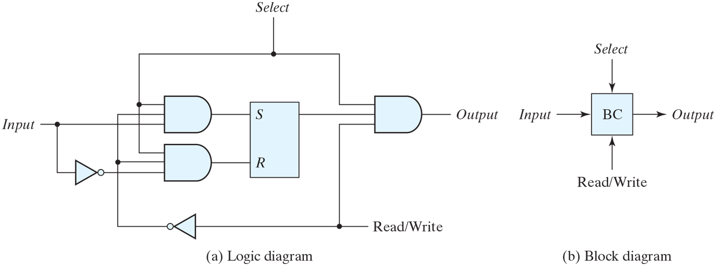
Figure 7.5 Memory cell.

Slide 8
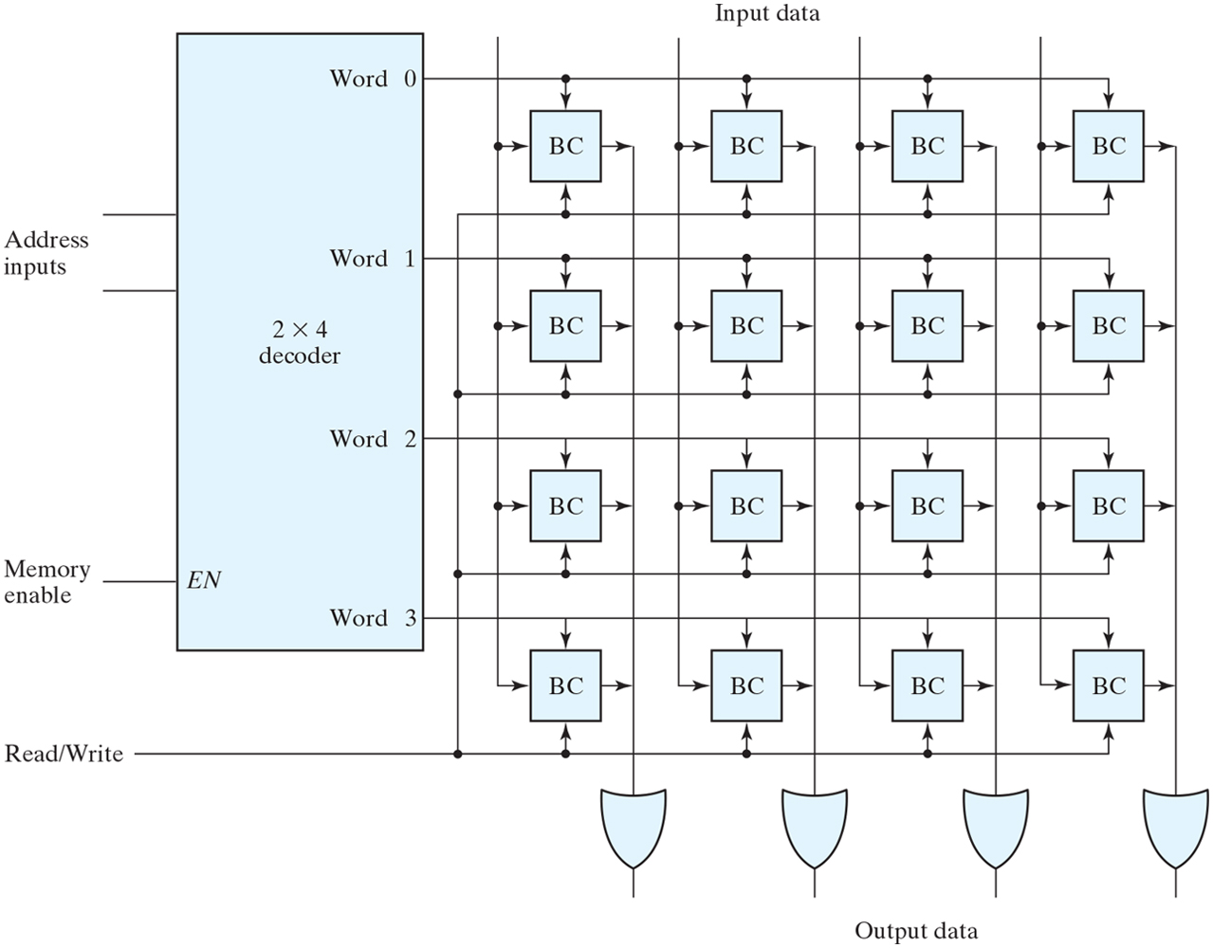
Figure 7.6 Diagram of a 4 × 4 RAM.

Slide 9
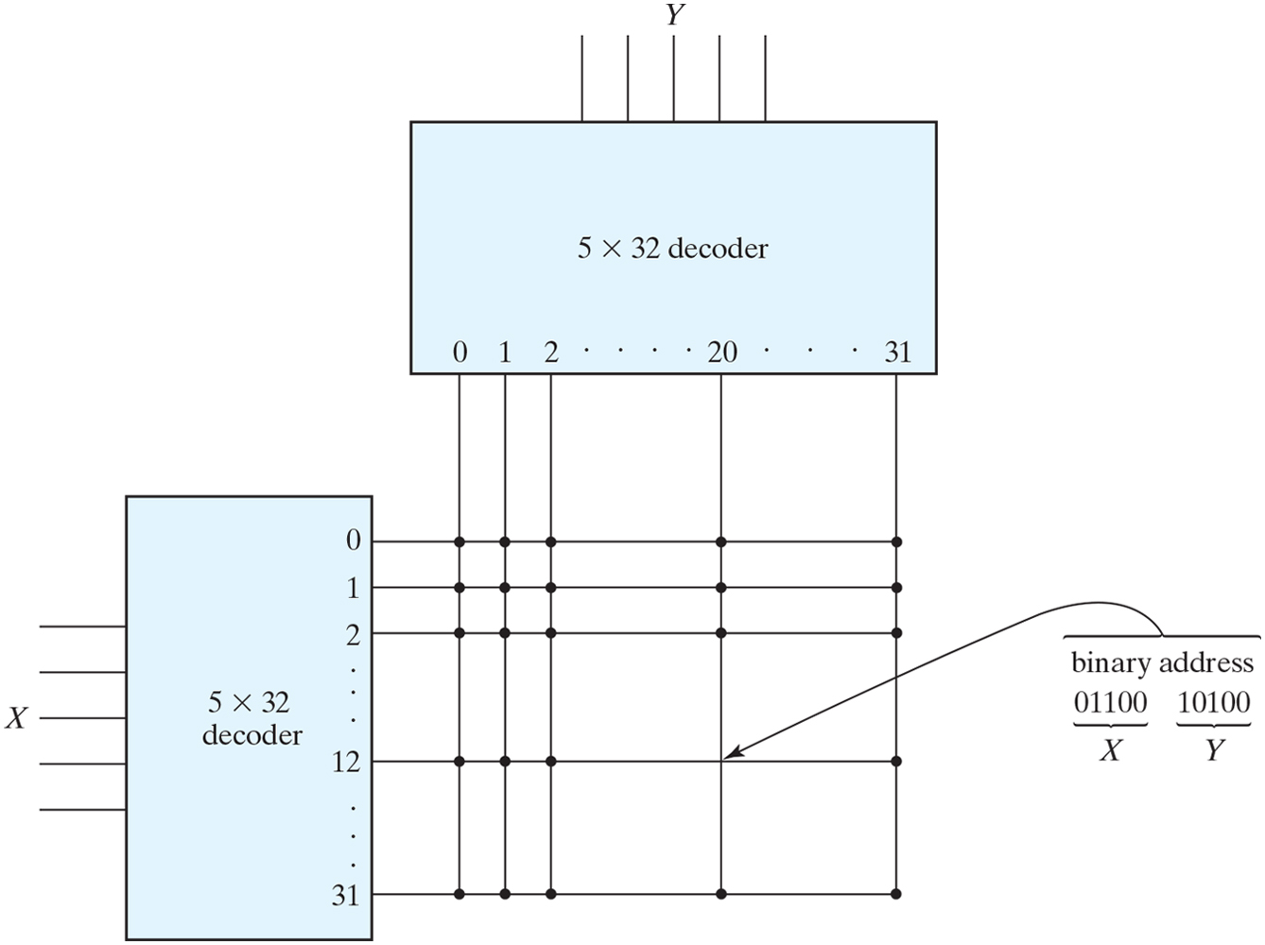
Figure 7.7 Two-dimensional decoding structure for a 1K-word memory.

Slide 10
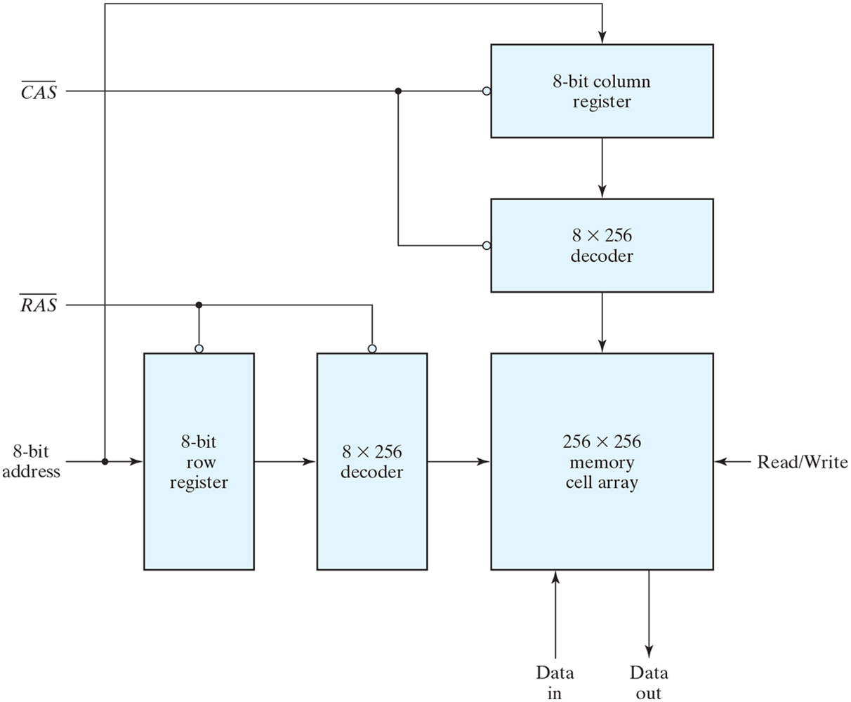
Figure 7.8 Address multiplexing for a 64K DRAM.

Slide 11
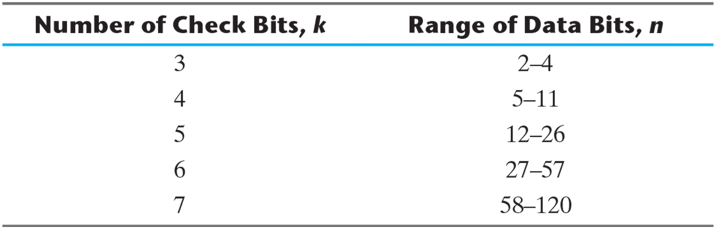
Table 7.2 Range of Data Bits for k Check Bits.

Slide 12
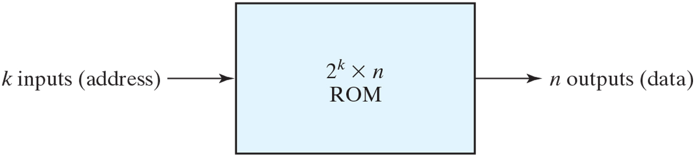
Figure 7.9 ROM block diagram.

Slide 13
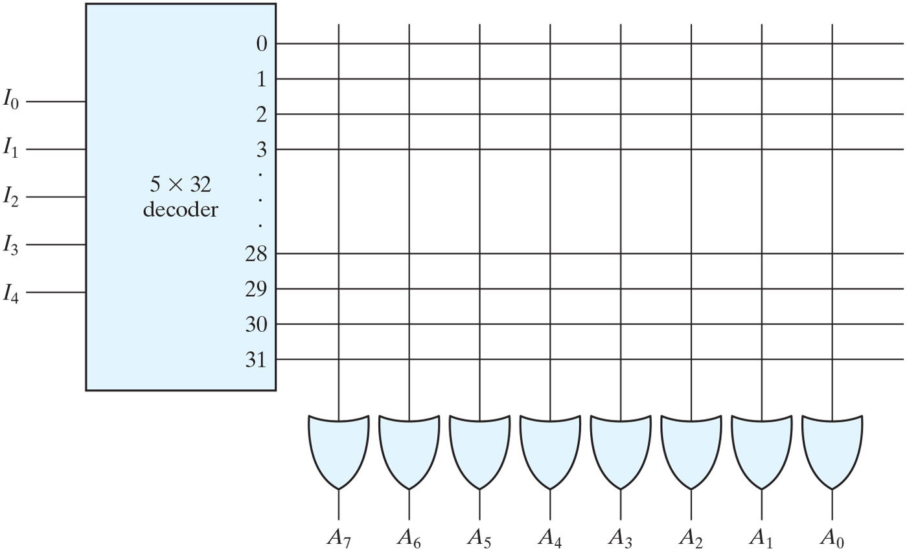
Figure 7.10 Internal logic of a 32 × 8 ROM.

Slide 14
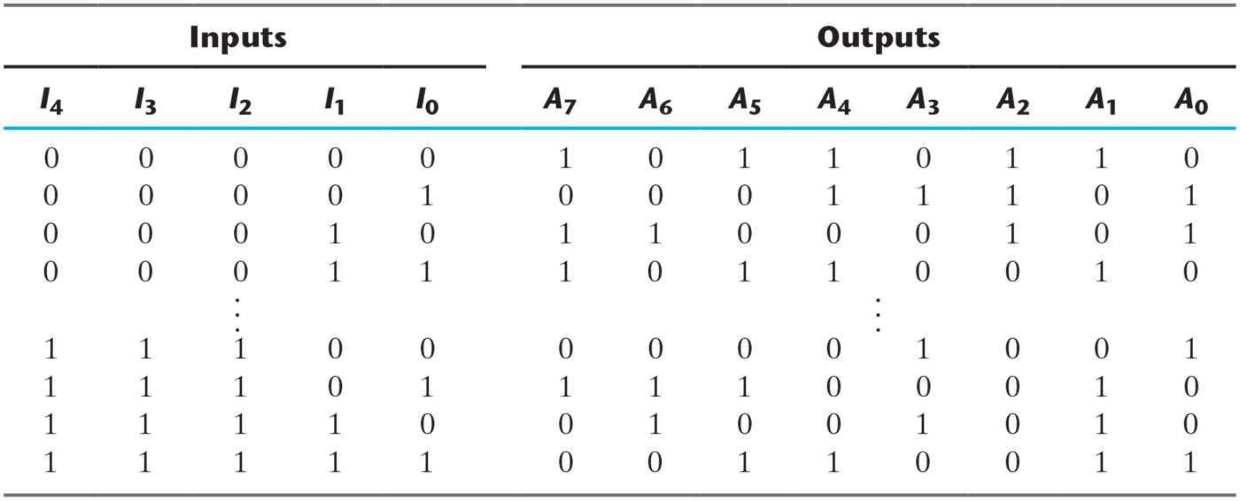
Table 7.3 ROM Truth Table (Partial).

Slide 15
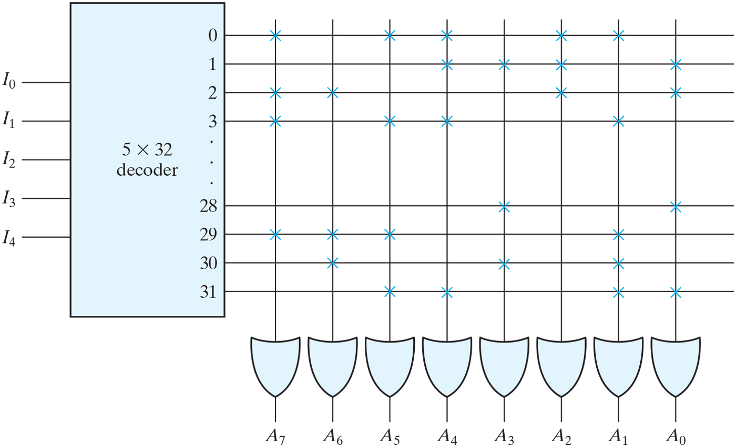
Figure 7.11 Programming the ROM according to Table 7.3.

Slide 16
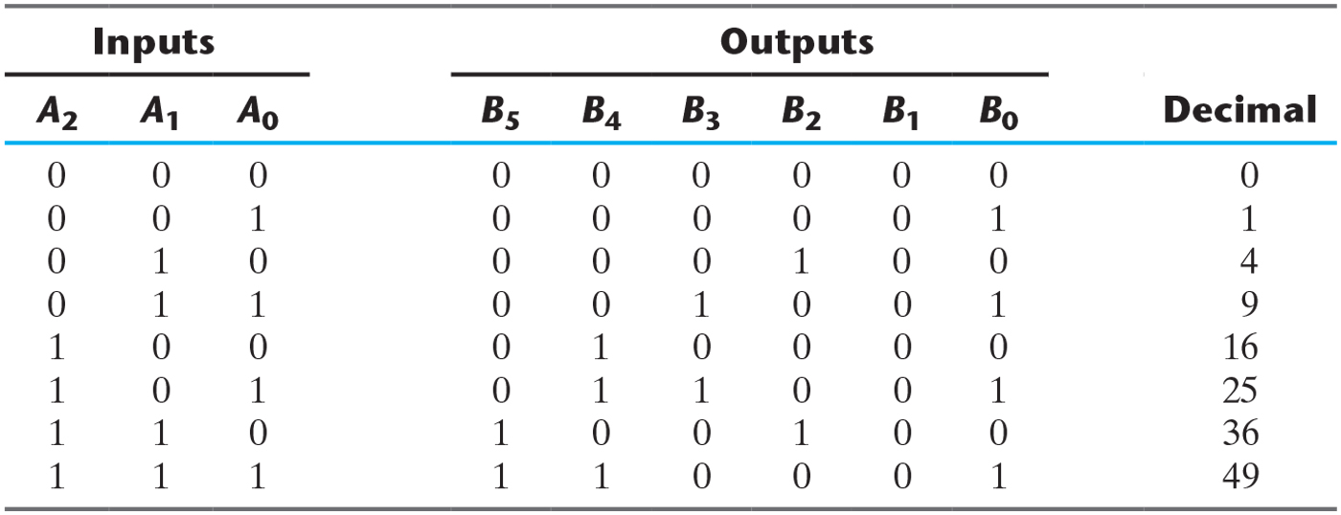
Table 7.4 Truth Table for Circuit of Example 7.1.

Slide 17
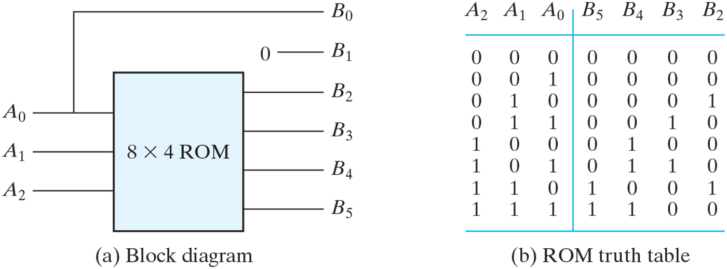
Figure 7.12 ROM implementation of Example 7.1.

Slide 18
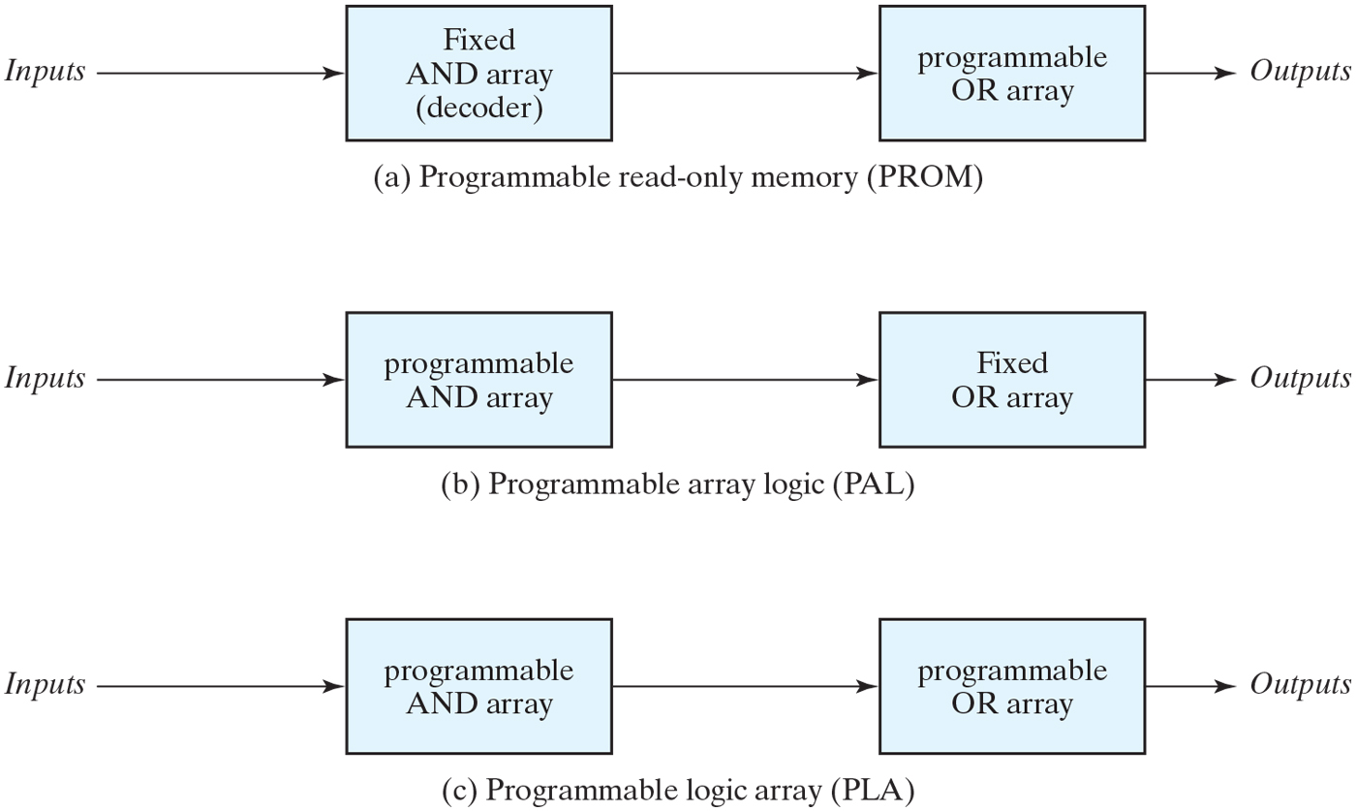
Figure 7.13 Basic configuration of three PLDs.

Slide 19
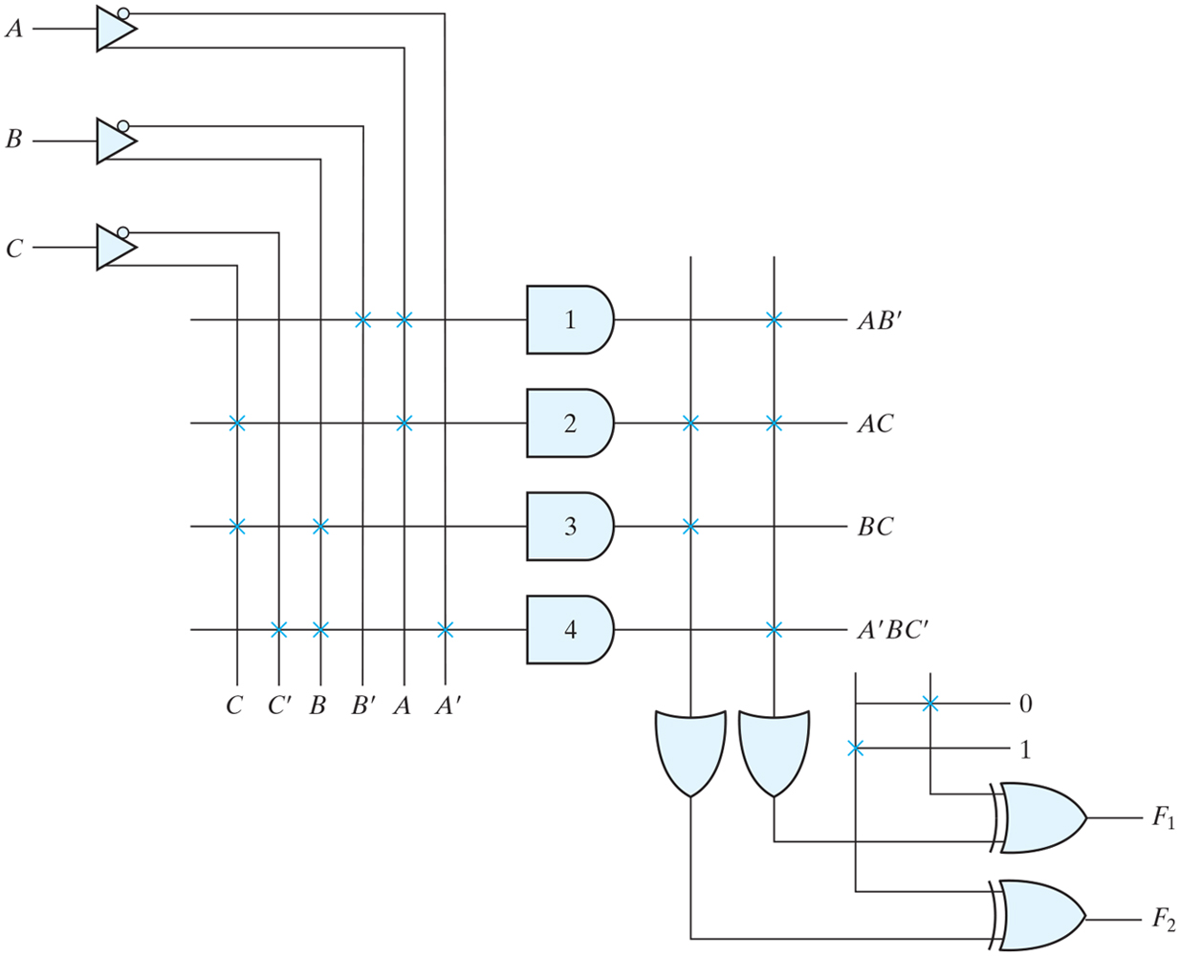
Figure 7.14 PLA with three inputs, four product terms, and two outputs.

Slide 20
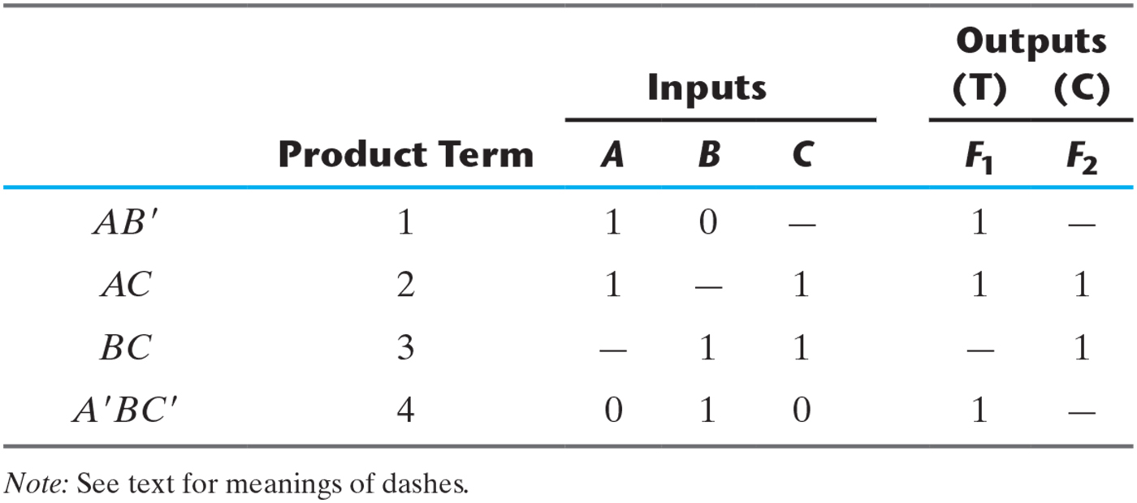
Table 7.5 PLA Programming Table.

Slide 21
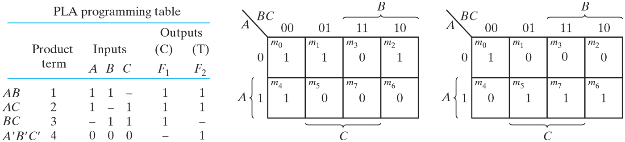
Figure 7.15 Solution to Example 7.2.

Slide 22
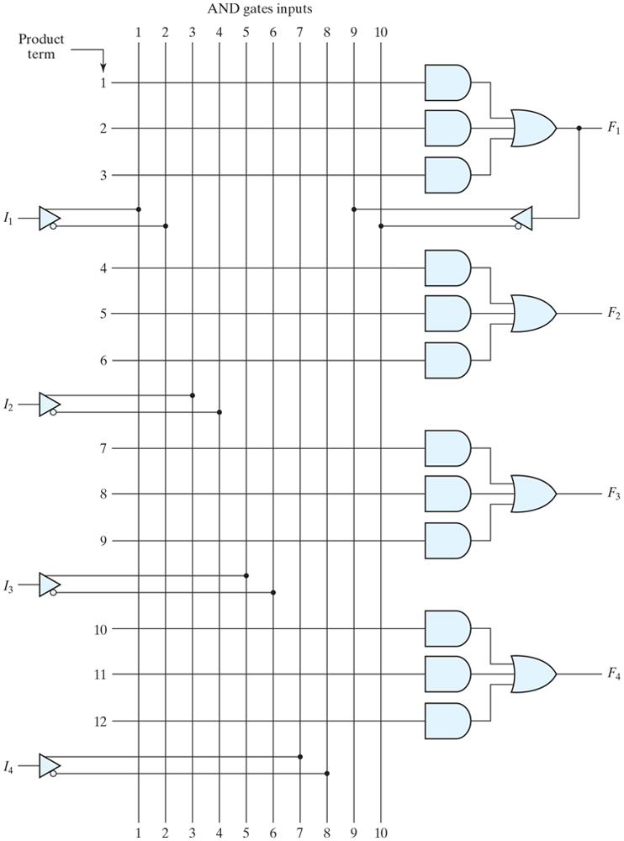
Figure 7.16 PAL with four inputs, four outputs, and a three-wide AND–OR structure.

Slide 23
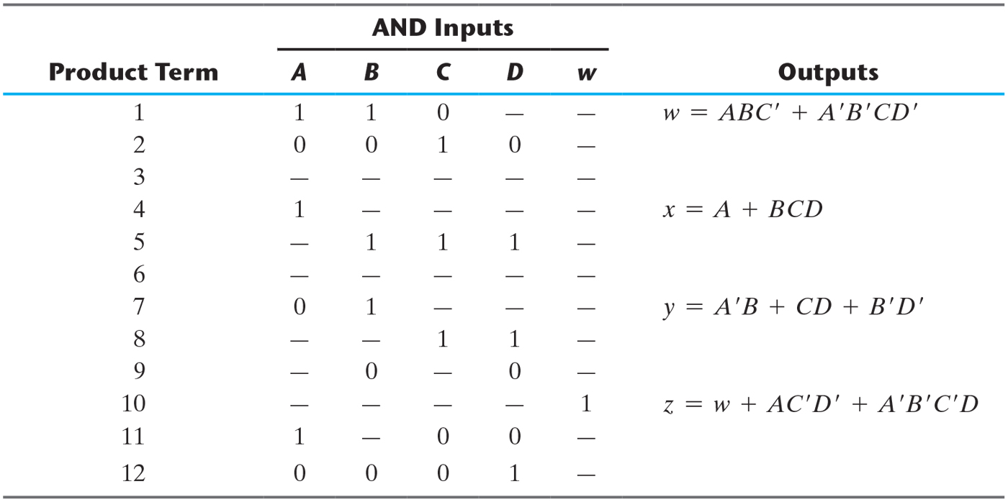
Table 7.6 PAL Programming Table.

Slide 24
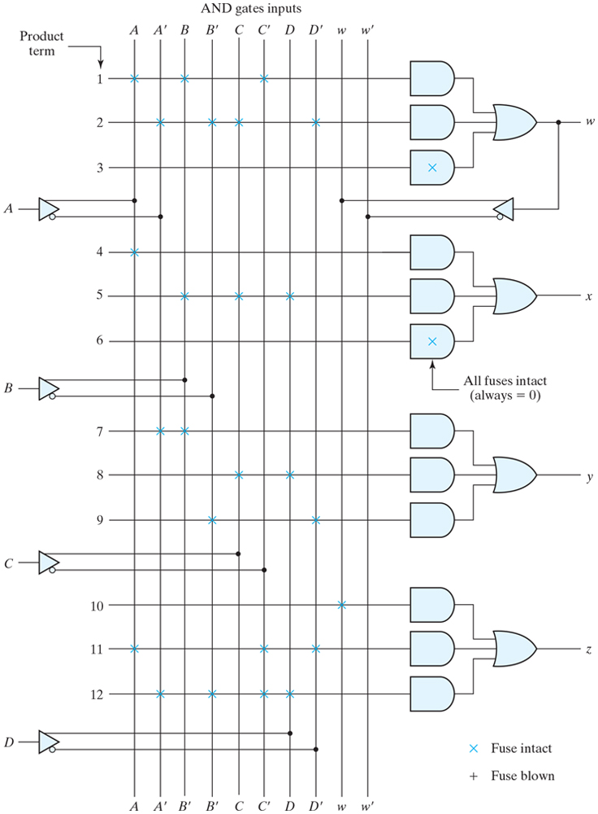
Figure 7.17 Fuse map for PA L as specified in Table 7.6.

Slide 25
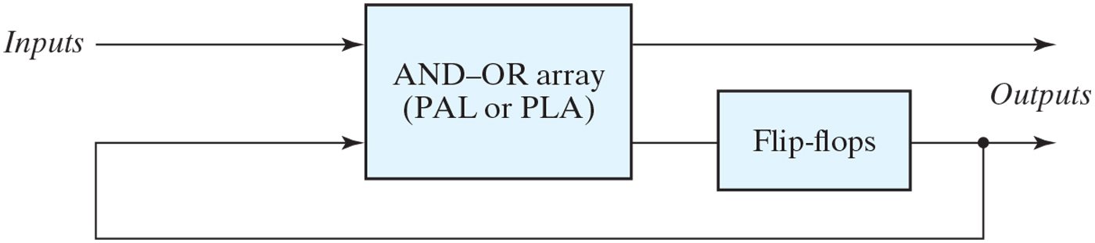
Figure 7.18 Sequential programmable logic device.

Slide 26
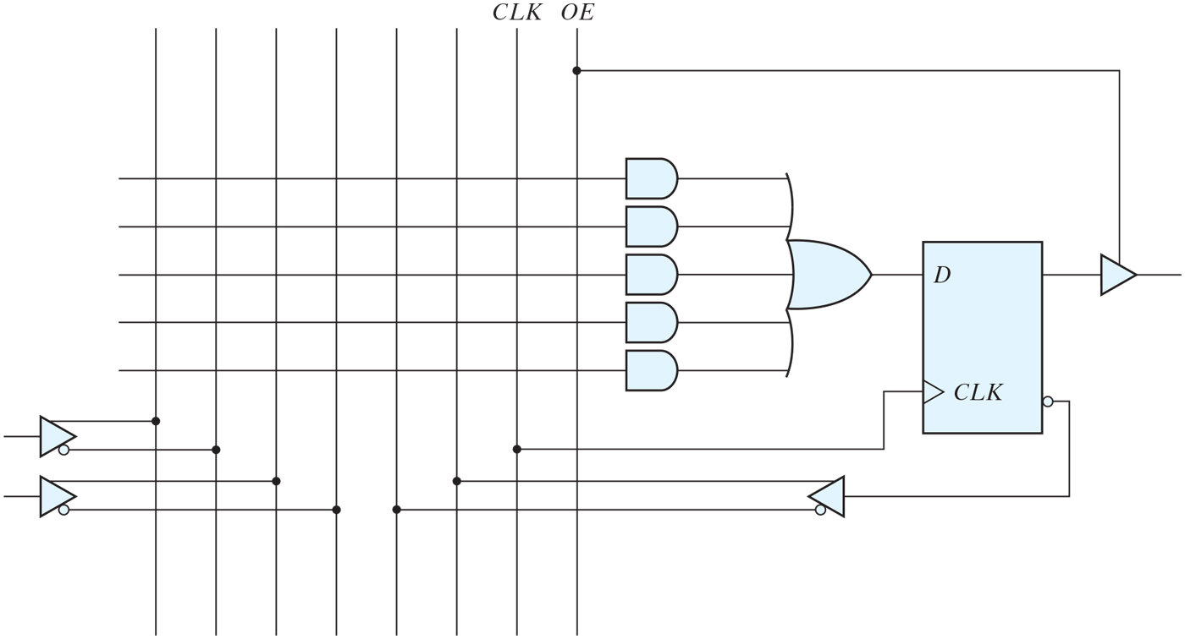
Figure 7.19 Basic macrocell logic.

Slide 27
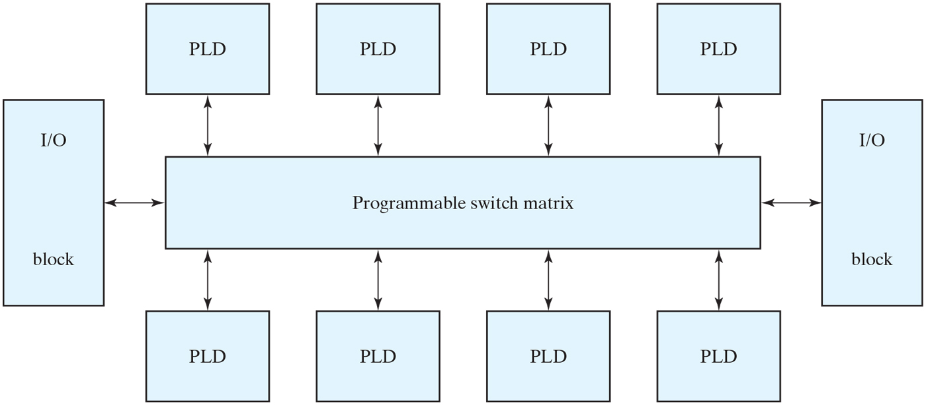
Figure 7.20 General CPLD configuration.

Slide 28
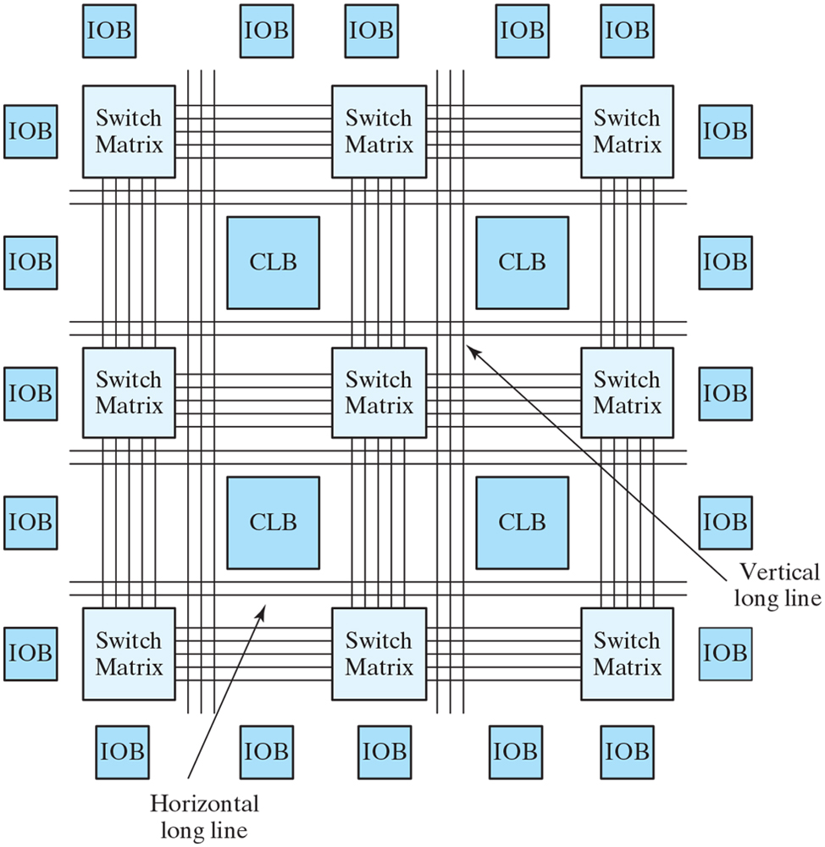
Figure 7.21 Basic architecture of Xilinx Spartan and predecessor devices.

Slide 29
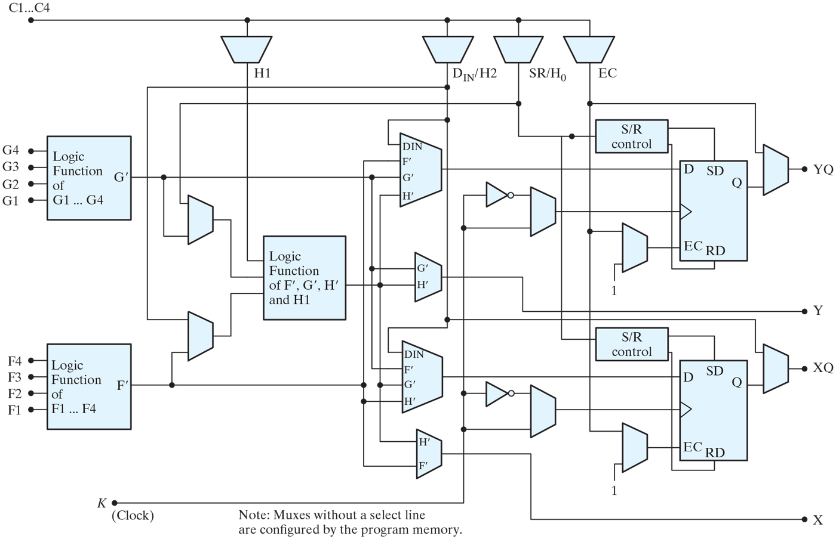
Figure 7.22 CLB architecture.

Slide 30
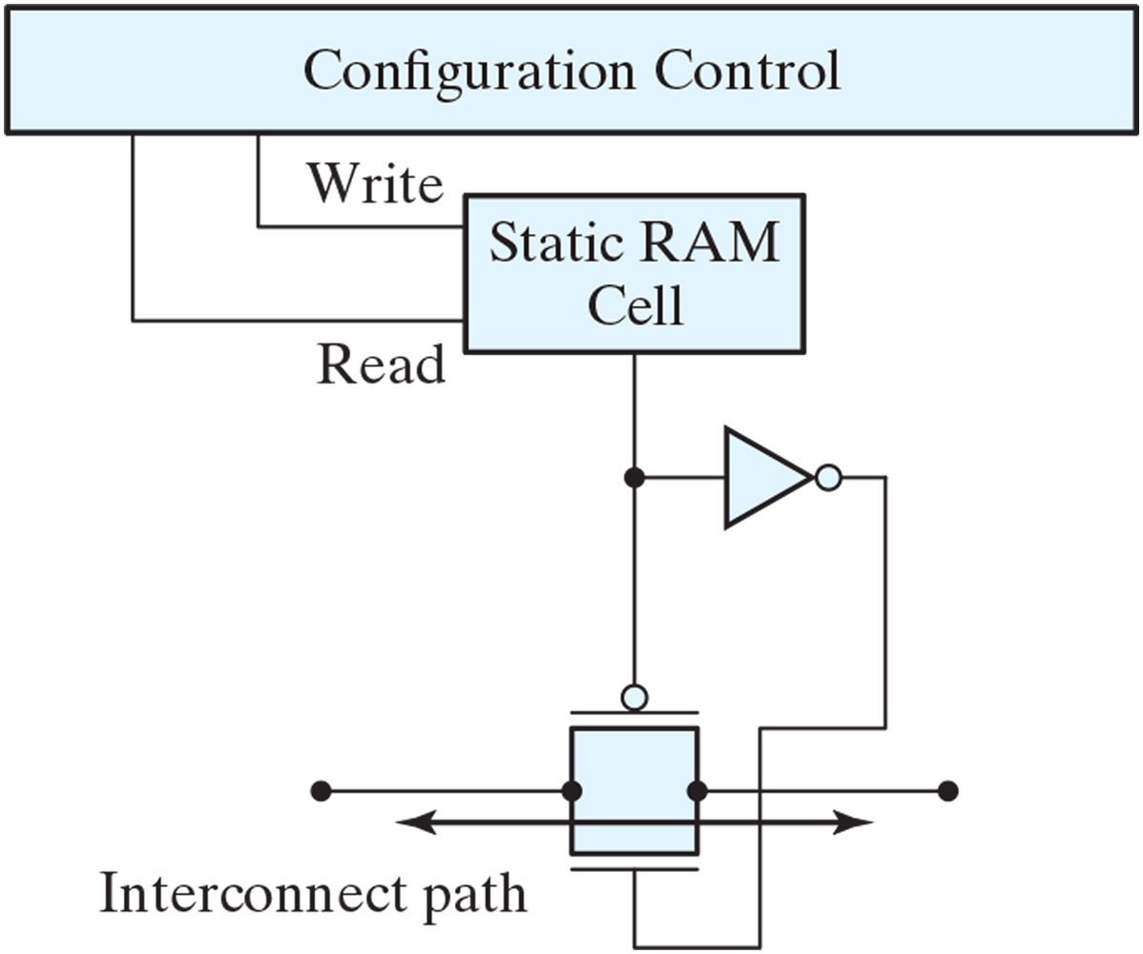
Figure 7.23 RAM cell controlling a PIP transmission gate.

Slide 31
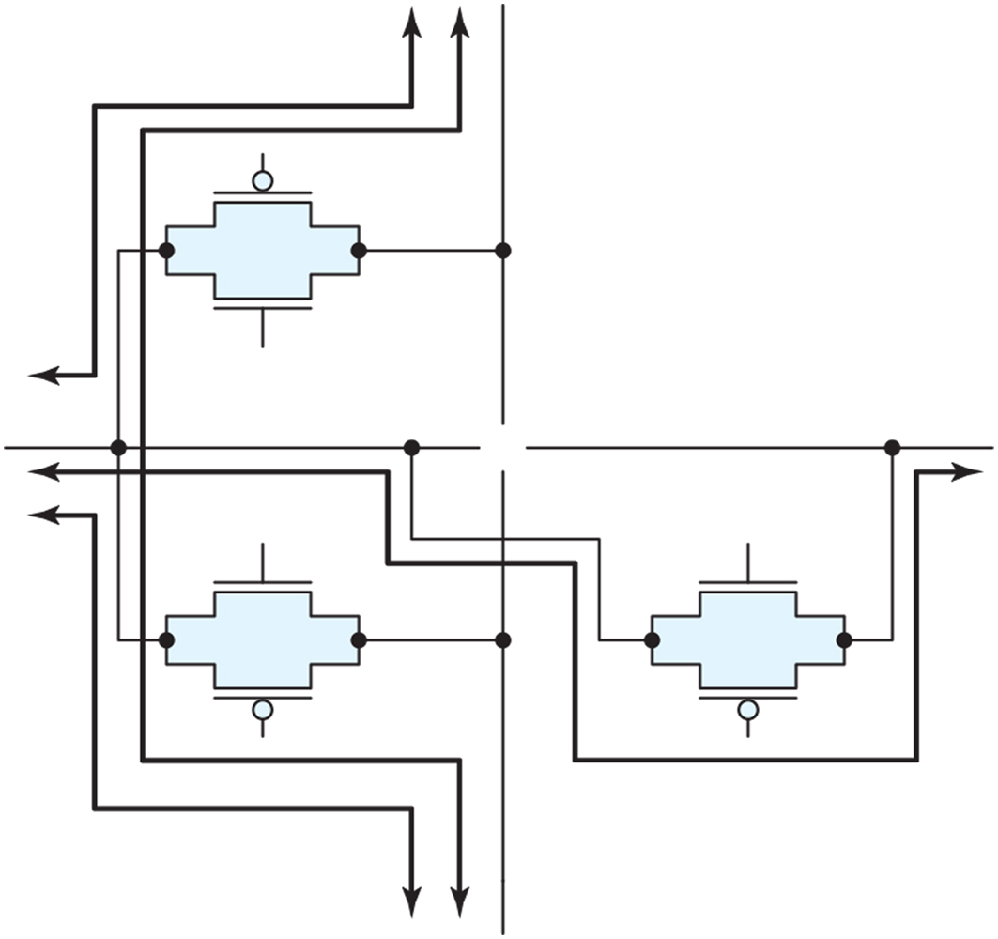
Figure 7.24 Circuit for a programmable PIP.

Slide 32
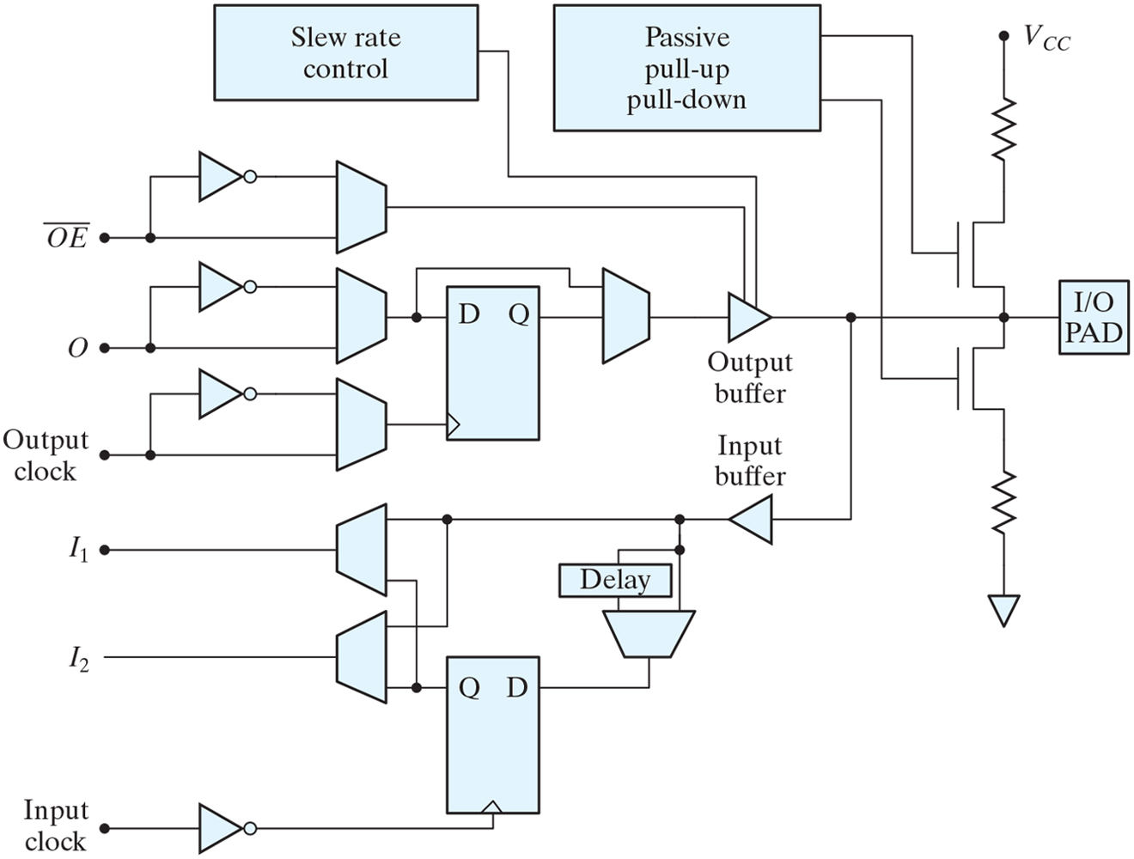
Figure 7.25 XC4000 series IOB.

Slide 33
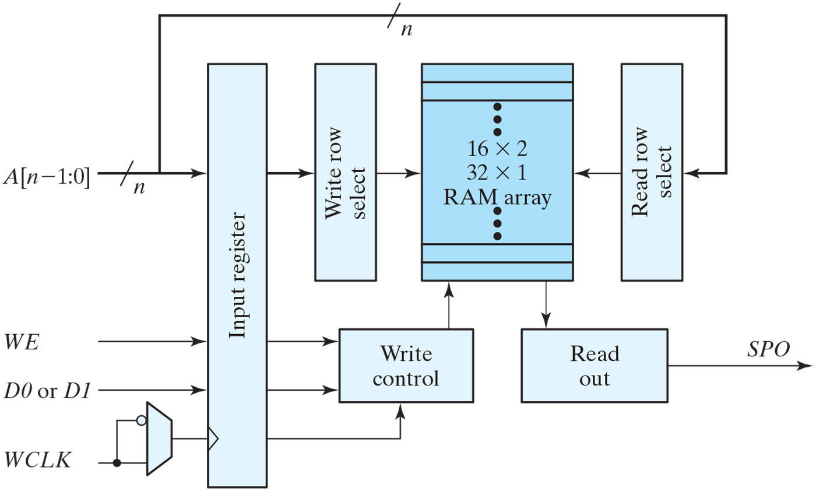
Figure 7.26 Distributed RAM cell formed from a lookup table.

Slide 34
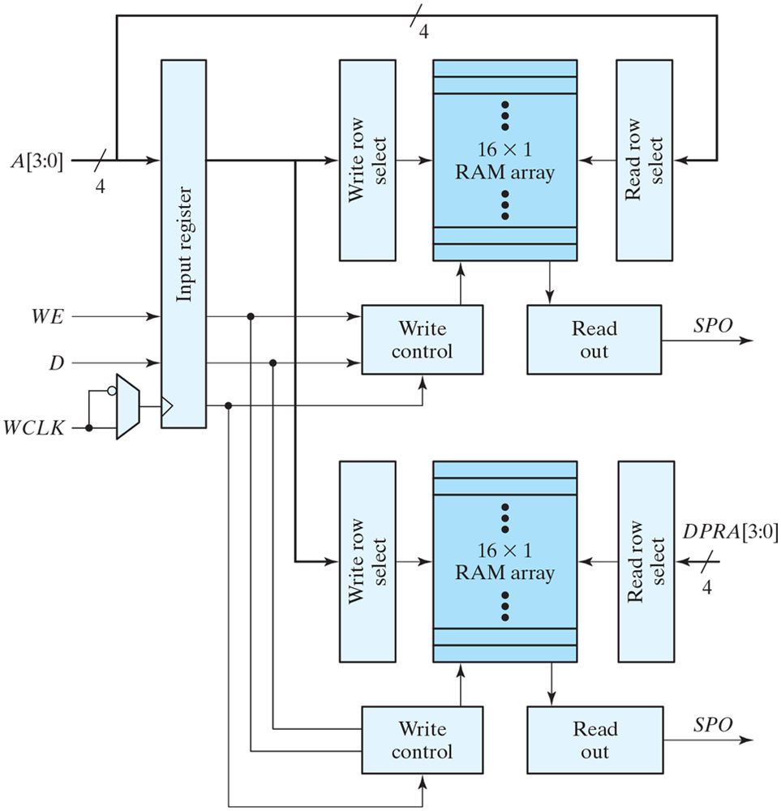
Figure 7.27 Spartan dual-port RAM.

Slide 35
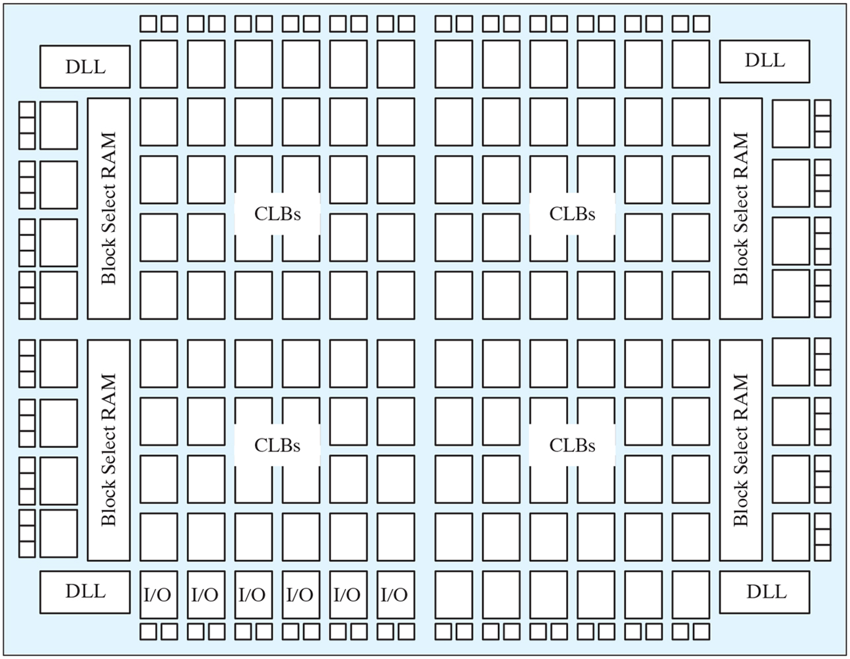
Figure 7.28 Spartan II architecture.

Slide 36
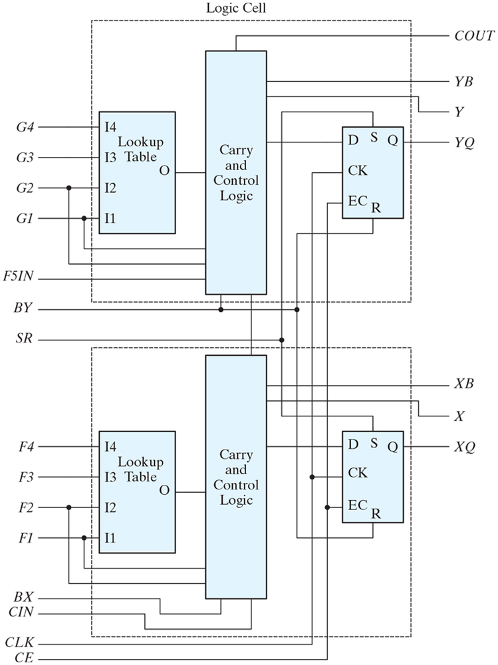
Figure 7.29 Spartan II CLB slice.

Slide 37
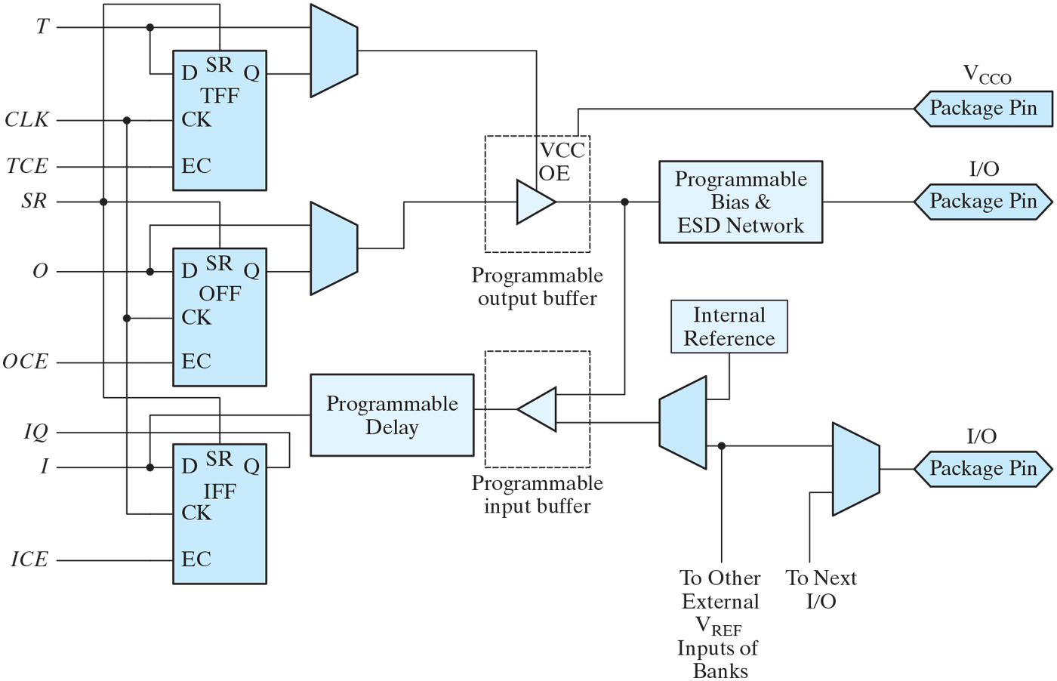
Figure 7.30 Spartan II IOB.

Slide 38
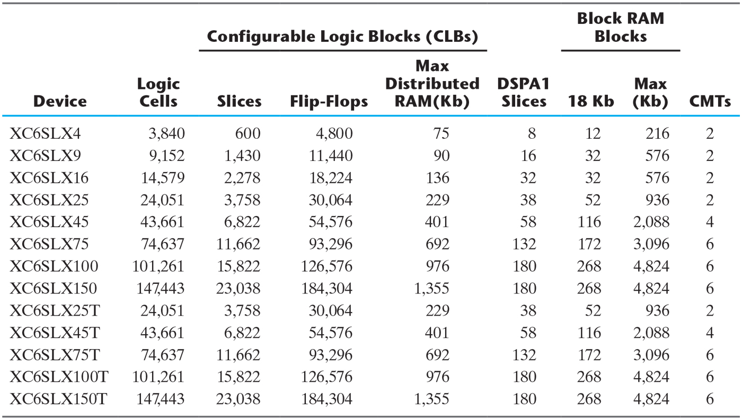
Table 7.7 Features of the Spartan-6 device family.

Slide 39
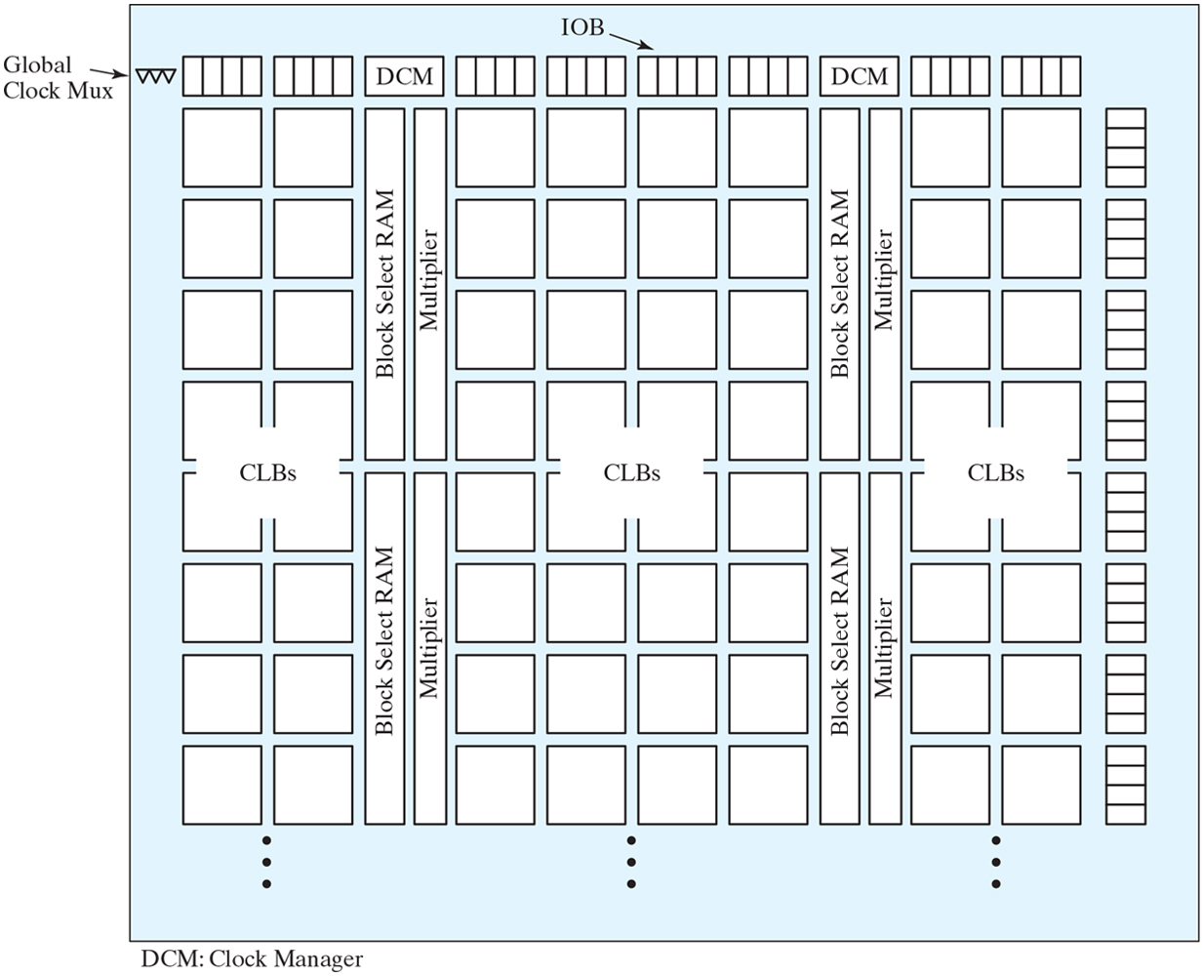
Figure 7.31 Virtex overall architecture.

Slide 40
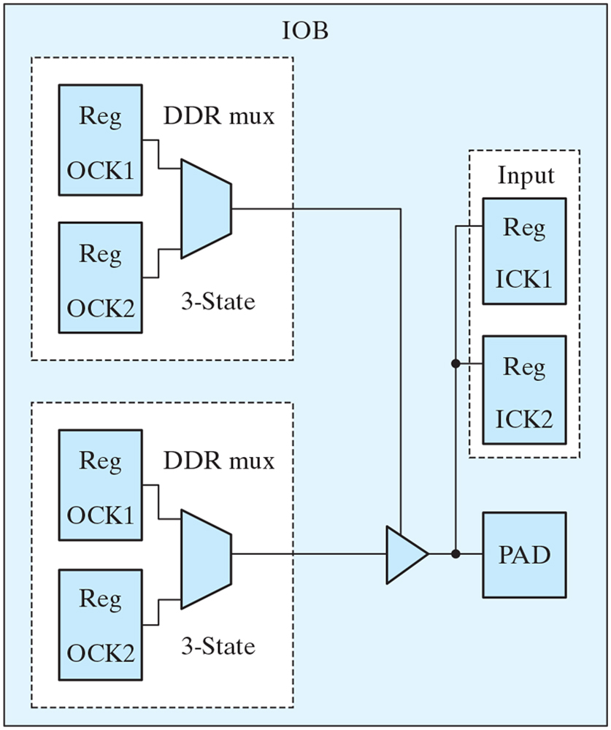
Figure 7.32 Virtex IOB block.

Slide 41
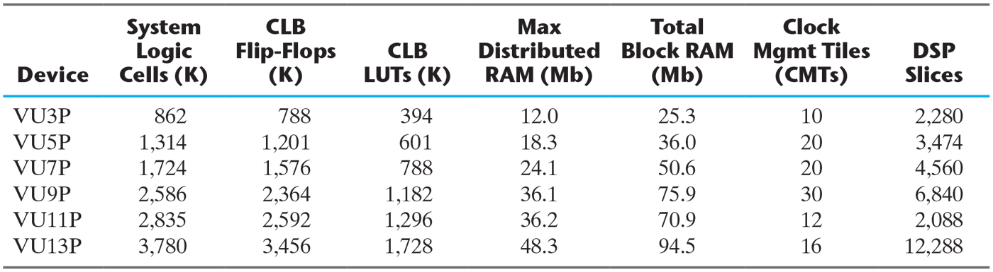
Table 7.8 Features of the Virtex Ultrascale device family.

Slide 42
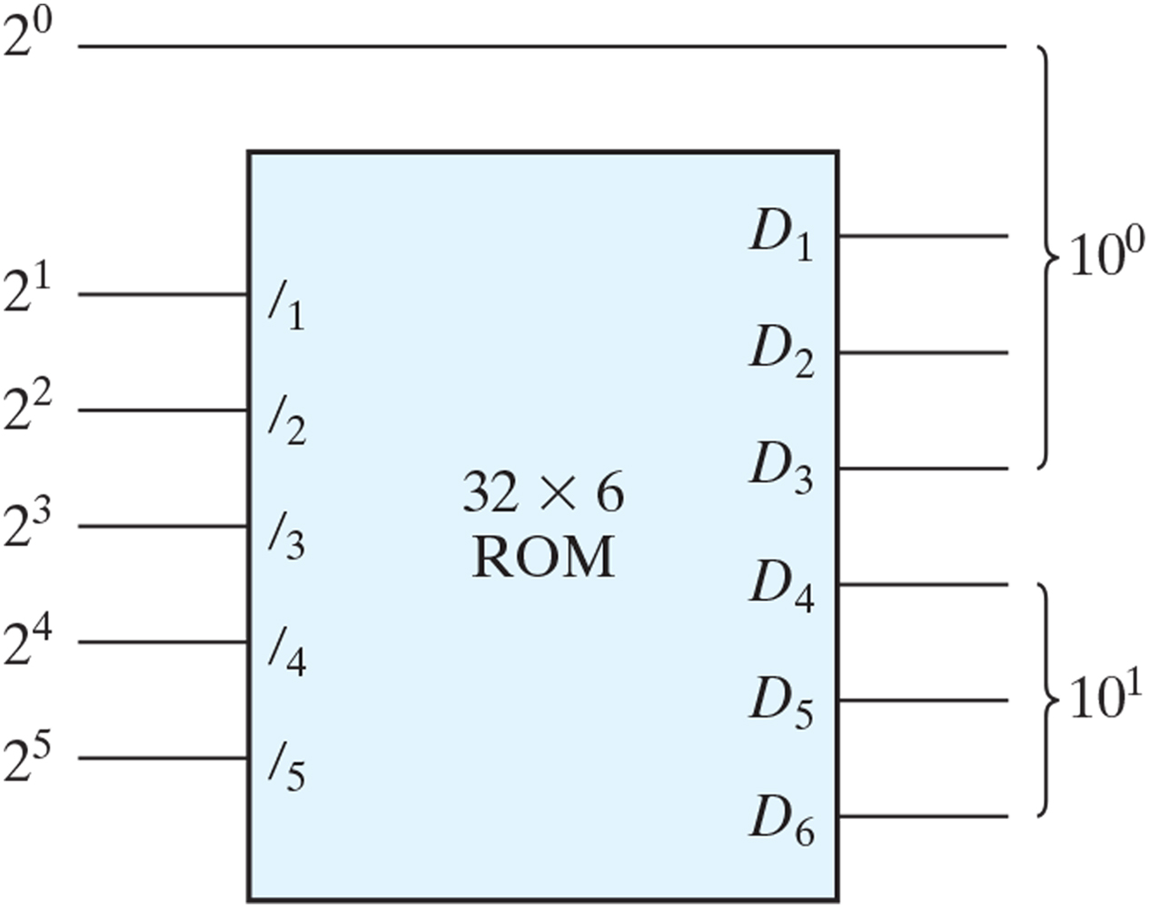
Figure P7.17

Slide 43
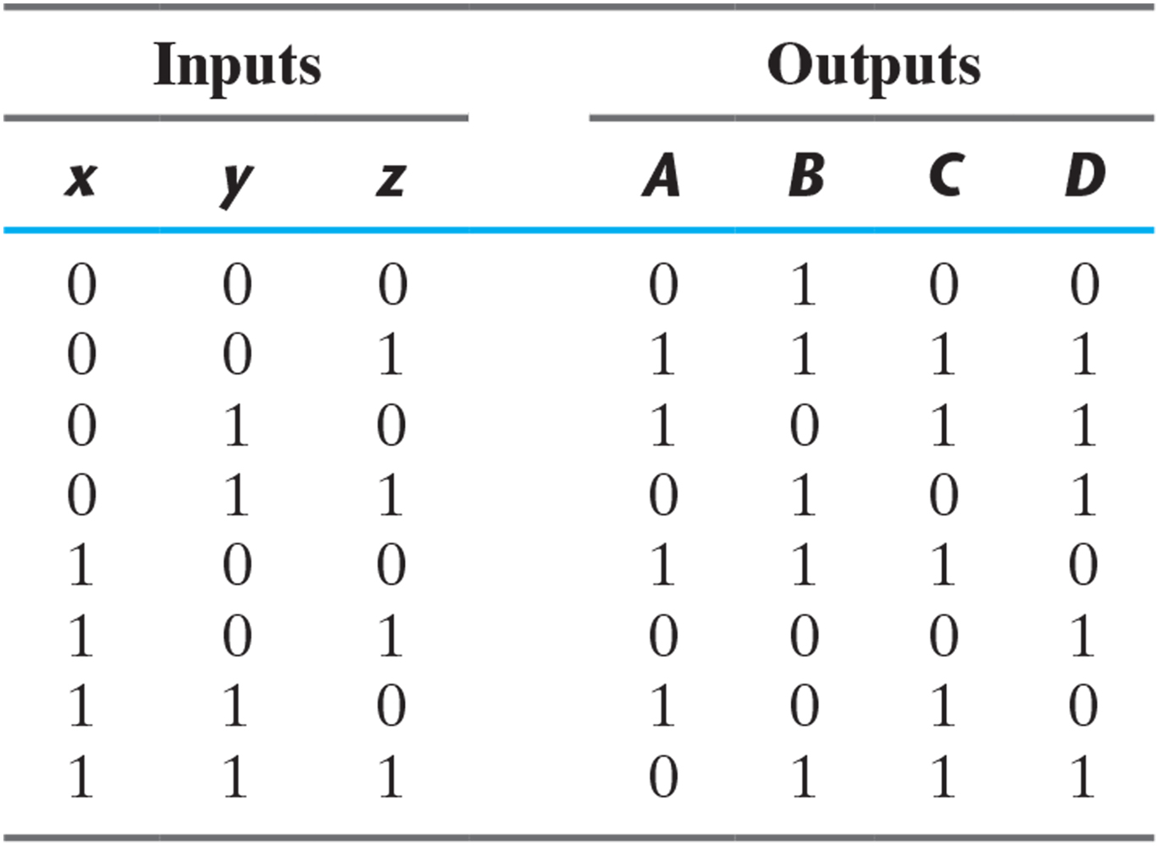
Problem 7.25

