Slide 1

Digital Design
With an Introduction to the Verilog HDL, VHDL, and SystemVerilog
6th Edition
Chapter 08
Design at the Register Transfer Level

Slide 2
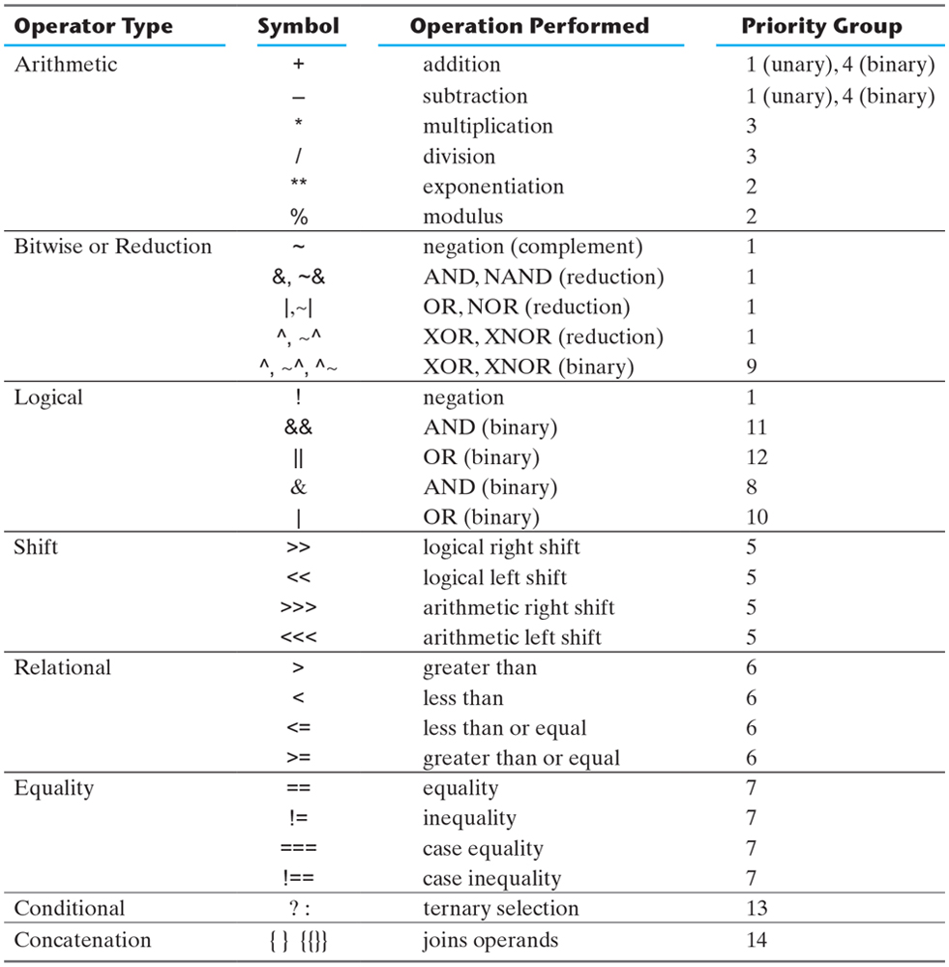
Table 8.1 Verilog 2001, 2005 HDL Operators.

Slide 3
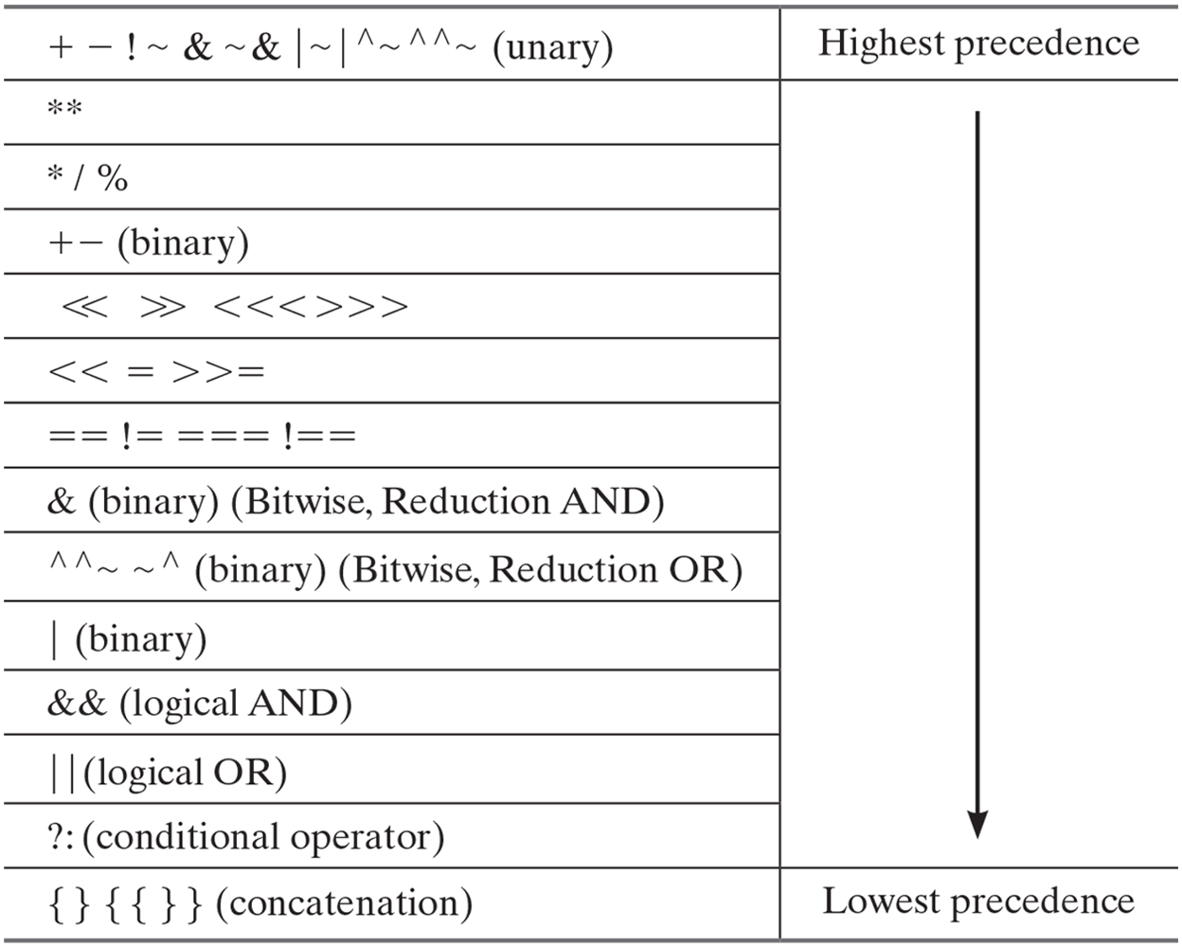
Table 8.2 Verilog Operator Precedence.

Slide 4
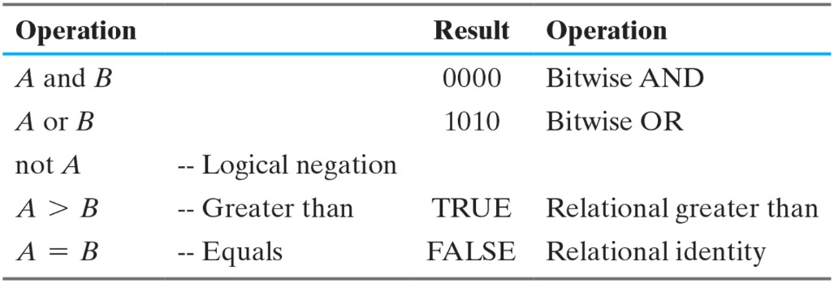
Table Operations

Slide 5
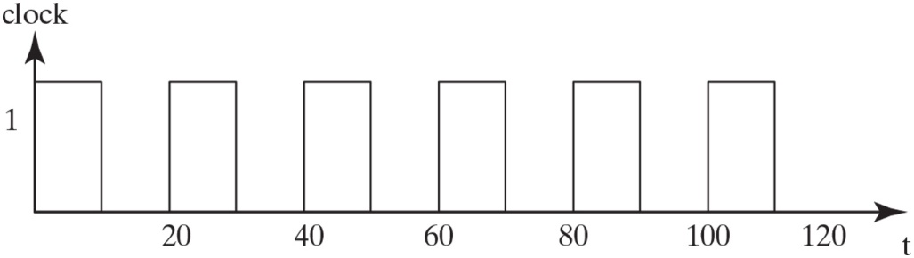
Figure PE 8.8

Slide 6
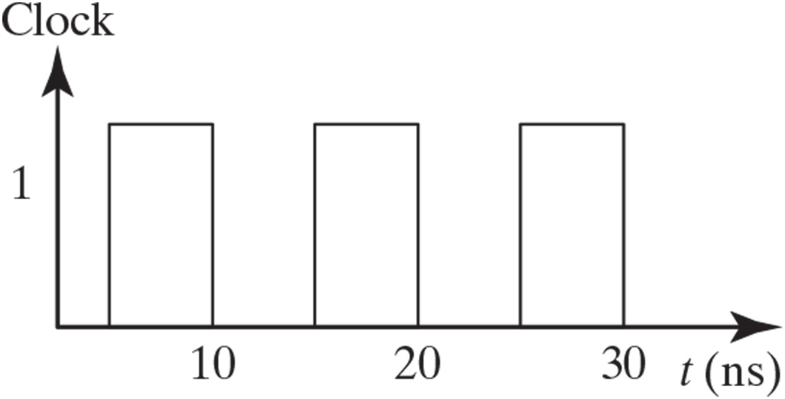
Figure PE 8.9

Slide 7
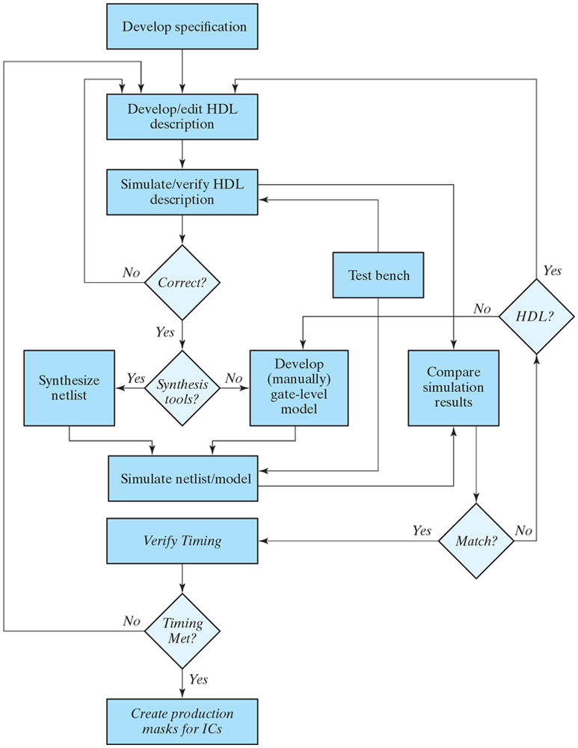
Figure 8.1 A simplified flowchart for HDL-based modeling, verification, and synthesis.

Slide 8
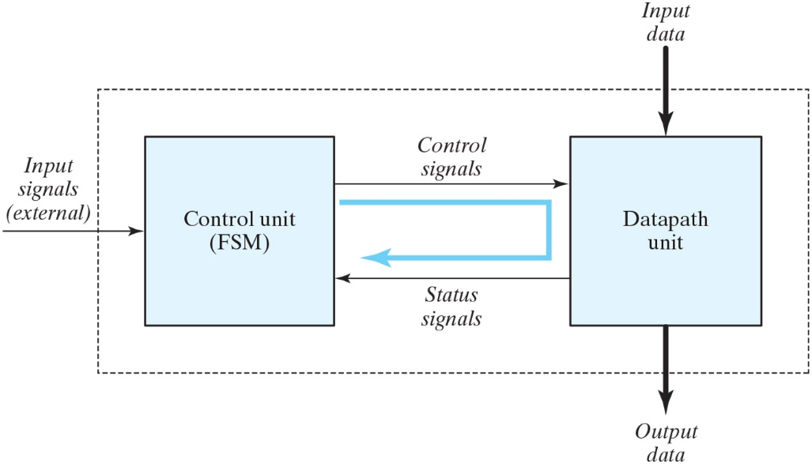
Figure 8.2 Control and datapath interaction.

Slide 9
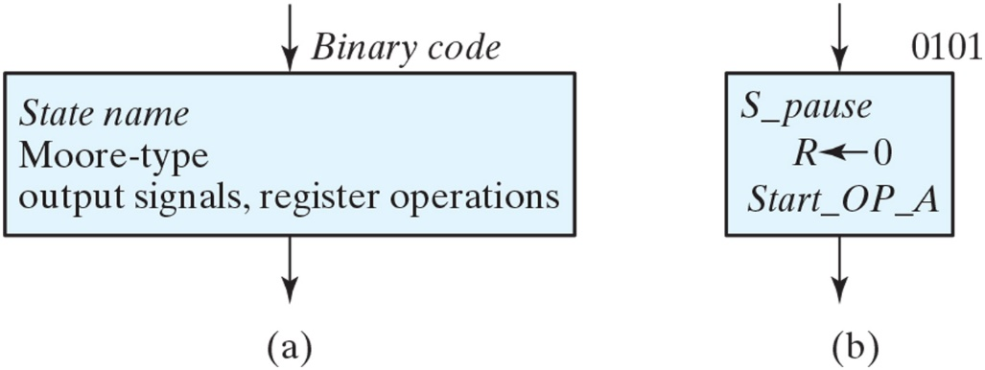
Figure 8.3 ASM chart state box.

Slide 10
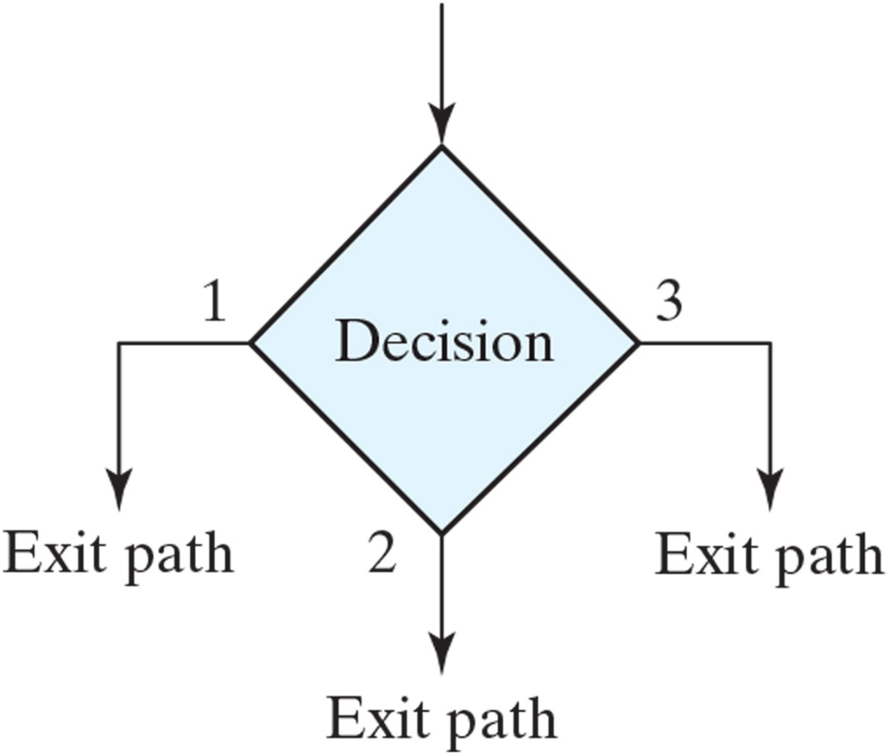
Figure 8.4 ASM chart decision box.

Slide 11
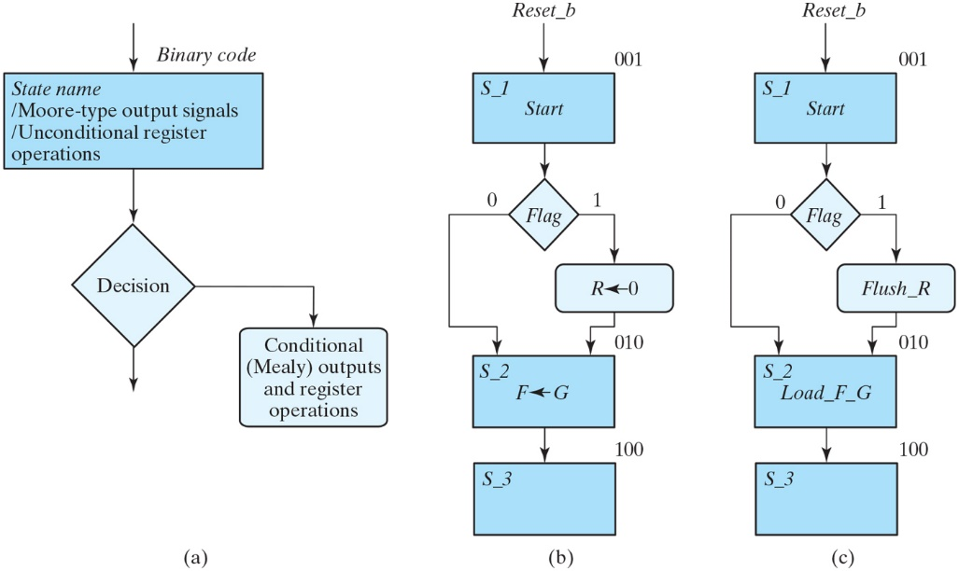
Figure 8.5 ASM chart conditional box and examples.

Slide 12
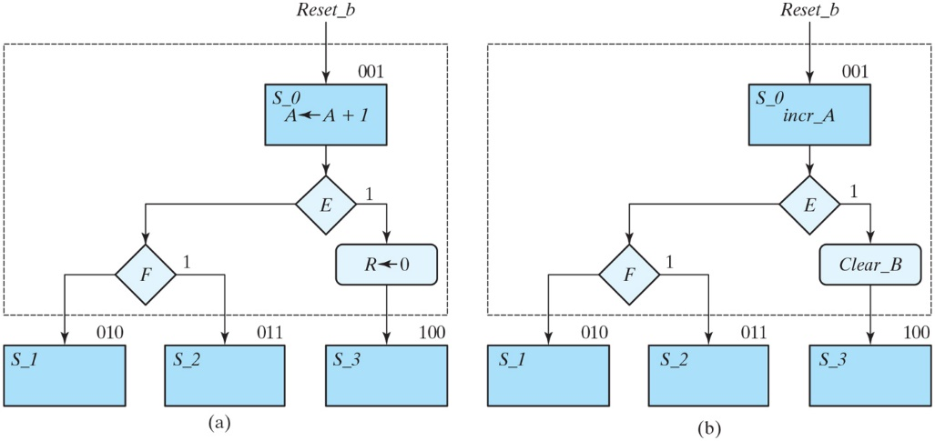
Figure 8.6 ASM blocks.

Slide 13
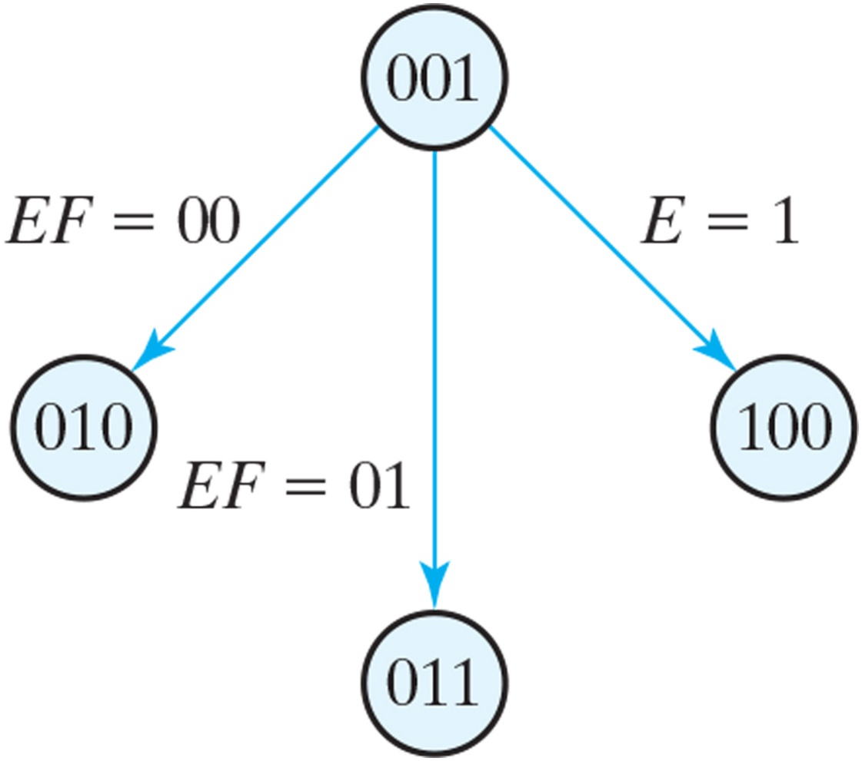
Figure 8.7 State diagram equivalent to the ASM chart of Fig. 8.6.

Slide 14
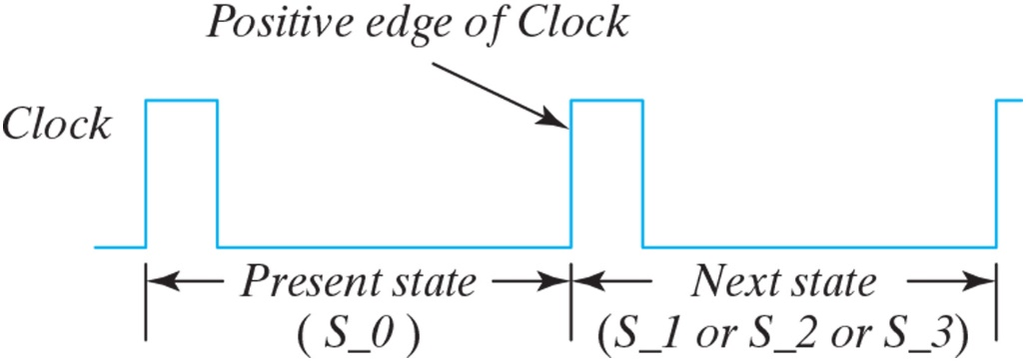
Figure 8.8 Transition between states.

Slide 15
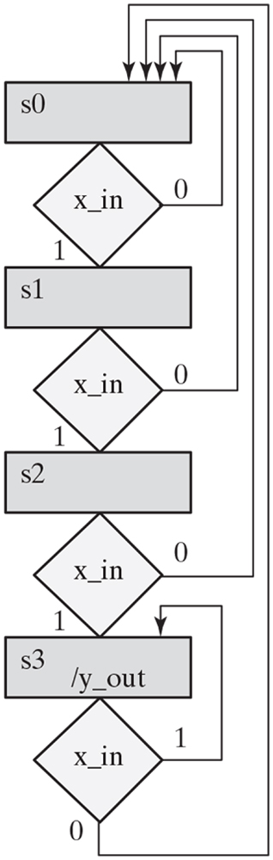
Figure PE 8.10

Slide 16
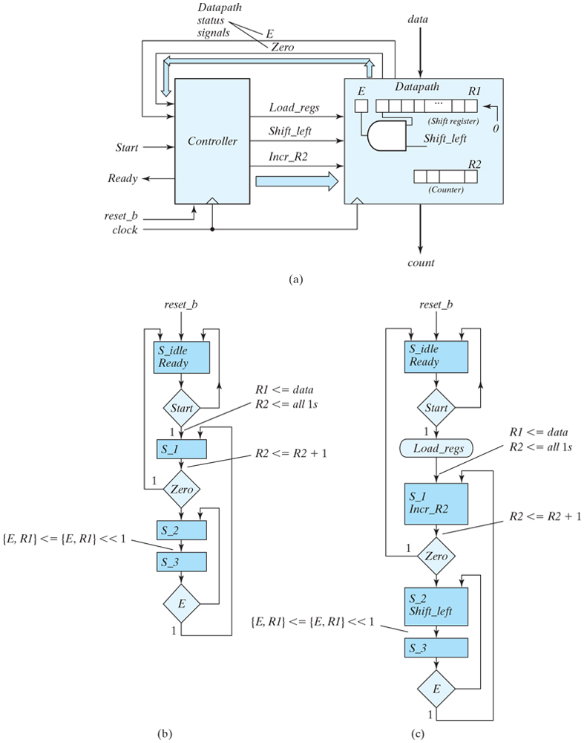
Figure 8.9 (a) Block diagram for design example; (b) ASM chart for controller state transitions, annotated with datapath register operations, asynchronous reset; (c) ASM chart for controller state transitions, annotated with datapath register operations, synchronous reset; (d) ASMD chart fora completely specified controller, identifying datapath operations and associated control signals,and asynchronous reset.

Slide 17
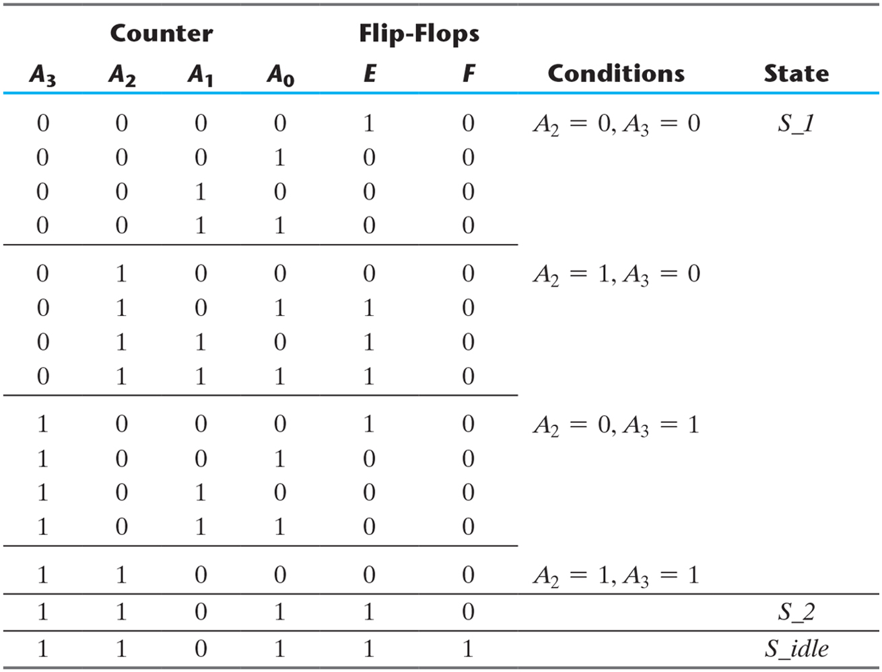
Table 8.3 Sequence of Operations for Design Example.

Slide 18
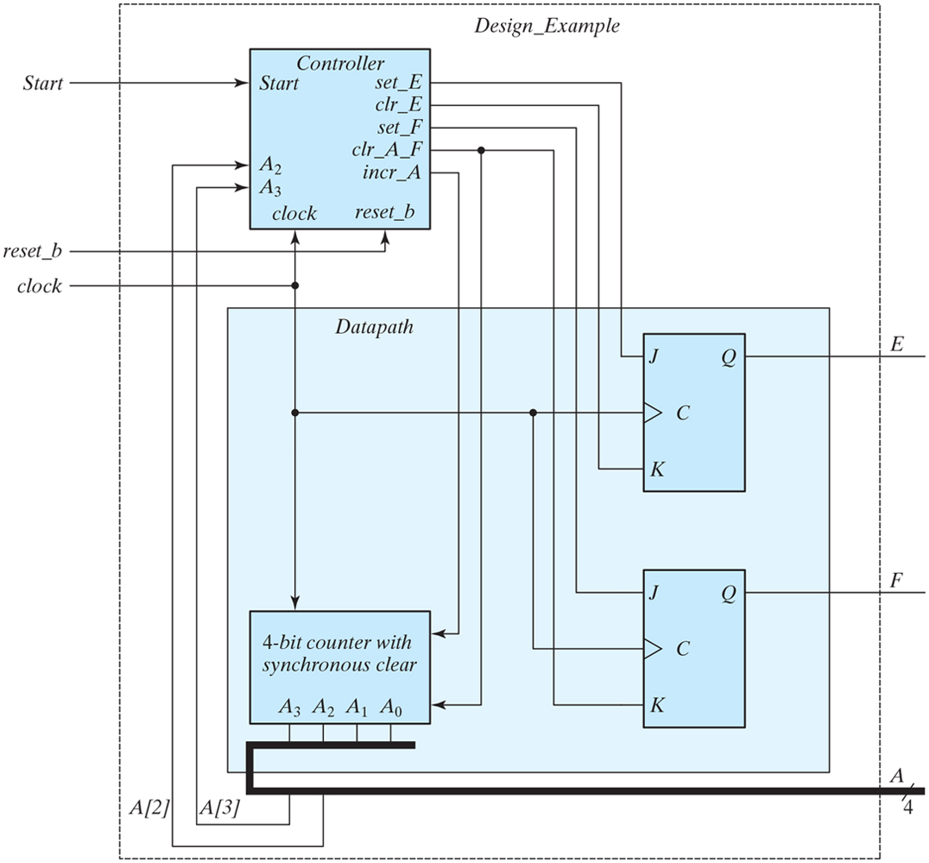
Figure 8.10 Datapath and controller for design example.

Slide 19
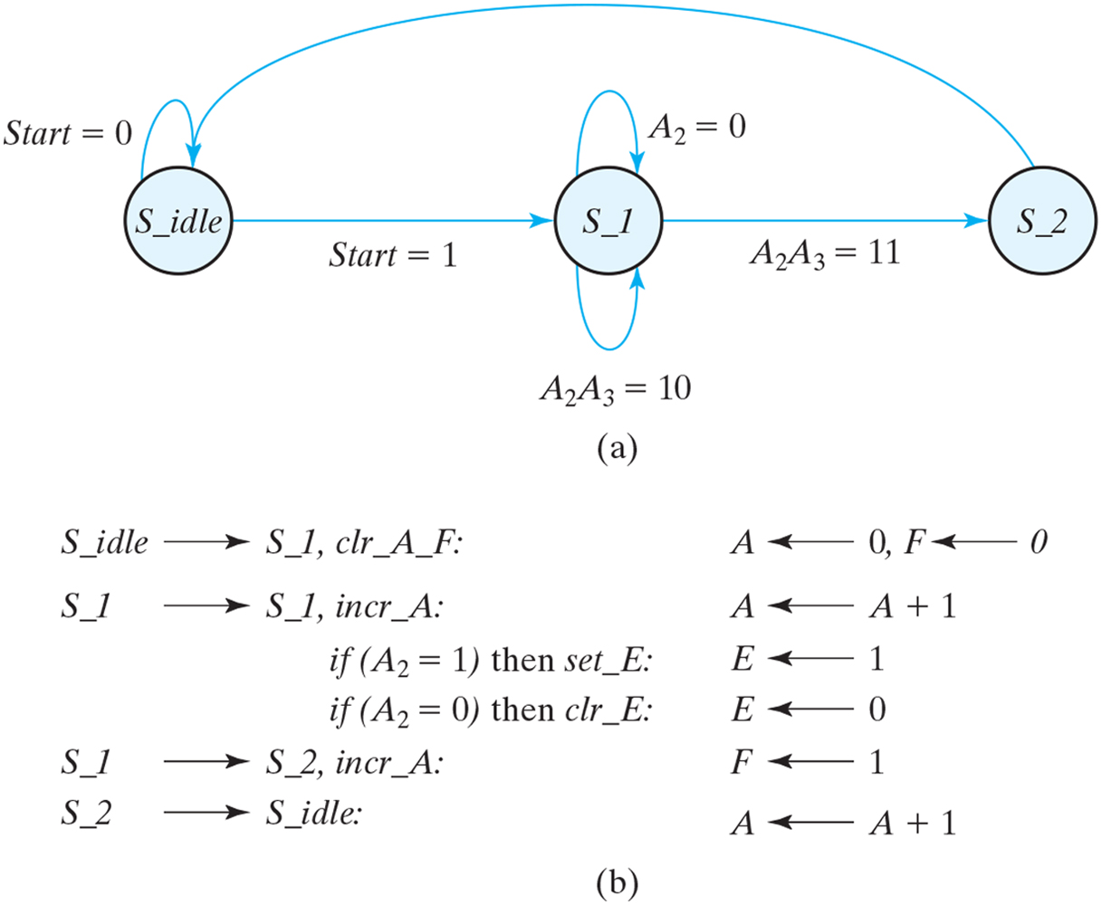
Figure 8.11 Register transfer-level description of design example.

Slide 20
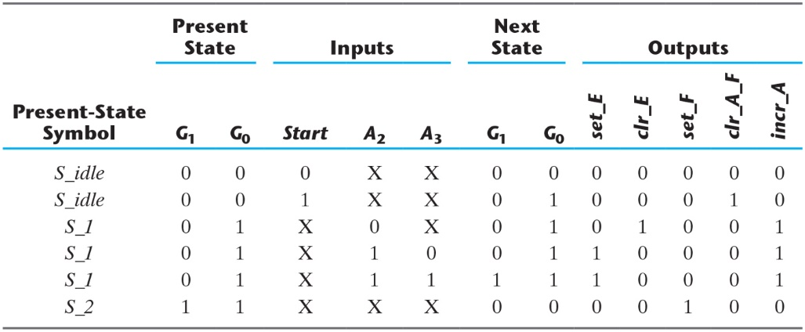
Table 8.4 State Table for the Controller of Fig. 8.10.

Slide 21
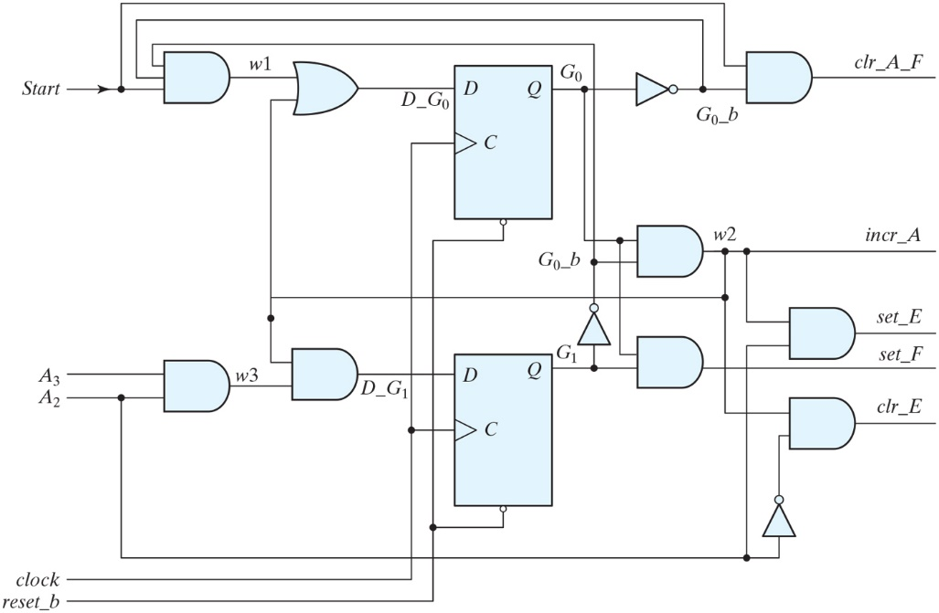
Figure 8.12 Logic diagram of the control unit for Fig. 8.10.

Slide 22
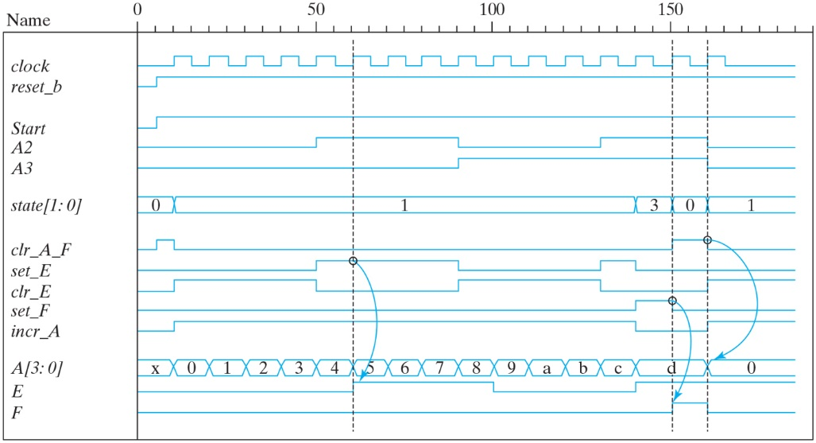
Figure 8.13 Simulation results for Design_Example_RTL.

Slide 23
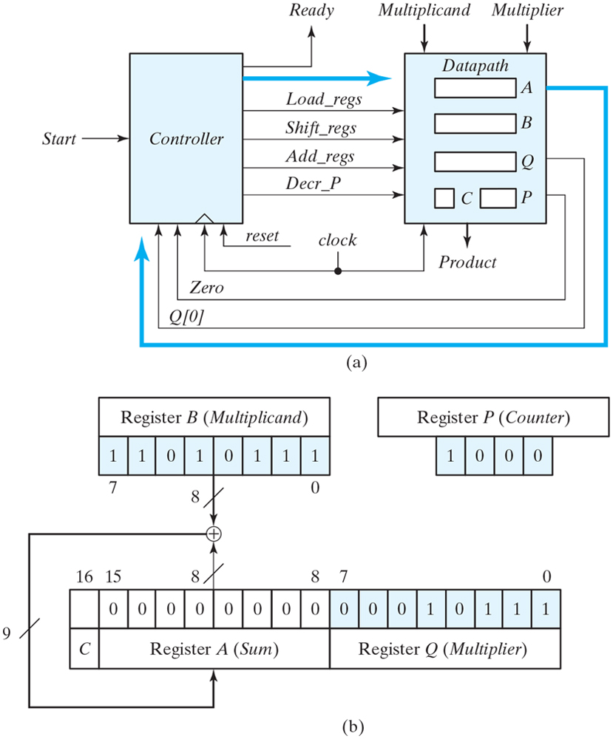
Figure 8.14 (a) Block diagram and (b) datapath of a binary multiplier.

Slide 24
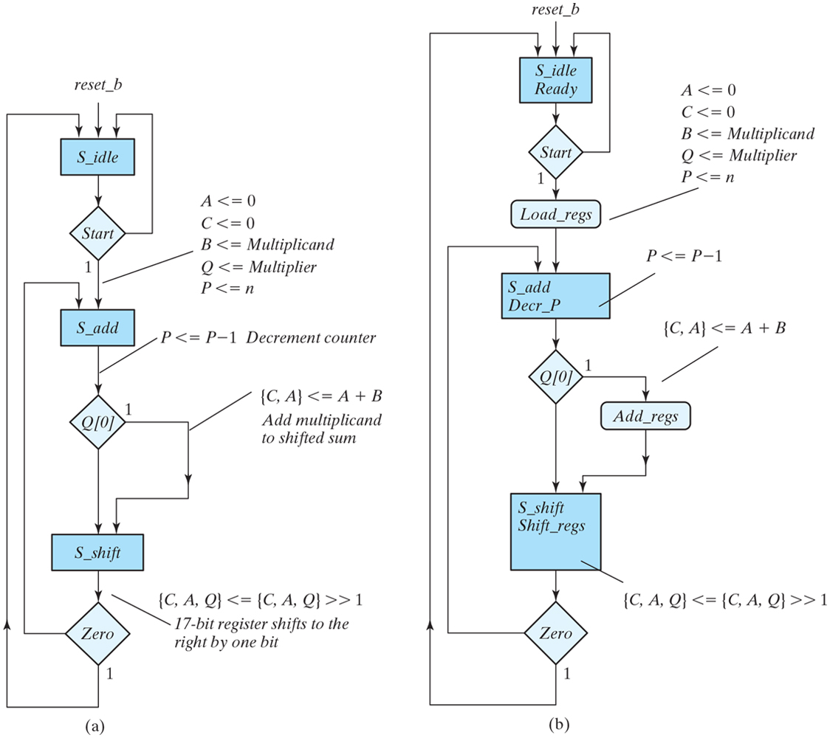
Figure 8.15 ASMD chart for binary multiplier.

Slide 25
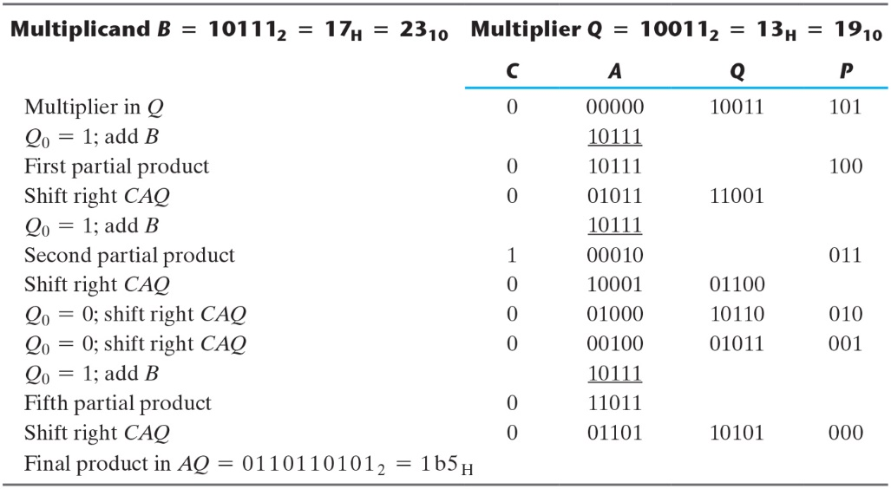
Table 8.5 Numerical Example For Binary Multiplier.

Slide 26
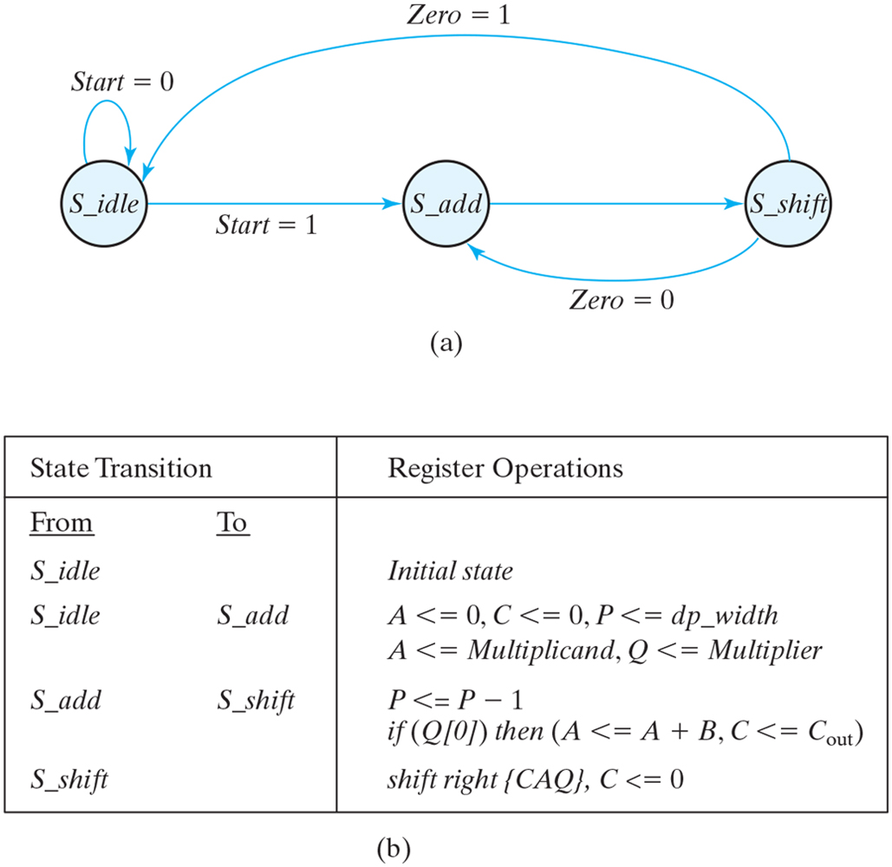
Figure 8.16 Control specifications for binary multiplier.

Slide 27
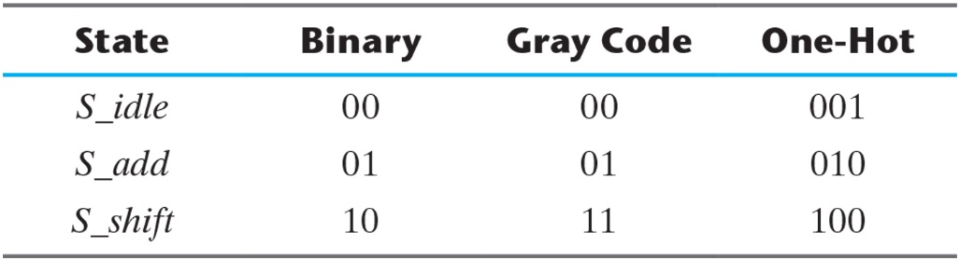
Table 8.6 State Assignment for Control.

Slide 28
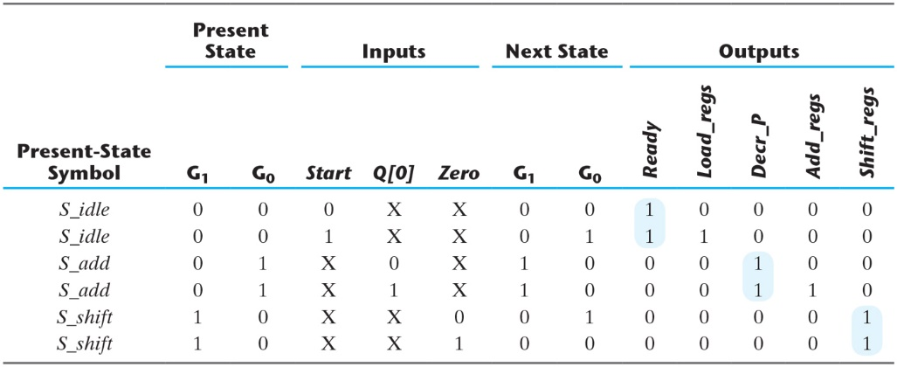
Table 8.7 State Table for Control Circuit.

Slide 29
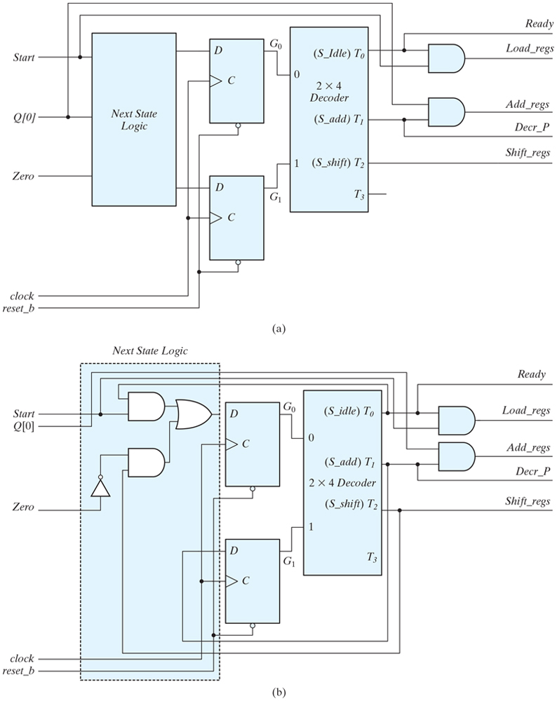
Figure 8.17 Logic diagram derived from Table 8.7 for controlling a binary multiplier using a sequence register and decoder.

Slide 30
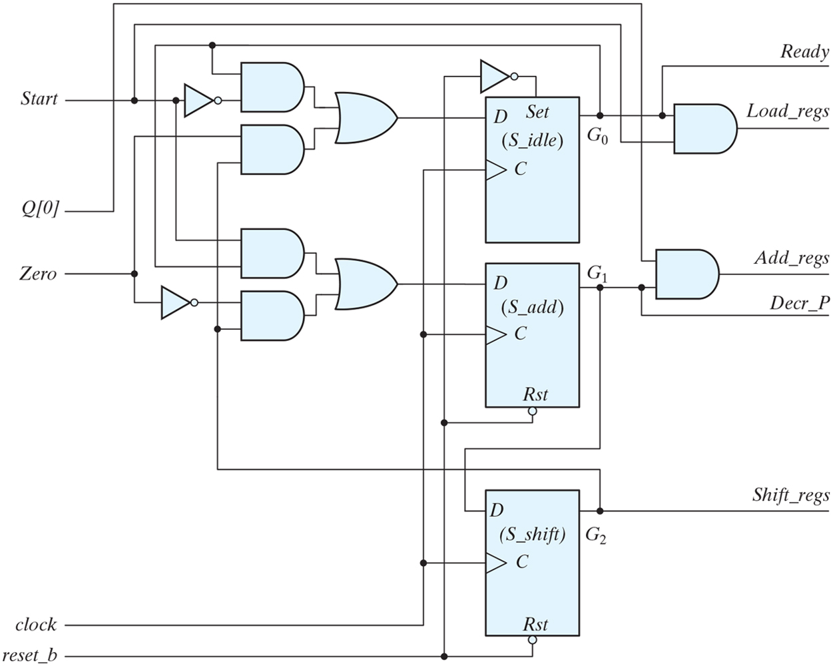
Figure 8.18 Logic diagram for one-hot state controller.

Slide 31
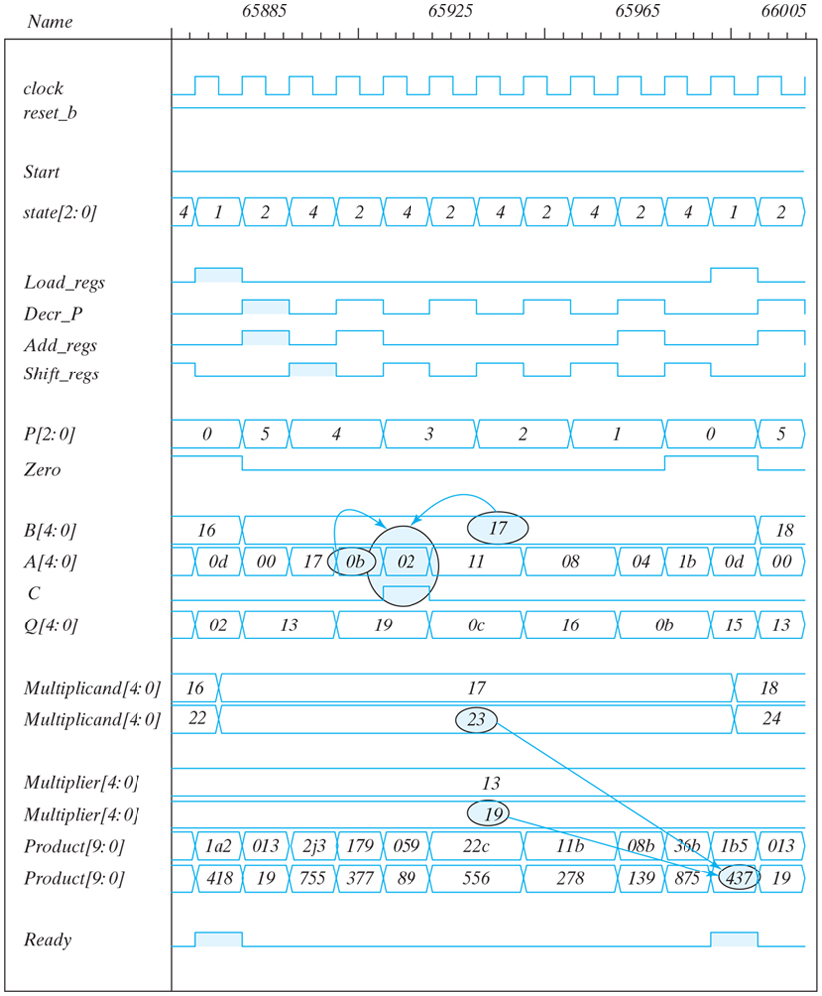
Figure 8.19 Simulation waveforms for one-hot state controller.

Slide 32
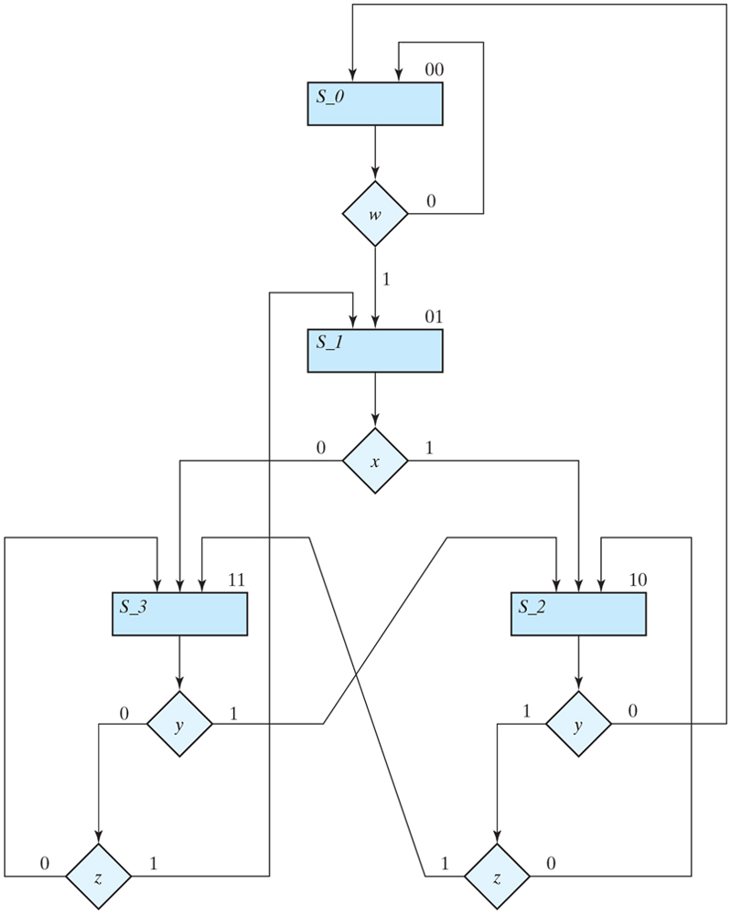
Figure 8.20 Example of ASM chart with four control inputs.

Slide 33
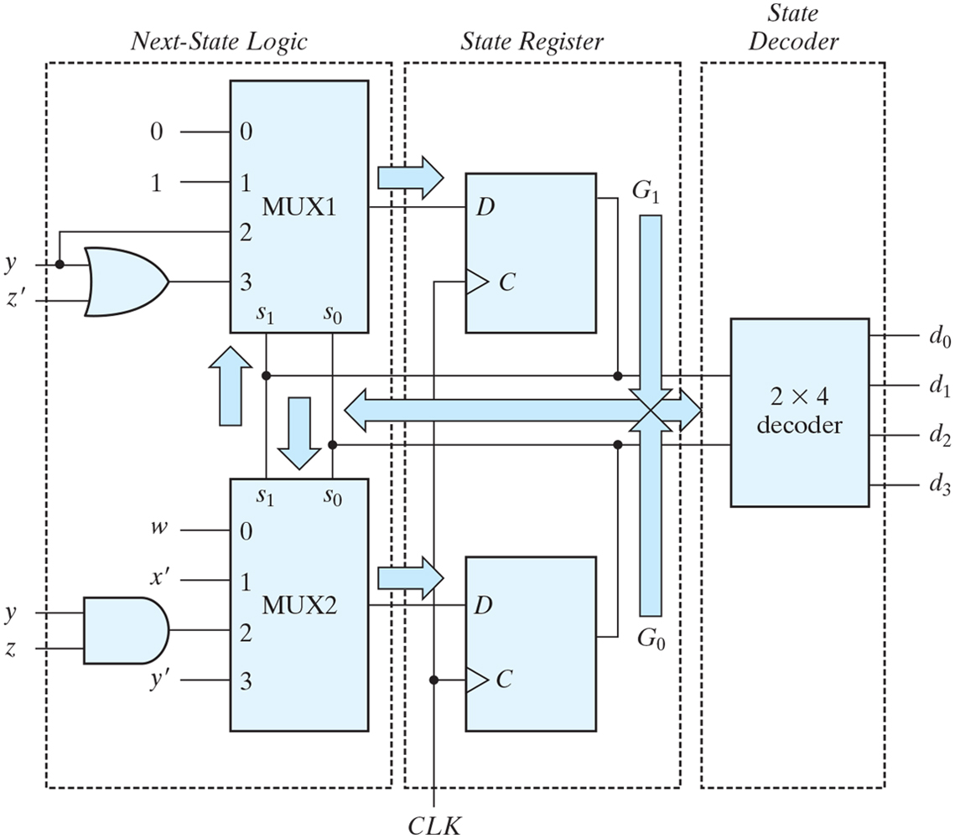
Figure 8.21 Control implementation with multiplexers.

Slide 34
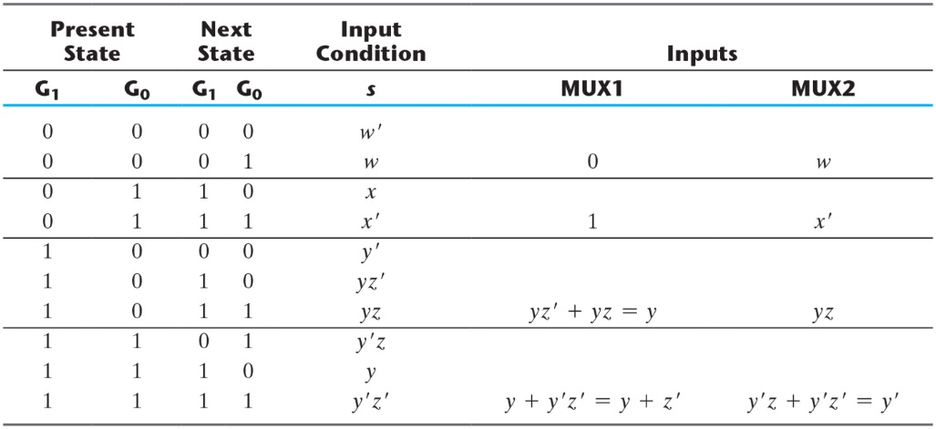
Table 8.8 Multiplexer Input Conditions.

Slide 35
Figure 8.22 Block diagram and ASMD chart for count-of-ones circuit.

Slide 36
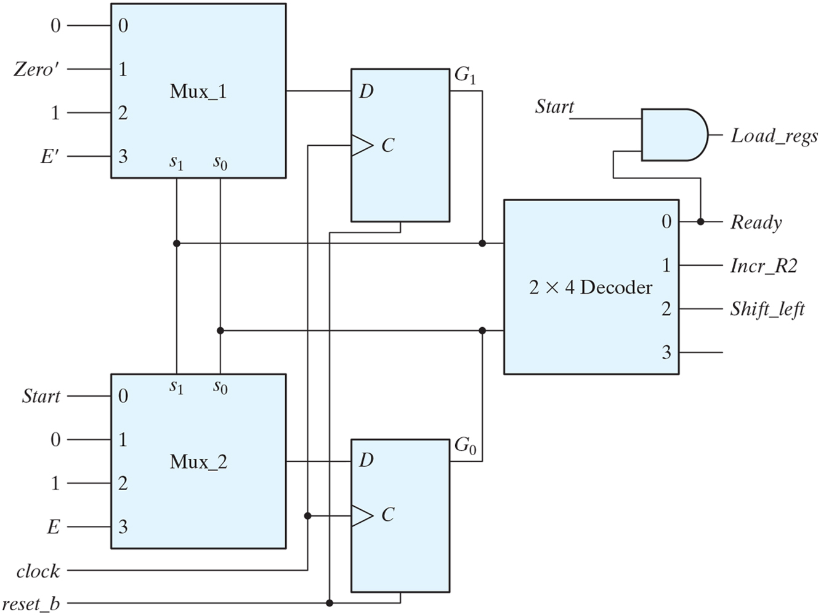
Figure 8.23 Control implementation for count-of-ones circuit.

Slide 37
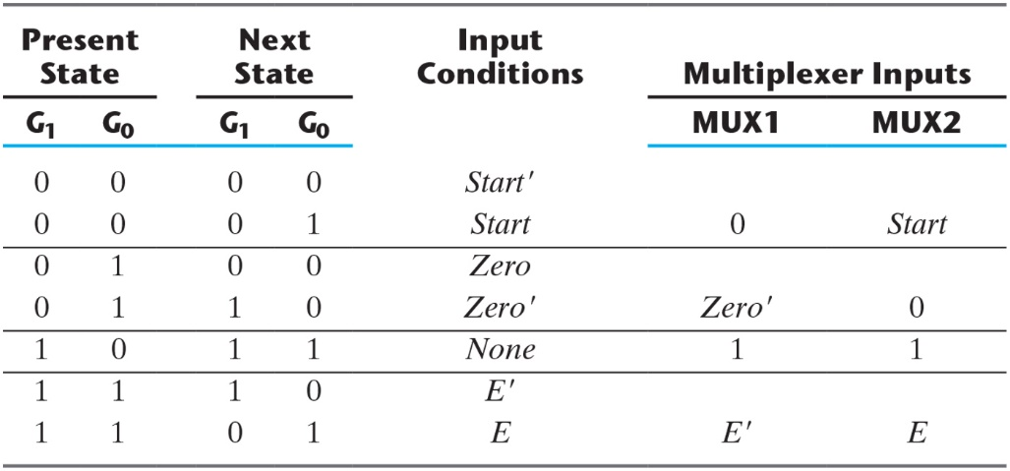
Table 8.9 Multiplexer Input Conditions for Design Example.

Slide 38
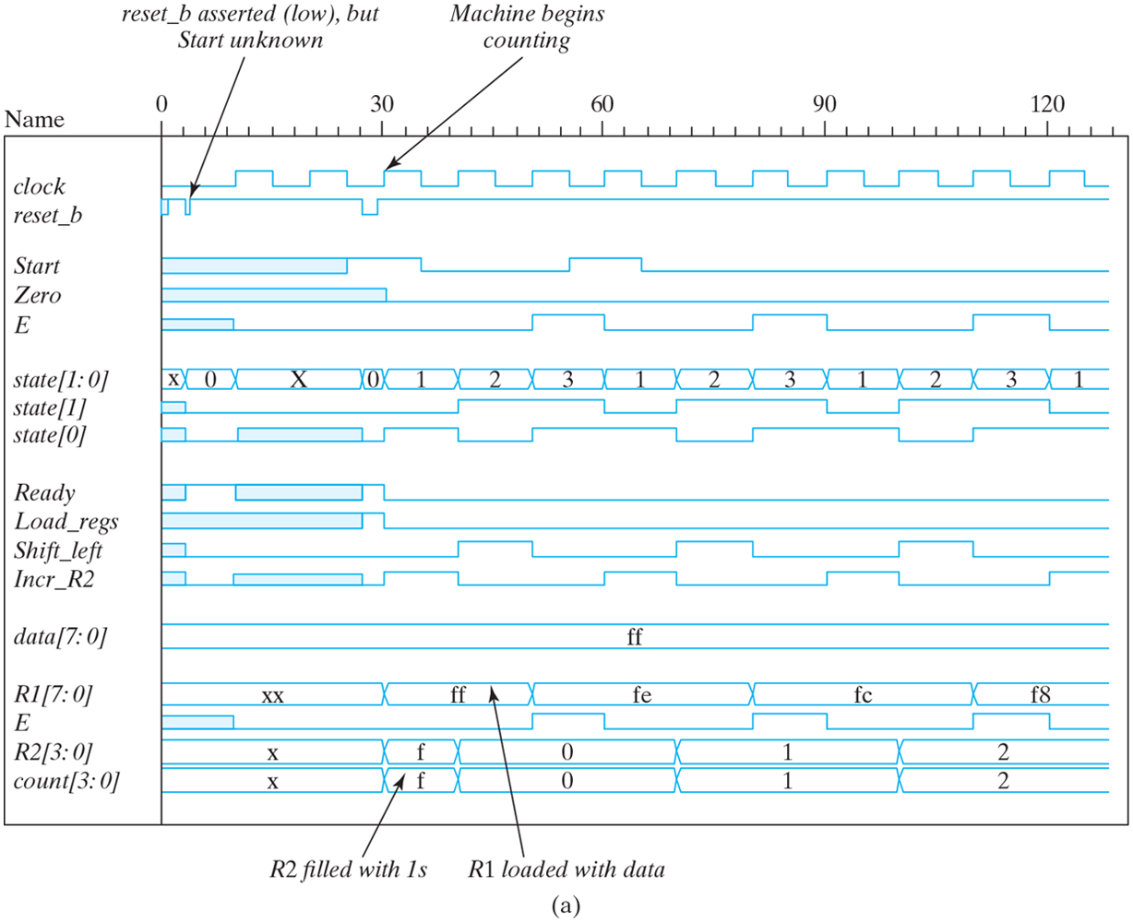
Figure 8.24 Simulation waveforms for count-of-ones circuit.

Slide 39
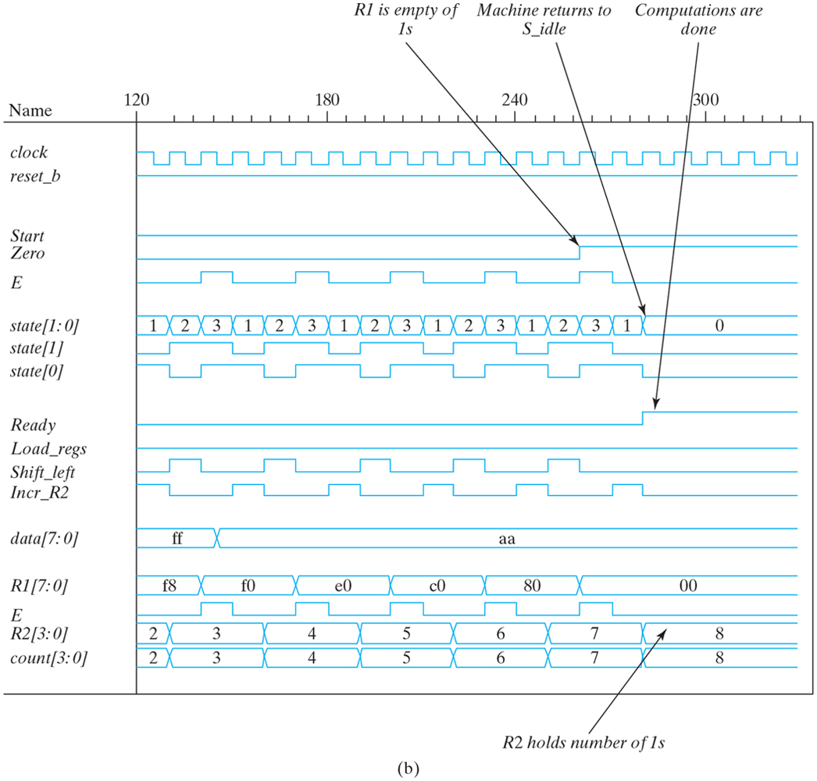
Figure 8.24 Simulation waveforms for count-of-ones circuit.

Slide 40
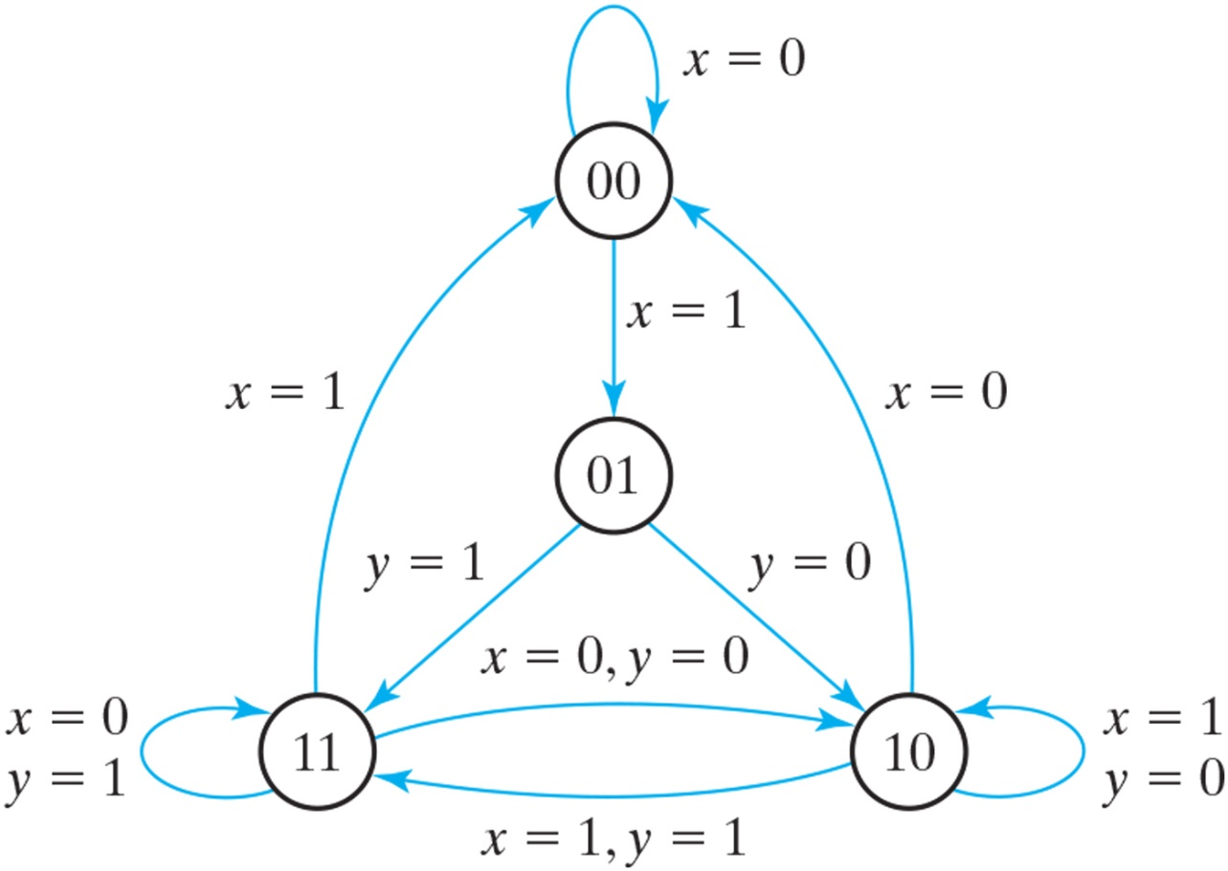
Figure P8.10 Control state diagram for Problems 8.10 and 8.11.

Slide 41
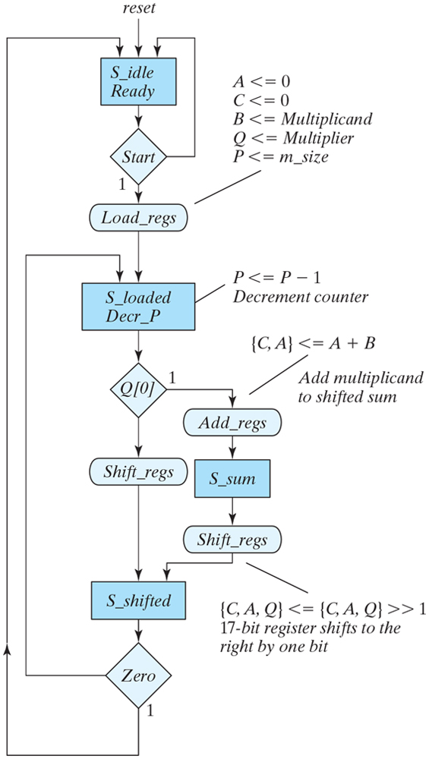
Figure P8.22 ASMD chart for Problem 8.22.

Slide 42
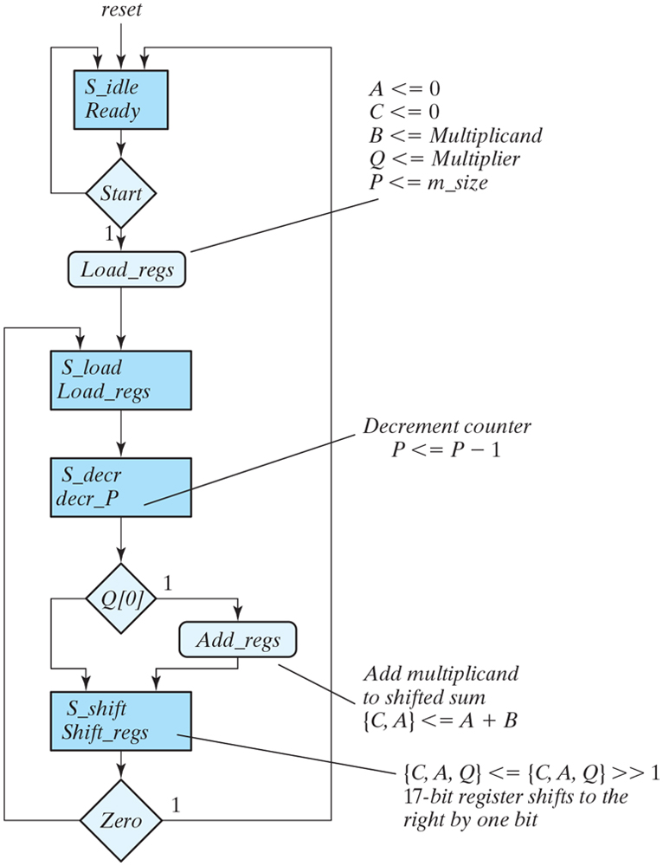
Figure P8.23 ASMD chart for Problem 8.23.

Slide 43
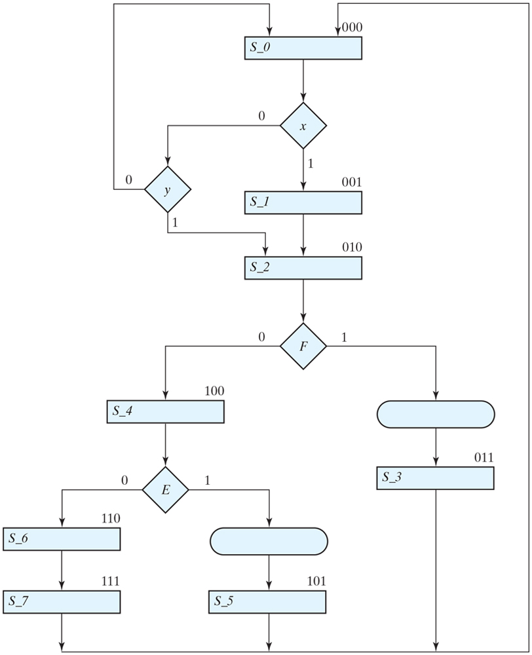
Figure P8.29 ASMD chart for Problem 8.29.

Slide 44
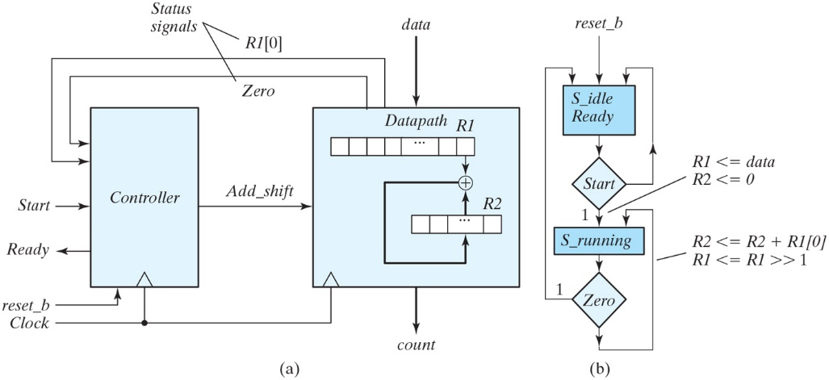
Figure P8.37 (a) Alternative circuit for a ones counter. (b) ASMD Chart for Problem 8.37.

Slide 45
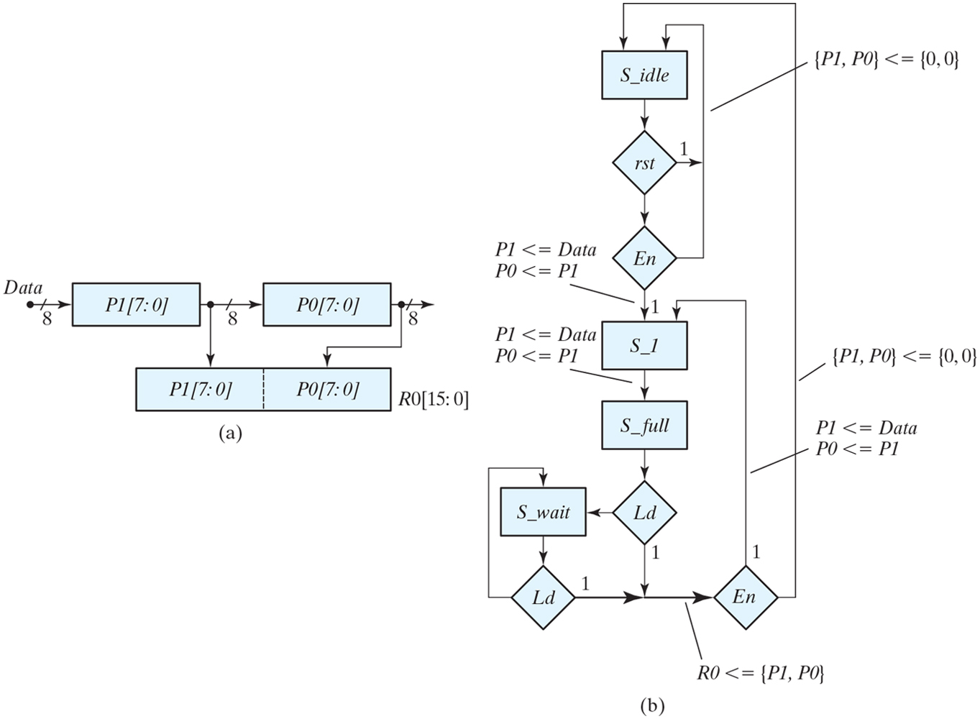
Figure P8.41 Two-stage pipeline register: Datapath unit and ASMD chart.

