Slide 1

Digital Design
With an Introduction to the Verilog HDL, VHDL, and SystemVerilog
6th Edition
Chapter 09
Laboratory Experiments with Standard ICs and FPGAs

Slide 2
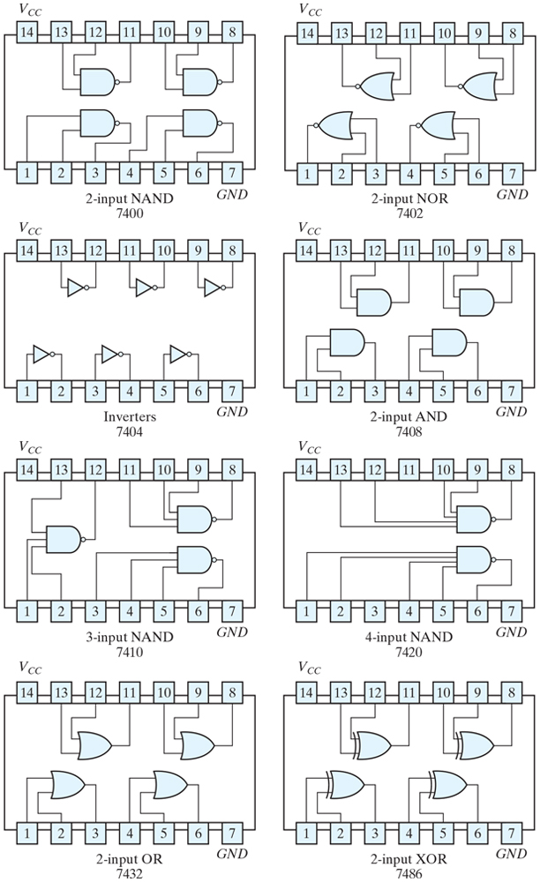
Figure 9.1 Digital gates in IC packages with identification numbers and pin assignments.

Slide 3
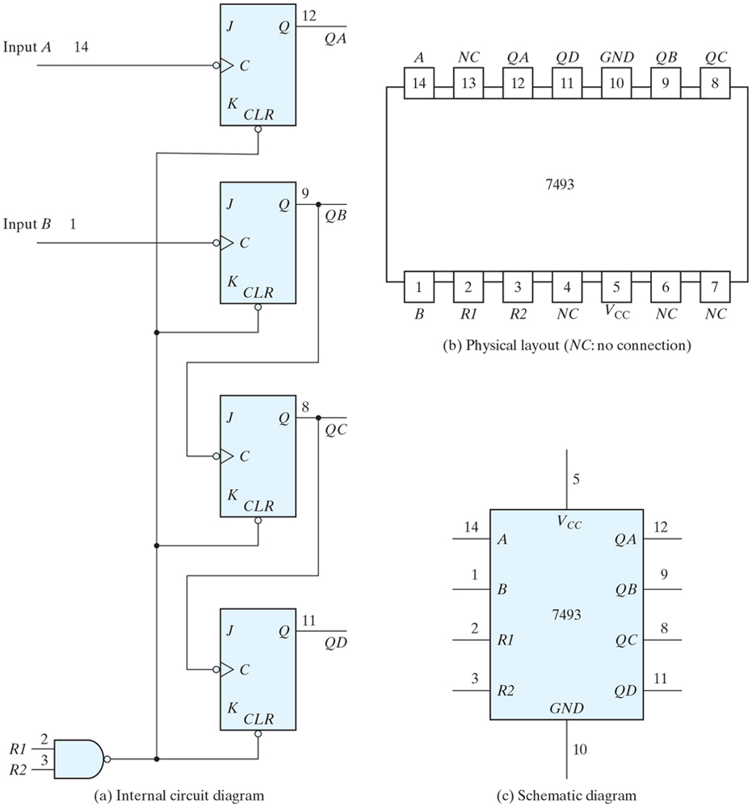
Figure 9.2 IC type 7493 ripple counter.

Slide 4
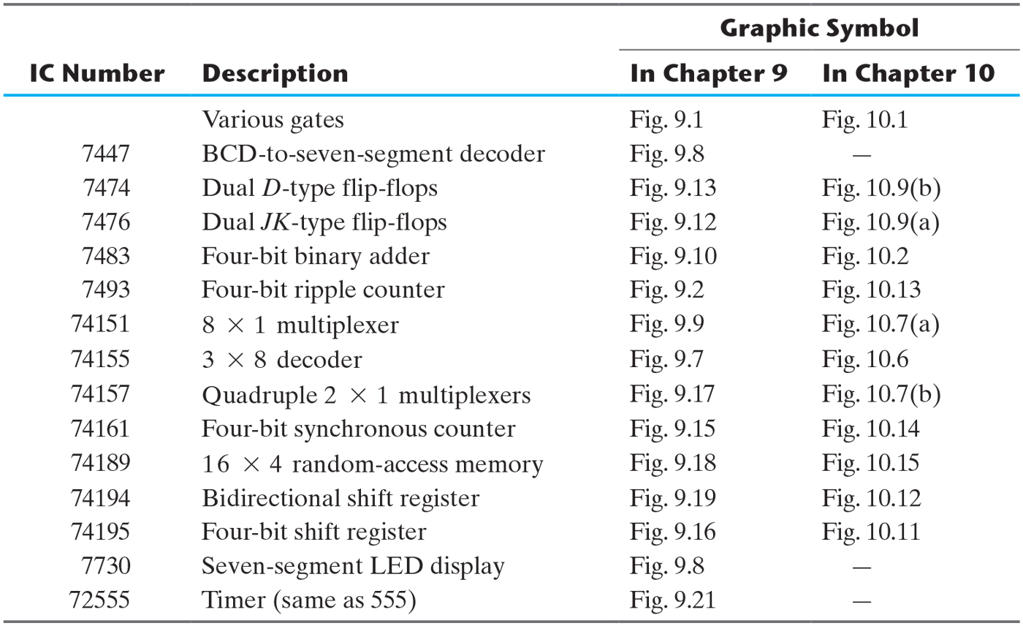
Table 9.1 Integrated Circuits Required for the Experiments.

Slide 5
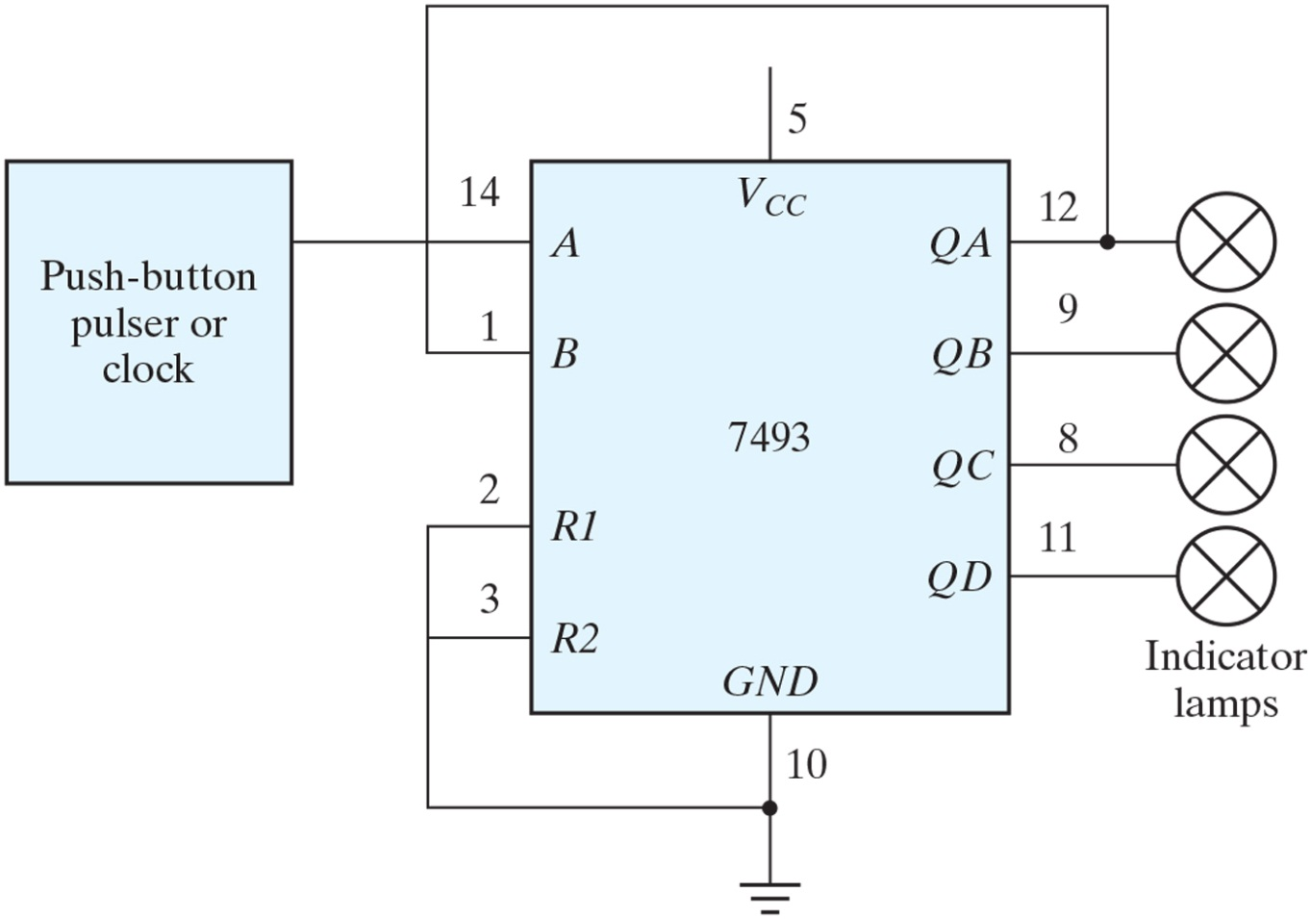
Figure 9.3 Binary counter.

Slide 6
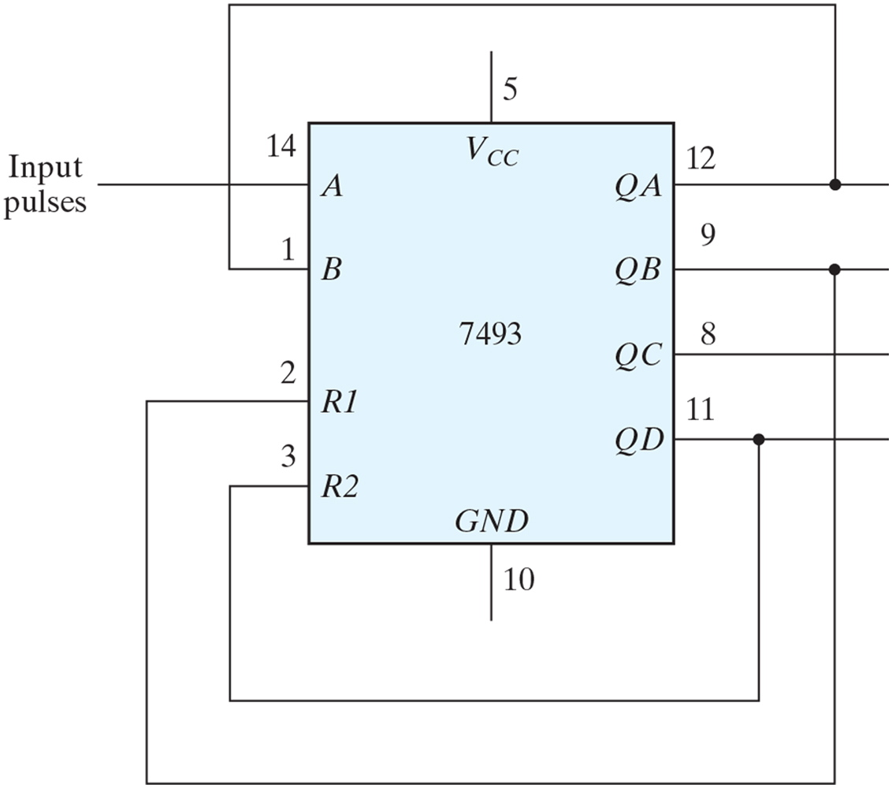
Figure 9.4 BCD counter.

Slide 7
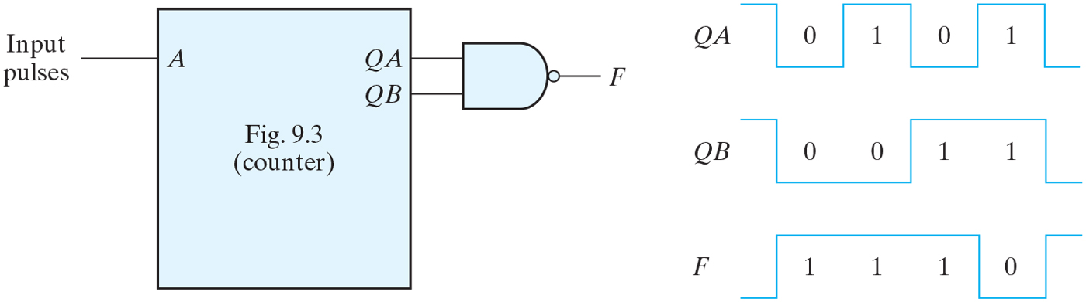
Figure 9.5 Waveforms for NAND gate.

Slide 8
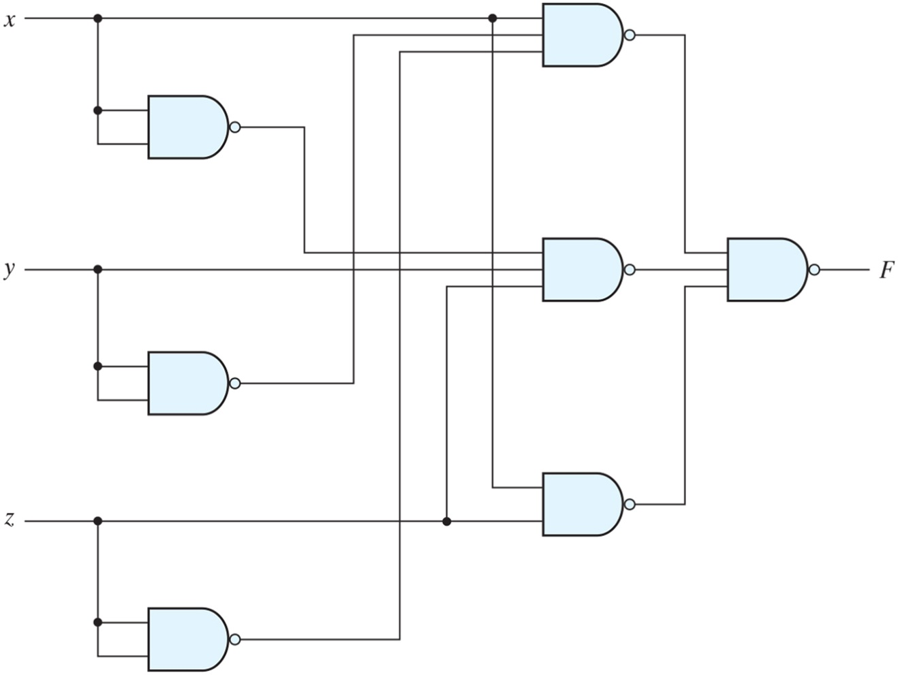
Figure 9.6 Logic diagram for Experiment 3.

Slide 9
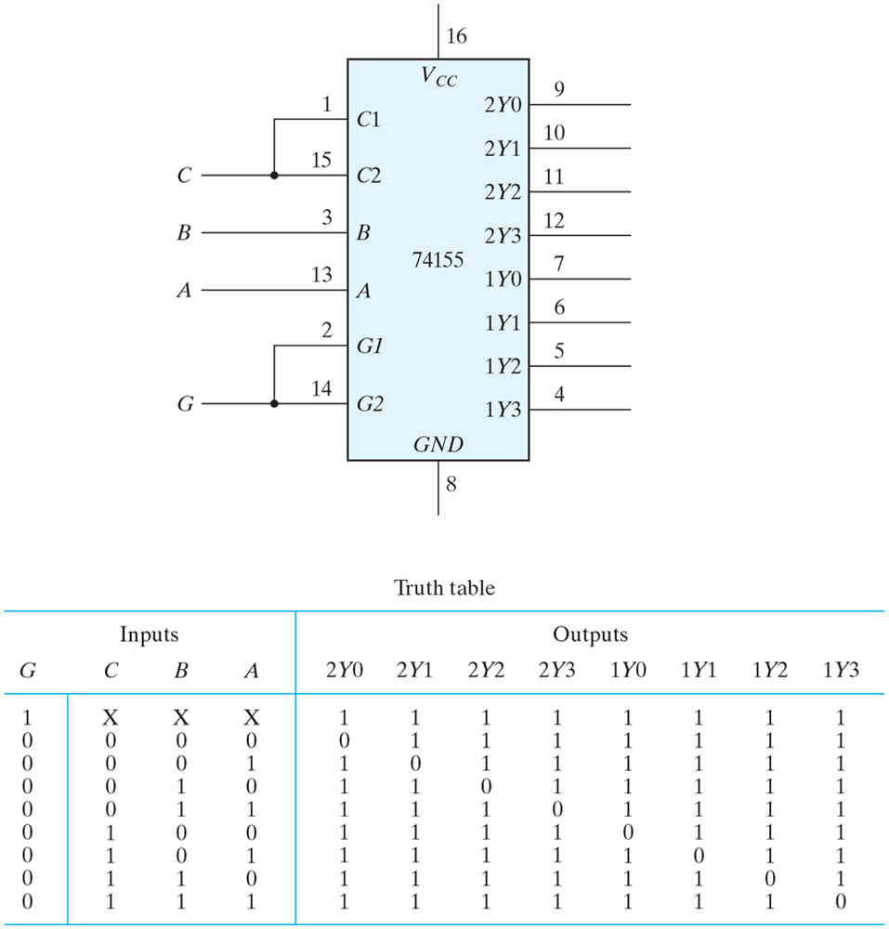
Figure 9.7 IC type 74155 connected as a 3 × 8 decoder.

Slide 10
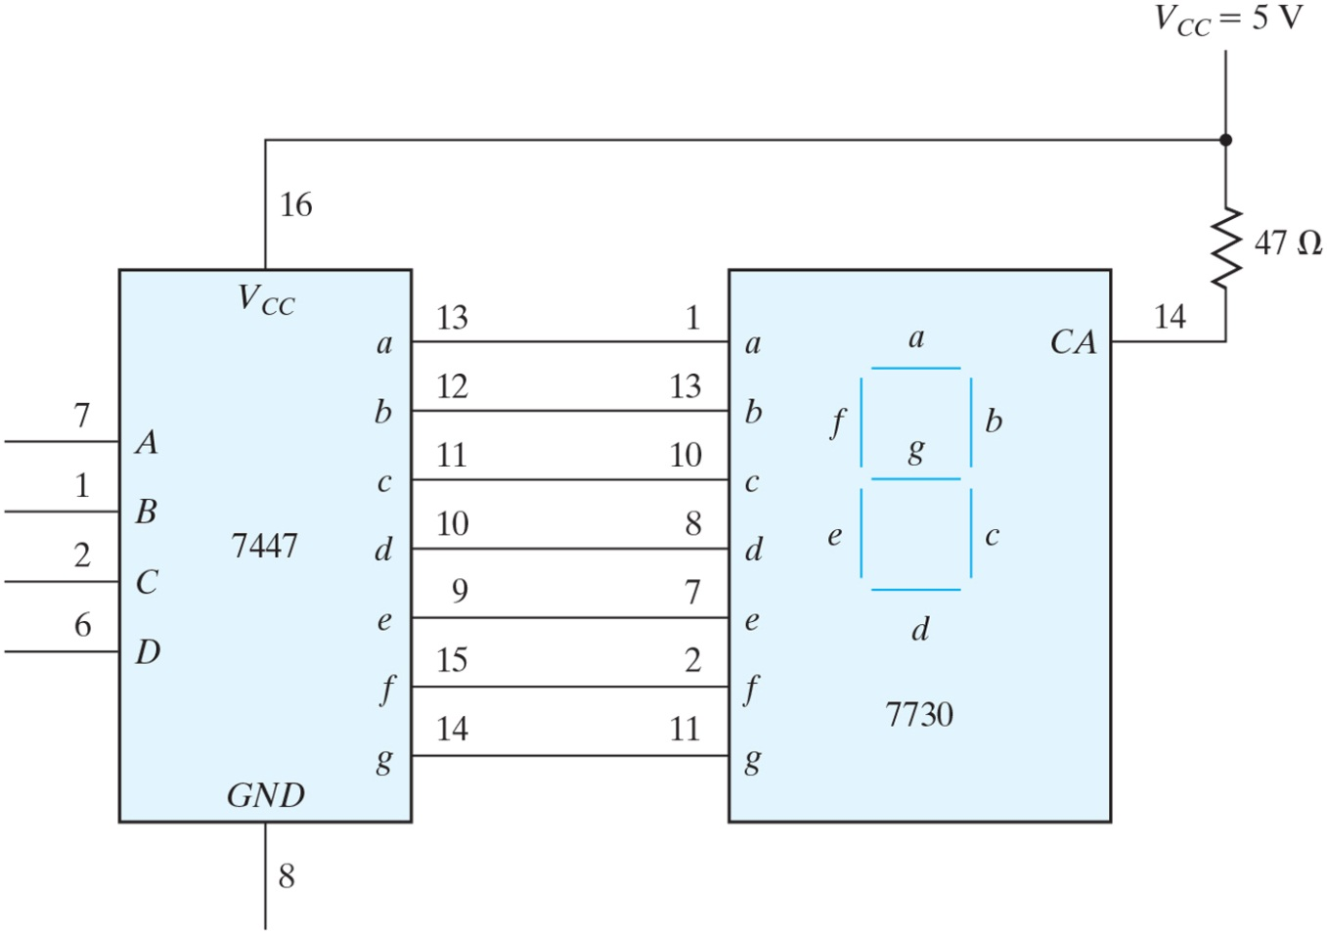
Figure 9.8 BCD-to-seven-segment decoder (7447) and seven-segment display (7730).

Slide 11
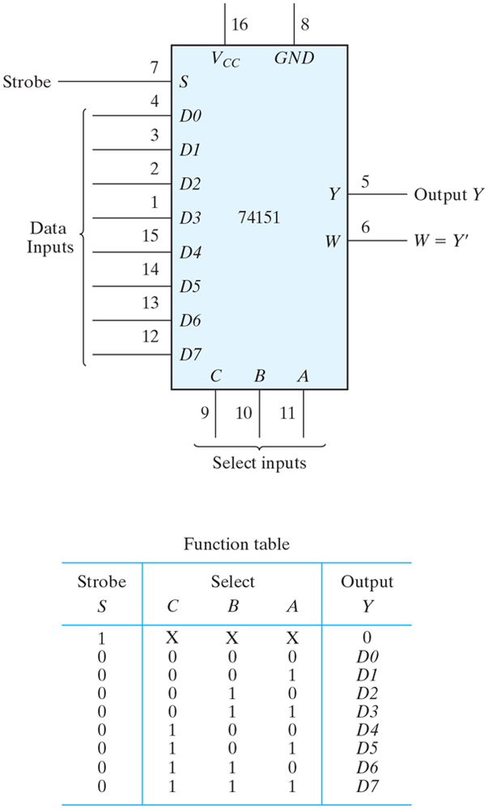
Figure 9.9 IC type 74151 8 × 1 multiplexer.

Slide 12
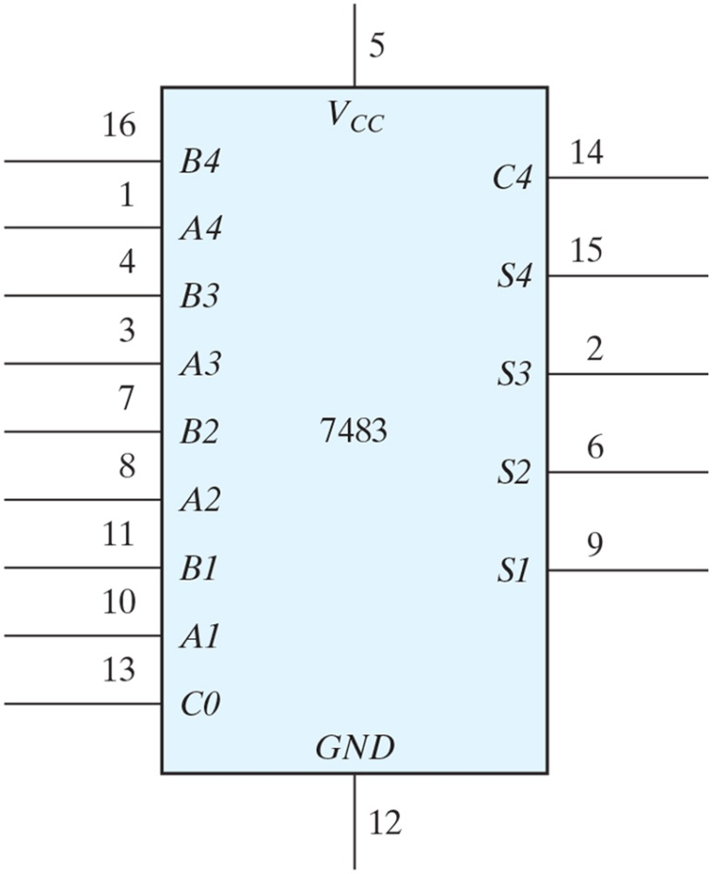
Figure 9.10 IC type 7483 four-bit binary adder.

Slide 13
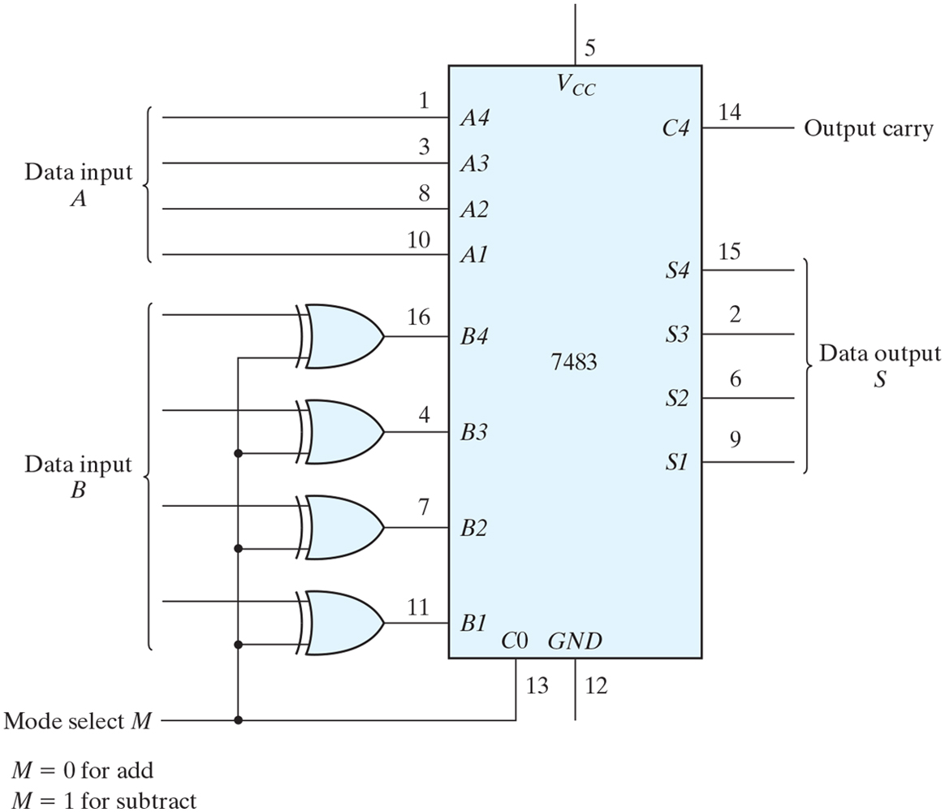
Figure 9.11 Four-bit adder–subtractor.

Slide 14
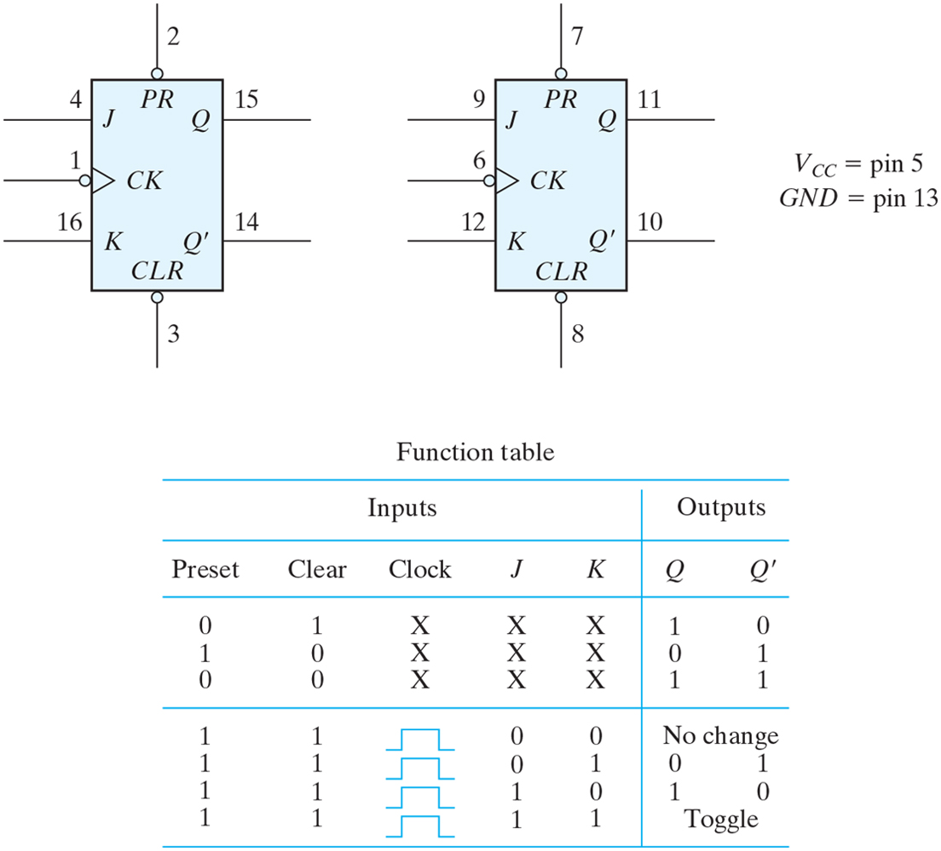
Figure 9.12 IC type 7476 dual JK master–slave flip-flops.

Slide 15
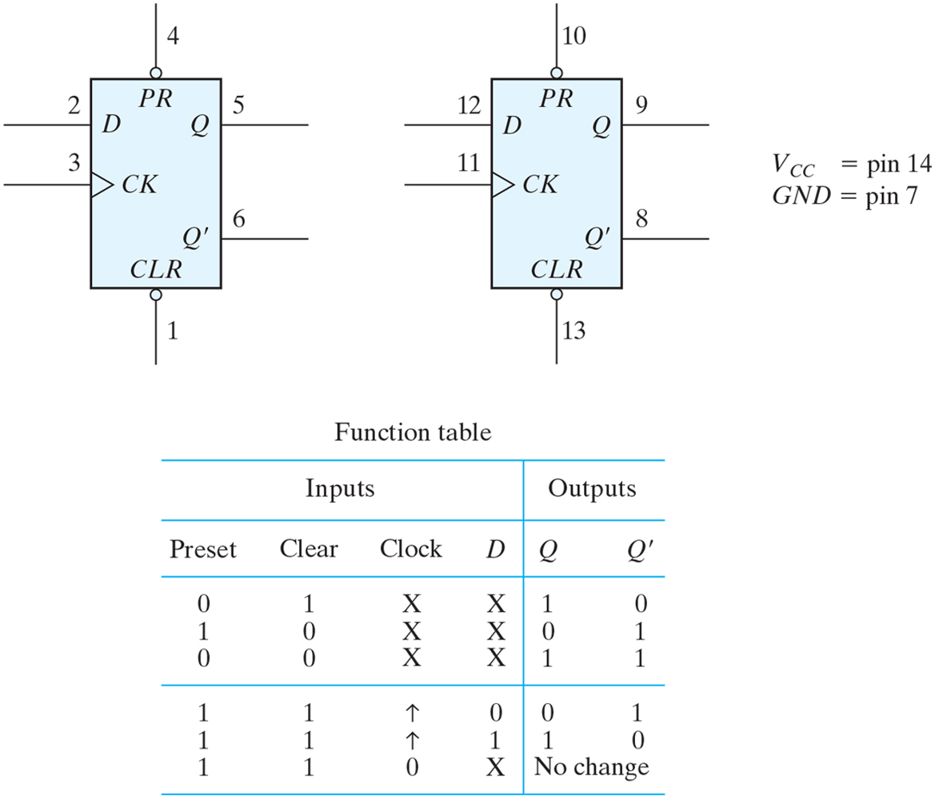
Figure 9.13 IC type 7474 dual D positive-edge-triggered flip-flops.

Slide 16
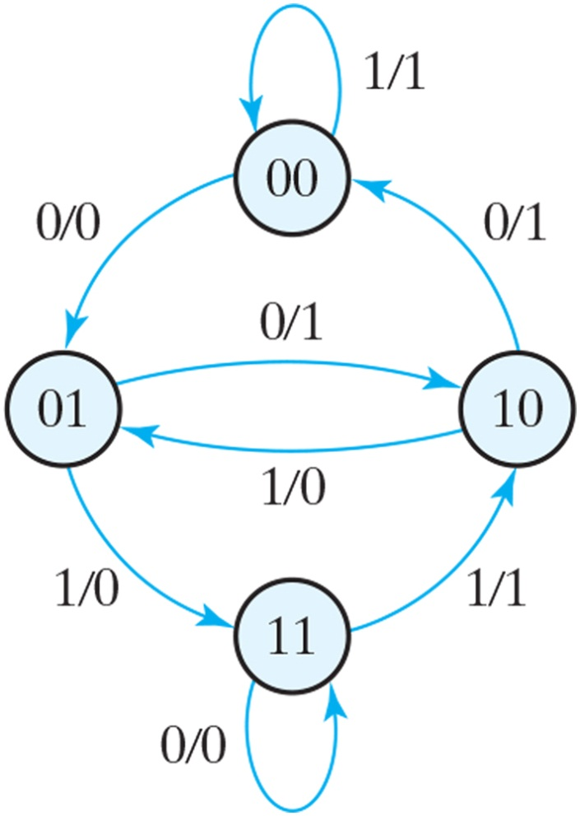
Figure 9.14 State diagram for Experiment 9.

Slide 17
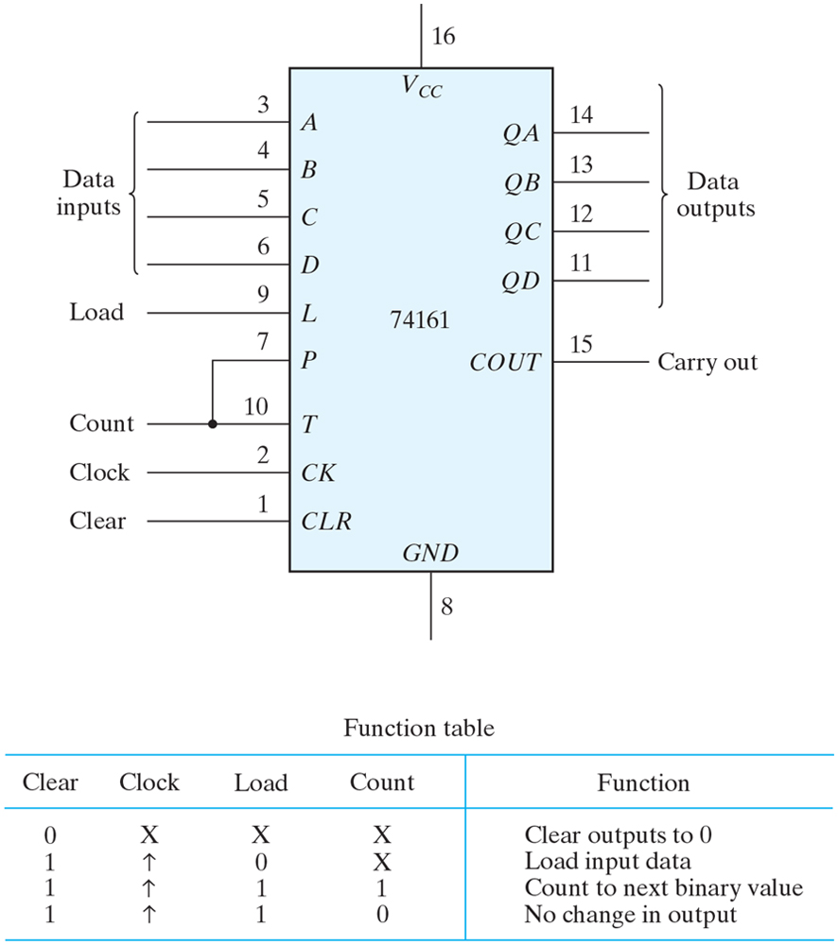
Figure 9.15 IC type 74161 binary counter with parallel load.

Slide 18
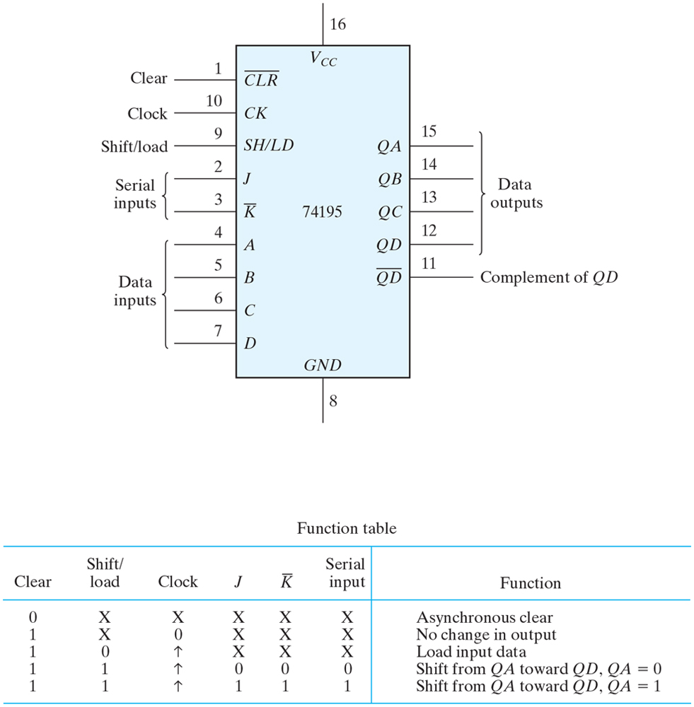
Figure 9.16 IC type 74195 shift register with parallel load.

Slide 19
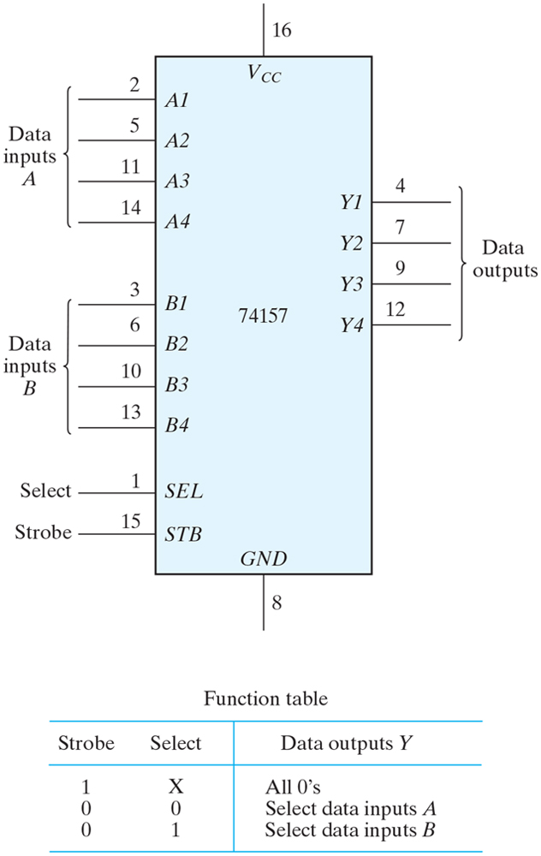
Figure 9.17 IC type 74157 quadruple 2 × 1 multiplexers.

Slide 20
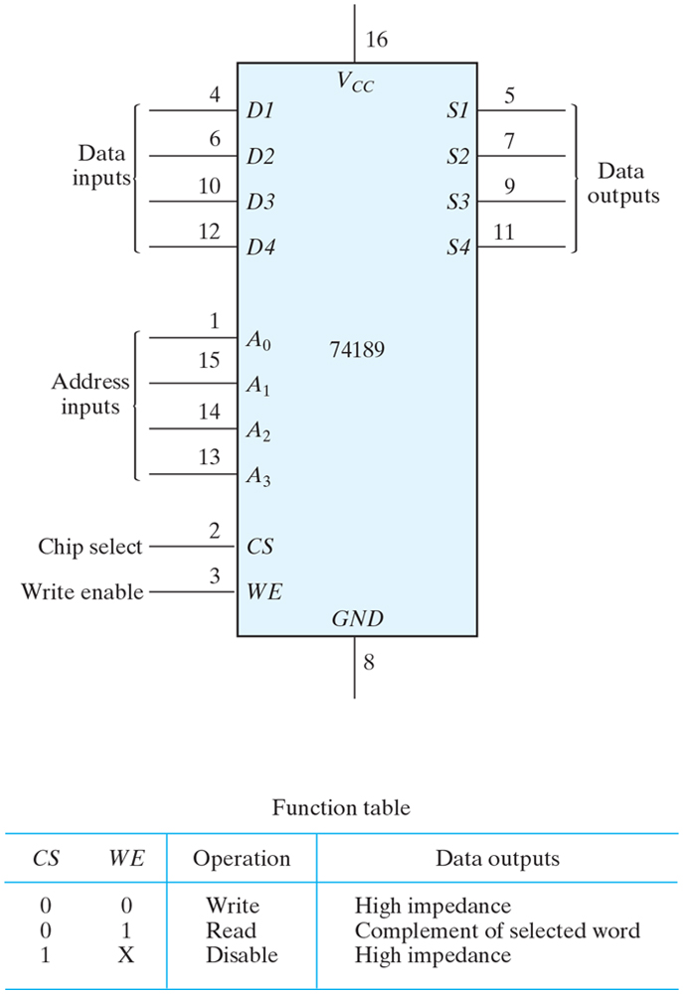
Figure 9.18 IC type 74189 16 × 4 RAM.

Slide 21
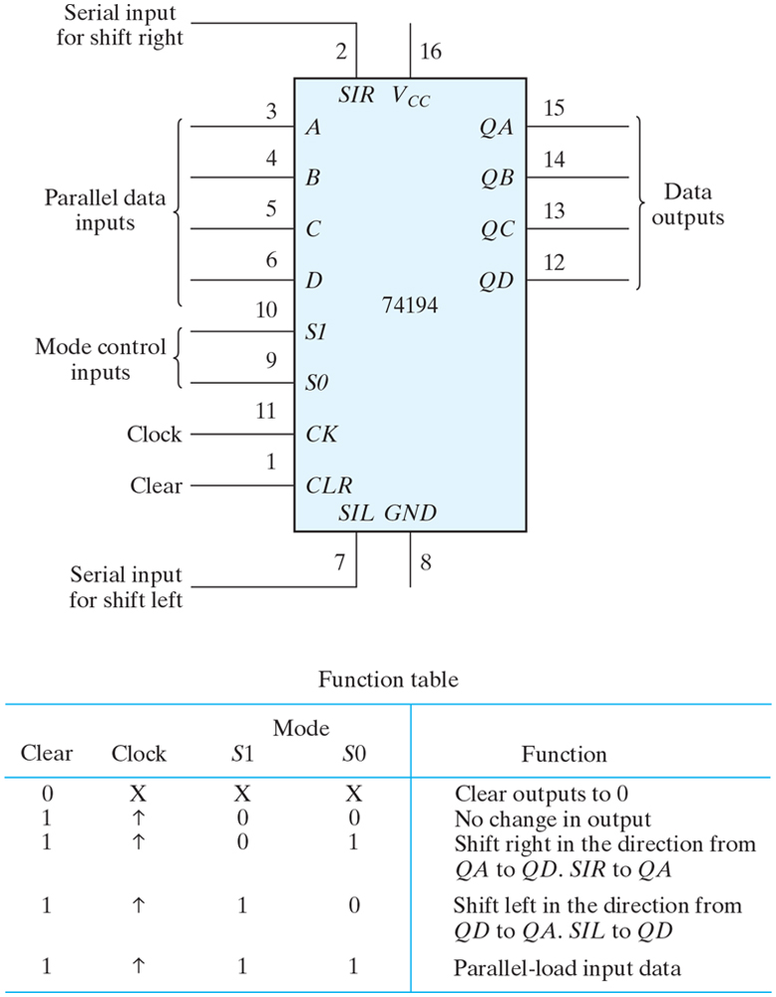
Figure 9.19 IC type 74194 bidirectional shift register with parallel load.

Slide 22
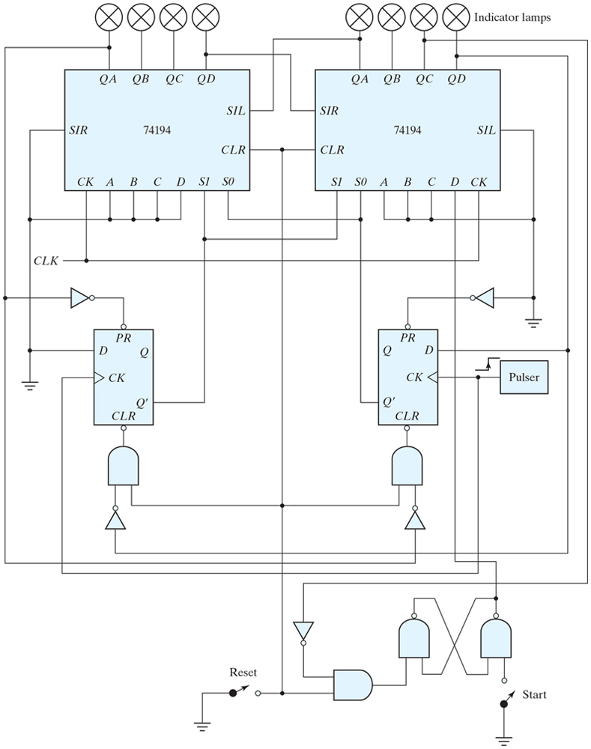
Figure 9.20 Lamp handball logic diagram.

Slide 23
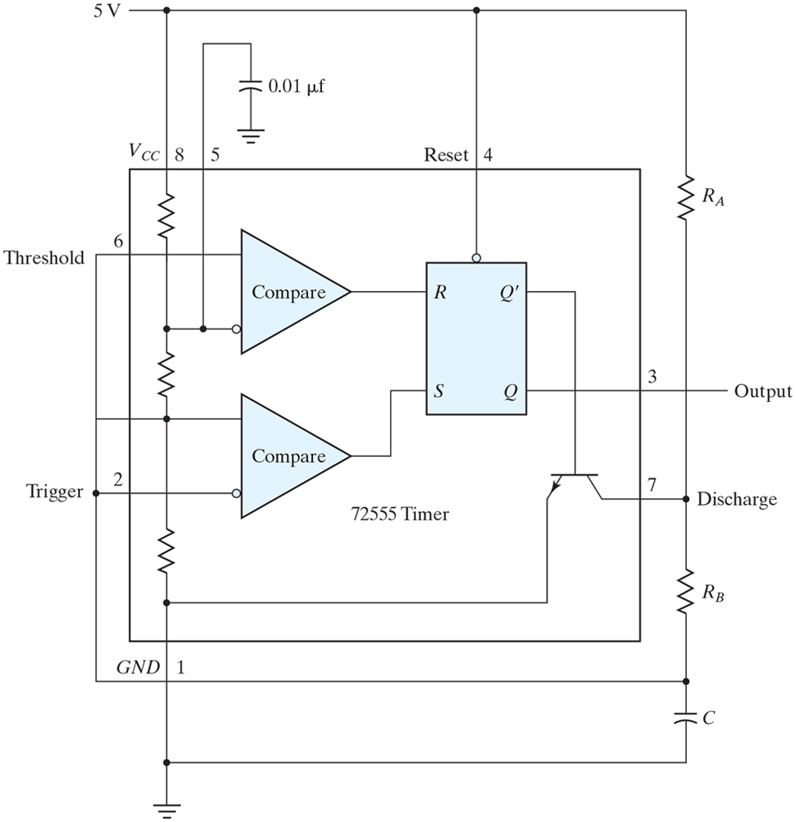
Figure 9.21 IC type 72555 timer connected as a clock-pulse generator.

Slide 24
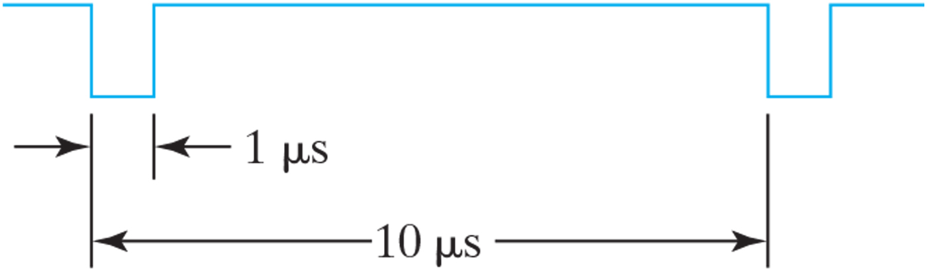
Figure 9.22 Output waveform for clock generator.

Slide 25
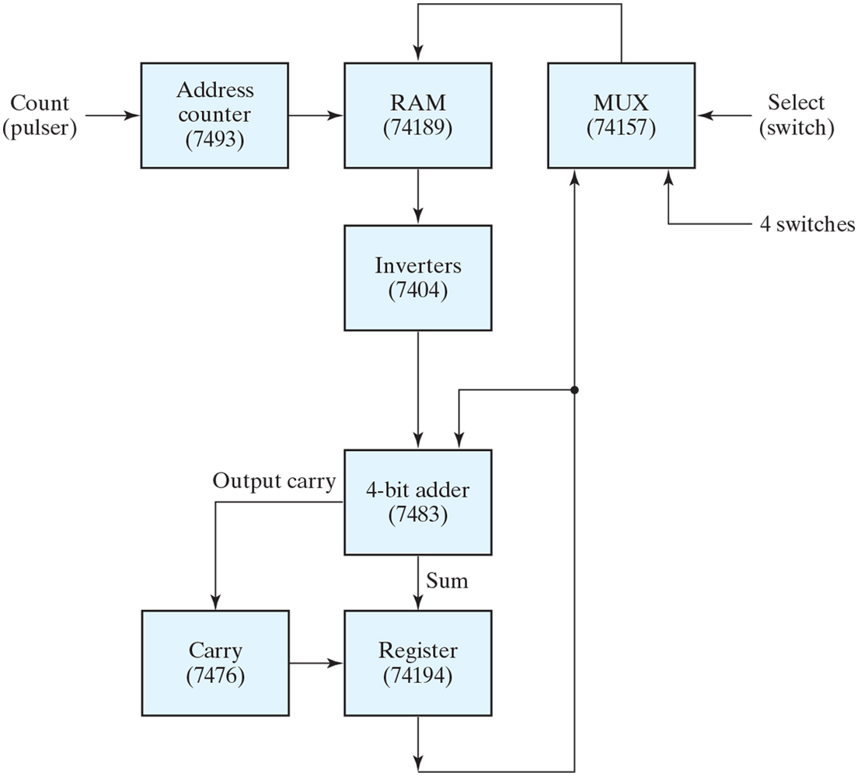
Figure 9.23 Block diagram of a parallel adder for Experiment 16.

Slide 26
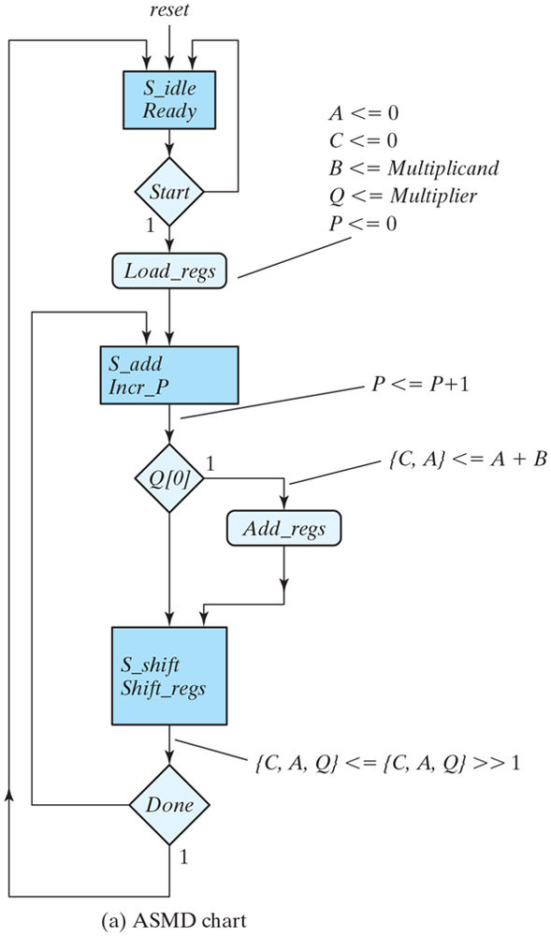
Figure 9.24 ASMD chart, block diagram of the datapath, control state diagram, and register operations of the binary multiplier circuit.

Slide 27
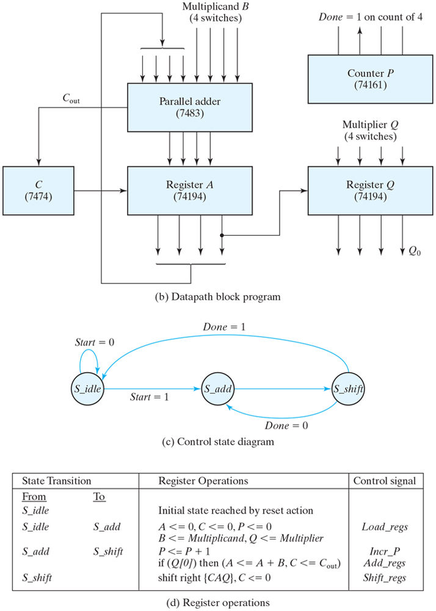
Figure 9.24 ASMD chart, block diagram of the datapath, control state diagram, and register operations of the binary multiplier circuit.

Slide 28
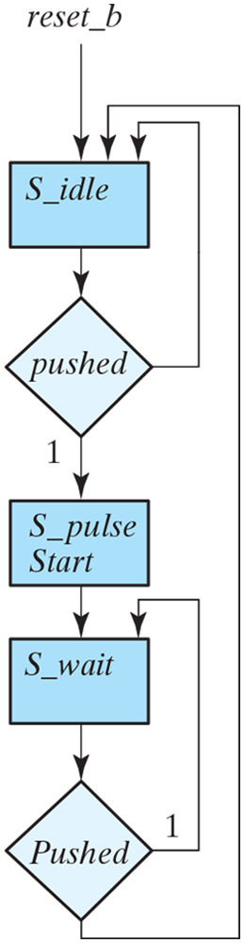
Figure 9.25 Pulser circuit for FPGA implementation of Experiment 1.

