Slide 1

Digital Design
With an Introduction to the Verilog HDL, VHDL, and SystemVerilog
6th Edition
Chapter 10
Standard Graphic Symbols

Slide 2
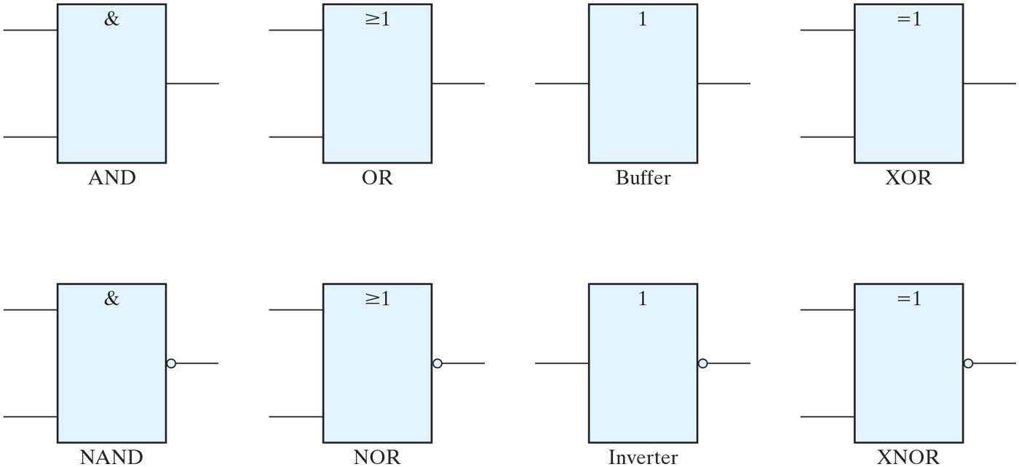
FIGURE 10.1
Rectangular-shape graphic symbols for gates.

Slide 3
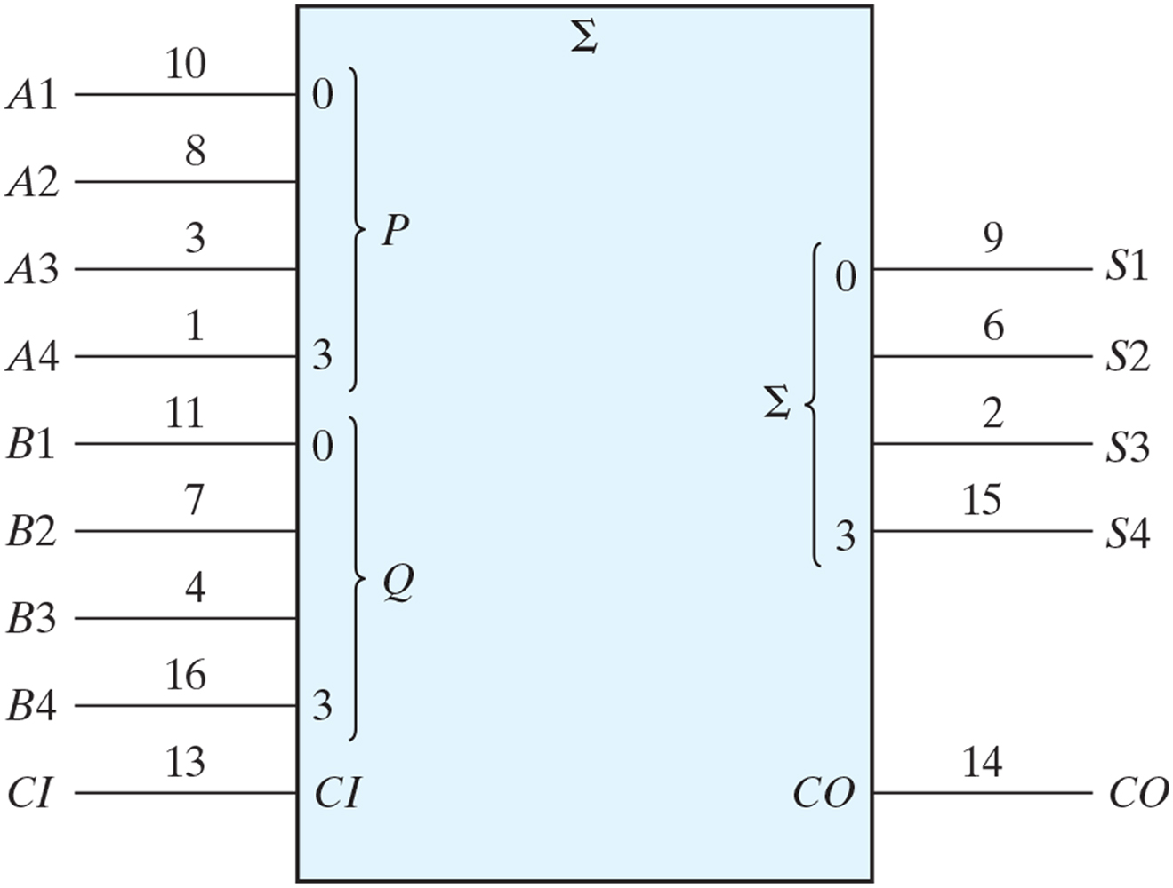
FIGURE 10.2
Standard graphic symbol for a four-bit parallel adder, IC type 7483.

Slide 4
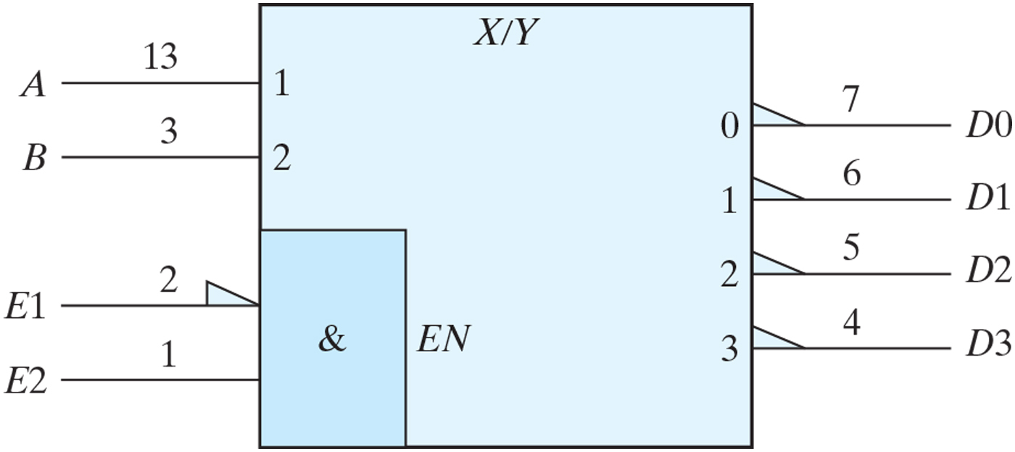
FIGURE 10.3
Standard graphic symbol for a 2-to-4-line decoder (one-half of IC type 74155).

Slide 5
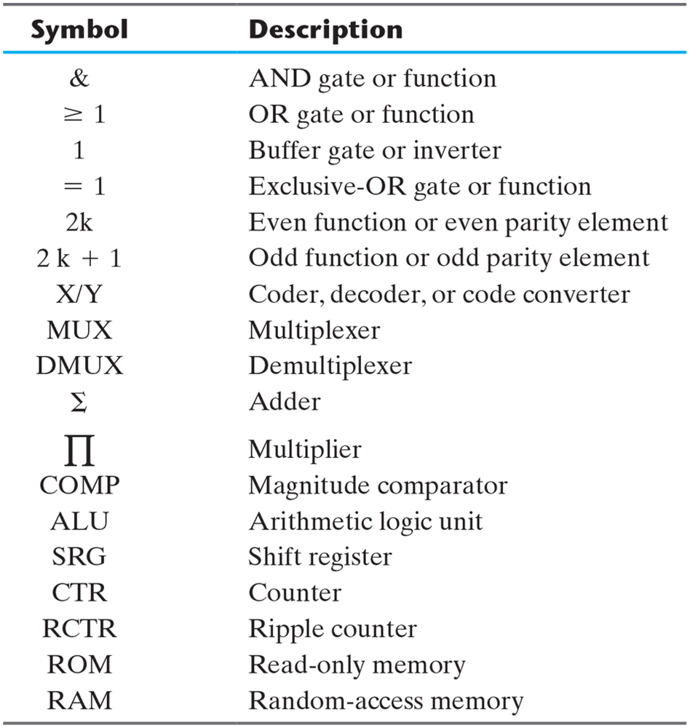
Table 10.1
General Qualifying Symbols.

Slide 6
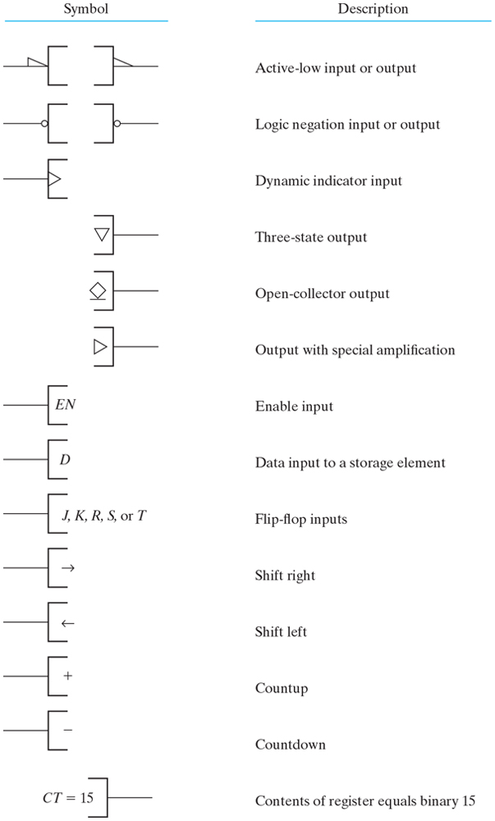
FIGURE 10.4
Qualifying symbols associated with inputs and outputs.

Slide 7
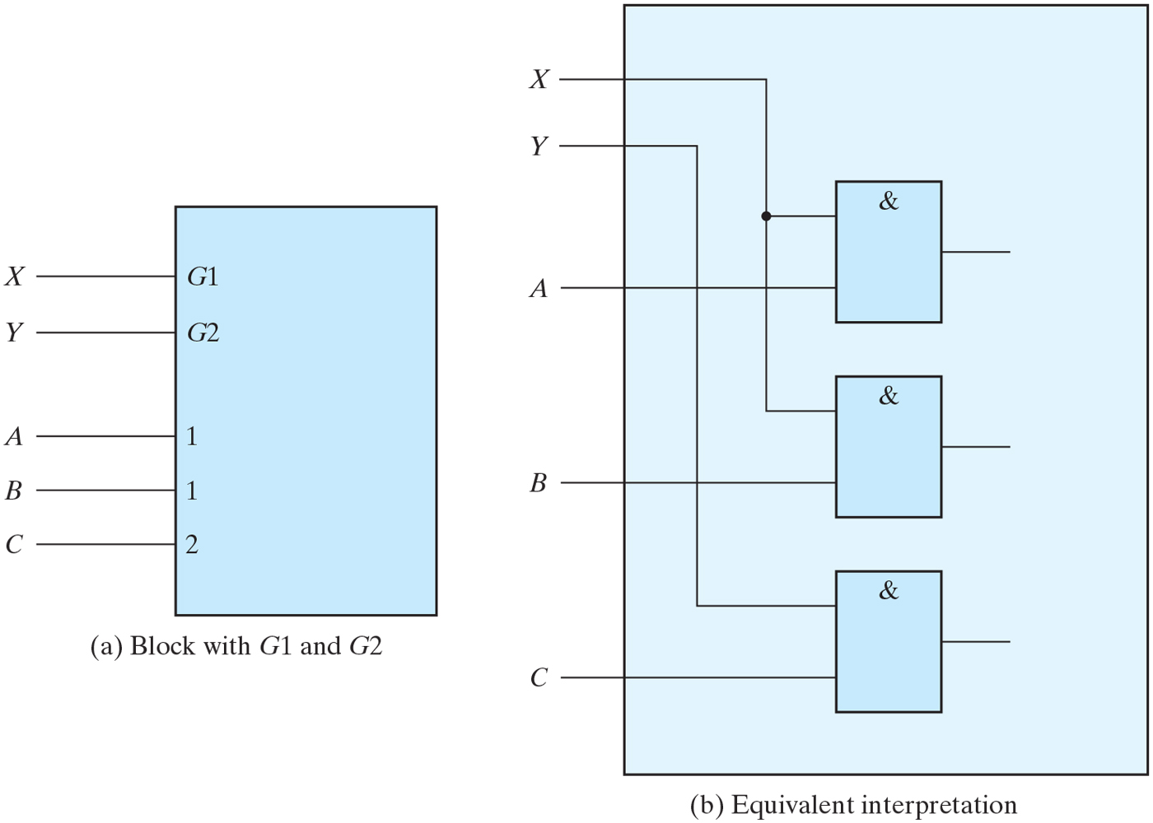
FIGURE 10.5
Example of G (AND) dependency.

Slide 8
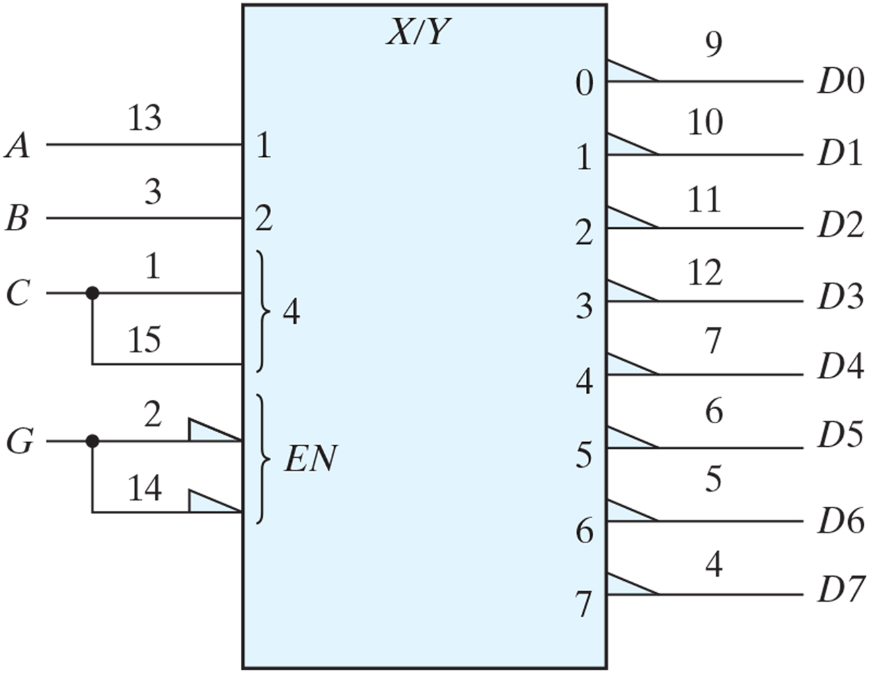
FIGURE 10.6
IC type 74155 connected as a 3 × 8 decoder.

Slide 9
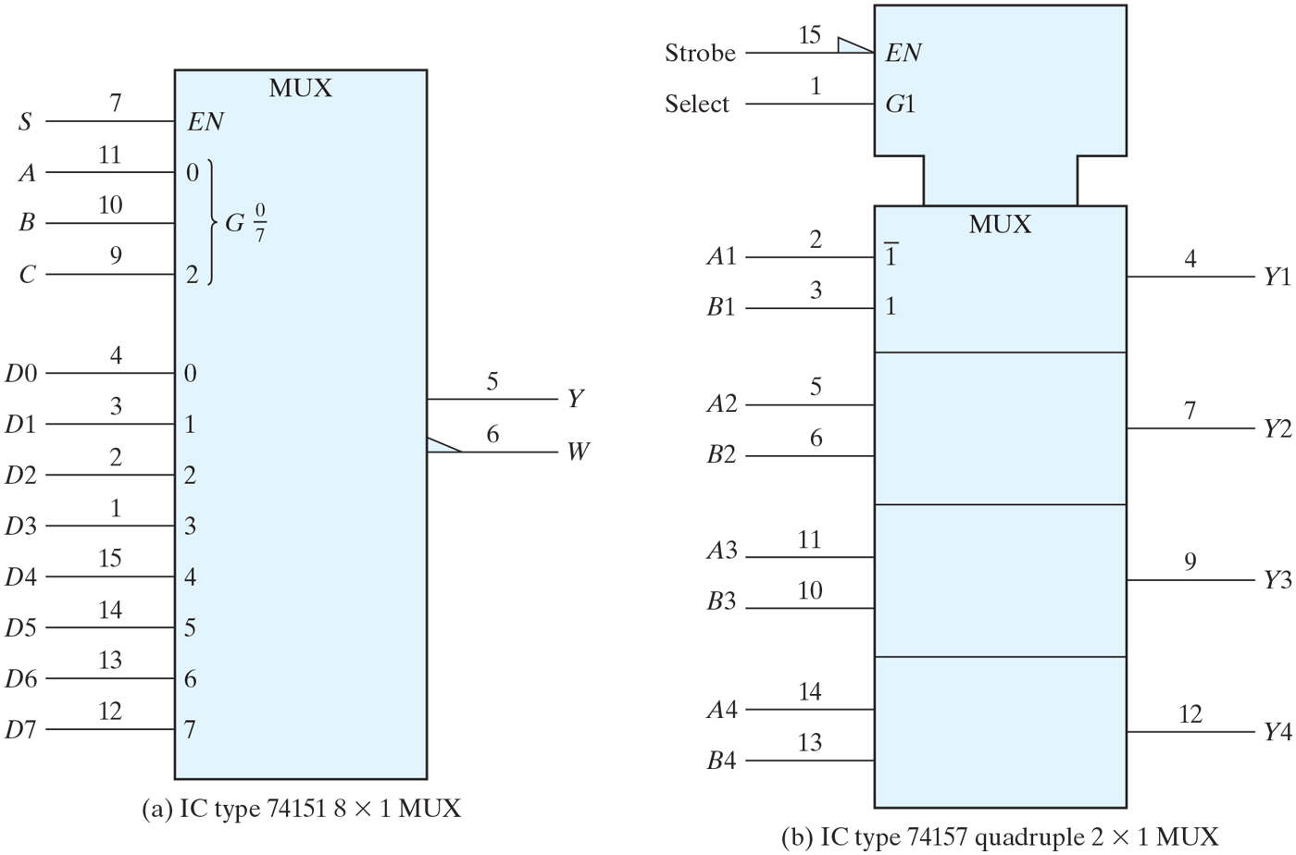
FIGURE 10.7
Graphic symbols for multiplexers.

Slide 10
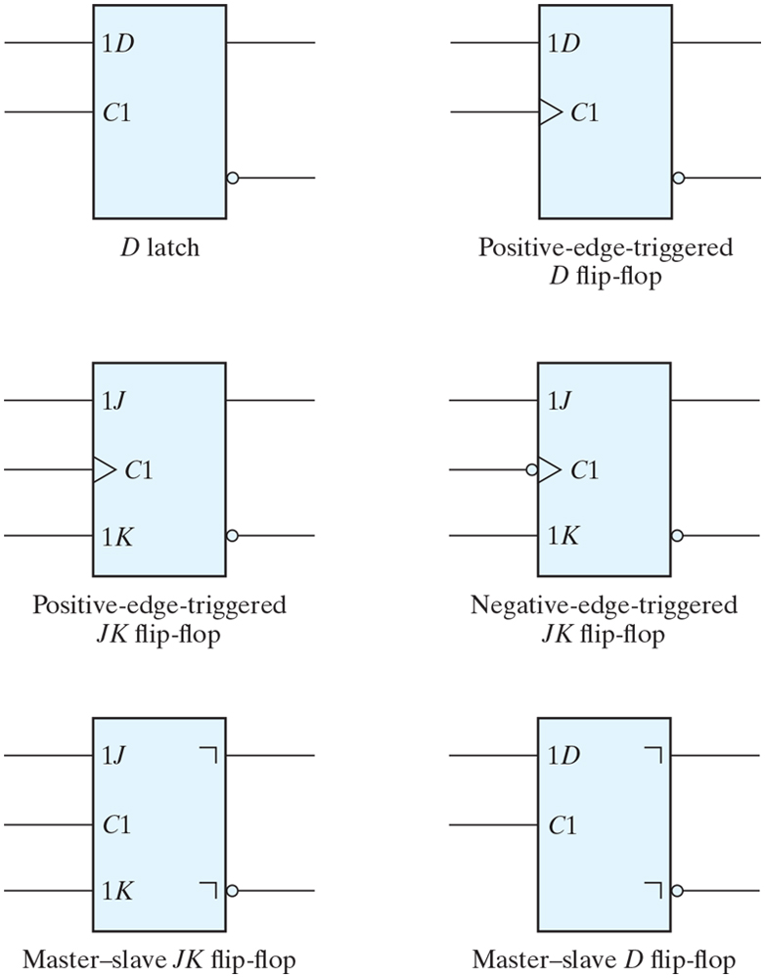
FIGURE 10.8
Standard graphic symbols for flip-flops.

Slide 11
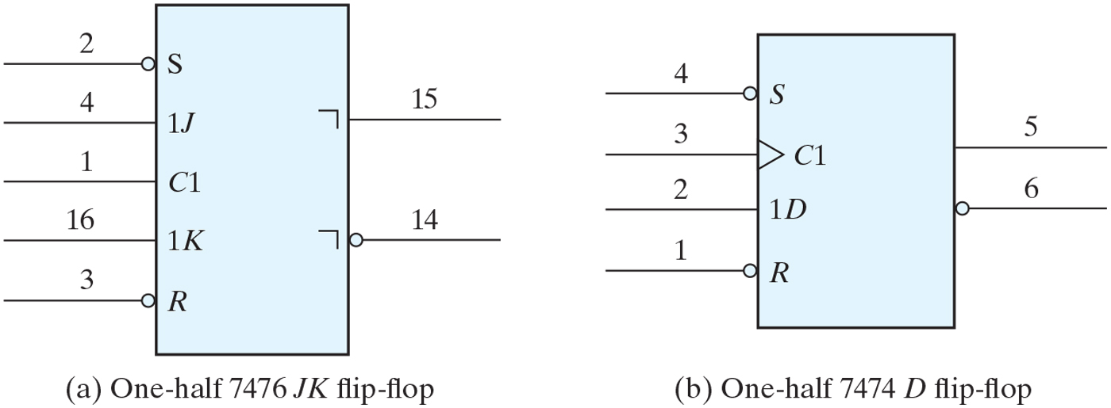
FIGURE 10.9
IC flip-flops with direct set and reset.

Slide 12
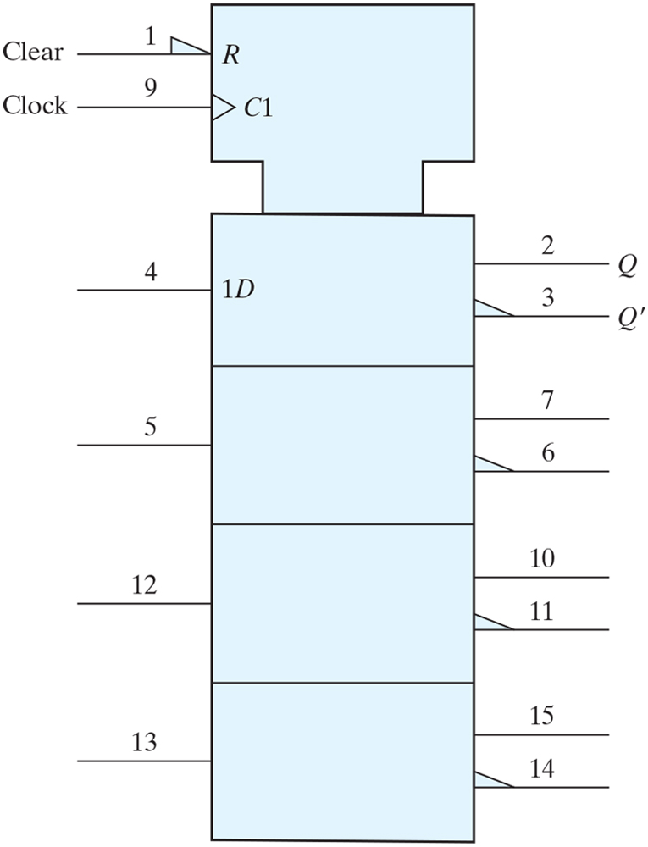
FIGURE 10.10
Graphic symbol for IC type 74175 quad flip-flop.

Slide 13
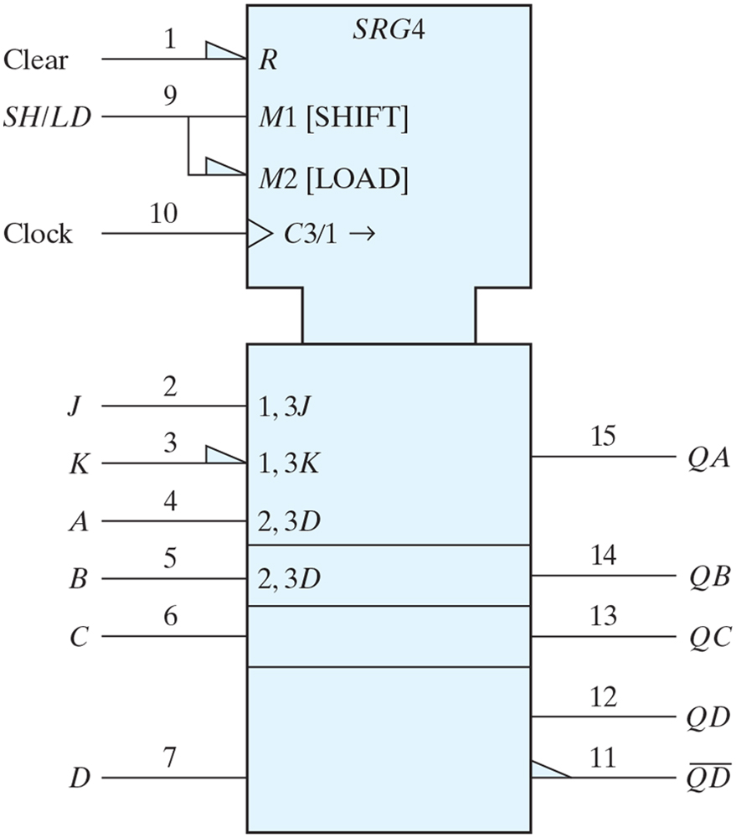
FIGURE 10.11
Graphic symbol for a shift register with parallel load, IC type 74195.

Slide 14
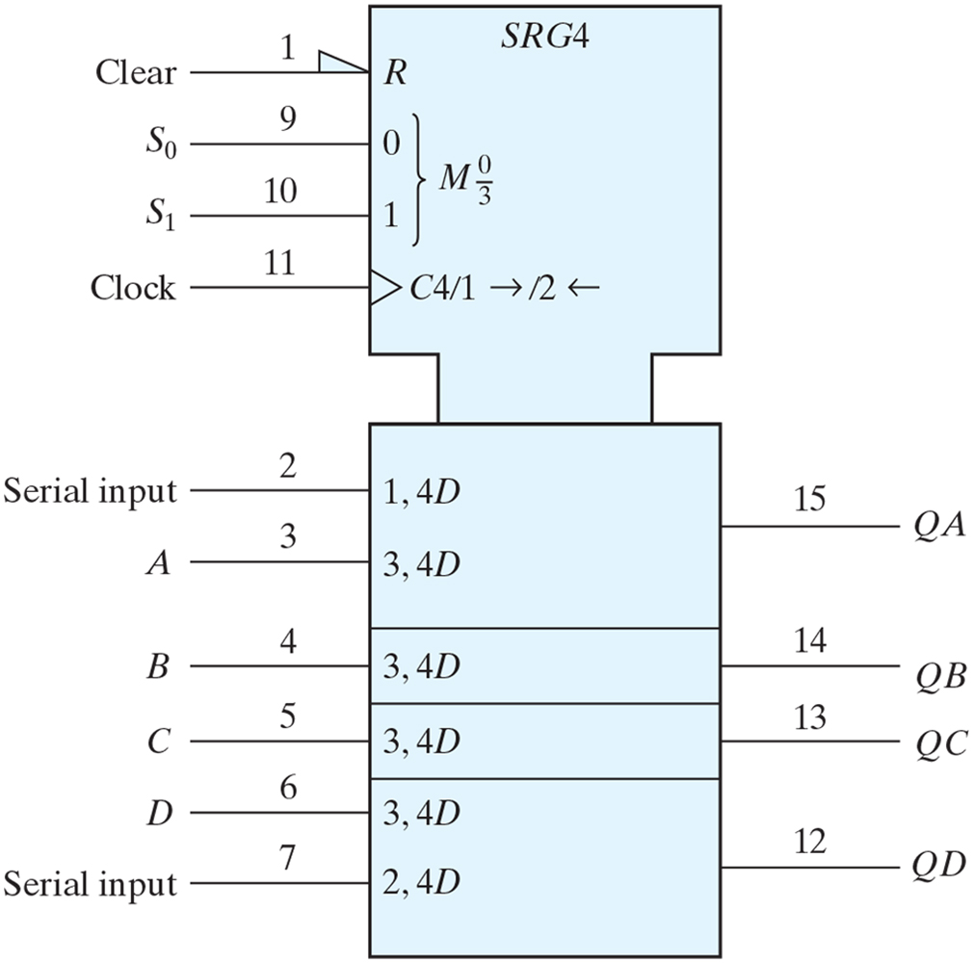
FIGURE 10.12
Graphic symbol for a bidirectional shift register with parallel load, IC type 74194.

Slide 15
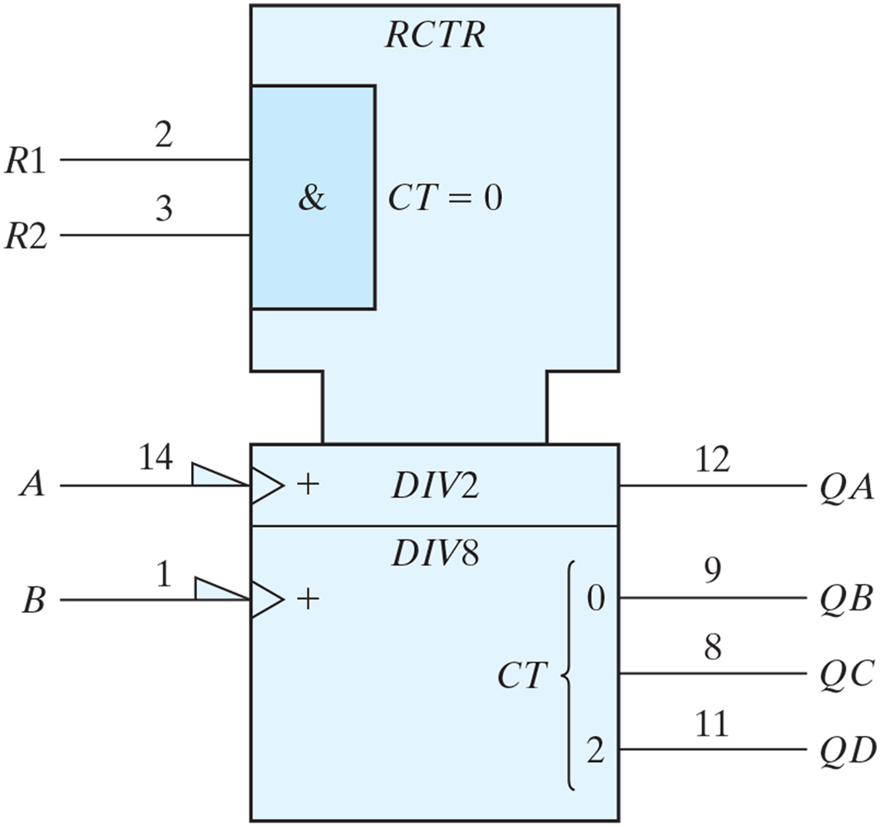
FIGURE 10.13
Graphic symbol for ripple counter, IC type 7493.

Slide 16
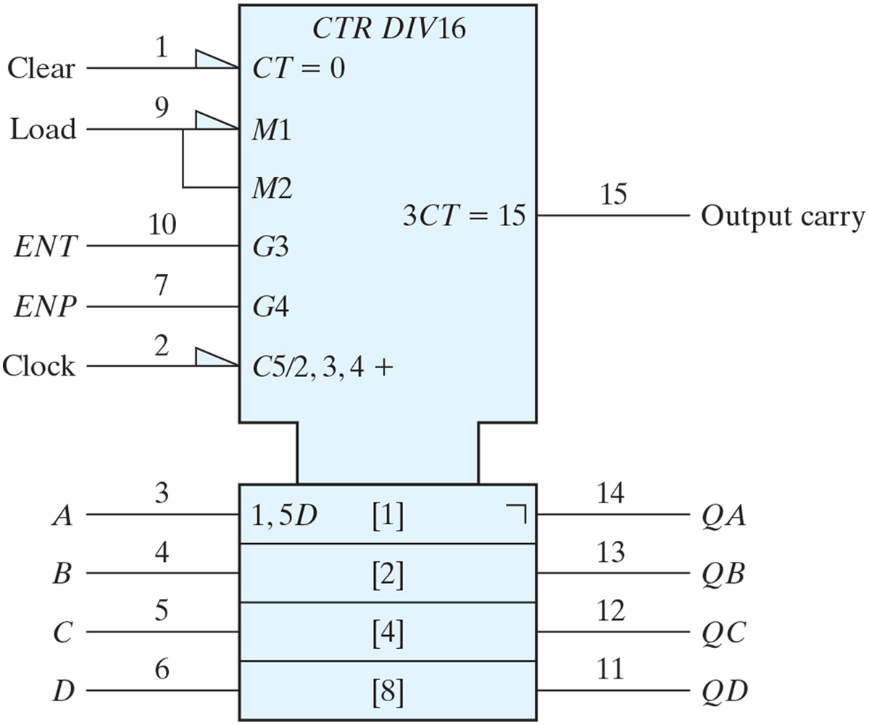
FIGURE 10.14
Graphic Symbol for 4-Bit Binary Counter with Parallel Load, IC Type 74161.

Slide 17
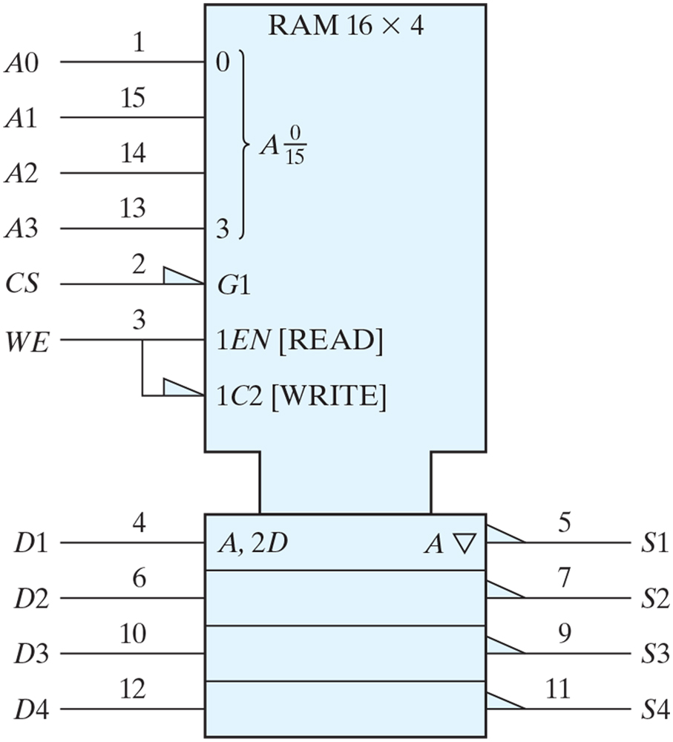
FIGURE 10.15
Graphic symbol for 16 × 4 RAM, IC type 74189.

