Slide 1

Engineering MECHANICS
BOJ ASSIGNMENT
Name of the Student 1 : Neeraj R Rugi
USN No of Student 1:PES2UG24CS311
Name of the Student 2 :
USN No of Student 2:
Department of Civil Engineering

Slide 2
Engineering MECHANICS
Banana Level Problem
Department of Civil Engineering

Slide 3
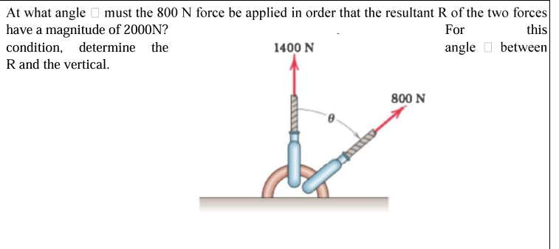
ENGINEERING MECHANICS
Banana Level Problem -1

Slide 4
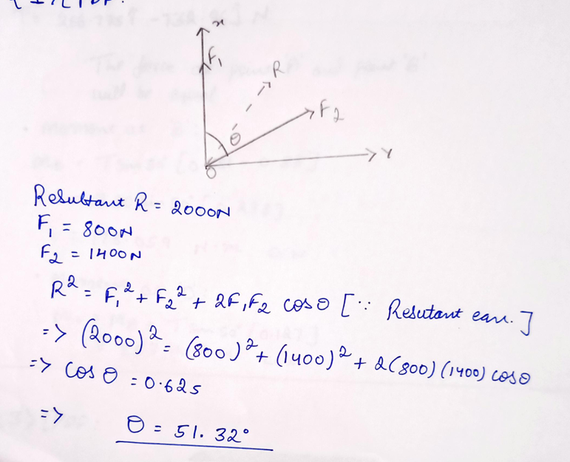
ENGINEERING MECHANICS
Banana Level Problem -1 Solution Manual

Slide 5
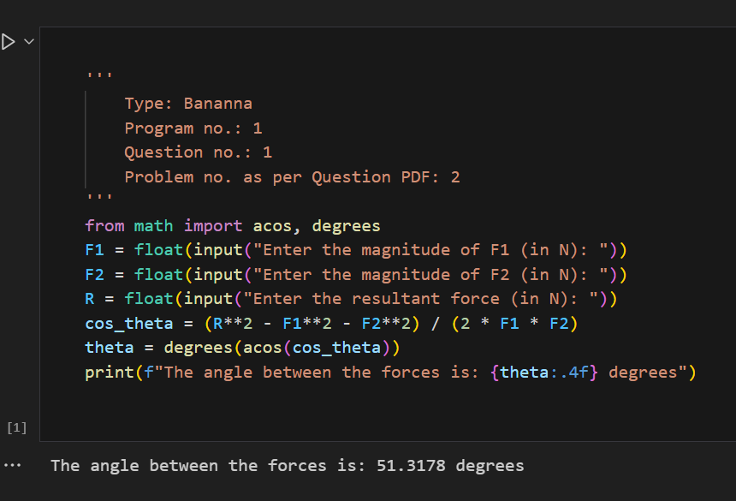
ENGINEERING MECHANICS
Banana Level Problem -1 Solution Script

Slide 6
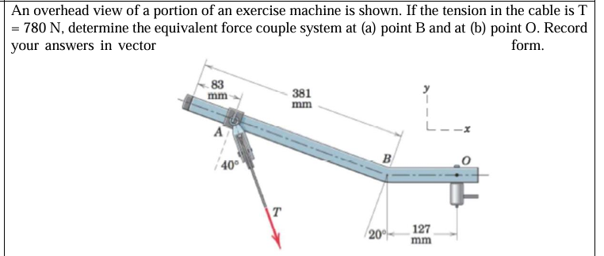
ENGINEERING MECHANICS
Banana Level Problem -2

Slide 7
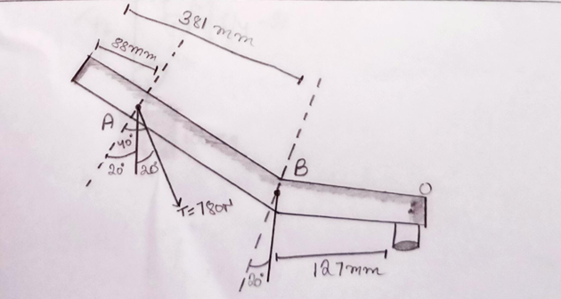
ENGINEERING MECHANICS
Banana Level Problem -2 Solution Manual

Slide 8
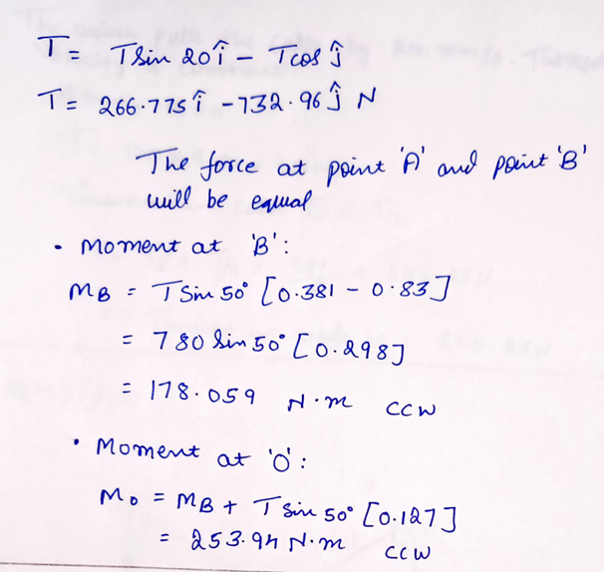
ENGINEERING MECHANICS
Banana Level Problem -2 Solution Manual

Slide 9
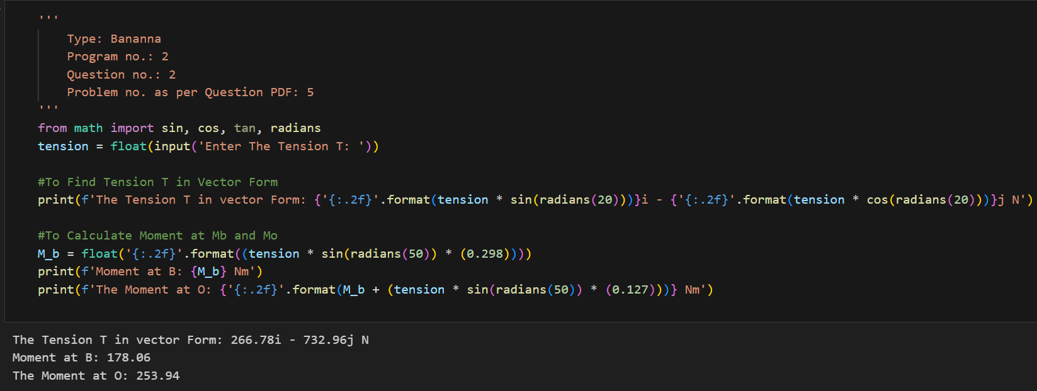
ENGINEERING MECHANICS
Banana Level Problem -2 Solution Script

Slide 10
Engineering MECHANICS
Orange Level Problem
Department of Civil Engineering

Slide 11
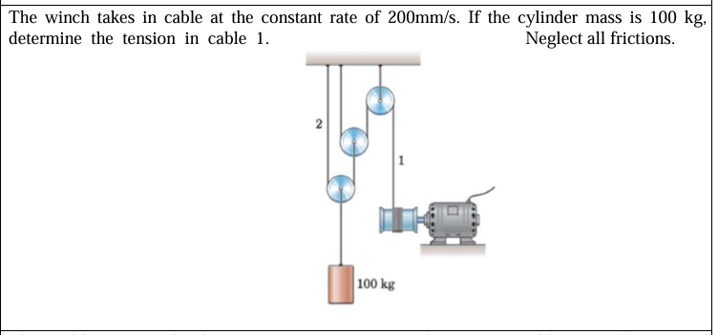
ENGINEERING MECHANICS
Orange Level Problem -1

Slide 12
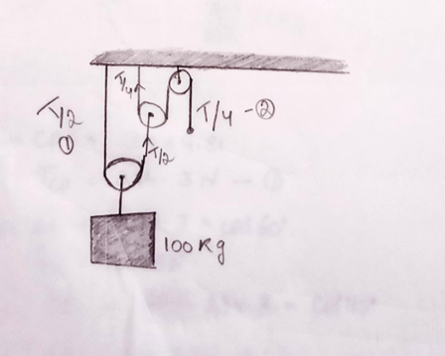
ENGINEERING MECHANICS
Orange Level Problem -1 Solution Manual

Slide 13
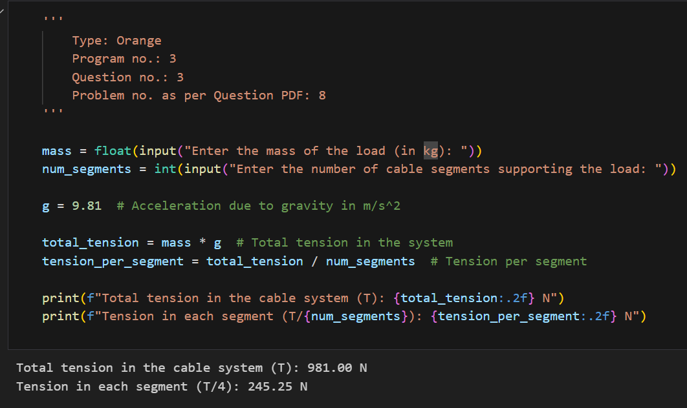
ENGINEERING MECHANICS
Orange Level Problem -1 Solution Script

Slide 14
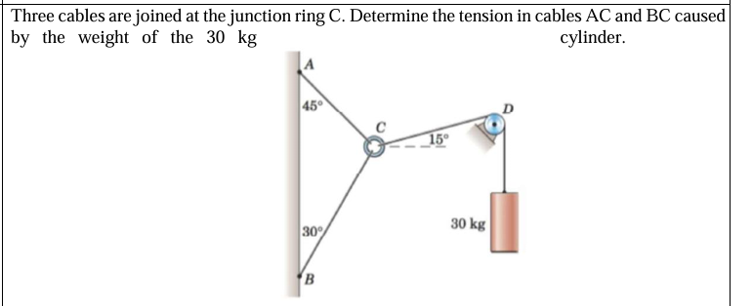
ENGINEERING MECHANICS
Orange Level Problem -2

Slide 15
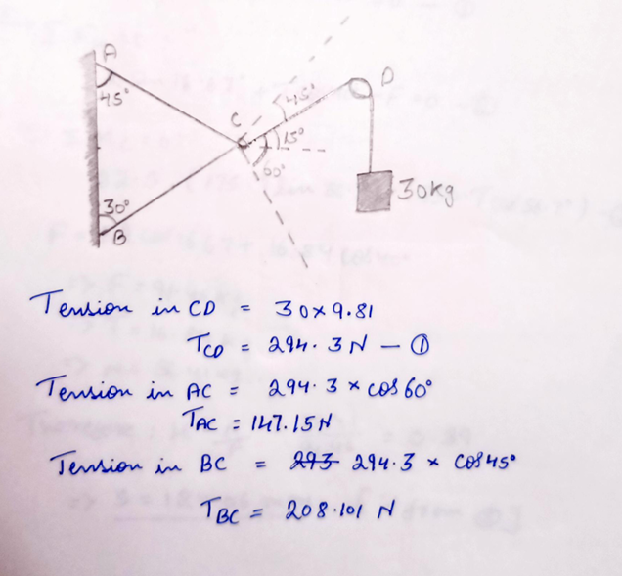
ENGINEERING MECHANICS
Orange Level Problem -2 Solution Manual

Slide 16
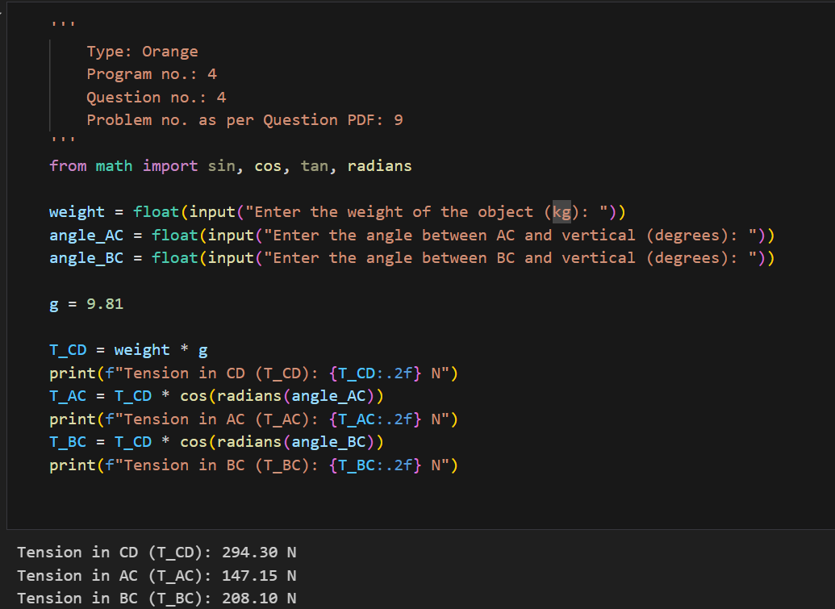
ENGINEERING MECHANICS
Orange Level Problem -2 Solution Script

Slide 17
Engineering MECHANICS
Jackfruit Level Problem
Department of Civil Engineering

Slide 18
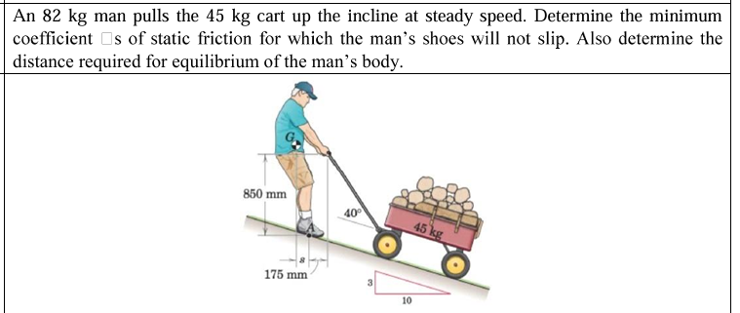
ENGINEERING MECHANICS
Jackfruit Level Problem -1

Slide 19
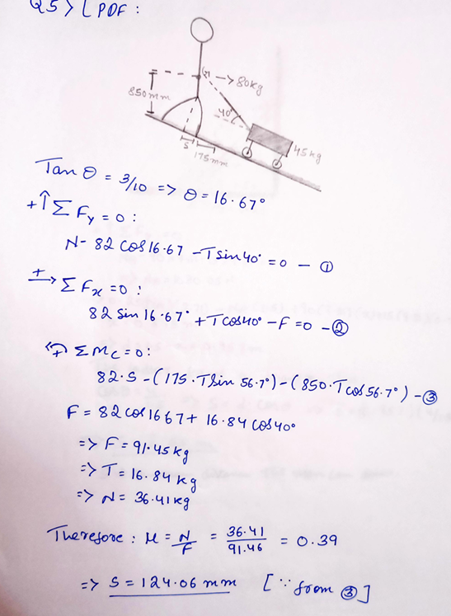
ENGINEERING MECHANICS
Jackfruit Level Problem -1 Solution Manual

Slide 20
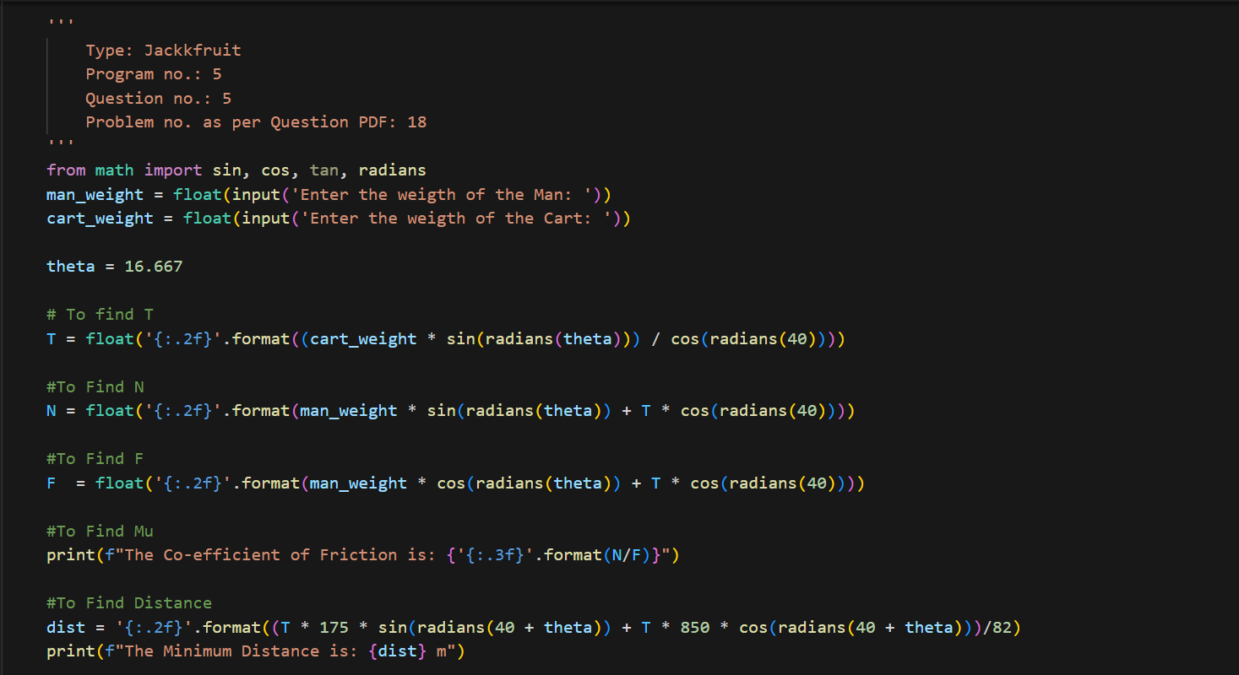
ENGINEERING MECHANICS
Jackfruit Level Problem -1 Solution Script

Slide 21
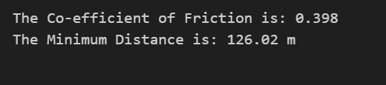
ENGINEERING MECHANICS
Jackfruit Level Problem -1 Solution Script

Slide 22
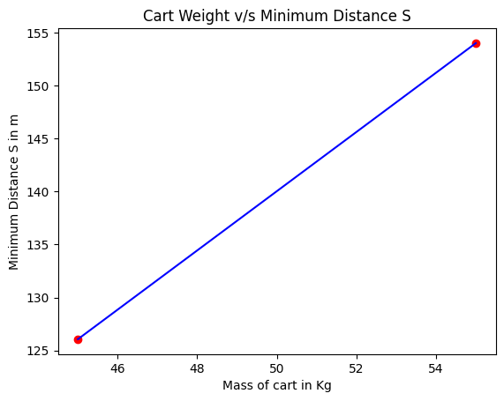
ENGINEERING MECHANICS
Jackfruit Level Problem -1 Solution Script –ML Integration

Slide 23
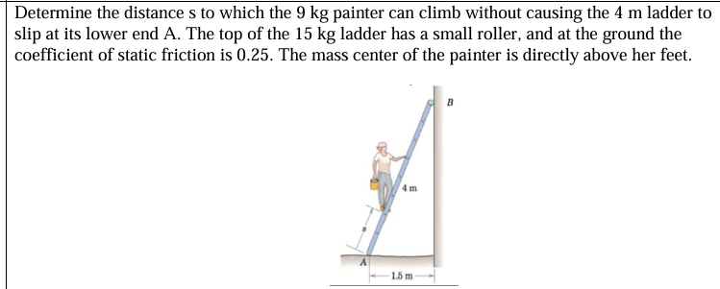
ENGINEERING MECHANICS
Jackfruit Level Problem -2

Slide 24
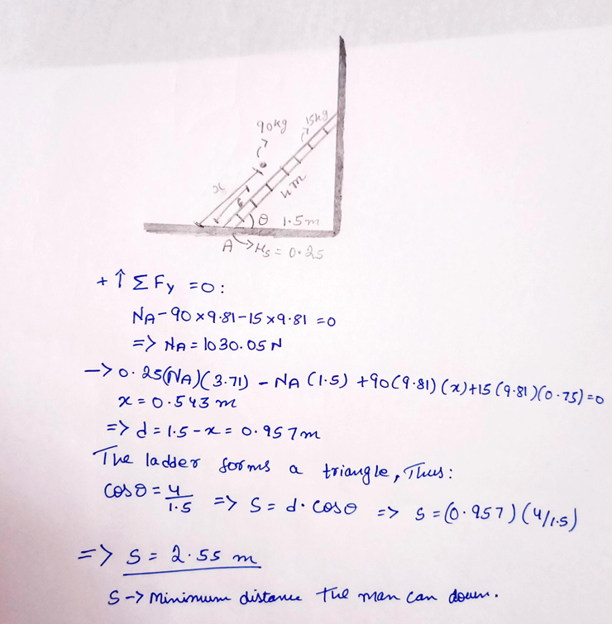
ENGINEERING MECHANICS
Jackfruit Level Problem -2

Slide 25
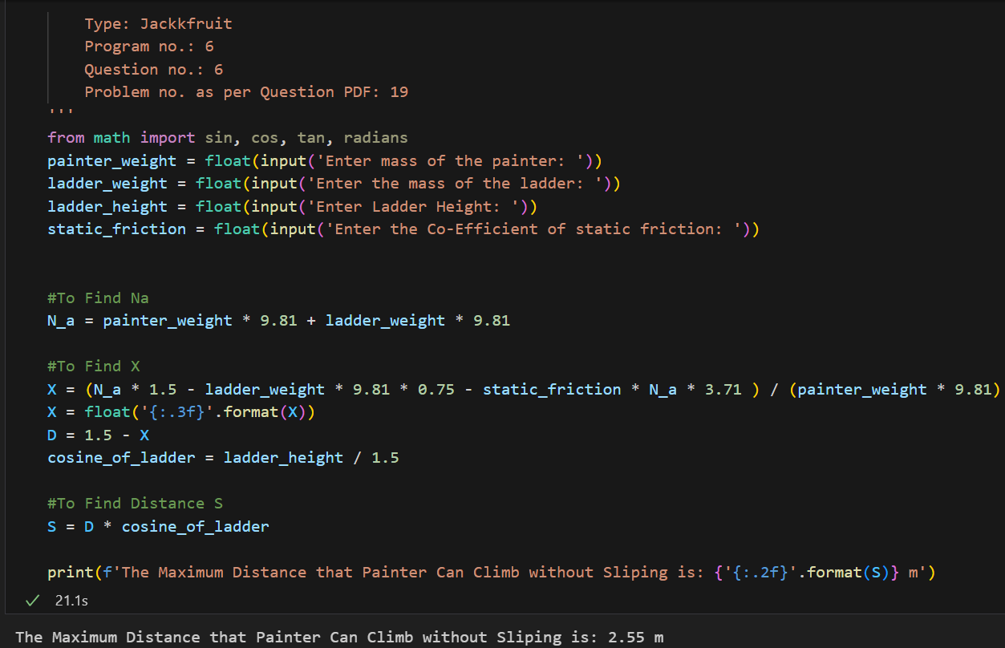
ENGINEERING MECHANICS
Jackfruit Level Problem -2

Slide 26
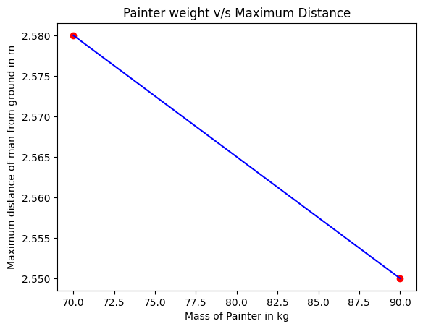
ENGINEERING MECHANICS
Jackfruit Level Problem -2 Solution Script –ML Integration

Slide 27
THANK YOU
Neeraj R Rugi and 2
neeraj.rugi@gmail.com
and 2

