Slide 1

ENGINEERING MATHEMATICS - I
Dr. Swetha D S
Department of Science and Humanities

Slide 2

ENGINEERING MATHEMATICS - I
Unit 4: Partial Differential Equations
Session : 10
Sub Topic : Application Problems on Partial Differential Equations
Department of Science and Humanities

Slide 3
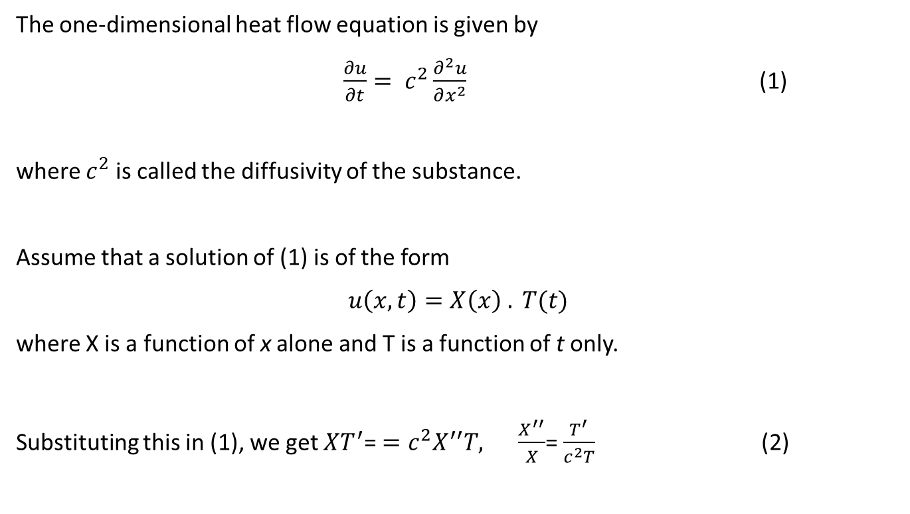
ENGINEERING MATHEMATICS - I
Solution of the Heat equation
The one-dimensional heat flow equation is given by
$\frac{∂u}{∂t}= c^{2}\frac{∂^{2}u}{∂x^{2}}$ (1)
where $c^{2}$ is called the diffusivity of the substance.
Assume that a solution of (1) is of the form
$$u\left(x, t\right)=X\left(x\right) . T(t)$$
where X is a function of x alone and T is a function of t only.
Substituting this in (1), we get $XT^{′}$= $=c^{2}X^{′′}T,$ $\frac{X^{′′}}{X}$= $\frac{T^{′}}{c^{2}T}$ (2)

Slide 4
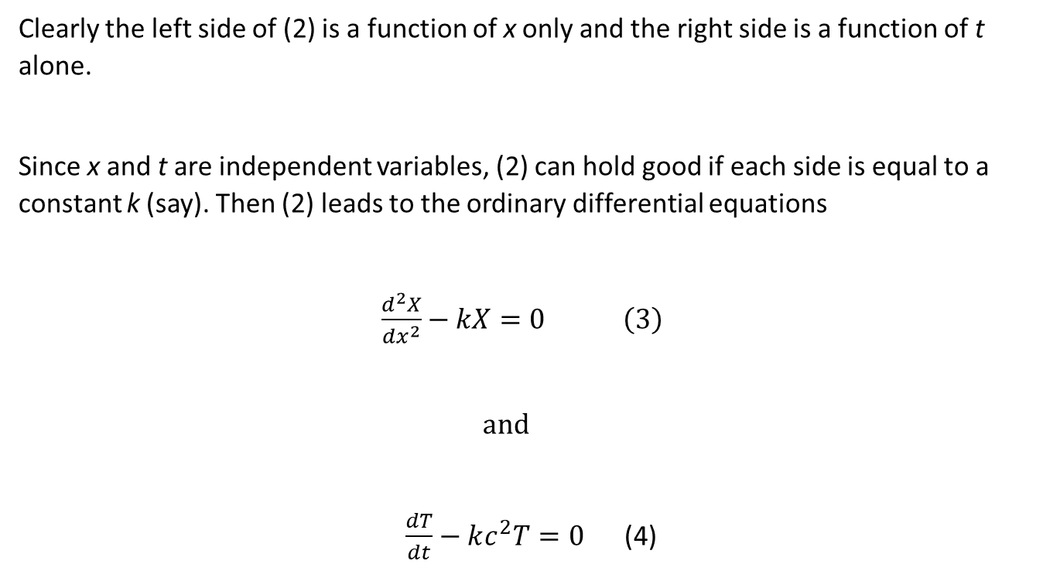
ENGINEERING MATHEMATICS - I
Solution of the Heat equation
Clearly the left side of (2) is a function of x only and the right side is a function of t alone.
Since x and t are independent variables, (2) can hold good if each side is equal to a constant k (say). Then (2) leads to the ordinary differential equations
$\frac{d^{2}X}{{dx}^{2}}−kX=0 \left(3\right)$
$$and$$
$\frac{dT}{dt}−kc^{2}T=0$ (4)

Slide 5

ENGINEERING MATHEMATICS - I
Solution of the heat equation
Solving (3) and (4), we get
When k is positive and = p², say :
$$X=c_{1}e^{px}+ c_{2}e^{−px}, T= c_{3}e^{c^{2}p^{2}t} ;$$
(ii) When k is negative and = - p², say :
$$X=c_{4}\cos{px}+ c_{5}\sin{px}, T= c_{6}e^{−c^{2}p^{2}t} ;$$
(iii) When k is zero :
$$X=c_{7}x+ c_{8}T= c_{9}.$$

Slide 6
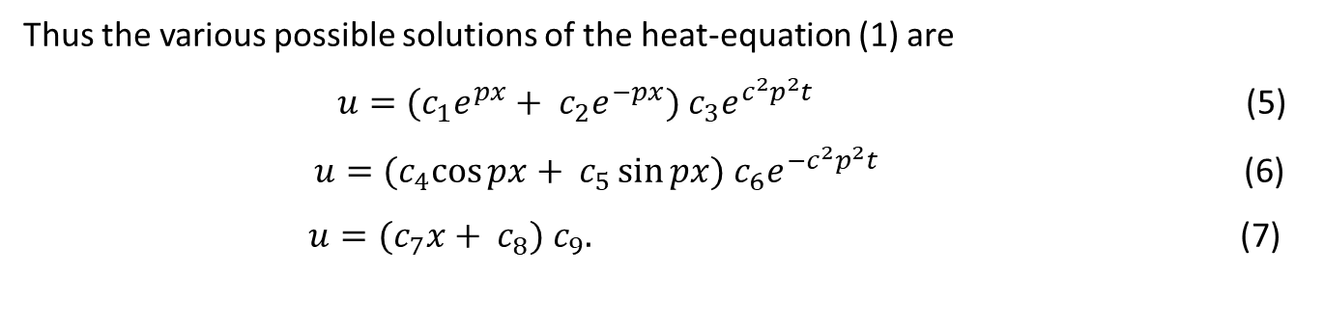
ENGINEERING MATHEMATICS - I
Solution of the heat equation
Thus the various possible solutions of the heat-equation (1) are
$u=(c_{1}e^{px}+ c_{2}e^{−px}) c_{3}e^{c^{2}p^{2}t}$ (5)
$u={(c}_{4}\cos{px}+ c_{5}\sin{px}) c_{6}e^{{−c}^{2}p^{2}t}$ (6)
$u={(c}_{7}x+ c_{8}) c_{9}.$ (7)

Slide 7
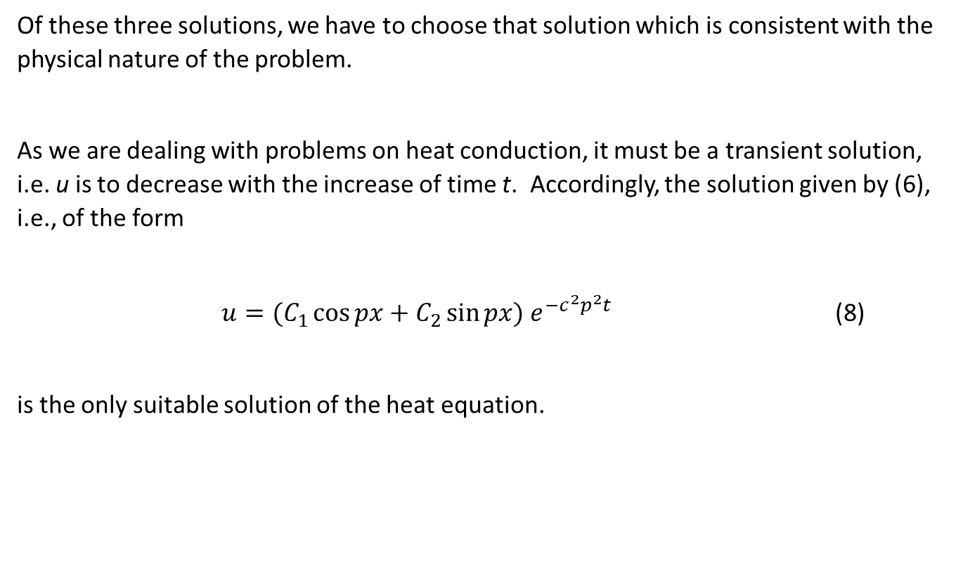
ENGINEERING MATHEMATICS - I
Solution of the heat equation
Of these three solutions, we have to choose that solution which is consistent with the physical nature of the problem.
As we are dealing with problems on heat conduction, it must be a transient solution, i.e. u is to decrease with the increase of time t. Accordingly, the solution given by (6), i.e., of the form
$u=(C_{1}\cos{px}+C_{2}\sin{px}) e^{{−c}^{2}p^{2}t}$ (8)
is the only suitable solution of the heat equation.

Slide 8
THANK YOU
Dr. SWETHA D S
Department of Science and Humanities

