Slide 1

ENGINEERING MATHEMATICS - I
Dr. Swetha D S
Department of Science and Humanities

Slide 2

ENGINEERING MATHEMATICS - I
Unit 4: Partial Differential Equations
Session : 11
Sub Topic : Application Problems on Partial Differential Equations Contd.,
Department of Science and Humanities

Slide 3

ENGINEERING MATHEMATICS - I
Solution of Laplace’s Equation
The Laplace’s Equation is
$\frac{∂^{2}u}{{∂x}^{2}}+\frac{∂^{2}u}{{∂y}^{2}}=0$ (1)
Let $u=X\left(x\right)Y(y)$ be a solution of (1).
Substituting it in (1), we get $\frac{d^{2}X}{{dx}^{2}}Y+X\frac{d^{2}Y}{{dy}^{2}}=0$
or separating the variables, $\frac{1}{X}\frac{d^{2}X}{{dx}^{2}}=−\frac{1}{Y}\frac{d^{2}Y}{{dy}^{2}}$ (2)

Slide 4
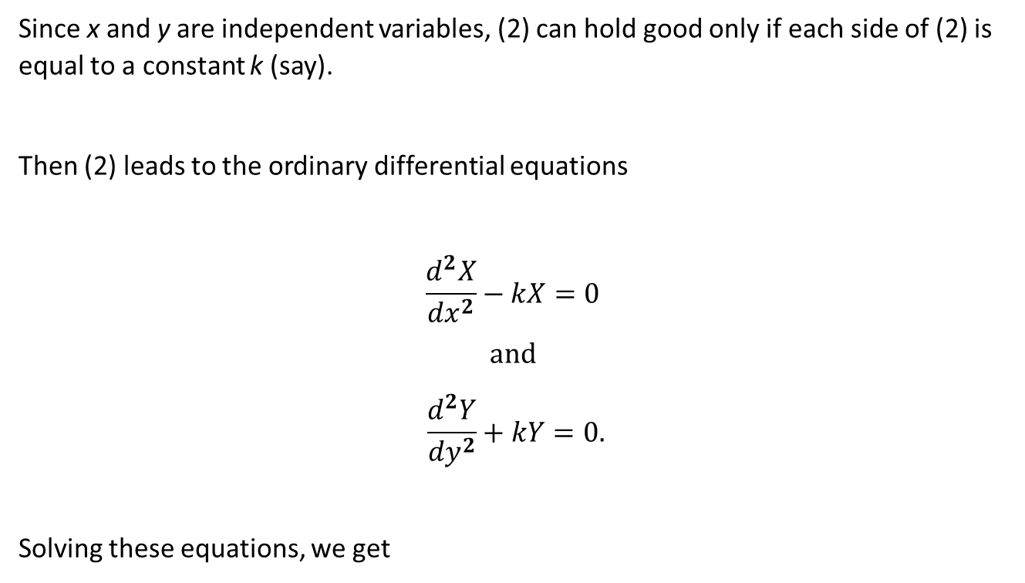
ENGINEERING MATHEMATICS - I
Solution of LAPLACE'S EQUATION
Since x and y are independent variables, (2) can hold good only if each side of (2) is equal to a constant k (say).
Then (2) leads to the ordinary differential equations
$$\frac{d^{2}X}{{dx}^{2}}−kX=0$$
$$and$$
$$\frac{d^{2}Y}{{dy}^{2}}+kY=0.$$
Solving these equations, we get

Slide 5
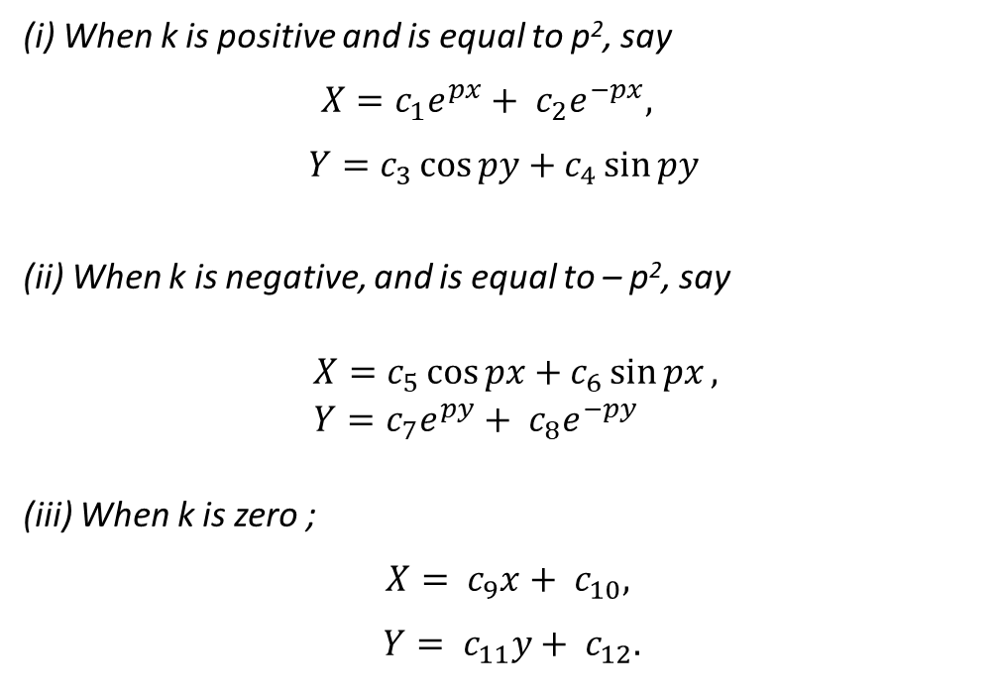
ENGINEERING MATHEMATICS - I
Solution of LAPLACE'S EQUATION
(i) When k is positive and is equal to p², say
$X=c_{1}e^{px}+ c_{2}e^{−px},$
$$Y=c_{3}\cos{py+c_{4}\sin{py}}$$
(ii) When k is negative, and is equal to – p², say
$X=c_{5}\cos{px+c_{6}\sin{px}},$
$Y=c_{7}e^{py}+ c_{8}e^{−py}$
(iii) When k is zero ;
$$X= c_{9}x+ c_{10},$$
$$Y= c_{11}y+ c_{12}.$$

Slide 6
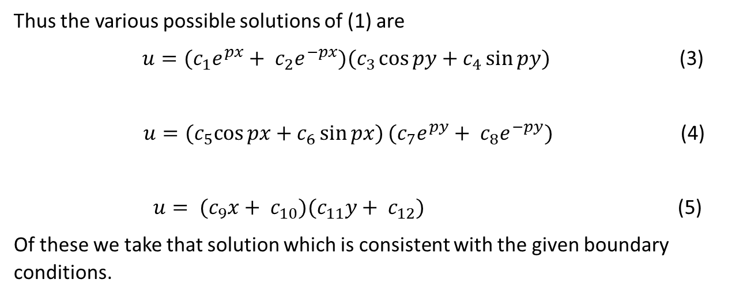
ENGINEERING MATHEMATICS - I
Solution of LAPLACE'S EQUATION
Thus the various possible solutions of (1) are
$u=(c_{1}e^{px}+ c_{2}e^{−px})(c_{3}\cos{py+c_{4}\sin{py)}}$ (3)
$u={(c}_{5}\cos{px+c_{6}\sin{px})}{(c}_{7}e^{py}+ c_{8}e^{−py})$ (4)
$u= {(c}_{9}x+ c_{10})(c_{11}y+ c_{12})$ (5)
Of these we take that solution which is consistent with the given boundary conditions.

Slide 7
THANK YOU
Dr. SWETHA D S
Department of Science and Humanities

