Slide 1

WEB TECHNOLOGIES
HTML 5 – Audio, Video and
Progress elements
Prof. Pavan A C
Department of Computer Science and Engineering
Acknowledgement:
Teaching Assistants(Harini B and Chandana MS)

Slide 2

HTML5 - Audio
Audio elements
A standard approach for browser to play audio without the use of plug-in.
Mp3, Wav and ogg formats supported by HTML5
Syntax
<audio controls="c1">
<source src="song.ogg" type="audio/ogg" />
<source src="song.mp3" type="audio/mp3" />
Your browser does not support the audio element.
</audio>

Slide 3
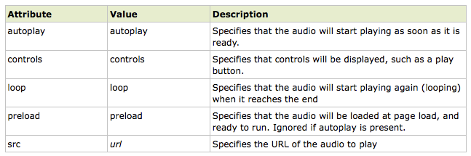
HTML5 - Audio
Audio element properties

Slide 4
HTML5 - Video
Video elements
A standard approach for browser to play video without the use of plug-in
Any content between the opening and closing tags is fallback content. This content is displayed only by browsers that don't support the <video> tag
Syntax
<video width="320" height="240" controls="controls">
<source src="movie.ogg" type="video/ogg" />
<source src="movie.mp4" type="video/mp4" />
<source src="movie.webm" type="video/webm" />
Your browser does not support the video tag.
</video>

Slide 5
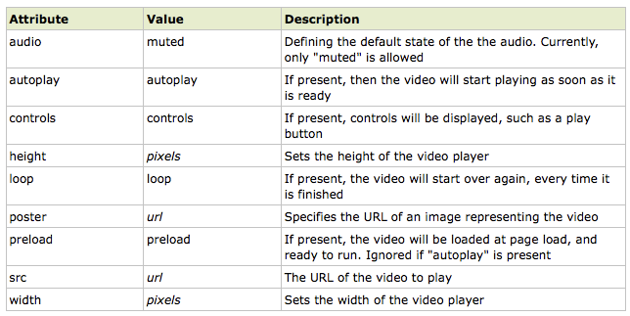
HTML5 - Video
Video element properties

Slide 6
HTML5 - Video
Progress elements
The <progress> tag represents the completion progress of a task.
Always add the <label> tag for describing the task!
Use JavaScript to manipulate the value of the progress bar
Syntax:
<label for="file">Downloading progress:</label>
<progress id="file" value="32" max="100"> 32% </progress>
Attribute | Value | Description
max | number | Specifies how much work the task requires in total. Default value is 1
value | number | Specifies how much of the task has been completed

Slide 7
HTML5 -
MCQ
1. Which HTML5 tag is used to embed audio files in a web page?
A) <video>
B) <sound>
C) <audio>
D) <music>
2. In the <audio> tag, which attribute is used to display the browser’s default audio controls?
A) autoplay
B) controls
C) loop
D) muted
3. What happens to the content placed between <video> and </video> tags if the browser does not support the <video> tag?
A) It is ignored.
B) It acts as fallback content and is displayed.
C) It throws an error.
D) It is automatically converted to audio.

Slide 8
HTML5 -
MCQ
4. Which attributes are used in the <progress> tag to indicate task completion?
A) loop and autoplay
B) src and controls
C) max and value
D) muted and preload
5. What is an “indeterminate” progress bar in HTML5?
A) A progress bar without color
B) A progress bar showing cyclic movement without exact progress value
C) A vertical progress bar
D) A disabled progress bar

Slide 9
HTML5 -
MCQ - Answers
Answer 1: C) <audio>
Answer 2: B) controls
Answer 3: B) It acts as fallback content and is displayed.
Answer 4: C) max and value
Answer 5: B) A progress bar showing cyclic movement without exact progress value

Slide 10
THANK YOU
Prof. Pavan A C
Department of Computer Science and Engineering

