Slide 1

ELEMENTS OF ELECTRICAL ENGINEERING
UE24EE141B
RENUKA R KAJUR
Department of Electrical & Electronics Engineering

Slide 2
ELEMENTS OF ELECTRICAL ENGINEERING UE24EE141
Network Terminology & Basic Concepts
Renuka Kajur
Department of Electrical & Electronics Engineering

Slide 3
ELEMENTS OF ELECTRICAL ENGINEERING
Network Terminology
Electrical Network:
An interconnection of electrical elements.
Electrical Circuit:
An electrical network with at least one source and a sink and having a closed path for current flow.

Slide 4
ELEMENTS OF ELECTRICAL ENGINEERING
Network Terminology
Active Element:
An element which supplies or delivers energy in an electrical network.
Eg: Voltage Sources & Current Sources
Passive Element:
An element which absorbs or stores energy in an electrical network.
Eg: Resistors, Inductors & Capacitors

Slide 5
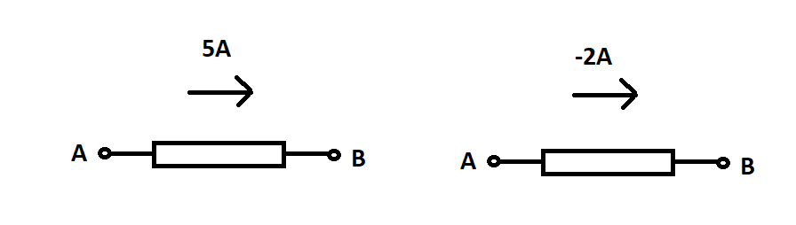

ELEMENTS OF ELECTRICAL ENGINEERING
Electric Current
An electric current is defined as the rate of flow of charges across the cross section of a conductor.
It is given by, I = $\frac{Q}{t}$ (or) i = $\frac{dq}{dt}$
It is measured in Amperes (A) & 1 Ampere = 1 Coulomb/sec

Slide 6
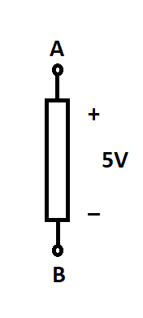

ELEMENTS OF ELECTRICAL ENGINEERING
Potential Difference
The energy required to move unit positive charge from one terminal to another is defined as the potential difference between the terminals.
It is given by, V = $\frac{W}{Q}$
It is measured in Volts (V) & 1 Volt = 1 Joule/Coulomb

Slide 7
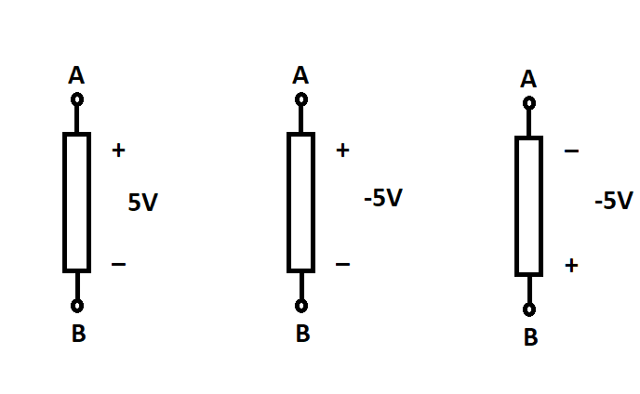
ELEMENTS OF ELECTRICAL ENGINEERING
Double Subscript Notation for Voltage
(a) (b) (c)
V_{AB} = 5V V_{AB} = -5V V_{AB} = 5V

Slide 8
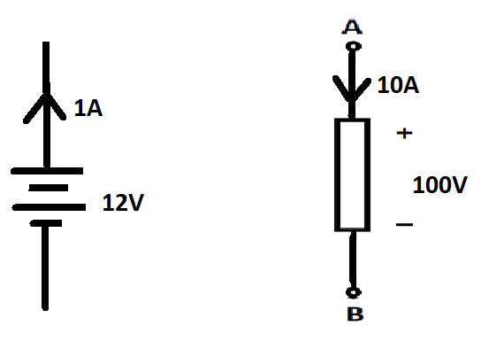


ELEMENTS OF ELECTRICAL ENGINEERING
Electric Power
The rate of absorption or delivery of Electrical energy is called Electrical Power.
It is given by, P = V*I
It is measured in Watts (W) & 1 Watt = (1 Volt)*(1 Ampere)

Slide 9

ELEMENTS OF ELECTRICAL ENGINEERING
Ohm’s Law
At a constant temperature, the potential difference across the terminals of a conductor is directly proportional to the current flowing through it.
i.e., V I
V = R*I
Here, R is the electrical resistance of the conductor.
It is measured in Ohms (Ω) and 1 Ohm = 1 Volt/Ampere

Slide 10
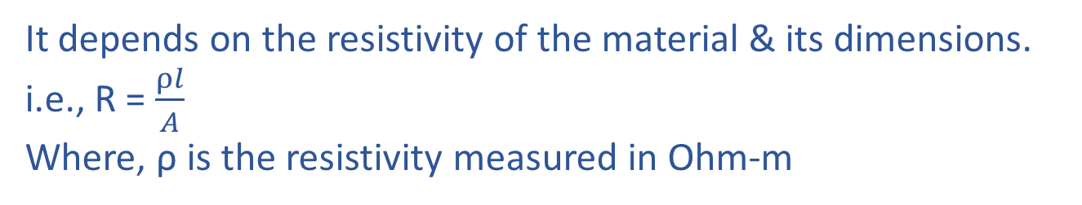

ELEMENTS OF ELECTRICAL ENGINEERING
Ohm’s Law
Resistance of a conductor is the opposition offered to the flow of current through it.
It depends on the resistivity of the material & its dimensions.
i.e., R = $\frac{ρl}{A}$
Where, ρ is the resistivity measured in Ohm-m
Conductance, G = $\frac{1}{R}$
It is measured in Siemens (S)

Slide 11
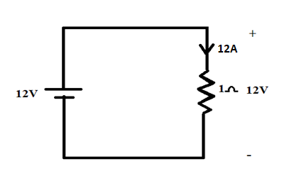
ELEMENTS OF ELECTRICAL ENGINEERING
Active and Passive Sign Conventions
Active sign convention:
Applicable to active elements
It says “current leaves positive terminal in an active element”.
Passive Sign Convention:
Applicable to passive elements
It says “current enters positive terminal in a passive element”.

Slide 12
ELEMENTS OF ELECTRICAL ENGINEERING
Text Book & References
Text Book:
“Electrical and Electronic Technology” E. Hughes (Revised by J. Hiley, K. Brown & I.M Smith), 11th Edition, Pearson Education, 2012.
Reference Books:
1. “Basic Electrical Engineering”, K Uma Rao, Pearson Education, 2011.
2. “Basic Electrical Engineering - Revised Edition”, D. C. Kulshreshta, Tata- McGraw-Hill, 2012.
3. “Engineering Circuit Analysis”, William Hayt Jr.,
Jack E. Kemmerly & Steven M. Durbin, 8th Edition,
McGraw-Hill, 2012.

Slide 13

THANK YOU
Renuka
Department of Electrical & Electronics Engineering
renukark@pes.edu

