Slide 1

ELEMENTS OF ELECTRICAL ENGINEERING
UE24EE141B
Renuka Kajur
Department of Electronics and Communication Engineering

Slide 2
ELEMENTS OF ELECTRICAL ENGINEERING UE24EE141
Concept of Ideal Sources, Kirchhoff’s Laws
Renuka Kajur
Department of Electrical & Electronics Engineering

Slide 3
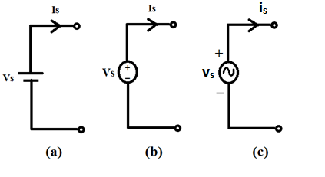
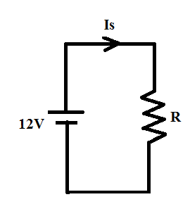
ELEMENTS OF ELECTRICAL ENGINEERING
Ideal Voltage Source
Its terminal voltage is independent of current flowing through it.
The current delivered by it depends on the circuit to which it is connected.
When R = 10Ω, I_{S} = 1.2A
When R = 1Ω, I_{S} = 12A

Slide 4
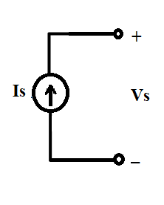
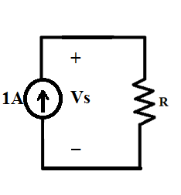
ELEMENTS OF ELECTRICAL ENGINEERING
Ideal Current Source
Its current is independent of the voltage across it.
The voltage across it depends on the circuit to which it is connected.
When R = 1Ω, V_{S} = 1V
When R = 10Ω, V_{S} = 10V

Slide 5
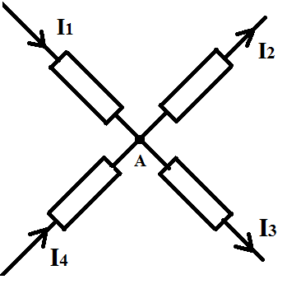
ELEMENTS OF ELECTRICAL ENGINEERING
Kirchhoff’s Current Law (KCL)
KCL States “At every node in an electric network, the algebraic sum of currents is Zero (or) sum of incoming currents is equal to the sum of outgoing currents”.
A point at which two or more elements are interconnected is a node.
KCL signifies the conservation of charge.
By KCL at node A,
I₁ + I₄ = I₂ + I₃

Slide 6
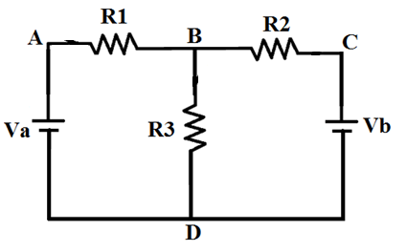
ELEMENTS OF ELECTRICAL ENGINEERING
Kirchhoff’s Voltage Law (KVL)
KVL States “Around every closed path in an electric network, the algebraic sum of voltages is Zero”.
A path in an electrical network which starts and ends at the same terminal is called a closed path.

Slide 7
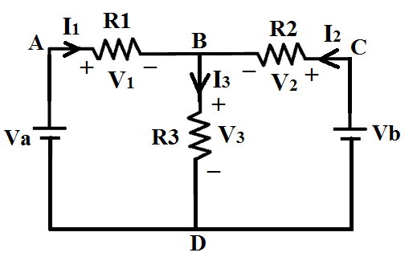
ELEMENTS OF ELECTRICAL ENGINEERING
Kirchhoff’s Voltage Law (KVL)
Conventionally, Voltage drop is considered negative and voltage rise as positive.
KVL in the path ABDA:
-V₁-V₃+V_{a} = 0
KVL in the path BCDB:
V₂-V_{b}+V₃ = 0
KVL in the path ABCDA:
-V₁+V₂-V_{b} +V_{a} = 0
KVL signifies conservation of energy.

Slide 8
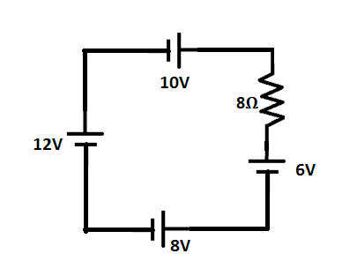
ELEMENTS OF ELECTRICAL ENGINEERING
Numerical Example on KVL
Example 1:
Find the current through 8Ω resistor in the network given.

Slide 9
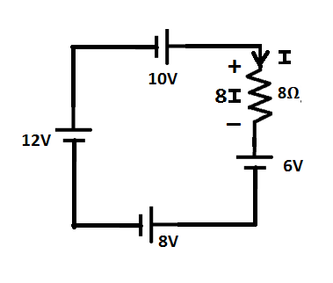
ELEMENTS OF ELECTRICAL ENGINEERING
Numerical Example on KVL
Solution:
KVL: +10-8I-6-8+12 = 0
Hence, I = 1A

Slide 10
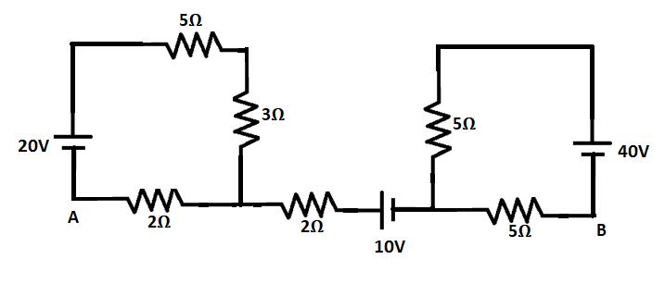
ELEMENTS OF ELECTRICAL ENGINEERING
Numerical Example on KVL
Example 2:
Find the voltage V_{AB} in the network shown:

Slide 11
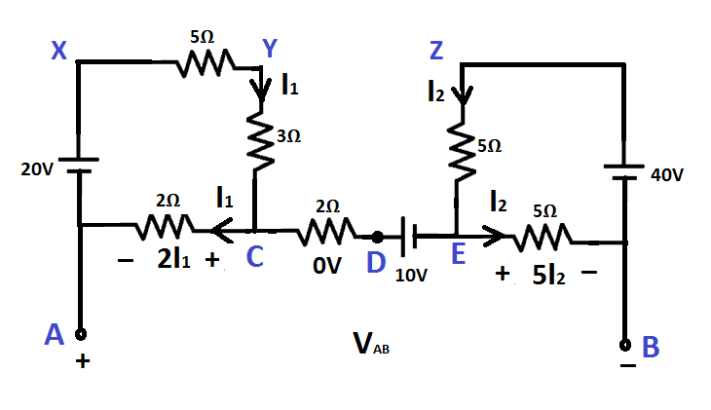
ELEMENTS OF ELECTRICAL ENGINEERING
Numerical Example on KVL
Solution:
KVL (AXYCA): +20-5I₁-3I₁-2I₁ = 0; Hence, I₁ = 2A
KVL (BZEB): +40-5I₂-5I₂ = 0; Hence, I₂ = 4A
KVL (ACDEBA): +2I₁-10-5I₂+V_{AB} = 0; Hence, V_{AB} = 26V

Slide 12
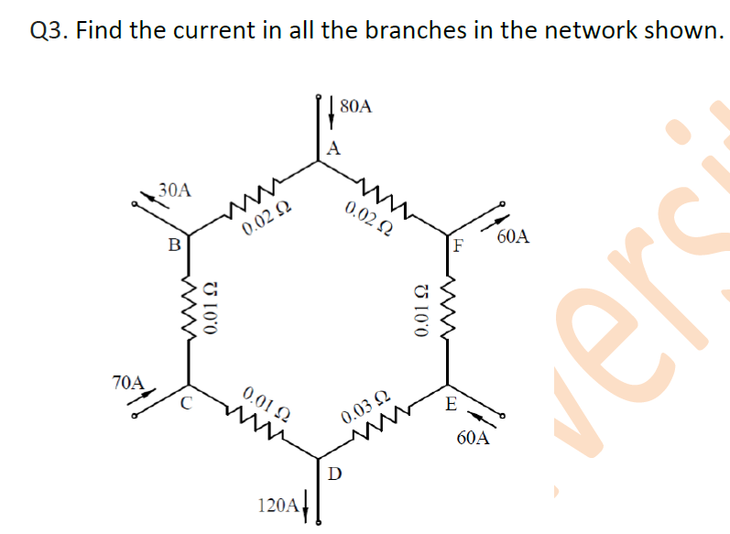
ELEMENTS OF ELECTRICAL ENGINEERING
Numerical Example on KVL

Slide 13
ELEMENTS OF ELECTRICAL ENGINEERING
Text Book & References
Text Book:
“Electrical and Electronic Technology” E. Hughes (Revised by J. Hiley, K. Brown & I.M Smith), 11th Edition, Pearson Education, 2012.
Reference Books:
1. “Basic Electrical Engineering”, K Uma Rao, Pearson Education, 2011.
2. “Basic Electrical Engineering - Revised Edition”, D. C. Kulshreshta, Tata- McGraw-Hill, 2012.
3. “Engineering Circuit Analysis”, William Hayt Jr.,
Jack E. Kemmerly & Steven M. Durbin, 8th Edition,
McGraw-Hill, 2012.

Slide 14
THANK YOU
Renuka r kajur
Department of Electronics and Communication Engineering
renukark@pes.edu

