Slide 1

ELEMENTS OF ELECTRICAL ENGINEERING
UE24EE141B
Renuka Kajur
Department of Electronics and Communication Engineering

Slide 2
ELEMENTS OF ELECTRICAL ENGINEERING
UE24EE141B
Voltage & Current Division Rules; Concept of Short Circuit & Open Circuit
Renuka R Kajur
Department of Electronics and Communication Engineering

Slide 3
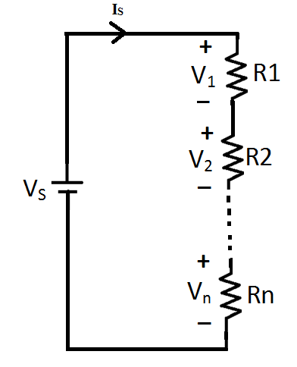
ELEMENTS OF ELECTRICAL ENGINEERING
Voltage Division Rule
It is applicable to Series Networks
V₁ = I_{S}*R₁
V₂ = I_{S}*R₂
.
.
.
V_{n} = I_{S}*R_{n}
By KVL,
V_{S} = V₁+V₂+…+V_{n}

Slide 4
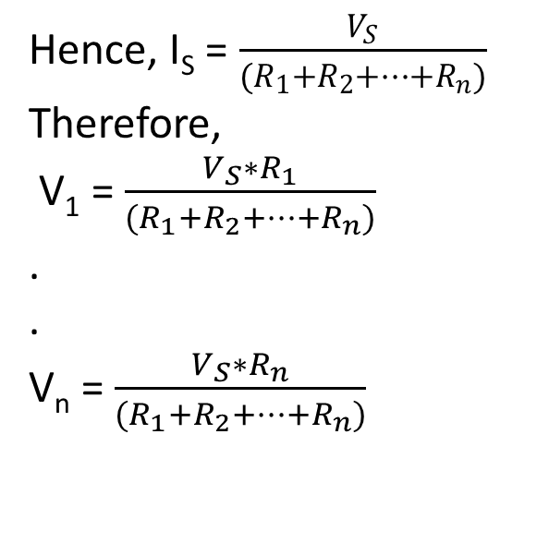
ELEMENTS OF ELECTRICAL ENGINEERING
Voltage Division Rule
Hence, I_{S} = $\frac{V_{S}}{(R_{1}+R_{2}+…+R_{n})}$
Therefore,
V₁ = $\frac{V_{S}∗R_{1}}{(R_{1}+R_{2}+…+R_{n})}$
.
.
V_{n} = $\frac{V_{S}∗R_{n}}{(R_{1}+R_{2}+…+R_{n})}$

Slide 5
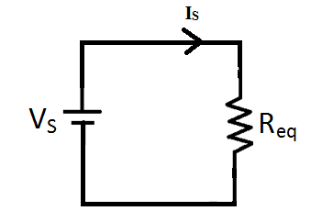
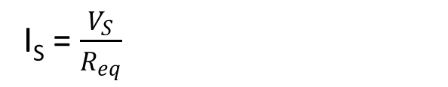
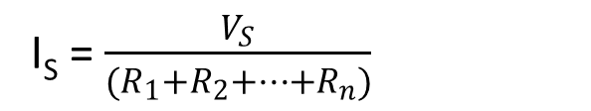
ELEMENTS OF ELECTRICAL ENGINEERING
Equivalent Series Resistance
I_{S} = $\frac{V_{S}}{R_{eq}}$
I_{S} = $\frac{V_{S}}{(R_{1}+R_{2}+…+R_{n})}$
R_{eq} = R₁+R₂+…+R_{n}

Slide 6
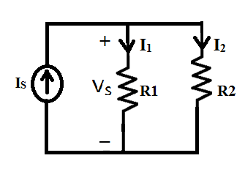

ELEMENTS OF ELECTRICAL ENGINEERING
Current Division Rule
It is applicable to Parallel Networks
I₁ = $\frac{V_{S}}{R_{1}}$
I₂ = $\frac{V_{S}}{R_{2}}$
By KCL,
I_{S} = I₁+I₂
I_{S} = V_{S}* ($\frac{1}{R_{1}}$ + $\frac{1}{R_{2}}$)

Slide 7
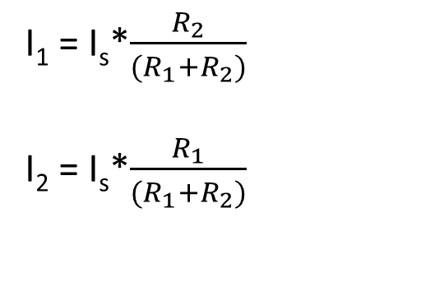
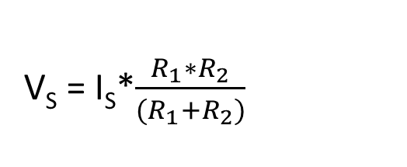
ELEMENTS OF ELECTRICAL ENGINEERING
Current Division Rule
V_{S} = I_{S}*$\frac{R_{1}∗R_{2}}{(R_{1}+R_{2})}$
I₁ = I_{s}*$\frac{R_{2}}{(R_{1}+R_{2})}$
I₂ = I_{s}*$\frac{R_{1}}{(R_{1}+R_{2})}$

Slide 8
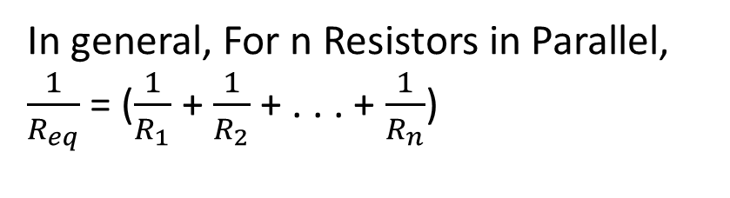
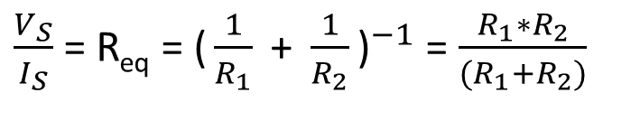
ELEMENTS OF ELECTRICAL ENGINEERING
Equivalent Parallel Resistance
$\frac{V_{S}}{I_{S}}$ = R_{eq} = ${\text{(}\frac{1}{R_{1}}\text{ + }\frac{1}{R_{2}}\text{)}}^{−1}$ = $\frac{R_{1}∗R_{2}}{(R_{1}+R_{2})}$
In general, For n Resistors in Parallel,
$\frac{1}{R_{eq}}$ = ($\frac{1}{R_{1}}$ + $\frac{1}{R_{2}}$ + . . . + $\frac{1}{R_{n}}$)

Slide 9
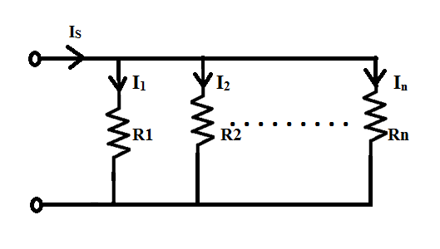

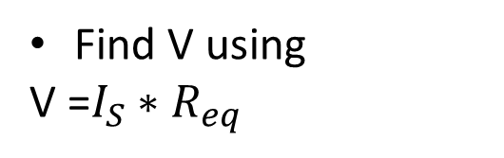
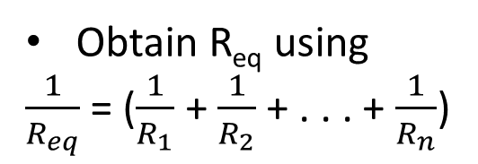
ELEMENTS OF ELECTRICAL ENGINEERING
Current Division Rule – More than two resistors in Parallel
Obtain R_{eq} using
$\frac{1}{R_{eq}}$ = ($\frac{1}{R_{1}}$ + $\frac{1}{R_{2}}$ + . . . + $\frac{1}{R_{n}}$)
Find V using
V =$I_{S}∗R_{eq}$
Use Ohm’s Law to find branch currents

Slide 10
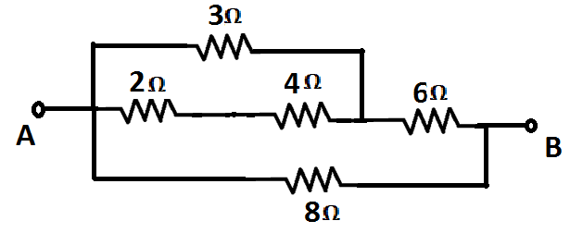
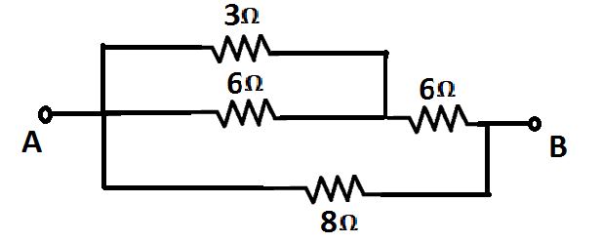
ELEMENTS OF ELECTRICAL ENGINEERING
Numerical Example – Finding Equivalent Resistance
Find the equivalent resistance between A & B
Solution:

Slide 11
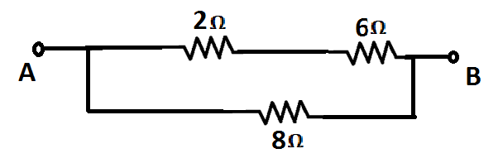
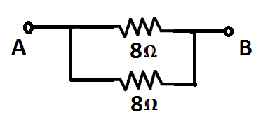

ELEMENTS OF ELECTRICAL ENGINEERING
Numerical Example – Finding Equivalent Resistance
Solution: (Continued..)

Slide 12

ELEMENTS OF ELECTRICAL ENGINEERING
Open Circuit
An Open Circuit has Infinite resistance.
Current through the Open Circuit is Zero.
Voltage across the Open Circuit can be any finite value.

Slide 13
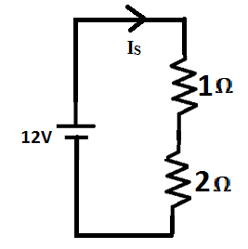
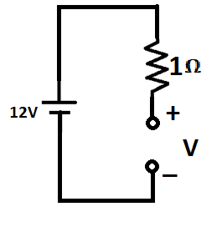
ELEMENTS OF ELECTRICAL ENGINEERING
Open Circuit
I_{S} = 4A
I_{S} = 0A
V = 12V

Slide 14
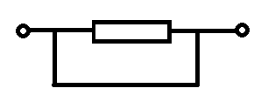

ELEMENTS OF ELECTRICAL ENGINEERING
Short Circuit
A Short Circuit has Zero resistance.
Voltage across a Short Circuit is Zero.
Current through the Short Circuit can be any finite value.
Current through a Dead Short Circuit is dangerously high.

Slide 15
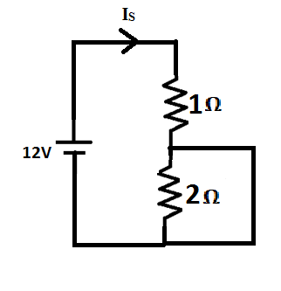
ELEMENTS OF ELECTRICAL ENGINEERING
Short Circuit
I_{S} = 4A
I_{S} = 12A

Slide 16
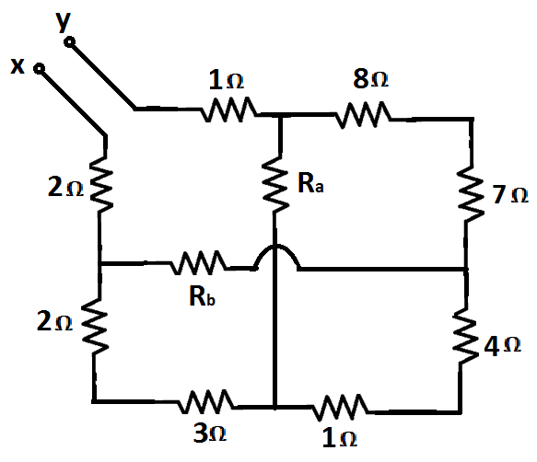
ELEMENTS OF ELECTRICAL ENGINEERING
Numerical Example – Open & Short Circuits
Find the equivalent resistance between X & Y if
i) R_{a} = ∞ & R_{b} = ∞
ii) R_{a} = 0 & R_{b} = ∞
iii) R_{a} = ∞ & R_{b} = 0
iv) R_{a} = 0 & R_{b} = 0

Slide 17
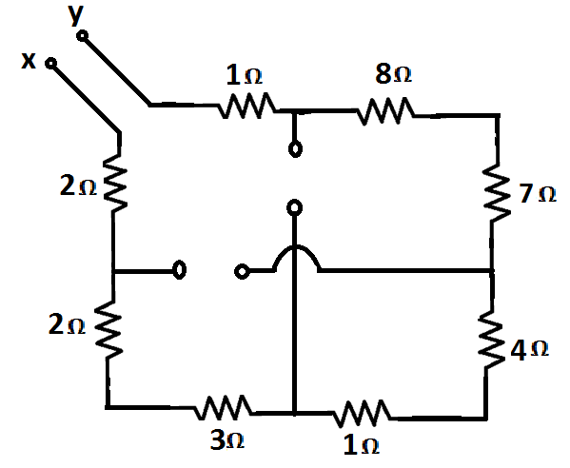
ELEMENTS OF ELECTRICAL ENGINEERING
Numerical Example – Open & Short Circuits
Solution:
Case i) R_{a} = ∞ & R_{b} = ∞
All the resistors are in series.
Hence, R_{XY} = 28Ω

Slide 18
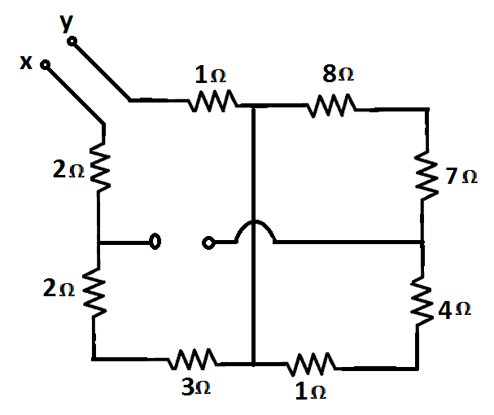
ELEMENTS OF ELECTRICAL ENGINEERING
Numerical Example – Open & Short Circuits
Solution:
Case ii) R_{a} = 0 & R_{b} = ∞
R_{XY} = 8Ω

Slide 19
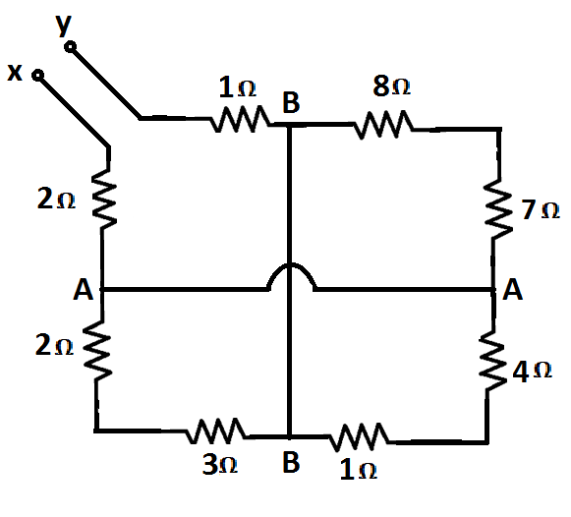
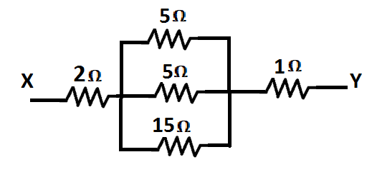
ELEMENTS OF ELECTRICAL ENGINEERING
Numerical Example – Open & Short Circuits
Solution:
Case iv) R_{a} = 0 & R_{b} = 0
R_{XY} = 5.143Ω

Slide 20
ELEMENTS OF ELECTRICAL ENGINEERING
Text Book & References
Text Book:
“Electrical and Electronic Technology” E. Hughes (Revised by J. Hiley, K. Brown & I.M Smith), 11th Edition, Pearson Education, 2012.
Reference Books:
1. “Basic Electrical Engineering”, K Uma Rao, Pearson Education, 2011.
2. “Basic Electrical Engineering - Revised Edition”, D. C. Kulshreshta, Tata- McGraw-Hill, 2012.
3. “Engineering Circuit Analysis”, William Hayt Jr.,
Jack E. Kemmerly & Steven M. Durbin, 8th Edition,
McGraw-Hill, 2012.

Slide 21
THANK YOU
Renuka r kajur
Department of Electronics and Communication Engineering
renukark@pes.edu

