Slide 1

ELEMENTS OF ELECTRICAL ENGINEERING
UE24EE141B
RENUKA R KAJUR
Department of Electrical & Electronics Engineering

Slide 2
ELEMENTS OF ELECTRICAL ENGINEERING UE24EE141
Practical Sources & Source Transformation
Renuka r Kajur
Department of Electronics and communication Engineering

Slide 3
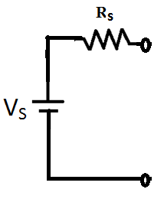
ELEMENTS OF ELECTRICAL ENGINEERING
Practical Voltage Source
Its terminal voltage falls as load current increases.
It is modelled as an ideal voltage source in series with
internal resistance.
Internal resistance is small, usually few mΩ.
Internal resistance of an ideal voltage source is Zero

Slide 4
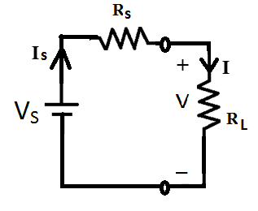
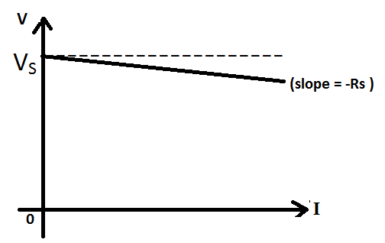
ELEMENTS OF ELECTRICAL ENGINEERING
Practical Voltage Source
V = V_{S} – I*R_{S}

Slide 5
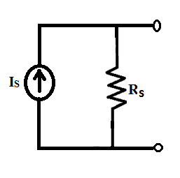
ELEMENTS OF ELECTRICAL ENGINEERING
Practical Current Source
Its terminal current falls as load voltage increases.
It is modelled as an ideal current source in parallel with
internal resistance.
Internal resistance is very high, usually few Mega Ohms
Internal resistance of an ideal current source is Infinite

Slide 6
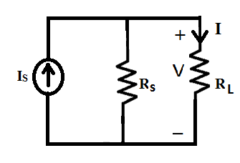
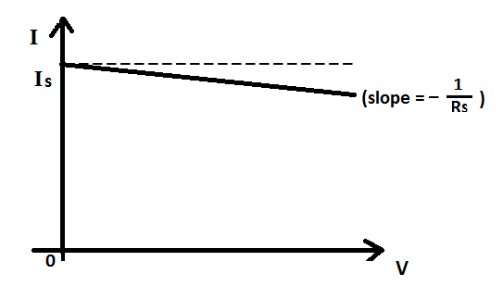

ELEMENTS OF ELECTRICAL ENGINEERING
Practical Current Source
I = I_{S} – ($\frac{V}{R_{S}}$)

Slide 7
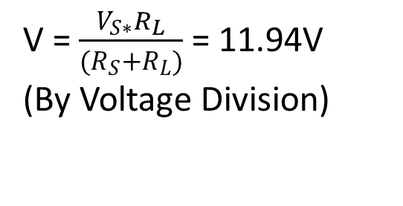
ELEMENTS OF ELECTRICAL ENGINEERING
Numerical Example on Practical Sources
Question:
A battery of EMF 12V and internal resistance of 0.05Ω supplies power to a load resistance R_{L}. Determine the % change in load voltage as load resistance varies from 10Ω to 100Ω.
Solution:
Case 1: R_{L} = 10Ω
V = $\frac{V_{S∗}R_{L}}{(R_{S}+R_{L})}$ = 11.94V
(By Voltage Division)

Slide 8
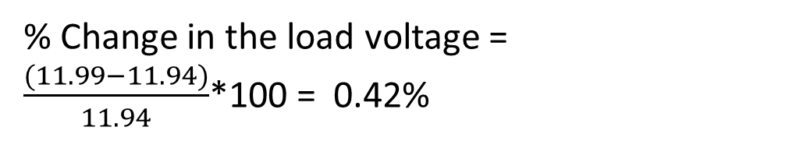
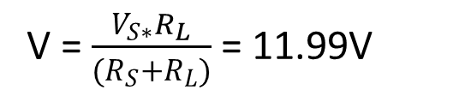
ELEMENTS OF ELECTRICAL ENGINEERING
Numerical Example on Practical Sources
Solution (Continued..):
Case 2: R_{L} = 100Ω
V = $\frac{V_{S∗}R_{L}}{(R_{S}+R_{L})}$ = 11.99V
% Change in the load voltage = $\frac{(11.99−11.94)}{11.94}$*100 = 0.42%

Slide 9
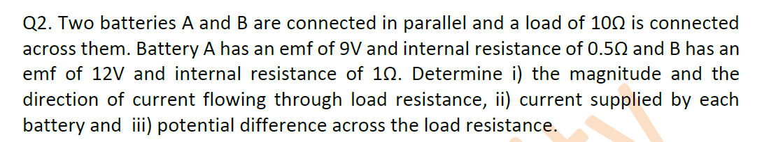
Numerical Example on Practical Sources

Slide 10
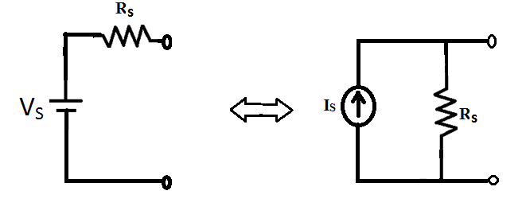
ELEMENTS OF ELECTRICAL ENGINEERING
Source Transformation
A Practical Voltage Source can be transformed to a Practical Current Source & Vice versa.
Two Sources are equivalent if they supply same terminal voltage and current when loaded with same load resistance.

Slide 11
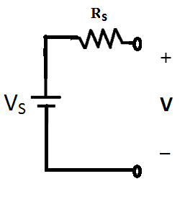
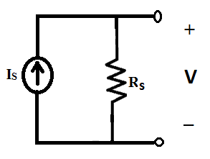
ELEMENTS OF ELECTRICAL ENGINEERING
Source Transformation
Case 1: Open Circuit Condition
V = V_{S}
V = I_{S}*R_{S}
Hence, V_{S} = I_{S}*R_{S}

Slide 12
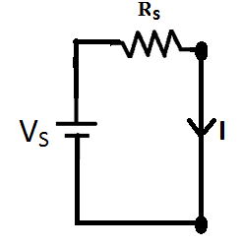
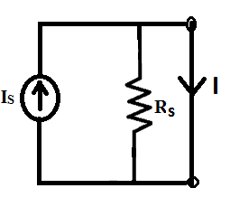
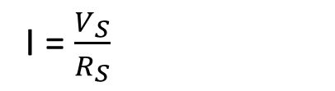
ELEMENTS OF ELECTRICAL ENGINEERING
Source Transformation
Case 2: Short Circuit Condition
I = $\frac{V_{S}}{R_{S}}$
I = I_{S}
Hence, V_{S} = I_{S}*R_{S}

Slide 13
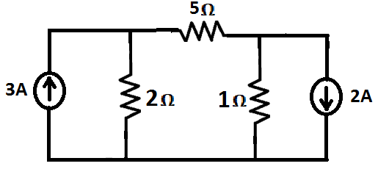
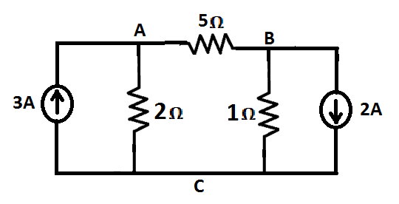
ELEMENTS OF ELECTRICAL ENGINEERING
Numerical Example on Source Transformation
Question:
Find the current through 5Ω resistor in the network shown:
Solution:
Replace 3A current source & 2Ω resistance with equivalent practical voltage source.
Repeat the same for 2A current source & 1Ω resistance.

Slide 14
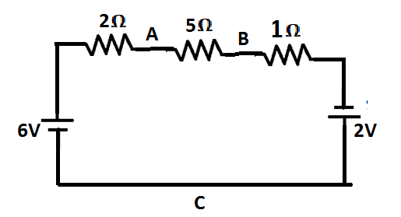
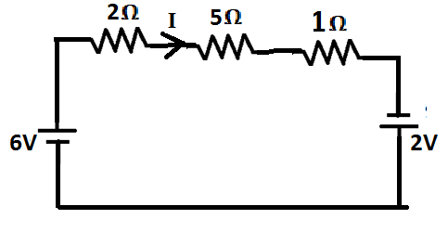
ELEMENTS OF ELECTRICAL ENGINEERING
Numerical Example on Practical Sources
Solution (Continued..):
By applying KVL
+6-2I – 5I – I+2 =0
I = 1A

Slide 15
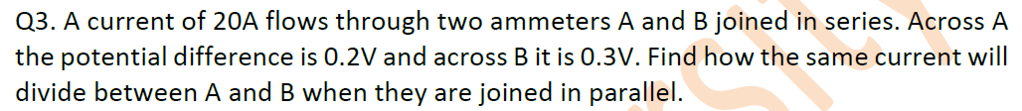
ELEMENTS OF ELECTRICAL ENGINEERING
Source Transformation

Slide 16
ELEMENTS OF ELECTRICAL ENGINEERING
Text Book & References
Text Book:
“Electrical and Electronic Technology” E. Hughes (Revised by J. Hiley, K. Brown & I.M Smith), 11th Edition, Pearson Education, 2012.
Reference Books:
1. “Basic Electrical Engineering”, K Uma Rao, Pearson Education, 2011.
2. “Basic Electrical Engineering - Revised Edition”, D. C. Kulshreshta, Tata- McGraw-Hill, 2012.
3. “Engineering Circuit Analysis”, William Hayt Jr.,
Jack E. Kemmerly & Steven M. Durbin, 8th Edition,
McGraw-Hill, 2012.

Slide 17

THANK YOU
Renuka
Department of Electrical & Electronics Engineering
renukark@pes.edu

