Slide 1

ENGINEERING MATHEMATICS-II
MATLAB
Department of Science and Humanities

Slide 2

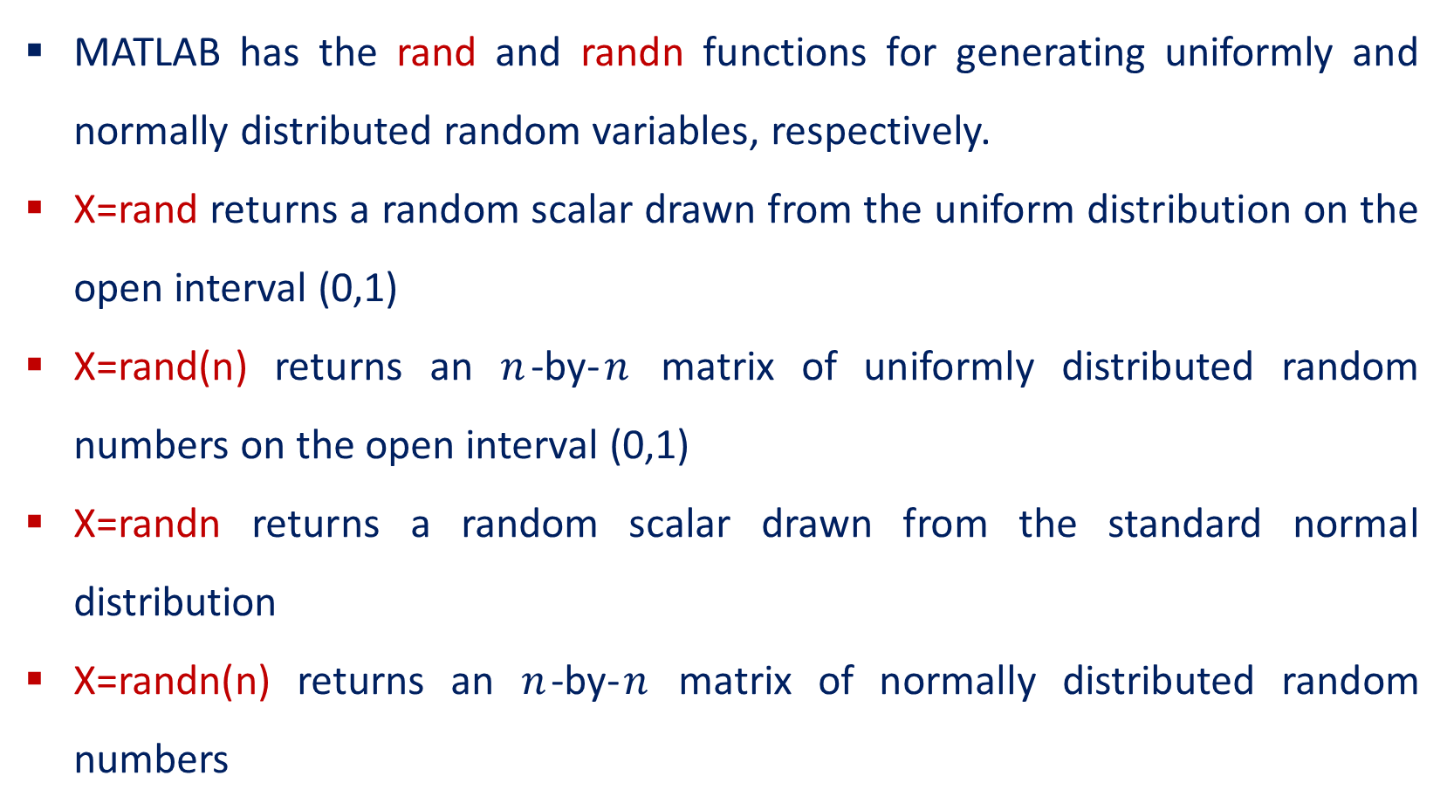
Random Number Generation
MATLAB has the rand and randn functions for generating uniformly and normally distributed random variables, respectively.
X=rand returns a random scalar drawn from the uniform distribution on the open interval (0,1)
X=rand(n) returns an $n$-by-$n$ matrix of uniformly distributed random numbers on the open interval (0,1)
X=randn returns a random scalar drawn from the standard normal distribution
X=randn(n) returns an $n$-by-$n$ matrix of normally distributed random numbers

Slide 3
Examples
>> X=rand(1,4)
X = 0.8147 0.9058 0.1270 0.9134
>> X=rand(1,4)
X =0.6324 0.0975 0.2785 0.5469
>> X=rand(2,2)
X = 0.1576 0.9572
0.9706 0.4854

Slide 4
Examples
>> X=rand(3)
X = 0.8003 0.9157 0.6557
0.1419 0.7922 0.0357
0.4218 0.9595 0.8491

Slide 5
Examples
>> X=randn(1,2)
X = 1.0933 1.1093
>> X=randn(3)
X = 0.0774 -0.0068 0.3714
-1.2141 1.5326 -0.2256
-1.1135 -0.7697 1.1174

Slide 6
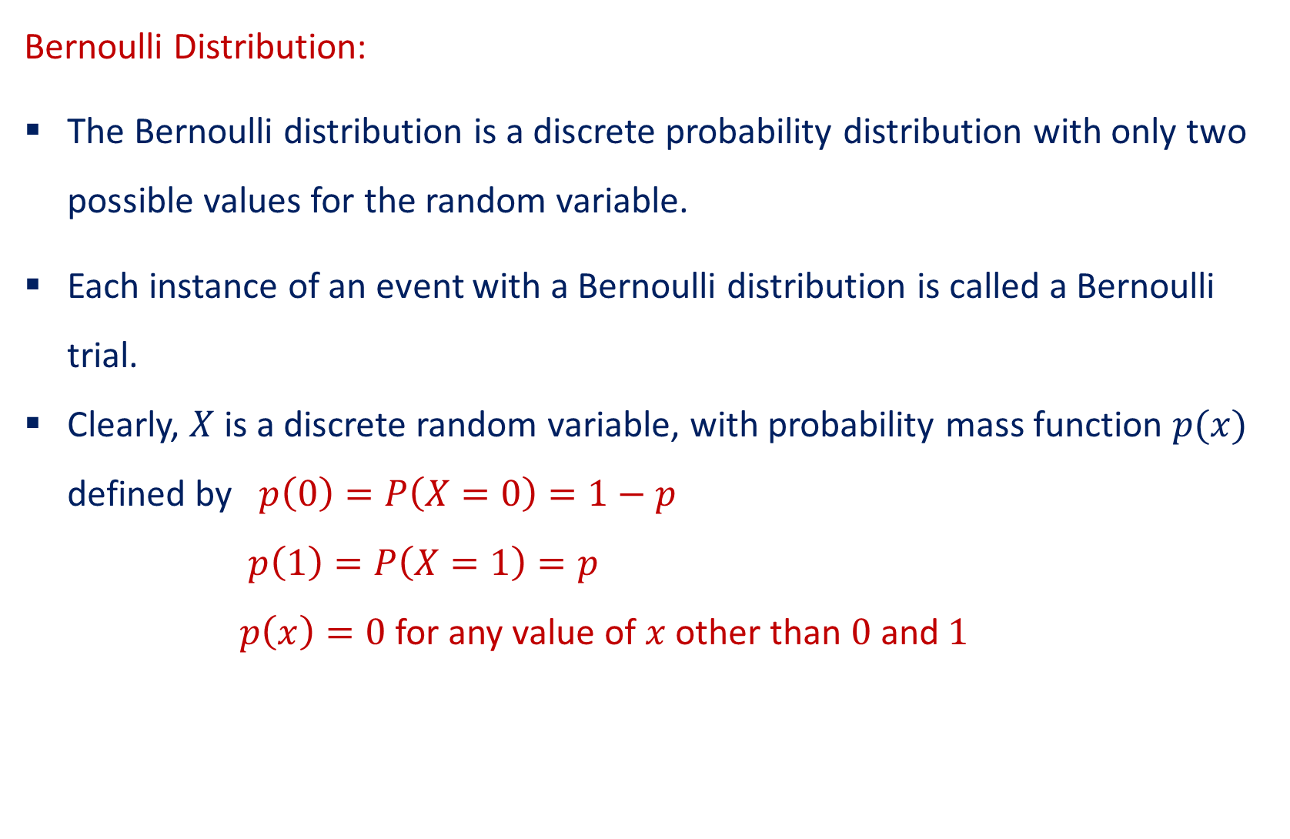
Probability Distribution in MATLAB
Bernoulli Distribution:
The Bernoulli distribution is a discrete probability distribution with only two possible values for the random variable.
Each instance of an event with a Bernoulli distribution is called a Bernoulli trial.
Clearly, $X$ is a discrete random variable, with probability mass function $p(x)$ defined by $p\left(0\right)=P\left(X=0\right)=1−p$
$p\left(1\right)=P\left(X=1\right)=p$
$p\left(x\right)=0$for any value of $x$ other than $0$and $1$

Slide 7
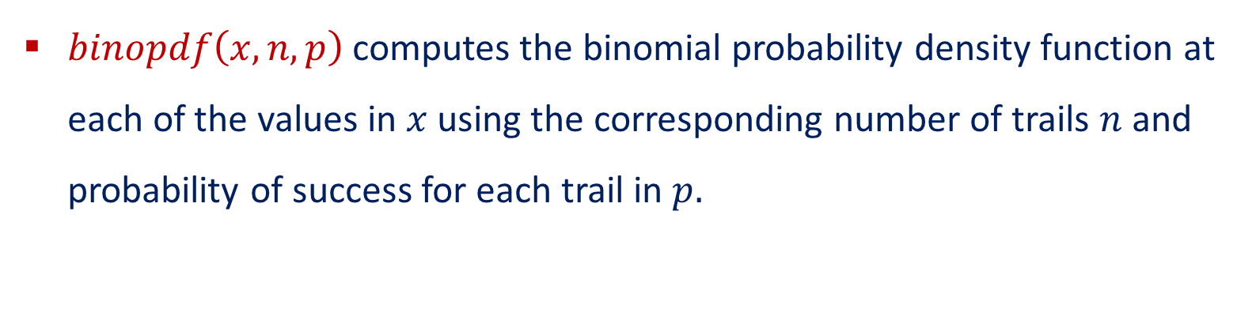
Bernoulli Distribution PDF
$binopdf\left(x,n,p\right)$ computes the binomial probability density function at each of the values in $x$ using the corresponding number of trails $n$ and probability of success for each trail in $p.$

Slide 8
Bernoulli Distribution PDF
Use binopdf to compute the pdf of the Bernoulli distribution with a probability success of 0.90.
>> p = 0.90;
>> x = 0:1;
>> y=binopdf(0:1,1,p)
y = 0.1000 0.9000

Slide 9
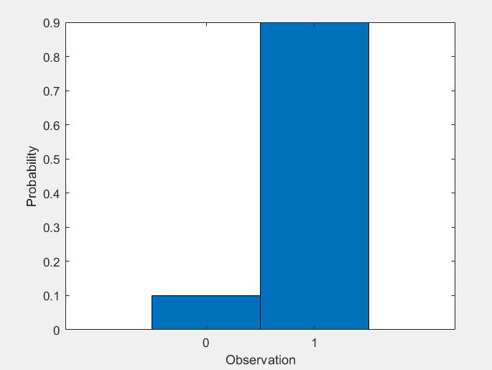
Bernoulli Distribution PDF
Now, plot the PDF with bars of width 1.
>> figure
bar(x,y,1)
xlabel('Observation’)
ylabel('Probability')

Slide 10
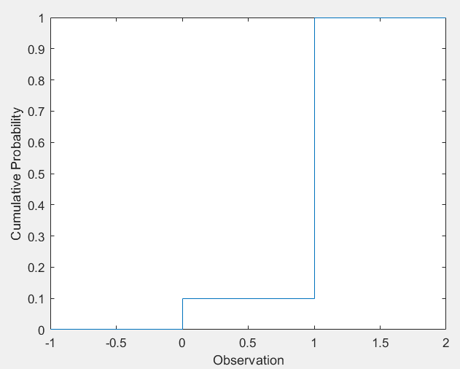
Bernoulli Distribution CDF
>> p = 0.90;
>> y = binocdf(-1:2,1,p)
y = 0 0.1000 1.0000 1.0000
Plotting of CDF:
>> figure
stairs(-1:2,y)
xlabel('Observation’)
ylabel('Cumulative Probability')

Slide 11
Binomial Distribution
The binomial distribution is a two-parameter family of curves.
The binomial distribution is used to model the total number of successes in a fixed number of independent trials that have the same probability of success, such as modeling the probability of a given number of heads in ten flips of a fair coin.

Slide 12
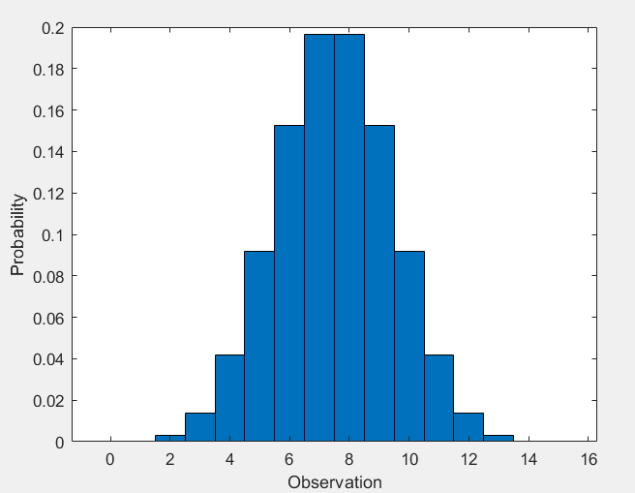
Binomial Distribution PDF
Compute the PDF of the binomial distribution with 15 trails and the probability of success 0.5.
>> x = 0:15
>> y = binopdf(x,15,0.5)
Plotting of PDF with bars of with 1:
>> figure
bar(x,y,1)
xlabel('Observation’)
ylabel('Probability')

Slide 13
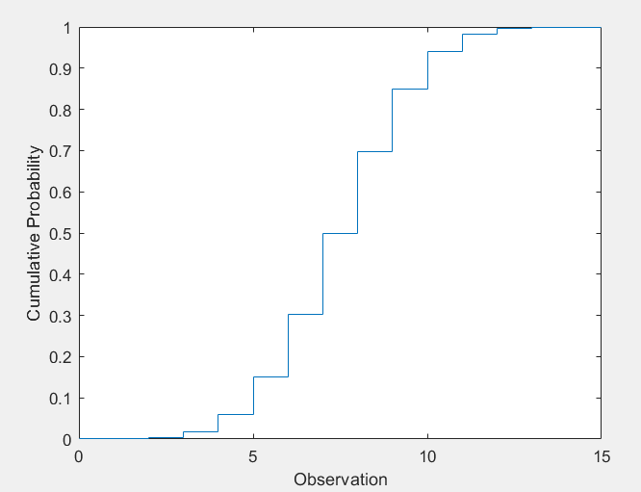
Binomial Distribution CDF
Compute the CDF of the binomial distribution with 15 trails and the probability of success 0.5.
>> x = 0:15
>> y = binocdf(x,15,0.5)
Plotting of CDF:
>> figure
stairs(x,y)
xlabel('Observation’)
ylabel('Cumulative Probability')

Slide 14
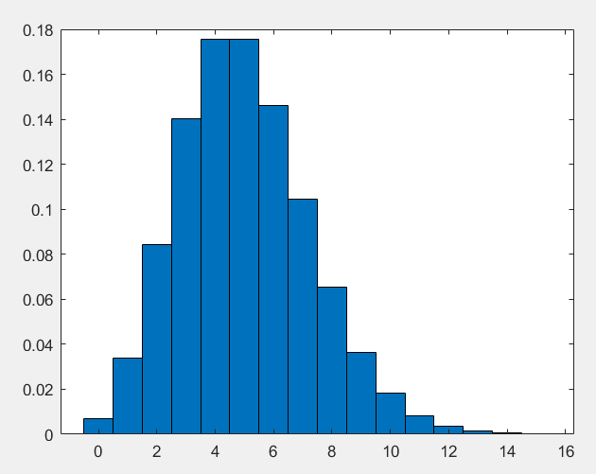
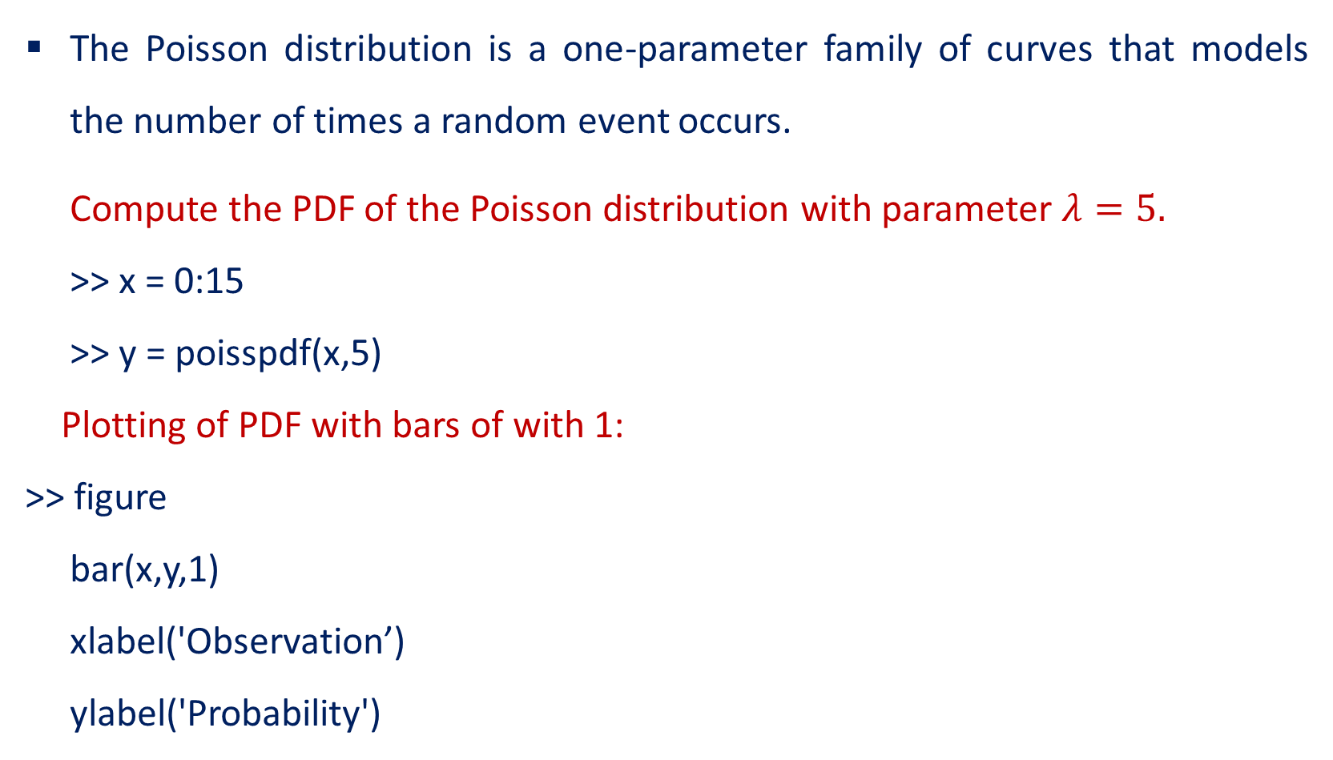
Poisson Distribution and its PDF
The Poisson distribution is a one-parameter family of curves that models the number of times a random event occurs.
Compute the PDF of the Poisson distribution with parameter $λ=5.$
>> x = 0:15
>> y = poisspdf(x,5)
Plotting of PDF with bars of with 1:
>> figure
bar(x,y,1)
xlabel('Observation’)
ylabel('Probability')

Slide 15
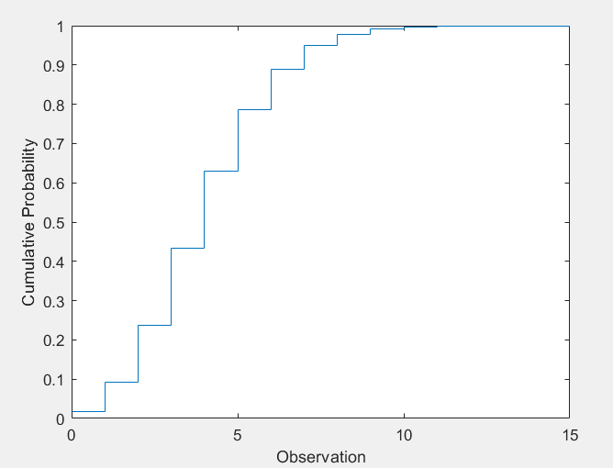
Poisson Distribution CDF
>> x = 0:15
>> y = poisspdf(x,5)
Plotting of CDF:
>> figure
stairs(x,y)
xlabel('Observation’)
ylabel('Cumulative Probability')

Slide 16
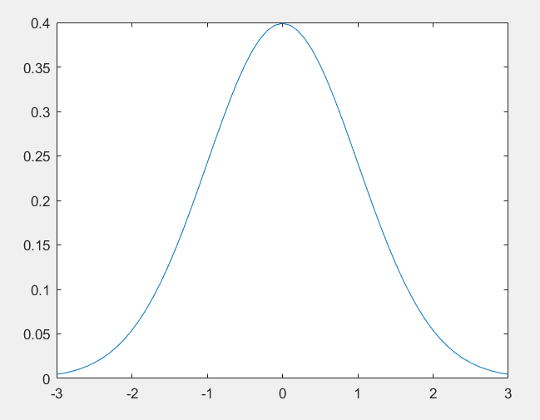

Normal Distribution and its PDF
The normal distribution, sometimes called the Gaussian distribution, is a two-parameter family of curves.
Compute the pdf of a standard normal distribution, with parameters
$μ=0; σ=1.$
>> x = [-3:.1:3];
>> y = normpdf(x,0,1);
Plotting of PDF
>> plot(x,y)

Slide 17
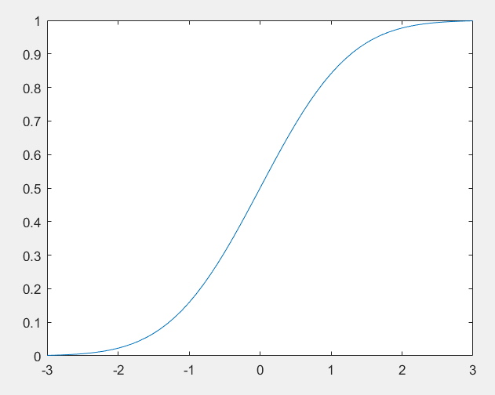
Normal Distribution CDF
>> pd = makedist('Normal’)
pd = NormalDistribution
Normal distribution
mu = 0
sigma = 1
>> x = -3:.1:3;
>> p = cdf(pd,x)
Plotting of CDF
>> plot(x,p)

Slide 18
THANK YOU

