Slide 1

ENGINEERING MATHEMATICS-II
MATLAB
Department of Science and Humanities

Slide 2

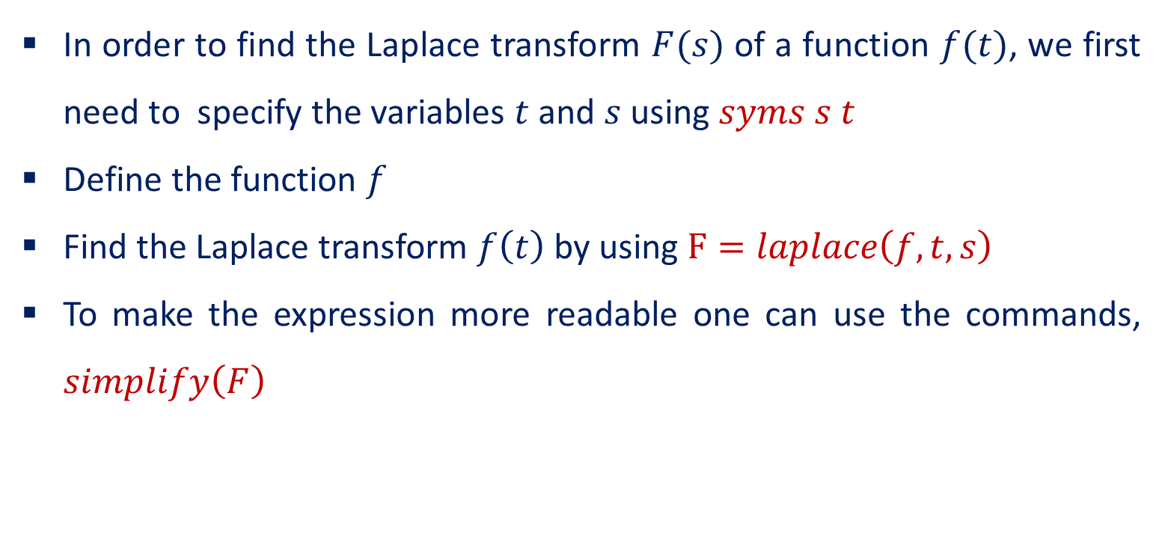
Laplace Transforms
In order to find the Laplace transform $F(s)$ of a function $f(t)$, we first need to specify the variables $t$ and $s$ using $syms s t$
Define the function $f$
Find the Laplace transform $f\left(t\right)$by using $F=laplace\left(f,t,s\right)$
To make the expression more readable one can use the commands, $simplify\left(F\right)$

Slide 3
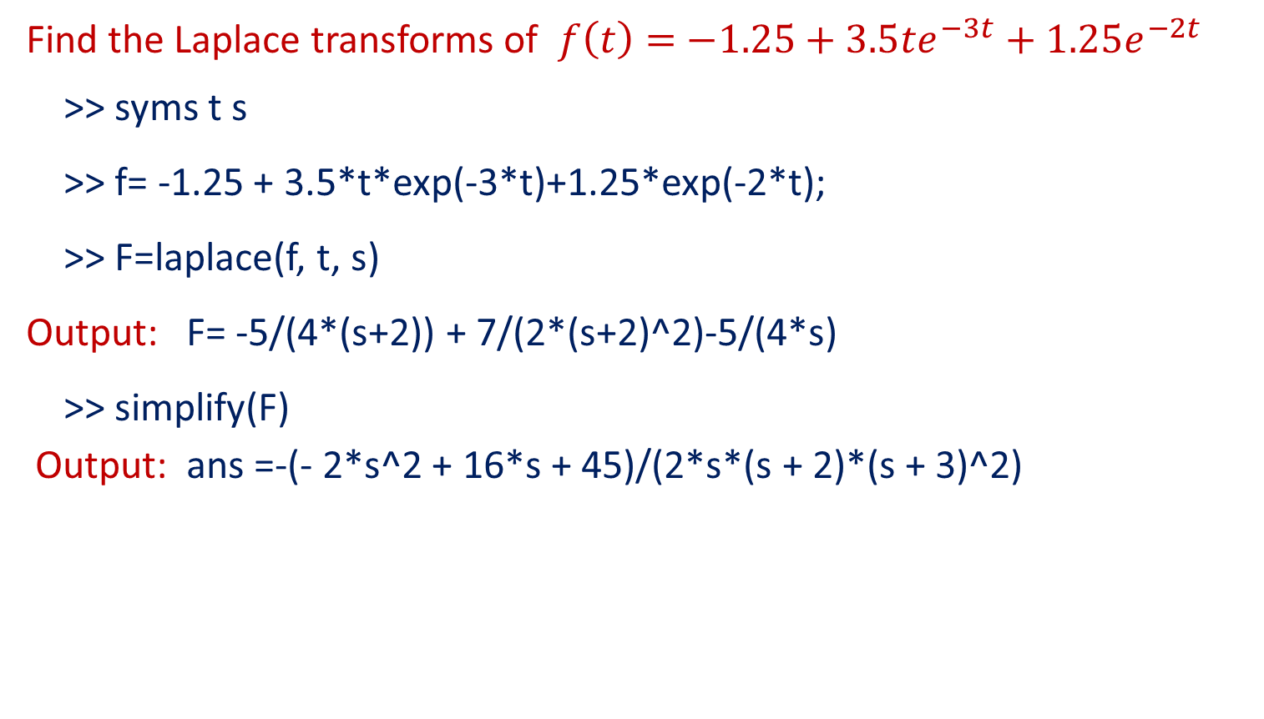
Examples
Find the Laplace transforms of $f\left(t\right)=$ $−1.25+3.5te^{−3t}+1.25e^{−2t}$
>> syms t s
>> f= -1.25 + 3.5*t*exp(-3*t)+1.25*exp(-2*t);
>> F=laplace(f, t, s)
Output: F= -5/(4*(s+2)) + 7/(2*(s+2)^2)-5/(4*s)
>> simplify(F)
Output: ans =-(- 2*s^2 + 16*s + 45)/(2*s*(s + 2)*(s + 3)^2)

Slide 4
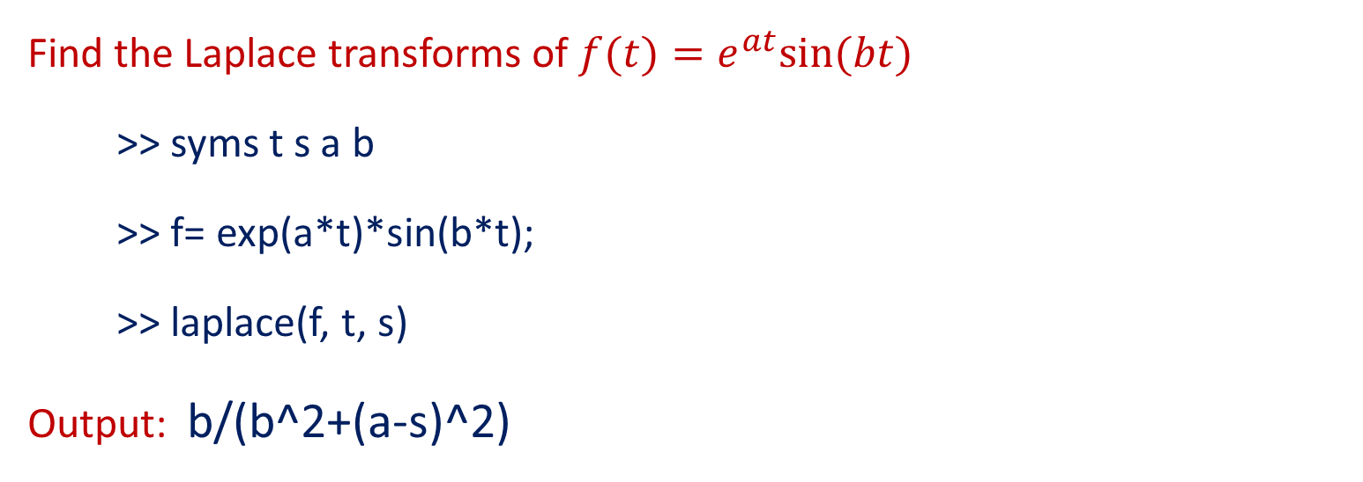
Examples
Find the Laplace transforms of $f(t)=e^{at}sin⁡(bt)$
>> syms t s a b
>> f= exp(a*t)*sin(b*t);
>> laplace(f, t, s)
Output: b/(b^2+(a-s)^2)

Slide 5
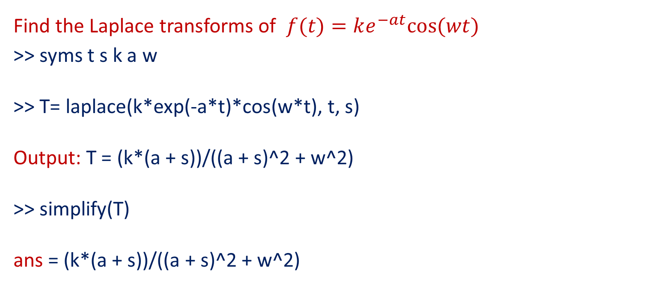
Examples
Find the Laplace transforms of $f(t)=ke^{−at}cos⁡(wt)$
>> syms t s k a w
>> T= laplace(k*exp(-a*t)*cos(w*t), t, s) Output: T = (k*(a + s))/((a + s)^2 + w^2)
>> simplify(T)
ans = (k*(a + s))/((a + s)^2 + w^2)

Slide 6
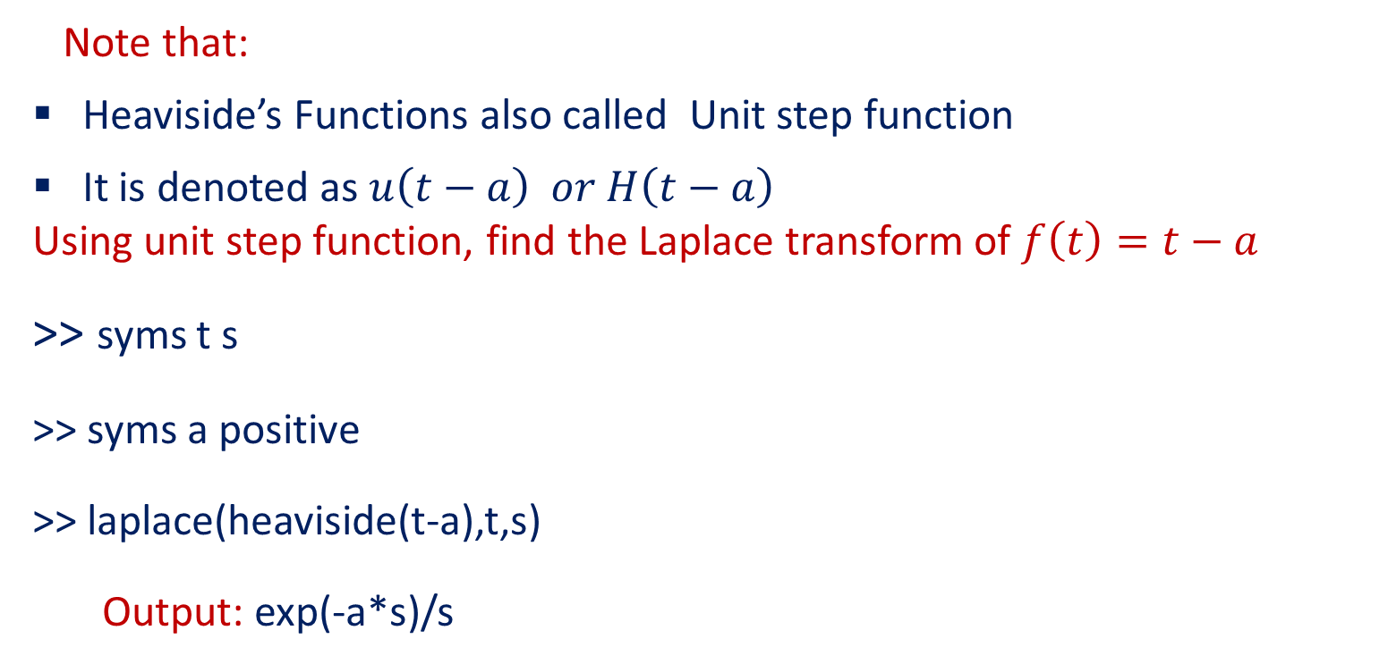
Laplace transformation of Dirac Delta and Heaviside’s Functions
Note that:
Heaviside’s Functions also called Unit step function
It is denoted as $u\left(t−a\right) or H\left(t−a\right)$
Using unit step function, find the Laplace transform of $f\left(t\right)=t−a$
>> syms t s
>> syms a positive
>> laplace(heaviside(t-a),t,s)
Output: exp(-a*s)/s

Slide 7
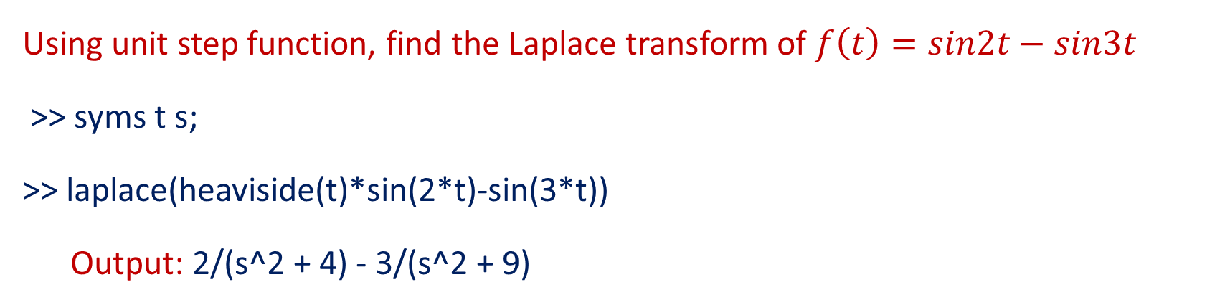
Laplace transformation of Dirac Delta and Heaviside’s Functions
Using unit step function, find the Laplace transform of $f\left(t\right)=sin2t−sin3t$
>> syms t s;
>> laplace(heaviside(t)*sin(2*t)-sin(3*t))
Output: 2/(s^2 + 4) - 3/(s^2 + 9)

Slide 8
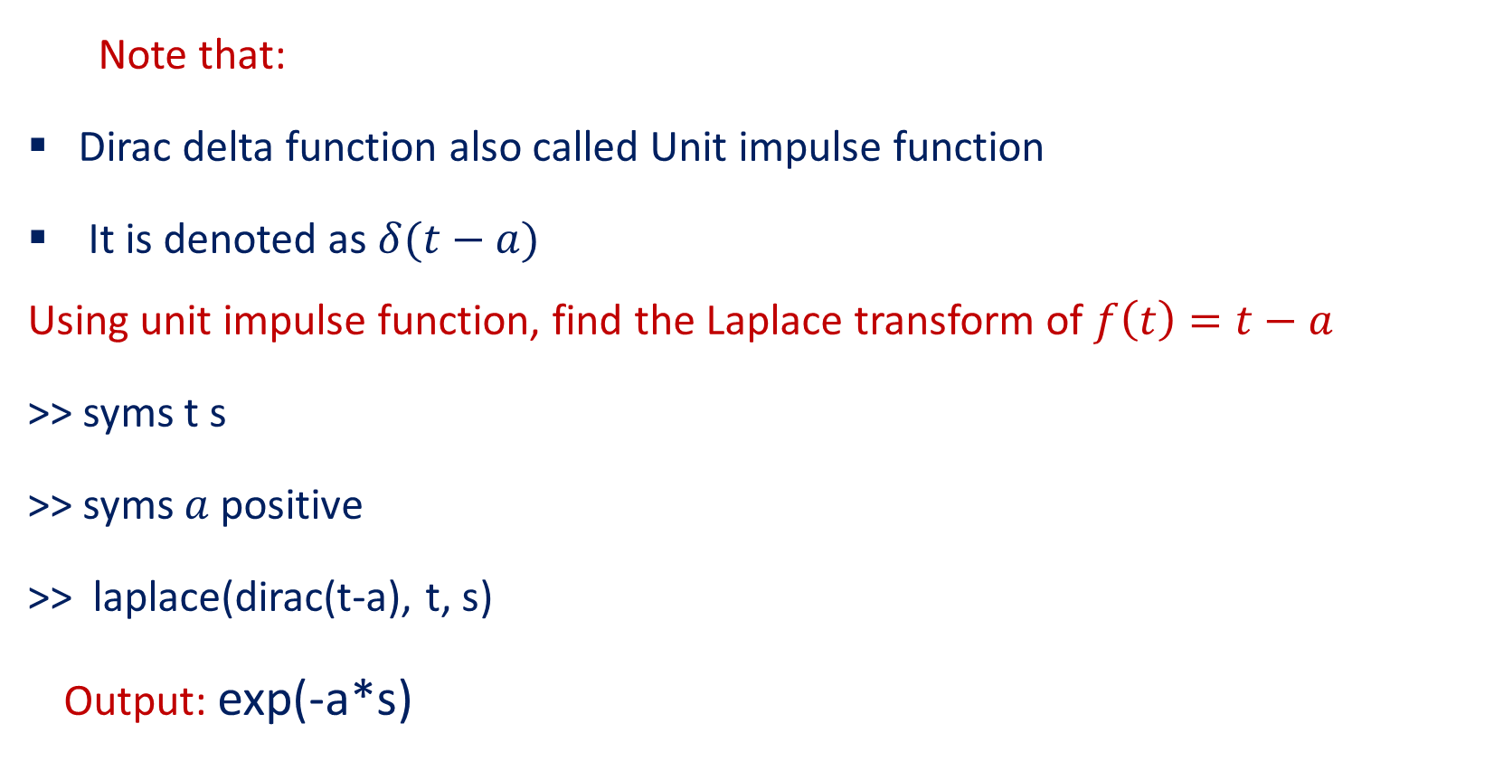
Dirac delta Functions
Note that:
Dirac delta function also called Unit impulse function
It is denoted as $δ(t−a)$
Using unit impulse function, find the Laplace transform of $f\left(t\right)=t−a$
>> syms t s
>> syms $a$ positive
>> laplace(dirac(t-a), t, s)
Output: exp(-a*s)

Slide 9

Dirac delta Functions
Using unit impulse function, find the Laplace transform of $f\left(t\right)=(t−1)$
>> syms t s
>> syms $a$ positive
>> laplace(dirac(t-1),t,s)
Output: exp(-s)

Slide 10
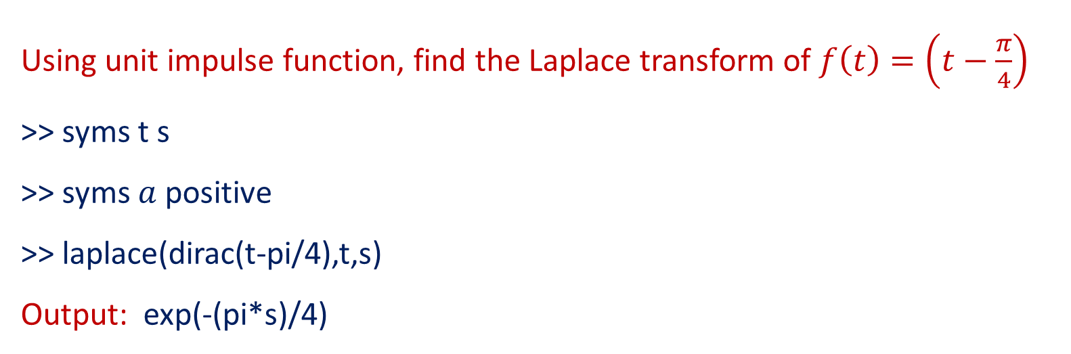
Dirac delta Functions
Using unit impulse function, find the Laplace transform of $f\left(t\right)=\left(t−\frac{π}{4}\right)$
>> syms t s
>> syms $a$ positive
>> laplace(dirac(t-pi/4),t,s)
Output: exp(-(pi*s)/4)

Slide 11
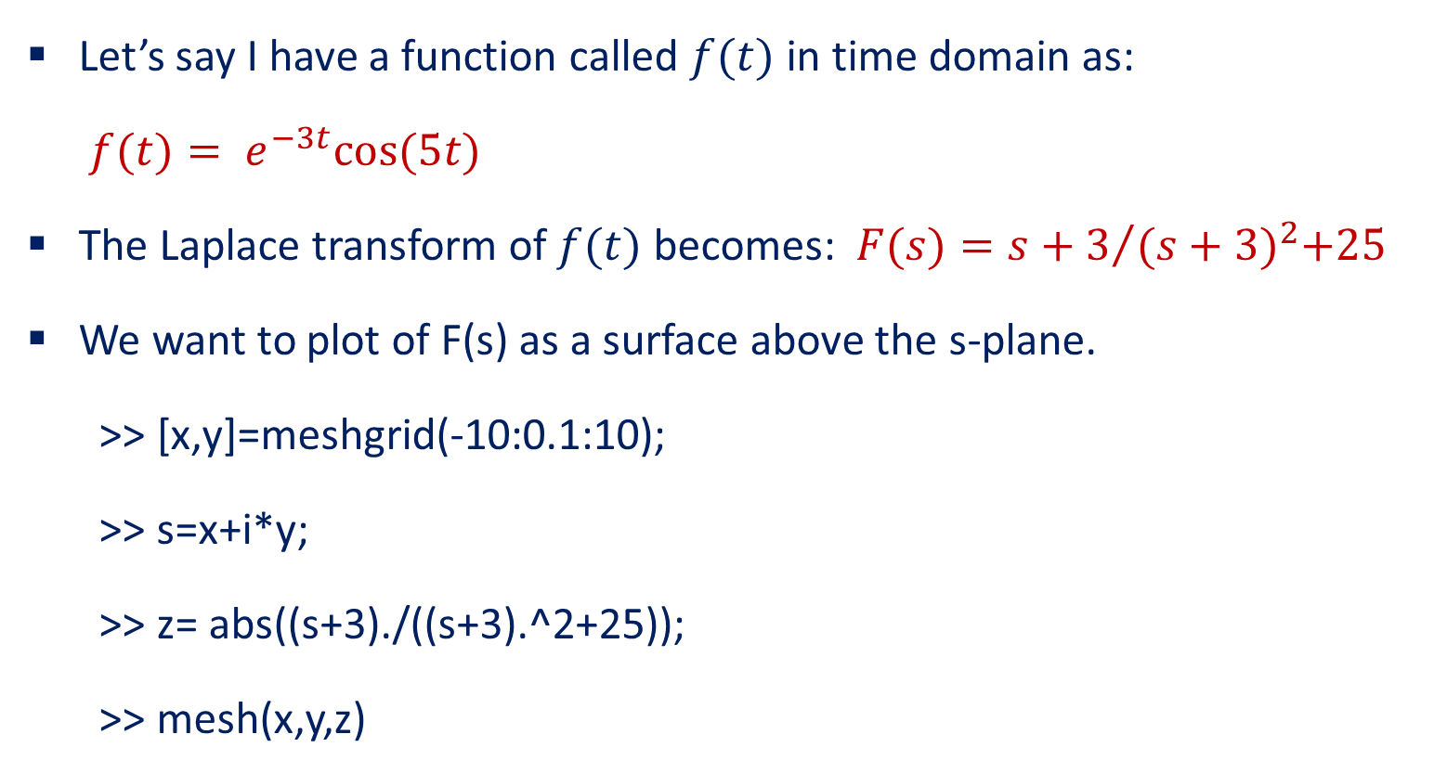
Plot a 3D graph of a given Laplace Transform of a function:
Let’s say I have a function called $f(t)$ in time domain as:
$f(t)= e^{−3t}cos⁡(5t)$
The Laplace transform of $f(t)$ becomes: $F(s)={s+3}/{{(s+3)}^{2}+25}$
We want to plot of F(s) as a surface above the s-plane.
>> [x,y]=meshgrid(-10:0.1:10);
>> s=x+i*y;
>> z= abs((s+3)./((s+3).^2+25));
>> mesh(x,y,z)

Slide 12
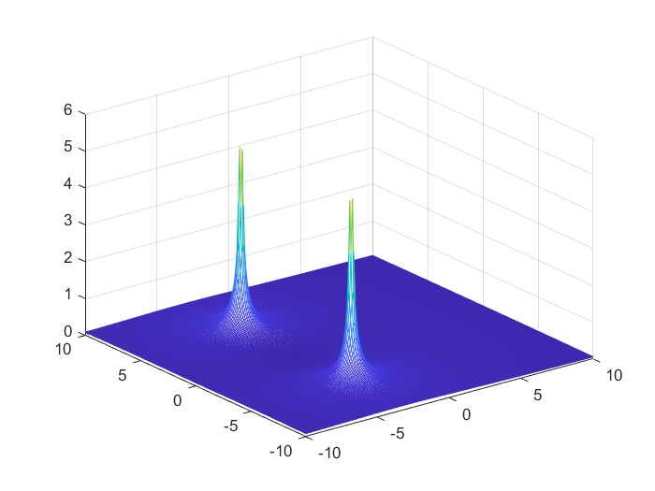
Plot a 3D graph of a given Laplace Transform of a function continu:
Output:

Slide 13
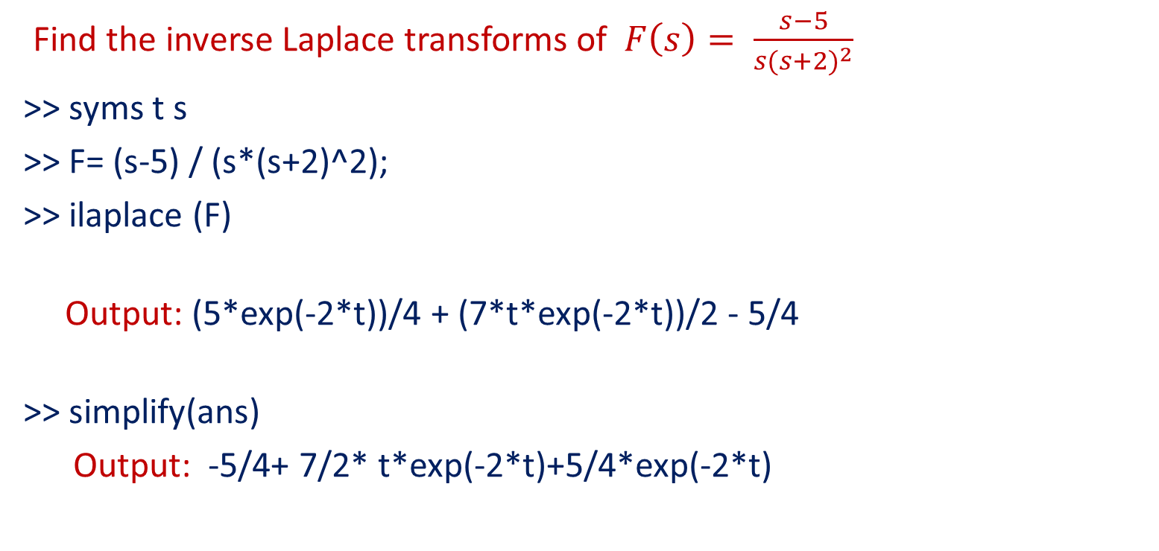
Inverse Laplace Transform
The command for ILT ilaplace.
Find the inverse Laplace transforms of $F\left(s\right)= \frac{s−5}{s{(s+2)}^{2}}$
>> syms t s
>> F= (s-5) / (s*(s+2)^2);
>> ilaplace (F)
Output: (5*exp(-2*t))/4 + (7*t*exp(-2*t))/2 - 5/4
>> simplify(ans)
Output: -5/4+ 7/2* t*exp(-2*t)+5/4*exp(-2*t)

Slide 14

Inverse Laplace Transform
Find the inverse Laplace transforms of $F(s)=\frac{10(s+2)}{s(s^{2}+4s+5)}$
>> syms t s
>> F = 10*(s+2)/(s*(s^2+4*s+5));
>> ilaplace(F)
Output: -4*exp(-2*t)*cos(t)+2*exp(-2*t)*sin(t)+4

Slide 15

Inverse Laplace Transform
Find the inverse Laplace transforms of $F\left(s\right)=\frac{4/s}{4+s^{2}}$
>> syms s t
>> f=(4/s)/(4+s^2);
>> ilaplace(f,s,t)
Output: 1-cos2*t

Slide 16

Inverse Laplace Transform
Find the inverse Laplace transforms of $F\left(s\right)=\frac{a}{(s^{2}−a^{2})}$
>> syms s a t
>> f= a/(s^2-a^2);
>> r=ilaplace(f,s,t)
Ouput: exp(a*t)/2 - exp(-a*t)/2

Slide 17
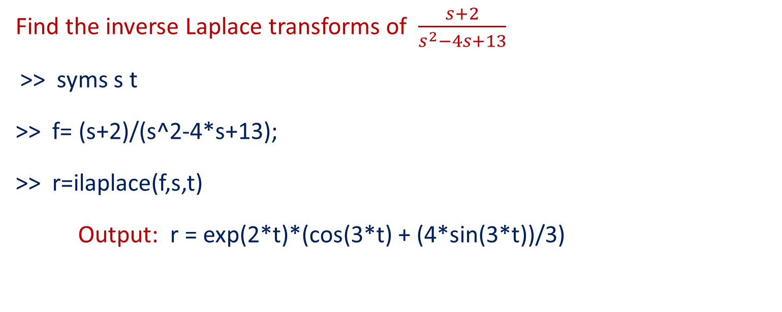
Inverse Laplace Transform
Find the inverse Laplace transforms of $\frac{s+2}{s^{2}−4s+13}$
>> syms s t
>> f= (s+2)/(s^2-4*s+13);
>> r=ilaplace(f,s,t)
Output: r = exp(2*t)*(cos(3*t) + (4*sin(3*t))/3)

Slide 18
Solution of ODE’s using Laplace transform
This approach works only for linear differential equations with constant coefficients.
Right-hand side functions which are sums and products of polynomials, exponential functions, sine and cosine functions, Heaviside(unit step) functions, Dirac (impulse) “functions”, initial conditions given at t=0 .
The main advantage is that we can handle right-hand side functions which are piecewise defined, and which contain Dirac impulse “functions”.

Slide 19
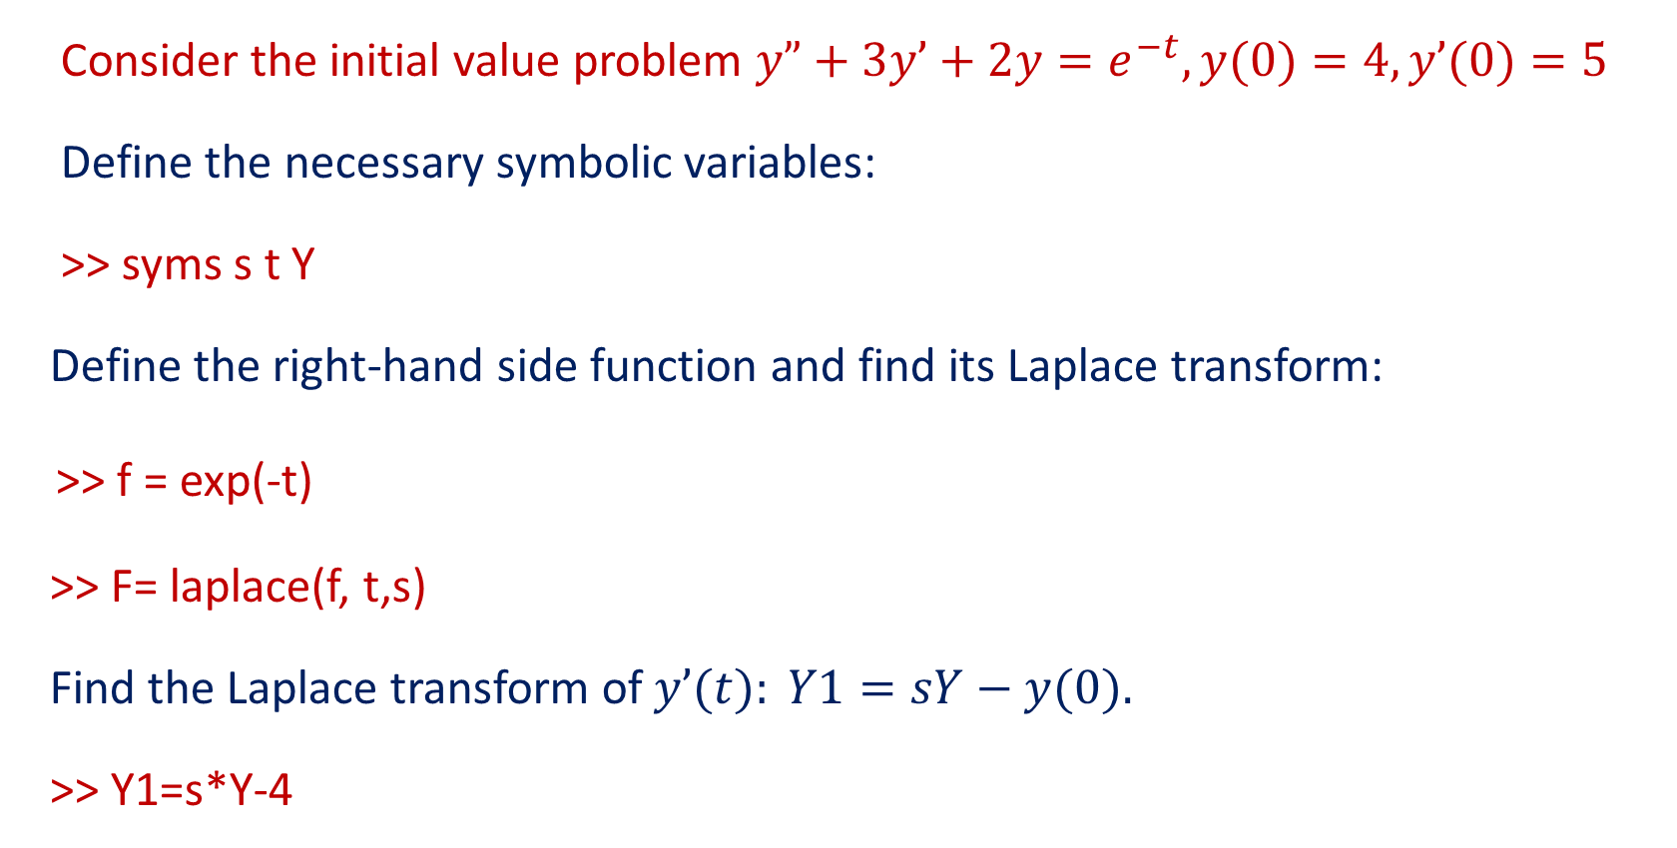
Solution of ODE’s using Laplace transform
Consider the initial value problem $y”+3y’+2y=e^{−t}, y(0)=4, y’(0)=5$
Define the necessary symbolic variables:
>> syms s t Y
Define the right-hand side function and find its Laplace transform:
>> f = exp(-t)
>> F= laplace(f, t,s)
Find the Laplace transform of $y’(t): Y1=sY−y(0).$
>> Y1=s*Y-4

Slide 20
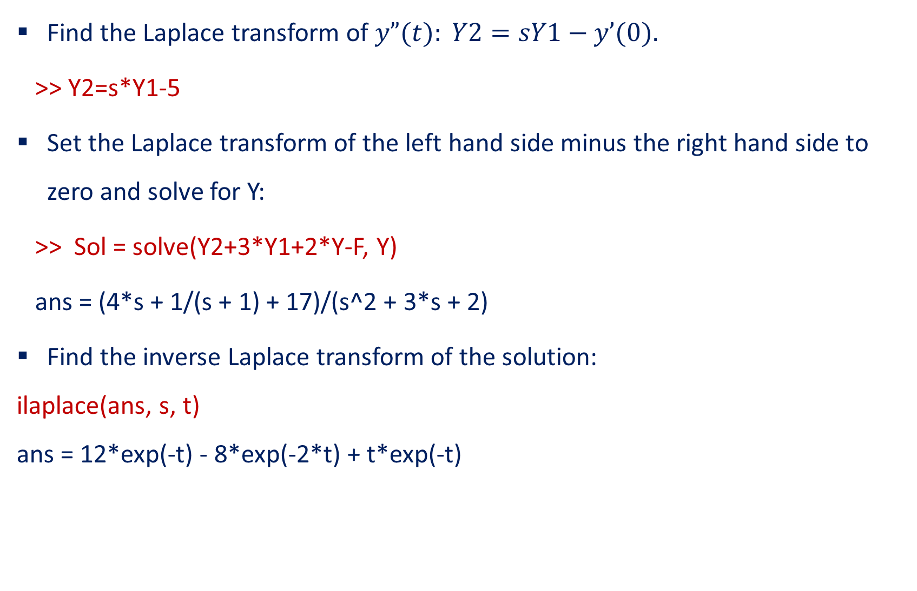
Solution of ODE’s using Laplace transform
Find the Laplace transform of $y”(t): Y2=sY1−y’(0).$
>> Y2=s*Y1-5
Set the Laplace transform of the left hand side minus the right hand side to zero and solve for Y:
>> Sol = solve(Y2+3*Y1+2*Y-F, Y)
ans = (4*s + 1/(s + 1) + 17)/(s^2 + 3*s + 2)
Find the inverse Laplace transform of the solution:
ilaplace(ans, s, t) ans = 12*exp(-t) - 8*exp(-2*t) + t*exp(-t)

Slide 21
THANK YOU

