Slide 1

ENGINEERING MATHEMATICS-II
UE23MA141B
Department of Science and Humanities

Slide 2
ENGINEERING MATHEMATICS-II
UE23MA141B
UNIT 3: Random variables and probability distribution
Class: Normal approximation to binomial and poisson distribution

Slide 3


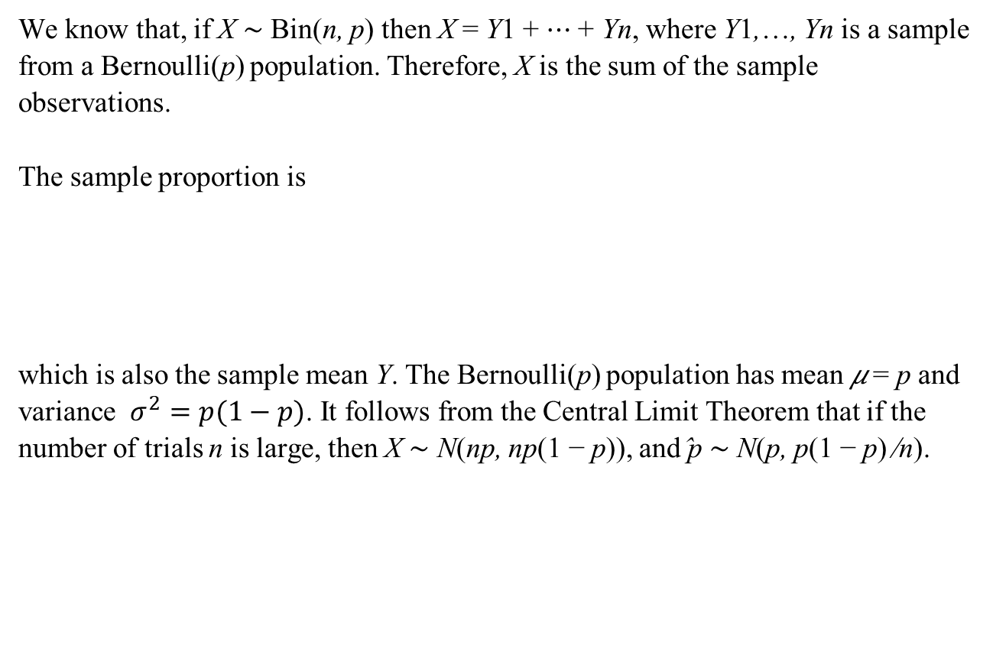
Normal approximation to binomial
We know that, if X ∼ Bin(n, p) then X = Y1 + ⋯ + Yn, where Y1,…, Yn is a sample from a Bernoulli(p) population. Therefore, X is the sum of the sample observations.
The sample proportion is
which is also the sample mean Y. The Bernoulli(p) population has mean 𝜇 = p and variance $σ^{2}=p(1−p)$. It follows from the Central Limit Theorem that if the number of trials n is large, then X ∼ N(np, np(1 − p)), and ̂p ∼ N(p, p(1 − p) ∕n).

Slide 4
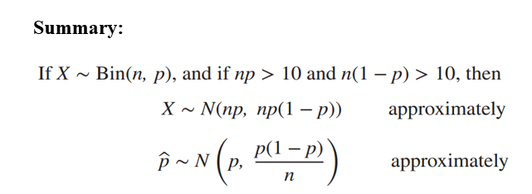
Normal approximation to binomial
In the binomial case, the accuracy of the normal approximation depends on the mean number of successes np and on the mean number of failures n(1−p). The larger the values of np and n(1−p), the better the approximation. A common rule of thumb is to use the normal approximation whenever np > 5 and n(1 − p) > 5. A better and more conservative rule is to use the normal approximation whenever np > 10 and n(1 − p) > 10.

Slide 5
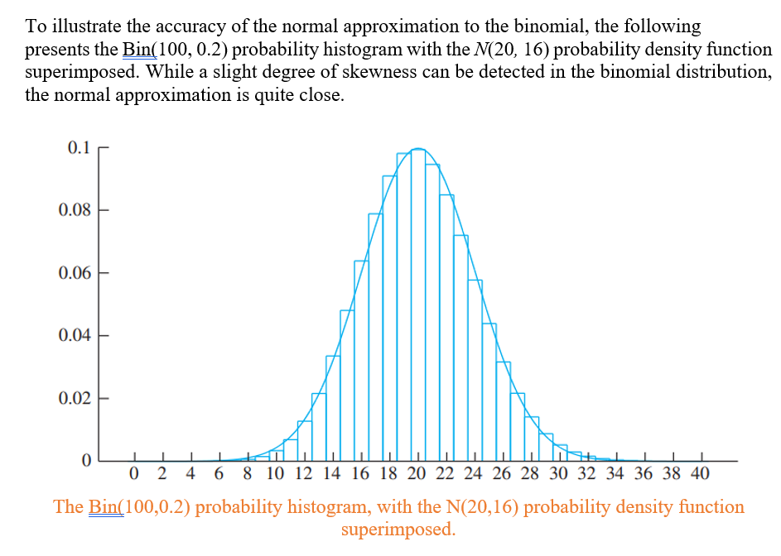
Normal approximation to binomial

Slide 6
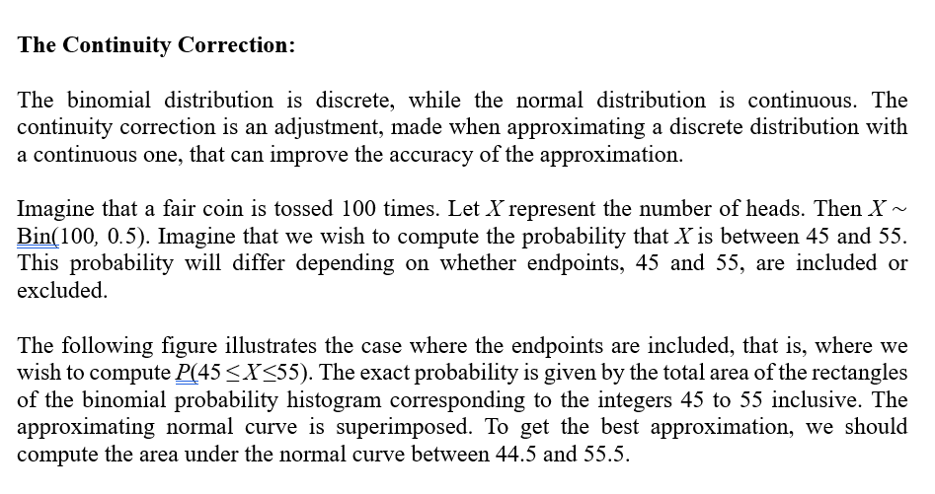
Normal approximation to binomial

Slide 7
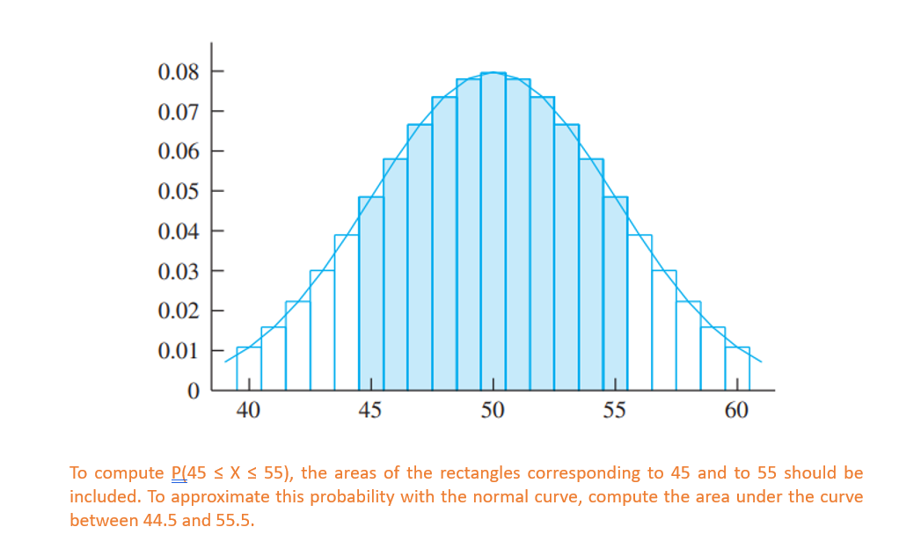
Normal approximation to binomial

Slide 8
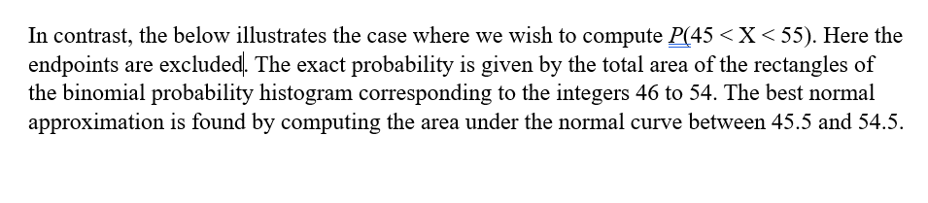
Normal approximation to binomial

Slide 9
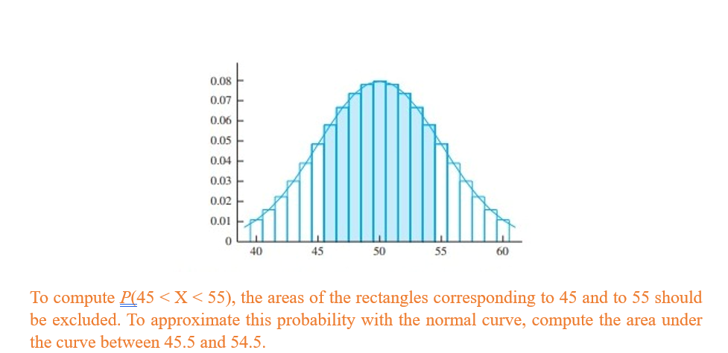
Normal approximation to binomial

Slide 10
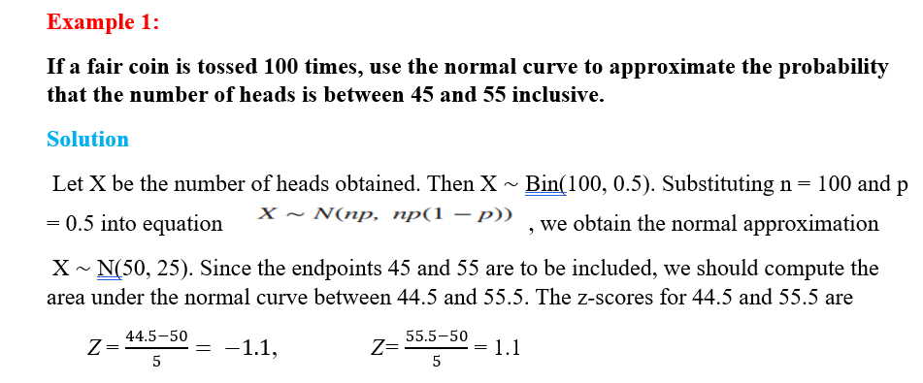
Normal approximation to binomial

Slide 11
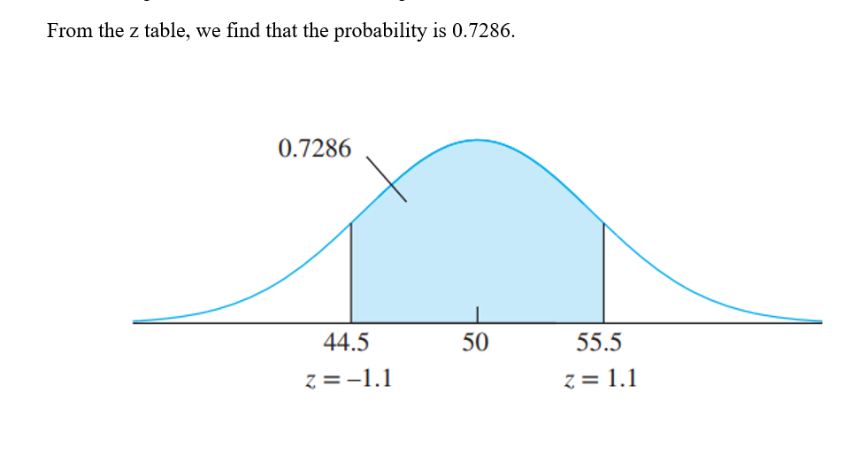
Normal approximation to binomial

Slide 12
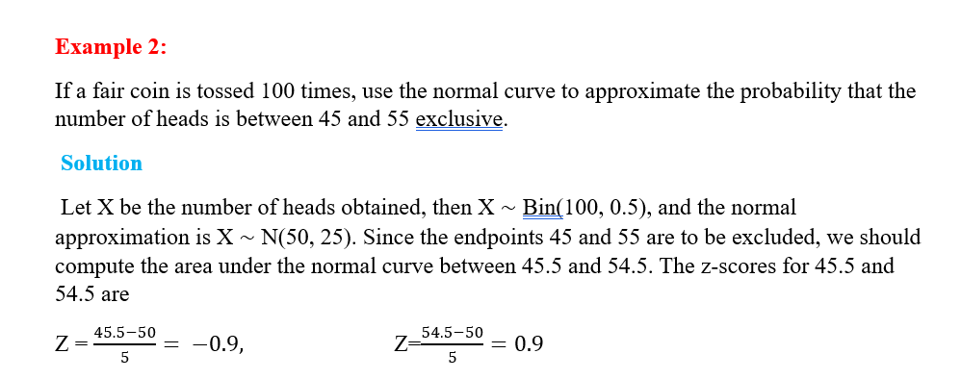
Normal approximation to binomial

Slide 13
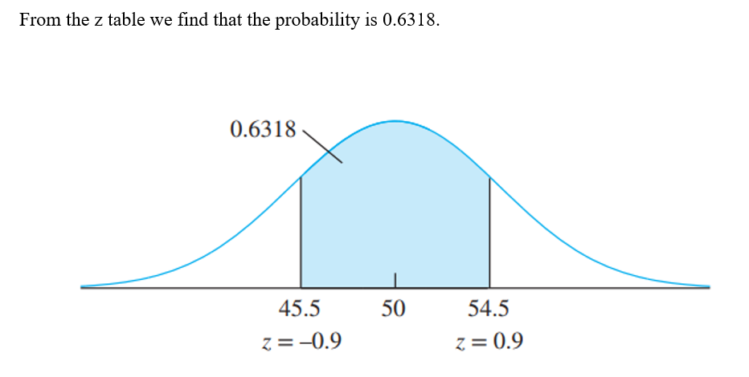
Normal approximation to binomial

Slide 14
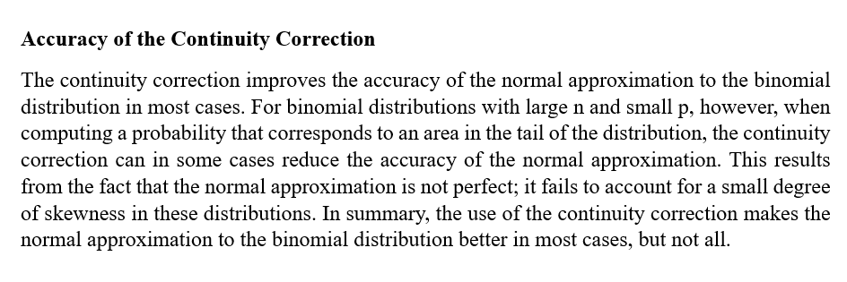
Normal approximation to binomial

Slide 15
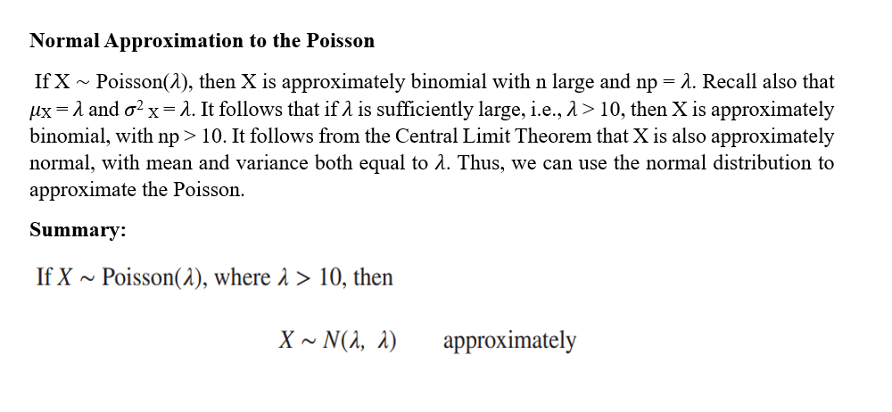
Normal approximation to poisson

Slide 16
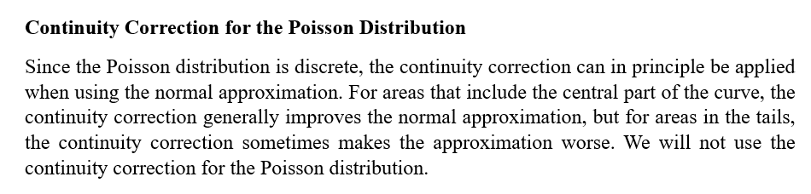
Normal approximation to poisson

Slide 17
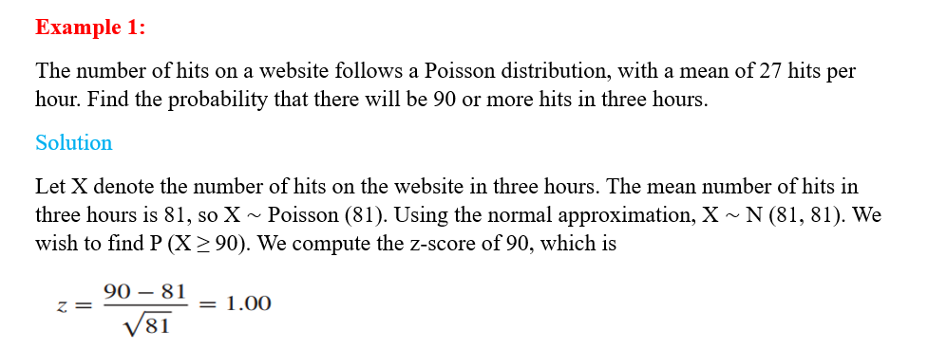
Normal approximation to poisson

Slide 18
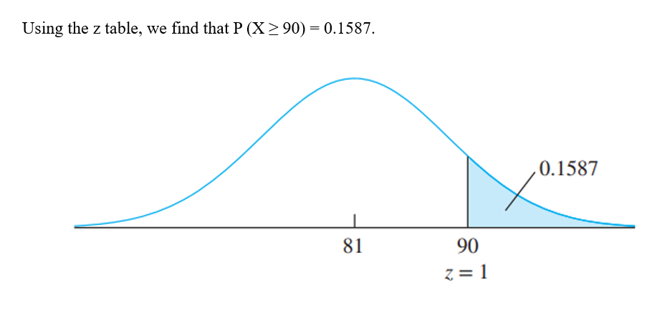
Normal approximation to poisson

Slide 19
THANK YOU

