Slide 1

Normal Distribution
V. Leela
Department of
Science and Humanities

Slide 2

NORMAL DISTRIBUTION Or GAUSSIAN DISTRIBUTION
Normal Distribution
Standard Normal Distribution
Normal curve
Mean and Variance
Standard Normal distribution table

Slide 3
NORMAL DISTRIBUTION Or GAUSSIAN DISTRIBUTION
Normal Distribution is a continuous distribution of fundamental importance ,any quantity whose variation depends on random causes is distributed according to normal law ,its importance lies in the fact that a large
number of distributions approximate to normal distribution .
Independently Gauss and Adrain developed the formula for normal distribution and showed that errors fit well by this distribution .

Slide 4
NORMAL AND STANDARD NORMAL DISTRIBUTION
FEATURES OF NORMAL DISTRIBUTION
Normal distribution, also known as the Gaussian distribution, is a probability distribution that is symmetric about the mean, showing that data near the mean is more frequent in occurrence than data far from the mean. In graph form, normal distribution will appear as a bell curve.
Normal distributions do not necessarily have the same means and standard deviations. A normal distribution with a mean of 0 and a standard deviation of 1 is called a standard normal distribution.

Slide 5
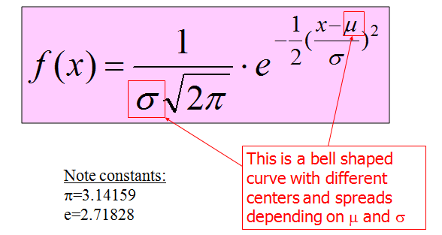
NORMAL DISTRIBUTION
The continuous probability distribution with Probability Density function as follows :

Slide 6
NORMAL DISTRIBUTION
FEATURES OF NORMAL DISTRIBUTION
It can be seen that the limiting form of the binomial
distribution for large values of n when neither ‘p’
nor ‘q’ is very small ,is the normal distribution .
The Normal Distribution function can be obtained
where and

Slide 7
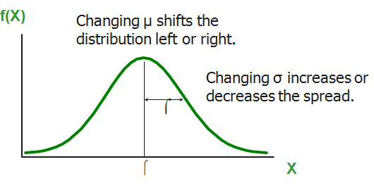
NORMAL AND STANDARD NORMAL DISTRIBUTION
FEATURES OF NORMAL DISTRIBUTION
The graph of the probability function f(x) is a
Bell shaped curve symmetrical about the line
and is known as normal probability curve

Slide 8
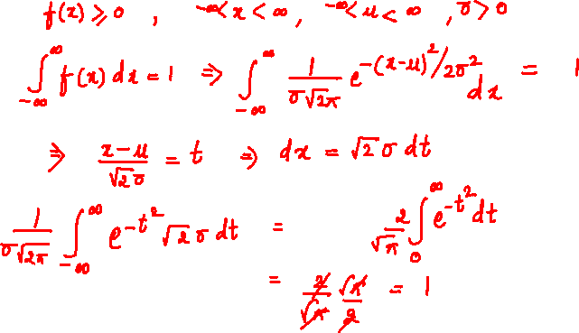
NORMAL AND STANDARD NORMAL DISTRIBUTION
FEATURES OF NORMAL DISTRIBUTION

Slide 9
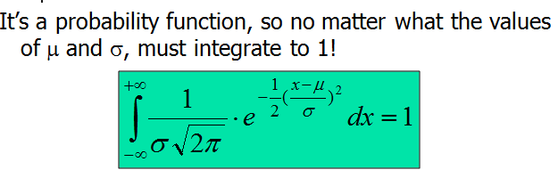
NORMAL DISTRIBUTION
The line divides the total area under the
Curve which is equal to 1 into two equal parts .
The area to the right and left of the line
is 0.5

Slide 10
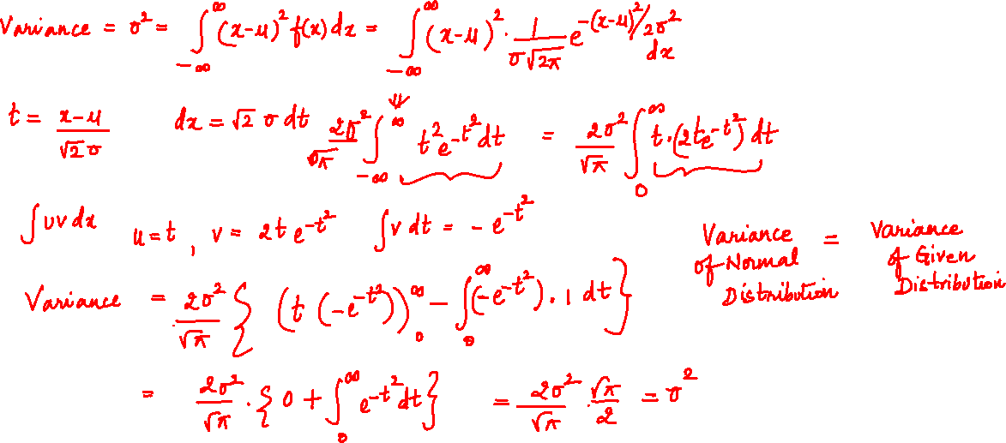
STANDARD NORMAL DISTRIBUTION

Slide 11
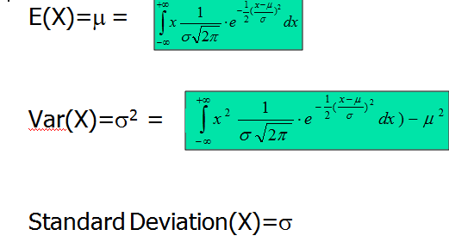
STANDARD NORMAL DISTRIBUTION
,

Slide 12
NORMAL AND STANDARD NORMAL DISTRIBUTION
FEATURES OF NORMAL DISTRIBUTION
In case of normal distribution
This integral cannot be evaluated by known methods of integration so we have to employ known techniques of numerical integration, which becomes tedious ,so it must be standarized .
taking ,

Slide 13

NORMAL AND STANDARD NORMAL DISTRIBUTION
FEATURES OF NORMAL DISTRIBUTION
be the values of ‘z’ corresponding to x= a and x=b
is same as
probability density function of normal distribution with mean
‘z’ is called standard normal variate and F(z) is called as standard normal curve which is symmetrical about the line z = 0

Slide 14
STANDARD NORMAL DISTRIBUTION
(Standard normal p.d.f. )
is the same as p.d.f. of normal distribution
with mean and is the (Standard Normal p.d.f.)
is called as the standard normal variate and
is called as standard normal curve which is
symmetrical about the line

Slide 15


GEOMETRY OF STANDARD NORMAL DISTRIBUTION
The curve is as follows :
the integral represents area bounded by standard normal curve between and
represents area under the
standard normal curve from
represents area under the standard
normal curve from

Slide 16









GEOMETRY OF STANDARD NORMAL DISTRIBUTION
denoted by represents area (shaded portion)
Since , total area is 1 , the area on either side of the
is 0.5
Tabulated values which gives the area for different
positive values of z are available and that helps us to in practical problems .

Slide 17

NORMAL AND STANDARD NORMAL DISTRIBUTION
Show that the area under the N.D curve is unity.
Proof:
Normal probability distribution is given by
$y=f\left(x\right)=\frac{1}{σ\sqrt{2π}}e^{−{\left(x−\overline{x}\right)}^{2}/2σ^{2}}$
Then the area A under the normal curve is
$A=\int_{−∞}^{∞}{\frac{1}{σ\sqrt{2π}}e^{−{\left(x−\overline{x}\right)}^{2}/2σ^{2}}}$
Put $\frac{x−\overline{x}}{σ}=z$ so $dx=σdz$
Or $A=\int_{−∞}^{∞}{\frac{1}{σ\sqrt{2π}}e^{−z^{2}/2}σdz}$

Slide 18

NORMAL AND STANDARD NORMAL DISTRIBUTION
Continued………………………………
Put $\frac{x−\overline{x}}{σ}=z$ so $dx=σdz$
Or $A=\int_{−∞}^{∞}{\frac{1}{σ\sqrt{2π}}e^{−z^{2}/2}σdz}=\sqrt{\frac{2}{π}}\int_{0}^{∞}{e^{−\frac{z^{2}}{2}}dz}$
Or $A.A=\left[\sqrt{\frac{2}{π}}\int_{0}^{∞}{e^{−\frac{x^{2}}{2}}dx}\right]\left[\sqrt{\frac{2}{π}}\int_{0}^{∞}{e^{−\frac{y^{2}}{2}}dy}\right]$
Here x, y are dummy variables
$A^{2}=\frac{2}{π}\int_{0}^{∞}{\int_{−∞}^{∞}{e^{−(x^{2}+y^{2})/2}dxdy}}$

Slide 19

NORMAL AND STANDARD NORMAL DISTRIBUTION
Continued…………………………..
Put $x=r\cos{θ}$,$y=r\sin{θ}$, $J$ = Jacobian = $r$ .
Limits for : 0 to $∞$,$θ$ = 0 to 2π (to cover the first quadrant 0 < x < ∞, 0 < y < ∞)
So $A^{2}=\frac{2}{π}\int_{0}^{\frac{π}{2}}{\int_{0}^{∞}{e^{−\frac{r^{2}}{2}}r dr dθ}}$
$=\int_{0}^{∞}{e^{−\frac{r^{2}}{2}}d\left(\frac{r^{2}}{2}\right)=\left.\frac{e^{−\frac{r^{2}}{2}}}{−1}\right|\begin{matrix}∞ \\ 0\end{matrix}}$=1
Thus A = area under the normal curve = 1.

Slide 20
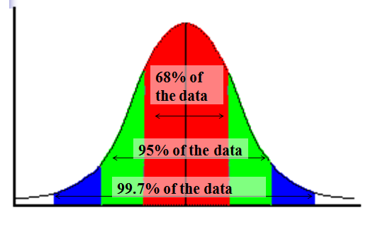
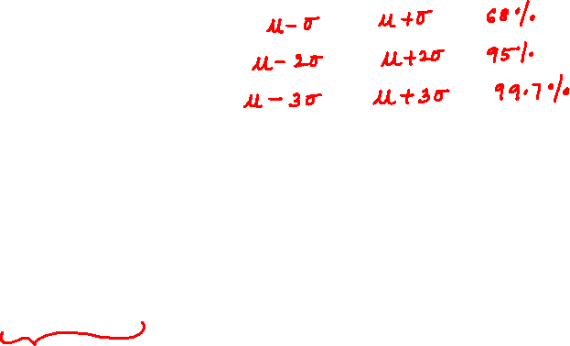

Slide 21
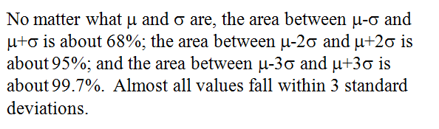


Area under the normal curve is distributed as follows:
68.27% area lies between $\overline{X}−σ$ to $\overline{X}+σ$
i.e., between $−1≤Z≤1$
94.45% area lies between $\overline{X}−2σ$ to $\overline{X}+2σ$
i.e., between $−2≤Z≤2$
99.73% area lies between $\overline{X}−3σ$ to $\overline{X}+3σ$
i.e., between $−3≤Z≤3$
Note: 50% area in the $Z$ – interval (-.745. + .745)
99% area in the$Z$ – interval (-2.58. + 2.58)

Slide 22
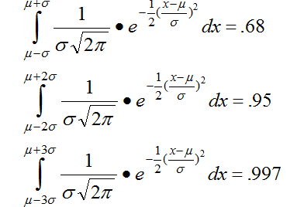

Slide 23
represents the area under the standard normal curve from 0 to z .
Tabulated values which gives the area for different positive values of ‘z’ is readily available ,such a table analogous to the format of a logarithmic table is called Normal probability table .

Slide 25
THANK YOU
V.Leela
Department of
Science and Humanities

