Slide 1

Normal Distribution
V.Leela
Department of
Science and Humanities

Slide 2

NORMAL DISTRIBUTION Or GAUSSIAN DISTRIBUTION
Standard Normal distribution table
Problems to evaluate area under
standard normal curve
Problems
Applications of Normal Distribution

Slide 3
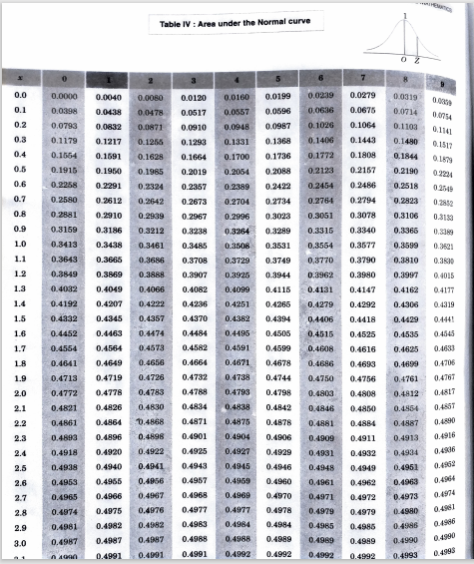



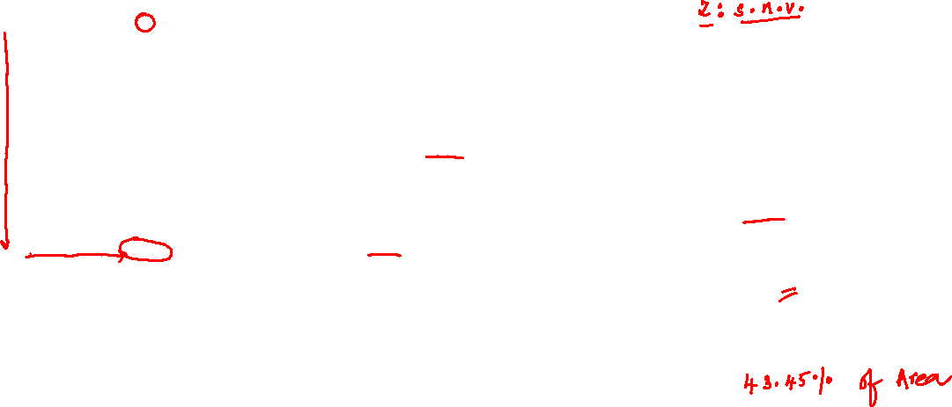




Slide 4
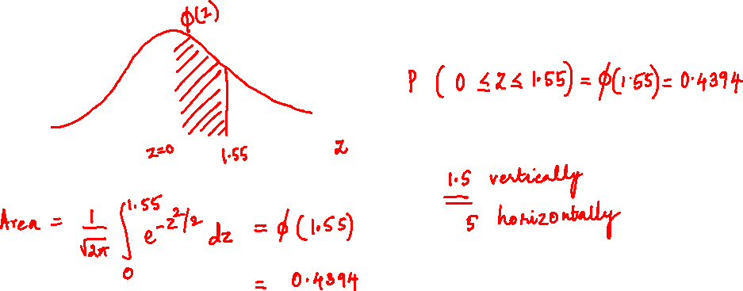
# Find the area under the standard normal curve between z=0 and z = 1.55

Slide 5
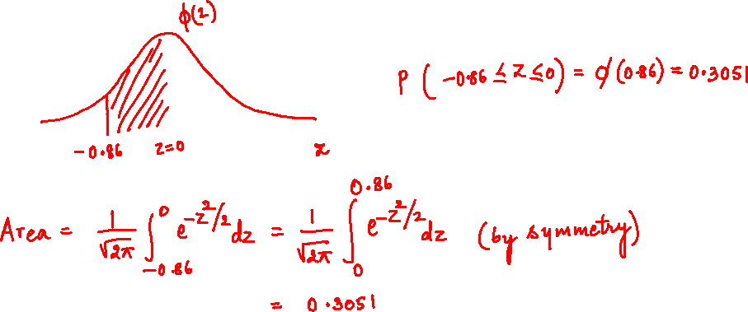
# Find the area under the standard normal curve between z=-0.86 and z = 0

Slide 6
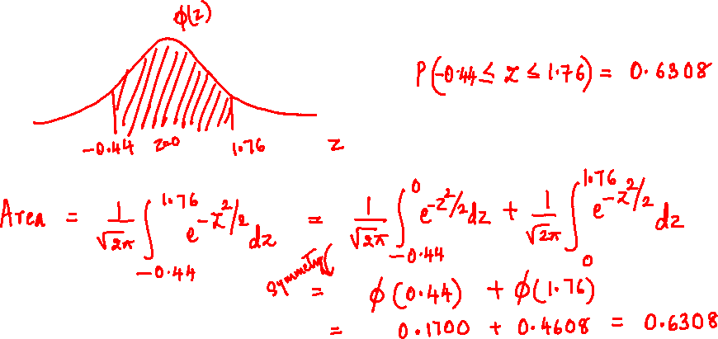
# Find the area under the standard normal curve between z=-0.44 and z = 1.76

Slide 7
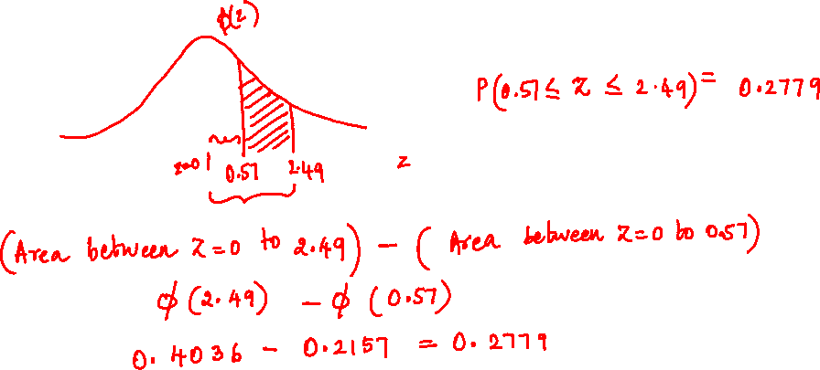
# Find the area under the standard normal curve between z=0.57 and z = 2.49

Slide 8

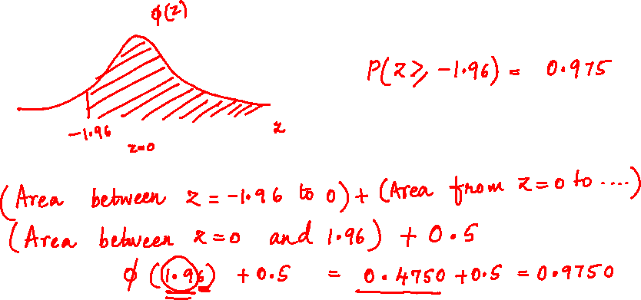

# Find the area under the standard normal curve
Towards the right of z = -1.96

Slide 9
# Prob 1 Evaluate the following probabilities with the help of normal probability tables
1)
2)
3)
4)

Slide 10
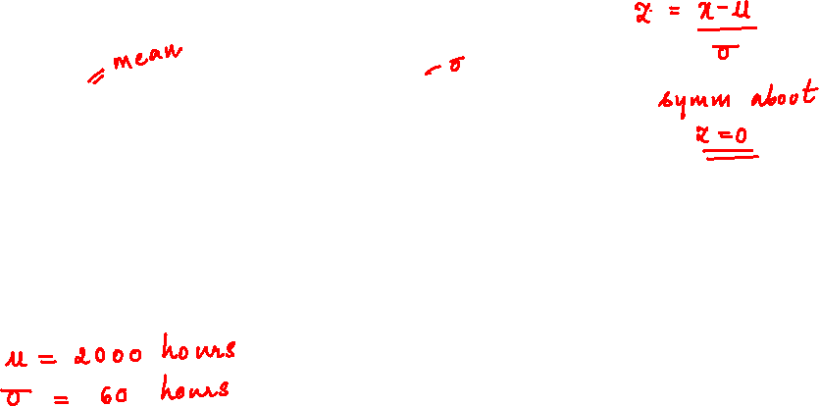
PROBLEMS ON NORMAL DISRIBUTION
# Prob2 : In the test on electric bulbs , it was found that the lifetime of a particular brand was normally distributed
With an average life of 2000 hours and S.D. of 60 hours.If a firm purchases 2500 bulbs .Estimate the number of bulbs likely to last for
More than 2100 hours
less than 1950 hours
more than 1900 hours and 2100 hours .
Ans :

Slide 11
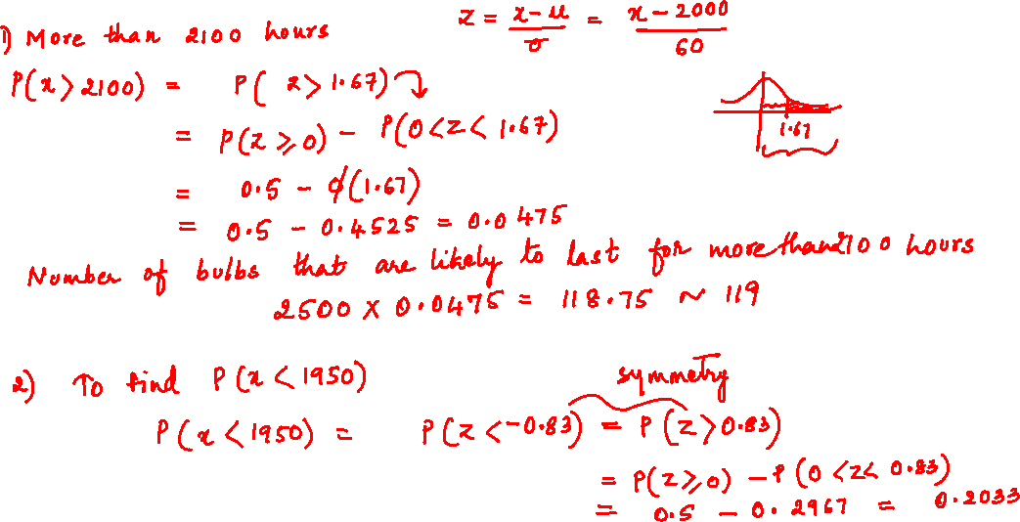
PROBLEMS ON NORMAL DISTRIBUTION

Slide 12
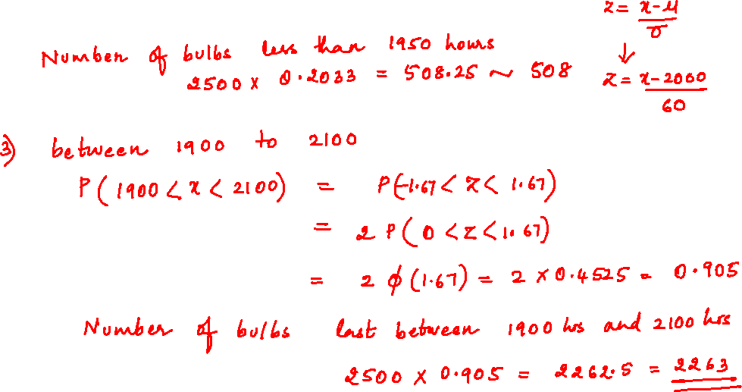
PROBLEMS ON NORMAL DISTRIBUTION

Slide 13
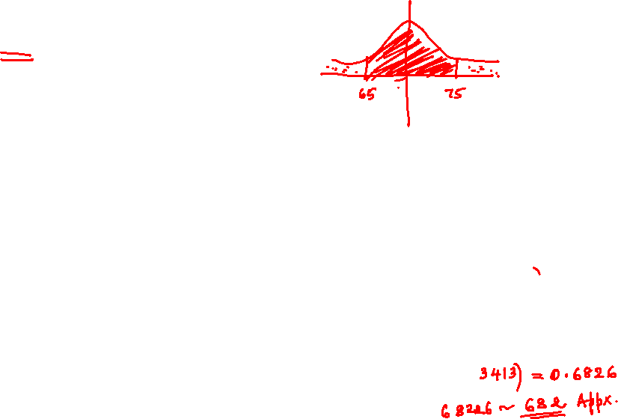
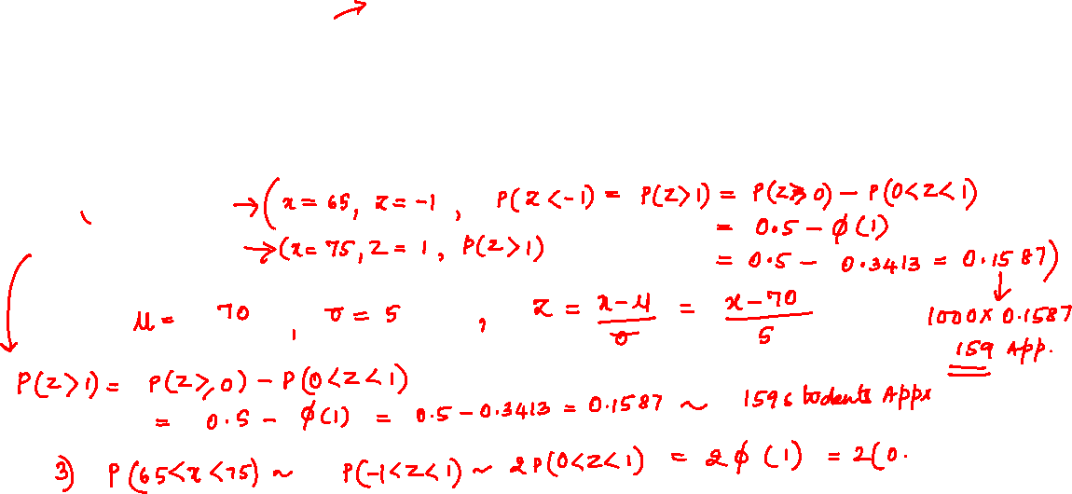
# Prob3 : The marks of 1000 students in an examination follows
A normal distribution with mean 70 and standard deviation 5 .Find the number of students whose marks will be
Less than 65
more than 75
between 65 and 75
Ans :

Slide 14
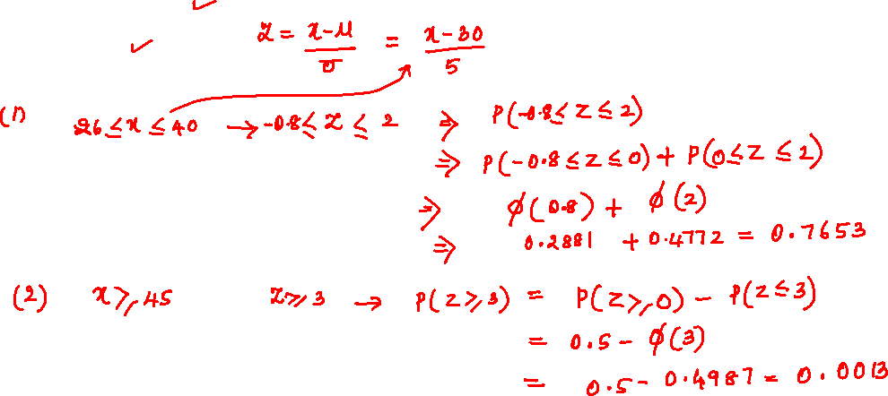
#Prob 4 : If ‘x’ is a normal variate with mean 30 and standard deviation 5 . Find the probability that
2)

Slide 15
APPLICATIONS OF NORMAL DISTRIBUTION
The distribution is applied in problems concerning :
Calculation of errors made by chance in experimental measurements
Computation of hit probability of a shot
3) Statistical inference in almost every branch of science
4) result analysis of a course examination
5) income Distribution in Economy

Slide 16
THANK YOU
V. Leela
Department of
Science and Humanities

