Slide 1
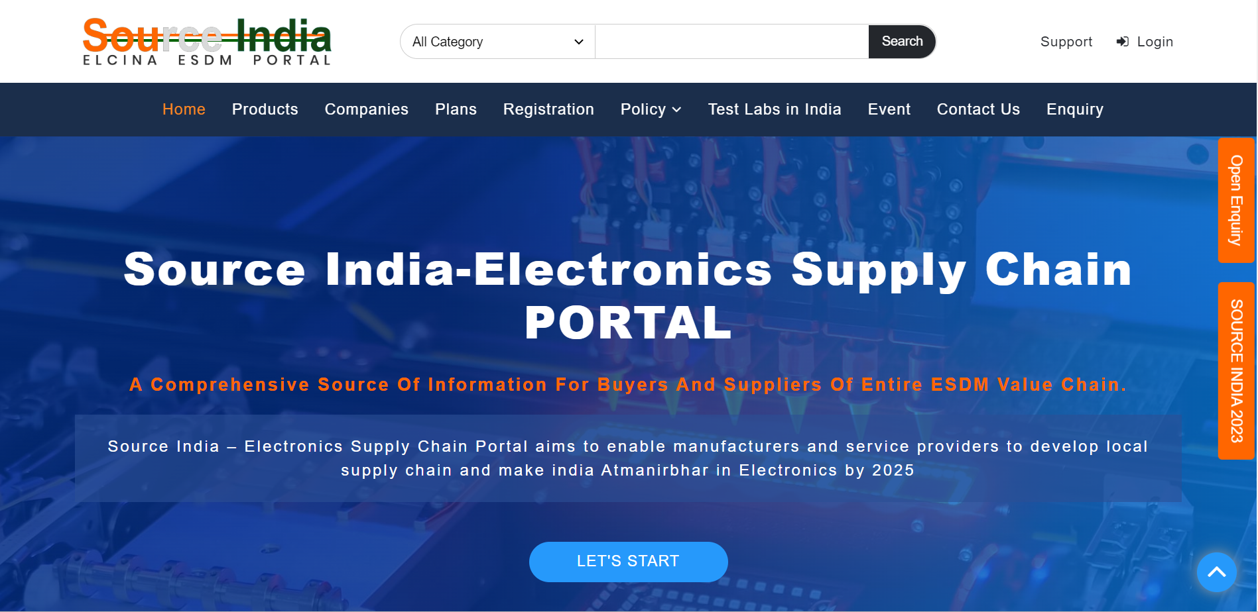

Slide 2
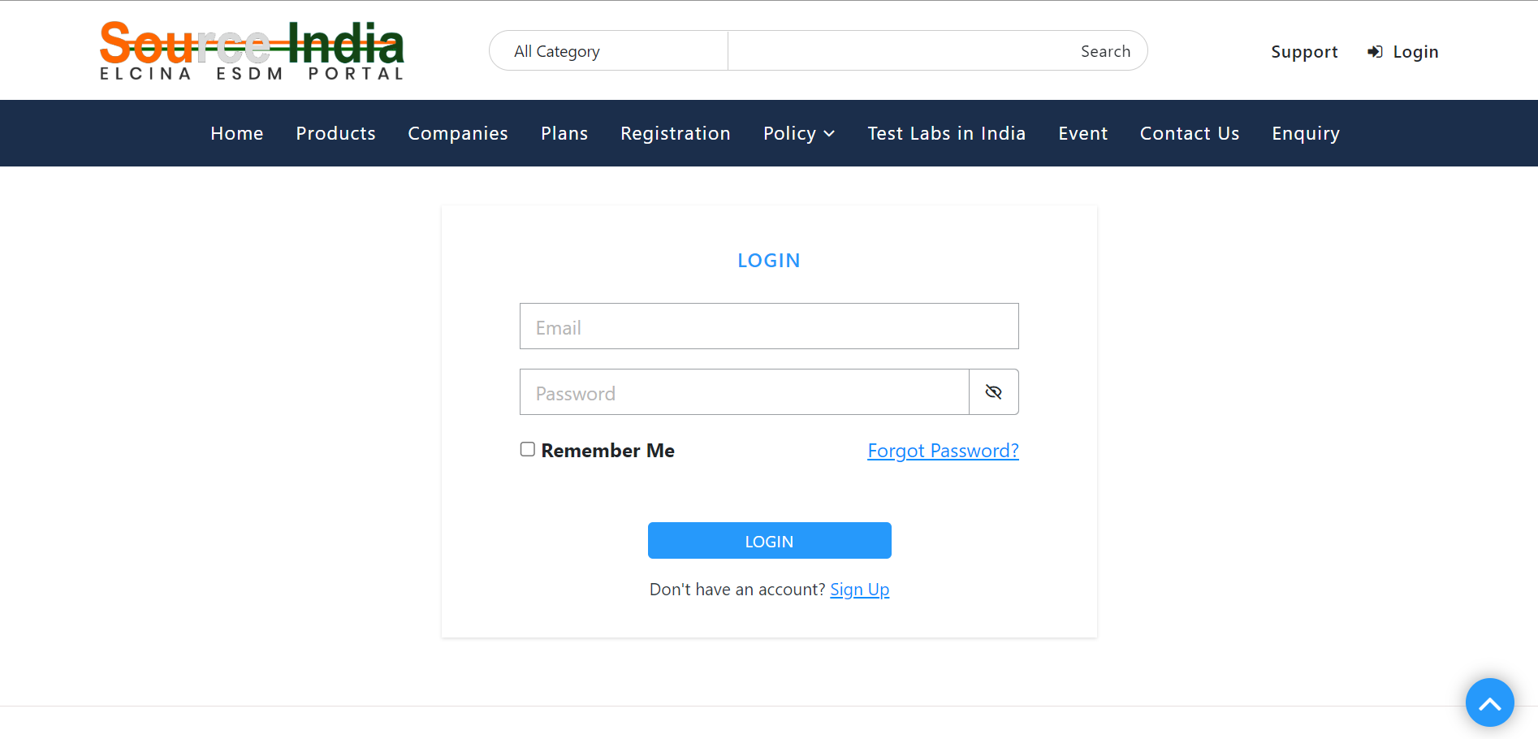
Log in with username and password

Slide 3
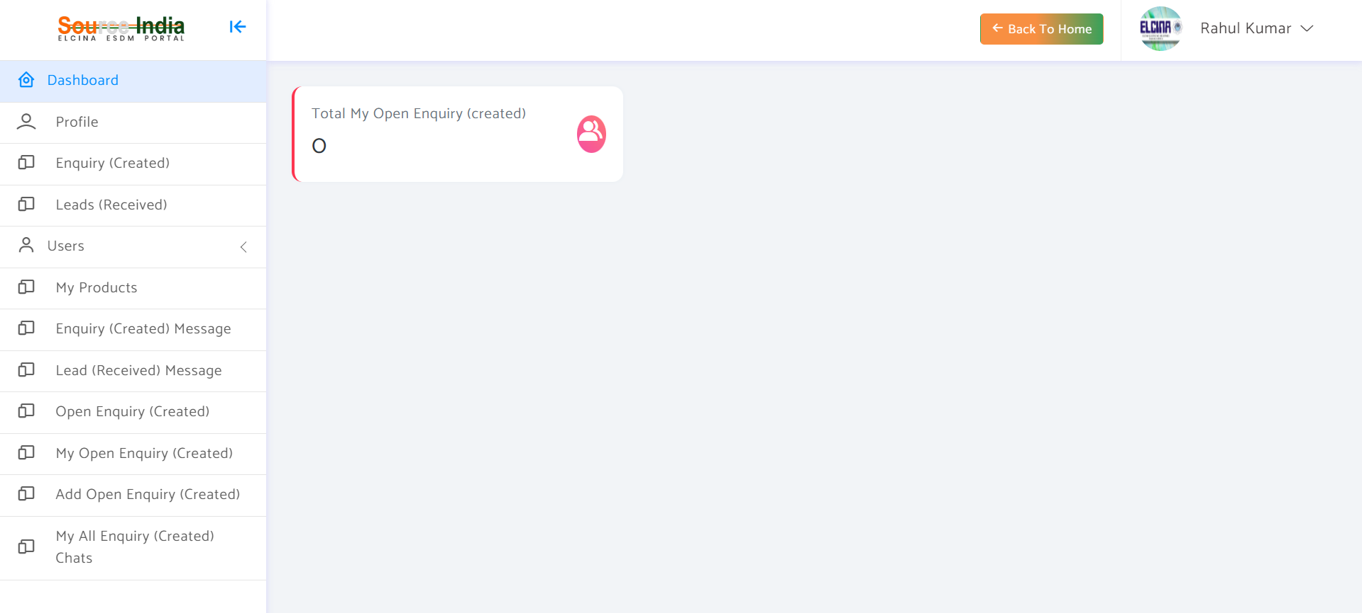
Landing page once you Log In

Slide 4
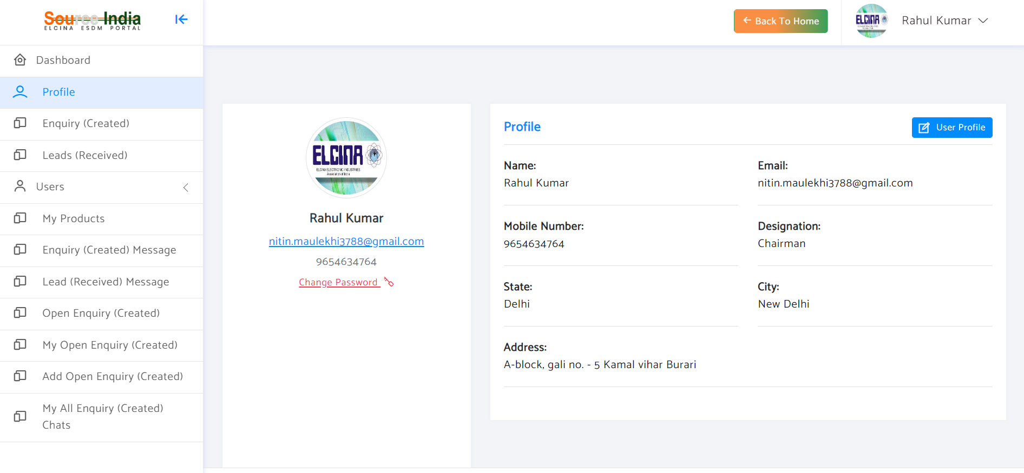
To edit your profile, click on "User Profile"

Slide 5
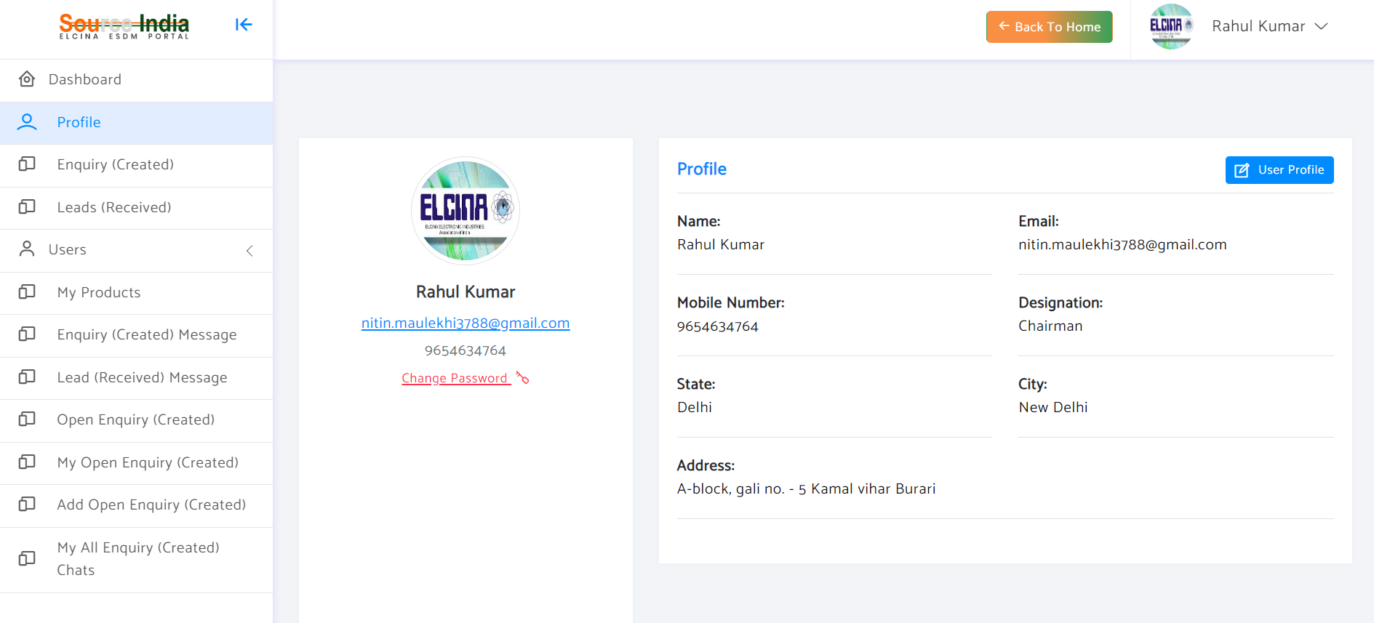
IT is advised to change your password on first login

Slide 6
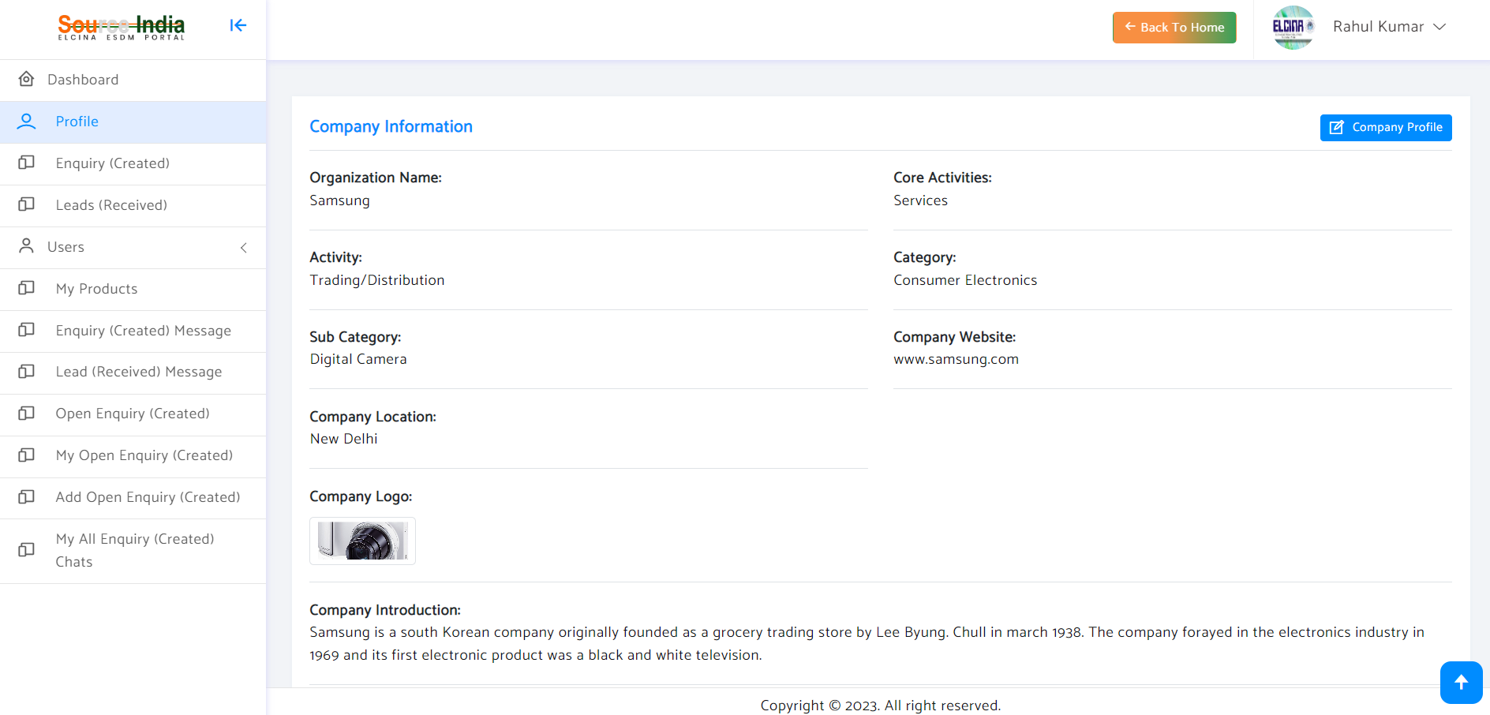
To edit your company profile, click on "Company Profile"

Slide 7
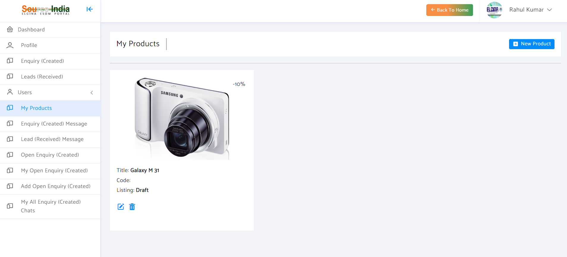
To add your products, click "New Product"

Slide 8
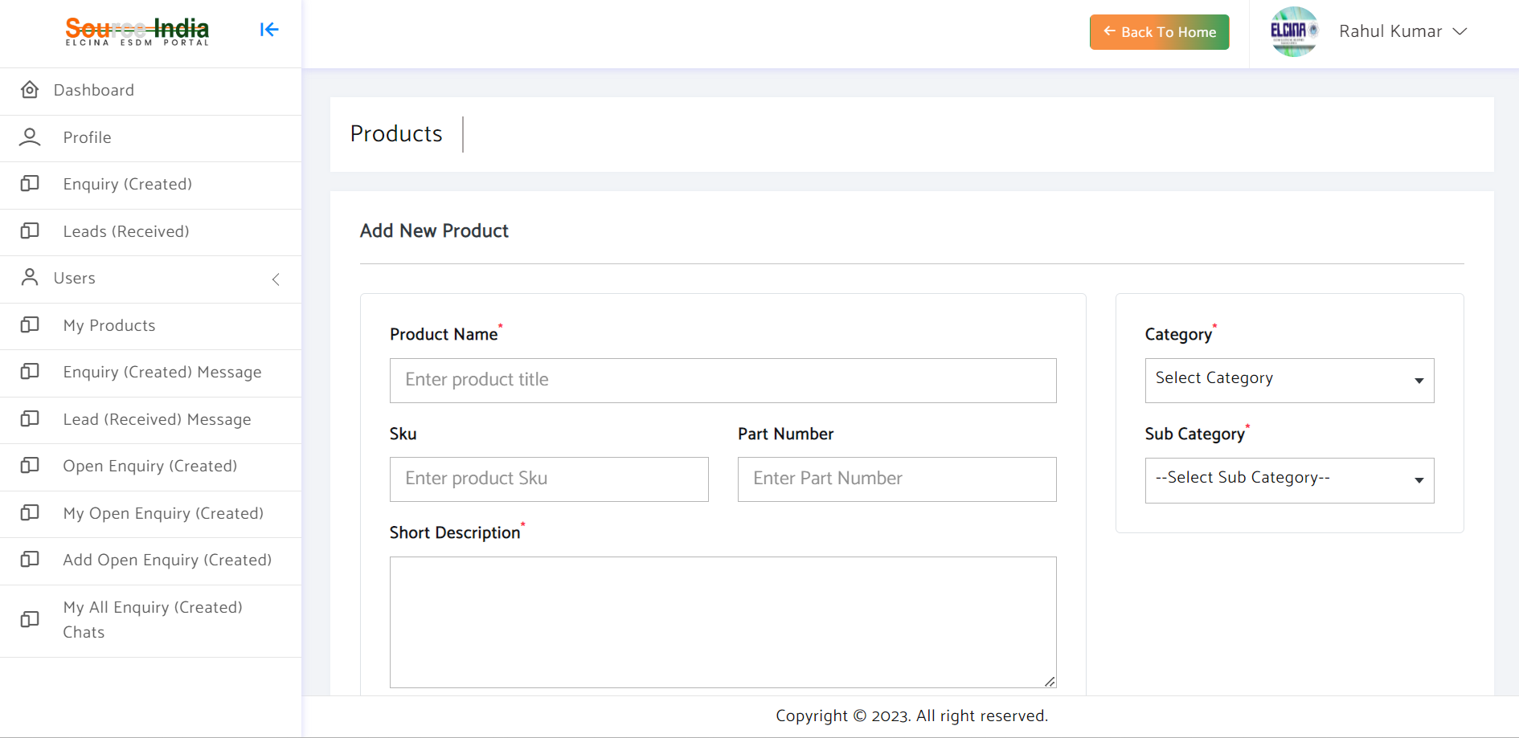
Add product details and save

Slide 9
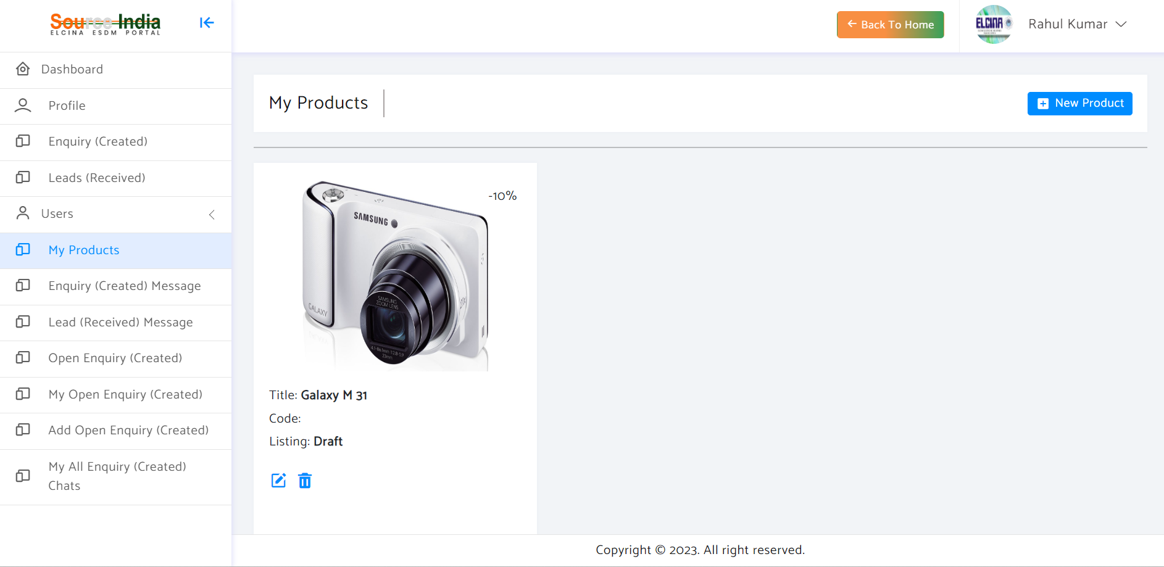
Later if required you can edit your product

Slide 10
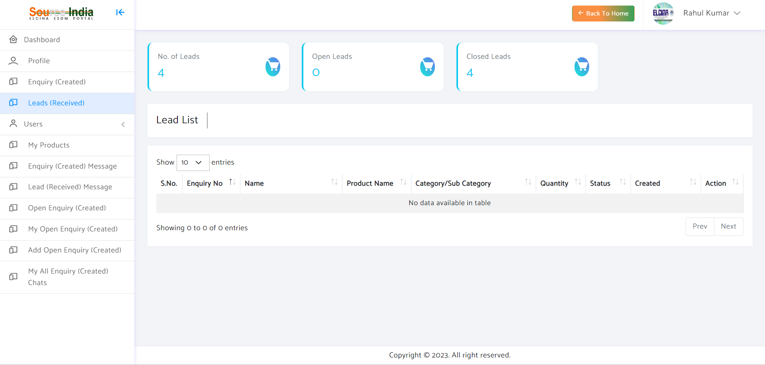
Here you can see all the "Leads" which you have received from other "Buyers"

Slide 11
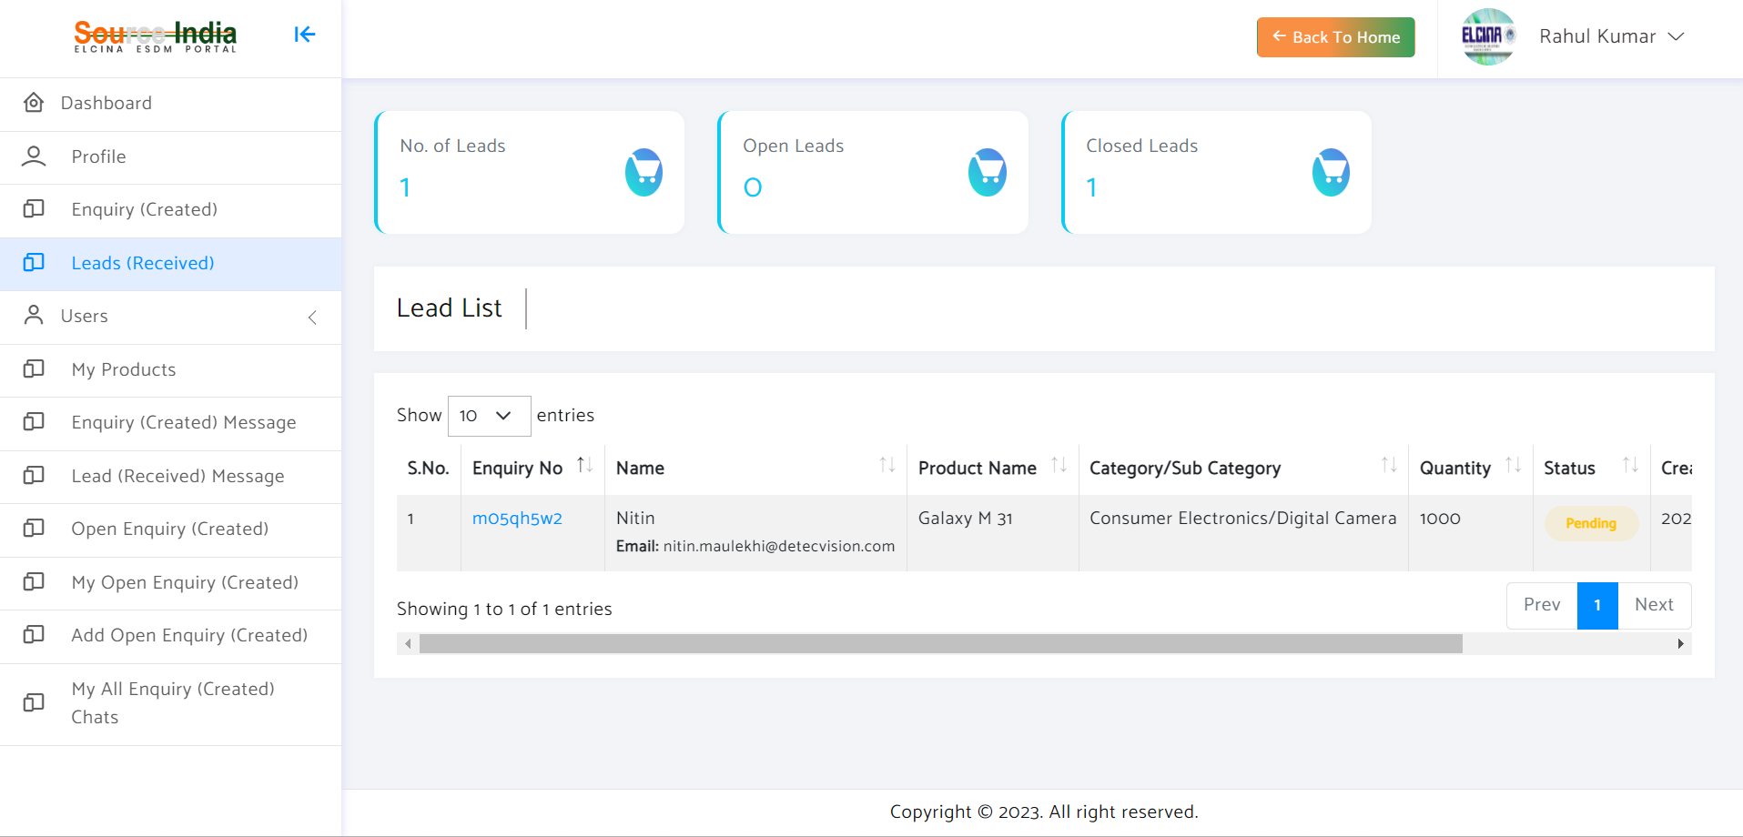
Click here to see your "Lead"

Slide 12
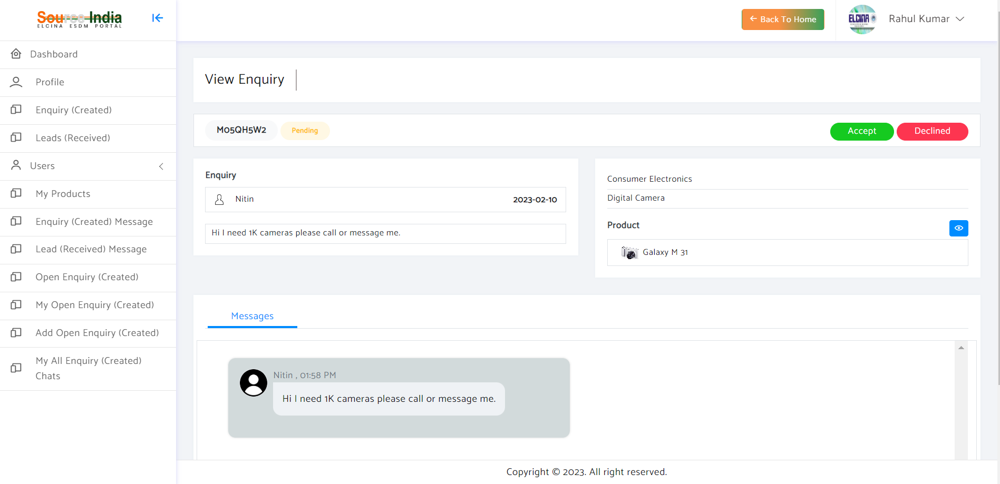
Choose "Accept" to continue the discussion over chat or "Declined"

Slide 13
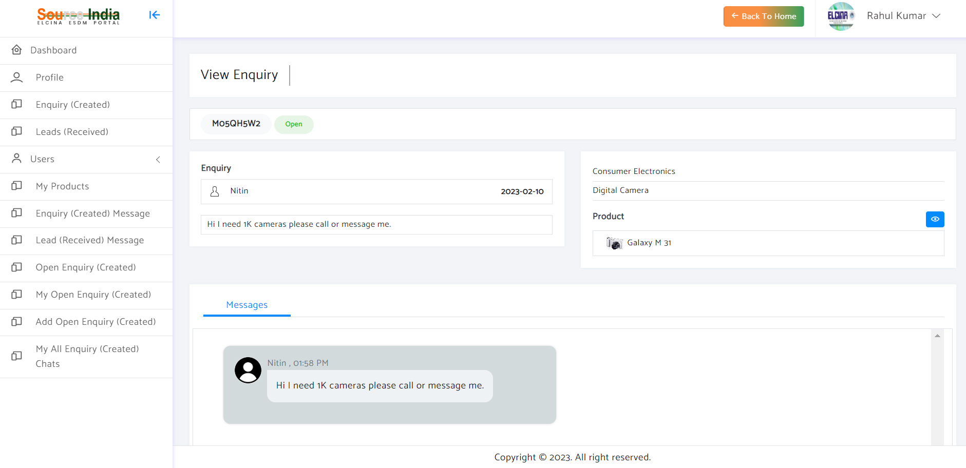
After "Accepting" the enquiry you can directly chat with the buyer

Slide 14
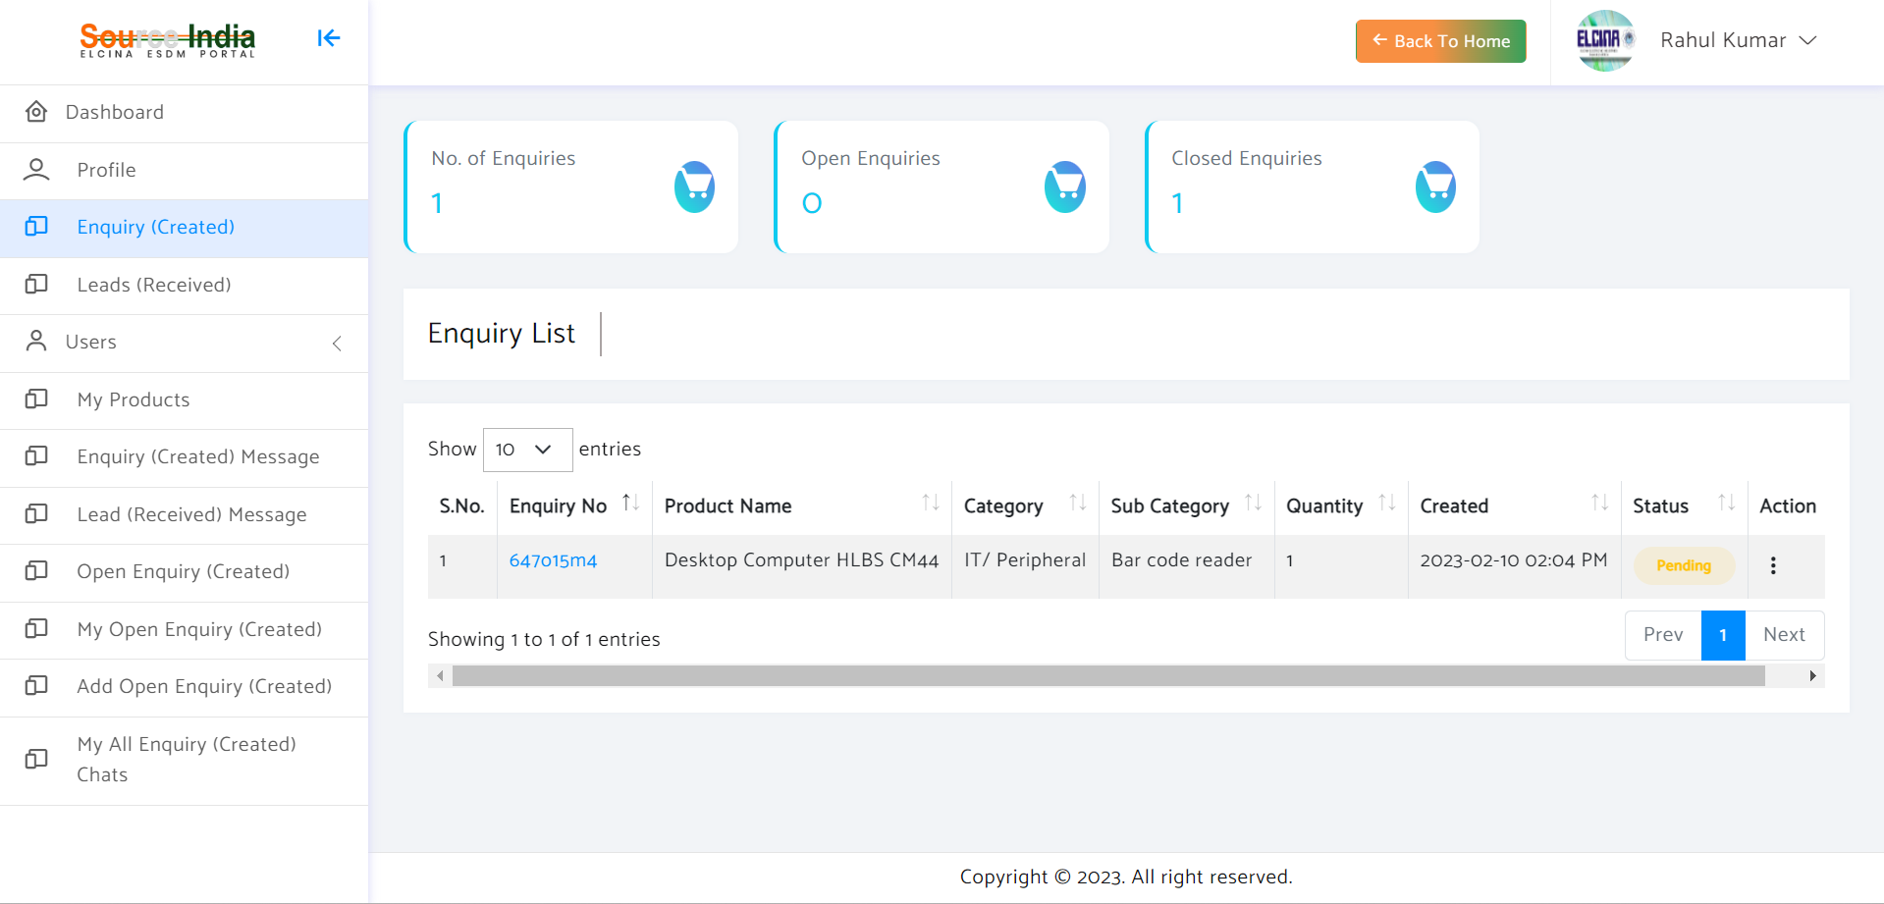
Here you can see all the "Enquiries" which you have created to "Buy Items"

Slide 15
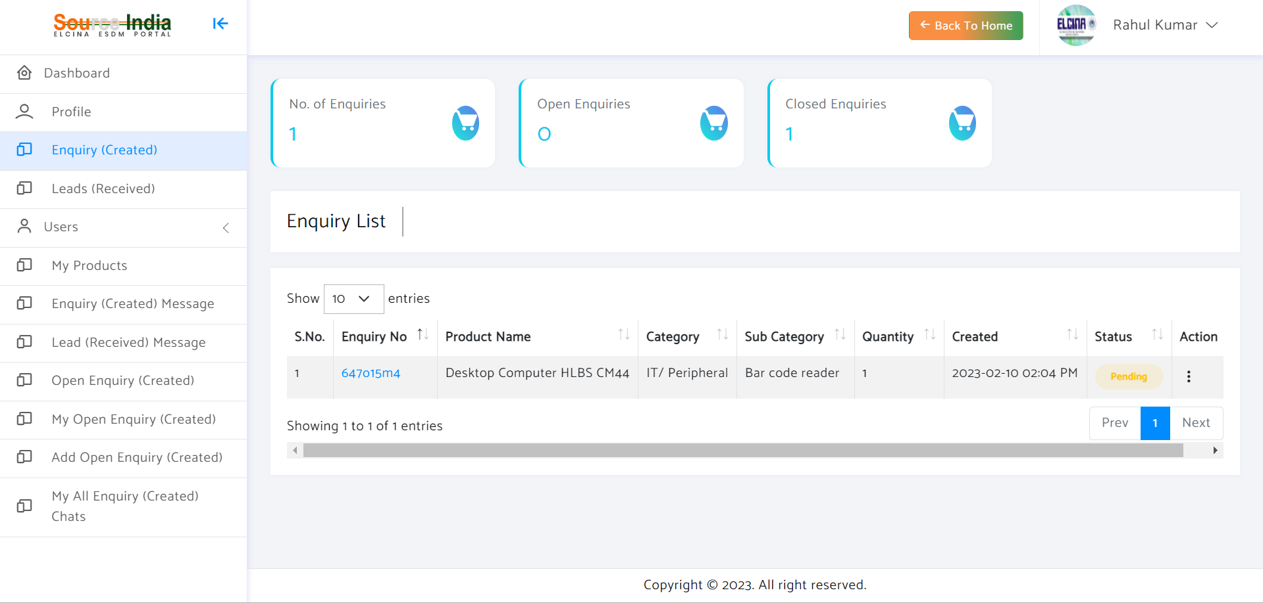
Click here to see your "Enquiry"

Slide 16
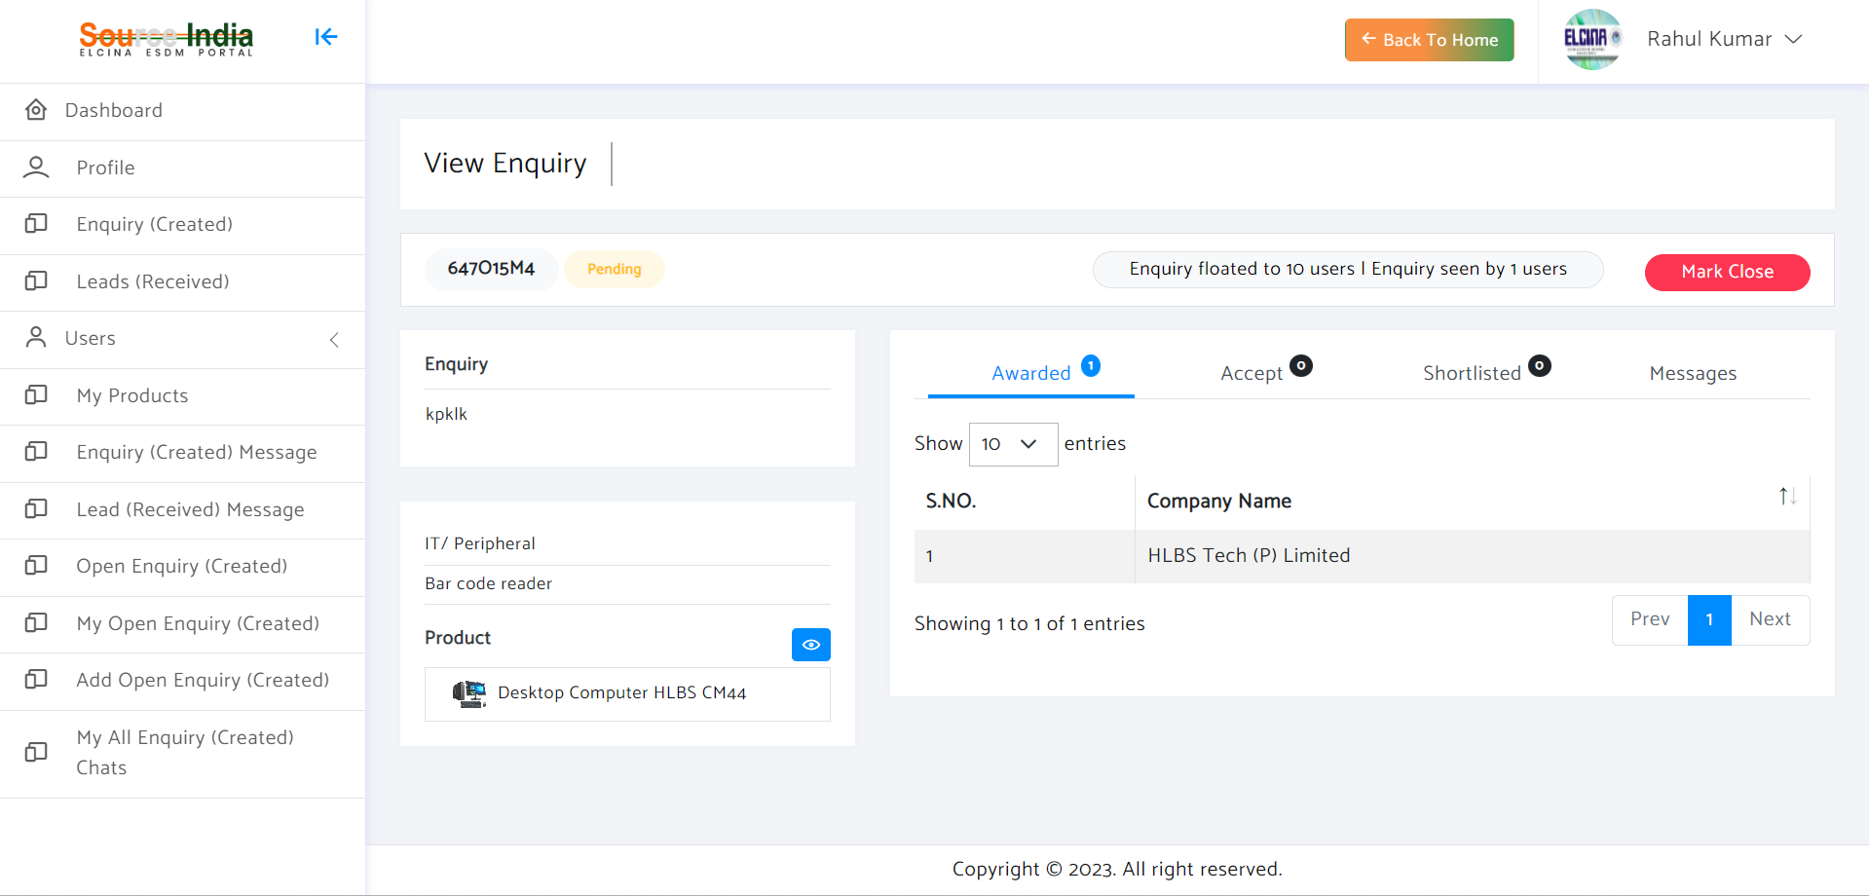
Here you can see the status of your "Enquiry"

Slide 17
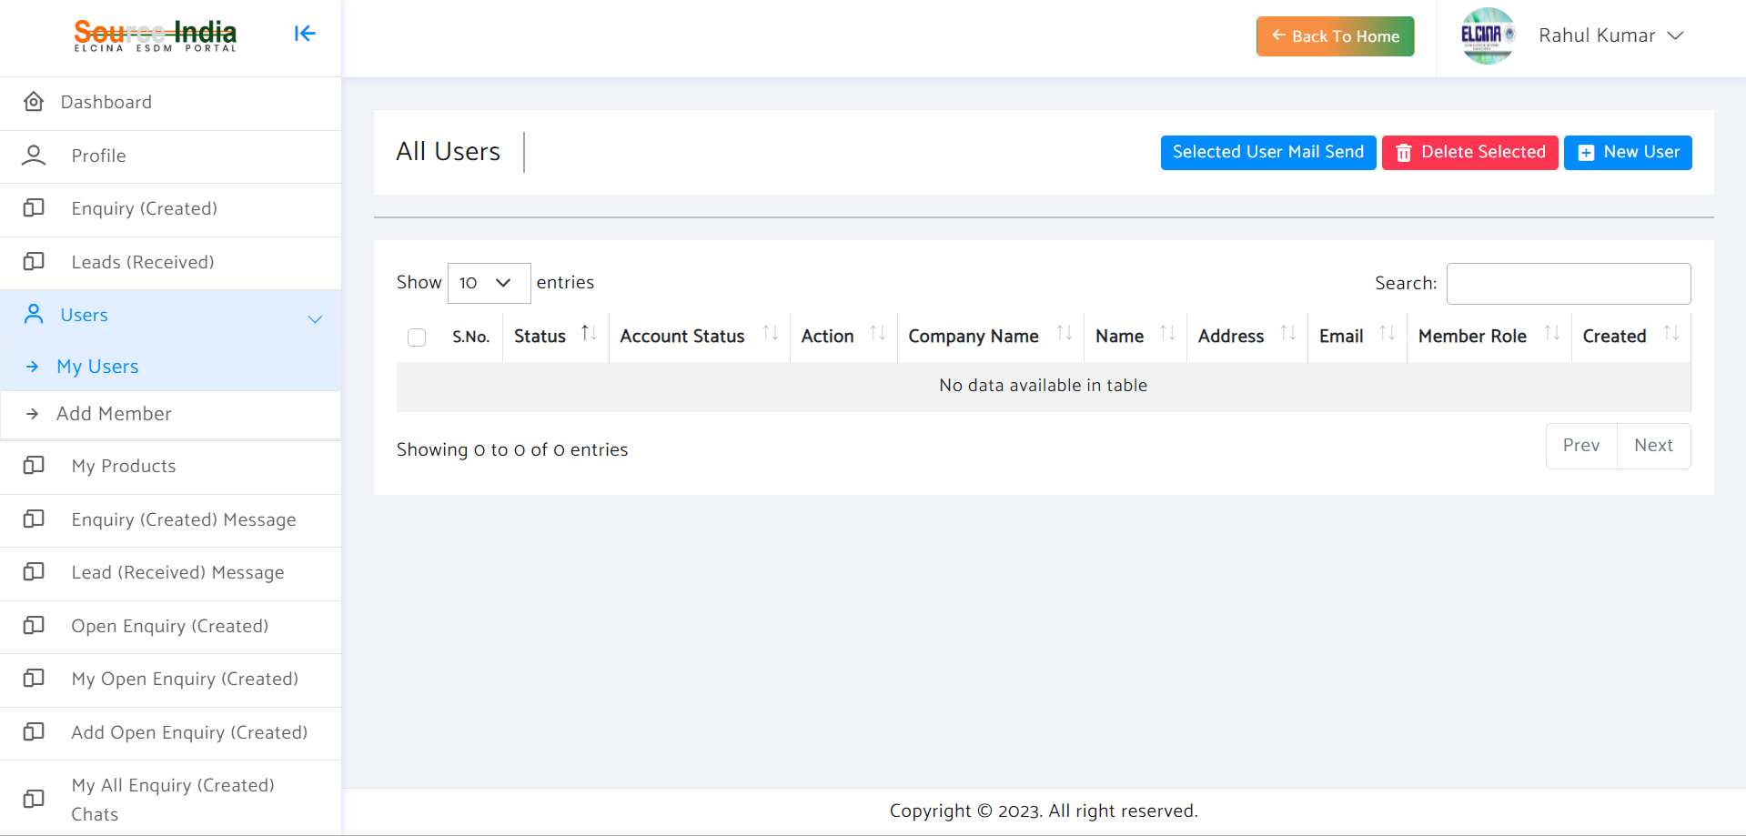
To add user, click "New User“, you may add user from your company and assign them roles

Slide 18
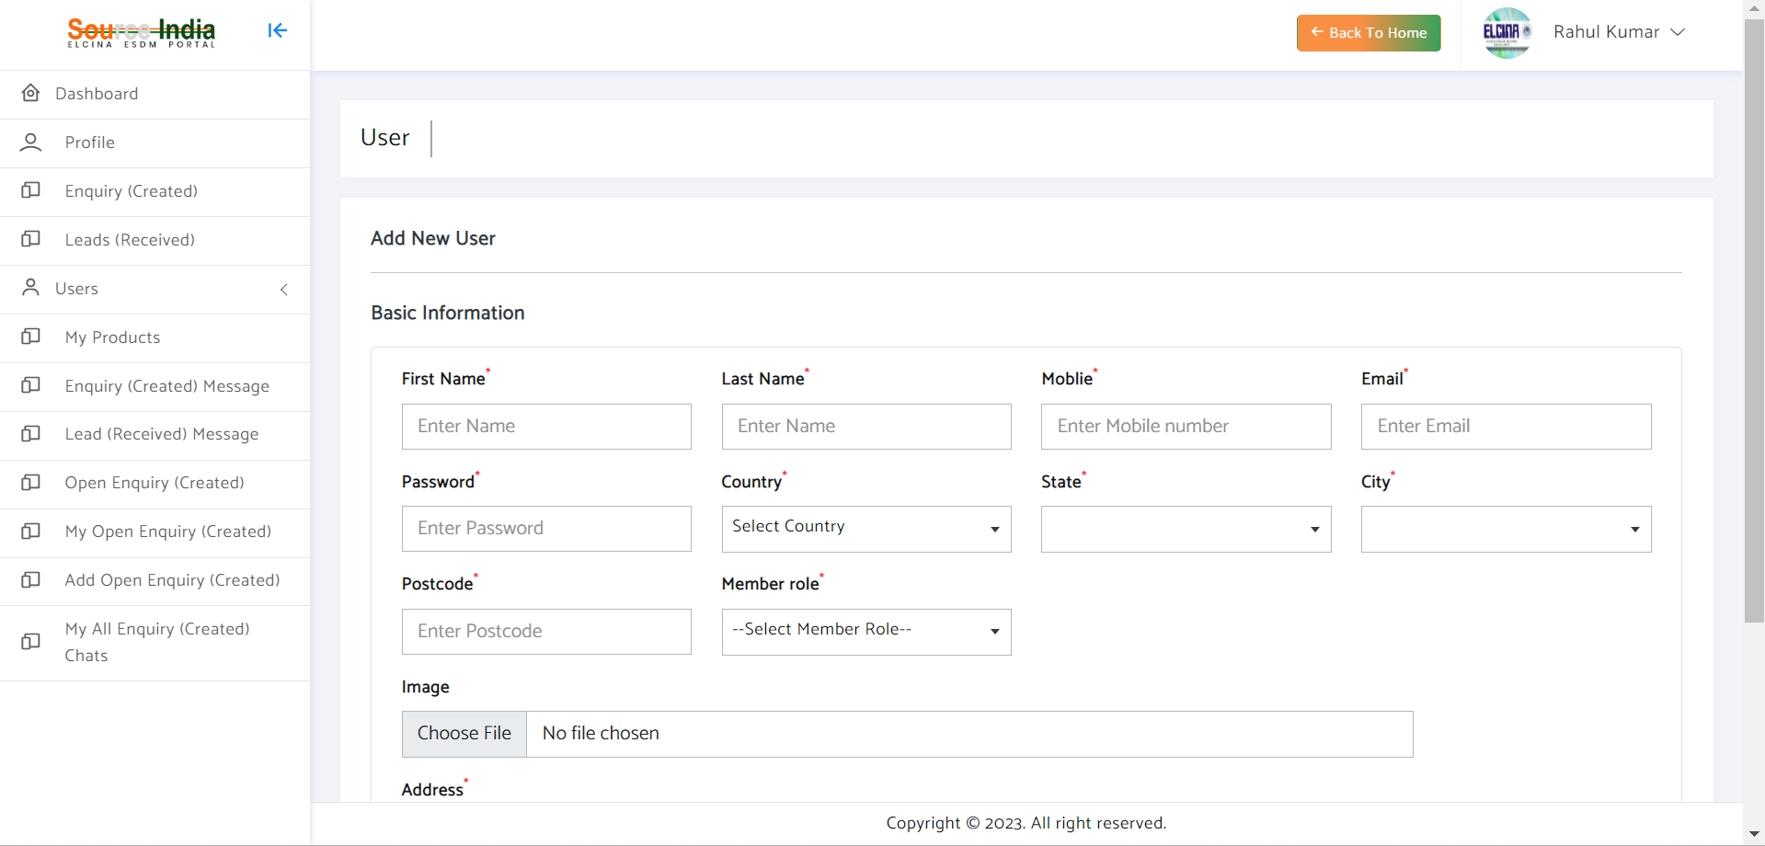
Add user details

Slide 19
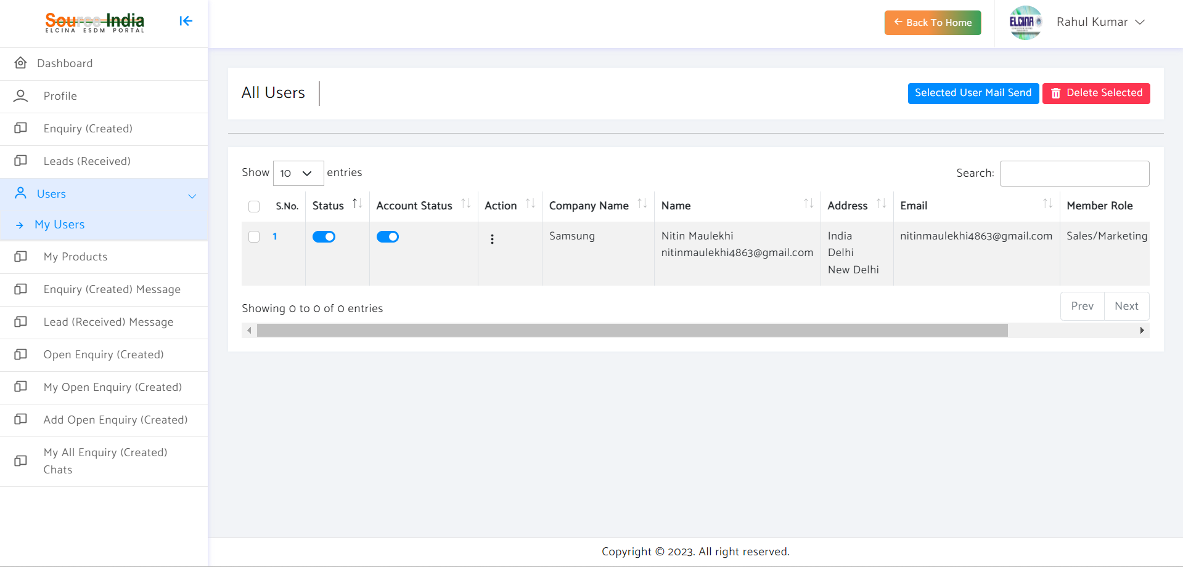
You can change their status and account status after clicking this

Slide 20
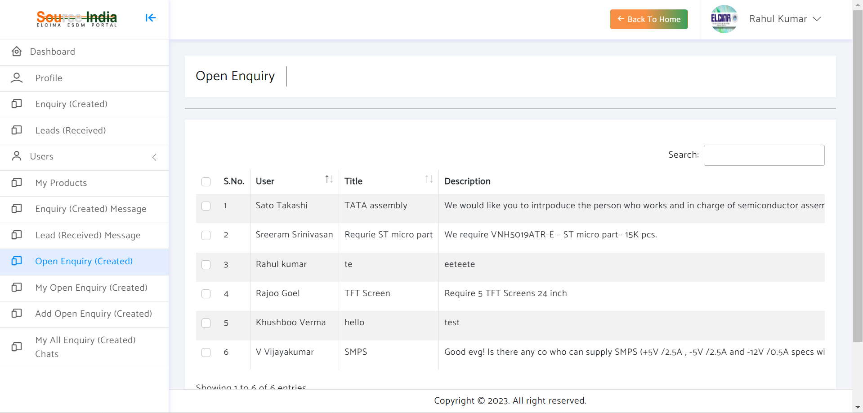
Here you can see all open enquiries, which are on the Portal and not specific to you. If you are interested, you may respond the enquiry and the buyer will be intimated.

Slide 21
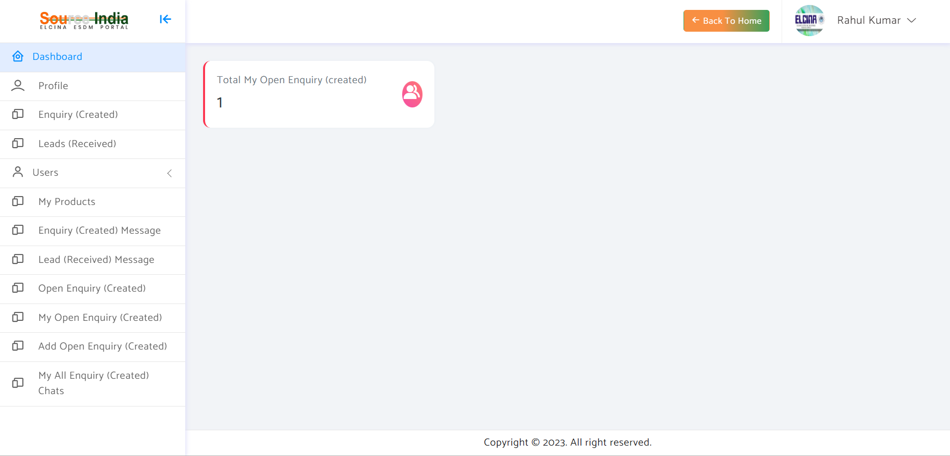
Here you may can add your open enquiry which will be listed on the Portal

Slide 22
Thank you!
Please send your feedback at sourceindia-electronics.com

