Slide 1
Defending the Digital World: A Comprehensive Guide Against SQL Injection Threats
Group Member:-
Gaurav Kailash Borana
Neeraj Harikesh Vishwakarma
Special Thanks to my Professor:-
Prof.Shakil Tamboli
Dr. Pooja Sharma
Dr. Moresh M. Mukhedkar
Prof.Nitin A.Dawande
DY.PATIL UNIVERSITY ,AMBI,PUNE.

Slide 2
Agenda
Introduction.
Literature Survey.
What is SQL Injection Attack ? And its types.
Prevention and Detection Techniques.
Application, Advantages and Disadvantages.
Result.
Conclusion.

Slide 3
Introduction
Our research is based on completely protecting data or information on online web applications.
Helping the organization or society by delivering various techniques to prevent their data and make awareness among them.
Our research aim is to develop powerful techniques to protect web applications against one of the Cyber attacking method “ SQL Injection Attack ” and utilize various techniques combinedly to save our sensitive data from Attacker.
100% hacking stop is not become but make minimize is in our hands.

Slide 4
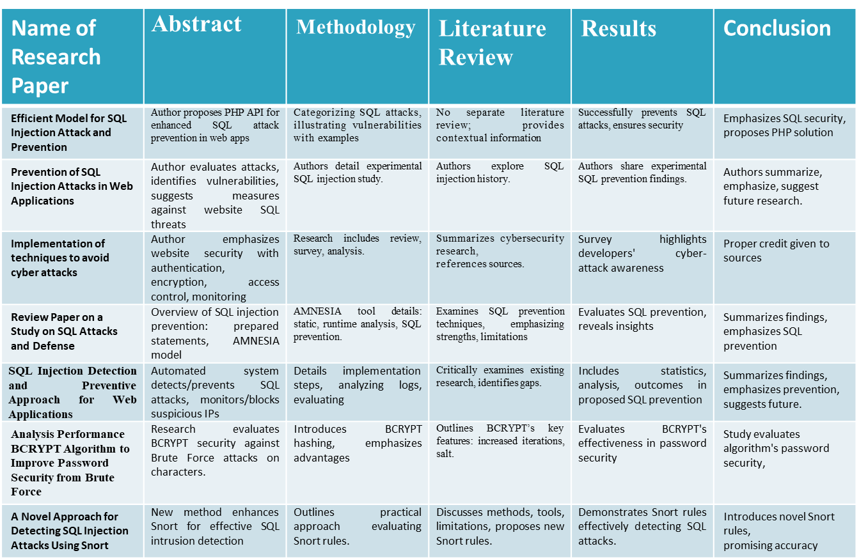
Literature Survey

Slide 5
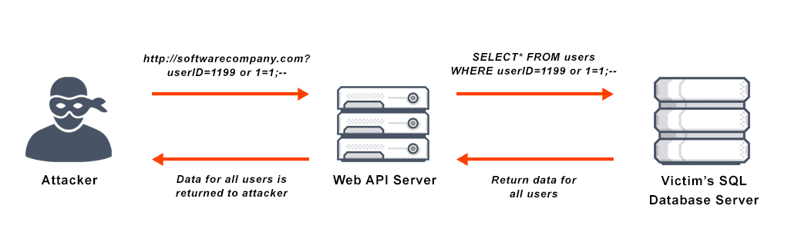
What is SQL Injection Attack ? And its types
SQL Injection Attack:- SQL Injection Attack is one type of cyber-attack mainly occur on web application through input field by injecting malicious code by attacker or hacker to corrupt the data stored on database.
How it happened ?

Slide 6
Type | Description | Example
Tautologies | Injects more than two queries to return true, typically using logical conditions | ` 'username' OR '1'='1'-- `
Piggy-back Queries | In this type additional queries execute along with original queries. First original queries run after those additional queries due to misconfiguration. | 'SELECT * FROM users; DROP TABLE users;' Additional queries is Drop table user
Union Queries | Union Queries: - In this type insert additional queries to existing statement but only work by adding UNION keyword. | `SELECT username, password FROM users UNION SELECT 'admin', 'admin123'; `
Logically Incorrect queries | In this attack, the attacker first gains knowledge about the type and structure of the back-end database. In some cases, when a website issues a warning about incorrect details, it becomes an opportunity for the attacker to introduce queries causing syntax and logical errors. | ` SELECT * FROM users WHERE username = 'admin' AND password = 'pass' OR 1=1; `--
Stored Procedure - | In this attacker think about the stored procedure that is present in database which can be vulnerable by programed code. Stored procedure basically uses for user- authentication return true or false | Consideration of specific stored procedures for exploitation
Table:-Types of SQL Injection Attack

Slide 7
Prevention and Detection Techniques
1) Array-based filtering: - Array-based filtration in PHP prevents SQL Injection by restricting input with predefined arrays, blocking malicious SQL syntax. Users get three chances; if the input doesn't match, access is denied, enhancing security against unauthorized database access.
2) Prepared statement: - It is one of the methods used for prevention queries, in these techniques each user input parameter gets separated from SQL processing code and make the database safe because of not directly interacting user input instead of prepared statement use placeholder and temporary variable within SQL processing code and later at execution time placeholder get convert into original user input.
3) Checksum: - Checksums verify data integrity, preventing SQL injection. Encryption algorithms ensure consistent data length, size, and key integrity. Detecting changes in decryption signals potential tampering, enhancing protection against attacks.
4) IP Address: -This type of technique store IP address of the user who enter to web application and utilize for monitoring unusual activity if some suspicious occurrence happened then that user IP address get store in suspicious table within backend of database along with time, date, number of attempts to enter into web application. And if user attempt greater than five time then block user with some time slot and store data on blocklist along with time, date. If we want to release that user then we compared the time with blocklist and time slot if they match then release that user. We can develop this system automatically to minimum the workload of administrator of application.

Slide 8
5)Sending Alerts to Administrator :-If an attacker tires to attack the database, the administrator receives an alert, enabling immediate action to secure the database. Alerts can be via email, SMS, voice call, or all three combined.
6)Honey Pot :- A honeypot is a detection technique designed to trap hackers. It's like a fake target that appears vulnerable to attracting hackers' attention. When hackers attempt to attack it, the honeypot catches them. It's useful for spotting attacks like SQL injections. While honeypots are tremendously helpful for detecting SQL injection attacks, they also require a substantial investment of time and resources to set up and maintain.
7)Using WAF:- Web Application Firewall (WAF) is like a security guard for your website. It sits between your website and the Internet and analyses all incoming and outgoing data. If it finds suspicious or dangerous content, it blocks it to keep your website protected from attacks.
8)Log Analysis: - Log analysis is the practice of examining log files created by web and database servers to identify security vulnerabilities. This involves looking for indications of malicious code, such as SQL injection attacks, within the log data. Log analysis can be done manually by reviewing log files line by line or using automated tools. It helps in detecting and resolving security issues but can be time-consuming and challenging, especially with large log files.
9) Stored Procedure :- Stored procedures were introduced to precompile SQL statements on the server. SQL injection instances decreased significantly as precompiled statements mitigated vulnerabilities.

Slide 9


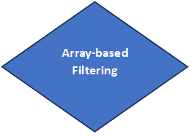


Log and Block IP
Traffic Filtering (WAF)
Figure:- Flow chart of established full work system
Stored Procedures
Honey Pot
Sending Alerts to Administrator
IP Address Monitoring
Log Analysis
End
Suspicious Activity Detection

Slide 10
Application, Advantages and Disadvantages
Application:-
1.User Input Handling: - Implementing various mechanism or filtration techniques to restrict user.
2.Maintaining Database: - Maintain confidentiality, integrity, availability, on data within database.
3.Network Security: -Maintaining integrity of data is important on the network. Utilize Checksum techniques to handle data and also check integrity of data.
4.High Performance: -To handle performance. Performance can be increase by optimize database queries through Prepared statement.
5.Applicable to all sector: - Applicable to various sector where maintaining the data privacy is crucial.
Advantages:-
1. Protects against common attacks like SQL injection, keeping user data safe from unauthorized access or tampering.
2. It ensures that sensitive information stays private and that data in the database remains reliable, which is important for user privacy.
3. By using checksum techniques, ensures that data sent over the network reaches its destination without being altered.
4. Automates security processes, making the system more efficient and less human involvement.

Slide 11
Disadvantages:-
1. The security measures and constant monitoring may need a lot of computer resources, potentially slowing down the system.
2. The added security measures might slow down certain processes or need more computer power.
3. Adapting to evolving technologies is essential, but frequently changing systems can be a bit challenging.

Slide 12
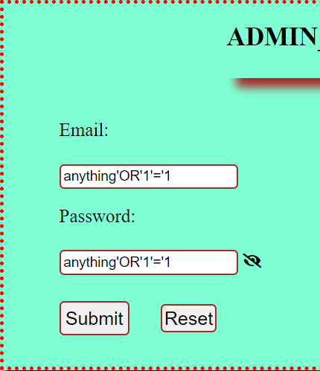
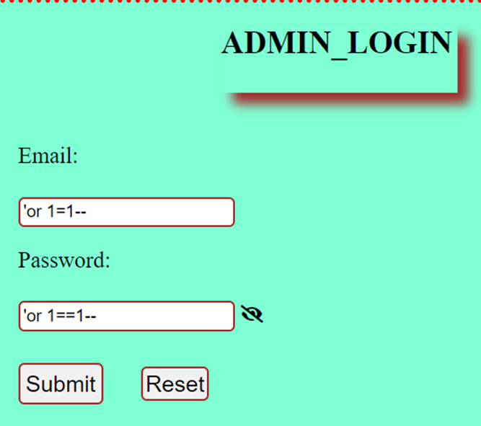
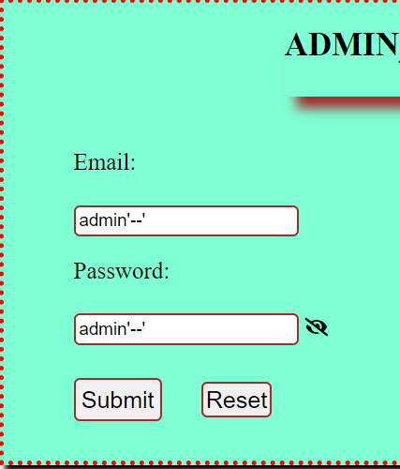
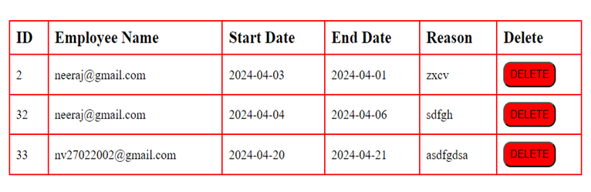
Result
Without utilization of security within system:-

Slide 13
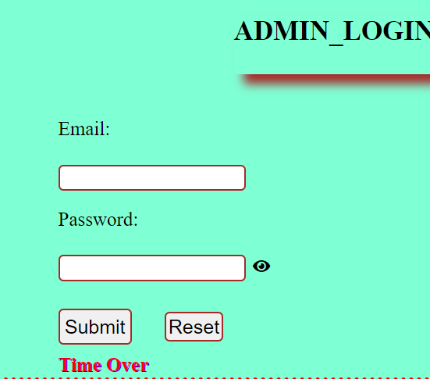
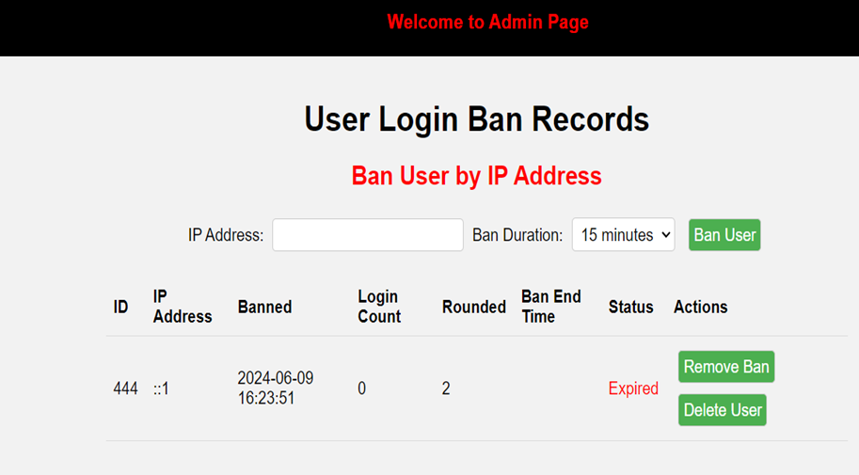
With utilization of security within system: -
Array-based filter
IP Address

Slide 14
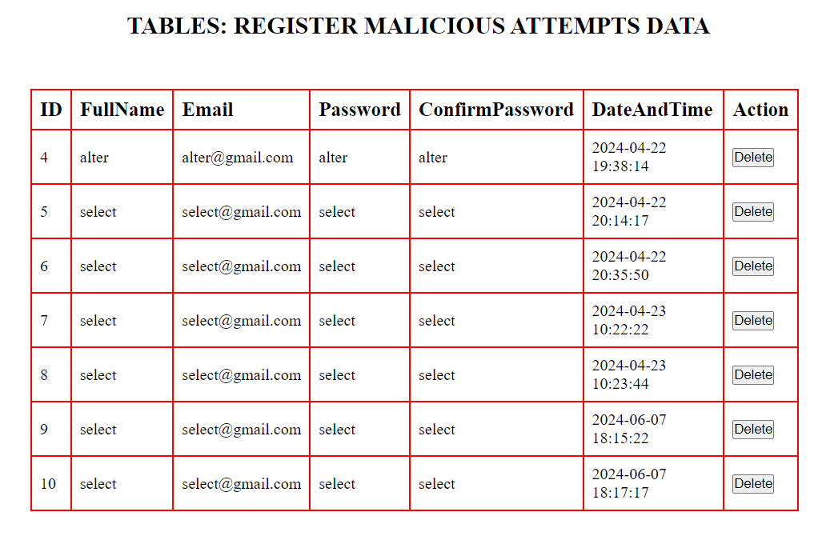
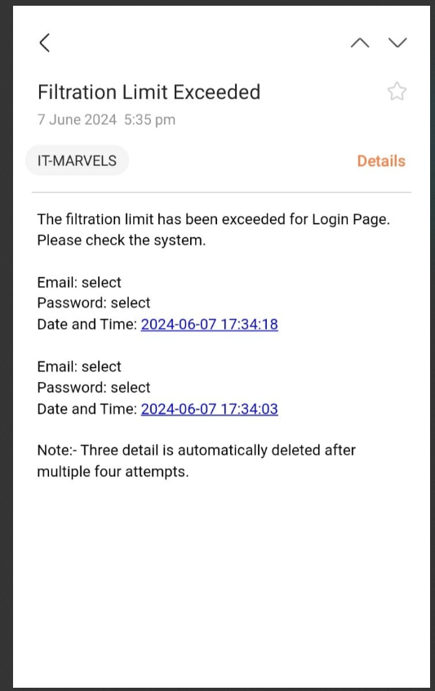
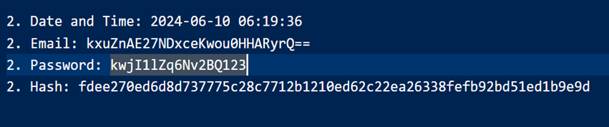
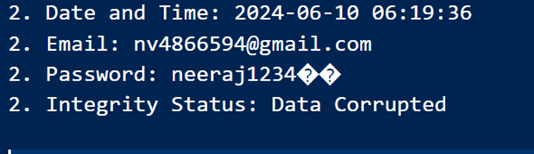
Log Analysis
Send notification to admin
Encryption
Decryption

Slide 15
Conclusion
SQL Injection attack is one type, many more cyber-attacks occur day by day. To make data secure various tools and techniques are there, and each technique has its advantages and disadvantages. However, finding gaps and minimizing each technique's drawback is the way to deal with various cyber threats.
The future scope is to utilize trending technology such as Artificial Intelligence (AI), Machine Learning, IoT, Blockchain, Cloud Computing, etc. to minimize the risk by implementing strong techniques through this technology and make the system powerful against cyberattacks.

Slide 16
References
1.SQL Injection Attack: Quick View. Mesopotamian journal of Cybersecurity Vol.2023, pp. 30–34.
2.An Efficient Model for SQL Injection Attack and Prevention. Journal of Survey in Fisheries Sciences 10(2S) 340-344(2023).
3.Prevention of SQL Injection Attacks in Web Applications. Journal of Survey in Fisheries Sciences 10(2S) 1113-1119(2023).
4.Implementation of techniques to avoid cyber-attacks. The Online Journal of Distance Education and e-Learning, April 2023 Volume 11, Issue 2
5.Review Paper on a Study on SQL Attacks and Defense. International Journal of Advanced Research in Science, Communication and Technology (IJARSCT) Volume 2, Issue 1, August 2022.
6.SQL Injection Detection and Preventive Approach for Web Applications. [Date of publication July 31, 2022, date of current version Aug. 12, 2022.]
7.Analysis Performance BCRYPT Algorithm to Improve Password Security from Brute Force. Journal of Physics: Conference Series.
8.A Novel Approach for Detecting SQL Injection Attacks Using Snort. J. Inst. Eng. India Ser. B https://doi.org/10.1007/s40031-022-00749-z

Slide 17
Thanks You……..

