Slide 1
EDUTHON
Project name: Education4All
Team members:
1.Rohit kumar
2.Anushka Jadav
3.Vimal Tripathi
4.Neeraj Pandey

Slide 2

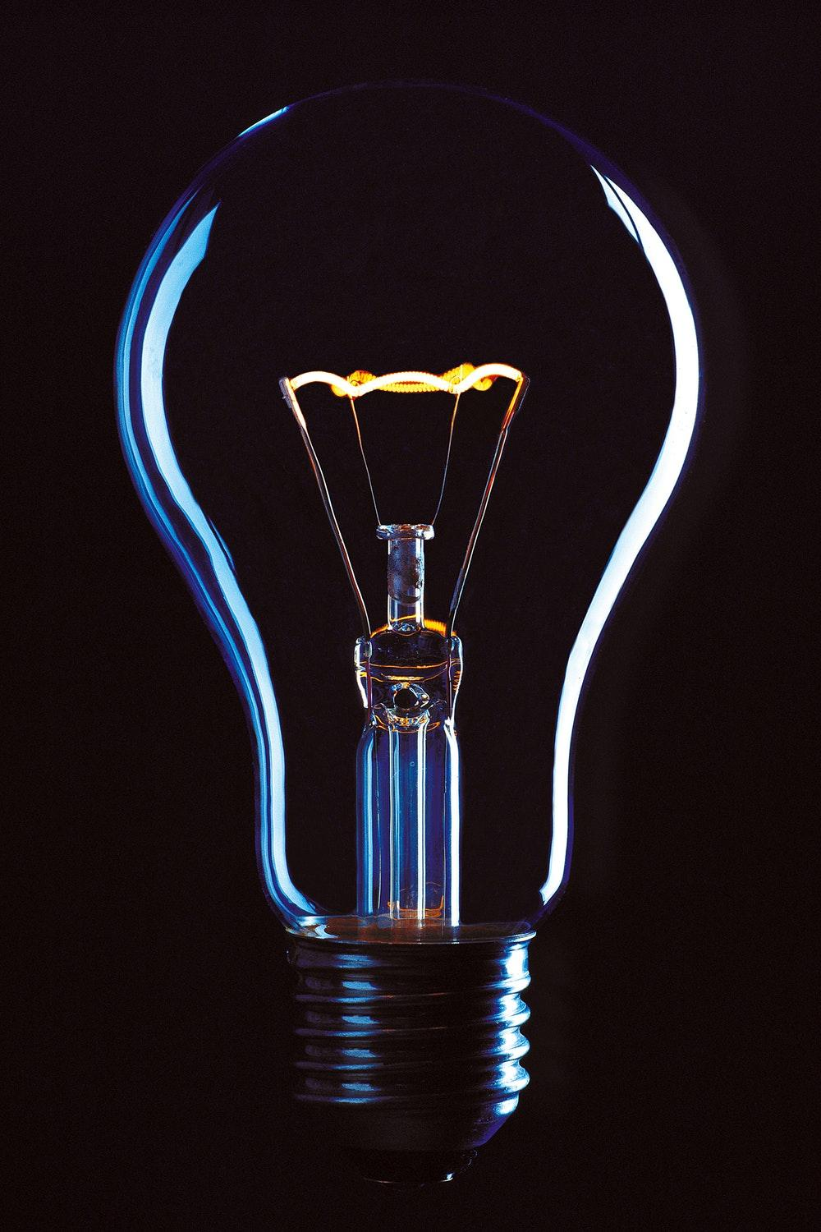
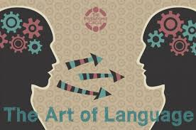
Problem statement
REASON WHY THIS HAPPENING ?
Urban students are blessed with the resources internet today has to offer. But for rural area student, the connectivity is distant reality. Therefore a solution where providing the rural area students contents and resources for learning through internet is challenge in itself .A solution based solely on technology , needs infrastructure advancements before even implementing the actual solution.
Hence , deduce the solution that incorporates technology to the minimum and solve major problems in rural education , such as LACK OF RESOURCES and LANGUAGE BARRIER
LACK OF KNOWLEDGE
INTERNET ISSUES
LANGUAGE BARRIER

Slide 3
Development of your techstack
Explain how the techstack was developed, or if used existing techstack then briefly explain them.
Our whole solution is majorly based on a Android Application.
For the support of our application we have used google text engines and in between we have used our own machine learning model which we have deployed on FireBase ML kit.
To remove the latency in our application we have made a downloadable package that will be auto downloaded while using it first time, after we are able to run our software even without internet.
Apart from this we have used pyhon and javascript for our website development.

Slide 4
Development
Rather than reinventing the wheel, we incorporate our solution to the already available Ministry of Education initiative.
Ministry of Education started an initiative in which students pursuing higher education can watch supportive video lectures from professors of reputed universities through specially broadcasted channels.
We take use of this content and propose a solution where with the help of our application , the lectures broadcasted in the TV can be translated in real time into any regional language, that too without any internet.
What all the user needs?
Just a 50 rupee aux cable and smartphone.

Slide 5
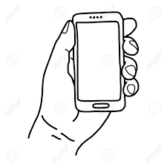
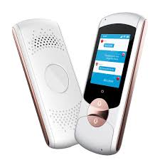
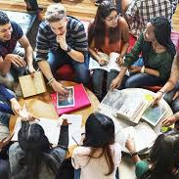
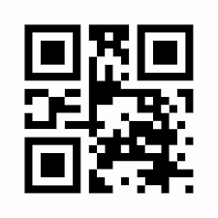
Working
Real time language translation . It can read a stream of QR codes and generate PDF without internet connectivity.
Students / Educators
Using television students watch the lectures and by connecting aux cable with smartphone they can get the lectures in their native languages in real time and get the notes as well after scanning the QR codes at the end.
Video containing the original stream, combined with stream of generated QR codes containing notes
-> Works offline : No Internet Connection Required

Slide 6
Future scope
Explain how the project plan is for the future, about it’s sustainability as well scalability.
We are ready to go to implement it in any governmental bodies so that our system can accompany the main ongoing system such that everyone in this nation can watch video in their respective languages.
Organisation like BYJU’s,Udemy ,Unacademy all can use our SDK in there application to provide multi- language feature in there application.
While in terms of scalability i would say this solution is very scalable as every one has a mobile phone,a television in his home so after that he will be able to watch any educational content in any language.

Slide 7
Market Viability
Source of revenue | Target | Means/Channel
SDK for the application available in the market | All students using Video Learning | SDK
License Key for MHRD and other organisations | All students using Video Learning from Television | Direct on Our Application
Notes Summarizer | Content Creators | Content Creation Portal
Personalised Voice | Content Creators | Content Creation Portal

Slide 8
How our “app” makes India Atma Nirbhar
See if I from very rural part of India and I am not very much comfortable other than my regional language then it is not possible for me to study in any language other than my language. This thing govt have also introduced and they have introduced learning in regional language in new education curriculum . In that way too it is making whole education system atma nirbhar on itself not on any lang
SO here comes our solution you could watch any thing to anything ,isn't it amazing . In this way our app is making india atma nirbhar.
Not even atma nirbhar it is a step for india to be a next superpower.

Slide 9
THANK YOU!

