Slide 1

Design Credit Project
Active Noise Cancellation
INDIAN INSTITUTE OF TECHNOLOGY
JODHPUR
Under the Supervision of:
Dr. Amrita Puri
Department of Mechanical Engineering
Submitted by - Neeraj Kumar Singh(B20BB025)

Slide 2
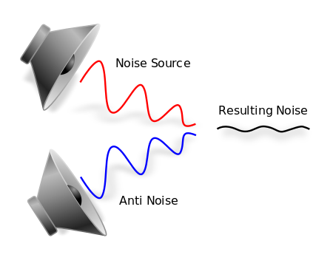
Introduction
Noise cancellation can be achieved by the Passive noise control or Active noise control. Passive noise control can be achieved by use surrounding noise producing device with noise absorbing material. Whereas active noise control can be done through technique by adding a second sound that is specially made to cancel the first one, here it require power supply.
Image reference

Slide 3
Following the development of aeroplanes or specially designed jets with Mach 1 or above, it became difficult for pilots to concentrate, which led to the invention of headsets with noise cancellation.It was soon used in a number of sectors, including the industrial sector to reduce the heavy noise it made. Nowadays, we can find its use in earphones as well. In the case of ANC, noise signal is cancelled in live time with the different type technique like LMS, RLS, FxLMS (for the linear ANC type) ,FsLMS, Spline FxLMS (for nonlinear ANC type) and many other.

Slide 4
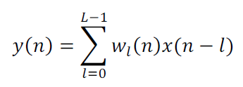
FxLMS
FxLMS is widely being used in active noise and vibration control system. Its use highly popular because of many reasons.Firstly,As it can be used in broadband and narrowband control. Secondly, it is easier to explain and understand and other reasons too.The block diagram of FxLMS is given below, as a result of the sensor being placed near a sound source, samples of the input signal x(n) are collected for the system to process. A time-varying FIR filter is used to compute a time-varying actuator output signal y(n)

Slide 5
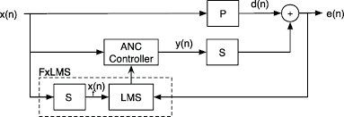
Where W_{l}(n), 0<= l <= L is the weight at n having L filter length. An error sensor collects the combined results of the controller's acoustic output and noise sound as they propagate through region.
Image reference

Slide 6

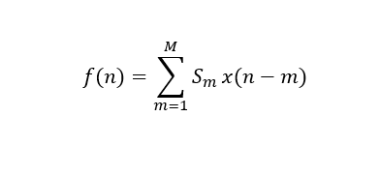
At each step, the algorithm updates the weights by finding the gradient of the mean square error in order to start with small weights (zero in most cases). Finally, weight update is given by
where μ is the algorithm step size, the filtered input sequence is computed as

Slide 7
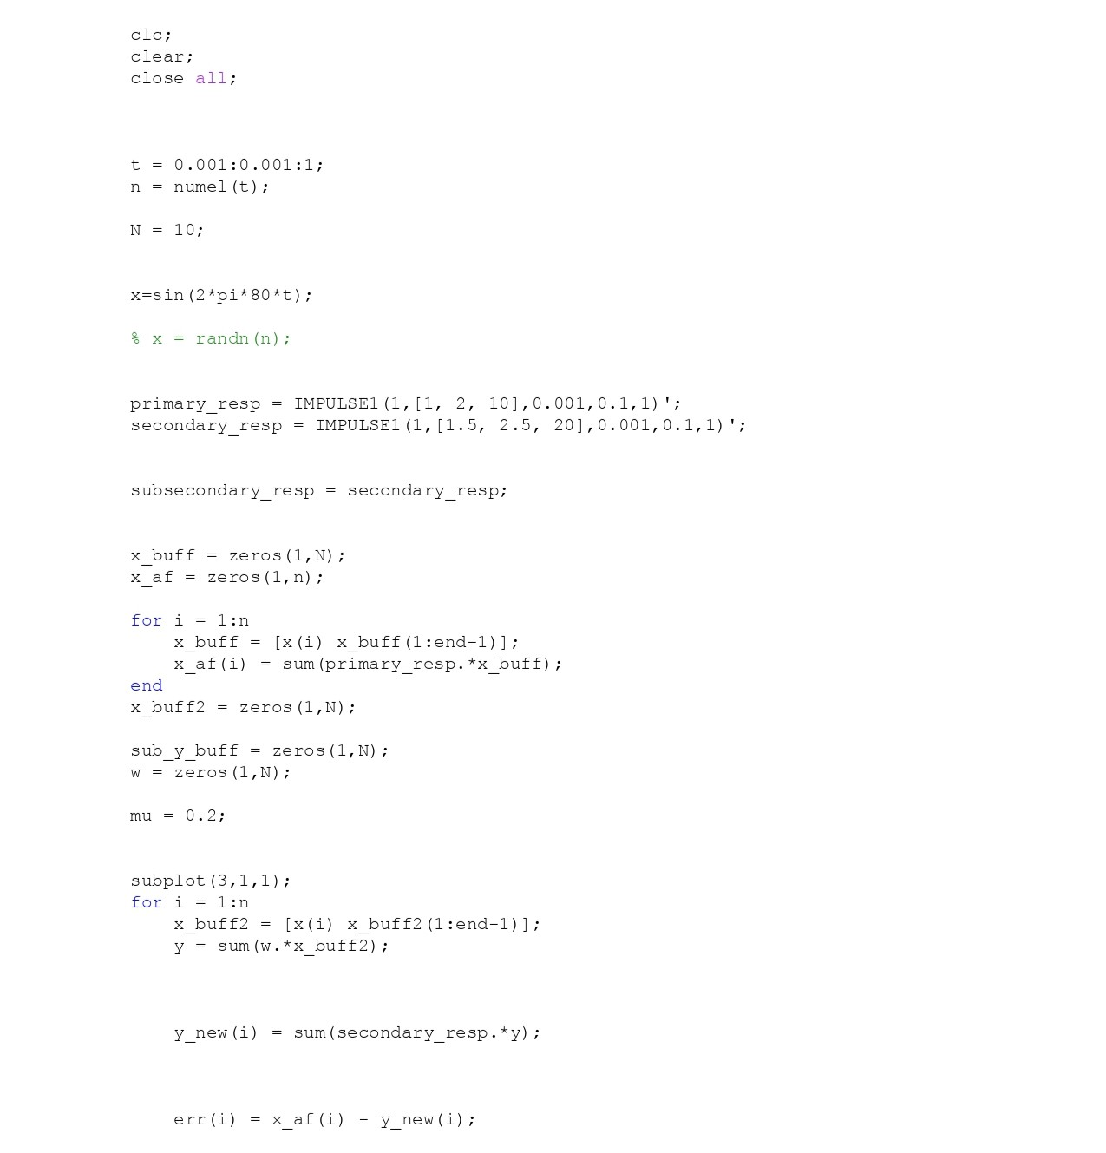
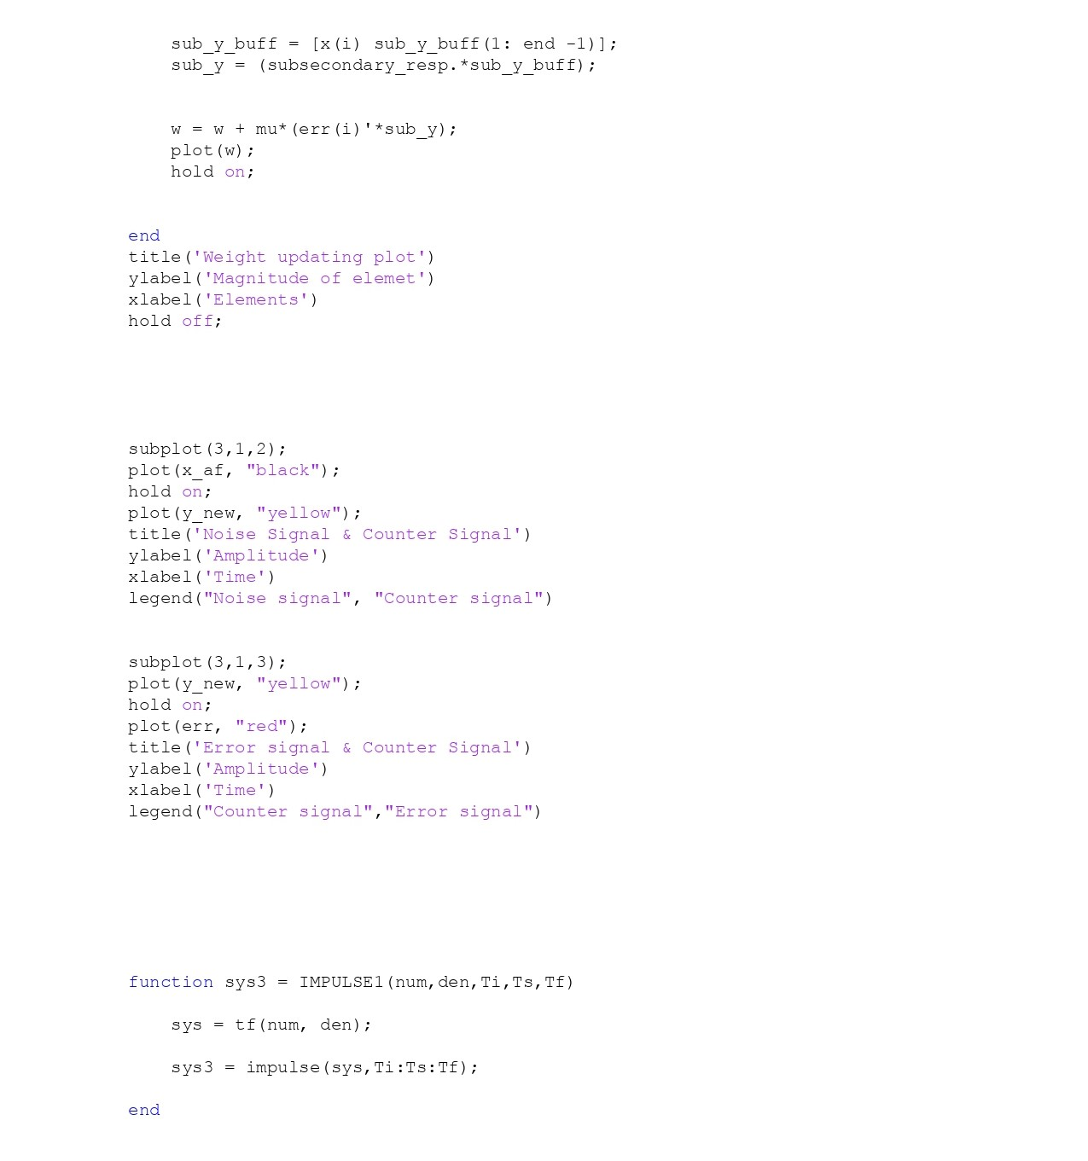
Matlab Code for FxLMS

Slide 8
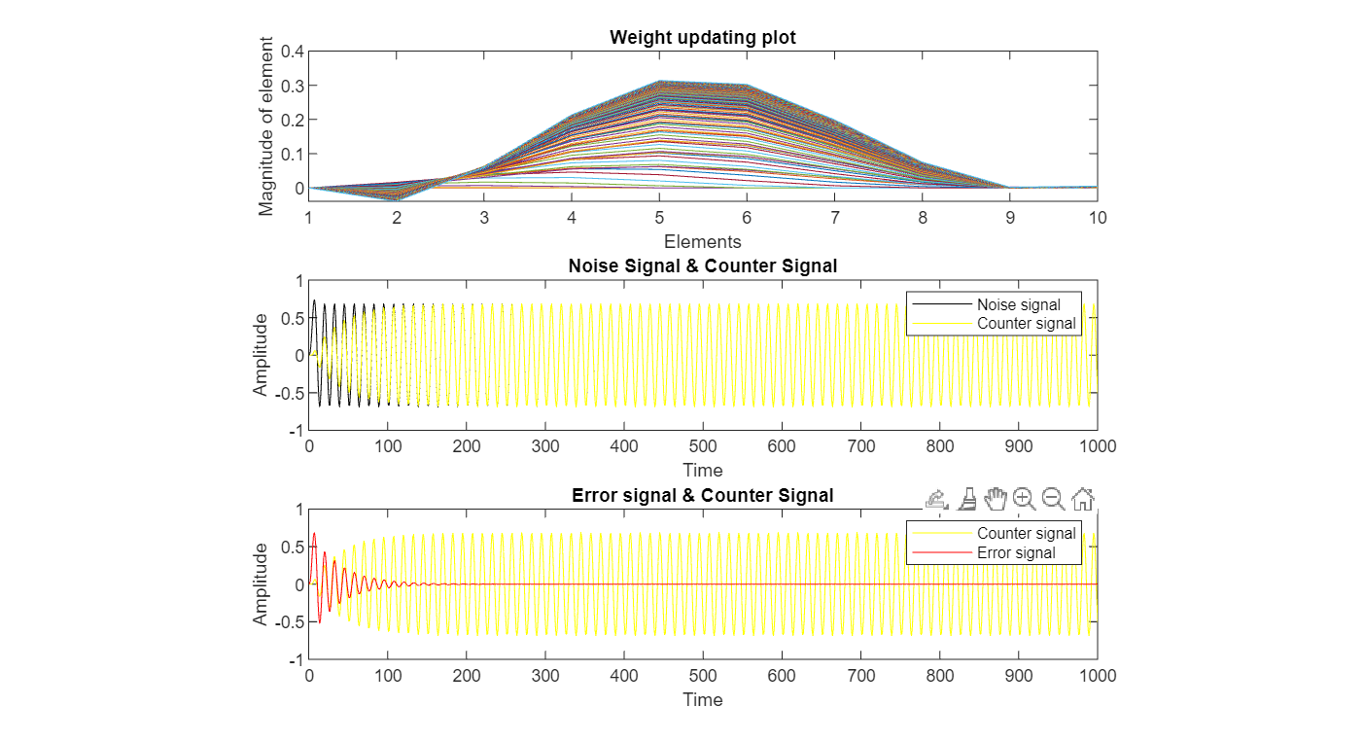
Plots

Slide 9
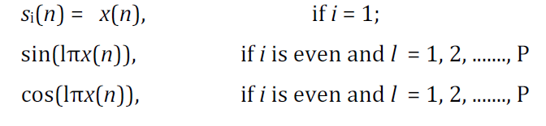
FsLMS
Due to its simplicity, the FXLMS algorithm is most popular for Active Noise Control applications. Despite this, the FXLMS algorithm does not perform well for nonlinear noise processes.A nonlinear control structure can be used to improve this by converting the input signal into a trigonometric expansion in the case of FsLMs. It just a minor modification in the FxLMS. Which is shown in the picture below.

Slide 10
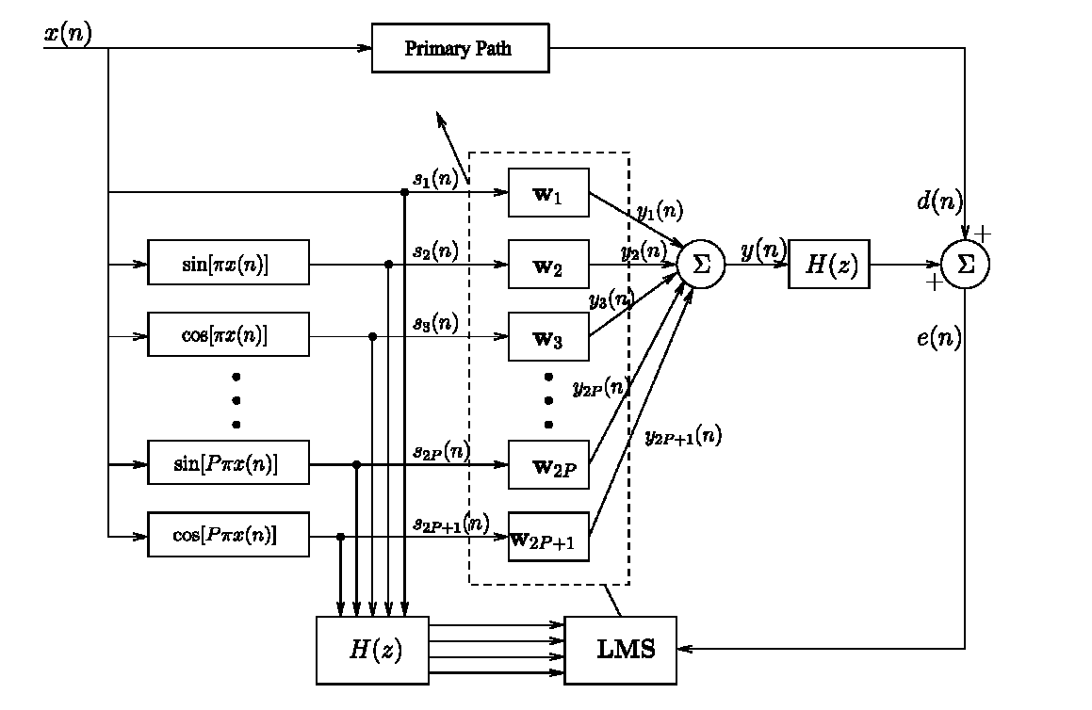
Here,S_{i}(n) is the i^{th} element of the signal expansion. Also, each element get updated individually, as shown in the picture. Irrespective of that each components ressemble the FxLMS algorithm.

Slide 11
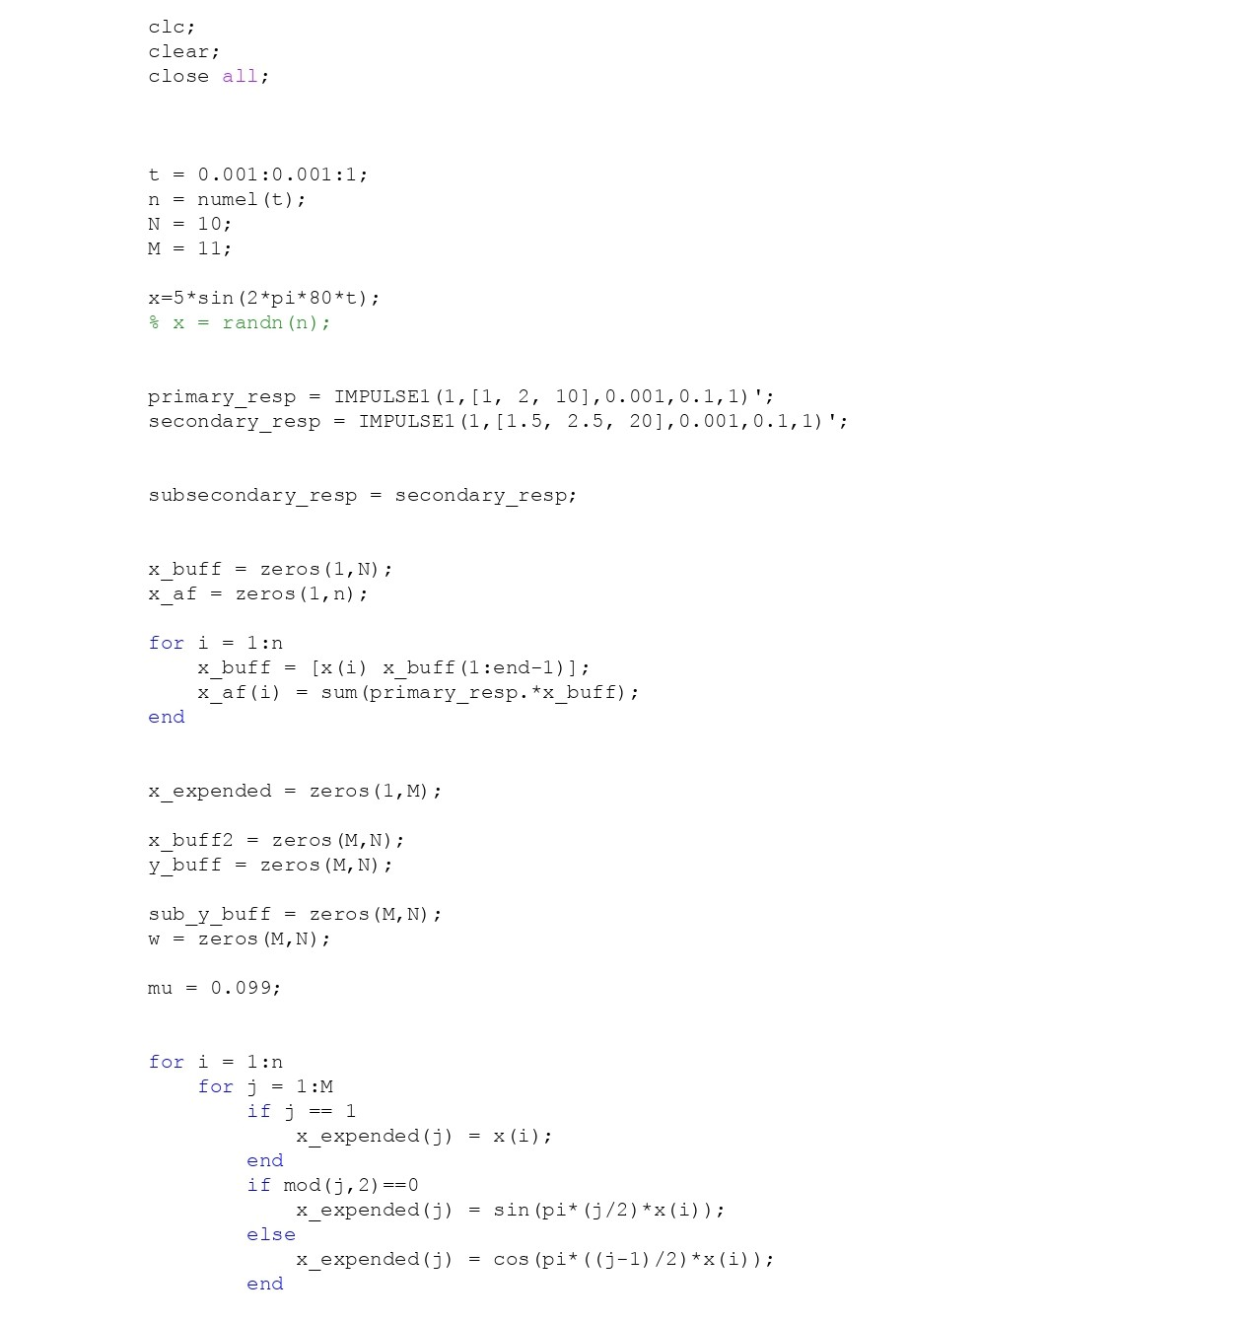
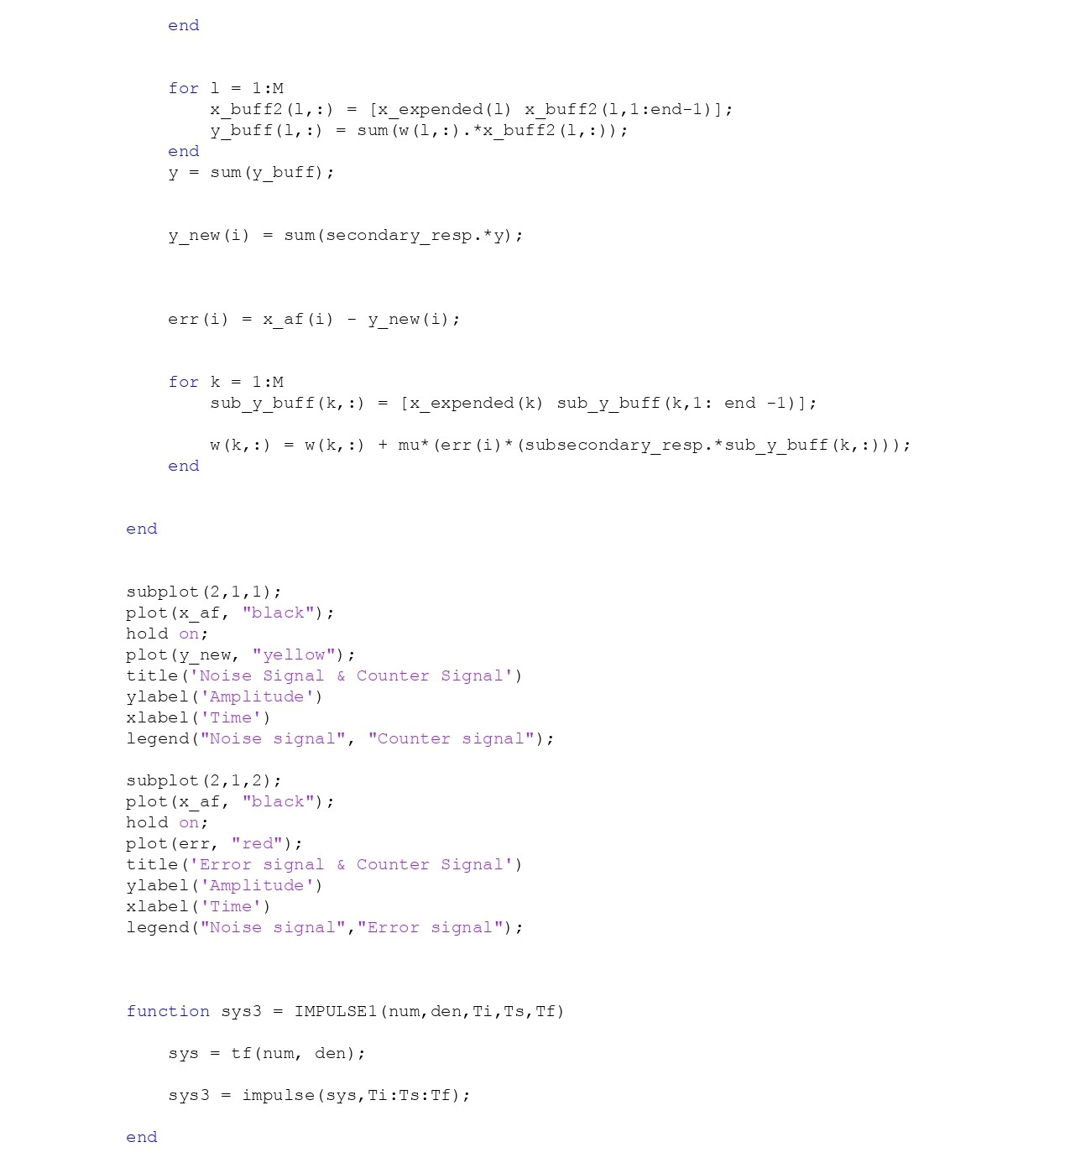
FsLMS matlab Code

Slide 12
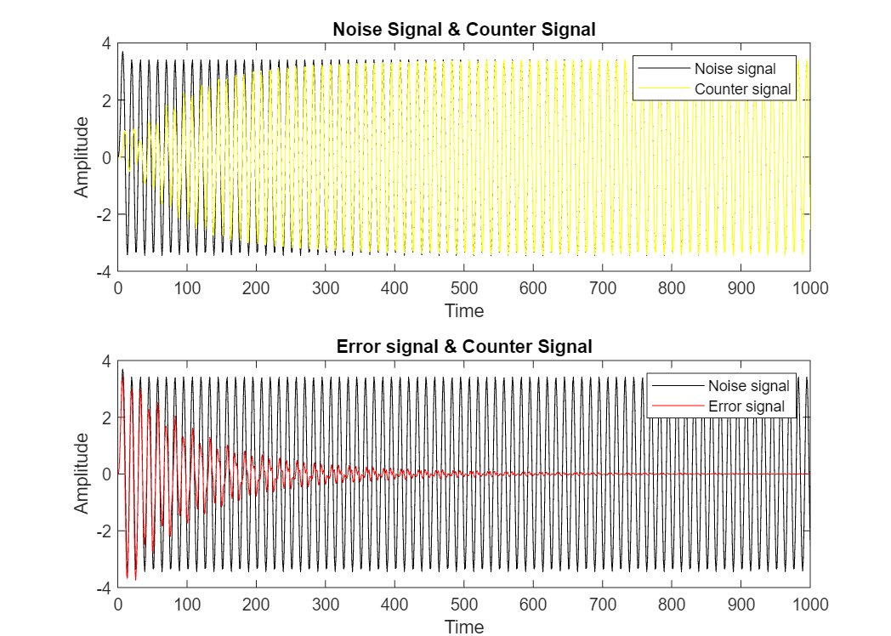
Plots

Slide 13
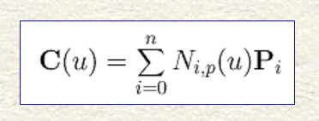
B- Spline
B-spline curve is define by the equation:
where N_{i,p}(u) is B-spline basis functions of degree p, P_{i} is control point having n+1 element and u is define as the knot vector which lies between 0 to n+p+1. One additional parameter is required when defining B-spline basis functions, which is the degree of these basis functions.This is written as N_{i,p}(u), and we define it recursively as follows:

Slide 14
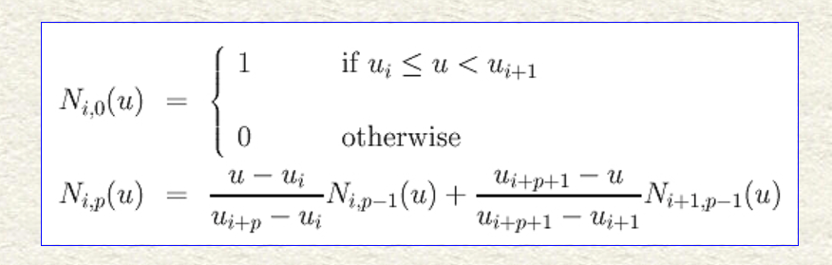
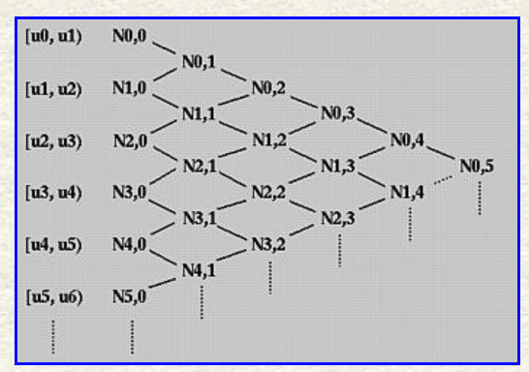
The above is usually referred to as the Cox-de Boor recursion formula.Using the triangular computation scheme, we can understand how Ni,p(u) is calculated for p greater than 0.In the first column, you will find all knot spans; in the second, all degree zero basis functions.This is shown on the figure beside:

Slide 15
Spline Adaptive Filter
SAF is based on spline interpolation and the cascade of a number of linear filters and memoryless nonlinear functions.In order to determine the explicit dependence between the input signal x[n] and the nonlinear output y[n], which is a spline interpolation of some adaptive control points in a LUT, in order to compute y[n] = ϕ(x[n]).In our case,we employ a three-order local polynomial interpolation (P = 3) to interpolate a uniformly spaced spline. The spline segment, denoted a span in this paper, is controlled by four (P + 1) control points, also known as knots, for which the span index i corresponds to the first element of the LUT related to the span.A nonlinear activation function, which uses the span index i and a local parameter u, connects the output of the linear network and the output of the spline adaptive network. These value is calculated as:

Slide 16
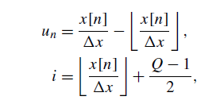



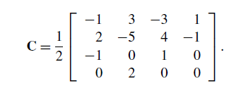

Here, Q is the number of control points and
The output of the nonlinear filter is given by the,
Here,

Slide 17
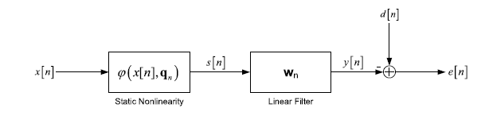


Wiener SAF
The Wiener SAF is the cascade of nonlinear filter and linear filter.
Where linear filter fed with the output of nonlinear filter (which is spline interpolation scheme whose knots are denoted by the vector q_{n}). Weight update and control point update take place by stochastic gradient adaptation.

Slide 18
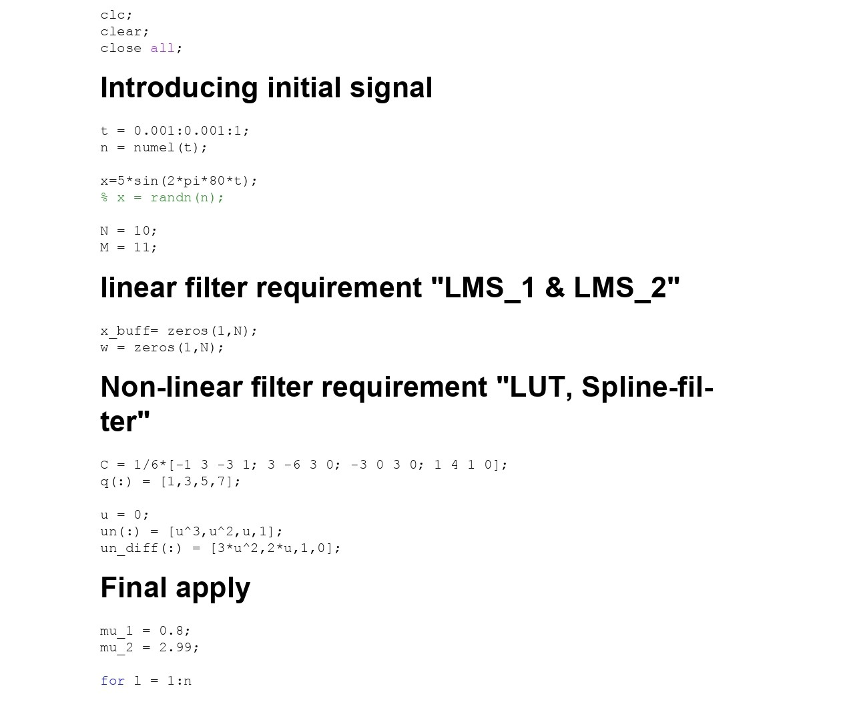
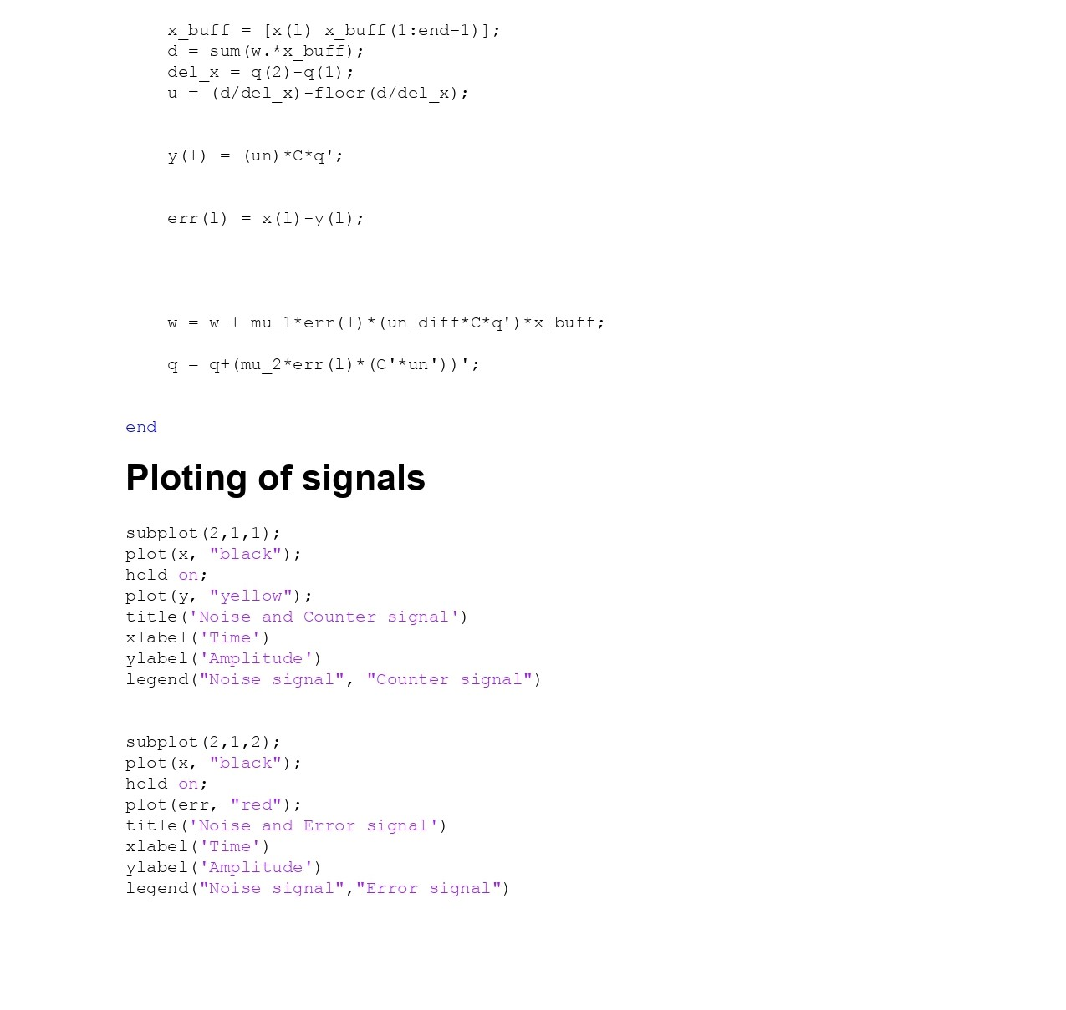
Code for WSAF

Slide 19
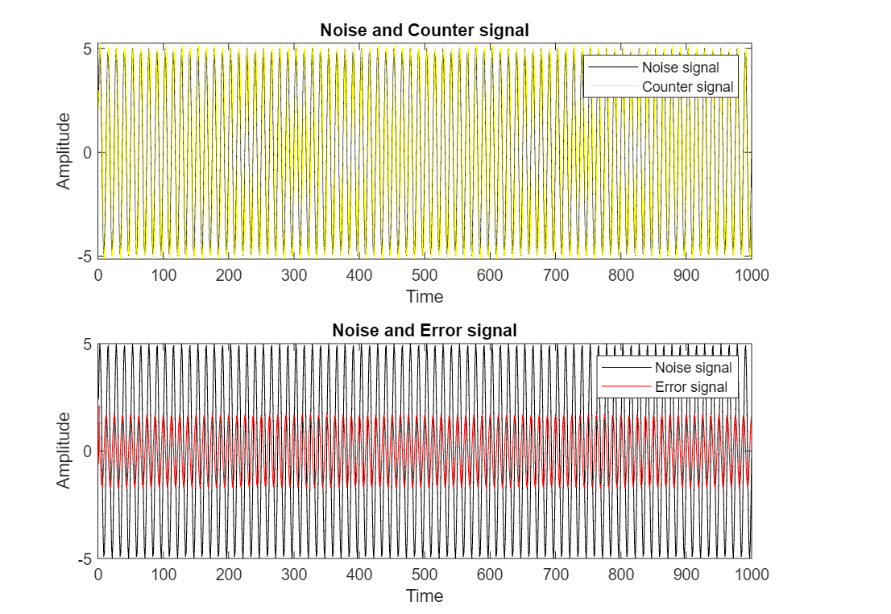
Plots

Slide 20
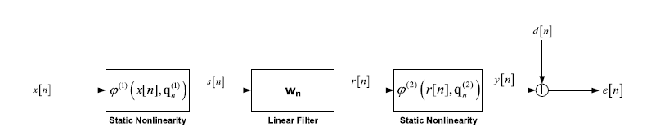



Different Variant of SAF

Slide 21
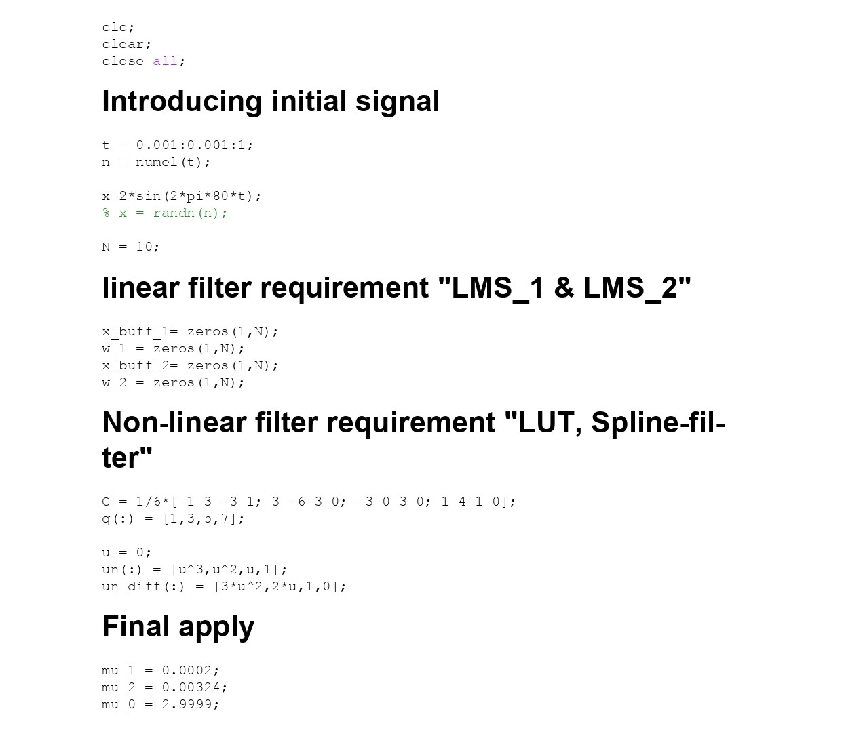
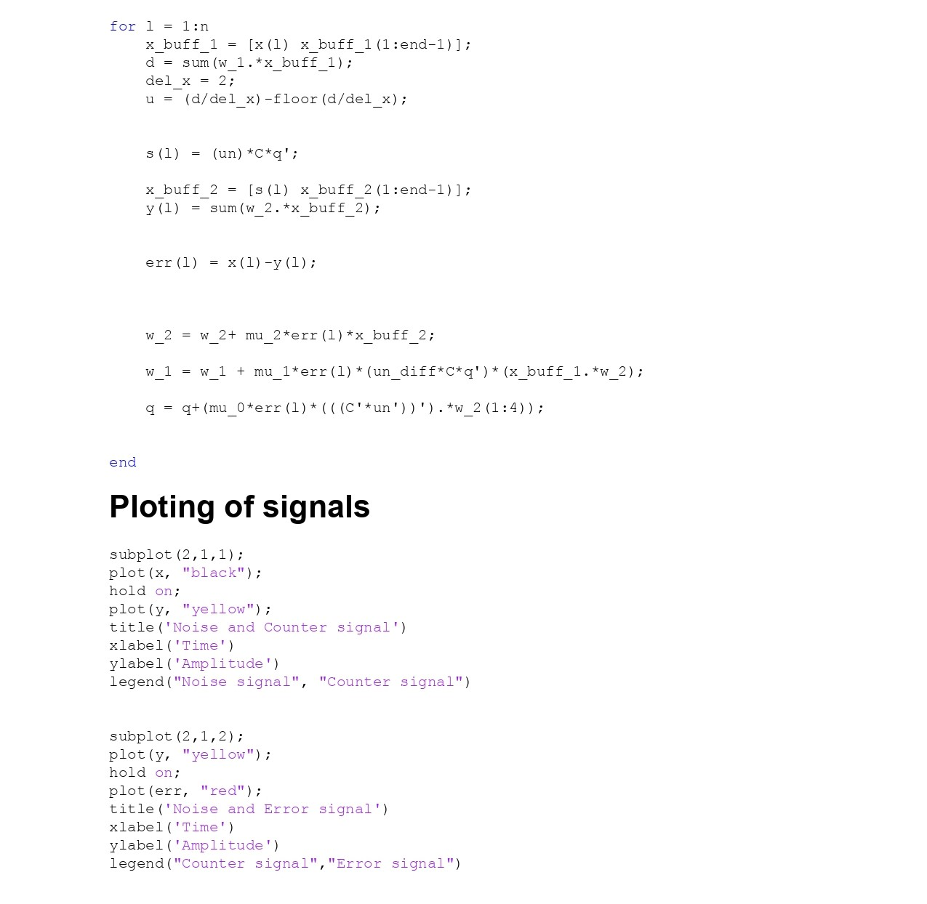
Matlab Code

Slide 22
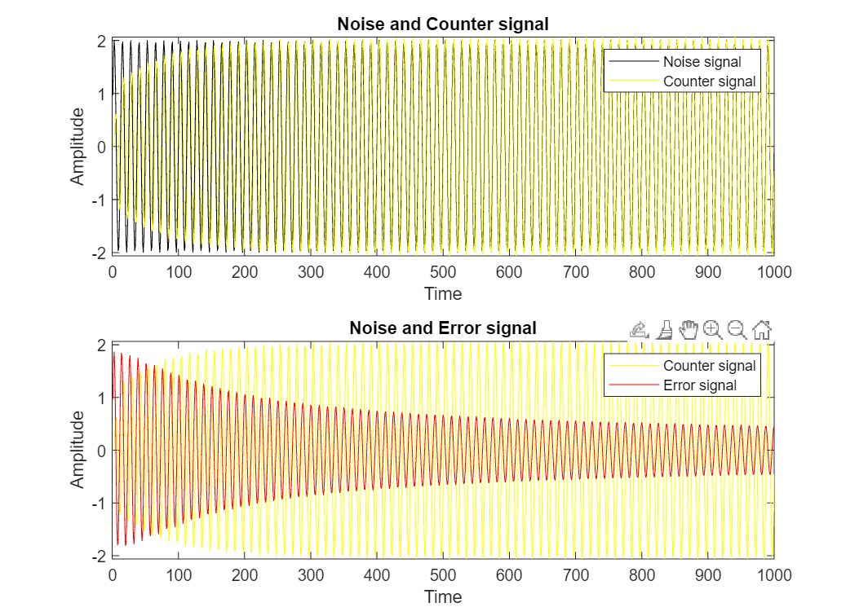
Plots

Slide 23
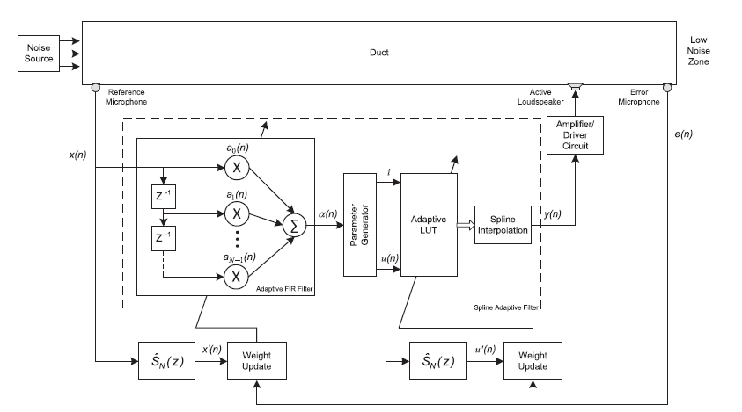

The above ANC system is also a one of the variant of SAF which comprises of FIR filter having input signal with a set of past signal which then feed to the LUT. Finally, it goes for spline interpolation and cancel the noise signal. The updating parameters are give as
Here, u’ is the local parameter goes through impulse response convolution and for linear filter weight updation remain same as it like to be.

Slide 24
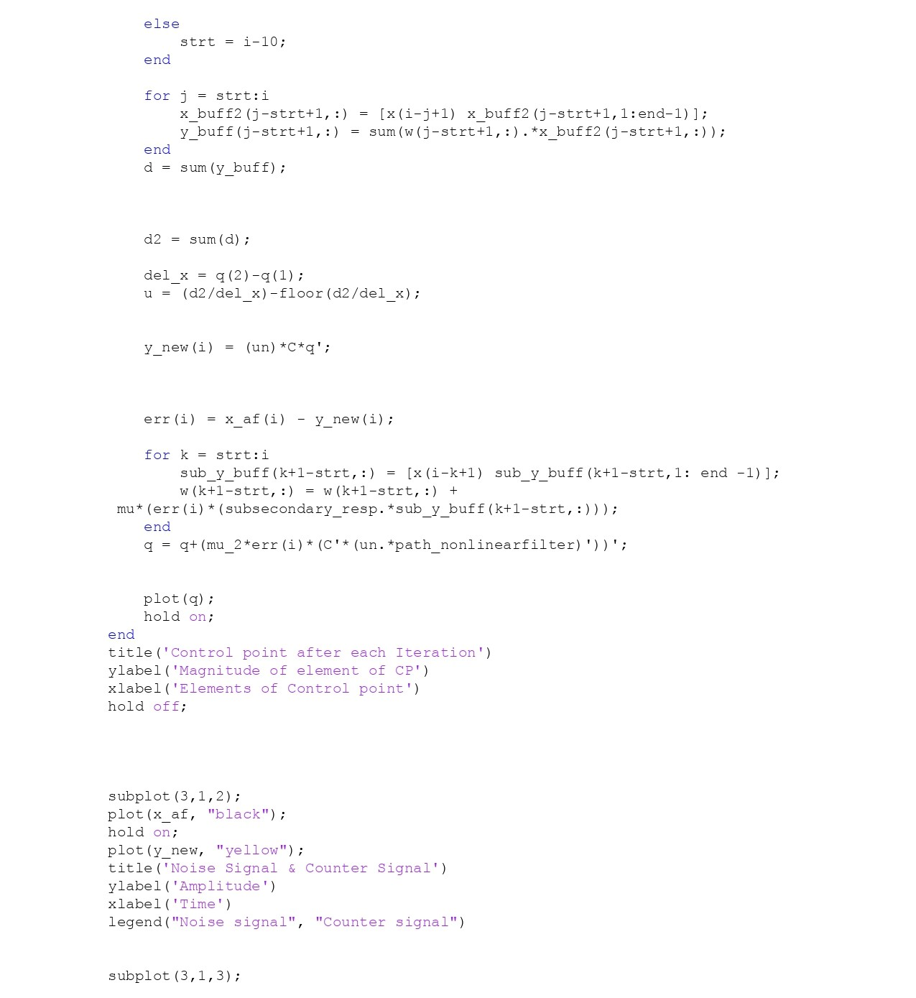
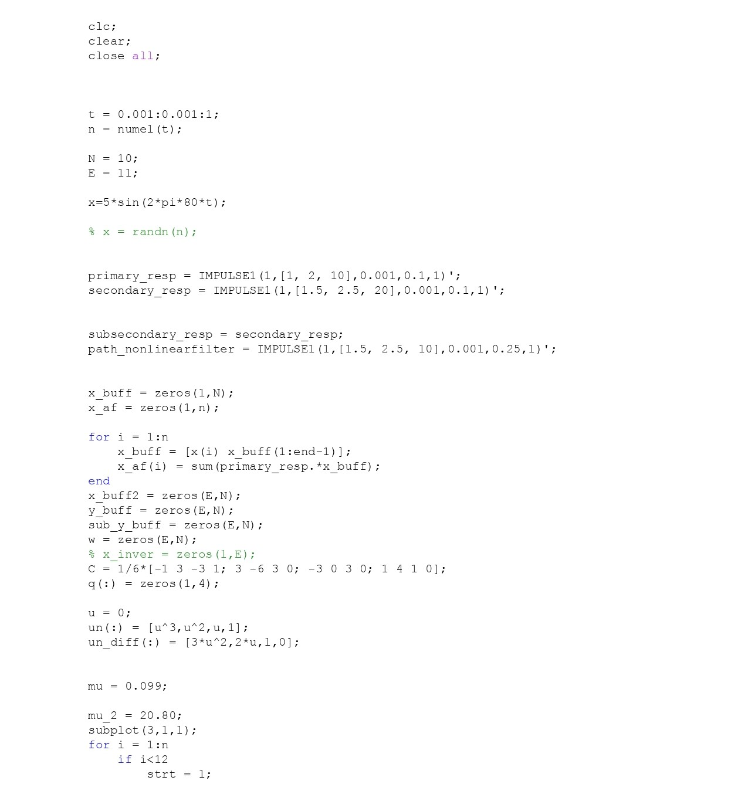
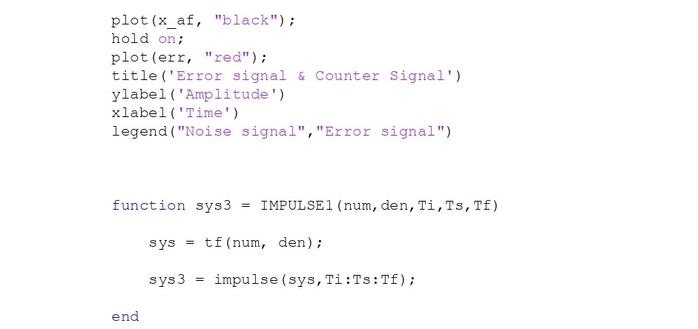
Matlab Code

Slide 25
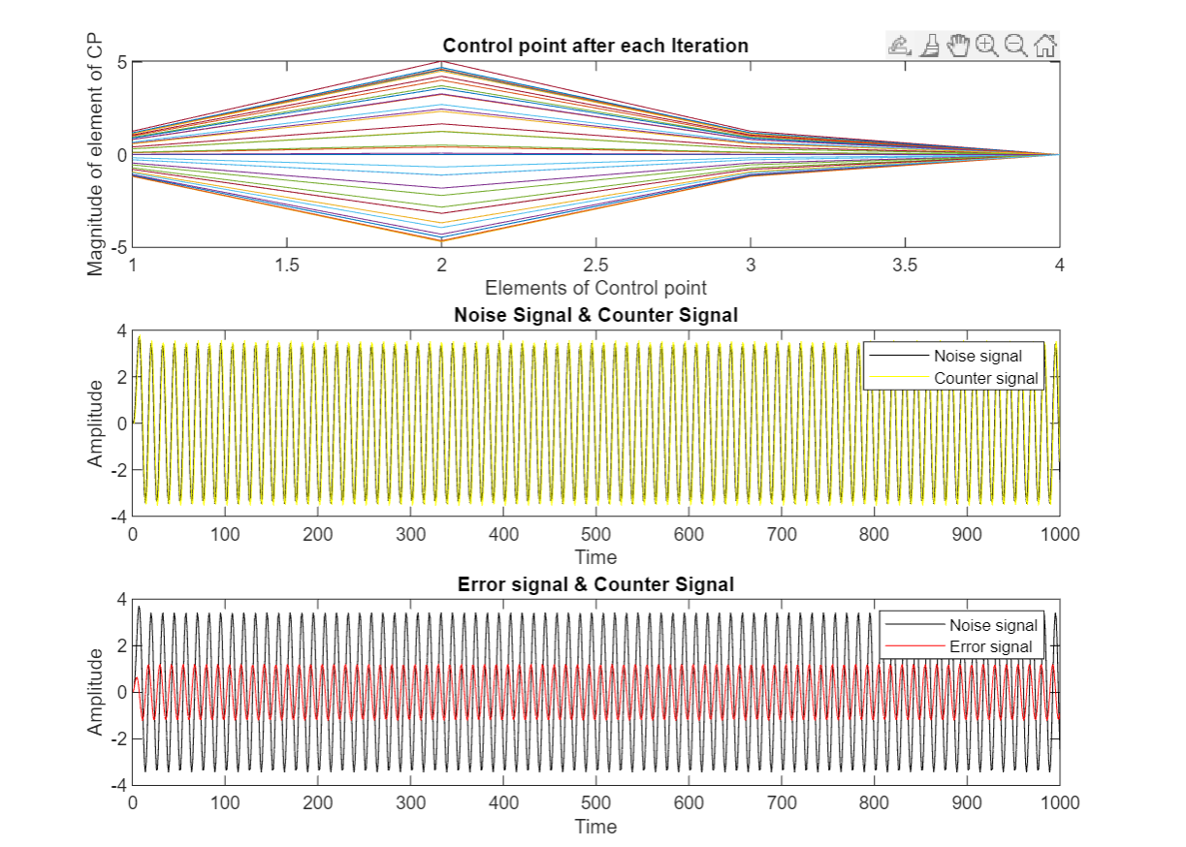
Plots

