Slide 1
Brand Management
Visual Listening: Extracting Brand Image Portrayed on Social Media
27 April 2020 - Zurich
Neeraj Kumar | Linda Samsinger | Theebana Rajendram | Vincent Rüegge
Notes:
Welcome to our presentation on Brand Management – a project of the «Deep Learning for Marketing» class taught at the University of Zurich.
Our project is based on the study conductd by Liu Liu, Daria Dzyabura, and Natalie Mizik about “Visual Listening In: Extracting Brand Image Portrayed on Social Media” as of Feb 27th, 2020.

Slide 2
Agenda
DL4Marketing
Introduction
Marketing Benefits of the Web Application
Design of the Deep Learning Model
Architecture and Challenges
Limitations and Improvements
How to use Deep Learning for Marketing?
Notes:
First, in our introduction we give a general overview of the project. This includes what the project was about, the WHY, the approach we took, the HOW, and the result of the project, the WHAT.
Second, we outline the project goal’s marketing benefits.
Third, we explain how our deep learning architecture can be used to get noteworthy statistical results from feeding in image data.
Forth, we take the opportunity to walk you through all the steps we took from getting the raw image input to the model deployment output in the Web Application. Additionally, we will discuss the challenges for each step.
Finally, we will take a moment to discuss the limitations and an outlook of what can be done in the future will close off this presentation.

Slide 3
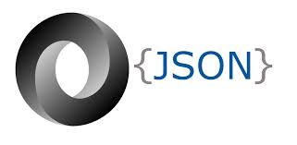


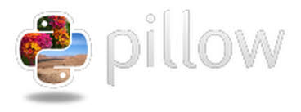




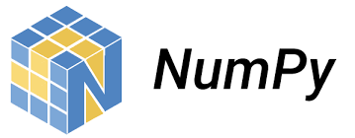


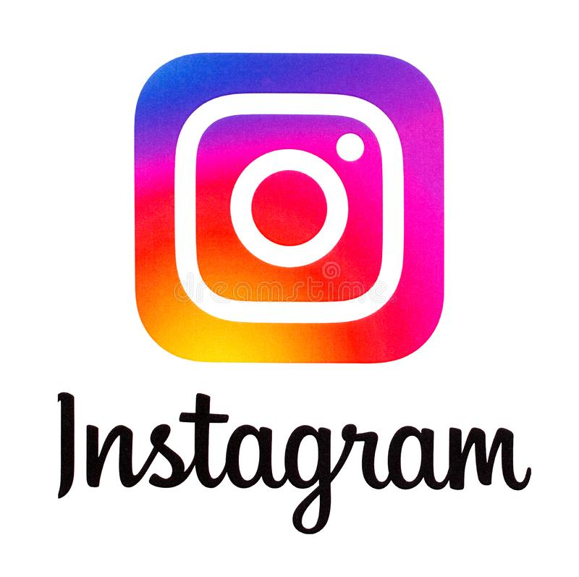



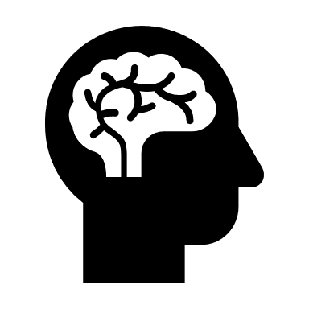
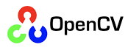
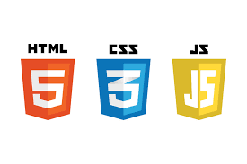

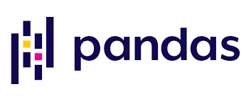
Introduction
DL4Marketing
Task: Create a Web Application to help brand managers analyze brands based on the classification of official and unofficial social media brand image posts
Approach: Full-Stack engineering pipeline combining Deep Learning models, data collection, data preprocessing, and Web Application frameworks
Social Media | BPA*
Flickr, Instagram | fun, healthy, rugged, glamorous
Key in brand name: official + unofficial social media profile
Get Social Media Brand name
*brand personality attributes
Request
Web Application
Response
Model Prediction
Deep Learning Model
Classification of one brand at a time into fixed brand attributes
How to use Deep Learning for Marketing?
Notes:
Our task was to construct a Web Application to help brand managers analyze brands. The analysis is based on the classification of official and unofficial social media brand image posts. Therefore, we constructed a Deep Learning model to categorize images into four personality brand attributes which are either fun, healthy, glamorous, or rugged. We created methods to collect and preprocess attribute-labelled images from Flickr and use them as input for training the Deep Learning model. The Deep Learning model then predicts attributes for images taken from a brand’s official and unofficial Instagram page. The frequencies - in absolute and relative numbers - are displayed on the Web Application to enable an analysis of the brand’s personality. Finally, we embedded our work in a marketing environment to fully breed its applicability and future potential.

Slide 4
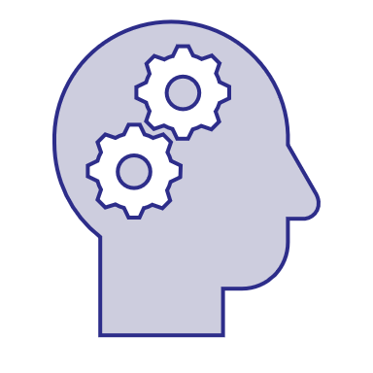
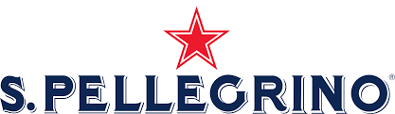
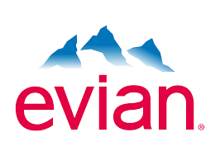


Marketing Benefits of the Web Application
DL4Marketing
Consumer Insights - Better gauge consumer brand perception San Pellegrino (Instagram unofficial): 21% fun and 70% healthy
Benchmarking - Brand positioning &
comparison with competitors San Pellegrino (Instagram official): 54% fun and 41% healthy Evian (Instagram official): 13% fun and 59% healthy San Pellegrino (Instagram unofficial): 21% fun and 70% healthy Evian (Instagram unofficial): 32% fun and 35% healthy
New Opportunities - Improve corporate brand personality Marketing department can focus on the mismatch and develop corresponding strategies to harmonize their brand’s personality
How to use Deep Learning for Marketing?
Notes:
From a marketing perspective, brand management is centered around the three fundamental pillars of consumer insight, benchmarking, and new opportunities. Thus, brands can better understand their consumer’s brand perception, position their brand according to their needs and compare it to competitors, and improve their overall corporate brand personality.
In the case of the brand «San Pellegrino» for example, we derive an evidence-based answer for devising a suitable marketing plan for the years to come. San Pellegrino’s official Instagram page aims to come across as healthy and fun. However, unofficial images reveal that their brand is perceived much more as healthy and much less as fun.
From this analysis, San Pellegrino can develop strategies to harmonize their brand image. More concretely, San Pellegrino could develop marketing campaigns, strenghtening its brand’s health benefits in advertising and social media campaigns. Thus, consumers might feel more connected to the brand on a personal level which in turn can boost overall sales.

Slide 5
Design of the Deep Learning Model
DL4Marketing
OneVsRest Multiclass Image Classification Problem
We downloaded manually annotated images from Flickr using Linux-on-Windows and classified them into one of the four attributes fun, healthy, glamorous, and rugged. For the final classification, we took the argmax probability.
Transfer Learning Approach
We used a pre-trained «ResNet50» model with more than 23 million parameters and added our own last fully connected classifier layer.
Model Prediction
We predicted class labels for brand images.
Example: Brand «DAR-VIDA»
Input: Brand Image
Output: Class Label
How to use Deep Learning for Marketing?
Notes:
We used a combination of transfer learning and a one versus rest multiclass aproach to build our classification model. We pretrained a ResNet 50 model – an already existing convolutional neural network – to build our classifier. We freezed the weights of ResNet 50 model except for the last sigmoid output layer and added our own fully connected layer on top for task-specific fine tuning.

Slide 6
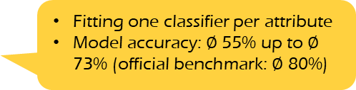
Architecture and Challenges
DL4Marketing
Resize images to same dimensions (300,300)
Remove corrupt images
Data augmentation
1
2
Labeled
Flickr
Images
Data Preprocessing
3
4
5
Train-Test-Validation Split: 80:10:10
One-vs-Rest approach: multiclass classification
Input Training
Training
Validation
Testing
6
7
Unlabeled
Instagram
Images
Prediction
Fitting one classifier per attribute
Model accuracy: $∅$ 55% up to $∅$ 73% (official benchmark: $∅$ 80%)
8
9
Output
Web Application
Input Prediction
How to use Deep Learning for Marketing?
Notes:
In this slide we can see the overall architecture of our Web Application. Broadly speaking there are three parts. 1. data collection and preprocessing, 2. model training and testing, and 3. the Web Application framework connecting everything together.
First, we scraped Flickr images using the code provided by the Visual Listening study. Second, we preprocessed the images including resizing, removing corrupt images, and data augmentation. As a next step, we trained, validated, and tested (ratio: 80:10:10) our Deep Learning model on these images building one classifier for each attribute. This resulted in a total of four models, each the size of about 190MB using a multiclass instead of a multilabel approach. Then, we used Instagram’s private API to construct an infinite scroll scraper function which allowed us to collect unlabelled images from Instagram.We used these Instagram images and the models to predict the brand’s personality. Finally, we built a Web Application capable of combining the above mentioned steps and handling the entire pipeline in a user-friendly fashion. We display the prediction results for brand management and analytics.
For each part we encountered various challenges:
We tried multiple iterations for the model training/testing phase. The following is a list of iterations we tried:
We trained a single ResNet 50 model for classifying all attributes. The model was trained to classify an image as belonging to one of the attributes. We got a model accuracy of 56% with this approach.
We tried different hyperparemeter tunings like changing the input shape, finetuning different amount of layers, using different dropout rates, retraining the whole model, with small increases in model accuracy.
We got an accuracy of 70% by using a one-vs-rest multiclass modelling approach. We trained four classifiers, one for each attribute, and took the label with the highest probability.
Since the dataset is quite large, and we needed to create four datasets each one containing around 10’000 images, our GPU ran out of memory while training all four classifiers simultaneously.
We worked around this problem, by saving the training data set as np arrays, and training each model separately (clearing Notebook Memory after training or saving the model)
We further improved the performance to 73% by using data augmentation.
Our Instagram data collection process went through multiple cycles. In a first step, we developed a script capable of collecting the images displayed on the first page only. As this approach is not suitable for an in-depth analysis, we enhanced the script to use Instagram’s private API, allowing us to collect an infinite number of images. However, this approach had impacts on the overall performance and introduced one more dependency into the overall system. For the image preprocessing we had to find a way to transform the collected images according to the models’ expectations without saving them on the user’s computer. This approach is more convenient from a user perspective but introduced challenges from a Web Application framework perspective.
The Web Application would have needed a database running in the background to be able to pass around the collected images. Thus, displaying the images within the Web Application would have been possible. Additionally, using tensorflow models introduced various challenges for deployment. The sheer size of the models reduced the number of potential hosting services and reduced performance to a large extent. This had consequences on testing the application prior to deployment. Additionally, certain hosting services assume certain versions of tensorflow which were not always in-sync with the version we used.

Slide 7
Limitations and Improvements
DL4Marketing
Data collection: adding e.g. Pinterest and Twitter images (developers API application still pending), matching social media handles to user input, performance enhancements to collect more images, added Flickr images for 12 more attributes
Attribute selection: adding more attributes, e.g. calm, cheerful, confident, creative, exciting, fiery, happy, intelligent, natural, reliable, strong, wholesome
Applicability due to copyright: obtaining proper licenses for commercialisation of the Web App
Model: hyper-parameter tuning to find out the best parameters for the models, i.e optimizer, loss function, numbers of layers to fine tune, multilabel classification : associating an image with multiple attributes instead of single attribute, build smaller model for easy deployment
Web App: error handling, UI enhancements, database integration, image display
Deployment: starting with a simple pipeline and gradually increase its complexity to better understand arising problems, handling of server side issues on Google App Engine, Microsft Azure, or Heroku
How to use Deep Learning for Marketing?
Notes:
The following is a list of limitations and future improvements regarding the overall project:
Besides Flickr and Instagram, we considered getting images from Twitter and Pinterest. In our discussion about Twitter and Pinterest, we realized that Pinterest would be the better platform to source images because of the image content they supply which is much more straightforward and tightly linked to the keyword searched than on Twitter. Efforts towards getting the Pinterest and Twitter API were made, but the applications are still pending as of now.
Other limitations we faced were circumventing video posts on Instagram brand pages instead of image posts, a 16/18 or 21-year-of-age limit that blocked access to the Instagram posts and the official brand’s Instagram account name that could be anything from sanpellegrino_official to gap_usa. As of now, we solve this issue by prompting the user to enter the correct Instagram name. Future improvements could be made by creating a matching table of Instagram accounts and error handling in the Web Application if a user enters an invalid Instagram name.
Extending the number of brand personality attributes would certainly be interesting for the future. Thus, the analysis would be more in-depth. Comparing this with performance-enhancement procedures to be able to collect large amounts of data within a reasonable amount of time would greatly enhance the applicability of the Web Application.
Another issue we needed to consider is respecting users’ rights when downloading copyrighted content or not using images/videos from Instagram for commercial intent. Although the web tool is meant for commercial use, the project’s outer make-up will make any real-world commercialization of the final product less likely.
Regarding the model, improvements towards increasing the overall accuracy could be done. For example, hyper-parameter tuning, or various optimizer loss functions. Also, it would be an interesting idea to visualize the representations learned by various hidden layers and compare the kind of information learnt by initial layers and layers close to the output. Another interesting idea would be to try even bigger models like ResNet 150 and see the impact on performance. Additionally, constructing a model capable of adding more than one label to an image could further improve the project’s applicability.
Our preset time horizon did not allow us to follow up on our mock-ups, nevertheless we tentatively considered a multimedia document embedding for our webtool – showing both official and unofficial Instagram images with predicted labels on a separete website. But this would have required a database back-up for which we would not have the time to see it through to the end.
The deployment of the entire pipeline is another improvement for the future. We decided to focus on a local pipeline to be able to show the entire project and its interactions.

Slide 8
Thank you for watching!
Neeraj Kumar | Linda Samsinger | Theebana Rajendram | Vincent Rüegge
Notes:
With this, we have come to the end of our presentation about the project we have been working on for the last couple of weeks. We have learned a lot about image processing, python programming, finding workarounds, web scraping, deep learning models, API management, the Github universe, and web programming. Thank you.
Should you have questions about our project, please do not hesitate to ask in the follow-up section.
Thank you for your attention.

