Slide 1
Brand Management
The final PowerPoint presentation should be max. 5 slide describing briefly
(1) the task
(2) the input/output
(3) all steps taken (process flow diagram)
(4) the main problems for each step
(5) the (meaningful) ways to improve your projects furthers if you would have gotten more time
Visual Listening: Extracting Brand Image Portrayed on Social Media
21 April 2020 - Zurich
Neeraj Kumar | Linda Samsinger | Theebana Rajendram | Vincent Rüegge
Notes:
Welcome to our presentation on Brand Management. First of all, let’s take a loot at the agenda for today.

Slide 2
Agenda
AI4Marketing
Introduction
Benefits of a Brand Management Web Tool for Marketing Personnel
Design of the Deep Learning Model Architecture
From Image Data to Model Deployment on a Web Application – Challenges
Limitations and Improvements
How to use Deep Learning for Marketing?
Notes:
First, in our introduction we give a general overview of the project. This includes what the project was about, the WHY, the approach we took, the HOW, and the result of the project, the WHAT.
Second, we outline the project goal’s marketing benefits.
Third, we explain how our deep learning architecture can be used to get noteworthy statistical results from feeding in image data.
Forth, we take the opportunity to walk you through all the steps we took from getting the raw image input to the model deployment output in the Web Application. Additionally, we will discuss the challenges for each step.
Finally, we will take a moment to discuss the limitations and an outlook of what can be done in the future will close off this presentation.

Slide 3



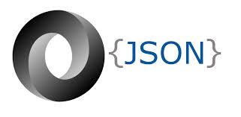

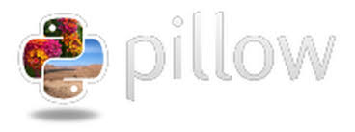






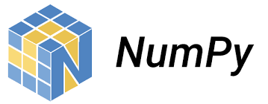



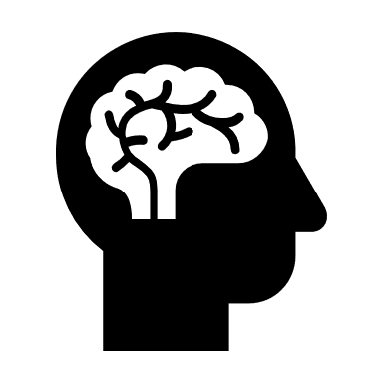

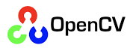

Introduction
DL4Marketing
Task: Categorise and compare official and unofficial social media brand images to measure how these brands are portrayed on the respective social media platform
Approach: Full-Stack engineering procedure combining Deep Learning models, data collection and preprocessing, and Web Application frameworks
Social Media | Categories
Flickr, Instagram | fun, healthy, rugged, glamorous
Request
Web Application
Response
Model Prediction
Deep Learning Model
Key in brand name: official + unofficial social media profile
Get Social Media Brand name
Classification of one brand at a time into fixed brand attributes
How to use Deep Learning for Marketing?
Notes:
Our task was to construct an infrastructure capable of measuring how brands are perceived on certain social media platforms. Therefore, we constructed a Deep Learning model to categorise images as either fun, healthy, glamorous, or rugged. We created methods to collect and preprocess images from Instagram and use them as input for the Deep Learning model. Furthermore, we established a pipeline spanning from user input capture to output display using a Python based Web framework. Finally, we embedded our work in a marketing environment to fully breed its applicability and future potential.

Slide 4


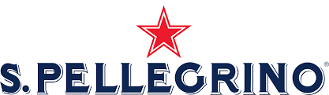

Benefits of a Brand Management Web Tool for Marketing Personnel
DL4Marketing
Consumer Insights - Better understand consumer brand perception
Benchmarking - Brand positioning and comparison with competitors
New Opportunities - Improve corporate brand image
San Pellegrino
54% labelled as fun and 41% labelled as healthy from the official Instagram page
21% labelled as fun and 70% labelled as healthy from the unofficial Instagram page
→ Marketing department can focus on this mismatch and develop corresponding strategies to harmonise San Pellegrino’s brand image
How to use Deep Learning for Marketing?
Notes:
From a marketing perspective, brand management is centered around the three fundamental pillars of consumer insight, benchmarking, and new opportunities. Thus, brands can better understand their consumer’s brand perception, position their brand acording to their needs, and improve their overall corporate brand image.
In the case of the brand «San Pellegrino» for example, we derive an evidence-based answer for devising a suitable marketing plan for the years to come. San Pellegrino’s official Instagram page aims to come across as healthy and fun in the images they release on their Instagram channel. However, unofficial images reveal that their brand is not considered as fun as much as it is for being perceived as healthy.
From this analysis, San Pellegrino can develop strategies to harmonise their brand image. More concrete, San Pellegrino could develop marketing campaigns focusing on health aspects. Thus, consumers might feel more connected to the brand on a personal level which in turn can boost overall sales.

Slide 5
Design of the Deep Learning Model Architecture
DL4Marketing
OneVsRest Multiclass Image Classification Problem
Classified manually annotated images downloaded from Flickr using Linux-on-Windows into one of the following 4 attributes (+ their antonyms + UNK classes) taking the argmax probability :
Transfer Learning Approach
Used pre-trained «ResNet50» model (CNN) with (> 23 Million )parameters and added our own last fully connected classifier layer.
Model Prediction
Predicted class label for brand images.
Example: Brand «DAR-VIDA»
Fun | Healthy
Glamorous | Rugged
Input: Brand Image
Output: Class Label
How to use Deep Learning for Marketing?
Notes:
Machine Learning: We are using a combination of transfer learning and one vs rest multiclass aproach to build our classification model. We pretrained a resnet 50 model(CNN) to build our classifier. We freezed the weights of Resnet 50 model except the last output layer and add a fully connected layer on top for task specific fine tuning.

Slide 6
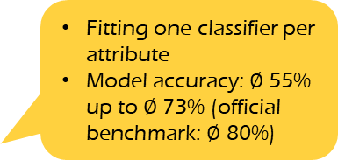
From Image Data to Model Deployment on a Web App – Challenges
DL4Marketing
Resize images to same dimensions (300,300)
Remove corrupt images
Label antonym negatives for attributes
Data augmentation
1
2
Labeled
Flickr
Images
Data Preprocessing
3
4
5
Train-Test-Validation Split: 80:10:10
One-vs-Rest approach: multiclass classification used where each classifier was trained independently for the corresponding attribute in the dataset
Train
Validate
Test
6
7
Fitting one classifier per attribute
Model accuracy: $∅$ 55% up to $∅$ 73% (official benchmark: $∅$ 80%)
Unlabeled
Instagram
Images
Label Classifier Model
8
9
Model Prediction
Web Application
How to use Deep Learning for Marketing?
Notes:
In this slide we can see the overall architecture of our Web Application. Broadly speaking there are three parts. 1. model training and testing, 2. data collection and preprocessing, and 3. the Web Application framework connecting everything together.
For each part we encountered various challenges:
We tried multiple iterations for the model training/testing phase. Following is a list of iterations we tried,
Trained a single resnet 50 model for classifying all attributes. Model was trained to classify an image as belonging to one of the attribute. Got a model accuracy of 56% with this model.
We tried different hyperparmenter tunings like changing the input shape, finetuning different amount of layers, different dropout rates, retraing the whole model itself, without much success.
We got an accuracy of 70% by using One-vs-rest multiclass modelling approach. We trained 4 classifiers, 1 for each attribute, and took the label with the highest probability.
Since dataset is quite large, and we need to create 4 datasets each one containing around 10K images, GPU ran out of memory if we train all the 4 classifiers simultaneously.
We worked around this problem, by saving the training data set as np arrays, and train each model separately(Clear Notebook Memory after training/saving the model)
We further improved the performance to 73% by using data augmentation.
Our data collection process went through multiple cycles. In a first step, we developed a script capable of collecting the images displayed on the first page only. As this approach is not suitable for an in-depth analysis, we enhanced the script to use Instagram’s private API, allowing us to collect more images. However, this approach had negative impacts on the overall performance and introduced one more dependency into the overall system. For the image preprocessing we had to find a way to transform the collected images according to the models’ expectations without saving them on the user’s computer. This approach is more convenient from a user perspective but introduced challenges from a Web Application framework perspective.
The Web Application would have needed a database running in the background to be able to pass around the collected images. Thus, displaying the images within the Web Application would have been possible. Additionally, using tensorflow models introduced various challenges for deployment. The sheer size of the models reduced the number of potential hosting services and reduced performance to a large extent. This had negative consequences on testing the application prior to deployment. Additionally, certain hosting services assume certain versions of tensorflow which were not always in-sync with the version we used.

Slide 7
Limitations and Improvements
DL4Marketing
Data collection adding e.g. Pinterest and Twitter images, matching social media handles to user input, performance enhancements to collect more images
Attribute selection adding more attributes
Applicability due to copyright obtaining proper licenses for commercialisation of the Web App
Model Hyper-Parameter Tuning to find out the best parameters for the models, i.e Optimizer, Loss Function, Numbers of layers to fine tune.
Multilabel Classification : Associating an image with multiple attributes, inseatd of single attribute.
Web App error handling, UI enhancements, database integration, image display
Deployment starting with a simple pipeline and gradually increase ist complexity to better understand arising problems
How to use Deep Learning for Marketing?
Notes:
Besides Flickr and Instagram, we considered getting images from Twitter and Pinterest. In our discussion about Twitter and Pinterest, we realized that Pinterest would be the better platform to source images because of the image content they supply which is much more straightforward and tightyl linked to the keyword searched than on Twitter. Efforts towards getting the Pinterest API were made, but the application is still pending as of now.
Another challenge we faced was video posts on Instagram brand profiles instead of images, 16/18 or 21-year-of-age limit that blocked access to the Instagram posts and the official brand’s Instagram account name that could be anything from sanpellegrino_official to gap_usa. As of now, we solve this issue by prompting the user to enter the correct Instagram name. Future improvements could be made by creating a matching table of Instagram accounts and error handling in the Web Application if a user enters an invalid command.
Extending the original brand personality attributes, fun, healthy, rugged, and glamorous to more attributes would certainly be interesting for the future. Thus, the analysis would be more in-depth. Comparing this with performance-enhancement procedures to be able to collect large amounts of data within a reasonable amount of time would greatly enhance the applicability of the project.
Another issue we need to consider is respecting user’s rights when downloading copyrighted content or not using images/videos from Instagram for commercial intent. Although the web tool is meant for commercial use, the project’s outer make-up will make any real-world commercialization of the final product a less likely probability.
Because of time constraints, we were not able to try various hyper parameter tuning to find out the best performing hyper parameters. It will be an interesting idea to visualize the representations learned by various hidden layers and compare the kind of information learnt by initial layers and layer close to the output. Another interesting idea would be try even bigger models like resnet 150 and see the impact on performance.
Our preset time horizon did not allow us to follow up on our mock-ups, nevertheless we tentatively considered a multimedia document embedding for our webtool – showing both official and unofficial Instagram images with predicted labels on a separete website. But this would have required a database back-up for which we would not have the time to see it through to the end. Also priority was given to make the deep learning model workflow as good as possible.
The deployment of the entire pipeline is another improvement for the future. Given the time and the absence of knowledge in the realm of web development / deployment, and handling server-side issues, we were not able to deploy the application to the web. We decided to focus on a local pipeline to be able to show the entire project and its interaction.

Slide 8
Thank you for listening!
Neeraj Kumar | Linda Samsinger | Theebana Rajendram | Vincent Rüegge
Notes:
With this, we have come to the end of our presentation about the project we have been working on for the last couple of weeks. We have learned a lot about image processing, python programming, finding workarounds, web scraping, deep learning models, API management, the Github universe, and web programming. Thank you.
Should you have questions about our project, please do not hesitate to ask them in the follow-up section.
Thank you for your attention.

