Slide 1
Webapp
Brand Management

Slide 2

Brand Personality Calculator
Discover how your brand is perceived.
Brand: Manor
Account name¹: manor_schweiz
The brand personality is assessed on Instagram based on the following categories: 1. fun 2. glamorous 3. healthy 4. rugged 5. honest 6. competent 7. intelligent 8. sophisticated 9. excited 10. sincere 11. wholesome 12. cheerful 13. daring 14. spirited 15. imaginative 16. reliable 17. charming 18. outdoorsy 19. tough 20. successful
1. Official Instagram brand account name

Slide 3

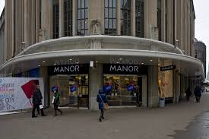
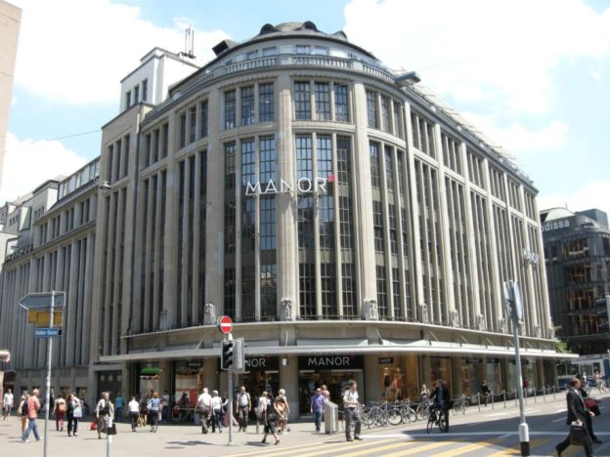
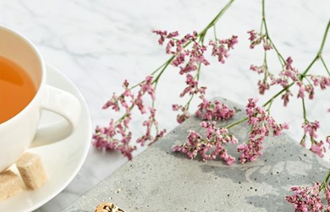
Image Classification
rugged
Brand: Manor
Social Media: Instagram
Rank | Attribute | Official Instagram |  | Inofficial Instagram
1. | Healthy | 20 | 60.6% | 432 | 80%
2. | Rugged | 13 | 21.5% | 144 | 78%
3. | Optimistic | 7 | 11.4% | 90 | 66%
4. | Reliable | 5 | 5% | 66 | 50%
5. | Fun | 4 | 4.5% | 45 | 47%
6. | Daring | 3 | 3.2% | 36 | 45%
7. | cheerful | 3 | 3.3% | 32 | 24%
rugged
fun

Slide 4
Machine Learning

Slide 5
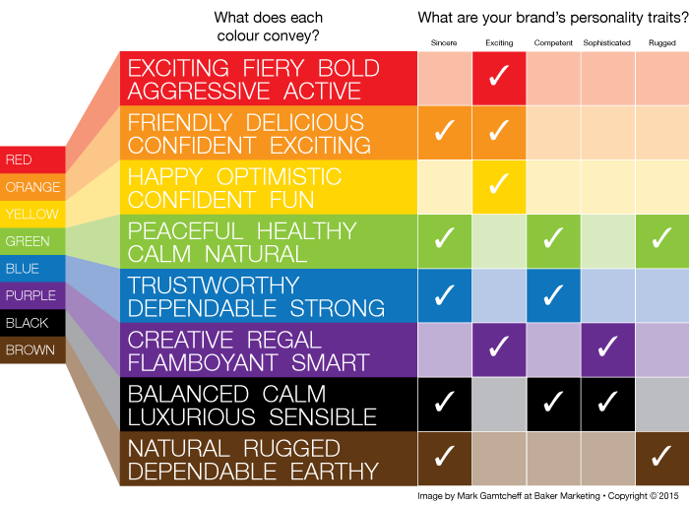
Attributes
1 | Exciting, fiery
2 | Friendly, confident
3 | Fun, happy
4 | Healthy, wholesome
5 | Strong, honest
6 | Creative, intelligent
7 | Glamorous, calm
8 | Rugged, natural
Number of attributes: 16
Brand category: 2x
Based on:

Slide 6
Deep Learning
Computer Vision: For image classification using deep learning, a rule of thumb is 1,000 images per class, where this number can go down significantly if one uses pre-trained models [6].

