Slide 1
COVID-19
Prediction of ICU Need and Analysis of COVID Patients
Presented by:
Neeraj Singh

Slide 2
Descriptive Summary & Observations
The overview of the dataset shows the shape of the dataset, missing values in the form of NA (and 97,98,99) present, and the least correlated columns.
Dealt with missing values and modified the dates columns.
Analyzed the Data Set by EDA
Applied different Machine Learning Algorithms

Slide 3
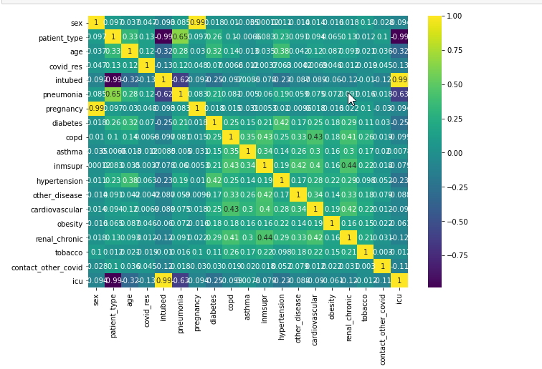
correlation analysis
From this chart we can analyse
that the ICU is mostly
correlated with
Patient_type,intubed,Pneumonia
ICU requires the covid patient with Pneumonia

Slide 4
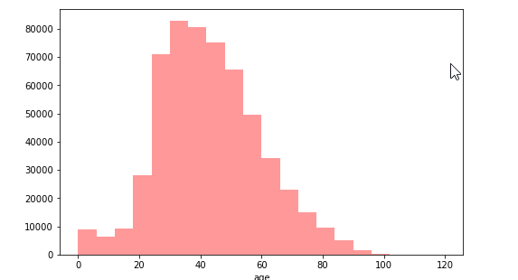
From the above graph we can observe that the age of 30 to 50 are more affected by the COVID_19

Slide 5
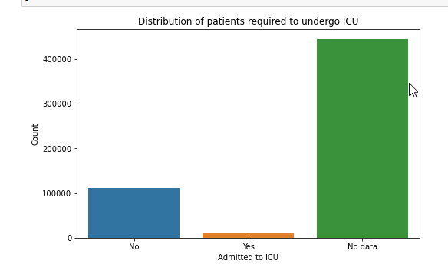
Above graph shows that very few patients got into the icu and lots of data is missing

Slide 6
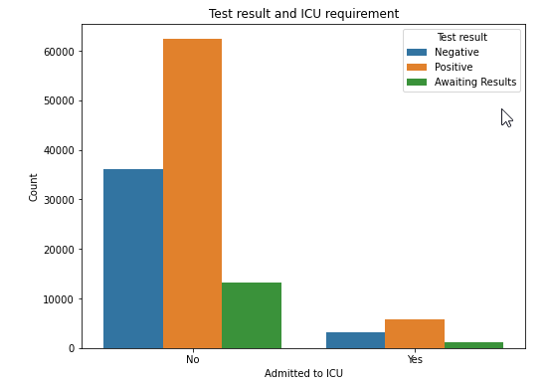
Above graph reveals that the most of the positive patients didn't go to the icu.

Slide 7
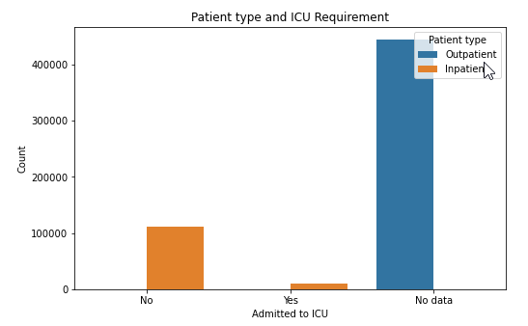
Above graph shows that the lots of outpatient data is missing and very few inpatient types got the icu.

Slide 8
Feature Engineering
Dropped some missing values from different columns.
Dropped columns with least correlated with icu.
Created new column of “num_days_symptoms” to see the number of days passed when the symptoms occurred before testing.
Created dummy variable in “covid_res” column because it has the categorical data in it.

Slide 9
Modeling
Performed oversampling using SMOTE because the target variable was imbalanced.
Split the final dataset into the train and test.
Used StandardScaler and MinMaxScaler.

Slide 10
Algorithms used
Logistic Regression
Decision Tree
Random Forest
KNN

Slide 11
Logistic Regression
Best Score on the train data:
precision :0.7647168608177676
Recall :0.6373912705305869
F1_score :0.6952728403964987
Best Score on the test data:
precision :0.7643374722353712
Recall :0.6349364791288566
F1_score :0.693653652330519:

Slide 12
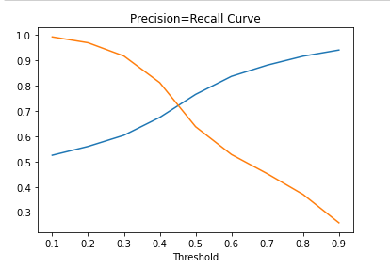
Precision-Recall Curve

Slide 13
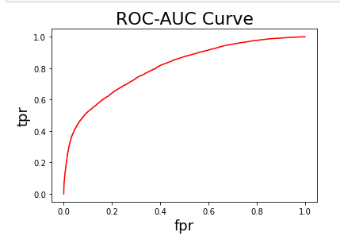
ROC Curve

Slide 14
Decision Tree
Best Score on the train data (Max depth = 37):
precision :0.933716962363222
Recall :0.961265734175082
F1_score :0.9472910997841055
Best Score on the test data (Max depth = 37):
precision :0.8303439426483304
Recall :0.9003932244404114
F1_score :0.8639510078509337

Slide 15
Random Forest
Best Score on the train data.
precision :0.8711570266657604
Recall :0.9969277038150919
F1_score :0.9298085467812042
Best Score on the train data.
precision :0.808217062245791
Recall :0.9496672716273442
F1_score :0.873251189052374

Slide 16
KNN
Train rsme : 0.29
Test rsme : 0.36

Slide 17
Conclusion of the model:
Decision Tree is the model which gave the best score in the form of precision, recall and F1_score on training and testing data.
Threshold 37 is the best to get the prediction from the DT algorithm.
Below is the scores:
DT Best score on scaled data
train29
precision :0.9176697819314642 Recall :0.9546544639037606 F1_score 0.9357968371762044
test29
precision :0.8210637060826712 Recall :0.8970356926799758 F1_score 0.8573700111305455

Slide 18
Recapitulation from the data :
COVID patients with Pneumonia, Pulmonary Disease, Diabetes, or Hypertension are required to get into the icu.
Patients are suffered for the long time with the COVID before testing are also at risk depending upon their condition they need to move to the icu.

