Slide 1
UNIT-3
BY
JOHN A

Slide 2
SYLLABUS
Sort, Filter, Conditional Formatting, Charts, Pivot Tables, Tables, What if Analysis, Solver, Descriptive Statistics, Correlation, Regression, Introduction to Programming Languages for AI

Slide 3
Sort
Sorting data is an integral part of Data Analysis. You can arrange a list of names in alphabetical order, compile a list of sales figures from highest to lowest, or order rows by colors or icons. Sorting data helps you quickly visualize and understand your data better, organize and find the data that you want, and ultimately make more effective decisions.
You can sort by columns or by rows. Most of the sorts that you use will be column sorts.
You can sort data in one or more columns by
text (A to Z or Z to A)
numbers (smallest to largest or largest to smallest)
dates and times (oldest to newest and newest to oldest)
a custom list (E.g. Large, Medium, and Small)
format, including cell color, font color, or icon set

Slide 4
Descriptive Statistics
Descriptive statistics are brief descriptive coefficients that summarize a given data set, which can be either a representation of the entire population or a sample of a population. Descriptive statistics are broken down into measures of central tendency and measures of variability.
Correlation
Regression

Slide 5
Regression Techniques
When Regression is chosen?
A regression problem is when the output variable is a real or continuous value, such as “salary” or “weight”. Many different models can be used, the simplest is linear regression. It tries to fit data with the best hyper plane which goes through the points.

Slide 6
Regression Analysis is a statistical process for estimating the relationships between the dependent variables or criterion variables and one or more independent variables or predictors. Regression analysis explains the changes in criteria in relation to changes in select predictors.
Three major uses for regression analysis are determining the strength of predictors, forecasting an effect, and trend forecasting.

Slide 7
Y= aX+b
Y = dependent variables (target variables),
X= Independent variables (predictor variables),
a and b are the linear coefficients

Slide 8
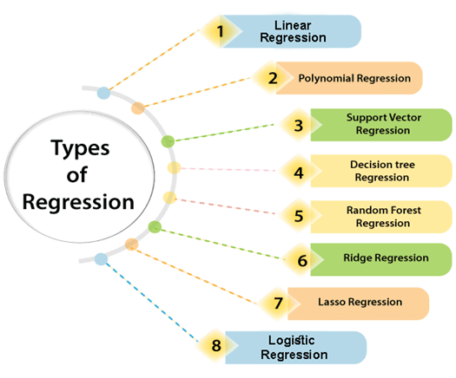


Slide 9
Types of Regression:
Linear regression is used for predictive analysis. Linear regression is a linear approach for modelling the relationship between the criterion or the scalar response and the multiple predictors or explanatory variables.
Linear regression focuses on the conditional probability distribution of the response given the values of the predictors.
For linear regression, there is a danger of overfitting. The formula for linear regression is: Y’ = bX + A.

Slide 10

Polynomial regression is used for curvilinear data. Polynomial regression is fit with the method of least squares. The goal of regression analysis is to model the expected value of a dependent variable y in regards to the independent variable x. The equation for polynomial regression is:

Slide 11

Stepwise regression is used for fitting regression models with predictive models. It is carried out automatically. With each step, the variable is added or subtracted from the set of explanatory variables. The approaches for stepwise regression are forward selection, backward elimination, and bidirectional elimination. The formula for stepwise regression is .

Slide 12

Ridge regression is a technique for analyzing multiple regression data. When multicollinearity occurs, least squares estimates are unbiased. A degree of bias is added to the regression estimates, and as a result, ridge regression reduces the standard errors. The formula for ridge regression is

Slide 13

ElasticNet regression is a regularized regression method that linearly combines the penalties of the lasso and ridge methods. ElasticNet regression is used for support vector machines, metric learning, and portfolio optimization

Slide 14
Correlation
Correlation refers to a process for establishing the relationships exist between two variables.
Methods of correlation summarize the relationship between two variables in a single number called the correlation coefficient. The correlation coefficient is usually represented using the symbol r, and it ranges from -1 to +1.

Slide 15
A correlation coefficient quite close to 0, but either positive or negative, implies little or no relationship between the two variables.
A correlation coefficient close to plus 1 means a positive relationship between the two variables, with increases in one of the variables being associated with increases in the other variable.

Slide 16
A correlation coefficient close to -1 indicates a negative relationship between two variables, with an increase in one of the variables being associated with a decrease in the other variable.

Slide 17
Types of Correlation
Positive Correlation – when the value of one variable increases with respect to another.
Negative Correlation – when the value of one variable decreases with respect to another.
No Correlation – when there is no linear dependence or no relation between the two variables.

Slide 18

Formula
Where n = Quantity of Information
Σx = Total of the First Variable Value
Σy = Total of the Second Variable Value
Σxy = Sum of the Product of first & Second Value
Σx² = Sum of the Squares of the First Value
Σy² = Sum of the Squares of the Second Value

