Slide 1
Chapter 19: Distributed Databases
Heterogeneous and Homogeneous Databases
Distributed Data Storage
Distributed Transactions
Commit Protocols
Concurrency Control in Distributed Databases
Availability
Distributed Query Processing
Heterogeneous Distributed Databases
Directory Systems

Slide 2
Distributed Database System
A distributed database system consists of loosely coupled sites that share no physical component
Database systems that run on each site are independent of each other
Transactions may access data at one or more sites

Slide 3
Homogeneous Distributed Databases
In a homogeneous distributed database
  All sites have identical software
  Are aware of each other and agree to cooperate in processing user requests.
  Each site surrenders part of its autonomy in terms of right to change schemas or software
  Appears to user as a single system
In a heterogeneous distributed database
  Different sites may use different schemas and software
    Difference in schema is a major problem for query processing
    Difference in softwrae is a major problem for transaction processing
  Sites may not be aware of each other and may provide only
  limited facilities for cooperation in transaction processing

Slide 4
Distributed Data Storage
Assume relational data model
Replication
  System maintains multiple copies of data, stored in different sites, for faster retrieval and fault tolerance.
Fragmentation
  Relation is partitioned into several fragments stored in distinct sites
Replication and fragmentation can be combined
  Relation is partitioned into several fragments: system maintains several identical replicas of each such fragment.

Slide 5
Data Replication
A relation or fragment of a relation is replicated if it is stored redundantly in two or more sites.
Full replication of a relation is the case where the relation is stored at all sites.
Fully redundant databases are those in which every site contains a copy of the entire database.

Slide 6
Data Replication (Cont.)
Advantages of Replication
  Availability: failure of site containing relation r does not result in unavailability of r is replicas exist.
  Parallelism: queries on r may be processed by several nodes in parallel.
  Reduced data transfer: relation r is available locally at each site containing a replica of r.
Disadvantages of Replication
  Increased cost of updates: each replica of relation r must be updated.
  Increased complexity of concurrency control: concurrent updates to distinct replicas may lead to inconsistent data unless special concurrency control mechanisms are implemented.
    One solution: choose one copy as primary copy and apply concurrency control operations on primary copy

Slide 7
Data Fragmentation
Division of relation r into fragments r₁, r₂, …, r_{n} which contain sufficient information to reconstruct relation r.
Horizontal fragmentation: each tuple of r is assigned to one or more fragments
Vertical fragmentation: the schema for relation r is split into several smaller schemas
  All schemas must contain a common candidate key (or superkey) to ensure lossless join property.
  A special attribute, the tuple-id attribute may be added to each schema to serve as a candidate key.
Example : relation account with following schema
Account-schema = (branch-name, account-number, balance)

Slide 8
Horizontal Fragmentation of account Relation
branch-name
account-number
balance
Hillside
Hillside
Hillside
A-305
A-226
A-155
500
336
62
account₁=σ_{branch-name=“Hillside”}(account)
branch-name
account-number
balance
Valleyview
Valleyview
Valleyview
Valleyview
A-177
A-402
A-408
A-639
205
10000
1123
750
account₂=σ_{branch-name=“Valleyview”}(account)

Slide 9
Vertical Fragmentation of employee-info Relation
branch-name
customer-name
tuple-id
Hillside
Hillside
Valleyview
Valleyview
Hillside
Valleyview
Valleyview
Lowman
Camp
Camp
Kahn
Kahn
Kahn
Green
1
2
3
4
5
6
7
deposit₁=Πbranch-name, customer-name, tuple-id(employee-info)
account number
balance
tuple-id
A-305
A-226
A-177
A-402
A-155
A-408
A-639
500
336
205
10000
62
1123
750
1
2
3
4
5
6
7
deposit₂=Πaccount-number, balance, tuple-id(employee-info)

Slide 10
Advantages of Fragmentation
Horizontal:
  allows parallel processing on fragments of a relation
  allows a relation to be split so that tuples are located where they are most frequently accessed
Vertical:
  allows tuples to be split so that each part of the tuple is stored where it is most frequently accessed
  tuple-id attribute allows efficient joining of vertical fragments
  allows parallel processing on a relation
Vertical and horizontal fragmentation can be mixed.
  Fragments may be successively fragmented to an arbitrary depth.

Slide 11
Data Transparency
Data transparency: Degree to which system user may remain unaware of the details of how and where the data items are stored in a distributed system
Consider transparency issues in relation to:
  Fragmentation transparency
  Replication transparency
  Location transparency

Slide 12
Naming of Data Items - Criteria
1. Every data item must have a system-wide unique name.
2. It should be possible to find the location of data items efficiently.
3. It should be possible to change the location of data items transparently.
4. Each site should be able to create new data items autonomously.

Slide 13
Centralized Scheme - Name Server
Structure:
  name server assigns all names
  each site maintains a record of local data items
  sites ask name server to locate non-local data items
Advantages:
  satisfies naming criteria 1-3
Disadvantages:
  does not satisfy naming criterion 4
  name server is a potential performance bottleneck
  name server is a single point of failure

Slide 14
Use of Aliases
Alternative to centralized scheme: each site prefixes its own site identifier to any name that it generates i.e., site 17.account.
  Fulfills having a unique identifier, and avoids problems associated with central control.
  However, fails to achieve network transparency.
Solution: Create a set of aliases for data items; Store the mapping of aliases to the real names at each site.
The user can be unaware of the physical location of a data item, and is unaffected if the data item is moved from one site to another.

Slide 15
Distributed Transactions

Slide 16
Distributed Transactions
Transaction may access data at several sites.
Each site has a local transaction manager responsible for:
  Maintaining a log for recovery purposes
  Participating in coordinating the concurrent execution of the transactions executing at that site.
Each site has a transaction coordinator, which is responsible for:
  Starting the execution of transactions that originate at the site.
  Distributing subtransactions at appropriate sites for execution.
  Coordinating the termination of each transaction that originates at the site, which may result in the transaction being committed at all sites or aborted at all sites.

Slide 17
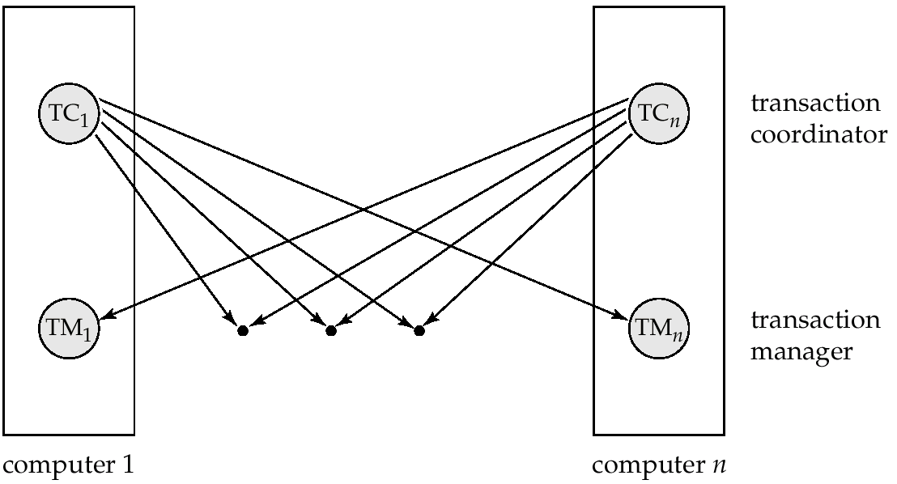
Transaction System Architecture

Slide 18
System Failure Modes
Failures unique to distributed systems:
  Failure of a site.
  Loss of massages
    Handled by network transmission control protocols such as TCP-IP
  Failure of a communication link
    Handled by network protocols, by routing messages via alternative links
  Network partition
    A network is said to be partitioned when it has been split into two or more subsystems that lack any connection between them
      Note: a subsystem may consist of a single node
Network partitioning and site failures are generally indistinguishable.

Slide 19
Commit Protocols
Commit protocols are used to ensure atomicity across sites
  a transaction which executes at multiple sites must either be committed at all the sites, or aborted at all the sites.
  not acceptable to have a transaction committed at one site and aborted at another
The two-phase commit (2 PC) protocol is widely used
The three-phase commit (3 PC) protocol is more complicated and more expensive, but avoids some drawbacks of two-phase commit protocol.

Slide 20
Two Phase Commit Protocol (2PC)
Assumes fail-stop model – failed sites simply stop working, and do not cause any other harm, such as sending incorrect messages to other sites.
Execution of the protocol is initiated by the coordinator after the last step of the transaction has been reached.
The protocol involves all the local sites at which the transaction executed
Let T be a transaction initiated at site S_{i}, and let the transaction coordinator at S_{i} be C_{i}

Slide 21
Phase 1: Obtaining a Decision
Coordinator asks all participants to prepare to commit transaction T_{i}.
  C_{i} adds the records <prepare T> to the log and forces log to stable storage
  sends prepare T messages to all sites at which T executed
Upon receiving message, transaction manager at site determines if it can commit the transaction
  if not, add a record <no T> to the log and send abort T message to C_{i}
  if the transaction can be committed, then:
  add the record <ready T> to the log
  force all records for T to stable storage
  send ready T message to C_{i}

Slide 22
Phase 2: Recording the Decision
T can be committed of C_{i} received a ready T message from all the participating sites: otherwise T must be aborted.
Coordinator adds a decision record, <commit T> or <abort T>, to the log and forces record onto stable storage. Once the record stable storage it is irrevocable (even if failures occur)
Coordinator sends a message to each participant informing it of the decision (commit or abort)
Participants take appropriate action locally.

Slide 23
Handling of Failures - Site Failure
When site S_{i} recovers, it examines its log to determine the fate of
transactions active at the time of the failure.
Log contain <commit T> record: site executes redo (T)
Log contains <abort T> record: site executes undo (T)
Log contains <ready T> record: site must consult C_{i} to determine the fate of T.
  If T committed, redo (T)
  If T aborted, undo (T)
The log contains no control records concerning T replies that S_{k} failed before responding to the prepare T message from C_{i}
  since the failure of S_{k} precludes the sending of such a
  response C₁ must abort T
  S_{k} must execute undo (T)

Slide 24
Handling of Failures- Coordinator Failure
If coordinator fails while the commit protocol for T is executing then participating sites must decide on T’s fate:
  If an active site contains a <commit T> record in its log, then T must be committed.
  If an active site contains an <abort T> record in its log, then T must be aborted.
  If some active participating site does not contain a <ready T> record in its log, then the failed coordinator C_{i} cannot have decided to commit T. Can therefore abort T.
  If none of the above cases holds, then all active sites must have a <ready T> record in their logs, but no additional control records (such as <abort T> of <commit T>). In this case active sites must wait for C_{i} to recover, to find decision.
Blocking problem : active sites may have to wait for failed coordinator to recover.

Slide 25
Handling of Failures - Network Partition
If the coordinator and all its participants remain in one partition, the failure has no effect on the commit protocol.
If the coordinator and its participants belong to several partitions:
  Sites that are not in the partition containing the coordinator think the coordinator has failed, and execute the protocol to deal with failure of the coordinator.
    No harm results, but sites may still have to wait for decision from coordinator.
The coordinator and the sites are in the same partition as the coordinator think that the sites in the other partition have failed, and follow the usual commit protocol.
    Again, no harm results

Slide 26
Recovery and Concurrency Control
In-doubt transactions have a <ready T>, but neither a
<commit T>, nor an <abort T> log record.
The recovering site must determine the commit-abort status of such transactions by contacting other sites; this can slow and potentially block recovery.
Recovery algorithms can note lock information in the log.
  Instead of <ready T>, write out <ready T, L> L = list of locks held by T when the log is written (read locks can be omitted).
  For every in-doubt transaction T, all the locks noted in the
  <ready T, L> log record are reacquired.
After lock reacquisition, transaction processing can resume; the commit or rollback of in-doubt transactions is performed concurrently with the execution of new transactions.

Slide 27
Three Phase Commit (3PC)
Assumptions:
  No network partitioning
  At any point, at least one site must be up.
  At most K sites (participants as well as coordinator) can fail
Phase 1: Obtaining Preliminary Decision: Identical to 2PC Phase 1.
  Every site is ready to commit if instructed to do so
Phase 2 of 2PC is split into 2 phases, Phase 2 and Phase 3 of 3PC
  In phase 2 coordinator makes a decision as in 2PC (called the pre-commit decision) and records it in multiple (at least K) sites
  In phase 3, coordinator sends commit/abort message to all participating sites,
Under 3PC, knowledge of pre-commit decision can be used to commit despite coordinator failure
  Avoids blocking problem as long as < K sites fail
Drawbacks:
  higher overheads
  assumptions may not be satisfied in practice
Won’t study it further

Slide 28
Alternative Models of Transaction Processing
Notion of a single transaction spanning multiple sites is inappropriate for many applications
  E.g. transaction crossing an organizational boundary
  No organization would like to permit an externally initiated transaction to block local transactions for an indeterminate period
Alternative models carry out transactions by sending messages
  Code to handle messages must be carefully designed to ensure atomicity and durability properties for updates
    Isolation cannot be guaranteed, in that intermediate stages are visible, but code must ensure no inconsistent states result due to concurrency
  Persistent messaging systems are systems that provide transactional properties to messages
    Messages are guaranteed to be delivered exactly once
    Will discuss implementation techniques later

Slide 29
Alternative Models (Cont.)
Motivating example: funds transfer between two banks
  Two phase commit would have the potential to block updates on the accounts involved in funds transfer
  Alternative solution:
    Debit money from source account and send a message to other site
    Site receives message and credits destination account
  Messaging has long been used for distributed transactions (even before computers were invented!)
Atomicity issue
  once transaction sending a message is committed, message must guaranteed to be delivered
    Guarantee as long as destination site is up and reachable, code to handle undeliverable messages must also be available
      e.g. credit money back to source account.
  If sending transaction aborts, message must not be sent

Slide 30
Error Conditions with Persistent Messaging
Code to handle messages has to take care of variety of failure situations (even assuming guaranteed message delivery)
  E.g. if destination account does not exist, failure message must be sent back to source site
  When failure message is received from destination site, or destination site itself does not exist, money must be deposited back in source account
    Problem if source account has been closed
      get humans to take care of problem
User code executing transaction processing using 2PC does not have to deal with such failures
There are many situations where extra effort of error handling is worth the benefit of absence of blocking
  E.g. pretty much all transactions across organizations

Slide 31
Persistent Messaging and Workflows
Workflows provide a general model of transactional processing involving multiple sites and possibly human processing of certain steps
  E.g. when a bank receives a loan application, it may need to
    Contact external credit-checking agencies
    Get approvals of one or more managers
  and then respond to the loan application
  We study workflows in Chapter 24 (Section 24.2)
  Persistent messaging forms the underlying infrastructure for workflows in a distributed environment

Slide 32
Implementation of Persistent Messaging
Sending site protocol
  Sending transaction writes message to a special relation messages-to-send. The message is also given a unique identifier.
    Writing to this relation is treated as any other update, and is undone if the transaction aborts.
    The message remains locked until the sending transaction commits
  A message delivery process monitors the messages-to-send relation
    When a new message is found, the message is sent to its destination
    When an acknowledgment is received from a destination, the message is deleted from messages-to-send
    If no acknowledgment is received after a timeout period, the message is resent
      This is repeated until the message gets deleted on receipt of acknowledgement, or the system decides the message is undeliverable after trying for a very long time
      Repeated sending ensures that the message is delivered
        (as long as the destination exists and is reachable
        within a reasonable time)

Slide 33
Implementation of Persistent Messaging
Receiving site protocol
  When a message is received
    it is written to a received-messages relation if it is not already present (the message id is used for this check). The transaction performing the write is committed
    An acknowledgement (with message id) is then sent to the sending site.
  There may be very long delays in message delivery coupled with repeated messages
      Could result in processing of duplicate messages if we are not careful!
    Option 1: messages are never deleted from received-messages
    Option 2: messages are given timestamps
      Messages older than some cut-off are deleted from received-messages
      Received messages are rejected if older than the cut-off

Slide 34
Concurrency Control in Distributed Databases

Slide 35
Concurrency Control
Modify concurrency control schemes for use in distributed environment.
We assume that each site participates in the execution of a commit protocol to ensure global transaction automicity.
We assume all replicas of any item are updated
  Will see how to relax this in case of site failures later

Slide 36
Single-Lock-Manager Approach
System maintains a single lock manager that resides in a single chosen site, say S_{i}
When a transaction needs to lock a data item, it sends a lock request to S_{i} and lock manager determines whether the lock can be granted immediately
  If yes, lock manager sends a message to the site which initiated the request
  If no, request is delayed until it can be granted, at which time a message is sent to the initiating site

Slide 37
Single-Lock-Manager Approach (Cont.)
The transaction can read the data item from any one of the sites at which a replica of the data item resides.
Writes must be performed on all replicas of a data item
Advantages of scheme:
  Simple implementation
  Simple deadlock handling
Disadvantages of scheme are:
  Bottleneck: lock manager site becomes a bottleneck
  Vulnerability: system is vulnerable to lock manager site failure.

Slide 38
Distributed Lock Manager
In this approach, functionality of locking is implemented by lock managers at each site
  Lock managers control access to local data items
    But special protocols may be used for replicas
Advantage: work is distributed and can be made robust to failures
Disadvantage: deadlock detection is more complicated
  Lock managers cooperate for deadlock detection
    More on this later
Several variants of this approach
  Primary copy
  Majority protocol
  Biased protocol
  Quorum consensus

Slide 39
Primary Copy
Choose one replica of data item to be the primary copy.
  Site containing the replica is called the primary site for that data item
  Different data items can have different primary sites
When a transaction needs to lock a data item Q, it requests a lock at the primary site of Q.
  Implicitly gets lock on all replicas of the data item
Benefit
  Concurrency control for replicated data handled similarly to unreplicated data - simple implementation.
Drawback
  If the primary site of Q fails, Q is inaccessible even though other sites containing a replica may be accessible.

Slide 40
Majority Protocol
Local lock manager at each site administers lock and unlock requests for data items stored at that site.
When a transaction wishes to lock an unreplicated data item Q residing at site S_{i}, a message is sent to S_{i} ‘s lock manager.
  If Q is locked in an incompatible mode, then the request is delayed until it can be granted.
  When the lock request can be granted, the lock manager sends a message back to the initiator indicating that the lock request has been granted.

Slide 41
Majority Protocol (Cont.)
In case of replicated data
  If Q is replicated at n sites, then a lock request message must be sent to more than half of the n sites in which Q is stored.
  The transaction does not operate on Q until it has obtained a lock on a majority of the replicas of Q.
  When writing the data item, transaction performs writes on all replicas.
Benefit
  Can be used even when some sites are unavailable
    details on how handle writes in the presence of site failure later
Drawback
  Requires 2(n/2 + 1) messages for handling lock requests, and (n/2 + 1) messages for handling unlock requests.
  Potential for deadlock even with single item - e.g., each of 3 transactions may have locks on 1/3rd of the replicas of a data.

Slide 42
Biased Protocol
Local lock manager at each site as in majority protocol, however, requests for shared locks are handled differently than requests for exclusive locks.
Shared locks. When a transaction needs to lock data item Q, it simply requests a lock on Q from the lock manager at one site containing a replica of Q.
Exclusive locks. When transaction needs to lock data item Q, it requests a lock on Q from the lock manager at all sites containing a replica of Q.
Advantage - imposes less overhead on read operations.
Disadvantage - additional overhead on writes

Slide 43
Quorum Consensus Protocol
A generalization of both majority and biased protocols
Each site is assigned a weight.
  Let S be the total of all site weights
Choose two values read quorum Q_{r} and write quorum Q_{w}
  Such that Q_{r} + Q_{w} > S and 2 * Q_{w} > S
  Quorums can be chosen (and S computed) separately for each item
Each read must lock enough replicas that the sum of the site weights is >= Q_{r}
Each write must lock enough replicas that the sum of the site weights is >= Q_{w}
For now we assume all replicas are written
  Extensions to allow some sites to be unavailable described later

Slide 44
Deadlock Handling
Consider the following two transactions and history, with item X and transaction T₁ at site 1, and item Y and transaction T₂ at site 2:
T₁: write (X)
write (Y)
T₂: write (Y)
write (X)
X-lock on X
write (X)
X-lock on Y
write (Y)
wait for X-lock on X
Wait for X-lock on Y
Result: deadlock which cannot be detected locally at either site

Slide 45
Centralized Approach
A global wait-for graph is constructed and maintained in a single site; the deadlock-detection coordinator
  Real graph: Real, but unknown, state of the system.
  Constructed graph:Approximation generated by the controller during the execution of its algorithm .
the global wait-for graph can be constructed when:
  a new edge is inserted in or removed from one of the local wait-for graphs.
  a number of changes have occurred in a local wait-for graph.
  the coordinator needs to invoke cycle-detection.
If the coordinator finds a cycle, it selects a victim and notifies all sites. The sites roll back the victim transaction.

Slide 46
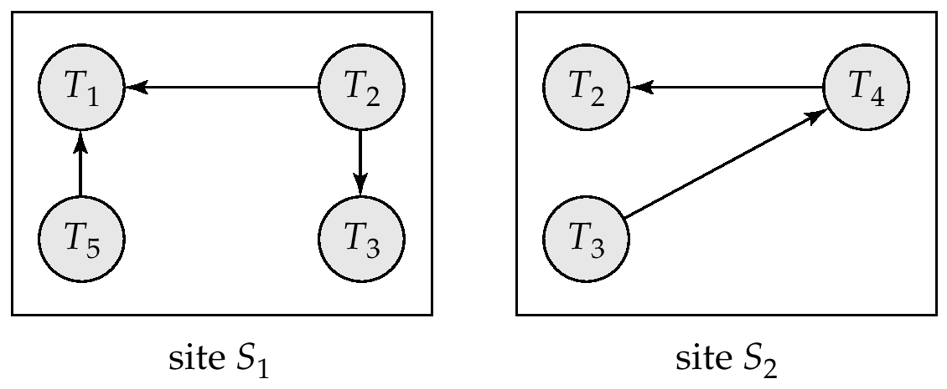
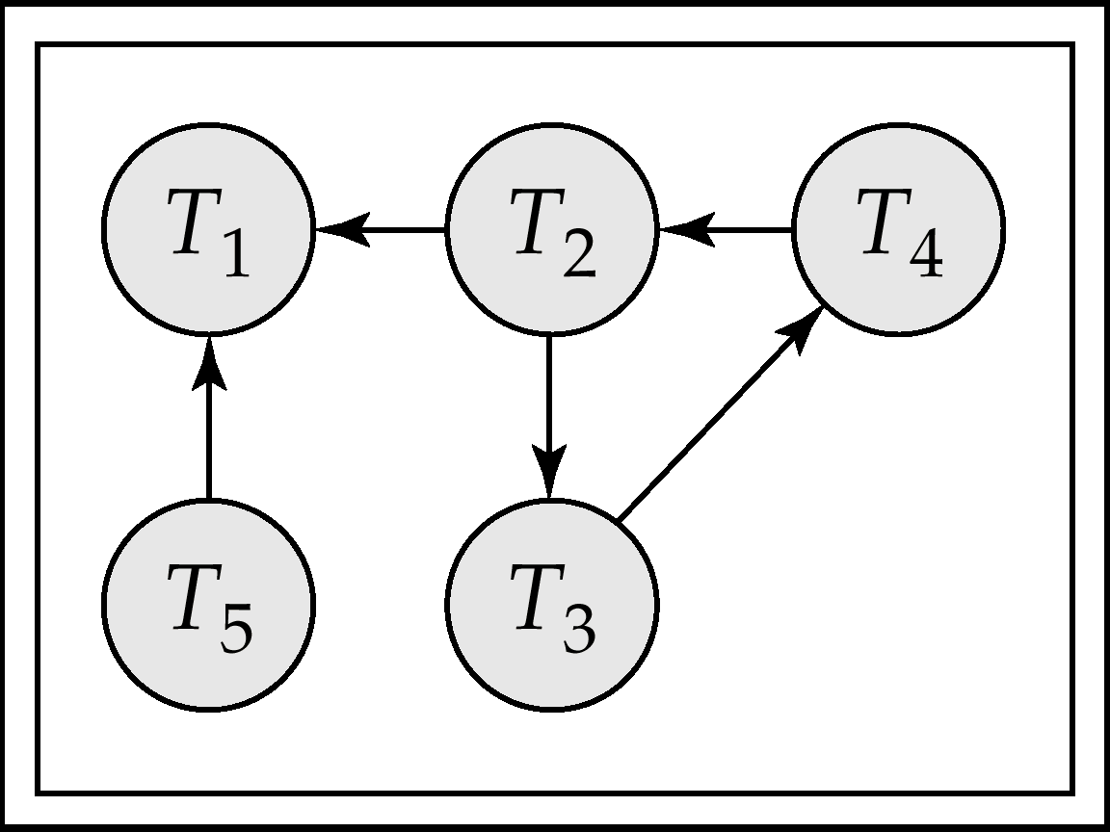
Local and Global Wait-For Graphs
Local
Global

Slide 47
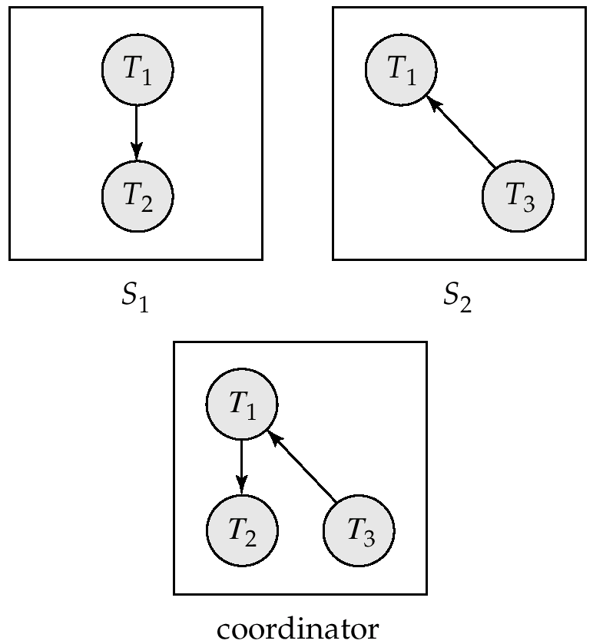
Example Wait-For Graph for False Cycles
Initial state:

Slide 48
False Cycles (Cont.)
Suppose that starting from the state shown in figure,
1. T₂ releases resources at S₁
    resulting in a message remove T₁ → T₂ message from the Transaction Manager at site S₁ to the coordinator)
2. And then T₂ requests a resource held by T₃ at site S₂
    resulting in a message insert T₂ → T₃ from S₂ to the coordinator
Suppose further that the insert message reaches before the delete message
  this can happen due to network delays
The coordinator would then find a false cycle
T₁ → T₂ → T₃ → T₁
The false cycle above never existed in reality.
False cycles cannot occur if two-phase locking is used.

Slide 49
Unnecessary Rollbacks
Unnecessary rollbacks may result when deadlock has indeed occurred and a victim has been picked, and meanwhile one of the transactions was aborted for reasons unrelated to the deadlock.
Unnecessary rollbacks can result from false cycles in the global wait-for graph; however, likelihood of false cycles is low.

Slide 50
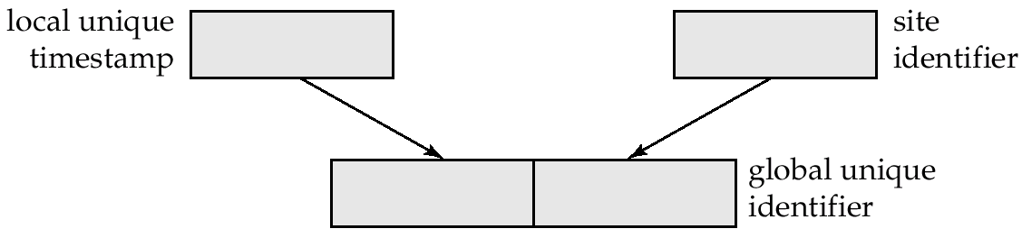
Timestamping
Timestamp based concurrency-control protocols can be used in distributed systems
Each transaction must be given a unique timestamp
Main problem: how to generate a timestamp in a distributed fashion
  Each site generates a unique local timestamp using either a logical counter or the local clock.
  Global unique timestamp is obtained by concatenating the unique local timestamp with the unique identifier.

Slide 51
Timestamping (Cont.)
A site with a slow clock will assign smaller timestamps
  Still logically correct: serializability not affected
  But: “disadvantages” transactions
To fix this problem
  Define within each site S_{i} a logical clock (LC_{i}), which generates the unique local timestamp
  Require that S_{i} advance its logical clock whenever a request is received from a transaction Ti with timestamp < x,y> and x is greater that the current value of LC_{i}.
  In this case, site S_{i} advances its logical clock to the value x + 1.

Slide 52
Replication with Weak Consistency
Many commercial databases support replication of data with weak degrees of consistency (I.e., without a guarantee of serializabiliy)
E.g.: master-slave replication: updates are performed at a single “master” site, and propagated to “slave” sites.
  Propagation is not part of the update transaction: its is decoupled
    May be immediately after transaction commits
    May be periodic
  Data may only be read at slave sites, not updated
    No need to obtain locks at any remote site
  Particularly useful for distributing information
    E.g. from central office to branch-office
  Also useful for running read-only queries offline from the main database

Slide 53
Replication with Weak Consistency (Cont.)
Replicas should see a transaction-consistent snapshot of the database
  That is, a state of the database reflecting all effects of all transactions up to some point in the serialization order, and no effects of any later transactions.
E.g. Oracle provides a create snapshot statement to create a snapshot of a relation or a set of relations at a remote site
  snapshot refresh either by recomputation or by incremental update
  Automatic refresh (continuous or periodic) or manual refresh

Slide 54
Multimaster Replication
With multimaster replication (also called update-anywhere replication) updates are permitted at any replica, and are automatically propagated to all replicas
  Basic model in distributed databases, where transactions are unaware of the details of replication, and database system propagates updates as part of the same transaction
    Coupled with 2 phase commit
  Many systems support lazy propagation where updates are transmitted after transaction commits
    Allow updates to occur even if some sites are disconnected from the network, but at the cost of consistency

Slide 55
Lazy Propagation (Cont.)
Two approaches to lazy propagation
  Updates at any replica translated into update at primary site, and then propagated back to all replicas
    Updates to an item are ordered serially
    But transactions may read an old value of an item and use it to perform an update, result in non-serializability
  Updates are performed at any replica and propagated to all other replicas
    Causes even more serialization problems:
      Same data item may be updated concurrently at multiple sites!
Conflict detection is a problem
  Some conflicts due to lack of distributed concurrency control can be detected when updates are propagated to other sites (will see later, in Section 23.5.4)
Conflict resolution is very messy
  Resolution may require committed transactions to be rolled back
    Durability violated
  Automatic resolution may not be possible, and human intervention
  may be required

Slide 56
Availability

Slide 57
Availability
High availability: time for which system is not fully usable should be extremely low (e.g. 99.99% availability)
Robustness: ability of system to function spite of failures of components
Failures are more likely in large distributed systems
To be robust, a distributed system must
  Detect failures
  Reconfigure the system so computation may continue
  Recovery/reintegration when a site or link is repaired
Failure detection: distinguishing link failure from site failure is hard
  (partial) solution: have multiple links, multiple link failure is likely a site failure

Slide 58
Reconfiguration
Reconfiguration:
  Abort all transactions that were active at a failed site
    Making them wait could interfere with other transactions since they may hold locks on other sites
    However, in case only some replicas of a data item failed, it may be possible to continue transactions that had accessed data at a failed site (more on this later)
  If replicated data items were at failed site, update system catalog to remove them from the list of replicas.
    This should be reversed when failed site recovers, but additional care needs to be taken to bring values up to date
  If a failed site was a central server for some subsystem, an election must be held to determine the new server
    E.g. name server, concurrency coordinator, global deadlock detector

Slide 59
Reconfiguration (Cont.)
Since network partition may not be distinguishable from site failure, the following situations must be avoided
  Two ore more central servers elected in distinct partitions
  More than one partition updates a replicated data item
Updates must be able to continue even if some sites are down
Solution: majority based approach
  Alternative of “read one write all available” is tantalizing but causes problems

Slide 60
Majority-Based Approach
The majority protocol for distributed concurrency control can be modified to work even if some sites are unavailable
  Each replica of each item has a version number which is updated when the replica is updated, as outlined below
  A lock request is sent to at least ½ the sites at which item replicas are stored and operation continues only when a lock is obtained on a majority of the sites
  Read operations look at all replicas locked, and read the value from the replica with largest version number
    May write this value and version number back to replicas with lower version numbers (no need to obtain locks on all replicas for this task)

Slide 61
Majority-Based Approach
Majority protocol (Cont.)
  Write operations
    find highest version number like reads, and set new version number to old highest version + 1
    Writes are then performed on all locked replicas and version number on these replicas is set to new version number
  Failures (network and site) cause no problems as long as
    Sites at commit contain a majority of replicas of any updated data items
    During reads a majority of replicas are available to find version numbers
    Subject to above, 2 phase commit can be used to update replicas
  Note: reads are guaranteed to see latest version of data item
  Reintegration is trivial: nothing needs to be done
Quorum consensus algorithm can be similarly extended

Slide 62
Read One Write All (Available)
Biased protocol is a special case of quorum consensus
  Allows reads to read any one replica but updates require all replicas to be available at commit time (called read one write all)
Read one write all available (ignoring failed sites) is attractive, but incorrect
  If failed link may come back up, without a disconnected site ever being aware that it was disconnected
  The site then has old values, and a read from that site would return an incorrect value
  If site was aware of failure reintegration could have been performed, but no way to guarantee this
  With network partitioning, sites in each partition may update same item concurrently
    believing sites in other partitions have all failed

Slide 63
Site Reintegration
When failed site recovers, it must catch up with all updates that it missed while it was down
  Problem: updates may be happening to items whose replica is stored at the site while the site is recovering
  Solution 1: halt all updates on system while reintegrating a site
    Unacceptable disruption
  Solution 2: lock all replicas of all data items at the site, update to latest version, then release locks
    Other solutions with better concurrency also available

Slide 64
Comparison with Remote Backup
Remote backup (hot spare) systems (Section 17.10) are also designed to provide high availability
Remote backup systems are simpler and have lower overhead
  All actions performed at a single site, and only log records shipped
  No need for distributed concurrency control, or 2 phase commit
Using distributed databases with replicas of data items can provide higher availability by having multiple (> 2) replicas and using the majority protocol
  Also avoid failure detection and switchover time associated with remote backup systems

Slide 65
Coordinator Selection
Backup coordinators
  site which maintains enough information locally to assume the role of coordinator if the actual coordinator fails
  executes the same algorithms and maintains the same internal state information as the actual coordinator fails executes state information as the actual coordinator
  allows fast recovery from coordinator failure but involves overhead during normal processing.
Election algorithms
  used to elect a new coordinator in case of failures
  Example: Bully Algorithm - applicable to systems where every site can send a message to every other site.

Slide 66
Bully Algorithm
If site S_{i} sends a request that is not answered by the coordinator within a time interval T, assume that the coordinator has failed S_{i} tries to elect itself as the new coordinator.
S_{i} sends an election message to every site with a higher identification number, S_{i} then waits for any of these processes to answer within T.
If no response within T, assume that all sites with number greater than i have failed, S_{i} elects itself the new coordinator.
If answer is received S_{i} begins time interval T’, waiting to receive a message that a site with a higher identification number has been elected.

Slide 67
Bully Algorithm (Cont.)
If no message is sent within T’, assume the site with a higher number has failed; S_{i} restarts the algorithm.
After a failed site recovers, it immediately begins execution of the same algorithm.
If there are no active sites with higher numbers, the recovered site forces all processes with lower numbers to let it become the coordinator site, even if there is a currently active coordinator with a lower number.

Slide 68
Distributed Query Processing

Slide 69
Distributed Query Processing
For centralized systems, the primary criterion for measuring the cost of a particular strategy is the number of disk accesses.
In a distributed system, other issues must be taken into account:
  The cost of a data transmission over the network.
  The potential gain in performance from having several sites process parts of the query in parallel.

Slide 70
Query Transformation
Translating algebraic queries on fragments.
  It must be possible to construct relation r from its fragments
  Replace relation r by the expression to construct relation r from its fragments
Consider the horizontal fragmentation of the account relation into
  account₁ = σ _{branch-name = “Hillside”} (account)
  account₂ = σ _{branch-name = “Valleyview”} (account)
The query σ _{branch-name = “Hillside”} (account) becomes
  σ _{branch-name = “Hillside”} (account₁ ∪ account₂)
which is optimized into
  σ _{branch-name = “Hillside”} (account₁) ∪ σ _{branch-name = “Hillside”} (account₂)

Slide 71
Example Query (Cont.)
Since account₁ has only tuples pertaining to the Hillside branch, we can eliminate the selection operation.
Apply the definition of account₂ to obtain
σ _{branch-name = “Hillside”} (σ _{branch-name = “Valleyview”} (account)
This expression is the empty set regardless of the contents of the account relation.
Final strategy is for the Hillside site to return account₁ as the result of the query.

Slide 72

Simple Join Processing
Consider the following relational algebra expression in which the three relations are neither replicated nor fragmented
account depositor branch
account is stored at site S₁
depositor at S₂
branch at S₃
For a query issued at site S_{I}, the system needs to produce the result at site S_{I}

Slide 73
Possible Query Processing Strategies
Ship copies of all three relations to site S_{I} and choose a strategy for processing the entire locally at site S_{I.}
Ship a copy of the account relation to site S₂ and compute temp₁ = account depositor at S₂. Ship temp₁ from S₂ to S₃, and compute temp₂ = temp₁ branch at S₃. Ship the result temp₂ to S_{I}.
Devise similar strategies, exchanging the roles S₁, S₂, S₃
Must consider following factors:
  amount of data being shipped
  cost of transmitting a data block between sites
  relative processing speed at each site

Slide 74
Semijoin Strategy
Let r₁ be a relation with schema R₁ stores at site S₁
Let r₂ be a relation with schema R₂ stores at site S₂
Evaluate the expression r₁ r₂ and obtain the result at S₁.
1. Compute temp₁ ← ∏_{R1 ∩ R2} (r1) at S1.
2. Ship temp₁ from S₁ to S₂.
3. Compute temp₂ ← r₂ temp1 at S₂
4. Ship temp₂ from S₂ to S₁.
5. Compute r₁ temp₂ at S₁. This is the same as r₁ r₂.

Slide 75
Formal Definition
The semijoin of r₁ with r₂, is denoted by:
r₁ r₂
it is defined by:
∏_{R1} (r₁ r₂)
Thus, r₁ r₂ selects those tuples of r₁ that contributed to r₁ r₂.
In step 3 above, temp₂=r₂ r₁.
For joins of several relations, the above strategy can be extended to a series of semijoin steps.

Slide 76
Join Strategies that Exploit Parallelism
Consider r₁ r₂ r₃ r₄ where relation ri is stored at site S_{i}. The result must be presented at site S₁.
r₁ is shipped to S₂ and r₁ r₂ is computed at S₂: simultaneously r₃ is shipped to S₄ and r₃ r₄ is computed at S₄
S₂ ships tuples of (r₁ r₂) to S₁ as they produced;
S₄ ships tuples of (r₃ r₄) to S₁
Once tuples of (r₁ r₂) and (r₃ r₄) arrive at S₁ (r₁ r₂) (r₃ r₄) is computed in parallel with the computation of (r₁ r₂) at S₂ and the computation of (r₃ r₄) at S₄.

Slide 77
Heterogeneous Distributed Databases
Many database applications require data from a variety of preexisting databases located in a heterogeneous collection of hardware and software platforms
Data models may differ (hierarchical, relational , etc.)
Transaction commit protocols may be incompatible
Concurrency control may be based on different techniques (locking, timestamping, etc.)
System-level details almost certainly are totally incompatible.
A multidatabase system is a software layer on top of existing database systems, which is designed to manipulate information in heterogeneous databases
  Creates an illusion of logical database integration without any physical database integration

Slide 78
Advantages
Preservation of investment in existing
  hardware
  system software
  Applications
Local autonomy and administrative control
Allows use of special-purpose DBMSs
Step towards a unified homogeneous DBMS
  Full integration into a homogeneous DBMS faces
    Technical difficulties and cost of conversion
    Organizational/political difficulties
      Organizations do not want to give up control on their data
      Local databases wish to retain a great deal of autonomy

Slide 79
Unified View of Data
Agreement on a common data model
  Typically the relational model
Agreement on a common conceptual schema
  Different names for same relation/attribute
  Same relation/attribute name means different things
Agreement on a single representation of shared data
  E.g. data types, precision,
  Character sets
    ASCII vs EBCDIC
    Sort order variations
Agreement on units of measure
Variations in names
  E.g. Köln vs Cologne, Mumbai vs Bombay

Slide 80
Query Processing
Several issues in query processing in a heterogeneous database
Schema translation
  Write a wrapper for each data source to translate data to a global schema
  Wrappers must also translate updates on global schema to updates on local schema
Limited query capabilities
  Some data sources allow only restricted forms of selections
    E.g. web forms, flat file data sources
  Queries have to be broken up and processed partly at the source and partly at a different site
Removal of duplicate information when sites have overlapping information
  Decide which sites to execute query
Global query optimization

Slide 81
Mediator Systems
Mediator systems are systems that integrate multiple heterogeneous data sources by providing an integrated global view, and providing query facilities on global view
  Unlike full fledged multidatabase systems, mediators generally do not bother about transaction processing
  But the terms mediator and multidatabase are sometimes used interchangeably
  The term virtual database is also used to refer to mediator/multidatabase systems

Slide 82
Distributed Directory Systems

Slide 83
Directory Systems
Typical kinds of directory information
  Employee information such as name, id, email, phone, office addr, ..
  Even personal information to be accessed from multiple places
    e.g. Web browser bookmarks
White pages
  Entries organized by name or identifier
    Meant for forward lookup to find more about an entry
Yellow pages
  Entries organized by properties
  For reverse lookup to find entries matching specific requirements
When directories are to be accessed across an organization
  Alternative 1: Web interface. Not great for programs
  Alternative 2: Specialized directory access protocols
    Coupled with specialized user interfaces

Slide 84
Directory Access Protocols
Most commonly used directory access protocol:
  LDAP (Lightweight Directory Access Protocol)
  Simplified from earlier X.500 protocol
Question: Why not use database protocols like ODBC/JDBC?
Answer:
  Simplified protocols for a limited type of data access, evolved parallel to ODBC/JDBC
  Provide a nice hierarchical naming mechanism similar to file system directories
    Data can be partitioned amongst multiple servers for different parts of the hierarchy, yet give a single view to user
      E.g. different servers for Bell Labs Murray Hill and Bell Labs Bangalore
  Directories may use databases as storage mechanism

Slide 85
LDAP:Lightweight Directory Access Protocol
LDAP Data Model
Data Manipulation
Distributed Directory Trees

Slide 86
LDAP Data Model
LDAP directories store entries
  Entries are similar to objects
Each entry must have unique distinguished name (DN)
DN made up of a sequence of relative distinguished names (RDNs)
E.g. of a DN
  cn=Silberschatz, ou-Bell Labs, o=Lucent, c=USA
  Standard RDNs (can be specified as part of schema)
    cn: common name ou: organizational unit
    o: organization c: country
  Similar to paths in a file system but written in reverse direction

Slide 87
LDAP Data Model (Cont.)
Entries can have attributes
  Attributes are multi-valued by default
  LDAP has several built-in types
    Binary, string, time types
    Tel: telephone number PostalAddress: postal address
LDAP allows definition of object classes
  Object classes specify attribute names and types
  Can use inheritance to define object classes
  Entry can be specified to be of one or more object classes
    No need to have single most-specific type

Slide 88
LDAP Data Model (cont.)
Entries organized into a directory information tree according to their DNs
  Leaf level usually represent specific objects
  Internal node entries represent objects such as organizational units, organizations or countries
  Children of a node inherit the DN of the parent, and add on RDNs
    E.g. internal node with DN c=USA
      Children nodes have DN starting with c=USA and further RDNs such as o or ou
    DN of an entry can be generated by traversing path from root
  Leaf level can be an alias pointing to another entry
    Entries can thus have more than one DN
      E.g. person in more than one organizational unit

Slide 89
LDAP Data Manipulation
Unlike SQL, LDAP does not define DDL or DML
Instead, it defines a network protocol for DDL and DML
  Users use an API or vendor specific front ends
  LDAP also defines a file format
    LDAP Data Interchange Format (LDIF)
Querying mechanism is very simple: only selection & projection

Slide 90
LDAP Queries
LDAP query must specify
  Base: a node in the DIT from where search is to start
  A search condition
    Boolean combination of conditions on attributes of entries
      Equality, wild-cards and approximate equality supported
  A scope
    Just the base, the base and its children, or the entire subtree from the base
  Attributes to be returned
  Limits on number of results and on resource consumption
  May also specify whether to automatically dereference aliases
LDAP URLs are one way of specifying query
LDAP API is another alternative

Slide 91
LDAP URLs
First part of URL specifis server and DN of base
  ldap:://aura.research.bell-labs.com/o=Lucent,c=USA
Optional further parts separated by ? symbol
  ldap:://aura.research.bell-labs.com/o=Lucent,c=USA??sub?cn=Korth
  Optional parts specify
    attributes to return (empty means all)
    Scope (sub indicates entire subtree)
    Search condition (cn=Korth)

Slide 92
C Code using LDAP API
#include <stdio.h>
#include <ldap.h>
main( ) {
LDAP *ld;
LDAPMessage *res, *entry;
char *dn, *attr, *attrList [ ] = {“telephoneNumber”, NULL};
BerElement *ptr;
int vals, i;
// Open a connection to server
ld = ldap_open(“aura.research.bell-labs.com”, LDAP_PORT);
ldap_simple_bind(ld, “avi”, “avi-passwd”);
… actual query (next slide) …
ldap_unbind(ld);
}

Slide 93
C Code using LDAP API (Cont.)
ldap_search_s(ld, “o=Lucent, c=USA”, LDAP_SCOPE_SUBTREE,
“cn=Korth”, attrList, /* attrsonly*/ 0, &res);
/*attrsonly = 1 => return only schema not actual results*/ printf(“found%d entries”, ldap_count_entries(ld, res));
for (entry=ldap_first_entry(ld, res); entry != NULL; entry=ldap_next_entry(id, entry)) {
dn = ldap_get_dn(ld, entry);
printf(“dn: %s”, dn); /* dn: DN of matching entry */
ldap_memfree(dn);
for(attr = ldap_first_attribute(ld, entry, &ptr); attr != NULL;
attr = ldap_next_attribute(ld, entry, ptr))
{ // for each attribute
printf(“%s:”, attr); // print name of attribute
vals = ldap_get_values(ld, entry, attr);
for (i = 0; vals[i] != NULL; i ++)
printf(“%s”, vals[i]); // since attrs can be multivalued
ldap_value_free(vals);
}
}
ldap_msgfree(res);

Slide 94
LDAP API (Cont.)
LDAP API also has functions to create, update and delete entries
Each function call behaves as a separate transaction
  LDAP does not support atomicity of updates

Slide 95
Distributed Directory Trees
Organizational information may be split into multiple directory information trees
  Suffix of a DIT gives RDN to be tagged onto to all entries to get an overall DN
    E.g. two DITs, one with suffix o=Lucent, c=USA
    and another with suffix o=Lucent, c=India
  Organizations often split up DITs based on geographical location or by organizational structure
  Many LDAP implementations support replication (master-slave or multi-master replication) of DITs (not part of LDAP 3 standard)
A node in a DIT may be a referral to a node in another DIT
  E.g. Ou= Bell Labs may have a separate DIT, and DIT for o=Lucent may have a leaf with ou=Bell Labs containing a referral to the Bell Labs DIT
  Referalls are the key to integrating a distributed collection of directories
  When a server gets a query reaching a referral node, it may either
    Forward query to referred DIT and return answer to client, or
    Give referral back to client, which transparently sends query to referred DIT (without user intervention)

Slide 96
End of Chapter
Extra Slides (material not in book)
3-Phase commit
Fully distributed deadlock detection
Naming transparency
Network topologies

Slide 97
Three Phase Commit (3PC)
Assumptions:
  No network partitioning
  At any point, at least one site must be up.
  At most K sites (participants as well as coordinator) can fail
Phase 1: Obtaining Preliminary Decision: Identical to 2PC Phase 1.
  Every site is ready to commit if instructed to do so
  Under 2 PC each site is obligated to wait for decision from coordinator
  Under 3PC, knowledge of pre-commit decision can be used to commit despite coordinator failure.

Slide 98
Phase 2. Recording the Preliminary Decision
Coordinator adds a decision record (<abort T> or
< precommit T>) in its log and forces record to stable storage.
Coordinator sends a message to each participant informing it of the decision
Participant records decision in its log
If abort decision reached then participant aborts locally
If pre-commit decision reached then participant replies with <acknowledge T>

Slide 99
Phase 3. Recording Decision in the Database
Executed only if decision in phase 2 was to precommit
Coordinator collects acknowledgements. It sends <commit T> message to the participants as soon as it receives K acknowledgements.
Coordinator adds the record <commit T> in its log and forces record to stable storage.
Coordinator sends a message to each participant to <commit T>
Participants take appropriate action locally.

Slide 100
Handling Site Failure
Site Failure. Upon recovery, a participating site examines its log and does the following:
  Log contains <commit T> record: site executes redo (T)
  Log contains <abort T> record: site executes undo (T)
  Log contains <ready T> record, but no <abort T> or <precommit T> record: site consults C_{i} to determine the fate of T.
    if C_{i} says T aborted, site executes undo (T) (and writes
    <abort T> record)
    if C_{i} says T committed, site executes redo (T) (and writes
    < commit T> record)
    if c says T committed, site resumes the protocol from receipt of precommit T message (thus recording <precommit T> in the log, and sending acknowledge T message sent to coordinator).

Slide 101
Handling Site Failure (Cont.)
Log contains <precommit T> record, but no <abort T> or <commit T>: site consults Ci to determine the fate of T.
  if C_{i} says T aborted, site executes undo (T)
  if C_{i} says T committed, site executes redo (T)
  if C_{i} says T still in precommit state, site resumes protocol at this point
Log contains no <ready T> record for a transaction T: site executes undo (T) writes <abort T> record.

Slide 102
Coordinator – Failure Protocol
1. The active participating sites select a new coordinator, C_{new}
2. C_{new} requests local status of T from each participating site
3. Each participating site including C_{new} determines the local
status of T:
  Committed. The log contains a < commit T> record
  Aborted. The log contains an <abort T> record.
  Ready. The log contains a <ready T> record but no <abort T> or <precommit T> record
  Precommitted. The log contains a <precommit T> record but no <abort T> or <commit T> record.
  Not ready. The log contains neither a <ready T> nor an <abort T> record.
A site that failed and recovered must ignore any precommit record in its log when determining its status.
4. Each participating site records sends its local status to C_{new}

Slide 103
Coordinator Failure Protocol (Cont.)
5. C_{new} decides either to commit or abort T, or to restart the
three-phase commit protocol:
  Commit state for any one participant ⇒ commit
  Abort state for any one participant ⇒ abort.
  Precommit state for any one participant and above 2 cases do not hold ⇒
  A precommit message is sent to those participants in the uncertain state. Protocol is resumed from that point.
  Uncertain state at all live participants ⇒ abort. Since at least n - k sites are up, the fact that all participants are in an uncertain state means that the coordinator has not sent a <commit T> message implying that no site has committed T.

Slide 104
Fully Distributed Deadlock Detection Scheme
Each site has local wait-for graph; system combines information in these graphs to detect deadlock
Local Wait-for Graphs
Global Wait-for Graphs
    T₁ → T₂ → T₃ → T₄ → T₅
Site 1
T₁ → T₂ → T₃
Site 2
T₃ → T₄ → T₅
Site 3
T₅ → T₁

Slide 105
Fully Distributed Approach (Cont.)
System model: a transaction runs at a single site, and makes requests to other sites for accessing non-local data.
Each site maintains its own local wait-for graph in the normal fashion: there is an edge T_{i} → T_{j} if T_{i} is waiting on a lock held by T_{j} (note: T_{i} and T_{j} may be non-local).
Additionally, arc T_{i} → T_{ex} exists in the graph at site S_{k} if
  (a) T_{i} is executing at site S_{k}, and is waiting for a reply to a request made on another site, or
  (b) T_{i} is non-local to site S_{k}, and a lock has been granted to T_{i} at S_{k}.
Similarly arc T_{ex} → T_{i} exists in the graph at site S_{k} if
  (a) T_{i} is non-local to site S_{k}, and is waiting on a lock for data at site S_{k}, or
  (b) T_{i} is local to site S_{k}, and has accessed data from an external site.

Slide 106
Fully Distributed Approach (Cont.)
Centralized Deadlock Detection - all graph edges sent to central deadlock detector
Distributed Deadlock Detection - “path pushing” algorithm
Path pushing initiated wen a site detects a local cycle involving Tex, which indicates possibility of a deadlock.
Suppose cycle at site Si is
      T_{ex} → T_{i} → T_{j} → ... → T_{n} → T_{ex}
and T_{n} is waiting for some transaction at site S_{j}. Then S_{i} passes on information about the cycle to S_{j}.
Optimization : S_{i} passes on information only if i >n.
S_{j} updates it graph with new information and if it finds a cycle it repeats above process.

Slide 107
Fully Distributed Approach: Example
Site 1
EX(3) →T₁ →T₂ →T₃ →EX(2)
Site 2
EX(1) →T₃ →T₄ →T₅ →EX(3)
Site 3
EX(2) →T₅ →T₁ →T₃ →EX(1)
EX (i): Indicates Tex, plus wait is on/by a transaction at Site i

Slide 108
Fully Distributed Approach Example (Cont.)
Site passes wait-for information along path in graph:
  Let EX(j) → T_{i} → ... T_{n} → EX (k) be a path in local wait-for graph at Site m
  Site m “pushes” the path information to site k if i > n
Example:
  Site 1 does not pass information : 1 > 3
  Site 2 does not pass information : 3 > 5
  Site 3 passes (T₅, T₁) to Site 1 because:
    5 > 1
    T₁ is waiting for a data item at site 1

Slide 109
Fully Distributed Approach (Cont.)
After the path EX (2) → T₅ → T₁ → EX (1) has been pushed to Site 1 we have:
Site 1
EX(2) →T₅ →T₁ →T₂ →T₃ → EX(2)
Site 2
EX(1) →T₃ →T₄ →T₅ →EX(3)
Site 3
EX(2) →T₅ →T₁ →EX(1)

Slide 110
Fully Distributed Approach (Cont.)
After the push, only Site 1 has new edges. Site 1 passes (T₅, T₁, T₂, T₃) to site 2 since 5 > 3 and T₃ is waiting for a data item, at site 2
The new state of the local wait-for graph:
Site 1
EX(2) →T₅ →T₁ →T₂ →T₃ → EX(2)
Site 2
T₅ →T₁ →T₂→T₃ → T₄
Deadlock Detected
Site 3
EX(2) →T₅ →T₁ →EX(1)

Slide 111
Naming of Items

Slide 112
Naming of Replicas and Fragments
Each replica and each fragment of a data item must have a unique name.
  Use of postscripts to determine those replicas that are replicas of the same data item, and those fragments that are fragments of the same data item.
  fragments of same data item: “.f₁”, “.f₂”, …, “.fn”
  replicas of same data item: “.r₁”, “.r₂”, …, “.rn”
  site17.account.f₃.r₂
refers to replica 2 of fragment 3 of account; this item was generated by site 17.

Slide 113
Name - Translation Algorithm
if name appears in the alias table
then expression := map (name)
else expression := name;
function map (n)
if n appears in the replica table
then result := name of replica of n;
if n appears in the fragment table
then begin
result := expression to construct fragment;
for each n’ in result do begin
replace n’ in result with map (n’);
end
end
return result;

Slide 114
Example of Name - Translation Scheme
A user at the Hillside branch (site S₁), uses the alias local-account for the local fragment account.f1 of the account relation.
When this user references local-account, the query-processing subsystem looks up local-account in the alias table, and replaces local-account with S₁.account.f₁.
If S₁.account.f₁ is replicated, the system must consult the replica table in order to choose a replica
If this replica is fragmented, the system must examine the fragmentation table to find out how to reconstruct the relation.
Usually only need to consult one or two tables, however, the algorithm can deal with any combination of successive replication and fragmentation of relations.

Slide 115
Transparency and Updates
Must ensure that all replicas of a data item are updated and that all affected fragments are updated.
Consider the account relation and the insertion of the tuple:
  (“Valleyview”, A-733, 600)
Horizontal fragmentation of account
account₁ = σ branch-name = “Hillside” (account)
account₂ = σ branch-name = “Valleyview” (account)
  Predicate P_{i} is associated with the i^{th} fragment
  Predicate P_{i} to the tuple (“Valleyview”, A-733, 600) to test whether that tuple must be inserted in the i^{th} fragment
  Tuple inserted into account₂

Slide 116
Transparency and Updates (Cont.)
Vertical fragmentation of deposit into deposit₁ and deposit₂
The tuple (“Valleyview”, A-733, ‘Jones”, 600) must be split into two fragments:
  one to be inserted into deposit₁
  one to be inserted into deposit₂
If deposit is replicated, the tuple (“Valleyview”, A-733, “Jones” 600) must be inserted in all replicas
Problem: If deposit is accessed concurrently it is possible that one replica will be updated earlier than another (see section on Concurrency Control).

Slide 117
Network Topologies

Slide 118
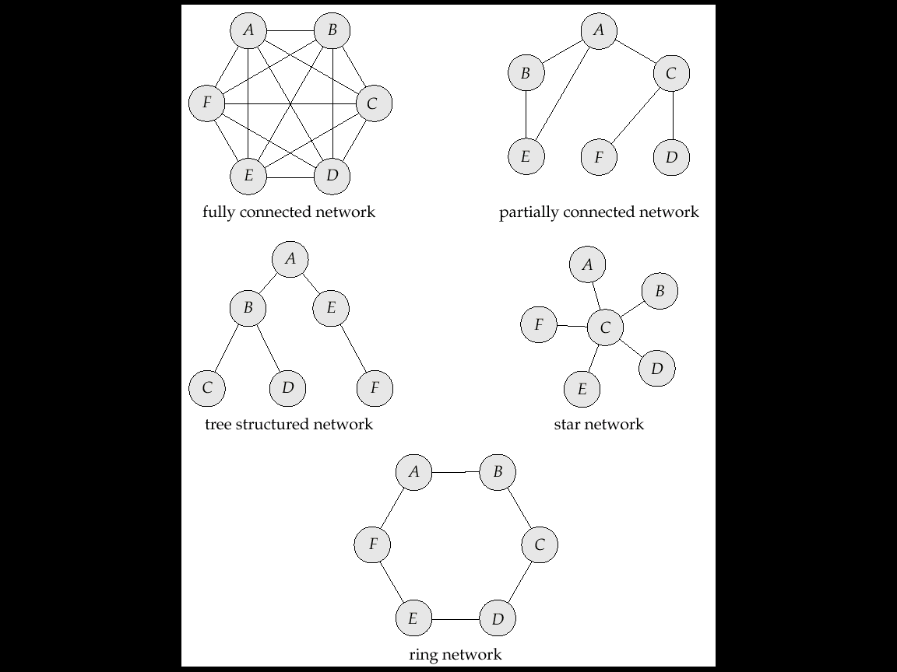
Network Topologies

Slide 119
Network Topologies (Cont.)

Slide 120
Network Topology (Cont.)
A partitioned system is split into two (or more) subsystems (partitions) that lack any connection.
Tree-structured: low installation and communication costs; the failure of a single link can partition network
Ring: At least two links must fail for partition to occur; communication cost is high.
Star:
  the failure of a single link results in a network partition, but since one of the partitions has only a single site it can be treated as a single-site failure.
  low communication cost
  failure of the central site results in every site in the system becoming disconnected

Slide 121
Robustness
A robustness system must:
  Detect site or link failures
  Reconfigure the system so that computation may continue.
  Recover when a processor or link is repaired
Handling failure types:
  Retransmit lost messages
  Unacknowledged retransmits indicate link failure; find alternative route for message.
  Failure to find alternative route is a symptom of network partition.
Network link failures and site failures are generally indistinguishable.

Slide 122
Procedure to Reconfigure System
If replicated data is stored at the failed site, update the catalog so that queries do not reference the copy at the failed site.
Transactions active at the failed site should be aborted.
If the failed site is a central server for some subsystem, an election must be held to determine the new server.
Reconfiguration scheme must work correctly in case of network partitioning; must avoid:
  Electing two or more central servers in distinct partitions.
  Updating replicated data item by more than one partition
Represent recovery tasks as a series of transactions; concurrent control subsystem and transactions management subsystem may then be relied upon for proper reintegration.

Slide 123
End of Chapter

Slide 124
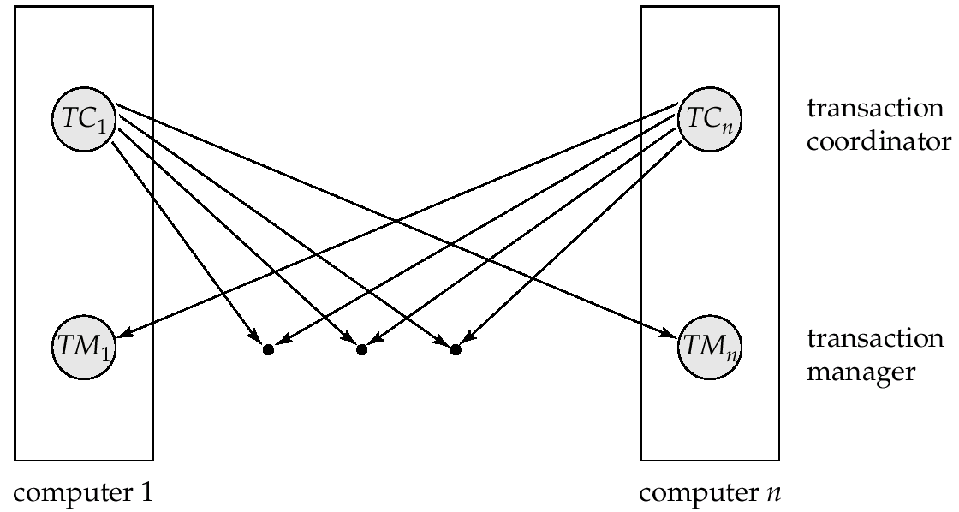
Figure 19.7

Slide 125
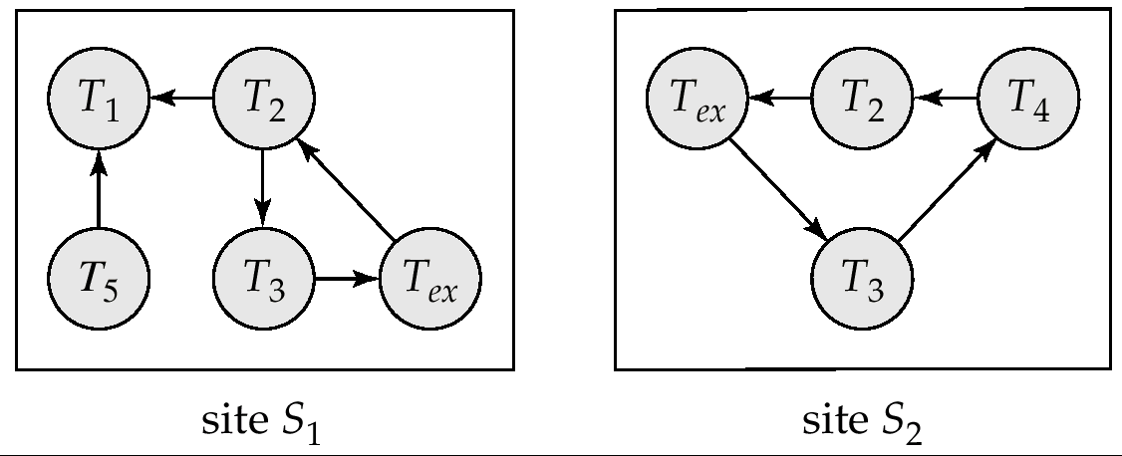
Figure 19.13

Slide 126
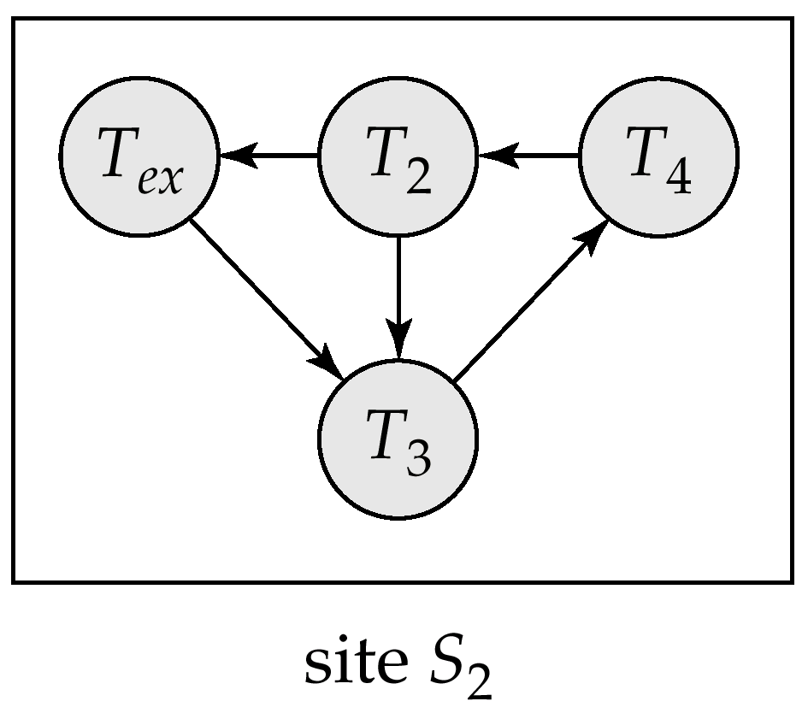
Figure 19.14

