Slide 1
Chapter 21:
Application Development and Administration

Slide 2
Overview
Web Interfaces to Databases
Performance Tuning
Performance Benchmarks
Standardization
E-Commerce
Legacy Systems

Slide 3
The World Wide Web
The Web is a distributed information system based on hypertext.
Most Web documents are hypertext documents formatted via the HyperText Markup Language (HTML)
HTML documents contain
  text along with font specifications, and other formatting instructions
  hypertext links to other documents, which can be associated with regions of the text.
  forms, enabling users to enter data which can then be sent back to the Web server

Slide 4
Web Interfaces to Databases
Why interface databases to the Web?
Web browsers have become the de-facto standard user interface to databases
  Enable large numbers of users to access databases from anywhere
  Avoid the need for downloading/installing specialized code, while providing a good graphical user interface
  E.g.: Banks, Airline/Car reservations, University course registration/grading, …

Slide 5
Web Interfaces to Database (Cont.)
Dynamic generation of documents
  Limitations of static HTML documents
    Cannot customize fixed Web documents for individual users.
    Problematic to update Web documents, especially if multiple Web documents replicate data.
  Solution: Generate Web documents dynamically from data stored in a database.
    Can tailor the display based on user information stored in the database.
      E.g. tailored ads, tailored weather and local news, …
    Displayed information is up-to-date, unlike the static Web pages
      E.g. stock market information, ..
Rest of this section: introduction to Web technologies needed for interfacing databases with the Web

Slide 6
Uniform Resources Locators
In the Web, functionality of pointers is provided by Uniform Resource Locators (URLs).
URL example:
http://www.bell-labs.com/topics/book/db-book
  The first part indicates how the document is to be accessed
    “http” indicates that the document is to be accessed using the Hyper Text Transfer Protocol.
  The second part gives the unique name of a machine on the Internet.
  The rest of the URL identifies the document within the machine.
The local identification can be:
    The path name of a file on the machine, or
    An identifier (path name) of a program, plus arguments to be passed to the program
      E.g. http://www.google.com/search?q=silberschatz

Slide 7
HTML and HTTP
HTML provides formatting, hypertext link, and image display features.
HTML also provides input features
    Select from a set of options
      Pop-up menus, radio buttons, check lists
    Enter values
      Text boxes
  Filled in input sent back to the server, to be acted upon by an executable at the server
HyperText Transfer Protocol (HTTP) used for communication with the Web server

Slide 8
Sample HTML Source Text
<html> <body>
<table border cols = 3>
<tr> <td> A-101 </td> <td> Downtown </td> <td> 500 </td> </tr>
…
</table>
<center> The <i>account</i> relation </center>
<form action=“BankQuery” method=get>
Select account/loan and enter number <br>
<select name=“type”>
<option value=“account” selected> Account
<option> value=“Loan”> Loan
</select>
<input type=text size=5 name=“number”>
<input type=submit value=“submit”>
</form>
</body> </html>

Slide 9
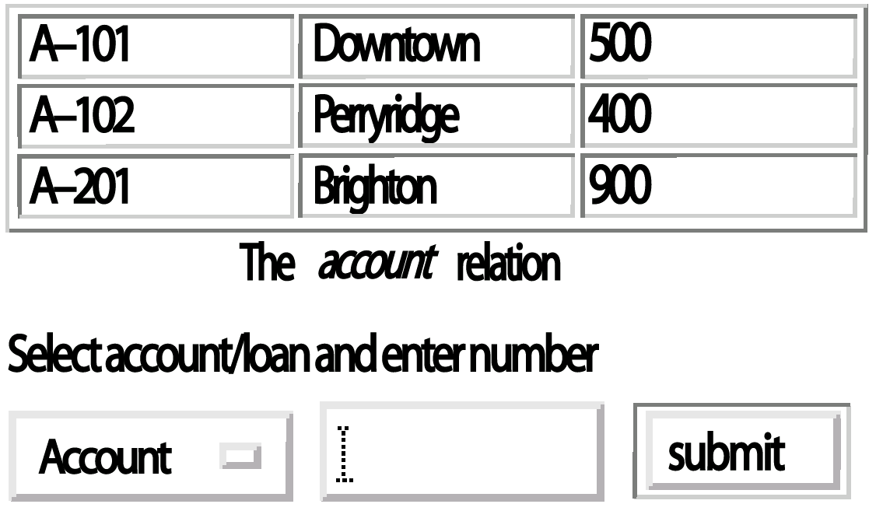
Display of Sample HTML Source

Slide 10
Client Side Scripting and Applets
Browsers can fetch certain scripts (client-side scripts) or programs along with documents, and execute them in “safe mode” at the client site
  Javascript
  Macromedia Flash and Shockwave for animation/games
  VRML
  Applets
Client-side scripts/programs allow documents to be active
  E.g., animation by executing programs at the local site
  E.g. ensure that values entered by users satisfy some correctness checks
  Permit flexible interaction with the user.
    Executing programs at the client site speeds up interaction by avoiding many round trips to server

Slide 11
Client Side Scripting and Security
Security mechanisms needed to ensure that malicious scripts do not cause damage to the client machine
  Easy for limited capability scripting languages, harder for general purpose programming languages like Java
E.g. Java’s security system ensures that the Java applet code does not make any system calls directly
  Disallows dangerous actions such as file writes
  Notifies the user about potentially dangerous actions, and allows the option to abort the program or to continue execution.

Slide 12
Web Servers
A Web server can easily serve as a front end to a variety of information services.
The document name in a URL may identify an executable program, that, when run, generates a HTML document.
  When a HTTP server receives a request for such a document, it executes the program, and sends back the HTML document that is generated.
  The Web client can pass extra arguments with the name of the document.
To install a new service on the Web, one simply needs to create and install an executable that provides that service.
  The Web browser provides a graphical user interface to the information service.
Common Gateway Interface (CGI): a standard interface between web and application server

Slide 13
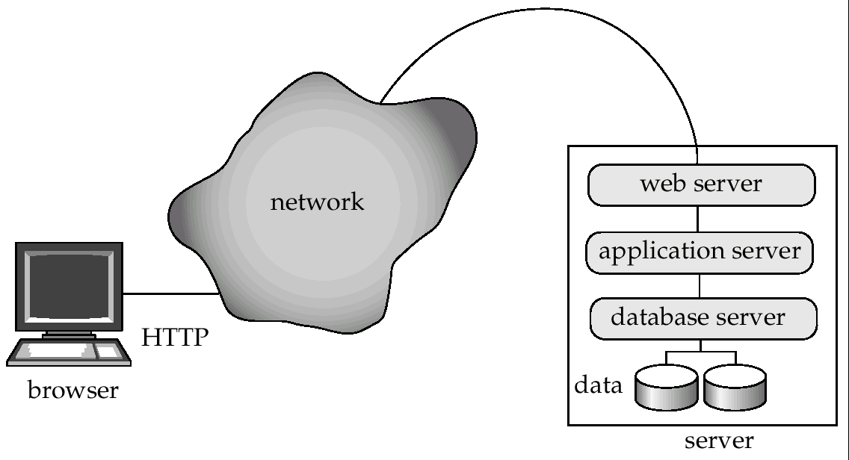
Three-Tier Web Architecture

Slide 14
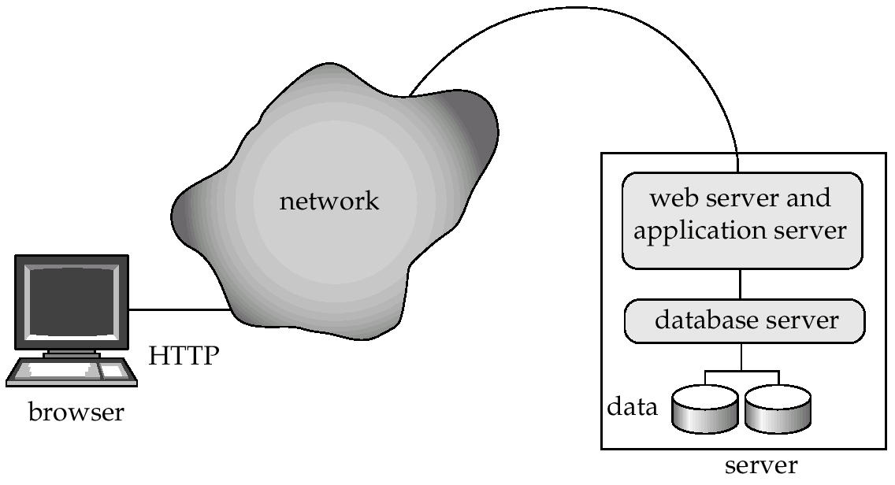
Two-Tier Web Architecture
Multiple levels of indirection have overheads
  Alternative: two-tier architecture

Slide 15
HTTP and Sessions
The HTTP protocol is connectionless
  That is, once the server replies to a request, the server closes the connection with the client, and forgets all about the request
  In contrast, Unix logins, and JDBC/ODBC connections stay connected until the client disconnects
    retaining user authentication and other information
  Motivation: reduces load on server
    operating systems have tight limits on number of open connections on a machine
Information services need session information
  E.g. user authentication should be done only once per session
Solution: use a cookie

Slide 16
Sessions and Cookies
A cookie is a small piece of text containing identifying information
  Sent by server to browser on first interaction
  Sent by browser to the server that created the cookie on further interactions
    part of the HTTP protocol
  Server saves information about cookies it issued, and can use it when serving a request
    E.g., authentication information, and user preferences
Cookies can be stored permanently or for a limited time

Slide 17
Servlets
Java Servlet specification defines an API for communication between the Web server and application program
  E.g. methods to get parameter values and to send HTML text back to client
Application program (also called a servlet) is loaded into the Web server
  Two-tier model
  Each request spawns a new thread in the Web server
    thread is closed once the request is serviced
Servlet API provides a getSession() method
  Sets a cookie on first interaction with browser, and uses it to identify session on further interactions
  Provides methods to store and look-up per-session information
    E.g. user name, preferences, ..

Slide 18
Example Servlet Code
Public class BankQuery(Servlet extends HttpServlet {
public void doGet(HttpServletRequest request, HttpServletResponse result)
throws ServletException, IOException {
String type = request.getParameter(“type”);
String number = request.getParameter(“number”);
…code to find the loan amount/account balance …
…using JDBC to communicate with the database..
…we assume the value is stored in the variable balance
result.setContentType(“text/html”);
PrintWriter out = result.getWriter( );
out.println(“<HEAD><TITLE>Query Result</TITLE></HEAD>”);
out.println(“<BODY>”);
out.println(“Balance on “ + type + number + “=“ + balance);
out.println(“</BODY>”);
out.close ( );
}
}

Slide 19
Server-Side Scripting
Server-side scripting simplifies the task of connecting a database to the Web
  Define a HTML document with embedded executable code/SQL queries.
  Input values from HTML forms can be used directly in the embedded code/SQL queries.
  When the document is requested, the Web server executes the embedded code/SQL queries to generate the actual HTML document.
Numerous server-side scripting languages
  JSP, Server-side Javascript, ColdFusion Markup Language (cfml), PHP, Jscript
  General purpose scripting languages: VBScript, Perl, Python

Slide 20
Improving Web Server Performance
Performance is an issue for popular Web sites
  May be accessed by millions of users every day, thousands of requests per second at peak time
Caching techniques used to reduce cost of serving pages by exploiting commonalities between requests
  At the server site:
    Caching of JDBC connections between servlet requests
    Caching results of database queries
      Cached results must be updated if underlying database changes
    Caching of generated HTML
  At the client’s network
    Caching of pages by Web proxy

Slide 21
Performance Tuning

Slide 22
Performance Tuning
Adjusting various parameters and design choices to improve system performance for a specific application.
Tuning is best done by
  identifying bottlenecks, and
  eliminating them.
Can tune a database system at 3 levels:
  Hardware -- e.g., add disks to speed up I/O, add memory to increase buffer hits, move to a faster processor.
  Database system parameters -- e.g., set buffer size to avoid paging of buffer, set checkpointing intervals to limit log size. System may have automatic tuning.
  Higher level database design, such as the schema, indices and transactions (more later)

Slide 23
Bottlenecks
Performance of most systems (at least before they are tuned) usually limited by performance of one or a few components: these are called bottlenecks
  E.g. 80% of the code may take up 20% of time and 20% of code takes up 80% of time
    Worth spending most time on 20% of code that take 80% of time
Bottlenecks may be in hardware (e.g. disks are very busy, CPU is idle), or in software
Removing one bottleneck often exposes another
De-bottlenecking consists of repeatedly finding bottlenecks, and removing them
  This is a heuristic

Slide 24
Identifying Bottlenecks
Transactions request a sequence of services
  e.g. CPU, Disk I/O, locks
With concurrent transactions, transactions may have to wait for a requested service while other transactions are being served
Can model database as a queueing system with a queue for each service
  transactions repeatedly do the following
    request a service, wait in queue for the service, and get serviced
Bottlenecks in a database system typically show up as very high utilizations (and correspondingly, very long queues) of a particular service
  E.g. disk vs CPU utilization
  100% utilization leads to very long waiting time:
    Rule of thumb: design system for about 70% utilization at peak load
    utilization over 90% should be avoided

Slide 25
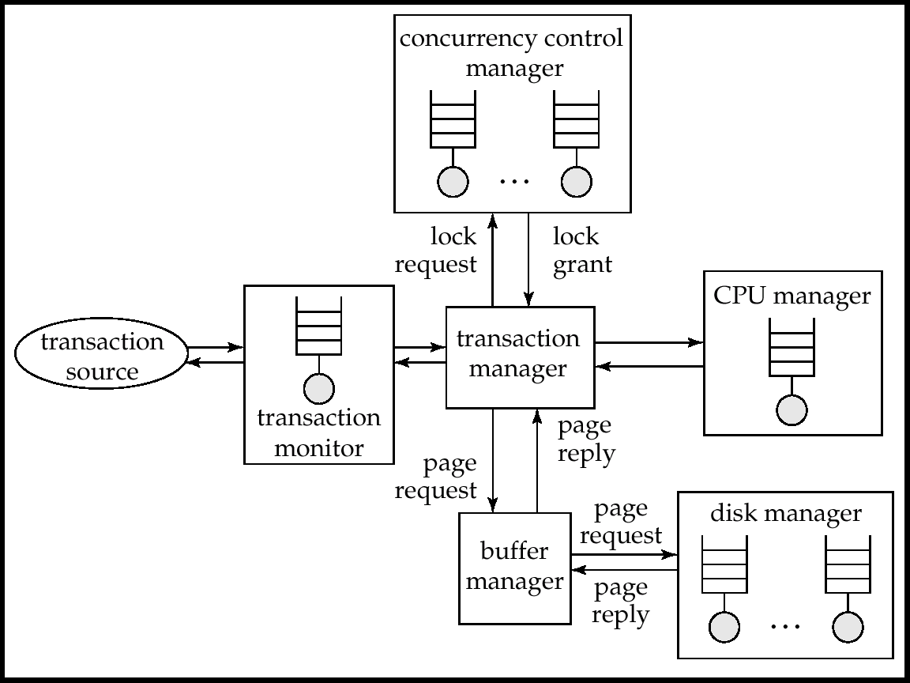
Queues In A Database System

Slide 26
Tunable Parameters
Tuning of hardware
Tuning of schema
Tuning of indices
Tuning of materialized views
Tuning of transactions

Slide 27
Tuning of Hardware
Even well-tuned transactions typically require a few I/O operations
  Typical disk supports about 100 random I/O operations per second
  Suppose each transaction requires just 2 random I/O operations. Then to support n transactions per second, we need to stripe data across n/50 disks (ignoring skew)
Number of I/O operations per transaction can be reduced by keeping more data in memory
  If all data is in memory, I/O needed only for writes
  Keeping frequently used data in memory reduces disk accesses, reducing number of disks required, but has a memory cost

Slide 28
Hardware Tuning: Five-Minute Rule
Question: which data to keep in memory:
  If a page is accessed n times per second, keeping it in memory saves
    n * price-per-disk-drive
    accesses-per-second-per-disk
  Cost of keeping page in memory
    price-per-MB-of-memory
    ages-per-MB-of-memory
  Break-even point: value of n for which above costs are equal
    If accesses are more then saving is greater than cost
  Solving above equation with current disk and memory prices leads to:
  5-minute rule: if a page that is randomly accessed is used more frequently than once in 5 minutes it should be kept in memory
    (by buying sufficient memory!)

Slide 29
Hardware Tuning: One-Minute Rule
For sequentially accessed data, more pages can be read per second. Assuming sequential reads of 1MB of data at a time:
1-minute rule: sequentially accessed data that is accessed
once or more in a minute should be kept in memory
Prices of disk and memory have changed greatly over the years, but the ratios have not changed much
  so rules remain as 5 minute and 1 minute rules, not 1 hour or 1 second rules!

Slide 30
Hardware Tuning: Choice of RAID Level
To use RAID 1 or RAID 5?
  Depends on ratio of reads and writes
    RAID 5 requires 2 block reads and 2 block writes to write out one data block
If an application requires r reads and w writes per second
  RAID 1 requires r + 2w I/O operations per second
  RAID 5 requires: r + 4w I/O operations per second
For reasonably large r and w, this requires lots of disks to handle workload
  RAID 5 may require more disks than RAID 1 to handle load!
  Apparent saving of number of disks by RAID 5 (by using parity, as opposed to the mirroring done by RAID 1) may be illusory!
Thumb rule: RAID 5 is fine when writes are rare and data is very large, but RAID 1 is preferable otherwise
  If you need more disks to handle I/O load, just mirror them since disk capacities these days are enormous!

Slide 31
Tuning the Database Design
Schema tuning
  Vertically partition relations to isolate the data that is accessed most often -- only fetch needed information.
    E.g., split account into two, (account-number, branch-name) and (account-number, balance).
      Branch-name need not be fetched unless required
  Improve performance by storing a denormalized relation
    E.g., store join of account and depositor; branch-name and balance information is repeated for each holder of an account, but join need not be computed repeatedly.
      Price paid: more space and more work for programmer to keep relation consistent on updates
    better to use materialized views (more on this later..)
  Cluster together on the same disk page records that would
  match in a frequently required join,
    compute join very efficiently when required.

Slide 32
Tuning the Database Design (Cont.)
Index tuning
  Create appropriate indices to speed up slow queries/updates
  Speed up slow updates by removing excess indices (tradeoff between queries and updates)
  Choose type of index (B-tree/hash) appropriate for most frequent types of queries.
  Choose which index to make clustered
Index tuning wizards look at past history of queries and updates (the workload) and recommend which indices would be best for the workload

Slide 33
Tuning the Database Design (Cont.)
Materialized Views
Materialized views can help speed up certain queries
  Particularly aggregate queries
Overheads
  Space
  Time for view maintenance
    Immediate view maintenance:done as part of update txn
      time overhead paid by update transaction
    Deferred view maintenance: done only when required
      update transaction is not affected, but system time is spent on view maintenance
        until updated, the view may be out-of-date
Preferable to denormalized schema since view maintenance
is systems responsibility, not programmers
  Avoids inconsistencies caused by errors in update programs

Slide 34
Tuning the Database Design (Cont.)
How to choose set of materialized views
  Helping one transaction type by introducing a materialized view may hurt others
  Choice of materialized views depends on costs
    Users often have no idea of actual cost of operations
  Overall, manual selection of materialized views is tedious
Some database systems provide tools to help DBA choose views to materialize
  “Materialized view selection wizards”

Slide 35
Tuning of Transactions
Basic approaches to tuning of transactions
  Improve set orientation
  Reduce lock contention
Rewriting of queries to improve performance was important in the past, but smart optimizers have made this less important
Communication overhead and query handling overheads significant part of cost of each call
  Combine multiple embedded SQL/ODBC/JDBC queries into a single set-oriented query
    Set orientation -> fewer calls to database
    E.g. tune program that computes total salary for each department using a separate SQL query by instead using a single query that computes total salaries for all department at once (using group by)
  Use stored procedures: avoids re-parsing and re-optimization
  of query

Slide 36
Tuning of Transactions (Cont.)
Reducing lock contention
Long transactions (typically read-only) that examine large parts of a relation result in lock contention with update transactions
  E.g. large query to compute bank statistics and regular bank transactions
To reduce contention
  Use multi-version concurrency control
    E.g. Oracle “snapshots” which support multi-version 2PL
  Use degree-two consistency (cursor-stability) for long transactions
    Drawback: result may be approximate

Slide 37
Tuning of Transactions (Cont.)
Long update transactions cause several problems
  Exhaust lock space
  Exhaust log space
    and also greatly increase recovery time after a crash, and may even exhaust log space during recovery if recovery algorithm is badly designed!
Use mini-batch transactions to limit number of updates that a single transaction can carry out. E.g., if a single large transaction updates every record of a very large relation, log may grow too big.
  * Split large transaction into batch of ``mini-transactions,'' each performing part of the updates
  Hold locks across transactions in a mini-batch to ensure serializability
    If lock table size is a problem can release locks, but at the cost of serializability
  * In case of failure during a mini-batch, must complete its
  remaining portion on recovery, to ensure atomicity.

Slide 38
Performance Simulation
Performance simulation using queuing model useful to predict bottlenecks as well as the effects of tuning changes, even without access to real system
Queuing model as we saw earlier
  Models activities that go on in parallel
Simulation model is quite detailed, but usually omits some low level details
  Model service time, but disregard details of service
  E.g. approximate disk read time by using an average disk read time
Experiments can be run on model, and provide an estimate of measures such as average throughput/response time
Parameters can be tuned in model and then replicated in real system
  E.g. number of disks, memory, algorithms, etc

Slide 39
Performance Benchmarks

Slide 40
Performance Benchmarks
Suites of tasks used to quantify the performance of software systems
Important in comparing database systems, especially as systems become more standards compliant.
Commonly used performance measures:
  Throughput (transactions per second, or tps)
  Response time (delay from submission of transaction to return of result)
  Availability or mean time to failure

Slide 41
Performance Benchmarks (Cont.)
Suites of tasks used to characterize performance
  single task not enough for complex systems
Beware when computing average throughput of different transaction types
  E.g., suppose a system runs transaction type A at 99 tps and transaction type B at 1 tps.
  Given an equal mixture of types A and B, throughput is not (99+1)/2 = 50 tps.
  Running one transaction of each type takes time 1+.01 seconds, giving a throughput of 1.98 tps.
  To compute average throughput, use harmonic mean:
  n
  Interference (e.g. lock contention) makes even this incorrect if
  different transaction types run concurrently
1/t₁ + 1/t₂ + … + 1/t_{n}

Slide 42
Database Application Classes
Online transaction processing (OLTP)
  requires high concurrency and clever techniques to speed up commit processing, to support a high rate of update transactions.
Decision support applications
  including online analytical processing, or OLAP applications
  require good query evaluation algorithms and query optimization.
Architecture of some database systems tuned to one of the two classes
  E.g. Teradata is tuned to decision support
Others try to balance the two requirements
  E.g. Oracle, with snapshot support for long read-only transaction

Slide 43
Benchmarks Suites
The Transaction Processing Council (TPC) benchmark suites are widely used.
  TPC-A and TPC-B: simple OLTP application modeling a bank teller application with and without communication
    Not used anymore
  TPC-C: complex OLTP application modeling an inventory system
    Current standard for OLTP benchmarking

Slide 44
Benchmarks Suites (Cont.)
TPC benchmarks (cont.)
  TPC-D: complex decision support application
    Superceded by TPC-H and TPC-R
  TPC-H: (H for ad hoc) based on TPC-D with some extra queries
    Models ad hoc queries which are not known beforehand
      Total of 22 queries with emphasis on aggregation
    prohibits materialized views
    permits indices only on primary and foreign keys
  TPC-R: (R for reporting) same as TPC-H, but without any restrictions on materialized views and indices
  TPC-W: (W for Web) End-to-end Web service benchmark modeling a Web bookstore, with combination of static and dynamically generated pages

Slide 45
TPC Performance Measures
TPC performance measures
  transactions-per-second with specified constraints on response time
  transactions-per-second-per-dollar accounts for cost of owning system
TPC benchmark requires database sizes to be scaled up with increasing transactions-per-second
  reflects real world applications where more customers means more database size and more transactions-per-second
External audit of TPC performance numbers mandatory
  TPC performance claims can be trusted

Slide 46
TPC Performance Measures
Two types of tests for TPC-H and TPC-R
  Power test: runs queries and updates sequentially, then takes mean to find queries per hour
  Throughput test: runs queries and updates concurrently
    multiple streams running in parallel each generates queries, with one parallel update stream
  Composite query per hour metric: square root of product of power and throughput metrics
  Composite price/performance metric

Slide 47
Other Benchmarks
OODB transactions require a different set of benchmarks.
  OO7 benchmark has several different operations, and provides a separate benchmark number for each kind of operation
  Reason: hard to define what is a typical OODB application
Benchmarks for XML being discussed

Slide 48
Standardization

Slide 49
Standardization
The complexity of contemporary database systems and the need for their interoperation require a variety of standards.
  syntax and semantics of programming languages
  functions in application program interfaces
  data models (e.g. object oriented/object relational databases)
Formal standards are standards developed by a standards organization (ANSI, ISO), or by industry groups, through a public process.
De facto standards are generally accepted as standards without any formal process of recognition
  Standards defined by dominant vendors (IBM, Microsoft) often become de facto standards
  De facto standards often go through a formal process of recognition and become formal standards

Slide 50
Standardization (Cont.)
Anticipatory standards lead the market place, defining features that vendors then implement
  Ensure compatibility of future products
  But at times become very large and unwieldy since standards bodies may not pay enough attention to ease of implementation (e.g.,SQL-92 or SQL:1999)
Reactionary standards attempt to standardize features that vendors have already implemented, possibly in different ways.
  Can be hard to convince vendors to change already implemented features. E.g. OODB systems

Slide 51
SQL Standards History
SQL developed by IBM in late 70s/early 80s
SQL-86 first formal standard
IBM SAA standard for SQL in 1987
SQL-89 added features to SQL-86 that were already implemented in many systems
  Was a reactionary standard
SQL-92 added many new features to SQL-89 (anticipatory standard)
  Defines levels of compliance (entry, intermediate and full)
  Even now few database vendors have full SQL-92 implementation

Slide 52
SQL Standards History (Cont.)
SQL:1999
  Adds variety of new features --- extended data types, object orientation, procedures, triggers, etc.
  Broken into several parts
    SQL/Framework (Part 1): overview
    SQL/Foundation (Part 2): types, schemas, tables, query/update statements, security, etc
    SQL/CLI (Call Level Interface) (Part 3): API interface
    SQL/PSM (Persistent Stored Modules) (Part 4): procedural extensions
    SQL/Bindings (Part 5): embedded SQL for different embedding languages

Slide 53
SQL Standards History (Cont.)
More parts undergoing standardization process
  Part 7: SQL/Temporal: temporal data
  Part 9: SQL/MED (Management of External Data)
    Interfacing of database to external data sources
      Allows other databases, even files, can be viewed as part of the database
  Part 10 SQL/OLB (Object Language Bindings): embedding SQL in Java
  Missing part numbers 6 and 8 cover features that are not near standardization yet

Slide 54
Database Connectivity Standards
Open DataBase Connectivity (ODBC) standard for database interconnectivity
  based on Call Level Interface (CLI) developed by X/Open consortium
  defines application programming interface, and SQL features that must be supported at different levels of compliance
JDBC standard used for Java
X/Open XA standards define transaction management standards for supporting distributed 2-phase commit
OLE-DB: API like ODBC, but intended to support non-database sources of data such as flat files
  OLE-DB program can negotiate with data source to find what features are supported
  Interface language may be a subset of SQL
ADO (Active Data Objects): easy-to-use interface to OLE-DB functionality

Slide 55
Object Oriented Databases Standards
Object Database Management Group (ODMG) standard for object-oriented databases
  version 1 in 1993 and version 2 in 1997, version 3 in 2000
  provides language independent Object Definition Language (ODL) as well as several language specific bindings
Object Management Group (OMG) standard for distributed software based on objects
  Object Request Broker (ORB) provides transparent message dispatch to distributed objects
  Interface Definition Language (IDL) for defining language-independent data types
  Common Object Request Broker Architecture (CORBA) defines specifications of ORB and IDL

Slide 56
XML-Based Standards
Several XML based Standards for E-commerce
  E.g. RosettaNet (supply chain), BizTalk
  Define catalogs, service descriptions, invoices, purchase orders, etc.
  XML wrappers are used to export information from relational databases to XML
Simple Object Access Protocol (SOAP): XML based remote procedure call standard
  Uses XML to encode data, HTTP as transport protocol
  Standards based on SOAP for specific applications
    E.g. OLAP and Data Mining standards from Microsoft

Slide 57
E-Commerce

Slide 58
E-Commerce
E-commerce is the process of carrying out various activities related to commerce through electronic means
Activities include:
  Presale activities: catalogs, advertisements, etc
  Sale process: negotiations on price/quality of service
  Marketplace: e.g. stock exchange, auctions, reverse auctions
  Payment for sale
  Delivery related activities: electronic shipping, or electronic tracking of order processing/shipping
  Customer support and post-sale service

Slide 59
E-Catalogs
Product catalogs must provide searching and browsing facilities
  Organize products into intuitive hierarchy
  Keyword search
  Help customer with comparison of products
Customization of catalog
  Negotiated pricing for specific organizations
  Special discounts for customers based on past history
    E.g. loyalty discount
  Legal restrictions on sales
    Certain items not exposed to under-age customers
Customization requires extensive customer-specific information

Slide 60
Marketplaces
Marketplaces help in negotiating the price of a product when there are multiple sellers and buyers
Several types of marketplaces
  Reverse auction
  Auction
  Exchange
Real world marketplaces can be quite complicated due to product differentiation
Database issues:
  Authenticate bidders
  Record buy/sell bids securely
  Communicate bids quickly to participants
    Delays can lead to financial loss to some participants
  Need to handle very large volumes of trade at times
    E.g. at the end of an auction

Slide 61
Types of Marketplace
Reverse auction system: single buyer, multiple sellers.
  Buyer states requirements, sellers bid for supplying items. Lowest bidder wins. (also known as tender system)
  Open bidding vs. closed bidding
Auction: Multiple buyers, single seller
  Simplest case: only one instance of each item is being sold
  Highest bidder for an item wins
  More complicated with multiple copies, and buyers bid for specific number of copies
Exchange: multiple buyers, multiple sellers
  E.g., stock exchange
  Buyers specify maximum price, sellers specify minimum price
  exchange matches buy and sell bids, deciding on price for the trade
    e.g. average of buy/sell bids

Slide 62
Order Settlement
Order settlement: payment for goods and delivery
Insecure means for electronic payment: send credit card number
  Buyers may present some one else’s credit card numbers
  Seller has to be trusted to bill only for agreed-on item
  Seller has to be trusted not to pass on the credit card number to unauthorized people
Need secure payment systems
  Avoid above-mentioned problems
  Provide greater degree of privacy
    E.g. not reveal buyers identity to seller
  Ensure that anyone monitoring the electronic transmissions cannot access critical information

Slide 63
Secure Payment Systems
All information must be encrypted to prevent eavesdropping
  Public/private key encryption widely used
Must prevent person-in-the-middle attacks
  E.g. someone impersonates seller or bank/credit card company and fools buyer into revealing information
    Encrypting messages alone doesn’t solve this problem
    More on this in next slide
Three-way communication between seller, buyer and credit-card company to make payment
  Credit card company credits amount to seller
  Credit card company consolidates all payments from a buyer and collects them together
    E.g. via buyer’s bank through physical/electronic
    check payment

Slide 64
Secure Payment Systems (Cont.)
Digital certificates are used to prevent impersonation/man-in-the middle attack
  Certification agency creates digital certificate by encrypting, e.g., seller’s public key using its own private key
    Verifies sellers identity by external means first!
  Seller sends certificate to buyer
  Customer uses public key of certification agency to decrypt certificate and find sellers public key
    Man-in-the-middle cannot send fake public key
  Sellers public key used for setting up secure communication
Several secure payment protocols
  E.g. Secure Electronic Transaction (SET)

Slide 65
Digital Cash
Credit-card payment does not provide anonymity
  The SET protocol hides buyers identity from seller
  But even with SET, buyer can be traced with help of credit card company
Digital cash systems provide anonymity similar to that provided by physical cash
  E.g. DigiCash
  Based on encryption techniques that make it impossible to find out who purchased digital cash from the bank
  Digital cash can be spent by purchaser in parts
    much like writing a check on an account whose owner is anonymous

Slide 66
Legacy Systems

Slide 67
Legacy Systems
Legacy systems are older-generation systems that are incompatible with current generation standards and systems but still in production use
  E.g. applications written in Cobol that run on mainframes
    Today’s hot new system is tomorrows legacy system!
Porting legacy system applications to a more modern environment is problematic
  Very expensive, since legacy system may involve millions of lines of code, written over decades
    Original programmers usually no longer available
  Switching over from old system to new system is a problem
    more on this later
One approach: build a wrapper layer on top of legacy application to allow interoperation between newer systems and legacy application
  E.g. use ODBC or OLE-DB as wrapper

Slide 68
Legacy Systems (Cont.)
Rewriting legacy application requires a first phase of understanding what it does
  Often legacy code has no documentation or outdated documentation
  reverse engineering: process of going over legacy code to
    Come up with schema designs in ER or OO model
    Find out what procedures and processes are implemented, to get a high level view of system
Re-engineering: reverse engineering followed by design of new system
  Improvements are made on existing system design in this process

Slide 69
Legacy Systems (Cont.)
Switching over from old to new system is a major problem
  Production systems are in every day, generating new data
  Stopping the system may bring all of a company’s activities to a halt, causing enormous losses
Big-bang approach:
  Implement complete new system
  Populate it with data from old system
    No transactions while this step is executed
    scripts are created to do this quickly
  Shut down old system and start using new system
  Danger with this approach: what if new code has bugs or performance problems, or missing features
    Company may be brought to a halt

Slide 70
Legacy Systems (Cont.)
Chicken-little approach:
  Replace legacy system one piece at a time
  Use wrappers to interoperate between legacy and new code
    E.g. replace front end first, with wrappers on legacy backend
      Old front end can continue working in this phase in case of problems with new front end
    Replace back end, one functional unit at a time
      All parts that share a database may have to be replaced together, or wrapper is needed on database also
  Drawback: significant extra development effort to build wrappers and ensure smooth interoperation
    Still worth it if company’s life depends on system

Slide 71
End of Chapter

