Slide 1
Chapter 22: Advanced Querying and Information Retrieval
Decision-Support Systems
  Data Analysis
    OLAP
    Extended aggregation features in SQL
      Windowing and ranking
  Data Mining
  Data Warehousing
Information-Retrieval Systems
  Including Web search

Slide 2
Decision Support Systems
Decision-support systems are used to make business decisions often based on data collected by on-line transaction-processing systems.
Examples of business decisions:
  what items to stock?
  What insurance premium to change?
  Who to send advertisements to?
Examples of data used for making decisions
  Retail sales transaction details
  Customer profiles (income, age, sex, etc.)

Slide 3
Decision-Support Systems: Overview
Data analysis tasks are simplified by specialized tools and SQL extensions
  Example tasks
    For each product category and each region, what were the total sales in the last quarter and how do they compare with the same quarter last year
    As above, for each product category and each customer category
Statistical analysis packages (e.g., : S++) can be interfaced with databases
  Statistical analysis is a large field will not study it here
Data mining seeks to discover knowledge automatically in the form of statistical rules and patterns from Large databases.
A data warehouse archives information gathered from multiple sources, and stores it under a unified schema, at a single site.
  Important for large businesses which generate data from multiple divisions, possibly at multiple sites
  Data may also be purchased externally

Slide 4
Data Analysis and OLAP
Aggregate functions summarize large volumes of data
Online Analytical Processing (OLAP)
  Interactive analysis of data, allowing data to be summarized and viewed in different ways in an online fashion (with negligible delay)
Data that can be modeled as dimension attributes and measure attributes are called multidimensional data.
  Given a relation used for data analysis, we can identify some of its attributes as measure attributes, since they measure some value, and can be aggregated upon. For instance, the attribute number of the sales relation is a measure attribute, since it measures the number of units sold.
  Some of the other attributes of the relation are identified as dimension attributes, since they define the dimensions on which measure attributes, and summaries of measure attributes, are viewed.

Slide 5
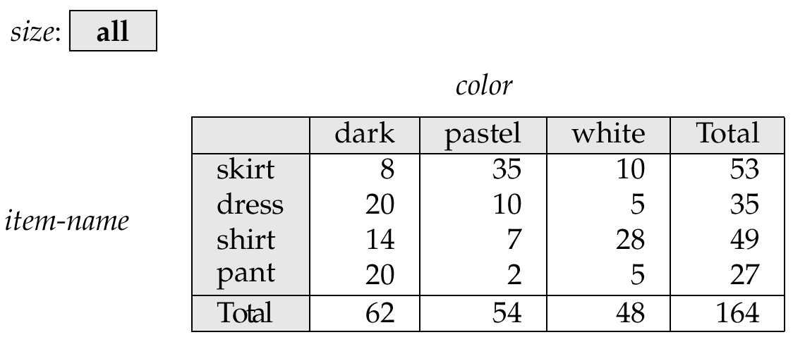
Cross Tabulation of sales by item-name and color
The table above is an example of a cross-tabulation (cross-tab), also referred to as a pivot-table.
A cross-tab is a table where
  values for one of the dimension attributes form the row headers, values for another dimension attribute form the column headers
    Other dimension attributes are listed on top
  Values in individual cells are (aggregates of) the values of the
  dimension attributes that specify the cell.

Slide 6
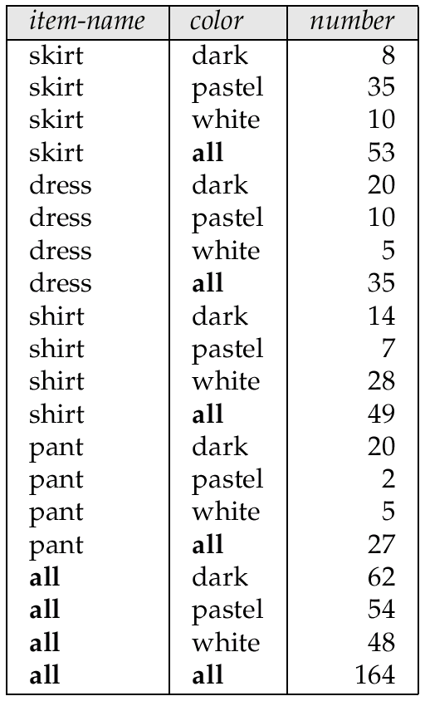
Relational Representation of Crosstabs
Crosstabs can be represented as relations
  The value all is used to represent aggregates
  The SQL:1999 standard actually uses null values in place of all
    More on this later….

Slide 7
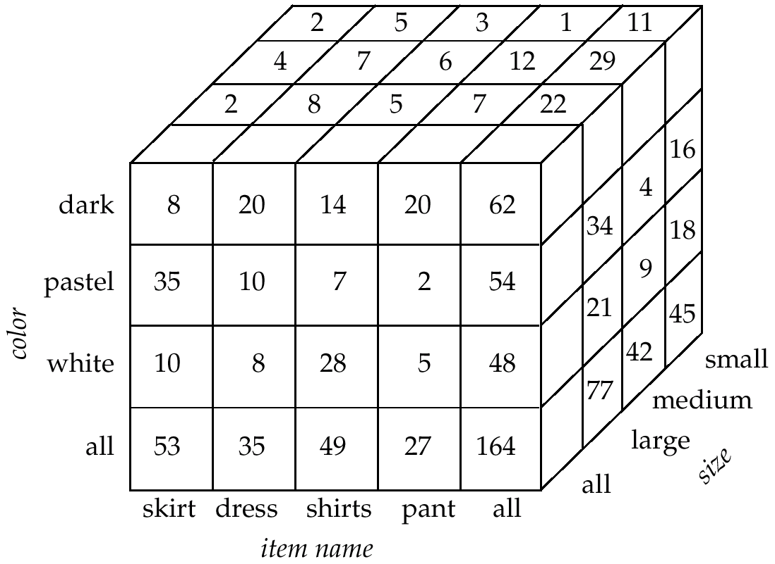
Three-Dimensional Data Cube
A data cube is a multidimensional generalization of a crosstab
  Cannot view a three-dimensional object in its entirety
    but crosstabs can be used as views on a data cube

Slide 8
Online Analytical Processing
The operation of changing the dimensions used in a cross-tab is called pivoting
Suppose an analyst wishes to see a cross-tab on item-name and color for a fixed value of size, for example, large, instead of the sum across all sizes.
  Such an operation is referred to as slicing.
    The operation is sometimes called dicing, particularly when values for multiple dimensions are fixed.
The operation of moving from finer-granularity data to a coarser granularity is called a rollup.
The opposite operation - that of moving from coarser-granularity data to finer-granularity data – is called a drill down.

Slide 9

Hierarchies on Dimensions
Hierarchy on dimension attributes: lets dimensions to be viewed at different levels of detail
  E.g. the dimension DateTime can be used to aggregate by hour of day, date, day of week, month, quarter or year

Slide 10
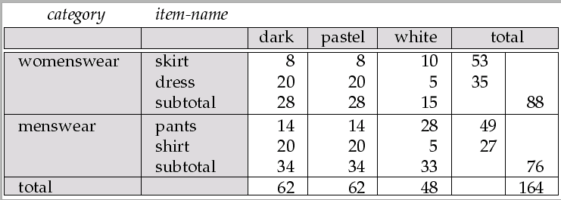
Cross Tabulation With Hierarchy
Crosstabs can be easily extended to deal with hierarchies
  Can drill down or roll up on a hierarchy

Slide 11
OLAP Implementation
The earliest OLAP systems used multidimensional arrays in memory to store data cubes, and are referred to as multidimensional OLAP (MOLAP) systems.
OLAP implementations using only relational database features are called relational OLAP (ROLAP) systems
Hybrid systems, which store some summaries in memory and store the base data and other summaries in a relational database, are called hybrid OLAP (HOLAP) systems.

Slide 12
OLAP Implementation (Cont.)
Early OLAP systems precomputed all possible aggregates in order to provide online response
  Space and time requirements for doing so can be very high
    2^{n} combinations of group by
  It suffices to precompute some aggregates, and compute others on demand from one of the precomputed aggregates
    Can compute aggregate on (item-name, color) from an aggregate on (item-name, color, size)
      For all but a few “non-decomposable” aggregates such as median
      is cheaper than computing it from scratch
Several optimizations available for computing multiple aggregates
  Can compute aggregate on (item-name, color) from an aggregate on
  (item-name, color, size)
  Can compute aggregates on (item-name, color, size),
  (item-name, color) and (item-name) using a single sorting
  of the base data

Slide 13
Extended Aggregation
SQL-92 aggregation quite limited
  Many useful aggregates are either very hard or impossible to specify
    Data cube
    Complex aggregates (median, variance)
    binary aggregates (correlation, regression curves)
    ranking queries (“assign each student a rank based on the total marks”
SQL:1999 OLAP extensions provide a variety of aggregation functions to address above limitations
  Supported by several databases, including Oracle and IBM DB2

Slide 14
Extended Aggregation in SQL:1999
The cube operation computes union of group by’s on every subset of the specified attributes
E.g. consider the query
select item-name, color, size, sum(number)
from sales
group by cube(item-name, color, size)
This computes the union of eight different groupings of the sales relation:
{ (item-name, color, size), (item-name, color),
(item-name, size), (color, size),
(item-name), (color),
(size), ( ) }
where ( ) denotes an empty group by list.
For each grouping, the result contains the null value
for attributes not present in the grouping.

Slide 15
Extended Aggregation (Cont.)
Relational representation of crosstab that we saw earlier, but with null in place of all, can be computed by
select item-name, color, sum(number)
from sales
group by cube(item-name, color)
The function grouping() can be applied on an attribute
  Returns 1 if the value is a null value representing all, and returns 0 in all other cases.
select item-name, color, size, sum(number),
grouping(item-name) as item-name-flag,
grouping(color) as color-flag,
grouping(size) as size-flag,
from sales
group by cube(item-name, color, size)
Can use the function decode() in the select clause to replace
such nulls by a value such as all
  E.g. replace item-name in first query by
  decode( grouping(item-name), 1, ‘all’, item-name)

Slide 16
Extended Aggregation (Cont.)
The rollup construct generates union on every prefix of specified list of attributes
E.g.
select item-name, color, size, sum(number)
from sales
group by rollup(item-name, color, size)
  Generates union of four groupings:
{ (item-name, color, size), (item-name, color), (item-name), ( ) }
Rollup can be used to generate aggregates at multiple levels of a
hierarchy.
E.g., suppose table itemcategory(item-name, category) gives the category of each item. Then
select category, item-name, sum(number)
from sales, itemcategory
where sales.item-name = itemcategory.item-name
group by rollup(category, item-name)
would give a hierarchical summary by item-name and by category.

Slide 17
Extended Aggregation (Cont.)
Multiple rollups and cubes can be used in a single group by clause
  Each generates set of group by lists, cross product of sets gives overall set of group by lists
E.g.,
select item-name, color, size, sum(number)
from sales
group by rollup(item-name), rollup(color, size)
generates the groupings
{item-name, ()} X {(color, size), (color), ()}
= { (item-name, color, size), (item-name, color), (item-name),
(color, size), (color), ( ) }

Slide 18
Ranking
Ranking is done in conjunction with an order by specification.
Given a relation student-marks(student-id, marks) find the rank of each student.
select student-id, rank( ) over (order by marks desc) as s-rank
from student-marks
An extra order by clause is needed to get them in sorted order
select student-id, rank ( ) over (order by marks desc) as s-rank
from student-marks
order by s-rank
Ranking may leave gaps: e.g. if 2 students have the same top mark, both have rank 1, and the next rank is 3
  dense_rank does not leave gaps, so next dense rank would be 2

Slide 19
Ranking (Cont.)
Ranking can be done within partition of the data.
“Find the rank of students within each section.”
select student-id, section,
rank ( ) over (partition by section order by marks desc)
as sec-rank
from student-marks, student-section
where student-marks.student-id = student-section.student-id
order by section, sec-rank
Multiple rank clauses can occur in a single select clause
Ranking is done after applying group by clause/aggregation
Exercises:
  Find students with top n ranks
    Many systems provide special (non-standard) syntax for “top-n” queries
  Rank students by sum of their marks in different courses
    given relation student-course-marks(student-id, course, marks)

Slide 20
Ranking (Cont.)
Other ranking functions:
  percent_rank (within partition, if partitioning is done)
  cume_dist (cumulative distribution)
    fraction of tuples with preceding values
  row_number (non-deterministic in presence of duplicates)
SQL:1999 permits the user to specify nulls first or nulls last
select student-id,
rank ( ) over (order by marks desc nulls last) as s-rank
from student-marks

Slide 21
Ranking (Cont.)
For a given constant n, the ranking the function ntile(n) takes the tuples in each partition in the specified order, and divides them into n buckets with qual numbers of tuples. For instance, we an sort employees by salary, and use ntile(3) to find which range (bottom third, middle third, or top third) each employee is in, and compute the total salary earned by employees in each range:
select threetile, sum(salary)
from (
select salary, ntile(3) over (order by salary) as threetile
from employee) as s
group by threetile

Slide 22
Windowing
E.g.: “Given sales values for each date, calculate for each date the average of the sales on that day, the previous day, and the next day”
Such moving average queries are used to smooth out random variations.
In contrast to group by, the same tuple can exist in multiple windows
Window specification in SQL:
  Ordering of tuples, size of window for each tuple, aggregate function
  E.g. given relation sales(date, value)
select date, sum(value) over
(order by date between rows 1 preceding and 1 following)
from sales
Examples of other window specifications:
  between rows unbounded preceding and current
  rows unbounded preceding
  range between 10 preceding and current row
    All rows with values between current row value –10 to current value
  range interval 10 day preceding
    Not including current row

Slide 23
Windowing (Cont.)
Can do windowing within partitions
E.g. Given a relation transaction(account-number, date-time, value), where value is positive for a deposit and negative for a withdrawal
  “Find total balance of each account after each transaction on the account”
  select account-number, date-time,
  sum(value) over
  (partition by account-number
  order by date-time
  rows unbounded preceding)
  as balance
  from transaction
  order by account-number, date-time

Slide 24
Data Mining

Slide 25
Data Mining
Broadly speaking, data mining is the process of semi-automatically analyzing large databases to find useful patterns
Like knowledge discovery in artificial intelligence data mining discovers statistical rules and patterns
Differs from machine learning in that it deals with large volumes of data stored primarily on disk.
Some types of knowledge discovered from a database can be represented by a set of rules.
  e.g.,: “Young women with annual incomes greater than $50,000 are most likely to buy sports cars”
Other types of knowledge represented by equations, or by prediction functions
Some manual intervention is usually required
  Pre-processing of data, choice of which type of pattern to find, postprocessing to find novel patterns

Slide 26
Applications of Data Mining
Prediction based on past history
  Predict if a credit card applicant poses a good credit risk, based on some attributes (income, job type, age, ..) and past history
  Predict if a customer is likely to switch brand loyalty
  Predict if a customer is likely to respond to “junk mail”
  Predict if a pattern of phone calling card usage is likely to be fraudulent
Some examples of prediction mechanisms:
  Classification
    Given a training set consisting of items belonging to different classes, and a new item whose class is unknown, predict which class it belongs to
  Regression formulae
    given a set of parameter-value to function-result mappings for an unknown function, predict the function-result for a new parameter-value

Slide 27
Applications of Data Mining (Cont.)
Descriptive Patterns
  Associations
    Find books that are often bought by the same customers. If a new customer buys one such book, suggest that he buys the others too.
    Other similar applications: camera accessories, clothes, etc.
  Associations may also be used as a first step in detecting causation
    E.g. association between exposure to chemical X and cancer, or new medicine and cardiac problems
  Clusters
    E.g. typhoid cases were clustered in an area surrounding a contaminated well
    Detection of clusters remains important in detecting epidemics

Slide 28
Classification Rules
Classification rules help assign new objects to a set of classes. E.g., given a new automobile insurance applicant, should he or she be classified as low risk, medium risk or high risk?
Classification rules for above example could use a variety of knowledge, such as educational level of applicant, salary of applicant, age of applicant, etc.
  ∀ person P, P.degree = masters and P.income > 75,000
    ⇒ P.credit = excellent
  ∀ person P, P.degree = bachelors and
  (P.income ≥ 25,000 and P.income ≤ 75,000)
  ⇒ P.credit = good
Rules are not necessarily exact: there may be some misclassifications
Classification rules can be compactly shown as a decision tree.

Slide 29
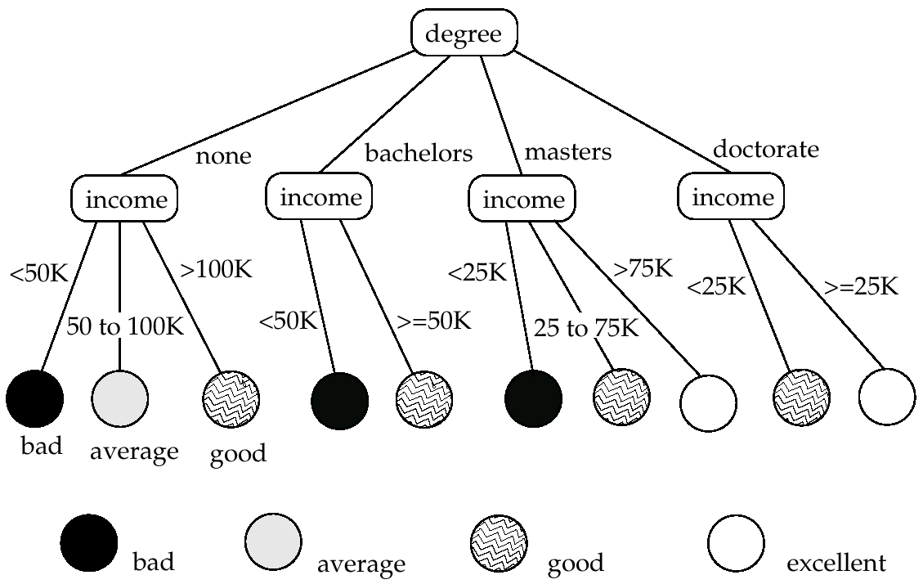
Decision Tree

Slide 30
Construction of Decision Trees
Training set: a data sample in which the grouping for each tuple is already known.
Consider credit risk example: Suppose degree is chosen to partition the data at the root.
  Since degree has a small number of possible values, one child is created for each value.
At each child node of the root, further classification is done if required. Here, partitions are defined by income.
  Since income is a continuous attribute, some number of intervals are chosen, and one child created for each interval.
Different classification algorithms use different ways of choosing which attribute to partition on at each node, and what the intervals, if any, are.
In general
  Different branches of the tree could grow to different levels.
  Different nodes at the same level may use different partitioning attributes.

Slide 31
Construction of Decision Trees (Cont.)
Greedy top down generation of decision trees.
  Each internal node of the tree partitions the data into groups based on a partitioning attribute, and a partitioning condition for the node
    More on choosing partioning attribute/condition shortly
    Algorithm is greedy: the choice is made once and not revisited as more of the tree is constructed
  The data at a node is not partitioned further if either
    all (or most) of the items at the node belong to the same class, or
    all attributes have been considered, and no further partitioning is possible.
    Such a node is a leaf node.
  Otherwise the data at the node is partitioned further by
  picking an attribute for partitioning data at the node.

Slide 32
Best Splits
Idea: evaluate different attributes and partitioning conditions and pick the one that best improves the “purity” of the training set examples
  The initial training set has a mixture of instances from different classes and is thus relatively impure
  E.g. if degree exactly predicts credit risk, partitioning on degree would result in each child having instances of only one class
    I.e., the child nodes would be pure
The purity of a set S of training instances can be measured quantitatively in several ways.
Notation: number of classes = k, number of instances = |S|,
fraction of instances in class i = p_{i}.
The Gini measure of purity is defined as
[
Gini (S) = 1 - ∑
  When all instances are in a single class, the Gini value is 0, while it reaches its maximum (of 1 –1 /k) if each class the same number of instances.
k
p²_{i}
i- 1

Slide 33
Best Splits (Cont.)
Another measure of purity is the entropy measure, which is defined as
entropy (S) = – ∑
When a set S is split into multiple sets Si, I=1, 2, …, r, we can measure the purity of the resultant set of sets as:
purity(S₁, S₂, ….., S_{r}) = ∑
The information gain due to particular split of S into S_{i}, i = 1, 2, …., r
Information-gain (S, {S₁, S₂, …., S_{r}) =
purity(S) – purity (S₁, S₂, … S_{r})
k
p_{i}log₂ p_{i}
i- 1
r
|S_{i}|
|S|
purity (S_{i})
i= 1

Slide 34
Best Splits (Cont.)
Measure of “cost” of a split:
Information-content(S, {S₁, S₂, ….., S_{r}})) =
– ∑
Information-gain ratio = Information-gain (S, {S₁, S₂, ……, S_{r}})
Information-content (S, {S₁, S₂, ….., S_{r}})
The best split for an attribute is the one that gives the maximum information gain ratio
Continuous valued attributes
  Can be ordered in a fashion meaningful to classification
  e.g. integer and real values
Categorical attributes
  Cannot be meaningfully ordered (e.g. country, school/university, item-color, .):
r
|S_{i}|
|S|
|S_{i}|
|S|
log₂
i- 1

Slide 35
Finding Best Splits
Categorical attributes:
  Multi-way split, one child for each value
    may have too many children in some cases
  Binary split: try all possible breakup of values into two sets, and pick the best
Continuous valued attribute
  Binary split:
    Sort values in the instances, try each as a split point
      E.g. if values are 1, 10, 15, 25, split at ≤1, ≤ 10, ≤ 15
    Pick the value that gives best split
  Multi-way split: more complicated, see bibliographic notes
    A series of binary splits on the same attribute has roughly equivalent effect

Slide 36
Decision-Tree Construction Algorithm
  Procedure Grow.Tree(S)
  Partition(S);
  Procedure Partition (S)
  if (purity(S) > δ_{p} or |S| < δ_{s}) then
  return;
  for each attribute A
  evaluate splits on attribute A;
  Use best split found (across all attributes) to partition
  S into S₁, S₂, …., S_{r},
  for i = 1, 2, ….., r
  Partition(S_{i});

Slide 37
Decision Tree Constr’n Algo’s. (Cont.)
Variety of algorithms have been developed to
  Reduce CPU cost and/or
  Reduce IO cost when handling datasets larger than memory
  Improve accuracy of classification
Decision tree may be overfitted, i.e., overly tuned to given training set
  Pruning of decision tree may be done on branches that have too few training instances
    When a subtree is pruned, an internal node becomes a leaf
      and its class is set to the majority class of the instances that map to the node
  Pruning can be done by using a part of the training set to build tree, and a second part to test the tree
    prune subtrees that increase misclassification on second part

Slide 38
Other Types of Classifiers
Further types of classifiers
  Neural net classifiers
  Bayesian classifiers
Neural net classifiers use the training data to train artificial neural nets
  Widely studied in AI, won’t cover here
Bayesian classifiers use Bayes theorem, which says
p(c_{j} | d) = p(d | c_{j} ) p(c_{j})
p(d)
where
p(c_{j} | d) = probability of instance d being in class c_{j},
p(d | c_{j}) = probability of generating instance d given class c_{j},
p(c_{j}) = probability of occurrence of class c_{j}, and
p(d) = probability of instance d occuring

Slide 39
Naïve Bayesian Classifiers
Bayesian classifiers require
  computation of p(d | c_{j})
  precomputation of p(c_{j})
  p(d) can be ignored since it is the same for all classes
To simplify the task, naïve Bayesian classifiers assume attributes have independent distributions, and thereby estimate
p(d|c_{j}) = p(d₁|c_{j}) * p(d₂|c_{j}) * ….* (p(d_{n}|c_{j})
  Each of the p(d_{i}|c_{j}) can be estimated from a histogram on d_{i} values for each class c_{j}
    the histogram is computed from the training instances
  Histograms on multiple attributes are more expensive to compute and store

Slide 40
Regression
Regression deals with the prediction of a value, rather than a class.
  Given values for a set of variables, X₁, X₂, …, X_{n}, we wish to predict the value of a variable Y.
One way is to infer coefficients a₀, a₁, a₁, …, a_{n} such that
Y = a₀ + a₁ * X₁ + a₂ * X₂ + … + a_{n} * X_{n}
Finding such a linear polynomial is called linear regression.
  In general, the process of finding a curve that fits the data is also called curve fitting.
The fit may only be approximate
  because of noise in the data, or
  because the relationship is not exactly a polynomial
Regression aims to find coefficients that give the best possible fit.

Slide 41
Association Rules
Retail shops are often interested in associations between different items that people buy.
  Someone who buys bread is quite likely also to buy milk
  A person who bought the book Database System Concepts is quite likely also to buy the book Operating System Concepts.
Associations information can be used in several ways.
  E.g. when a customer buys a particular book, an online shop may suggest associated books.
Association rules:
bread ⇒ milk DB-Concepts, OS-Concepts ⇒ Networks
  Left hand side: antecedent, right hand side: consequent
  An association rule must have an associated population; the population consists of a set of instances
    E.g. each transaction (sale) at a shop is an instance, and the set of all transactions is the population

Slide 42
Association Rules (Cont.)
Rules have an associated support, as well as an associated confidence.
Support is a measure of what fraction of the population satisfies both the antecedent and the consequent of the rule.
  E.g. suppose only 0.001 percent of all purchases include milk and screwdrivers. The support for the rule is milk ⇒ screwdrivers is low.
  We usually want rules with a reasonably high support
    Rules with low support are usually not very useful
Confidence is a measure of how often the consequent is true when the antecedent is true.
  E.g. the rule bread ⇒ milk has a confidence of 80 percent if 80 percent of the purchases that include bread also include milk.
  Usually want rules with reasonably large confidence.
    A rule with a low confidence is not meaningful.
Note that the confidence of bread ⇒ milk may be very
different from the confidence of milk ⇒ bread, although
both have the same supports.

Slide 43
Finding Association Rules
We are generally only interested in association rules with reasonably high support (e.g. support of 2% or greater)
Naïve algorithm
  Consider all possible sets of relevant items.
  For each set find its support (i.e. count how many transactions purchase all items in the set).
    Large itemsets: sets with sufficiently high support
  Use large itemsets to generate association rules.
    From itemset A generate the rule A - {b} ⇒b for each b ∈ A.
      Support of rule = support (A).
      Confidence of rule = support (A ) / support (A - {b})

Slide 44
Finding Support
Few itemsets: determine support of all itemsets via a single pass on set of transactions
  A count is maintained for each itemset, initially set to 0.
  When a transaction is fetched, the count is incremented for each set of items that is contained in the transaction.
  Large itemsets: sets with a high count at the end of the pass
Many itemsets: If memory not enough to hold all counts for all itemsets use multiple passes, considering only some itemsets in each pass.
Optimization: Once an itemset is eliminated because its count (support) is too small none of its supersets needs to be considered.
The a priori technique to find large itemsets:
  Pass 1: count support of all sets with just 1 item. Eliminate those items with low support
  Pass i: candidates: every set of i items such that all its i-1 item subsets are large
    Count support of all candidates
    Stop if there are no candidates

Slide 45
Other Types of Associations
Basic association rules have several limitations
Deviations from the expected probability are more interesting
  E.g. if many people purchase bread, and many people purchase cereal, quite a few would be expected to purchase both (prob1 * prob2)
  We are interested in positive as well as negative correlations between sets of items
    Positive correlation: co-occurrence is higher than predicted
    Negative correlation: co-occurrence is lower than predicted
Sequence associations/correlations
  E.g. whenever bonds go up, stock prices go down in 2 days
Deviations from temporal patterns
  E.g. deviation from a steady growth
  E.g. sales of winter wear go down in summer
    Not surprising, part of a known pattern.
    Look for deviation from value predicted using past patterns

Slide 46
Clustering
Clustering: Intuitively, finding clusters of points in the given data such that similar points lie in the same cluster
Can be formalized using distance metrics in several ways
E.g. Group points into k sets (for a given k) such that the average distance of points from the centroid of their assigned group is minimized
  Centroid: point defined by taking average of coordinates in each dimension.
  Another metric: minimize average distance between every pair of points in a cluster
Has been studied extensively in statistics, but on small data sets
  Data mining systems aim at clustering techniques that can handle very large data sets
  E.g. the Birch clustering algorithm (more shortly)

Slide 47
Hierarchical Clustering
Example from biological classification
  (the word classification here does not mean a prediction mechanism)
  chordata
  mammalia reptilia
  leopards humans snakes crocodiles
Other examples: Internet directory systems (e.g. Yahoo, more on this later)
Agglomerative clustering algorithms
  Build small clusters, then cluster small clusters into bigger clusters, and so on
Divisive clustering algorithms
  Start with all items in a single cluster, repeatedly refine (break) clusters into smaller ones

Slide 48
Clustering Algorithms
Clustering algorithms have been designed to handle very large datasets
E.g. the Birch algorithm
  Main idea: use an in-memory R-tree to store points that are being clustered
  Insert points one at a time into the R-tree, merging a new point with an existing cluster if is less than some δ distance away
  If there are more leaf nodes than fit in memory, merge existing clusters that are close to each other
  At the end of first pass we get a large number of clusters at the leaves of the R-tree
    Merge clusters to reduce the number of clusters

Slide 49
Collaborative Filtering
Goal: predict what movies/books/… a person may be interested in, on the basis of
  Past preferences of the person
  Other people with similar past preferences
  The preferences of such people for a new movie/book/…
One approach based on repeated clustering
  Cluster people on the basis of preferences for movies
  Then cluster movies on the basis of being liked by the same clusters of people
  Again cluster people based on their preferences for (the newly created clusters of) movies
  Repeat above till equilibrium
Above problem is an instance of collaborative filtering, where users collaborate in the task of filtering information to find information of interest

Slide 50
Other Types of Mining
Text mining: application of data mining to textual documents
  E.g. cluster Web pages to find related pages
  E.g. cluster pages a user has visited to organize their visit history
  E.g. classify Web pages automatically into a Web directory
Data visualization systems help users examine large volumes of data and detect patterns visually
  E.g. maps, charts, and color-coding
    E.g. locations with problems shown in red on a map
  Can visually encode large amounts of information on a single screen
  Humans are very good a detecting visual patterns

Slide 51
Data Warehousing

Slide 52
Data Warehousing
Large organizations have complex internal organizations, and have data stored at different locations, on different operational (transaction processing) systems, under different schemas
Data sources often store only current data, not historical data
Corporate decision making requires a unified view of all organizational data, including historical data
A data warehouse is a repository (archive) of information gathered from multiple sources, stored under a unified schema, at a single site
  Greatly simplifies querying, permits study of historical trends
  Shifts decision support query load away from transaction processing systems

Slide 53
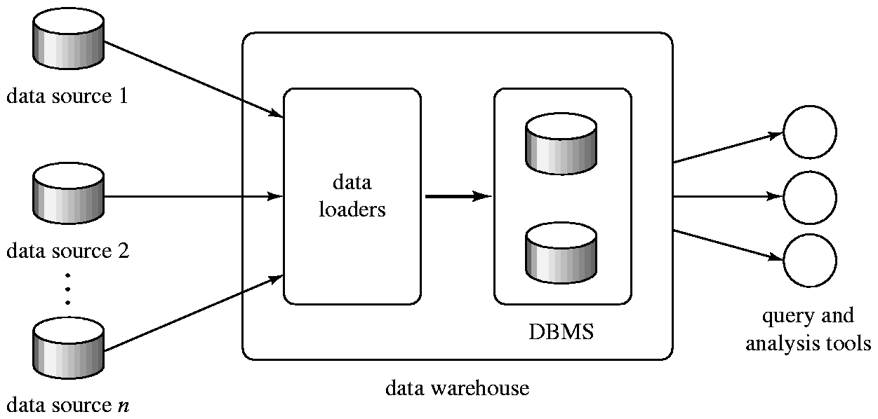
Data Warehousing

Slide 54
Components of Data Warehouse
When and how to gather data
  Source driven architecture: data sources transmit new information to warehouse, either continuously or periodically (e.g. at night)
  Destination driven architecture: warehouse periodically requests new information from data sources
  Keeping warehouse exactly synchronized with data sources (e.g. using two-phase commit) is too expensive
    Usually OK to have slightly out-of-date data at warehouse
    Data/updates are periodically downloaded form online transaction processing (OLTP) systems.
What schema to use
  Schema integration

Slide 55
Components of Data Warehouse (Cont.)
Data cleansing
  E.g. correct mistakes in addresses
    E.g. misspellings, zip code errors
  Merge address lists from different sources and purge duplicates
    Keep only one address record per household (“householding”)
How to propagate updates
  Warehouse schema may be a (materialized) view of schema from data sources
  Efficient techniques for update of materialized views
What data to summarize
  Raw data may be too large to store on-line
  Aggregate values (totals/subtotals) often suffice
  Queries on raw data can often be transformed by query optimizer to use aggregate values

Slide 56
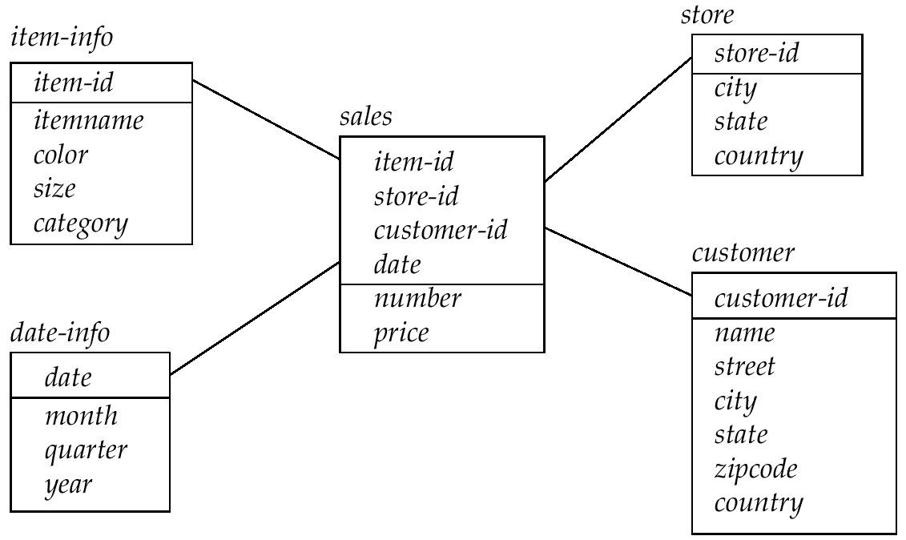
Data Warehouse Schemas

Slide 57
Warehouse Schemas
Typically warehouse data is multidimensional, with very large fact tables
  Examples of dimensions: item-id, date/time of sale, store where sale was made, customer identifier
  Examples of measures: number of items sold, price of items
Dimension values are usually encoded using small integers and mapped to full values via dimension tables
  Resultant schema is called a star schema
    More complicated schema structures
      Snowflake schema: multiple levels of dimension tables
      Constellation: multiple fact tables

Slide 58
Information Retrieval

Slide 59
Information Retrieval Systems
Information retrieval (IR) systems use a simpler data model than database systems
  Information organized as a collection of documents
  Documents are unstructured, no schema
Information retrieval locates relevant documents, on the basis of user input such as keywords or example documents
  e.g., find documents containing the words “database systems”
Can be used even on textual descriptions provided with non-textual data such as images
IR on Web documents has become extremely important
  E.g. google, altavista, …

Slide 60
Information Retrieval Systems (Cont.)
Differences from database systems
  IR systems don’t deal with transactional updates (including concurrency control and recovery)
  Database systems deal with structured data, with schemas that define the data organization
  IR systems deal with some querying issues not generally addressed by database systems
    Approximate searching by keywords
    Ranking of retrieved answers by estimated degree of relevance

Slide 61
Keyword Search
In full text retrieval, all the words in each document are considered to be keywords.
  We use the word term to refer to the words in a document
Information-retrieval systems typically allow query expressions formed using keywords and the logical connectives and, or, and not
  Ands are implicit, even if not explicitly specified
Ranking of documents on the basis of estimated relevance to a query is critical
  Relevance ranking is based on factors such as
    Term frequency
      Frequency of occurrence of query keyword in document
    Inverse document frequency
      How many documents the query keyword occurs in
        Fewer ➔ give more importance to keyword
    Hyperlinks to documents
      More links to a document ➔ document is more important

Slide 62
Relevance Ranking Using Terms
TF-IDF (Term frequency/Inverse Document frequency) ranking:
  Let n(d) = number of terms in the document d
  n(d, t) = number of occurrences of term t in the document d.
  Then relevance of a document d to a term t
    The log factor is to avoid excessive weightage to frequent terms
  And relevance of document to query Q
n(d, t)
r(d, t) = log
1 +
n(d)
r(d, t)
r(d, Q) =
∑
t∈Q
n(t)

Slide 63
Relevance Ranking Using Terms (Cont.)
Most systems add to the above model
  Words that occur in title, author list, section headings, etc. are given greater importance
  Words whose first occurrence is late in the document are given lower importance
  Very common words such as “a”, “an”, “the”, “it” etc are eliminated
    Called stop words
  Proximity: if keywords in query occur close together in the document, the document has higher importance than if they occur far apart
Documents are returned in decreasing order of relevance score
  Usually only top few documents are returned, not all

Slide 64
Relevance Using Hyperlinks
When using keyword queries on the Web, the number of documents is enormous (many billions)
  Number of documents relevant to a query can be enormous if only term frequencies are taken into account
Using term frequencies makes “spamming” easy
    E.g. a travel agent can add many occurrences of the words “travel agent” to his page to make its rank very high
Most of the time people are looking for pages from popular sites
Idea: use popularity of Web site (e.g. how many people visit it) to rank site pages that match given keywords
Problem: hard to find actual popularity of site
  Solution: next slide

Slide 65
Relevance Using Hyperlinks (Cont.)
Solution: use number of hyperlinks to a site as a measure of the popularity or prestige of the site
  Count only one hyperlink from each site (why?)
  Popularity measure is for site, not for individual page
    Most hyperlinks are to root of site
    Site-popularity computation is cheaper than page popularity computation
Refinements
  When computing prestige based on links to a site, give more weightage to links from sites that themselves have higher prestige
    Definition is circular
    Set up and solve system of simultaneous linear equations
  Above idea is basis of the Google PageRank ranking mechanism

Slide 66
Relevance Using Hyperlinks (Cont.)
Connections to social networking theories that ranked prestige of people
  E.g. the president of the US has a high prestige since many people know him
  Someone known by multiple prestigious people has high prestige
Hub and authority based ranking
  A hub is a page that stores links to many pages (on a topic)
  An authority is a page that contains actual information on a topic
  Each page gets a hub prestige based on prestige of authorities that it points to
  Each page gets an authority prestige based on prestige of hubs that point to it
  Again, prestige definitions are cyclic, and can be got by
  solving linear equations
  Use authority prestige when ranking answers to a query

Slide 67
Similarity Based Retrieval
Similarity based retrieval - retrieve documents similar to a given document
  Similarity may be defined on the basis of common words
    E.g. find k terms in A with highest r(d, t) and use these terms to find relevance of other documents; each of the terms carries a weight of r (d,t)
Similarity can be used to refine answer set to keyword query
  User selects a few relevant documents from those retrieved by keyword query, and system finds other documents similar to these

Slide 68
Synonyms and Homonyms
Synonyms
  E.g. document: “motorcycle repair”, query: “motorcycle maintenance”
    need to realize that “maintenance” and “repair” are synonyms
  System can extend query as “motorcycle and (repair or maintenance)”
Homonyms
  E.g. “object” has different meanings as noun/verb
  Can disambiguate meanings (to some extent) from the context
Extending queries automatically using synonyms can be problematic
  Need to understand intended meaning in order to infer synonyms
    Or verify synonyms with user
  Synonyms may have other meanings as well

Slide 69
Indexing of Documents
An inverted index maps each keyword K_{i} to a set of documents S_{i} that contain the keyword
  Documents identified by identifiers
Inverted index may record
  Keyword locations within document to allow proximity based ranking
  Counts of number of occurrences of keyword to compute TF
and operation: Finds documents that contain all of K₁, K₂, ..., K_{n}.
  Intersection S₁∩ S₂ ∩..... ∩ S_{n}
or operation: documents that contain at least one of K₁, K₂, …, K_{n}
  union, S₁∩ S₂ ∩..... ∩ S_{n},.
Each S_{i} is kept sorted to allow efficient intersection/union by merging
  “not” can also be efficiently implemented by merging of sorted lists

Slide 70
Measuring Retrieval Effectiveness
IR systems save space by using index structures that support only approximate retrieval. May result in:
  false negative (false drop) - some relevant documents may not be retrieved.
  false positive - some irrelevant documents may be retrieved.
  For many applications a good index should not permit any false drops, but may permit a few false positives.
Relevant performance metrics:
  Precision - what percentage of the retrieved documents are relevant to the query.
  Recall - what percentage of the documents relevant to the query were retrieved.

Slide 71
Measuring Retrieval Effectiveness (Cont.)
Ranking order can also result in false positives/false negatives
  Recall vs. precision tradeoff:
    Can increase recall by retrieving many documents (down to a low level of relevance ranking), but many irrelevant documents would be fetched, reducing precision
  Measures of retrieval effectiveness:
    Recall as a function of number of documents fetched, or
    Precision as a function of recall
      Equivalently, as a function of number of documents fetched
    E.g. “precision of 75% at recall of 50%, and 60% at a recall of 75%”
      In general: draw a graph of precision vs recall.
Problem: which documents are actually relevant, and which are not
  Usual solution: human judges
  Create a corpus of documents and queries, with humans
  deciding which documents are relevant to which queries
    TREC (Text REtrieval Conference) Benchmark

Slide 72
Web Crawling
Web crawlers are programs that locate and gather information on the Web
  Recursively follow hyperlinks present in known documents, to find other documents
    Starting from a seed set of documents
  Fetched documents
    Handed over to an indexing system
    Can be discarded after indexing, or store as a cached copy
Crawling the entire Web would take a very large amount of time
  Search engines typically cover only a part of the Web, not all of it
  Take months to perform a single crawl

Slide 73
Web Crawling (Cont.)
Crawling is done by multiple processes on multiple machines, running in parallel
  Set of links to be crawled stored in a database
  New links found in crawled pages added to this set, to be crawled later
Indexing process also runs on multiple machines
  Creates a new copy of index instead of modifying old index
  Old index is used to answer queries
  After a crawl is “completed” new index becomes “old” index
Multiple machines used to answer queries
  Indices may be kept in memory
  Queries may be routed to different machines for load balancing

Slide 74
Browsing
Storing related documents together in a library facilitates browsing
  users can see not only requested document but also related ones.
Browsing is facilitated by classification system that organizes logically related documents together.
Organization is hierarchical: classification hierarchy

Slide 75
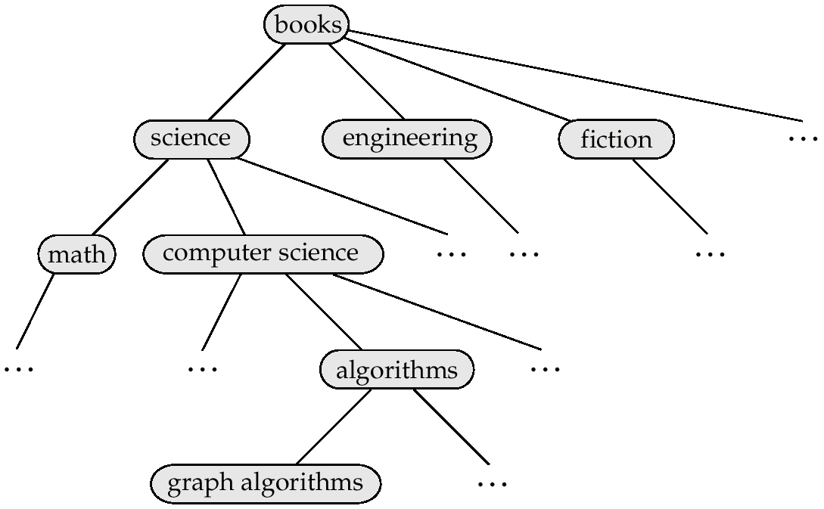
A Classification Hierarchy For A Library System

Slide 76
Classification DAG
Documents can reside in multiple places in a hierarchy in an information retrieval system, since physical location is not important.
Classification hierarchy is thus Directed Acyclic Graph (DAG)

Slide 77
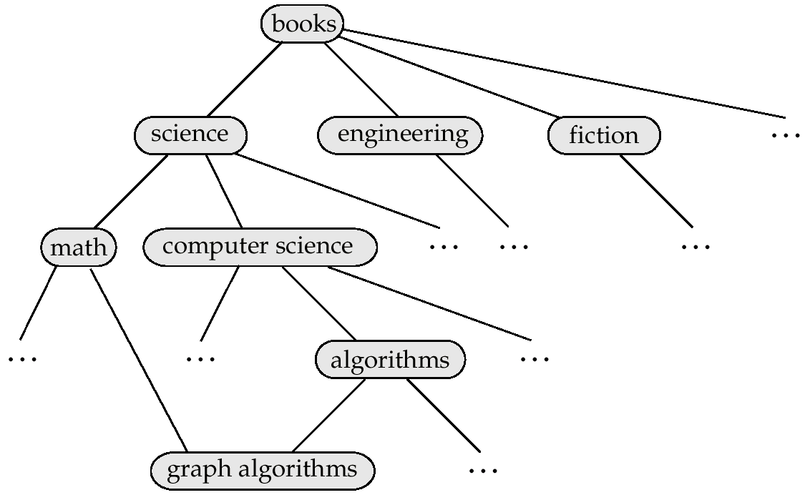
A Classification DAG For A Library Information Retrieval System

Slide 78
Web Directories
A Web directory is just a classification directory on Web pages
  E.g. Yahoo! Directory, Open Directory project
  Issues:
    What should the directory hierarchy be?
    Given a document, which nodes of the directory are categories relevant to the document
  Often done manually
    Classification of documents into a hierarchy may be done based on term similarity

