Slide 1
DATA ENCRYPTION STANDARD (DES)

Slide 2
Outline
History
Encryption
Key Generation
Decryption
Strength of DES
Ultimate

Slide 3
History
In 1971, IBM developed an algorithm, named LUCIFER which operates on a block of 64 bits, using a 128-bit key
Walter Tuchman, an IBM researcher, refined LUCIFER and reduced the key size to 56-bit, to fit on a chip.

Slide 4
History
In 1977, the results of Tuchman’s project of IBM was adopted as the Data Encryption Standard by NSA (NIST).

Slide 5
A Simplified DES-Type Algorithm
Suppose that a message has 12 bits and is written as L₀R₀ , where L₀ consists of the first 6 bits and R₀ consists of the last 6 bits.
The key K has 9 bits. The ith round of the algorithm transforms an input L_{i-1}R_{i-1} to the output L_{i}R_{i} using an 8-bit key K_{i} derived from K.
The main part of the encryption process is a function f(R_{i-1},K_{i}) that takes a 6-bit input

Slide 6
R_{i-1} and an 8-bit input K_{i} and produces a 6-bit
output which will be described later.
The output of the ith round is defined as:
L_{i} = R_{i-1} and R_{i} = L_{i-1} XOR f(R_{i-1},K_{i})
The decryption is the reverse of encryption.
[L_{n}] [R_{n} XOR f(L_{n}, K_{n})] = … =[R_{n-1}] [L_{n-1}]

Slide 7
The Operations of f Function
E(L_{i})=E(011001)=E(01010101) (Expander)
S-boxes
S₁ 101 010 001 110 011 100 111 000
001 100 110 010 000 111 101 011
S₂ 100 000 110 101 111 001 011 010
101 011 000 111 110 010 001 100
The input for an S-box has 4 bits. The first
bit specifies which row will be used: 0 for 1st

Slide 8
The other 3 bits represent a binary number that specifies the column: 000 for the 1st column, 001 for the 2nd column, … 111 for the 7th column. For example, an input 1010 for S₁ box will yield the output 110.
The key K consists of 9 bits. K_{i} is the key for the ith round starting with the ith bit of K. Let K=010011001, then K₄=01100101.

Slide 9
R_{i-1}=100110 and K_{i}=01100101
E(R_{i-1}) XOR K_{i} =10101010 XOR 01100101
= 11001111
S₁(1100)=000
S₂(1111)=100
Thus, R_{i} = f(R_{i-1},K_{i})=000100, L_{i} =R_{i-1} =100110
L_{i-1}R_{i-1} = 011100100110 → (?) L_{i}R_{i}
100110011000

Slide 10
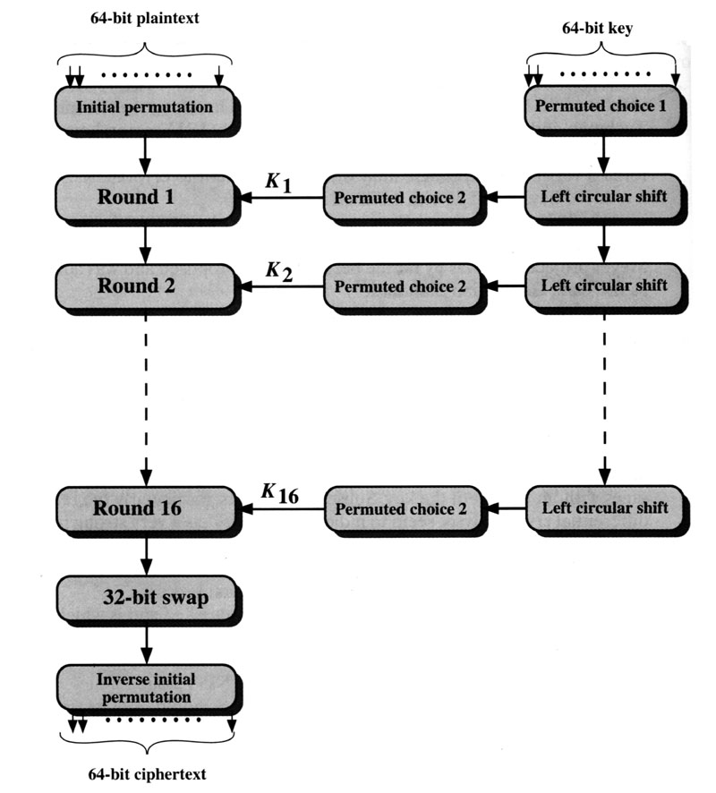
Encryption
[1]

Slide 11
Encryption (cont.)
64-bit plaintext (X)
Initial Permutation (IP)
64-bit key (K)
Key _{i}
Round _{(i)}
Key Generation (KeyGen)
32-bit Switch (SW)
Inversion of Initial Permutation (IP⁻¹)
64-bit ciphertext (Y)

Slide 12
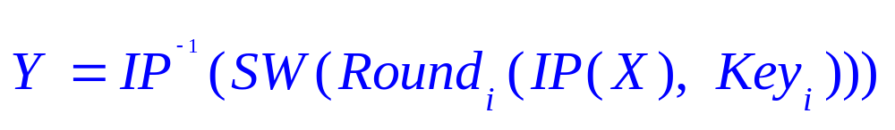
Encryption (cont.)
Plaintext: X
Initial Permutation: IP( )
Round_{i}: 1≤ i ≤ 16
32-bit switch: SW( )
Inverse IP: IP⁻¹( )
Ciphertext: Y

Slide 13
Encryption (IP, IP⁻¹)
IP
IP⁻¹
Bit | 0 | 1 | 2 | 3 | 4 | 5 | 6 | 7
1 | 58 | 50 | 42 | 34 | 26 | 18 | 10 | 2
9 | 60 | 52 | 44 | 36 | 28 | 20 | 12 | 4
17 | 62 | 54 | 46 | 38 | 30 | 22 | 14 | 6
25 | 64 | 56 | 48 | 40 | 32 | 24 | 16 | 8
33 | 57 | 49 | 41 | 33 | 25 | 17 | 9 | 1
41 | 59 | 51 | 43 | 35 | 27 | 19 | 11 | 3
49 | 61 | 53 | 45 | 37 | 29 | 21 | 13 | 5
57 | 63 | 55 | 47 | 39 | 31 | 23 | 15 | 7
Bit | 0 | 1 | 2 | 3 | 4 | 5 | 6 | 7
1 | 40 | 8 | 48 | 16 | 56 | 24 | 64 | 32
9 | 39 | 7 | 47 | 15 | 55 | 23 | 63 | 31
17 | 38 | 6 | 46 | 14 | 54 | 22 | 62 | 30
25 | 37 | 5 | 45 | 13 | 53 | 21 | 61 | 29
33 | 36 | 4 | 44 | 12 | 52 | 20 | 60 | 28
41 | 35 | 3 | 43 | 11 | 51 | 19 | 59 | 27
49 | 34 | 2 | 42 | 10 | 50 | 18 | 58 | 26
57 | 33 | 1 | 41 | 9 | 49 | 17 | 57 | 25
Note: IP(IP⁻¹) = IP⁻¹(IP) = I

Slide 14
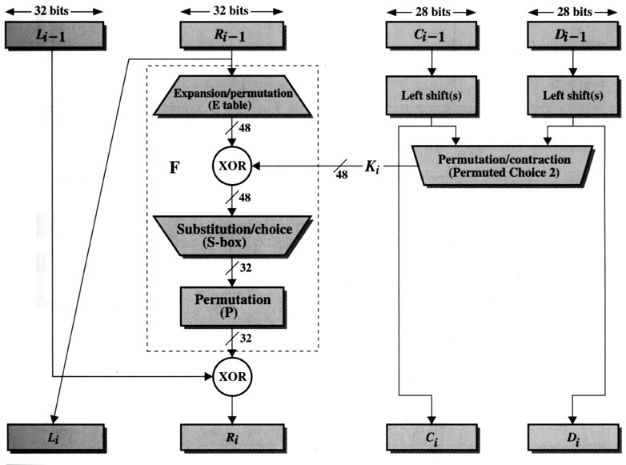
Encryption (Round)
(Key Generation)
[1]

Slide 15
Encryption (Round) (cont.)
L_{i-1}
R_{i-1}
Expansion/permutation (E_table)
XOR
K_{i}
F
Substitution/choice (S-box)
Permutation (P)
XOR
L_{i}
R_{i}

Slide 16
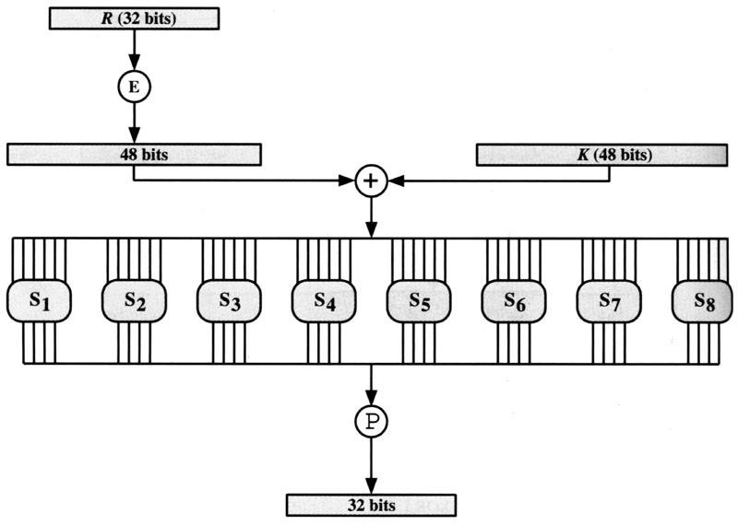
Encryption (Round) (cont.)
F
S-box
[1]

Slide 17
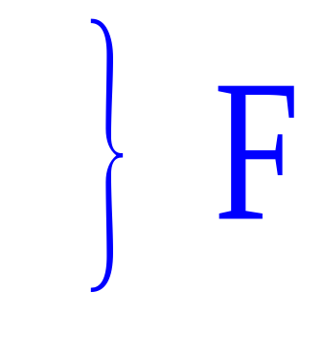
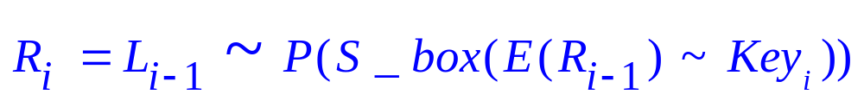
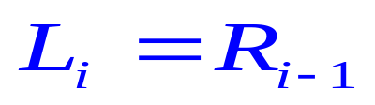
Encryption (Round) (cont.)
Separate plaintext as L₀R₀
  L₀: left half 32 bits of plaintext
  R₀: right half 32 bits of plaintext
Expansion/permutation: E( )
Substitution/choice: S-box( )
Permutation: P( )

Slide 18
Encryption (Round) (cont.)
E
P
32 | 1 | 2 | 3 | 4 | 5
4 | 5 | 6 | 7 | 8 | 9
8 | 9 | 10 | 11 | 12 | 13
12 | 13 | 14 | 45 | 16 | 17
16 | 17 | 18 | 19 | 20 | 21
20 | 21 | 22 | 23 | 24 | 25
24 | 25 | 26 | 27 | 28 | 29
28 | 29 | 30 | 31 | 32 | 1
16 | 7 | 20 | 21 | 29 | 12 | 28 | 17
1 | 15 | 23 | 26 | 5 | 18 | 31 | 10
2 | 8 | 24 | 14 | 32 | 27 | 3 | 9
9 | 13 | 30 | 6 | 22 | 11 | 4 | 25
Expansion
Expansion

Slide 19
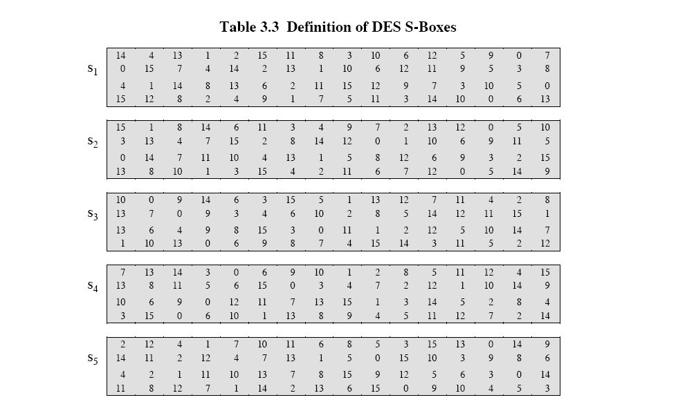
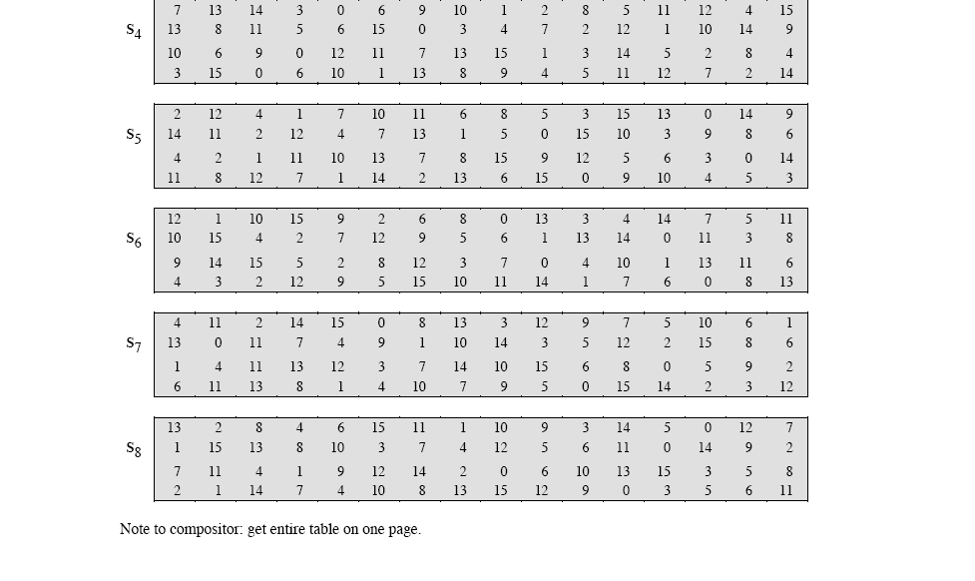
Encryption (Round) (cont.)
S-box
[1]

Slide 20
Key Generation
(Encryption)
[1]

Slide 21
Key Generation (cont.)
Input Key
Permuted Choice One (PC-1)
C₀
D₀
▪
▪
▪
▪
▪
▪
C_{i-1}
D_{i-1}
Permuted Choice Two (PC-2)
Key_{i}
Schedule of Left Shifts
C_{i}
D_{i}

Slide 22
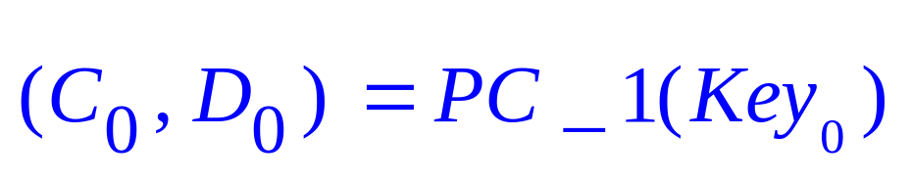
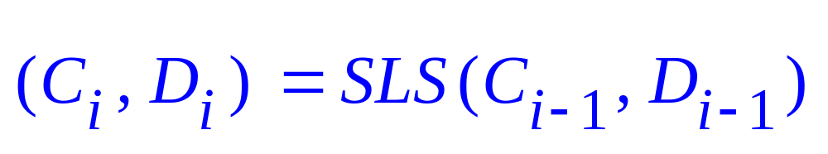
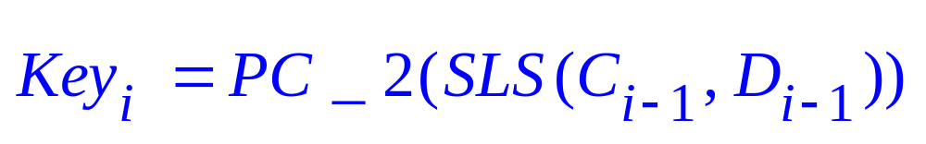
Key Generation (cont.)
Original Key: Key₀
Permuted Choice One: PC_1( )
Permuted Choice Two: PC_2( )
Schedule of Left Shift: SLS( )

Slide 23
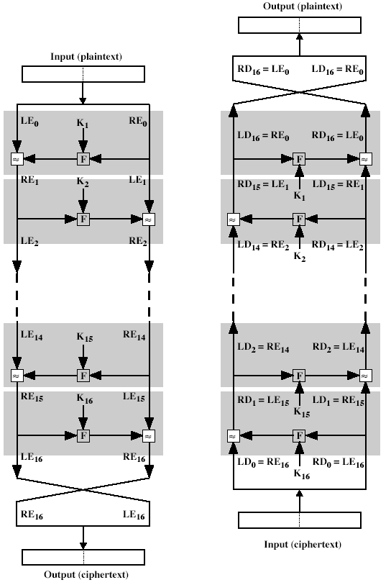
Decryption
The same algorithm as encryption.
Reversed the order of key (Key₁₆, Key₁₅, … Key₁).
For example:
  IP undoes IP⁻¹ step of encryption.
  1st round with SK16 undoes 16th encrypt round.
[1]

Slide 24
Strength of DES
Criticism
  Reduction in key size of 72 bits
    Too short to withstand with brute-force attack
  S-boxes were classified.
    Weak points enable NSA to decipher without key.
56-bit keys have 2⁵⁶ = 7.2 x 10¹⁶ values
  Brute force search looks hard.
  A machine performing one DES encryption per microsecond would take more than a thousand year to break the cipher.

Slide 25
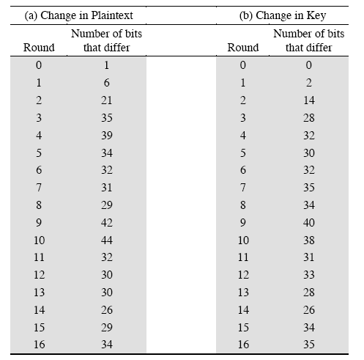
Strength of DES (cont.)
Avalanche effect in DES
  If a small change in either the plaintext or the key, the ciphertext should change markedly.
DES exhibits a strong avalanche effect.

Slide 26
Ultimate
DES was proved insecure
  In 1997 on Internet in a few months
  in 1998 on dedicated h/w (EFF) in a few days
  In 1999 above combined in 22hrs!

Slide 27
References
[1] William Stallings, Cryptography and
Network Security, 1999.

