Slide 1

School of Mechanical Engineering
Course Code: BME01T1001 Course Name: Engineering Graphics and Introduction to Digital Fabrication
Unit 1
Projection of Lines
Faculty Name: Mr. Brahma Nand Agrawal Program Name: B.Tech First Year

Slide 2
Prerequisite/Recapitulations
Drawing, Sketching
First angle & third angle projection
Basics of engineering graphics

Slide 3
Learning objectives
To acquire knowledge about:
Types of projection
Perspective
Oblique
Auxiliary
Orthographic
Isometric
Orthographic System of Projection
Principal Planes
Convention for Projection
Different cases of Projection of lines

Slide 4
Types of Projections
1. Perspective
2. Oblique
3. Auxiliary
4. Orthographic
5. Isometric

Slide 5
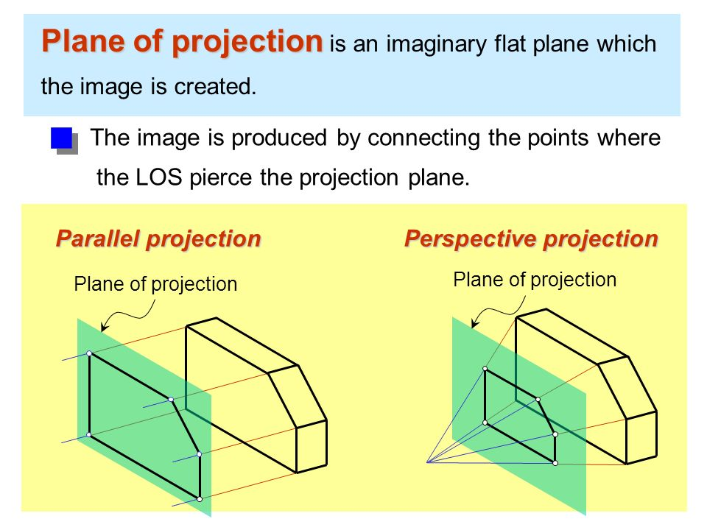
Perspective Projection
• Objects are drawn as it appears to human eye.
• Generally used for large objects such as building etc.
• The projection is obtained on a plane known as Picture Plane and the view is taken from a point known as Station Point

Slide 6
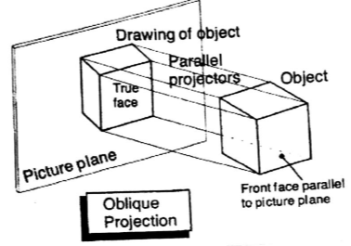
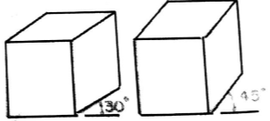
Oblique Projection
• In this the projectors are neither parallel nor at right angle to the picture plane.
• The size and shape of the object will change according to the angle of projector.

Slide 7
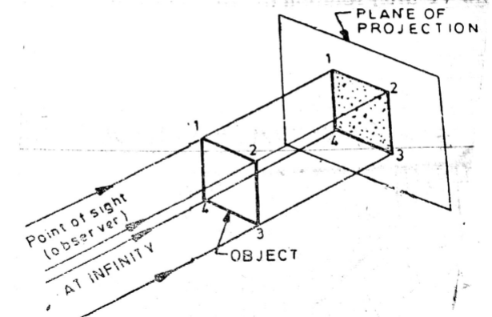
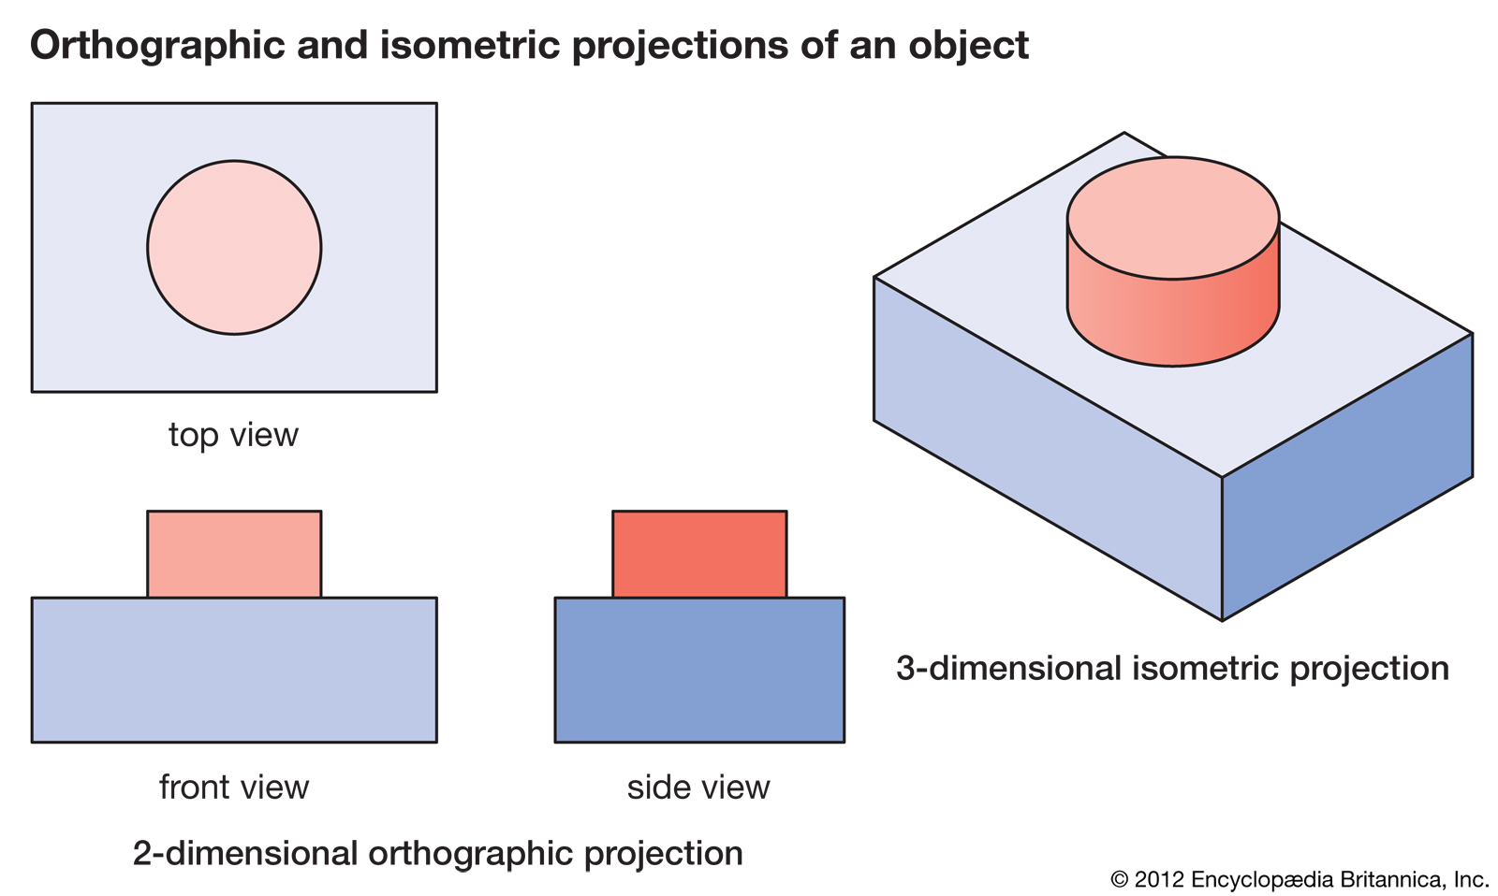
Orthographic Projection
• Projectors or the rays of light are parallel to each other
And perpendicular to the picture plane

Slide 8
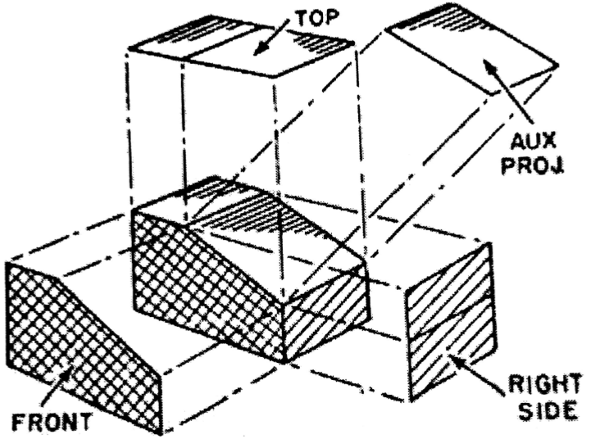
Auxiliary Projection
• When the edges of the object is not parallel to the principal plane, then in that case the true shape and size of the object is not projected.
• In order to show such edges and faces in their true shape and size and additional plane known as
auxiliary plane is used.

Slide 9
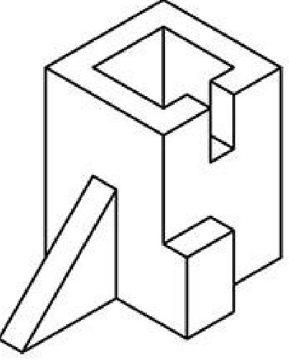
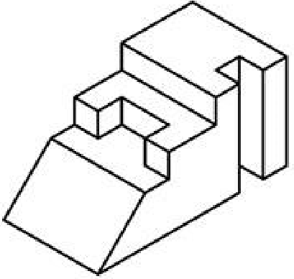
Isometric Projection
Isometric projection is a method for visually representing three-dimensional objects in two dimensions in technical and engineering drawings. It is an axonometric projection in which the three coordinate axes appear equally foreshortened.

Slide 10
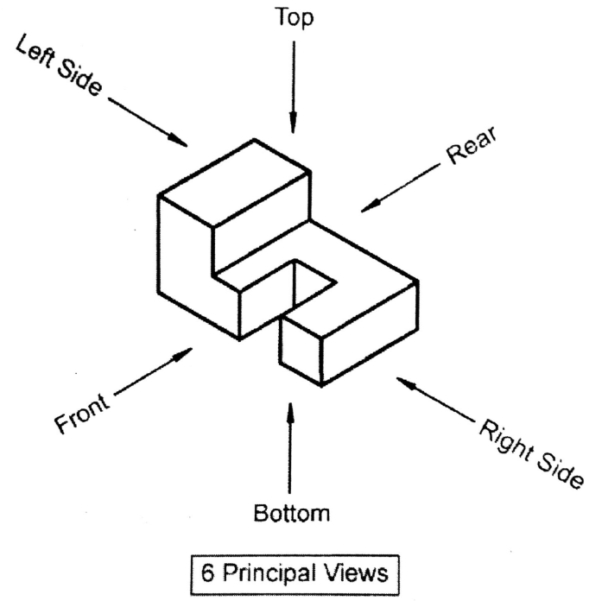
Six Principal Views

Slide 11
Different Cases of Projection of Straight Line
Straight line parallel to H.P. and V.P.
Straight line perpendicular to H.P. and parallel V.P.
Straight line parallel to H.P. and perpendicular to V.P.
Straight line in H.P.
Straight line in V.P.
Straight line in H.P. And V.P.
Straight line inclined to H.P. and parallel V.P.
Straight line inclined to V.P. and parallel H.P.
Straight line inclined to H.P. and V.P.

Slide 12
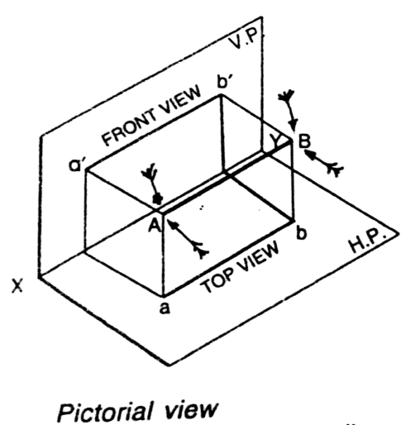
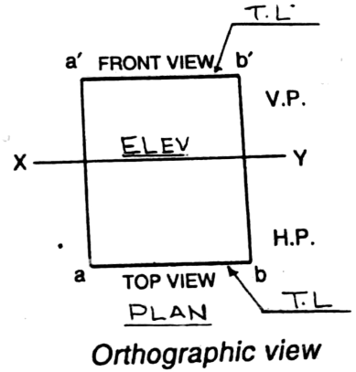
Straight line parallel to H.P. and V.P.

Slide 13
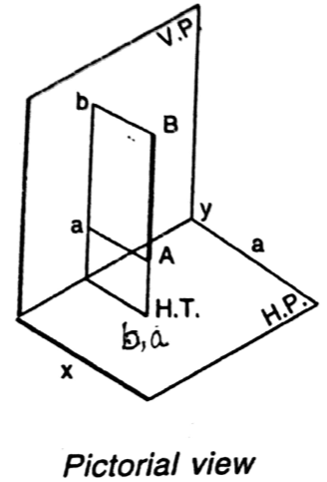
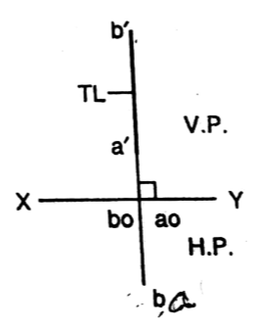

Straight line perpendicular to H.P. and parallel V.P.

Slide 14
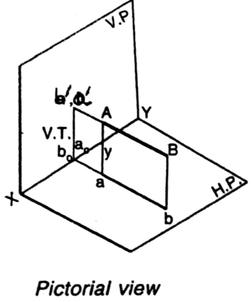
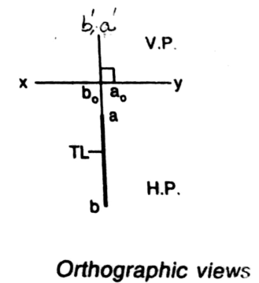
Straight line parallel to H.P. and perpendicular to V.P.

Slide 15
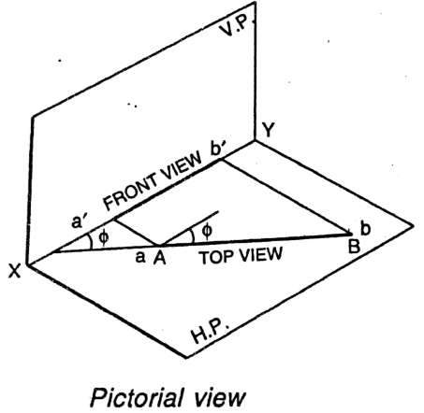
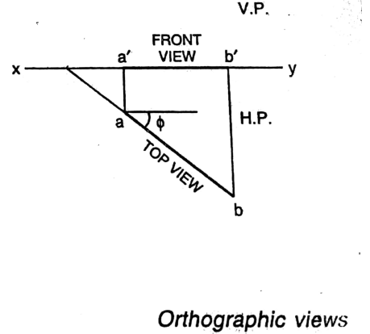
Straight Line in H.P.

Slide 16
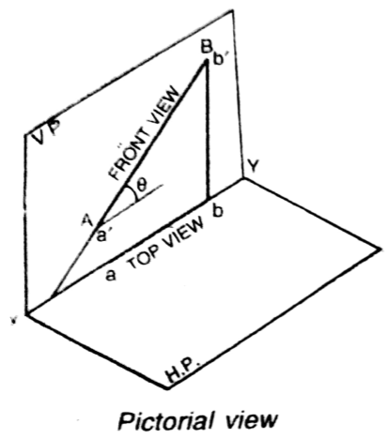
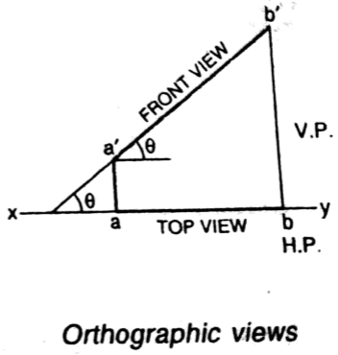
Straight Line in V.P.

Slide 17
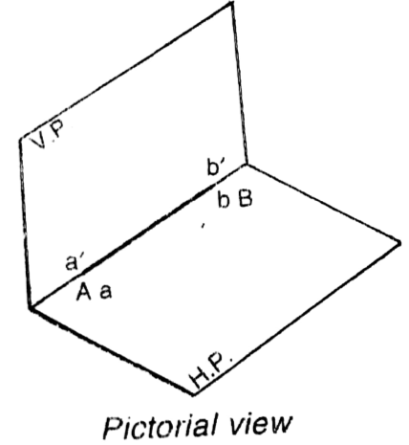
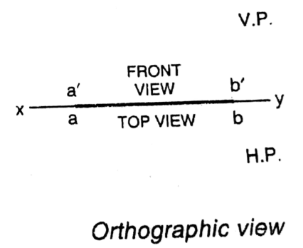
Straight Line in H.P. and V.P.

Slide 18
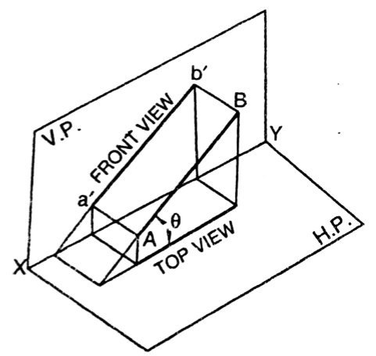
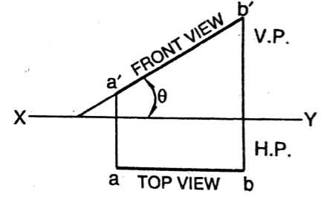

Straight line inclined to H.P. and parallel V.P.

Slide 19
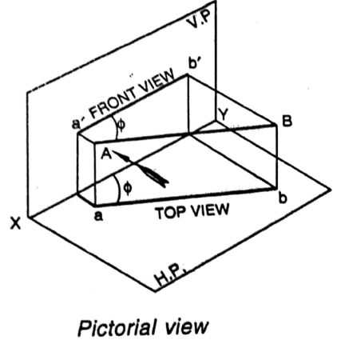
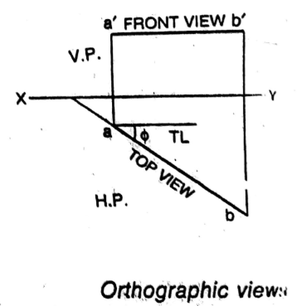
Straight line inclined to V.P. and parallel H.P.

Slide 20
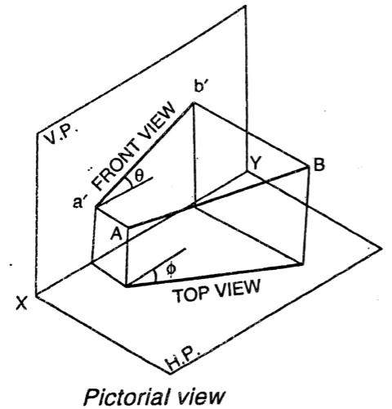
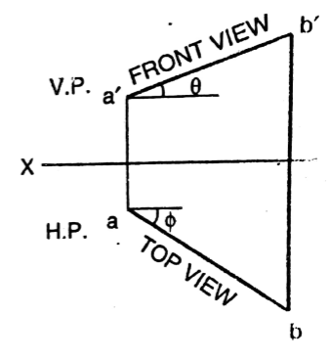

Straight Line inclined to H.P. and V.P.

Slide 21
Video for Visualization

Slide 22
Summary
Learners are able to draw:
Straight line parallel to H.P. and V.P.
Straight line perpendicular to H.P. and parallel V.P.
Straight line parallel to H.P. and perpendicular to V.P.
Straight line in H.P.
Straight line in V.P.
Straight line in H.P. And V.P.
Straight line inclined to H.P. and parallel V.P.
Straight line inclined to V.P. and parallel H.P.
Straight line inclined to H.P. and V.P.

Slide 23
Questions
How do you explain the types of projection:
Perspective
Oblique
Auxiliary
Orthographic
Isometric
Explain the orthographic system of projection
Explain the principal planes
Write the convention for projection
Explain the different cases of projection of lines

Slide 24
References
Engineering Drawing by N. D. Bhatt and V. M. Panchal
Engineering Graphics by K. C. John
NPTEL

Slide 25
Email: brahma.agrawal@galgotiasuniversity.edu.in
Thank You

