Slide 1
Django shopping websites BY: Neeraj Chandwani (20BCS2434) Abharan Singh (20BCS2438) Hardik Dhamija (20BCS2446) Harjeet Singh Thakral (20BCS2451) Vaasav Bhadwal (20BCS2534)

Slide 2
Project Introduction
In day to day life, we will need to buy lots of goods or products from a shop. It may be food items, electronic items, house hold items etc. Now a days, it is really hard to get some time to go out and get them by ourselves due to busy life style or lots of works. In order to solve this, B2C E-Commerce websites have been started. Using these websites, we can buy goods or products online just by visiting the website and ordering the item online by making payments online.
This existing system of buying goods has several disadvantages. It requires lots of time to travel to the particular shop to buy the goods. Since everyone is leading busy life now a days, time means a lot to everyone. Also there are expenses for travelling from house to shop. More over the shop from where we would like to buy some thing may not be open 24*7*365. Hence we have to adjust our time with the shopkeeper’s time or vendor’s time.
In order to overcome these, we have e-commerce solution, i.e one place where we can get all required goods/products online. The proposed system helps in building a website to buy, sell products or goods online using internet connection. Purchasing of goods online, user can choose different products based on categories , online payments , delivery services and hence covering the disadvantages of the existing system and making the buying easier and helping the vendors to reach wider market.

Slide 3
Advantages of the new system proposed :
Choose products faster and easier at one place.
Saves time of travelling to the vendor/seller’s place.
Good/Trusted & Tension free delivery services. Products bought online will be delivered to the footsteps of the buyer free of cost(may be varied based on the vendor/seller).
Alerts and real time reporting through Emails (to both vendor as well as buyer).
Reports generated can be saved for future references.
Inventory reports for the vendor/seller on daily, monthly, yearly basis.

Slide 4
Innovation in out project
There are many times when we don’t need our our old clothes which are too small for us to wear.
In your website we enabled an option for our customers to donate their old clothes to us so that we can further distribute them to the needy.
This was just a small vision we have for our project the more ambitious ones are yet to me implemented.

Slide 5
Future scope of the Project
Most generic consumer to consumer e-commerce website,which covers almost all possible categories,with 2 level listing.
Maximize benefits and minimize the disadvantages of a common e-commerce website.
User friendly, Vendor friendly environment.

Slide 6
Hardware requirements
The software should be ran on any sort of desktop or laptop environment, regardless of the operating system. The software also has the potential of running on tablets, but with a more simplified version. Essential input/output devices are keyboards, mouse, and printers; nothing else is required but can be recommended if desired.

Slide 7
Software requirements
The programming language to use will be HTML, CSS and JAVA SCRIPT.
Django will be used for the backend.

Slide 8
Modules
Admin
The admin can login the system
Can create categories
Can create subcategories
Can upload pictures
Can upload product features
Users
The buyers can login the system
The buyers can search for a particular product
Can order and buy products

Slide 9
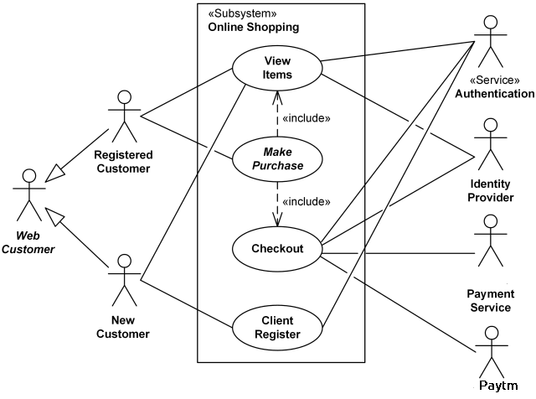
UML diagram

Slide 10
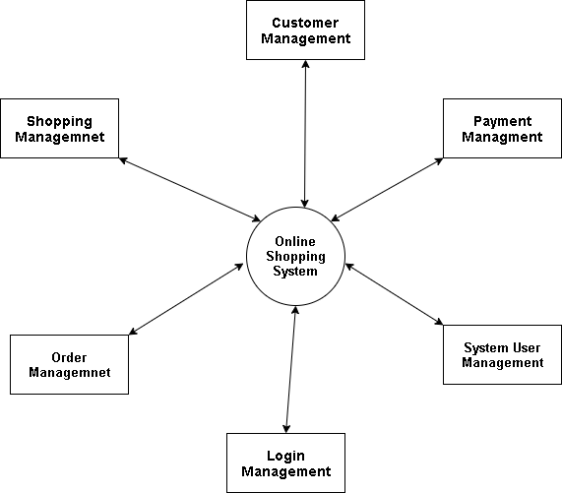
DFD

Slide 11
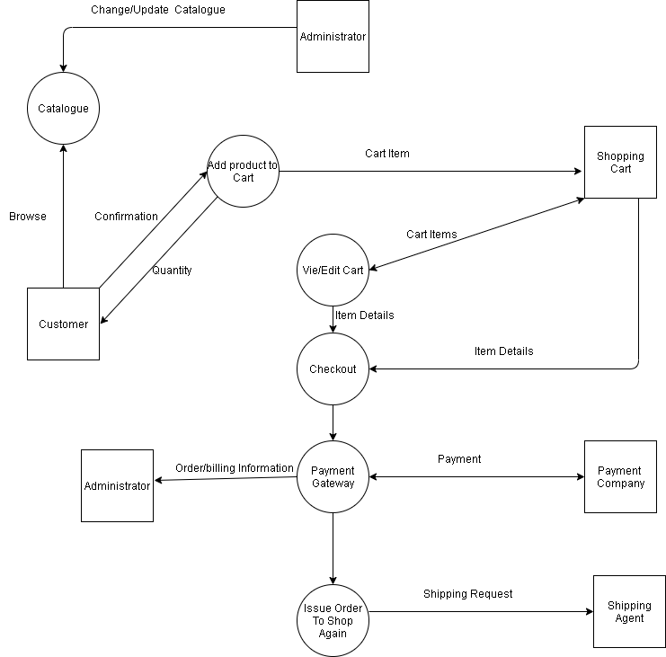

Slide 12
Technology used: Django
Django comes with the following design philosophies −
Loosely Coupled − Django aims to make each element of its stack independent of the others.
Less Coding − Less code so in turn a quick development.
Don't Repeat Yourself (DRY) − Everything should be developed only in exactly one place instead of repeating it again and again.
Fast Development − Django's philosophy is to do all it can to facilitate hyper-fast development.
Clean Design − Django strictly maintains a clean design throughout its own code and makes it easy to follow best web-development practices.

Slide 13
Advantages of Django
Object-Relational Mapping (ORM) Support − Django provides a bridge between the data model and the database engine, and supports a large set of database systems including MySQL, Oracle, Postgres, etc. Django also supports NoSQL database through Django-nonrel fork. For now, the only NoSQL databases supported are MongoDB and google app engine.
Multilingual Support − Django supports multilingual websites through its built-in internationalization system. So you can develop your website, which would support multiple languages.
Framework Support − Django has built-in support for Ajax, RSS, Caching and various other frameworks.
Administration GUI − Django provides a nice ready-to-use user interface for administrative activities.
Development Environment − Django comes with a lightweight web server to facilitate end-to-end application development and testing.

Slide 14
Technology used: HTML && CSS
What is HTML?
HTML stands for Hyper Text Markup Language
HTML is the standard markup language for creating Web pages
HTML describes the structure of a Web page
HTML consists of a series of elements
HTML elements tell the browser how to display the content
HTML elements label pieces of content such as "this is a heading", "this is a paragraph", "this is a link", etc.
What is CSS?
CSS stands for Cascading Style Sheets
CSS describes how HTML elements are to be displayed on screen, paper, or in other media
CSS saves a lot of work. It can control the layout of multiple web pages all at once
External stylesheets are stored in CSS files

Slide 15
conclusion
It is an user friendly application and promotes user to purchase and shop faster.
With new technology comes better ways of doing things.
Being able to buy anytime anywhere.
Allows to place order before purchasing.
Home delivery you don’t have to travel to shop.
Widespread effects on economy and e-commerce.
We also added a donation feature

Slide 16
Thanks!
Submitted by :
Neeraj Chandwani (20BCS2434)
Hardik Dhamija (20BCS2446)
Abharan Singh (20BCS2438)
Harjeet Singh Thakral (20BCS2451)
Vaasav Bhadwal (20BCS2534)

