Slide 1
Playing Flappy bird with deep neural network
Team 5

Slide 2
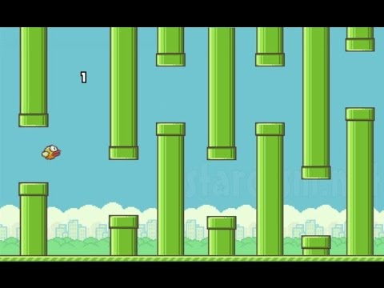
Introduction
Our problem was to train the flappy bird and after training use the weights corresponding to parameter to run the flappy bird game.

Slide 3
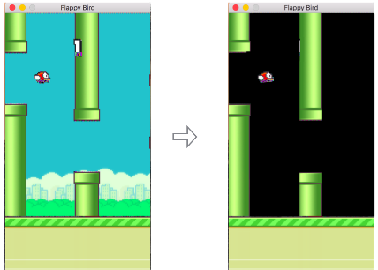
Environment
Since deep Q-network is trained on the raw pixel values observed from the game screen at each time step,the background appeared in the original game is removed so that it converges faster.

Slide 4
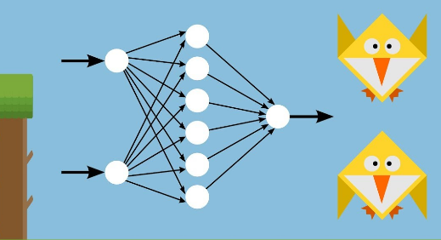
Model Formulation
Actions : Flap or do nothing.
Current frame: (xt).
Rewards : rewardPass,rewardDie.
Discount factor-γ

Slide 5
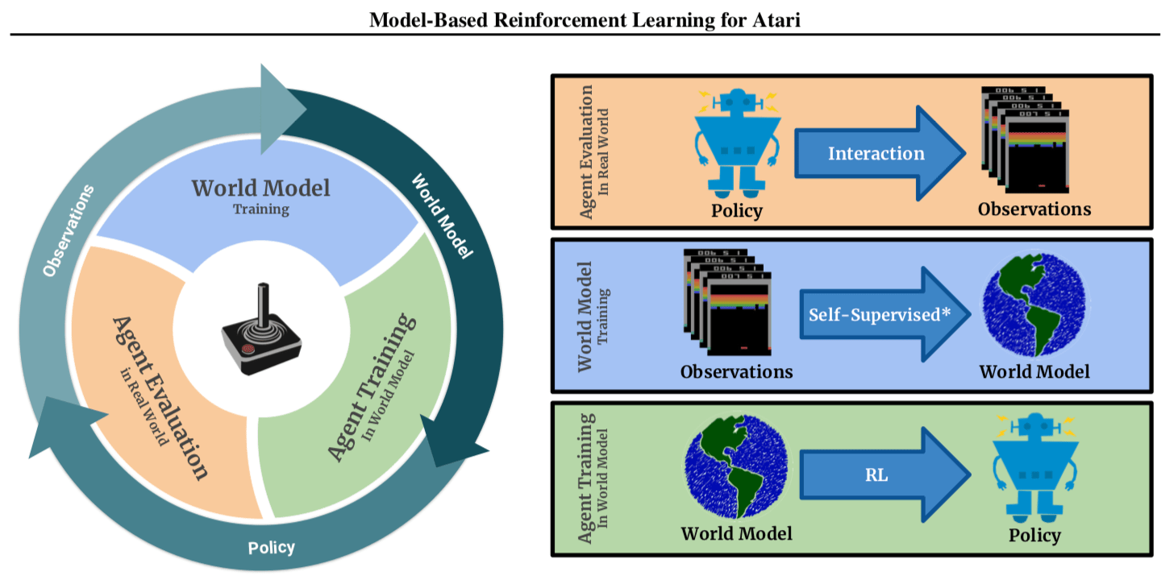

Slide 6
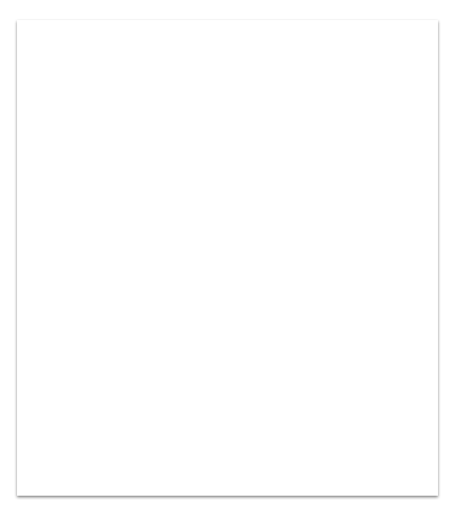
1. Techniques used
Machine learning algorithms can roughly be divided into two parts
Traditional learning algorithms Usually have much fewer learnable parameters and much less learning capacity.
Deep learning algorithms The central algorithm in deep learning is the deep neural network

Slide 7
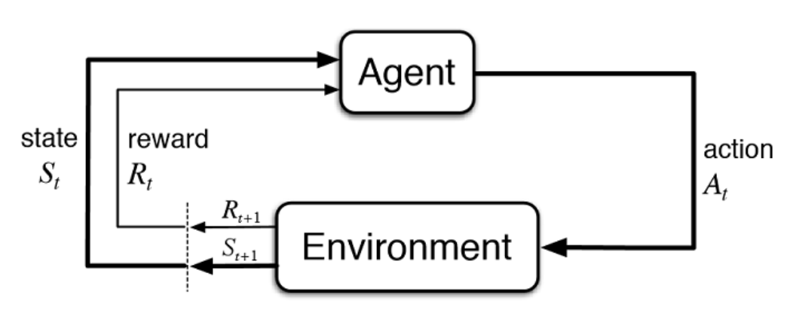
Reinforcement Learning in a nutshell

Slide 8
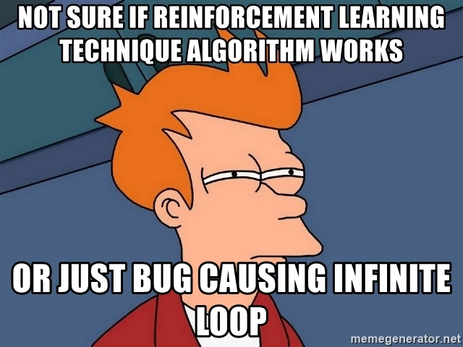

Slide 9
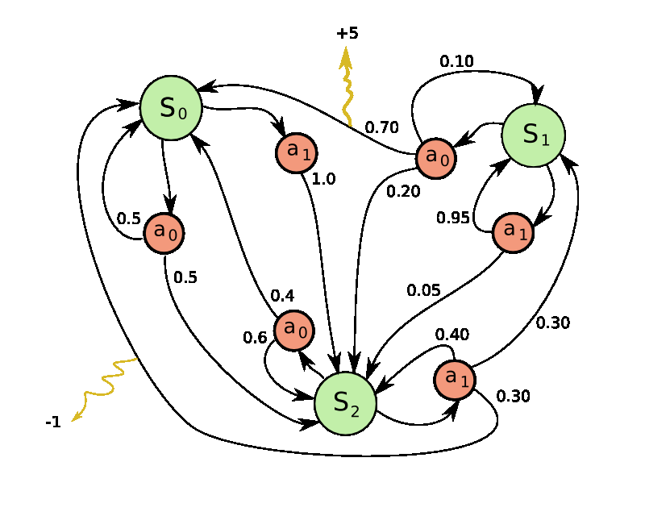
Markov Decision Process

Slide 10
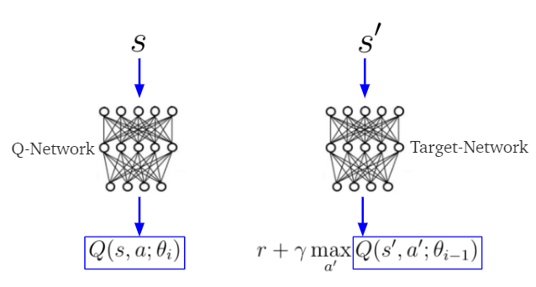
Bellman Equation
Q-function-To Represent quality of a certain action in a given state.
PI(s)=argmax_aQ(s,a)

Slide 11
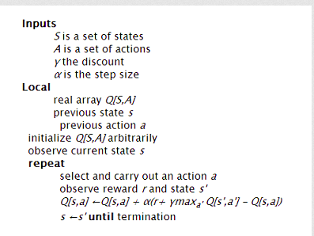
Description of Q-Learning

Slide 12
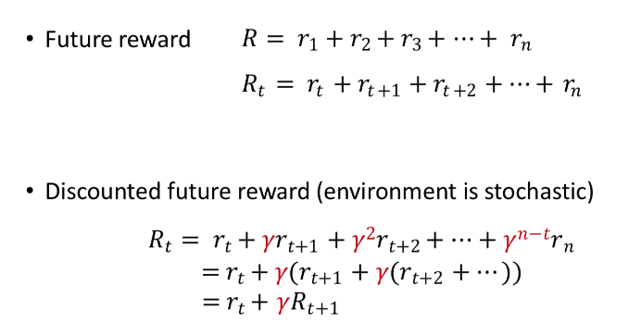

Slide 13
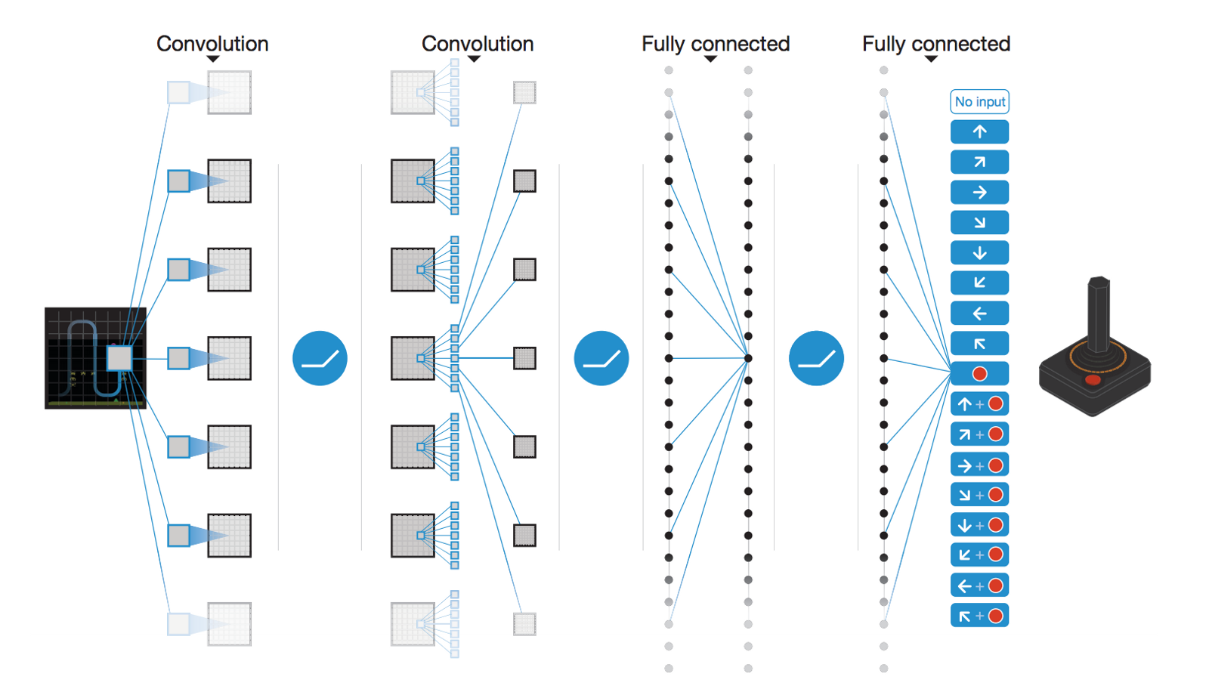

Slide 14
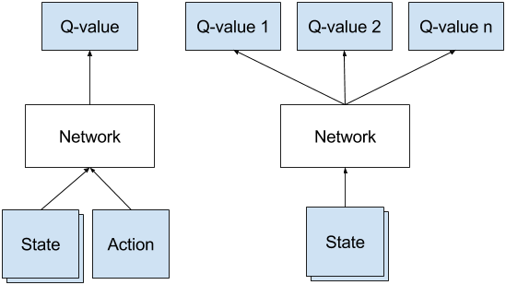
Deep Q-Network
It is a convolutional neural network trained with a variant of Q-learning ,whose input is raw pixels and whose outputs is a value function estimating future rewards

Slide 15
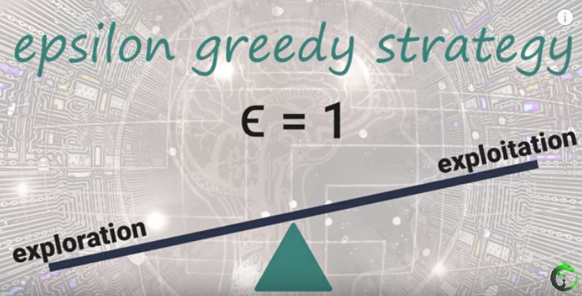
Exploration-Exploitation Tradeoff

Slide 16
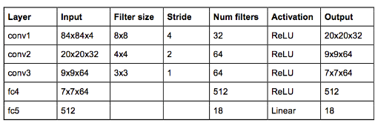
Architecture

Slide 17
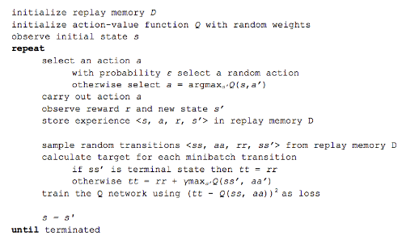
Deep Q Learning Algorithm

Slide 18

Stability
To encourage more stability in decreasing the loss function, we use a target network Q’(s,a).
Q’(s,a) is essentially the the same as Q(s,a).
The network has the same structure, but the parameters may be different.
At every C updates to the DQN Q(s,a), we update Q’(s,a). This Q’(s,a) is then used for computing the target yi.

Slide 19
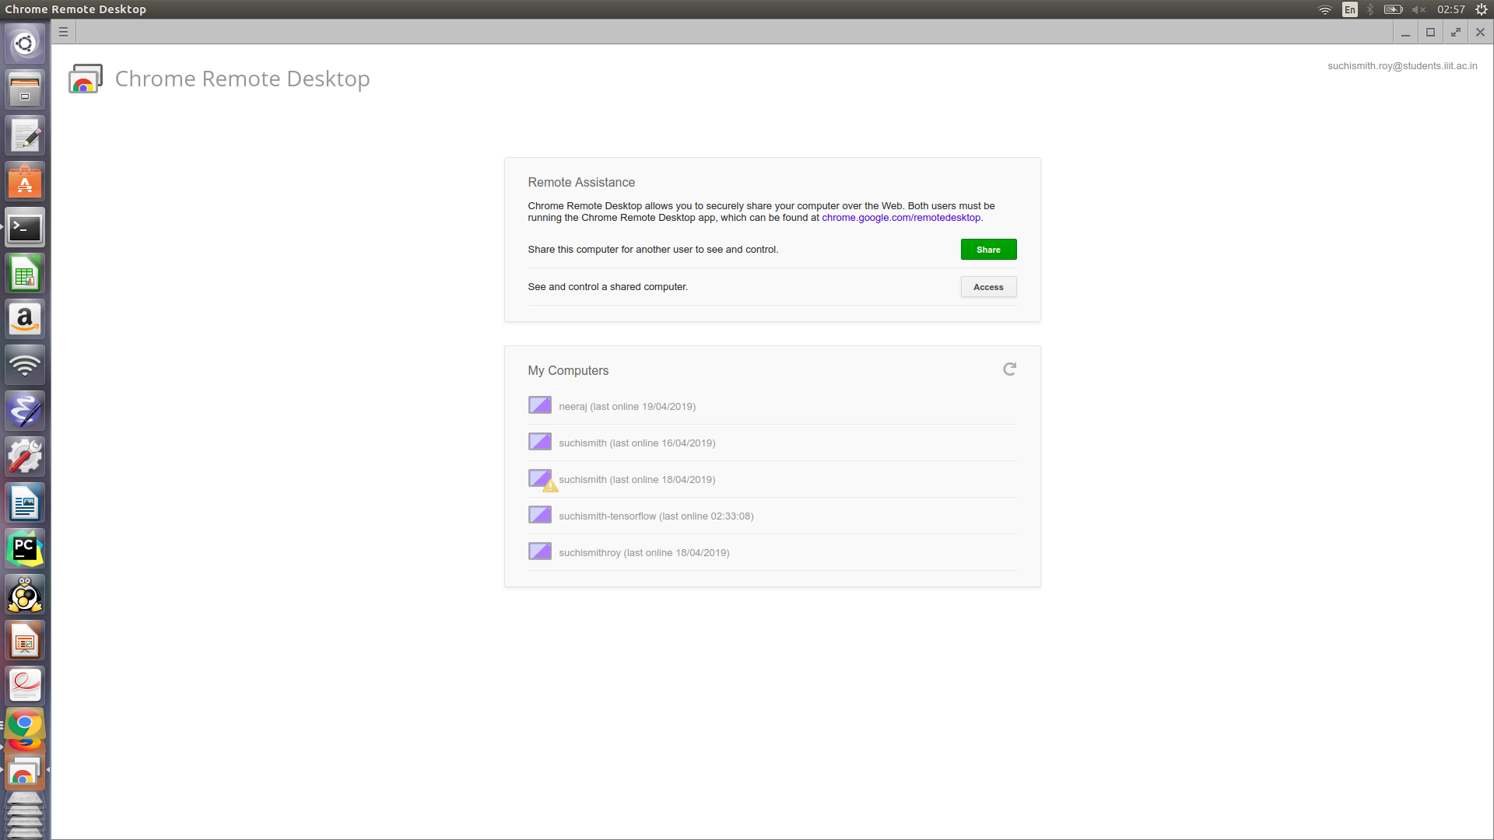
Challenges

Slide 20
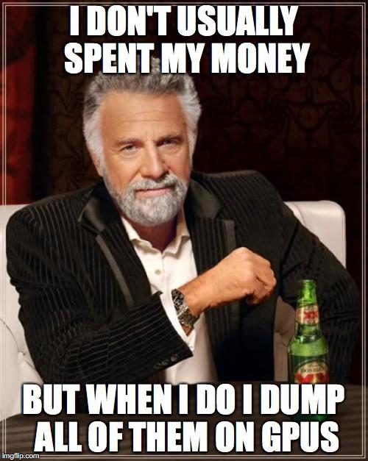

Slide 21

Thank You!!

