Slide 1
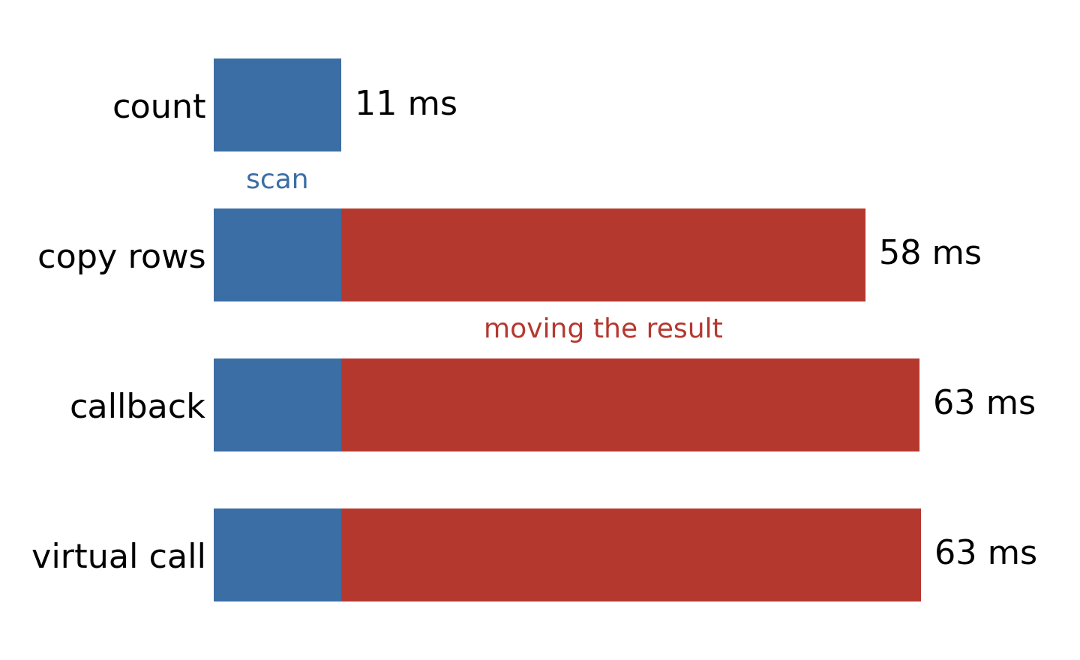
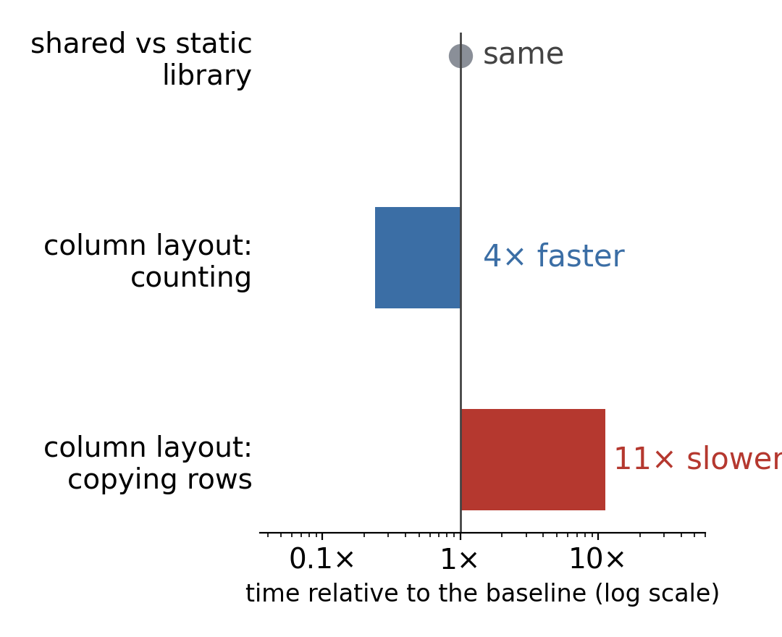
Counting 25 million readings: 11 ms.
Copying them out: 58 ms.
Same search, same 25.3 million matches. Only how the answer is returned changes.
Compared with the baseline: shared vs static library, column vs row layout.

