Slide 1



DATA ANALYSIS INTERNSHIP PROJECT
Team NARUTO Team lead : K JENNIFER, 20126
SR SRUJANA, 20165
G Neeraja, 20123
Supervisor Name : A ZAHEER SHA Trainers Name: A JAYANTH, SHAIK RAFEEQ AHAMED

Slide 2
About the Internship
INTERNCALL
• Duration: 2 Months
• Role: Data Analyst Intern • Tools Used: Pandas and Matplotlib

Slide 3

Problem Statement
College Fee Collection Performance Analysis

Slide 4
Dataset Information
Student_ID | StudentName | Department | Year | Semester | Total Fee | Amount Paid | Payment Date | Scholarship Amount
1 | Kavya | Bcom | 3rd | 5th | 20000 | 15000 | 16-08-2025 | 2000
2 | Srujana | Bcom | 3rd | 5th | 20000 | 15000 | 12-08-2025 | 2000
3 | Neeraja | Bcom | 3rd | 5th | 20000 | 15000 | 14-08-2025 | 2000
4 | Husna | Bcom | 3rd | 5th | 20000 | 10000 | 23-09-2025 | 1500
5 | Jennifer | Bcom | 3rd | 5th | 20000 | 10000 | 10-09-2025 | 1500
6 | Zeba | Bcom | 3rd | 5th | 20000 | 10000 | 20-09-2025 | 1500
7 | Vennela | Bcom | 3rd | 5th | 20000 | 15000 | 13-10-2025 | 3000
8 | Keerthana | Bcom | 3rd | 5th | 20000 | 15000 | 22-10-2025 | 3000
9 | Lakshmi | Bcom | 3rd | 5th | 20000 | 10000 | 16-10-2025 | 3000
10 | Radhika | Bcom | 3rd | 5th | 20000 | 10000 | 18-10-2025 | 3000

Slide 5
Tools & Technologies Used
Pandas
Matplotlib
Python
Google Colab

Slide 6
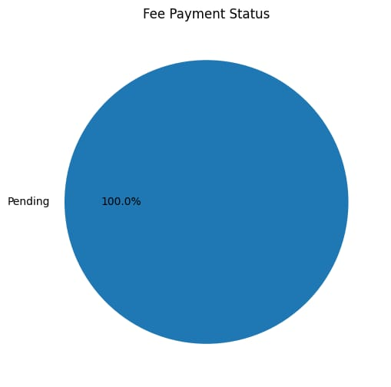
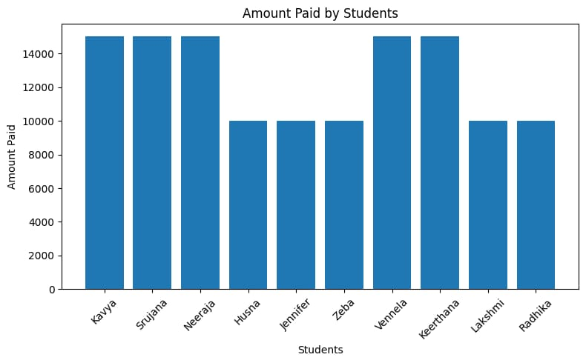
Code
plt.figure(figsize=(8,5))plt.bar(df["StudentName"], df["Amount Paid"])plt.xticks(rotation=45)plt.title("Amount Paid by Students")plt.xlabel("Students")plt.ylabel("Amount Paid")plt.tight_layout()plt.show()
plt.figure(figsize=(8,5))
plt.hist(df["Pending_Amount"])
plt.title("Pending Amount Distribution")
plt.xlabel("Pending Amount")plt.ylabel("Number of Students")plt.show()

Slide 7
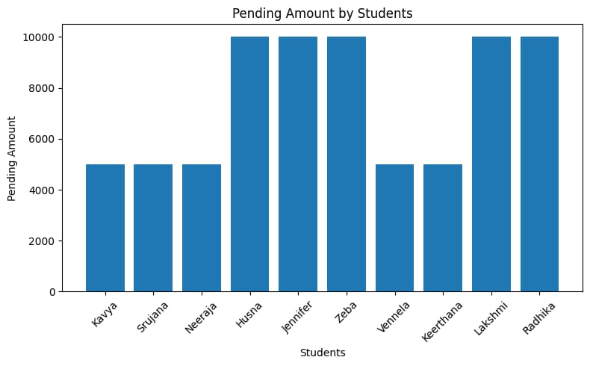
Code
plt.figure(figsize=(8,5))
plt.bar(df["StudentName"], df["Pending_Amount"])
plt.xticks(rotation=45)
plt.title("Pending Amount by Students")
plt.xlabel("Students")plt.ylabel("Pending Amount")
plt.tight_layout()plt.show()

Slide 8
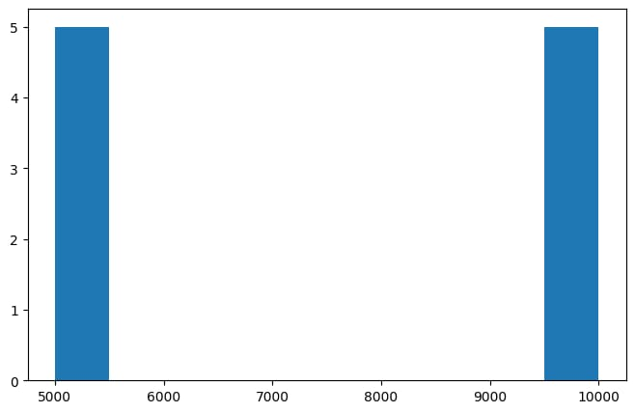
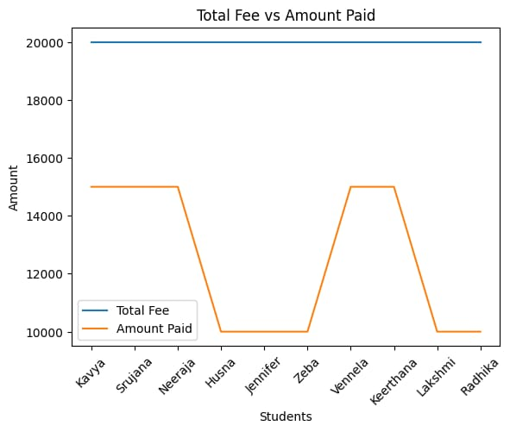
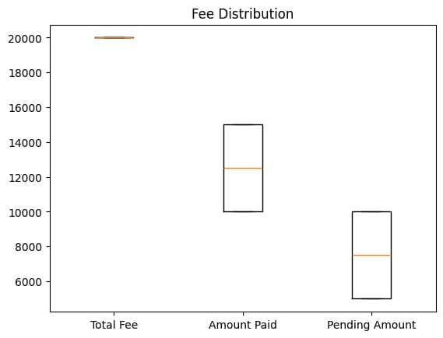
outputs

Slide 9
CHALLENGES FACED
Handling missing or incomplete student fee data
Ensuring the CSV file loads correctly in different environments
Managing file loading issues
Difficulty in cleaning the datase

Slide 10
CONCLUSION
This project successfully analyzed college fee data to identify paid and pending students. Using Python and data visualization ,the fee collection status become clear and easy to understand. The orject helps improve financial tracking and decision making for the institution

Slide 11
Future Improvements
Add automatic data validation and reduce errors
Handling very large datasets efficiently
Connect directly to a live database instead of CSV
Include student wise payment history

Slide 12
Thank You
Questions?

