Slide 1
Lead Scoring Case Study
Problem Statement:
For an education company, we need to identify the most promising leads, i.e. the leads that are most likely to convert into paying customers. We need to build a logistic regression model and assign a lead score to each of the leads such that the customers with higher lead score have a higher conversion chance and the customers with lower lead score have a lower conversion chance. This model will help the sales team to focus on the hot leads.

Slide 2
Steps followed for Analysis
1. Import all necessary libraries and load the data set.
2. Inspect the data frame by getting information about columns in the data set.
3. Prepare the data set by handling missing values and outliers.
4. Map binary variables to 0 and 1. Create dummy variables using one-hot encoding for categorical variables.
5. Split the data set into train and test set.
6. Apply feature scaling using MinMax scaling.
7. Check correlation matrix and remove highly correlated variables.
8. Using RFE feature selection, build the first training model and iterate model building till all variables with high p-value(>0.05) and high VIF(>5) are removed.

Slide 3
9. Find the optimal cut-off and calculate lead score for the train set.
10. Calculate metrics like accuracy score, sensitivity, specificity, precision, recall, positive predictive rate, negative predictive rate, false positive rate for the training set.
11. If all the metrics are good, apply the predictions on test set and calculate the metrics for test set.
12. If all the metrics on both train and test set are good, the model built is considered as a good model.

Slide 4
Brief description of various steps
Import Libraries and Load data set
All the needed libraries like pandas, numpy, matplotlib, seaborn, statsmodels, sklearn are imported.
The data is loaded from a csv file to a data frame.
2. Inspect the data frame
Check the shape of the data set.
Get information about all the variables.
Check for summary statistics of all numerical variables.
3. Data Preparation
Replace all occurrences of “Select” value to None.
Handle missing values in all the columns.
Handle outliers in all numerical columns.
Map binary variables to 0 and 1.
Apply one hot encoding for categorical variables.

Slide 5
4. Train Test Split
The data frame is divided into train and test set in the ratio 70:30.
The independent variables are added to X and the dependent variable is added to y.
The model is built using train set and the model is evaluated using the test set.
5. Feature Scaling
All numerical variables are brought to a common scale using StandardScaler/MinMaxScaler.
The correlation among the independent variables are checked and variables with high correlation are removed.
6. Model building
Using features selected by RFE, the initial model is built.
The p-value and VIF of all variables are inspected.
Variables having high p-value(>0.05) and high VIF(>5) are removed one by one and the model building is done iteratively till all variables with high p-value and high VIF are removed from the model.
7. Selecting Optimal cut-off using train set
Optimal cutoff probability is that probability where we get balanced sensitivity and specificity.
Sensitivity, Specificity, accuracy metrics are calculated for all cut-off values from 0 to 0.9 and the optimal cut-off is chosen where all the three curves meet.
Using the optimal cut-off, lead score is calculated for each data in the train data set.
Leads having conversion probability > optimal cut-off are predicted as 1 else it is predicted as 0.
Based on the predictions made, various metrics like accuracy score, Sensitivity, Specificity, Precision, Recall are calculated for the train set.

Slide 6
8. Making predictions on test set
Apply scaling on numerical variables in test set.
Apply the model to test data and calculate the lead score and predict the value for Converted variable.
Using the predictions compute the metrics for test data as well.
If all the metric values are good in both train and test set, the model is considered as a good model.

Slide 7
Results of Logistic Regression
The primary variables that are significant in predicting the Converted flag are
Total Time Spent on Website
Lead Origin_Lead Add Form
What is your current occupation_Working Professional
Lead Source_Welingak Website
Last Notable Activity_SMS Sent
Total Visits

Slide 8
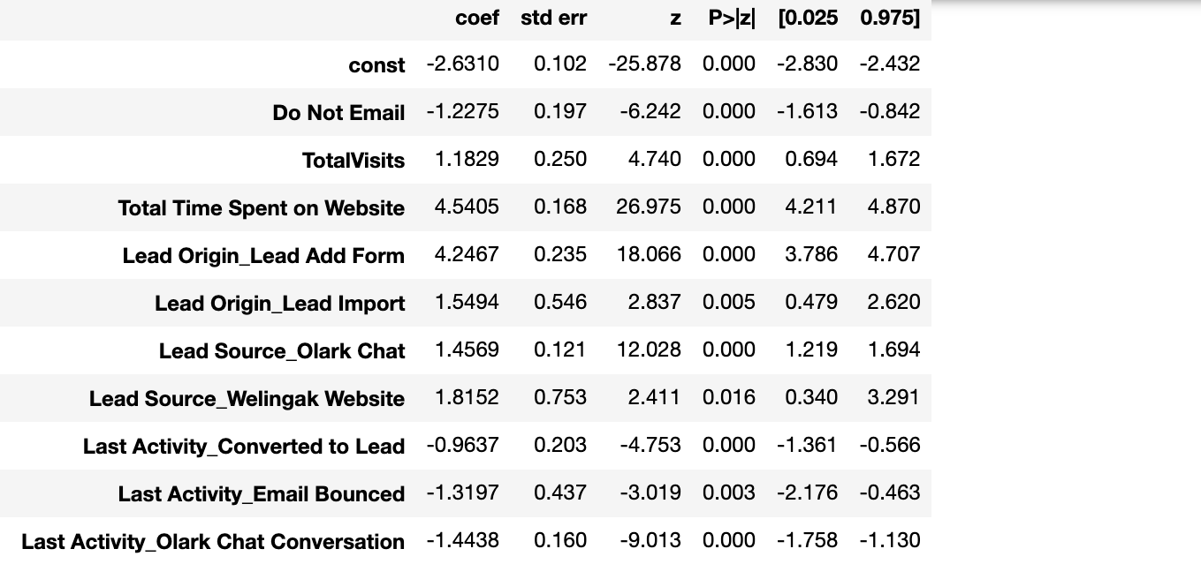
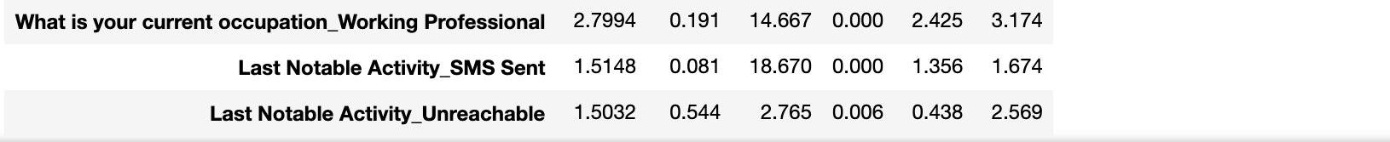

Slide 9
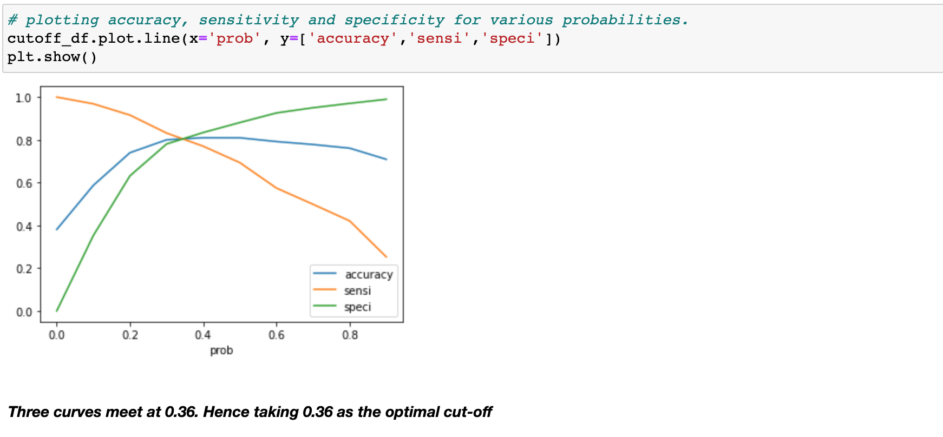
2. The optimal cut-off for the model is 0.36
The accuracy, Specificity and Sensitivity curves meets at 0.36. So the optimal cut-off for the model is 0.36

Slide 10
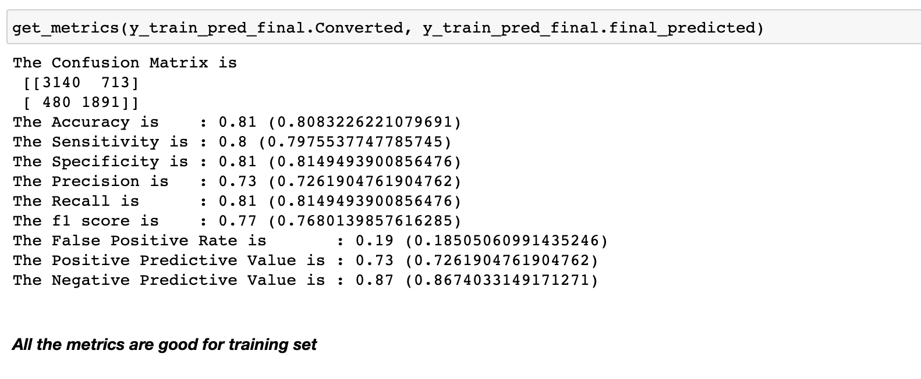
3. The metrics calculated for train set

Slide 11
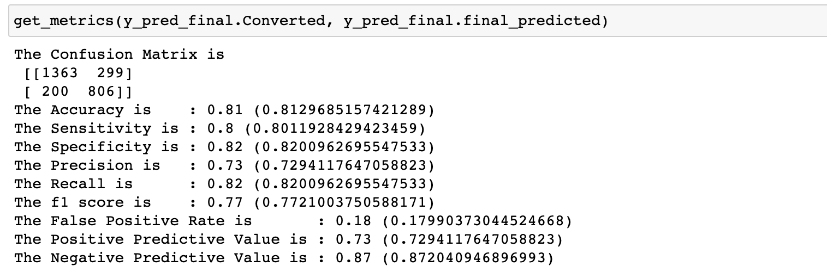
4. The metrics calculated for test set
All the metrics are good for both training and test set. Hence the model is good.

Slide 12
Conclusion
To improve the conversion rate, the sales should focus on leads with high values for below variables
Total Time Spent on Website
Lead Origin_Lead Add Form
What is your current occupation_Working Professional
Lead Source_Welingak Website
Last Notable Activity_SMS Sent
Total Visits

