Slide 1
Introduction to Oracle DB
By Neeraj Sachan

Slide 2
Agenda
Brief Oracle History
File Vs Database
Database Structure
Logical Structure
Physical Structure
Memory Structure
Schema Objects
Database Model
Relational Model
ACID properties
Data Integrity

Slide 3
Oracle History
1979 Oracle Release 2(First Relational DB, SQL based DBMS)
1983 Oracle Release 3(Available to run on mainframes and PC)
1984 Oracle Release 4(Introducing read consistency. Multiversion, Msdos Version)
1985 Oracle Release 5(supported client/server computing and distributed database systems)
1986 enhancement of client/server relational database(scalability, backup and recovery options)
1989 Oracle 6 (First PL/SQL version)
1992 Oracle 7 (introduces PL/SQL procedure & triggers)
1997 Oracle 8 (object relational, support java, many new data types)
1999 Oracle 8i (support Web technologies)
2001 Oracle 9i database server(Database introduced Oracle RAC, enabling multiple instances to access a single database simultaneously. Native XML support to store and query XML.
2003 Oracle 10g (Grid Computing).
2005 Oracle 10g Express Edition ( First Free version)
2007 Oracle 11g (Featured rich version)
2013 Oracle 12c ( Cloud Computation)

Slide 4
Oracle Family
Personal Oracle- for single users. Used to develop systems
Oracle Standard Edition- (Entry level Workgroup server)
Oracle Express edition- simple to install and manage, and is free to develop, deploy, and distribute
Oracle Enterprise edition- Extended functionality
Oracle Lite- (Oracle mobile) single users using wireless devices.

Slide 5
Some Developer Tools
Oracle Forms Developer
Oracle Reports Developer
Oracle Jdeveloper
Oracle Designer

Slide 6
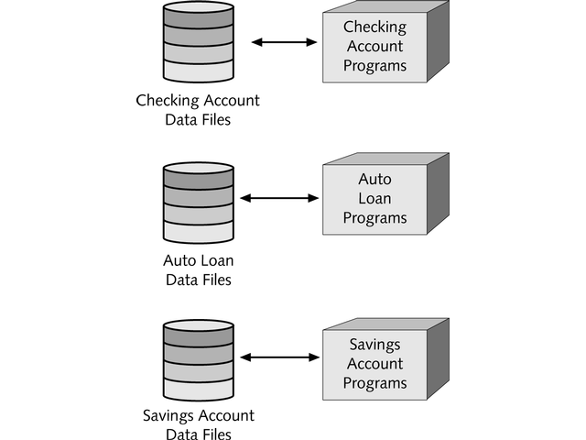
File Processing

Slide 7
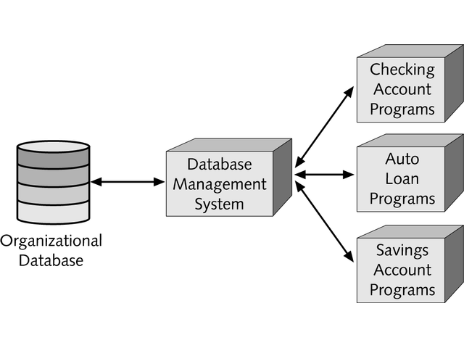
Database
Processing

Slide 8
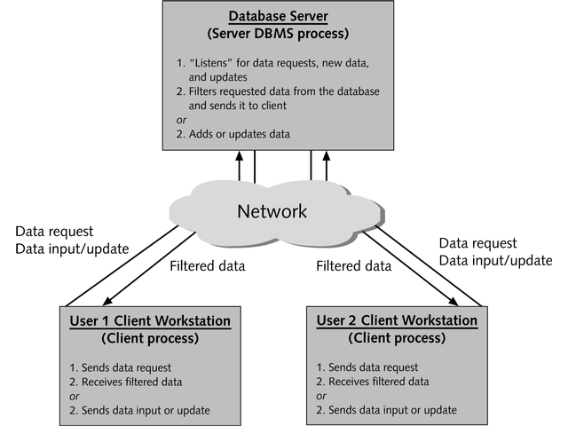

Slide 9
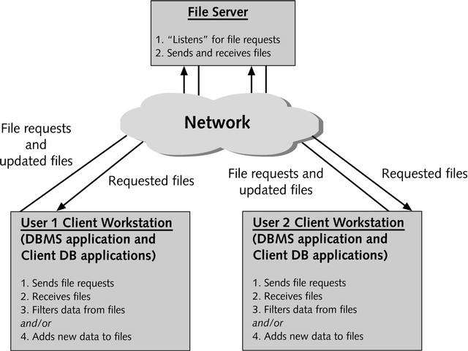

Slide 10
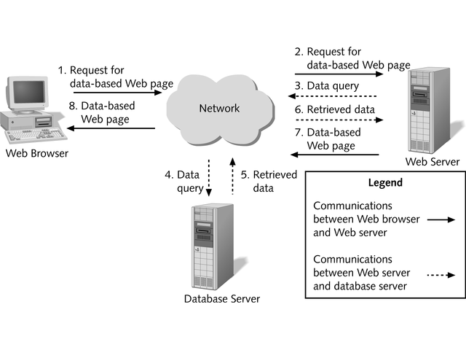

Slide 11
Database Structure
Logical structure - maps the data to the Physical structure.
Physical structure -part of the operating system’s file structure.
Memory structure - where all the processing takes place.

Slide 12
The Logical structures
control how the data must be stored in the database.
five Logical structures:
  tablespaces
  segments
  extents
  data blocks
  schema objects

Slide 13
TableSpaces
A database is divided into logical storage units called Tablespaces.
logical construct for arranging different types of data
An Oracle database must have at least a system tablespace.
It is recommended to have different tablespaces for user and system data.

Slide 14
Create Tablespace
CREATE TABLESPACE test
DATAFILE '\oraserv\ORADATA\a.dbf'
SIZE 10M
AUTOEXTEND ON
NEXT 10M MAXSIZE 100M;
CREATE TABLE cust(id int,name varchar2(20))
TABLESPACE test;

Slide 15
Tablespaces
a logical structure
Data1
Data2
Data1_01.dbf
Data2_01.dbf
Data2_02.dbf
The DATA1
Tablespace =
One datafile
The DATA2
Tablespace =
Two datafiles
Notes:
Tablespaces
A database is divided into logical storage units called tablespaces, which group
related logical structures together. For example, tablespaces commonly group all of
an application’s objects to simplify some administrative operations.
 Each database is logically divided into one or more tablespaces.
 One or more datafiles are explicitly created for each tablespace to physically
store the data of all logical structures in a tablespace.
 The combined size of a tablespace’s datafiles is the total storage capacity of the
tablespace (SYSTEM tablespace has 2 MB storage capacity while USERS
tablespace has 4 MB).
 The combined storage capacity of a database’s tablespaces is the total storage
capacity of the database (6 MB).

Slide 16
7 Logical Tablespaces
SYSTEM
DATA
INDEX
USERS
ROLLBACK
TEMP
TOOLS

Slide 17
Schemas and Schema Objects
Collection of database objects
  Tables
  Views
  Sequences
  Synonyms
  Indexes
  Procedures
  Functions
  Packages
  Triggers

Slide 18
Data Blocks
The smallest unit of Input/Output used by Oracle database.
The size of data block for any database is fixed at the time of creation of the database;
Some values of the data block size are 2KB, 8KB, 16KB, and 32KB.
Oracle recommends a size of 8KB

Slide 19
Extents
The next level of data storage.
One extent consists of a specific number of data blocks
One or more extents in turn make up a segment.
When the existing space in a segment is completely used, Oracle allocates a new extent for the segment.

Slide 20
Segment
A segment consists of a set of extents
Each table’s data is stored in its own single segment.
Each index’s data is stored in a single segment.
More extents are automatically allocated by Oracle to a segment if its existing extents become full.
The different types of segments are the data segments, index segments,rollback segments, and temporary segments.

Slide 21
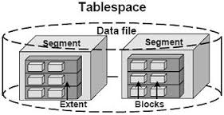
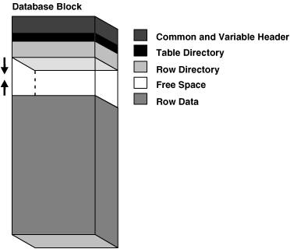
Notes:
Datafiles
Every Oracle database has one or more physical datafiles. A database’s datafiles
contain all the database data. The data of logical database structures such as tables
and indexes is physically stored in the datafiles allocated for a database.
The characteristics of datafiles are:
 A datafile can be associated with only one database.
 Datafiles can have certain characteristics set to allow them to automatically
extend when the database runs out of space.
 One or more datafiles form a logical unit of database storage called a tablespace,
as discussed earlier in this chapter.

Slide 22
Physical structures
Parameter files
Password files
Datafiles
Redo log files
Control files

Slide 23
Physical Database Structure
Password file - which contain the password information for all users.
Parameter file - which contains all the important information necessary to start a database.
Datafiles - which contain the application data being stored, as well as any data necessary to store user-IDs, passwords, and privileges.
Redo log files - which store all the transactions made to the database. These files are also called transaction log files.
Control files - which store information specifying the structure of the database,such as the name and time of creation of the database and the name and location of the datafiles.

Slide 24
Control files
Identify
Identify
Record changes to
Redo Log
Files
Data files
The Physical files that make up a database
Notes:
Datafiles
Every Oracle database has one or more physical datafiles. A database’s datafiles
contain all the database data. The data of logical database structures such as tables
and indexes is physically stored in the datafiles allocated for a database.
The characteristics of datafiles are:
 A datafile can be associated with only one database.
 Datafiles can have certain characteristics set to allow them to automatically
extend when the database runs out of space.
 One or more datafiles form a logical unit of database storage called a tablespace,
as discussed earlier in this chapter.

Slide 25
Control Files
Contain a list of all other files in the database
Key information such as
  Name of the database
  Date created
  Current state
  Backups performed
  Time period covered by redo files
Notes:
Control Files
Every Oracle database has a control file. A control file contains entries that specify
the physical structure of the database. For example, it contains the following types
of information:
 Database name
 Names and locations of datafiles and redo log files
 Time stamp of database creation
Like the redo log, Oracle allows the control file to be multiplexed for protection of
the control file.
The Use of Control Files Every time an instance of an Oracle database is started, its
control file is used to identify the database and redo log files that must be opened
for database operation to proceed. If the physical makeup of the database is altered
(for example, a new datafile or redo log file is created), the control file is
automatically modified by Oracle to reflect the change.

Slide 26
Redo Log Files
Store a recording of changes made to the database as a result of transactions and internal Oracle Activities
When Oracle fills one redo log, it automatically fills a second.
Used for database recovery
Notes:
Redo Log Files
Every Oracle database has a set of two or more redo log files. The set of redo log files
for a database is collectively known as the database’s redo log. A redo log is made up
of redo entries (also called redo records), each of which is a group of change vectors
describing a single atomic change to the database.
The primary function of the redo log is to record all changes made to data. Should a
failure prevent modified data from being permanently written to the datafiles, the
changes can be obtained from the redo log and work is never lost.
Redo log files are critical in protecting a database against failures. To protect against
a failure involving the redo log itself, Oracle allows a multiplexed redo log so that two
or more copies of the redo log can be maintained on different disks.

Slide 27
Memory structures
System Global Area (SGA)
  It is shared area
Program Global Area (PGA)
  It is private area
User Global Area (UGA)
  The UGA is memory associated with a user session
The Oracle database uses these memory areas to store information before they are made permanent in the database.

Slide 28
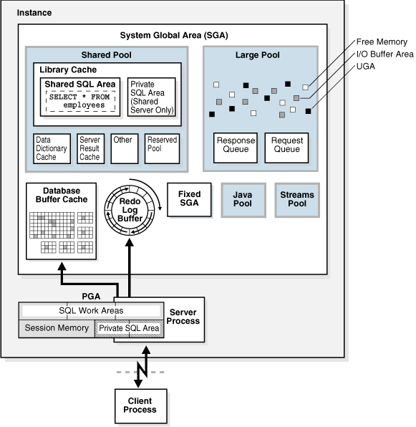
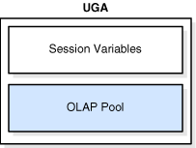
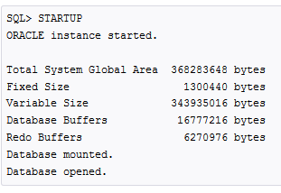
Memory Architecture
Notes:
Tablespaces
A database is divided into logical storage units called tablespaces, which group
related logical structures together. For example, tablespaces commonly group all of
an application’s objects to simplify some administrative operations.
 Each database is logically divided into one or more tablespaces.
 One or more datafiles are explicitly created for each tablespace to physically
store the data of all logical structures in a tablespace.
 The combined size of a tablespace’s datafiles is the total storage capacity of the
tablespace (SYSTEM tablespace has 2 MB storage capacity while USERS
tablespace has 4 MB).
 The combined storage capacity of a database’s tablespaces is the total storage
capacity of the database (6 MB).

Slide 29
Summary
Brief Oracle History
File Vs Database
Database Structure
Logical Structure
Physical Structure
Memory Structure
Schema Objects
Database Model
Relational Model
ACID properties
Data Integrity

Slide 30
Security Mechanisms
Database users and schemas
Privileges
Roles
Storage settings and quotas
Resource limits
Auditing
Notes:
Roles
Oracle provides for easy and controlled privilege management through roles. Roles
are named groups of related privileges that are granted to users or other roles.
A privilege is a right to execute a particular type of SQL statement. Some examples
of privileges include the right to:
Connect to the database (create a session)
Create a table in your schema
Select rows from someone else’s table
Execute someone else’s stored procedure

Slide 31
Data Access: SQL
Data definition language (DDL) statements
Data manipulation language (DML) statements
Transaction control statements
Session control statements
System control statements
Embedded SQL statements

Slide 32
Database Model
It describe how data should be stored, organized and manipulated. The most popular example of a database model is the relational model, which uses a table-based format.
Some common logical data models for databases include:
• Hierarchical database model
• Network model
• Relational model
• Entity–relationship model
• Object model

Slide 33
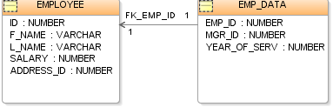
Relational Model
Three key terms are used extensively in relational
database models: relations, attributes, and domains. A relation is a table with columns and rows. The named
columns of the relation are called attributes, and the domain is the set of values the attributes are allowed to take.

Slide 34
ACID Properties
Atomicity
Atomicity requires that each transaction is "all or nothing": if one part of the transaction fails, the entire transaction fails, and the database state is left unchanged.
Consistency
The consistency property ensures that any transaction will bring the database from one valid state to another. No transaction leads system into inconsistent state.
Isolation
Isolation level defines how/when the changes made by one operation become visible to other.
Durability
The durability property ensures that once a transaction has been committed, it will remain so, even in the event of power loss, crashes, or errors.

Slide 35
Transactions
A transaction is a logical unit of work that comprises one or more SQL statement executed by a single user. According to the ANSI/ISO SQL standard, with which Oracle is compatible, a transaction begins with the user’s first executable SQL statement. A transaction ends when it is explicitly committed or rolled back.

Slide 36
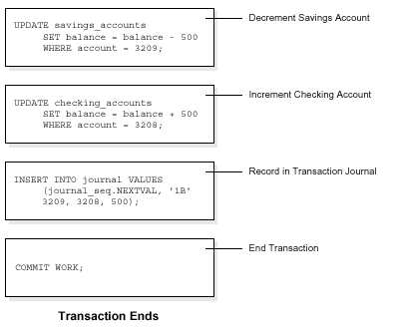
Transaction Example
Notes:
Consider a banking database. When a bank customer transfers money from a
savings account to a checking account, the transaction might consist of three
separate operations: decrease the savings account, increase the checking account,
and record the transaction in the transaction journal.
Oracle must guarantee that all three SQL statements are performed to maintain the
accounts in proper balance. When something prevents one of the statements in the
transaction from executing (such as a hardware failure), the other statements of the
transaction must be undone; this is called rolling back. If an error occurs in making
either of the updates, then neither update is made.

Slide 37
Isolation Levels
In database systems, isolation determines how transaction integrity is visible to other users and systems.
database Isolation level defines how/when the changes made by one operation become visible to other.
Below Isolation levels
Read Committed (Default)
Serializable Transactions
Read-only

Slide 38
Setting of Isolation level
Setting at Transaction Level:
SET TRANSACTION ISOLATION LEVEL READ COMMITTED;
SET TRANSACTION ISOLATION LEVEL SERIALIZABLE;
SET TRANSACTION READ ONLY;
Setting at Session Level:
ALTER SESSION SET ISOLATION_LEVEL READ COMMITTED;
ALTER SESSION SET ISOLATION_LEVEL SERIALIZABLE;
ALTET SESSION SET ISOLATION_LEVEL READ ONLY;

Slide 39
Data Integrity
Certain Conditions, rules or relationship must be followed before/after any modification to data.
Techniques for Guaranteeing Data Integrity.
Triggers
Programming.
Integrity constraints.

Slide 40
Questions?

