Slide 1
Akka Actor

Slide 2
Actor Model
Primitive unit of computation.
Receives message and
Does some computation itself
Creates more actors
Sends messages to other actors
Designates what to do with the next message
Notes:
Designates what to do with the next message -

Slide 3
async
Notes:
Messages are async
Actors process 1 message at a time.

Slide 4
Actor Components
ActorRef
Dispatcher
Mailbox
Actor Instance

Slide 5
ActorRef
Dispatcher
Enqueue
Mailbox
Invoke
Actor Instance
Notes:
The actor blocks the thread to which it is allocated for as long as it takes to process the message. While this doesn’t block the sender of the message, it means that lengthy operations degrade overall performance, as all the other actors have to be scheduled for processing messages on one of the remaining threads.
Hence, a core principle to follow for your Receive partial functions is to spend as little time inside them as possible. Most importantly, avoid calling blocking code inside your message processing code, if possible at all.

Slide 6
Actor System
Heavyweight process
Root on actors structure
Managing shared facilities
Scheduling services
Configuration
Logging

Slide 8
Fault Tolerance and Supervisor Strategies
Actors form hierarchies
Actors need to be created and destroyed
Fault handling is done via supervision hierarchies
Parent actor supervises children actors

Slide 9
Fault Handling
When a failure happens, parent can
Resume child
Restart child
Stop child permanently
Escalate

Slide 10
Supervision Strategies
OneForOne(default)
Parent apply the choice only to one of the children
OneForAll
Parent apply the choice on all children

Slide 11
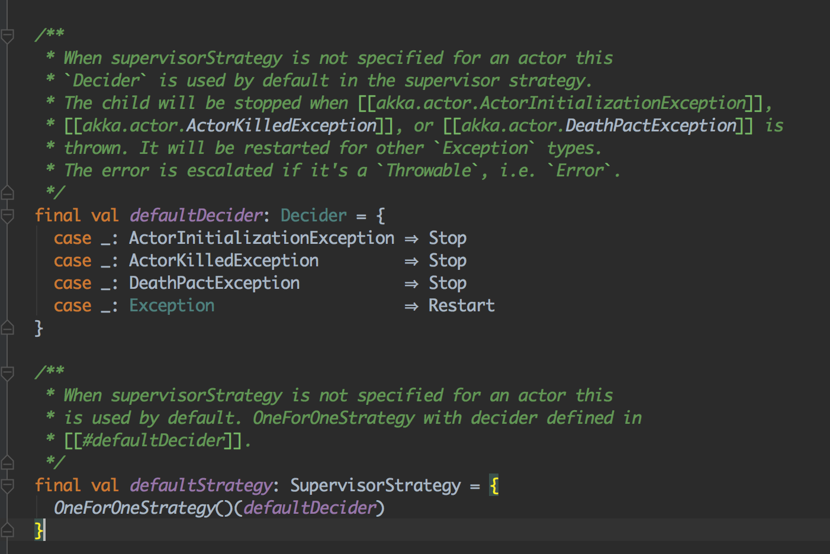
Default strategy

Slide 12
Akka Actor Routing
Route messages among multiple instances of an actor
Types
Round-robin
Random
Balancing pool
Smallest mailbox
Broadcast
Scatter-gather first completed router
Tail chopping
Consistent hashing

Slide 13
Best Practices
Don’t use actors for concurrency. Use actor for shared state
(https://www.chrisstucchio.com/blog/2013/actors_vs_futures.html)
Never block
Communicate only via messages
Messages should be immutable
Keep important state as far at the top of the actor hierarchy as possible, while pushing error-prone tasks as far to the bottom of the hierarchy as possible
(http://danielwestheide.com/blog/2013/03/20/the-neophytes-guide-to-scala-part-15-dealing-with-failure-in-actor-systems.html)

Slide 14
Reference
https://www.toptal.com/scala/concurrency-and-fault-tolerance-made-easy-an-intro-to-akka
https://medium.com/akka-for-newbies/actor-lifecycle-94b05bd2f600
https://doc.akka.io/docs/akka/2.5/general/actor-systems.html
https://github.com/akka/akka/blob/master/akka-actor/src/main/resources/reference.conf
https://www.safaribooksonline.com/library/view/learning-path-akka/9781788396271/

