Slide 1
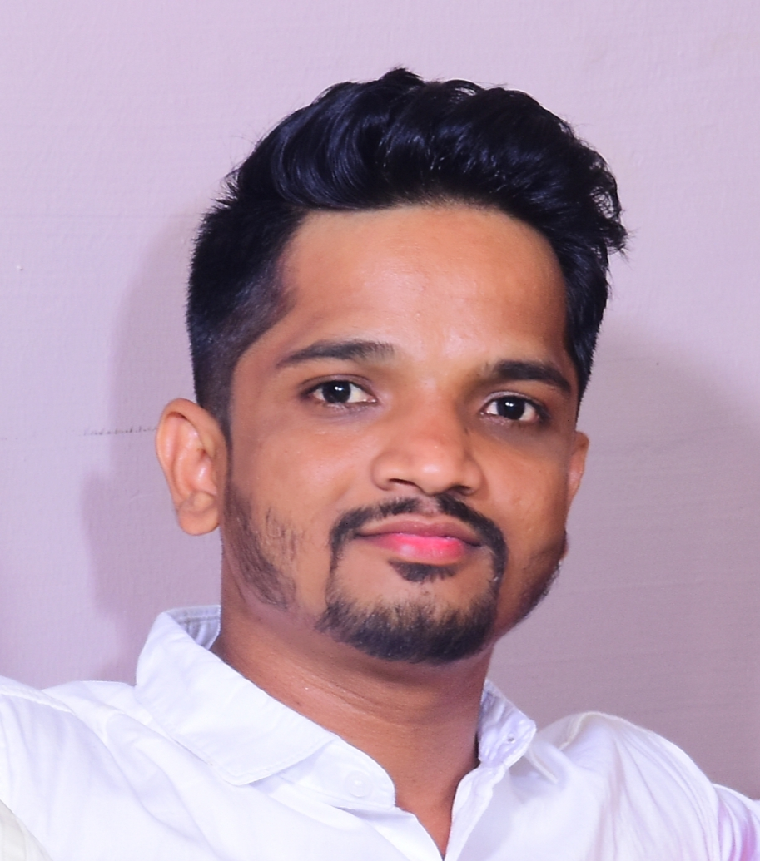
About
Proactive Security Professional with 4.5+ years of experience in Security Monitoring, Incident response, Threats hunting , Threat Intelligence, Email Security, Endpoint Security and Network security.
Experience
Security Analyst | Dec 2021 - Present
Akamai Technologies India Pvt Ltd , Bangalore
Security Analyst | July 2018 - Nov 2021
Robert Bosch Engineering and Business Solutions Private Limited, Bangalore
Skills/Technologies
Splunk SIEM, EDR, IDS, Firewall, OTRS, OSINT, Malware analysis/PEStudio, Wireshark, MITRE framework, Cyber Kill Chain, OWASP Top 10.
Krishna Badiger
Security Analyst at Akamai Technologies

