Slide 1
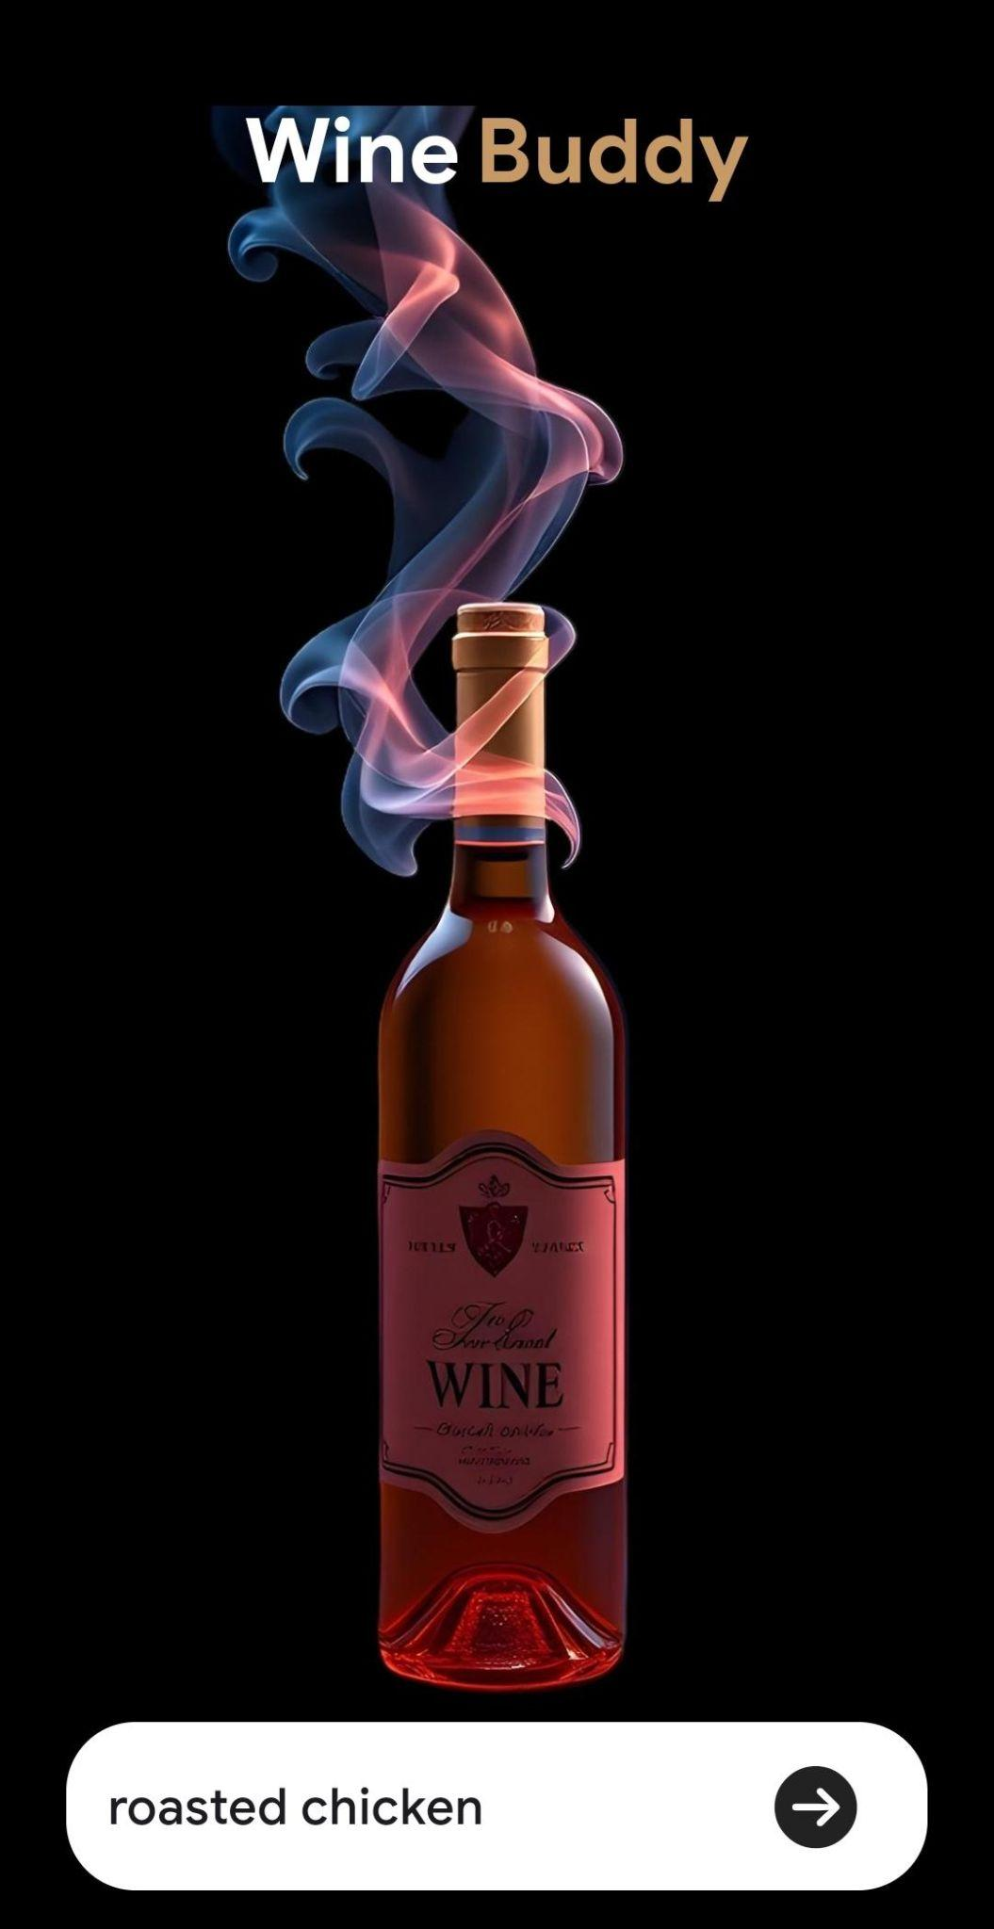
WineBuddy
Taste the story, Share the Craft.

Slide 2
Challenges
Solution
Direct Marketing
Difficulty in Promotion
Finding perfect wine to match meals
Users are overwhelmed by a vast selection
Wine recommendation based on recipes
Virtual Wine Tasting Experience

Slide 3
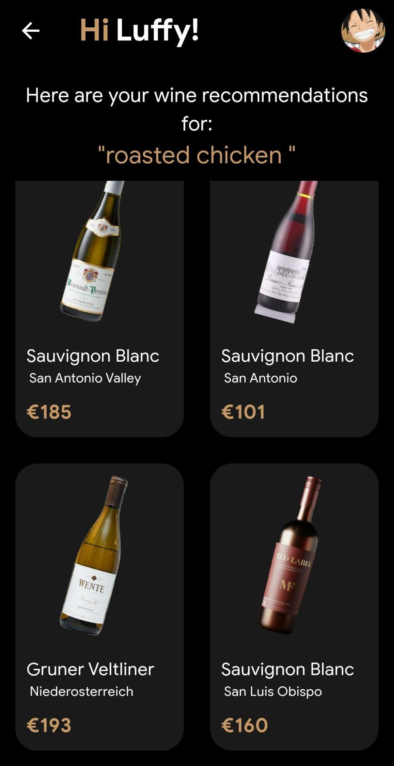
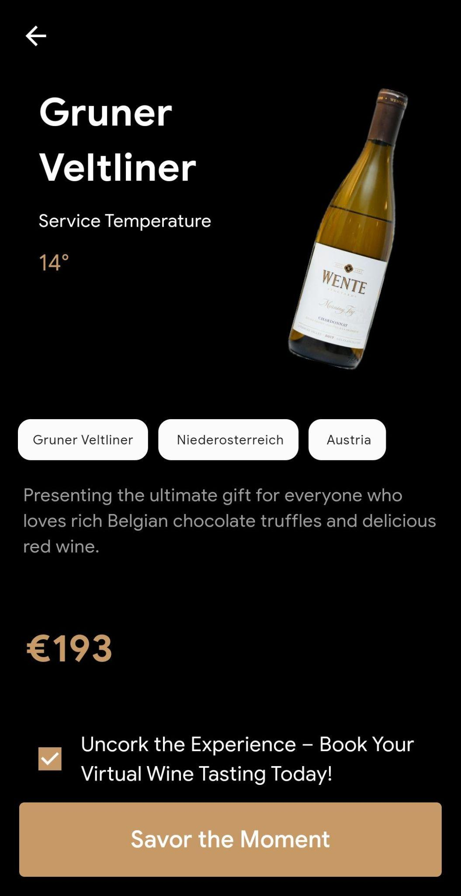
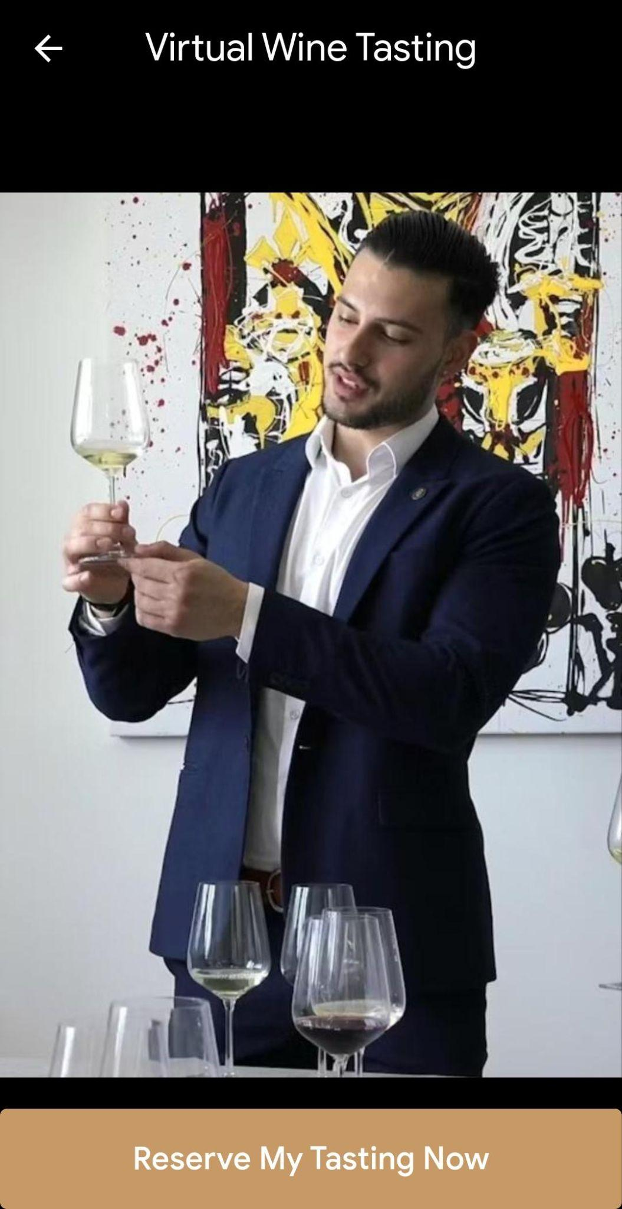
WineBuddy

Slide 4
Wine Recommendation Workflow
Wine Reviews
Food Reviews
Wine Aromatic Profile
NLP Model(Word2Vec)
Trained Model

Slide 5
Implementation
Chatbot
User inputs data
Wine recommendation
Trained Model
Buy + Book Appointment
Virtual Wine Tasting

Slide 6
Future Roadmap
Marketing/Revenue
Expand database for recipes and wines
Predictive Analysis based on users evolving taste preferences
Understand market dynamics for effective wine marketing strategies.
Social Media Marketing
Wine makers story telling
x% Commission per order value

