Slide 1
Bapatla Engineering College
Plant Leaf Disease Classification and
Detection using ResNet9 and ResNet50
Presented By:
Guide:
V. Neeraj(Y20ACS520)
M. Yaswanth(Y20ACS505)
M. Subhash(Y20ACS497)
N. Hemadri(Y20ACS521)
Mr.K.Suman
Asst.prof
Dept. of CSE

Slide 2
Agenda
Abstract
Existing System
Proposed System
Desing
Implementation
Results
Conclusion

Slide 3
Abstract
In agriculture automatic plant disease detection is essential one in monitoring large fields of crops, and thus automatically detect symptoms of disease as soon as they appear on plant leaves. For this approach, Deep Learning Models will be used for classification based on learning with some training samples. Finally the simulated result shows that used network classifier provides minimum error during training and better accuracy in classification

Slide 4
Existing system
Existing Model used basic CNN for plant leaf identification
In existing model they got the accuracy of 95%
It uses less variety of plants for training

Slide 5
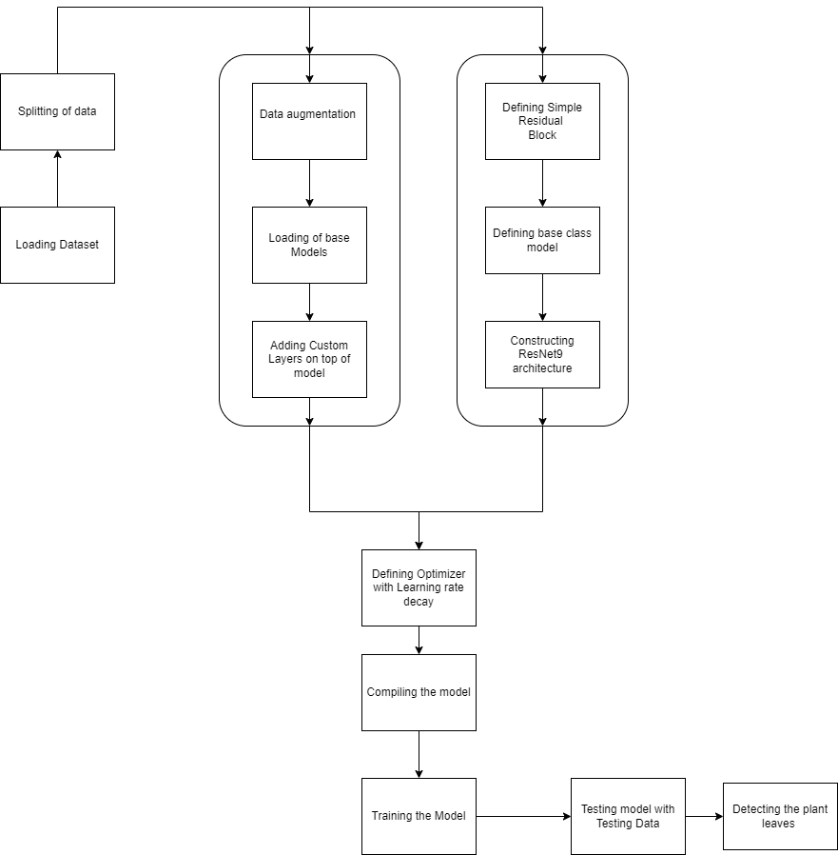
Proposed System
Our project is mainly divided into two parts in which Resnet50 is used for detection and
Resnet9 for classification

Slide 6
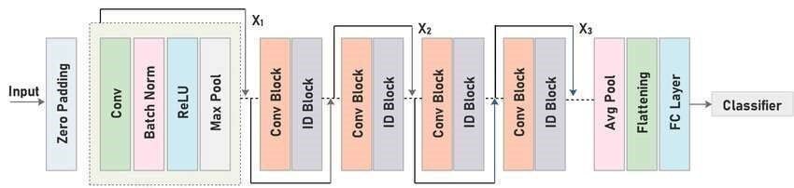
Design : ResNet50
ResNet50V2 is a deep learning model based on the ResNet architecture that uses residual connections to improve gradient flow and avoid the vanishing gradient problem. ResNet50V2 is a variant of ResNet50 with some changes, such as using pre-activation instead of post-activation and using step 2 in the first 3x3 convolution of each block instead of the first 1x1 convolution.It is used Detection in our code

Slide 7
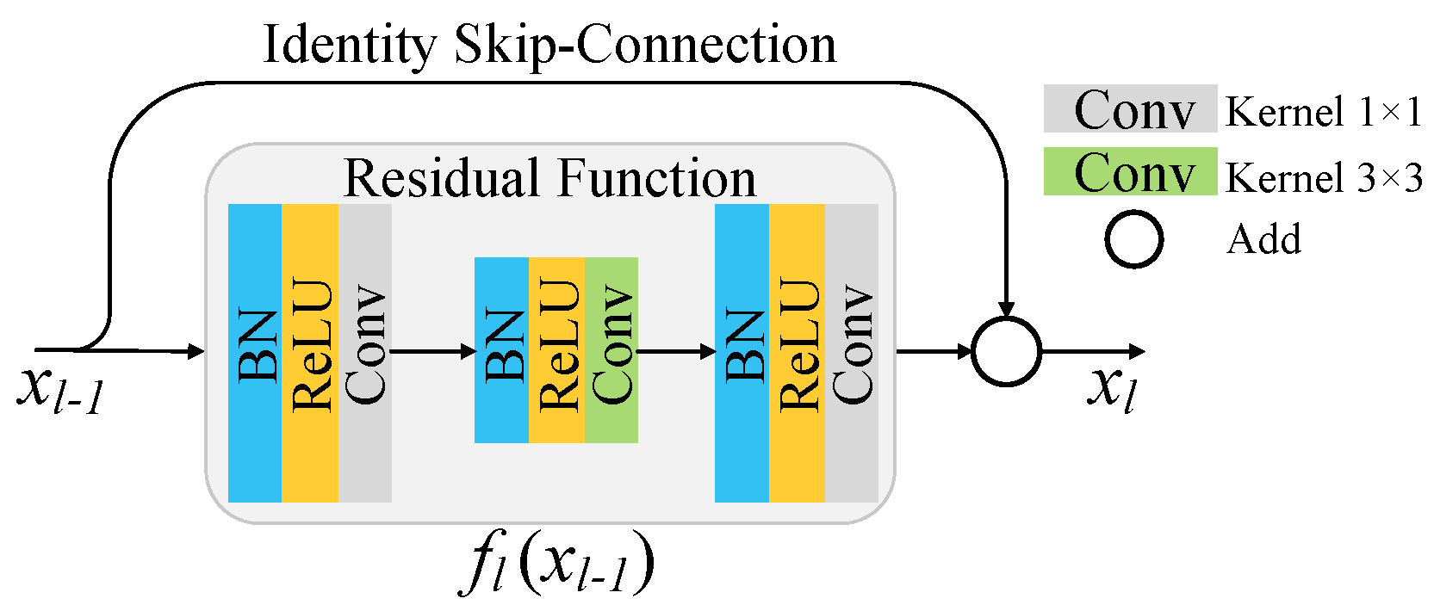
ResNet9
ResNet9 is a variant of the popular ResNet (Residual Network) architecture, designed to balance performance and computational efficiency. It consists of nine convolutional layers, including convolutional, batch normalization, and ReLU activation layers. Unlike deeper versions of ResNet, ResNet9 aims to reduce computational complexity

Slide 8
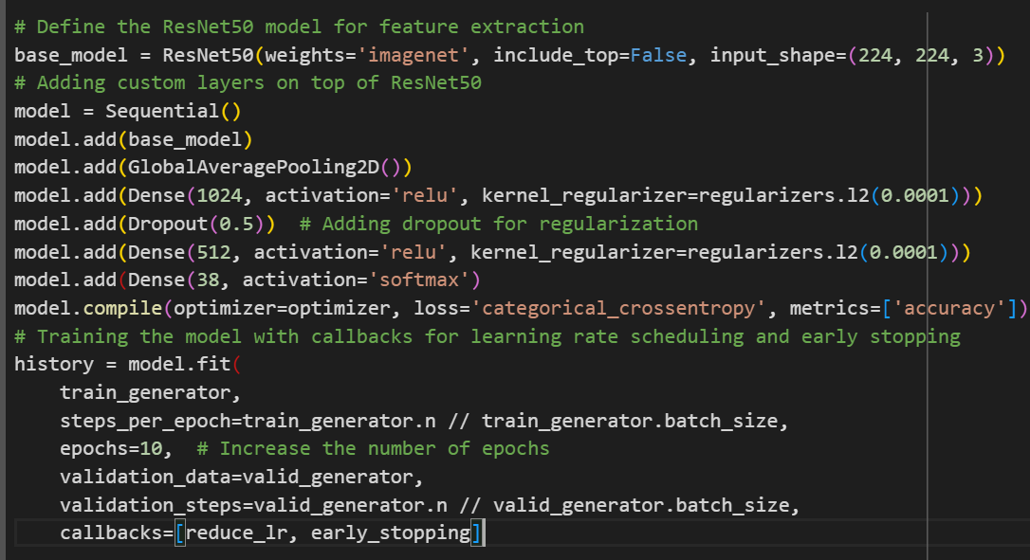
ResNet50 Implementation

Slide 9
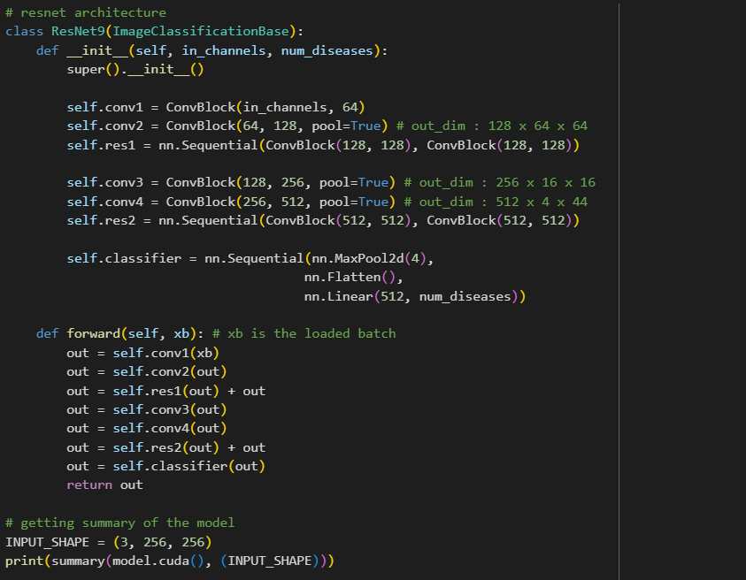
ResNet9 Implementation

Slide 10
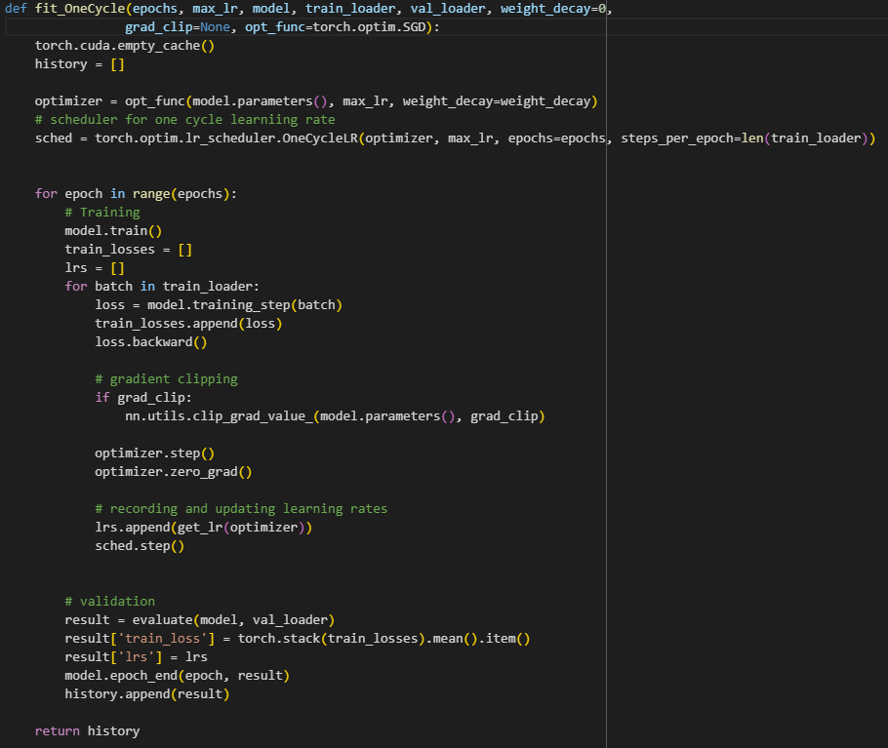
Cont..

Slide 11
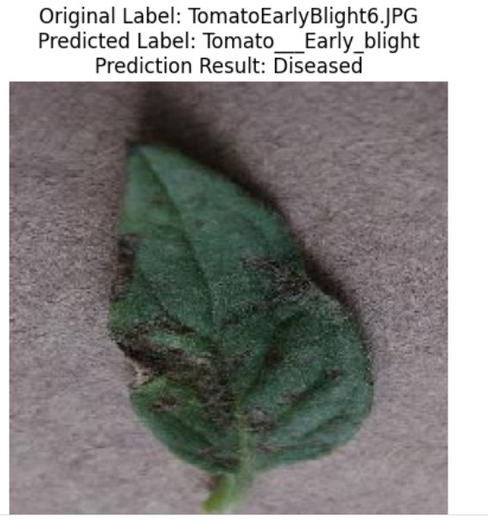
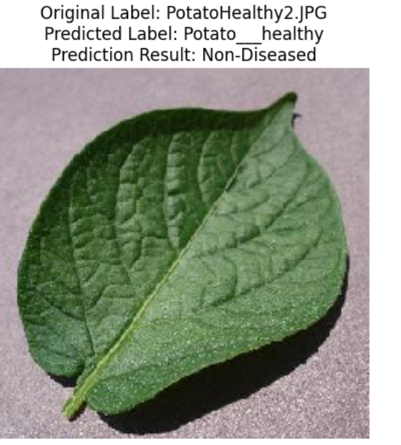
ResNet50 Results
It detects if the leaf is diseased or non-diseased

Slide 12
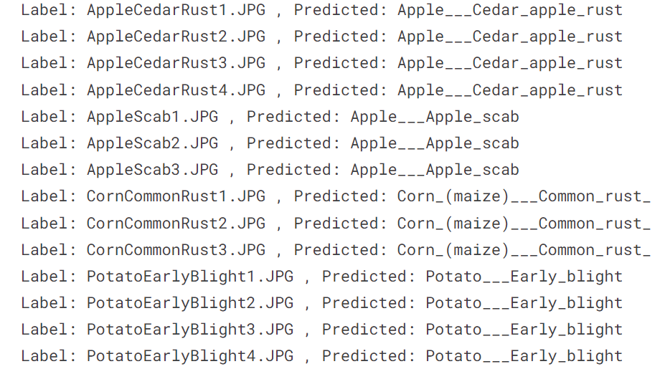
ResNet9 Results
It Classifies the type of leaf which is given as input to model

Slide 13
Accuracy for models
S.NO. | MODEL | ACCURACY
1 | ResNet9 | 99.24%
2 | ResNet50 | 97%

Slide 14
Conclusion
We have successfully developed a deep learning based system for plant disease classification and detection with average 99% accuracy and 97% accuracy which can detect and classify the plant leaf images more efficiently

