Slide 1
FORBES FAB LUXE RESIDENCES
Complete Website Showcase & Design Review
Comprehensive Look & Feel Presentation with High-Res Screenshots & Strategic UX Modification Recommendations based on Client Review
Location: Sector 4, Greater Noida West | Product: 3+1 & 4+1 BHK Serviced Residences | Client Presentation

Slide 2
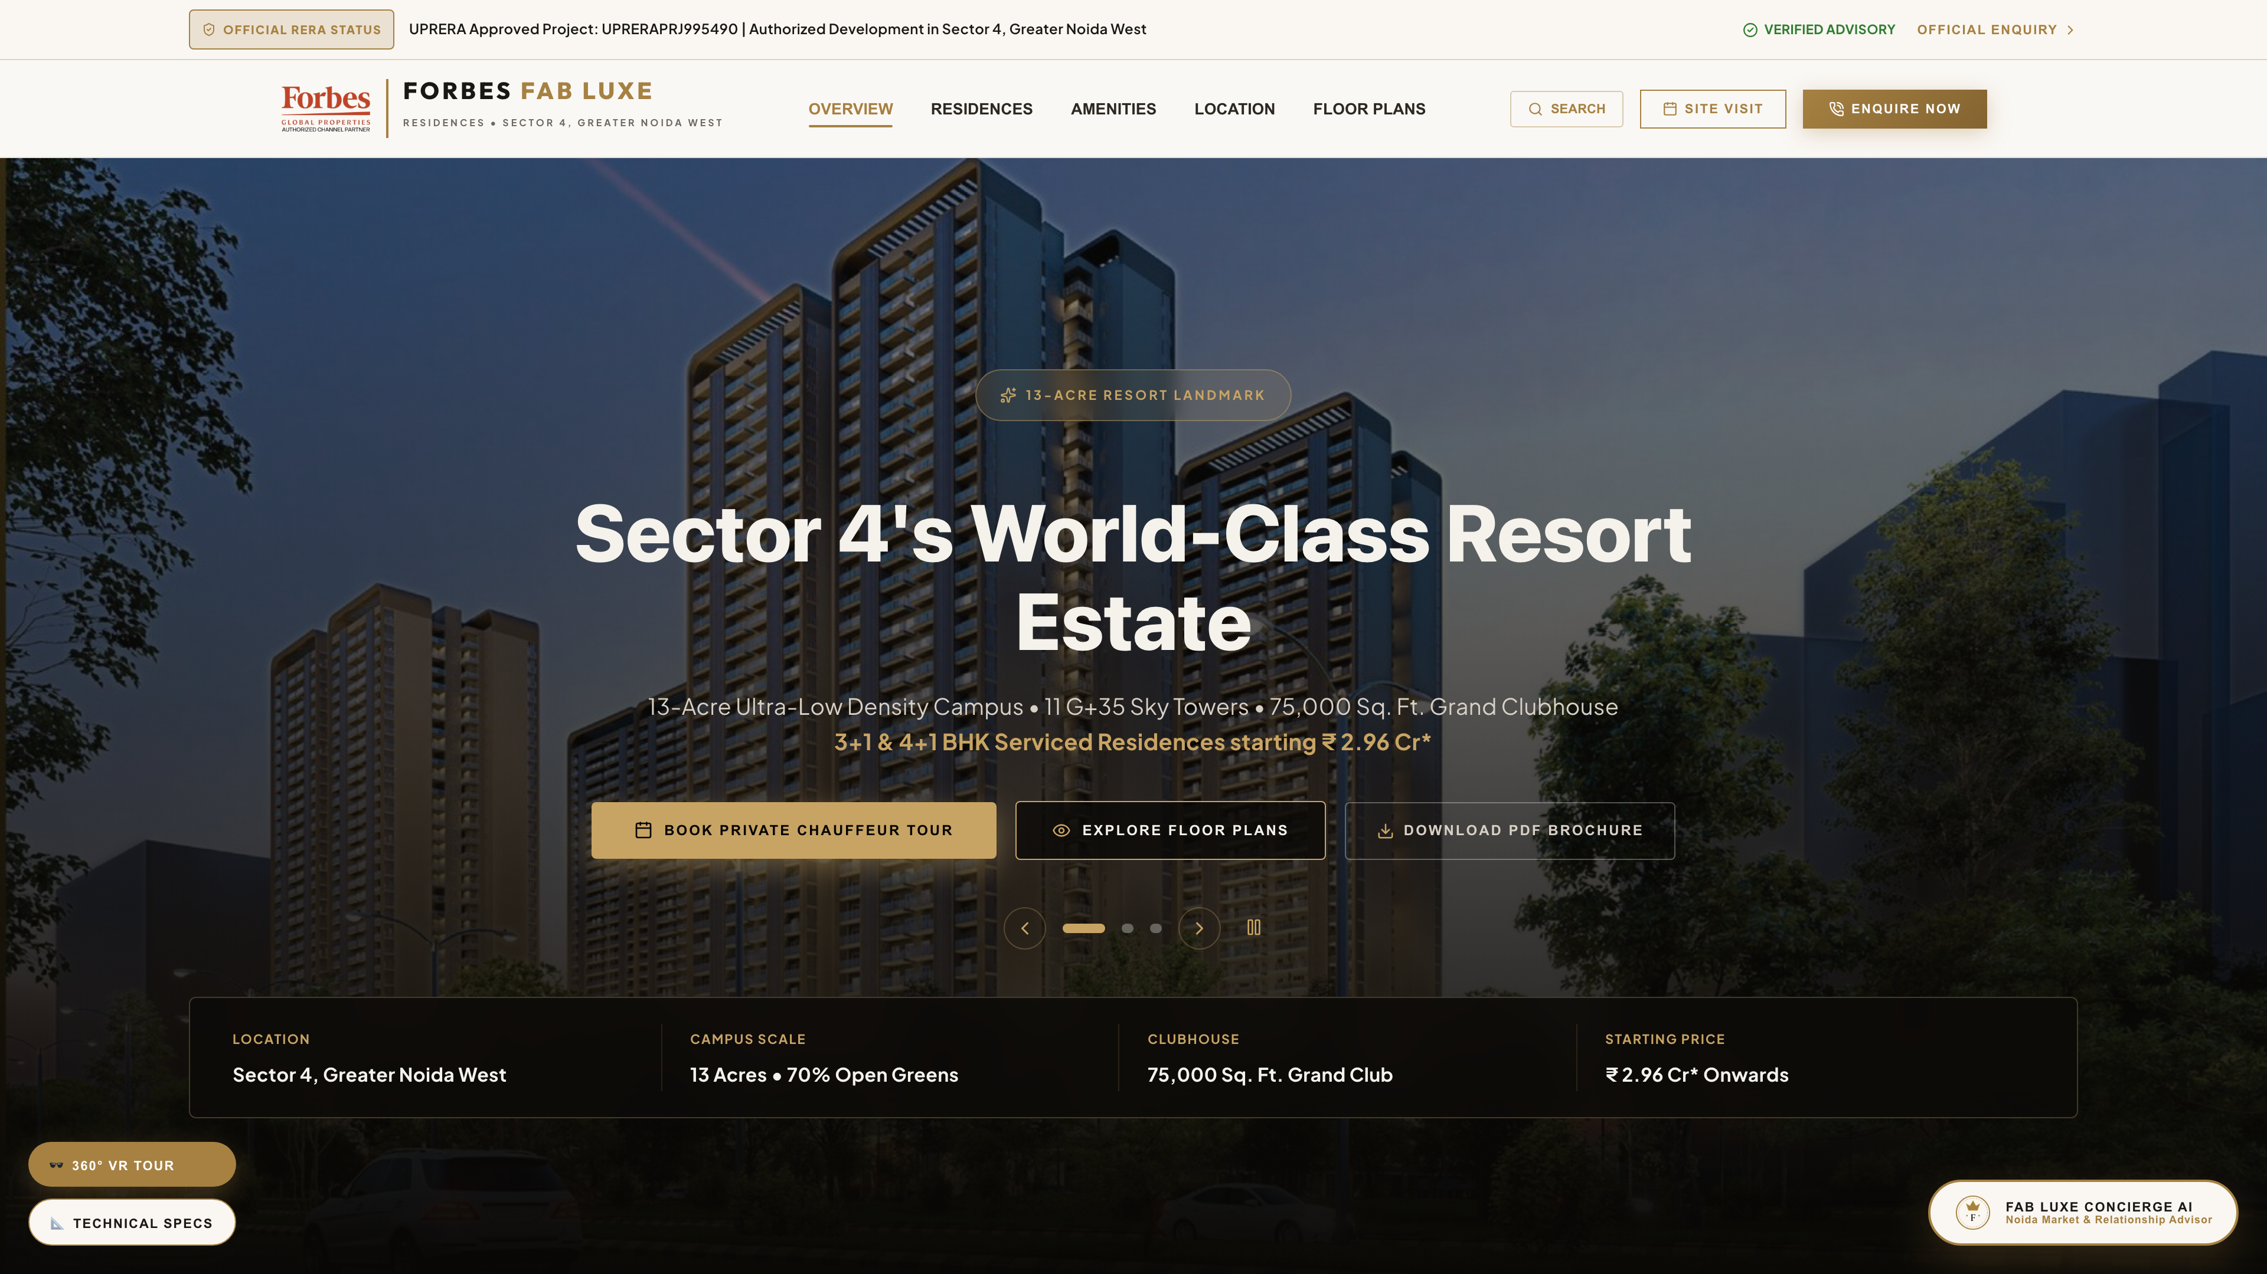
FORBES FAB LUXE • WEBSITE LOOK & FEEL PRESENTATION
1. Hero Banner & Navigation Experience
✨ Current Look & Feel Highlights
• Dark luxury aesthetic with gold accents and high-res imagery
• Live Real-Time Buyer Signal Ticker at top bar
• Dynamic Tag: '13-ACRE RESORT LANDMARK' with rotating carousel
• Sticky header with phone CTA, Schedule Site Visit & Navigation Links
🛠️ Recommended Modifications (Client Response)
➔ Add video background option in Hero for immersive resort tour
➔ Incorporate WhatsApp quick chat floating icon next to CTA
➔ Make price starting tag ('₹ 2.96 Cr*') more bold with EMI badge
➔ Enhance mobile navbar dropdown with quick property filters

Slide 3
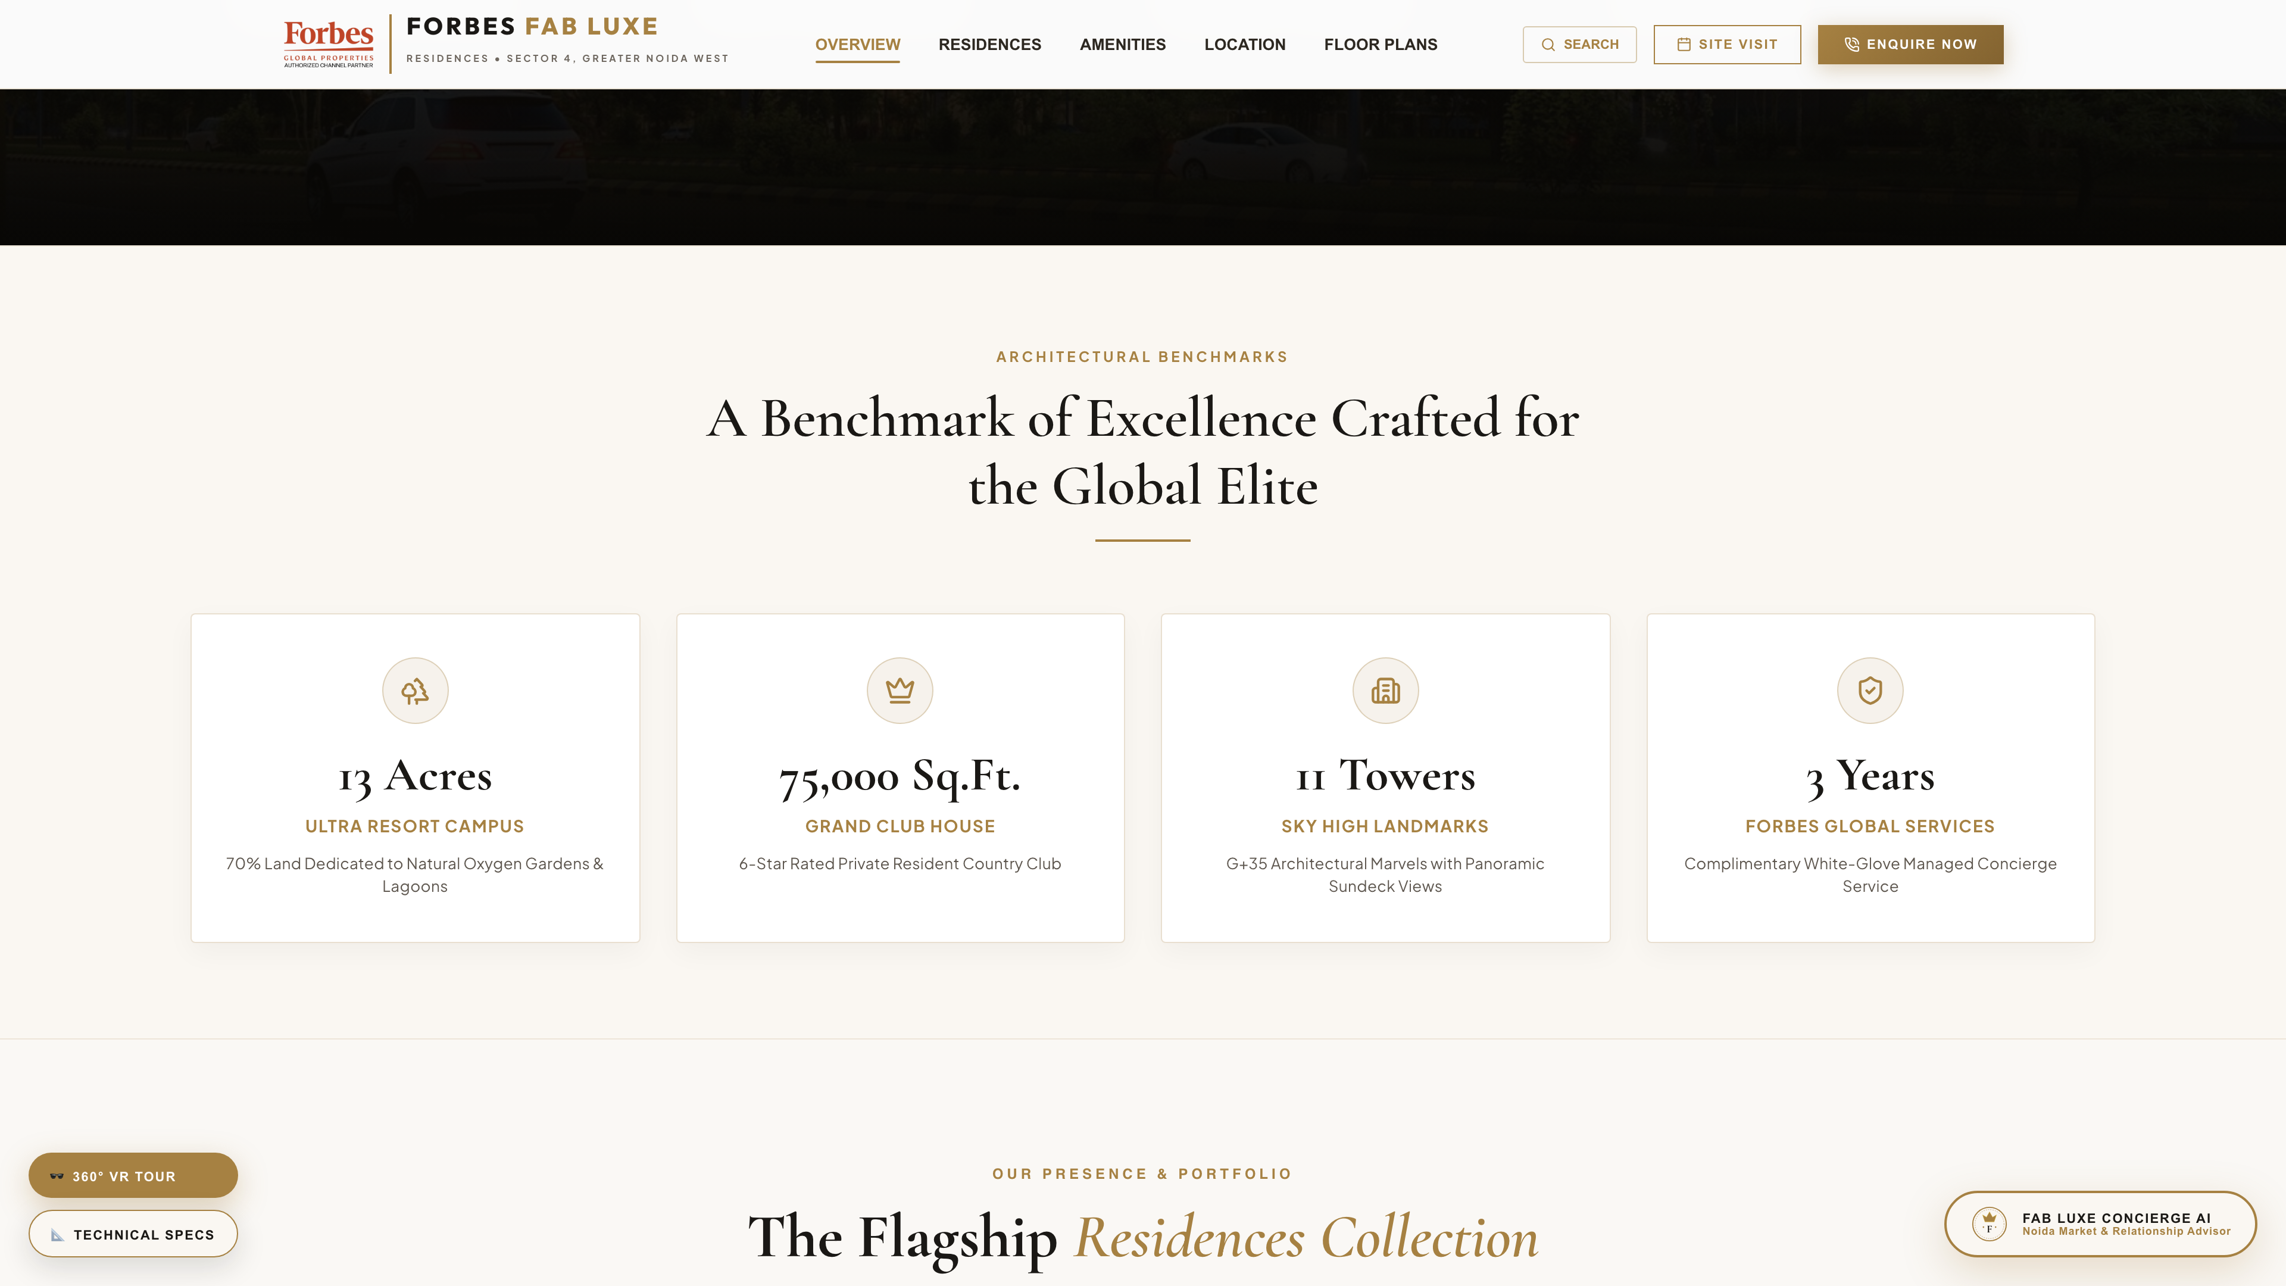
FORBES FAB LUXE • WEBSITE LOOK & FEEL PRESENTATION
2. Legacy Metrics & Key Statistics
✨ Current Look & Feel Highlights
• High-impact numerical metrics: 13 Acres, 75K Sq.Ft. Club, 11 Towers
• RERA Registration approval numbers clearly prominently highlighted
• Forbes Fab Luxe trust positioning in Sector 4 Greater Noida West
🛠️ Recommended Modifications (Client Response)
➔ Add animated counter effect when user scrolls into view
➔ Include clickable 'Verify RERA Certificate' link modal for trust
➔ Add mini icons for 'Possession Timeline' and 'Construction Status'

Slide 4
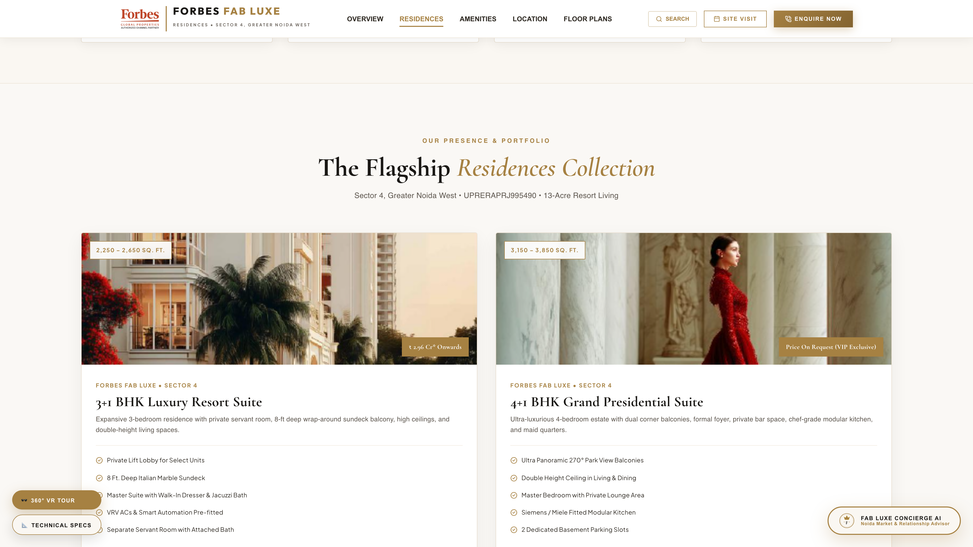
FORBES FAB LUXE • WEBSITE LOOK & FEEL PRESENTATION
3. Flagship Developments & Tower Showcase
✨ Current Look & Feel Highlights
• Detailed card grid showcasing 3+1 BHK & 4+1 BHK Luxury Towers
• Interactive buttons for Site Visit, Floor Plans & Download Brochure
• High-resolution exterior rendering showcase
🛠️ Recommended Modifications (Client Response)
➔ Add unit filter tabs (All / 3 BHK / 4 BHK / Penthouses)
➔ Include 'Starting Price per Sq. Ft.' badge on individual cards
➔ Enable 360-degree exterior tower viewer directly on card hover

Slide 5
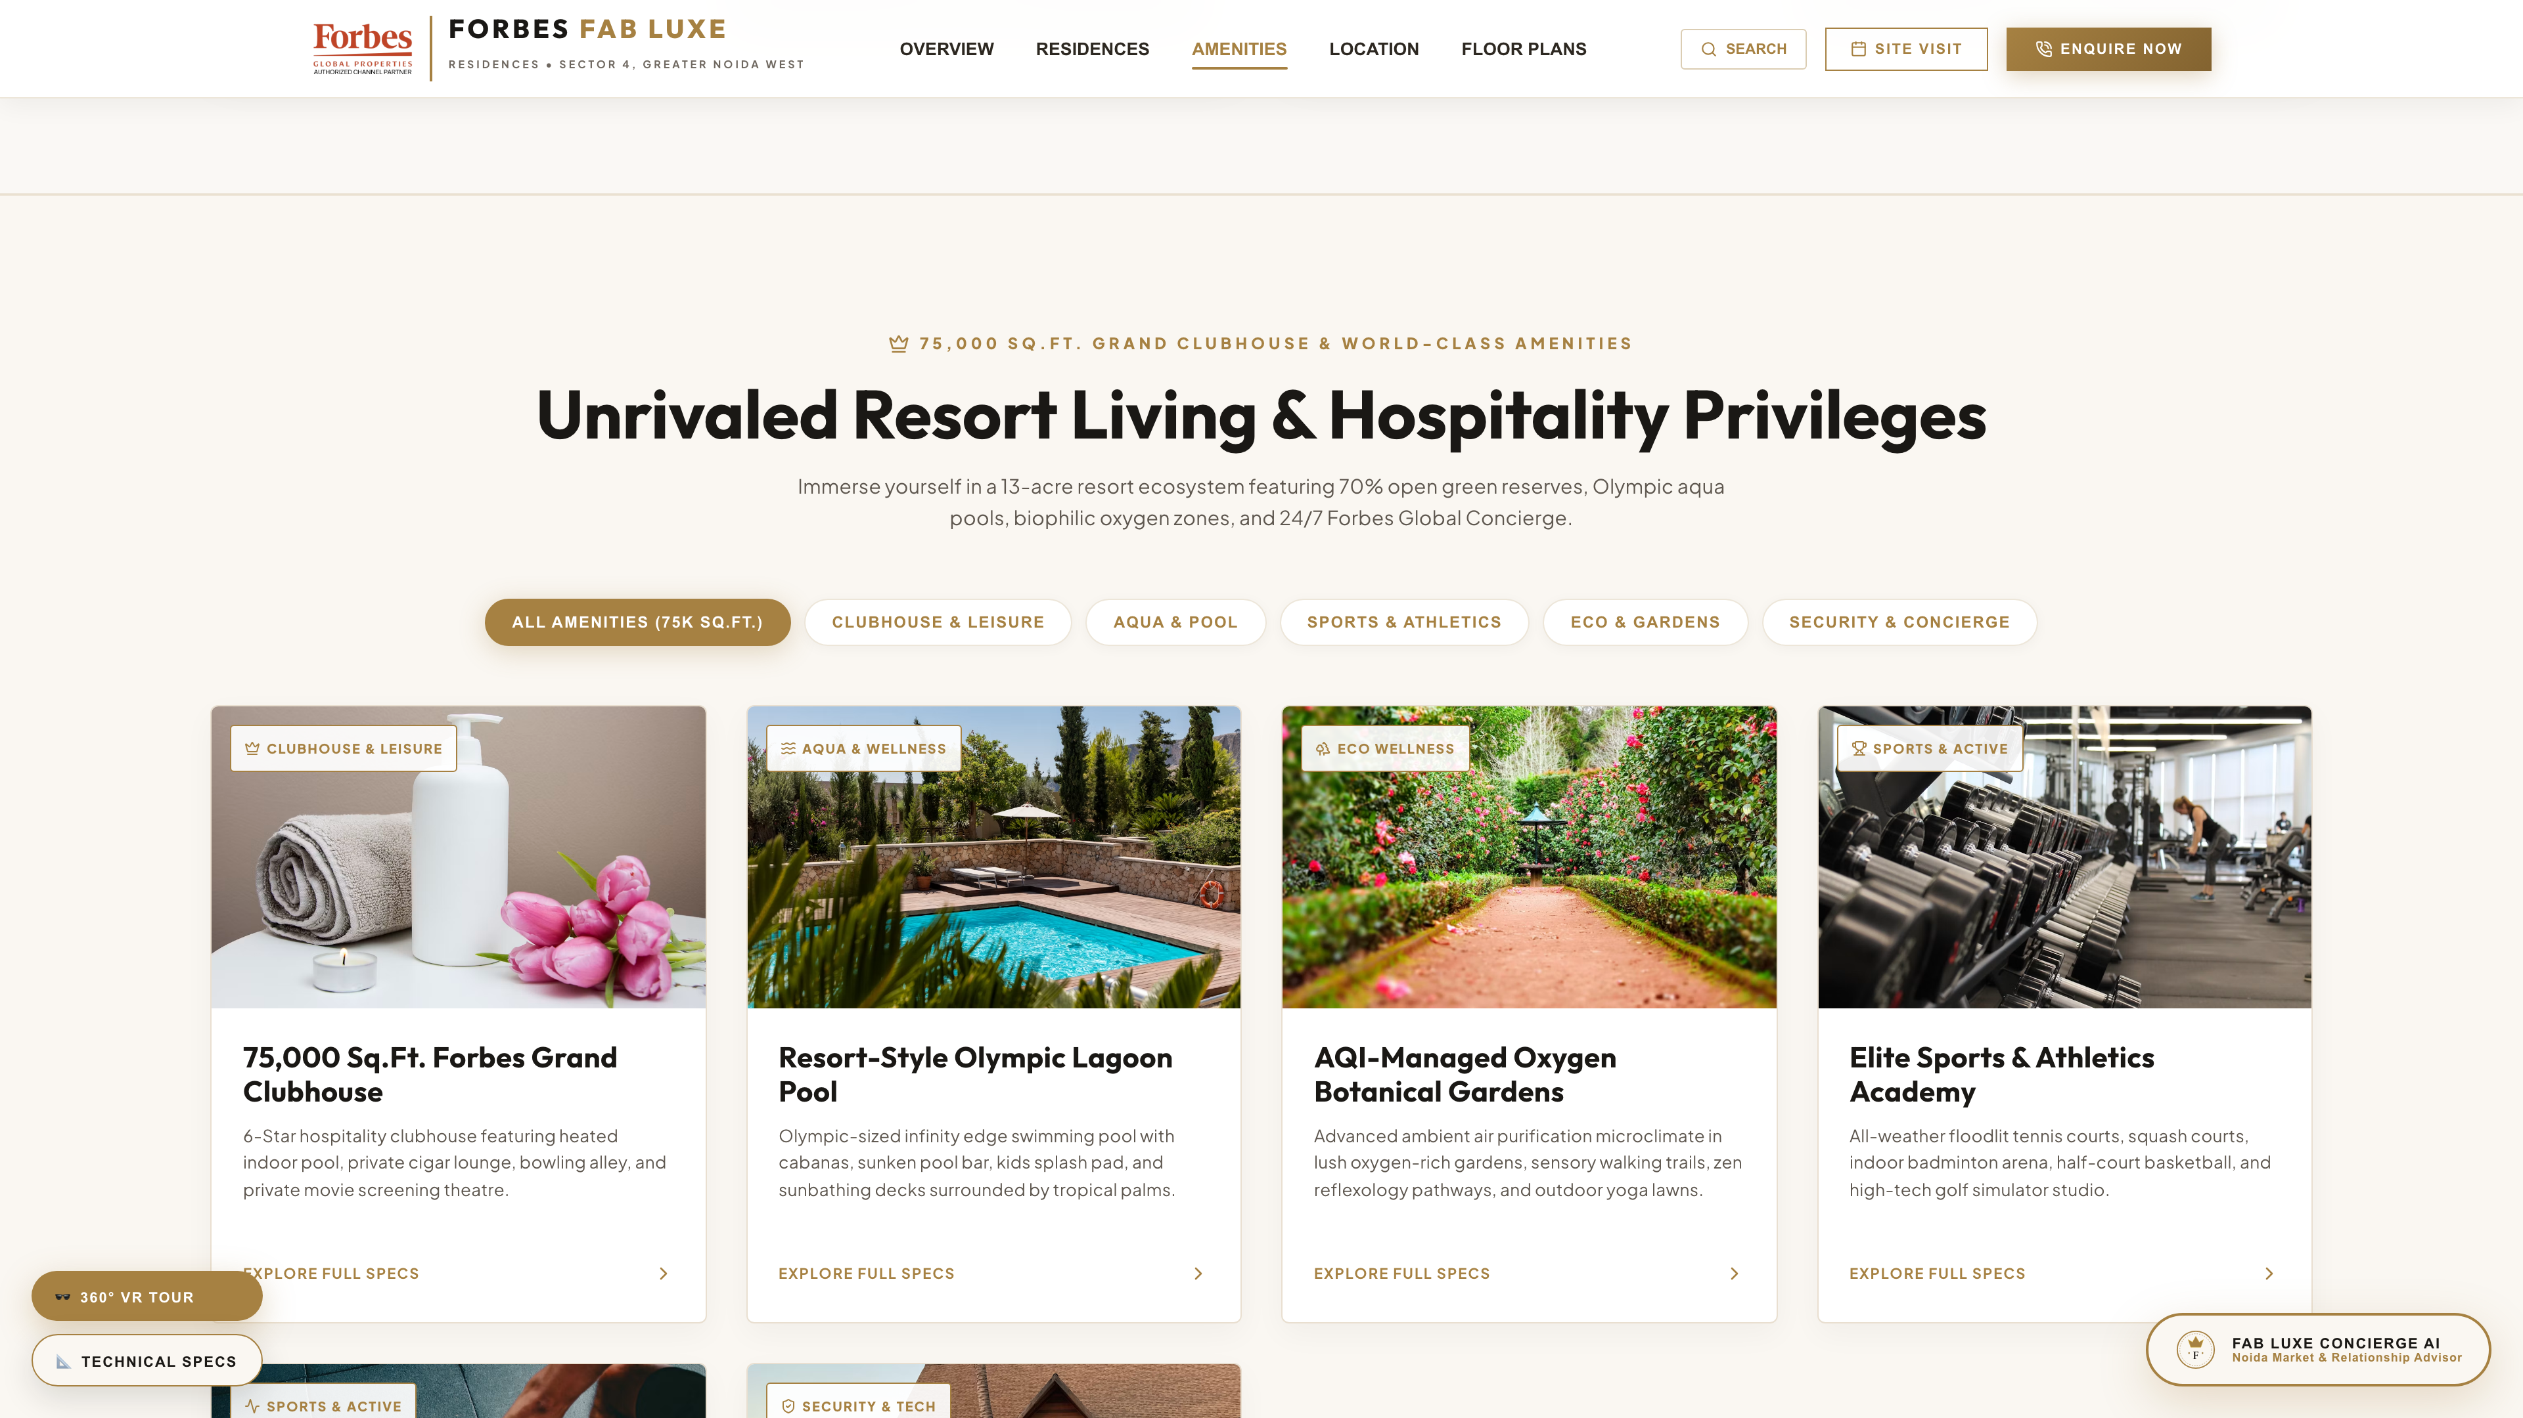
FORBES FAB LUXE • WEBSITE LOOK & FEEL PRESENTATION
4. 75,000 Sq.Ft. World-Class Amenities & Club
✨ Current Look & Feel Highlights
• Spotlights 6-Star Resident Club, Lagoon Pool & Technogym Fitness
• Structured icon grid covering Sports, Wellness, Dining & Leisure
• Saint Amand Hospitality partnership feature badge
🛠️ Recommended Modifications (Client Response)
➔ Group amenities by categories (Wellness, Sports, Kids, Club)
➔ Add interactive image gallery/lightbox when amenity card is clicked
➔ Highlight AQI Monitored Oxygen Gardens with live air quality badge

Slide 6
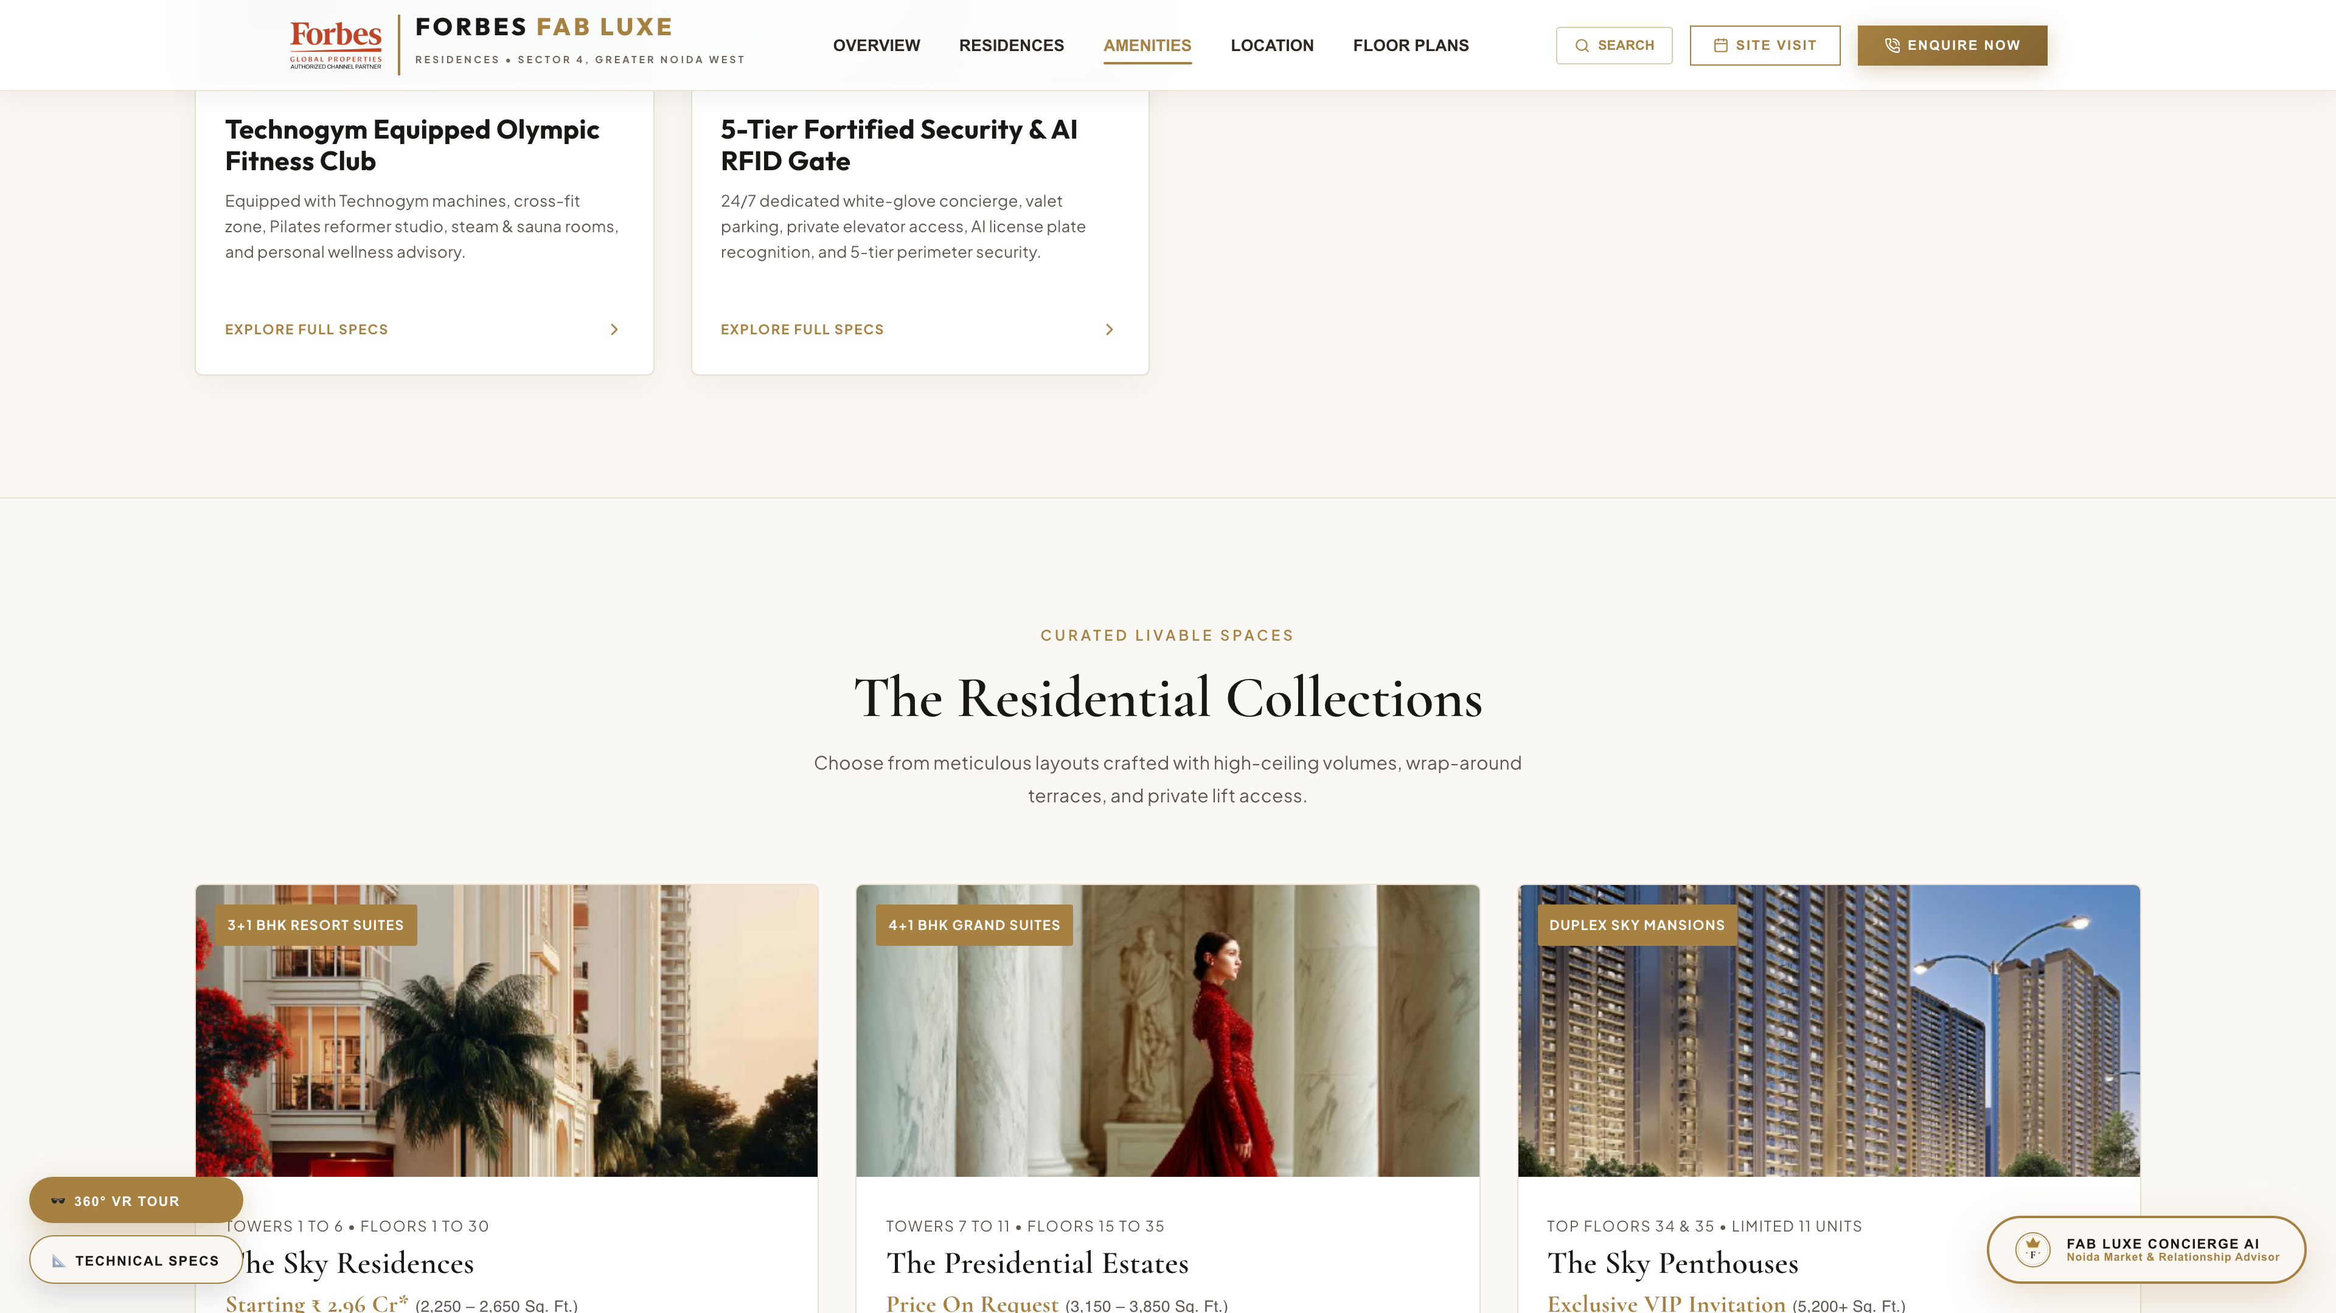
FORBES FAB LUXE • WEBSITE LOOK & FEEL PRESENTATION
5. Architectural Collections & Floor Plans
✨ Current Look & Feel Highlights
• Presents 3+1 & 4+1 BHK floor configurations with dimensions
• Highlights wrap-around sundecks, double-height living & VRV AC
• Clear CTAs to view detailed architectural floor plans
🛠️ Recommended Modifications (Client Response)
➔ Enable interactive 2D/3D Floor Plan toggle with zoom controls
➔ Add 'Request Customized Floor Plan' direct enquiry button
➔ Show carpet area vs super area comparison for clarity

Slide 7
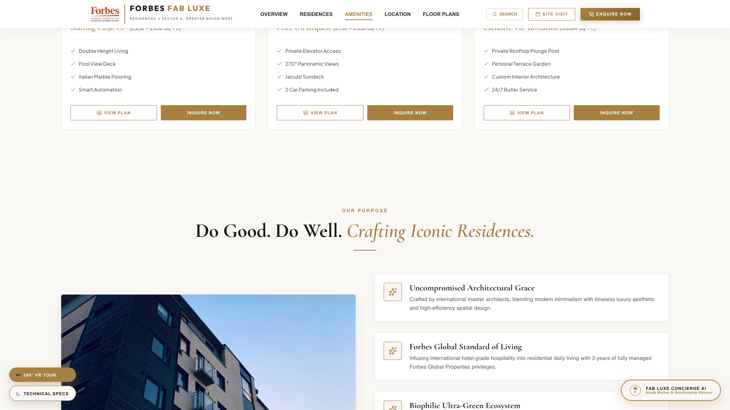
FORBES FAB LUXE • WEBSITE LOOK & FEEL PRESENTATION
6. Brand Philosophy & Design Ethos
✨ Current Look & Feel Highlights
• Refined dark card styling showcasing core design pillars
• Articulates low-density living, green canopy & timeless luxury
• Creates emotional resonance with high-net-worth buyers
🛠️ Recommended Modifications (Client Response)
➔ Incorporate architect quote & design firm credential seal
➔ Add downloadable 'Design Concept & Architecture Note' PDF
➔ Refine typography line-height for easier mobile reading

Slide 8
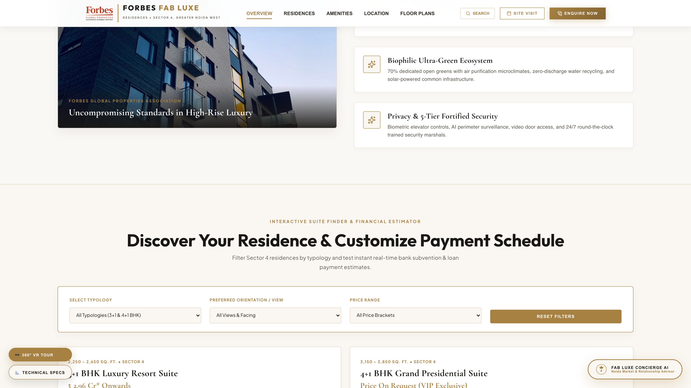
FORBES FAB LUXE • WEBSITE LOOK & FEEL PRESENTATION
7. Property Finder & EMI Loan Estimator
✨ Current Look & Feel Highlights
• Interactive unit search filter (BHK, Budget, Tower, Floor Preference)
• Embedded home loan EMI estimator with slider controls
• Instant price calculation & downpayment summary
🛠️ Recommended Modifications (Client Response)
➔ Integrate bank partner logos (HDFC, SBI, ICICI) with special rates
➔ Add 'Save Configured Unit & Send to WhatsApp' CTA button
➔ Improve slider responsiveness on mobile touch screens

Slide 9
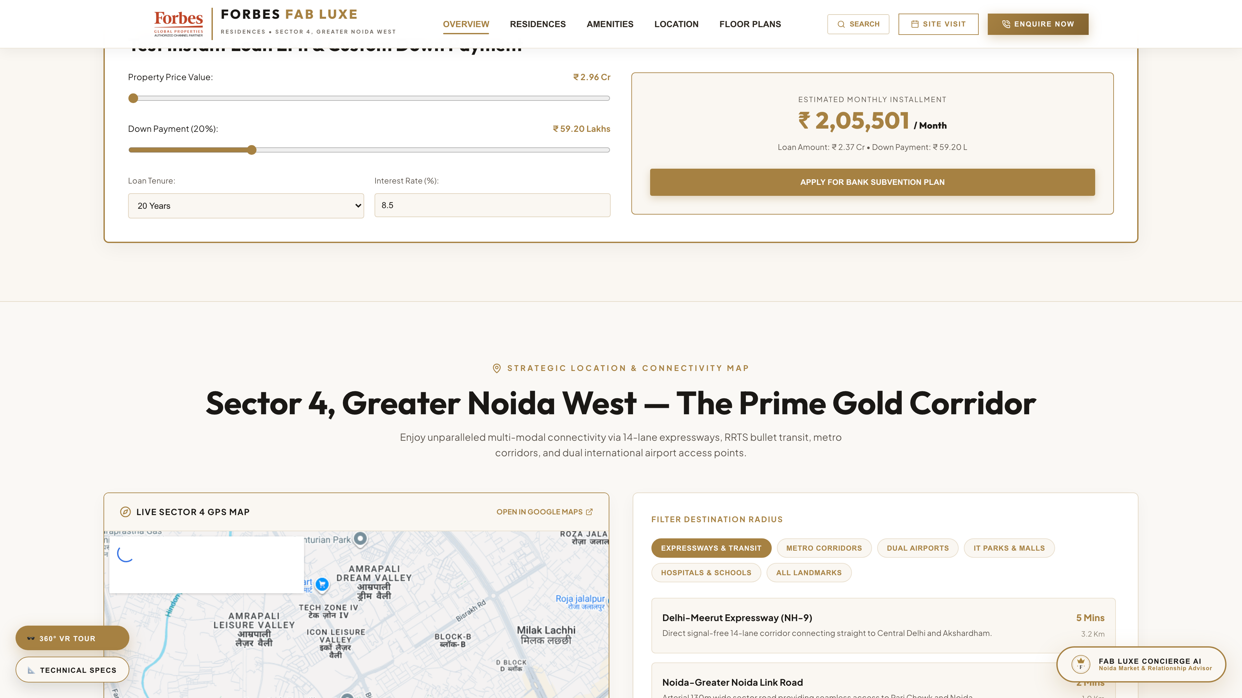
FORBES FAB LUXE • WEBSITE LOOK & FEEL PRESENTATION
8. Sector 4 Location & Connectivity Map
✨ Current Look & Feel Highlights
• Interactive map section showing Sector 4 Greater Noida West
• Distance markers to Jewar Airport, Metro Station, Expressways & Schools
• Neighborhood infrastructure highlights
🛠️ Recommended Modifications (Client Response)
➔ Embed interactive Google Maps embed with route direction button
➔ Add distance filter tabs (Schools, Hospitals, Malls, Airport)
➔ Include future infrastructure growth drivers (Proposed Metro, Jewar Airport timeline)

Slide 10
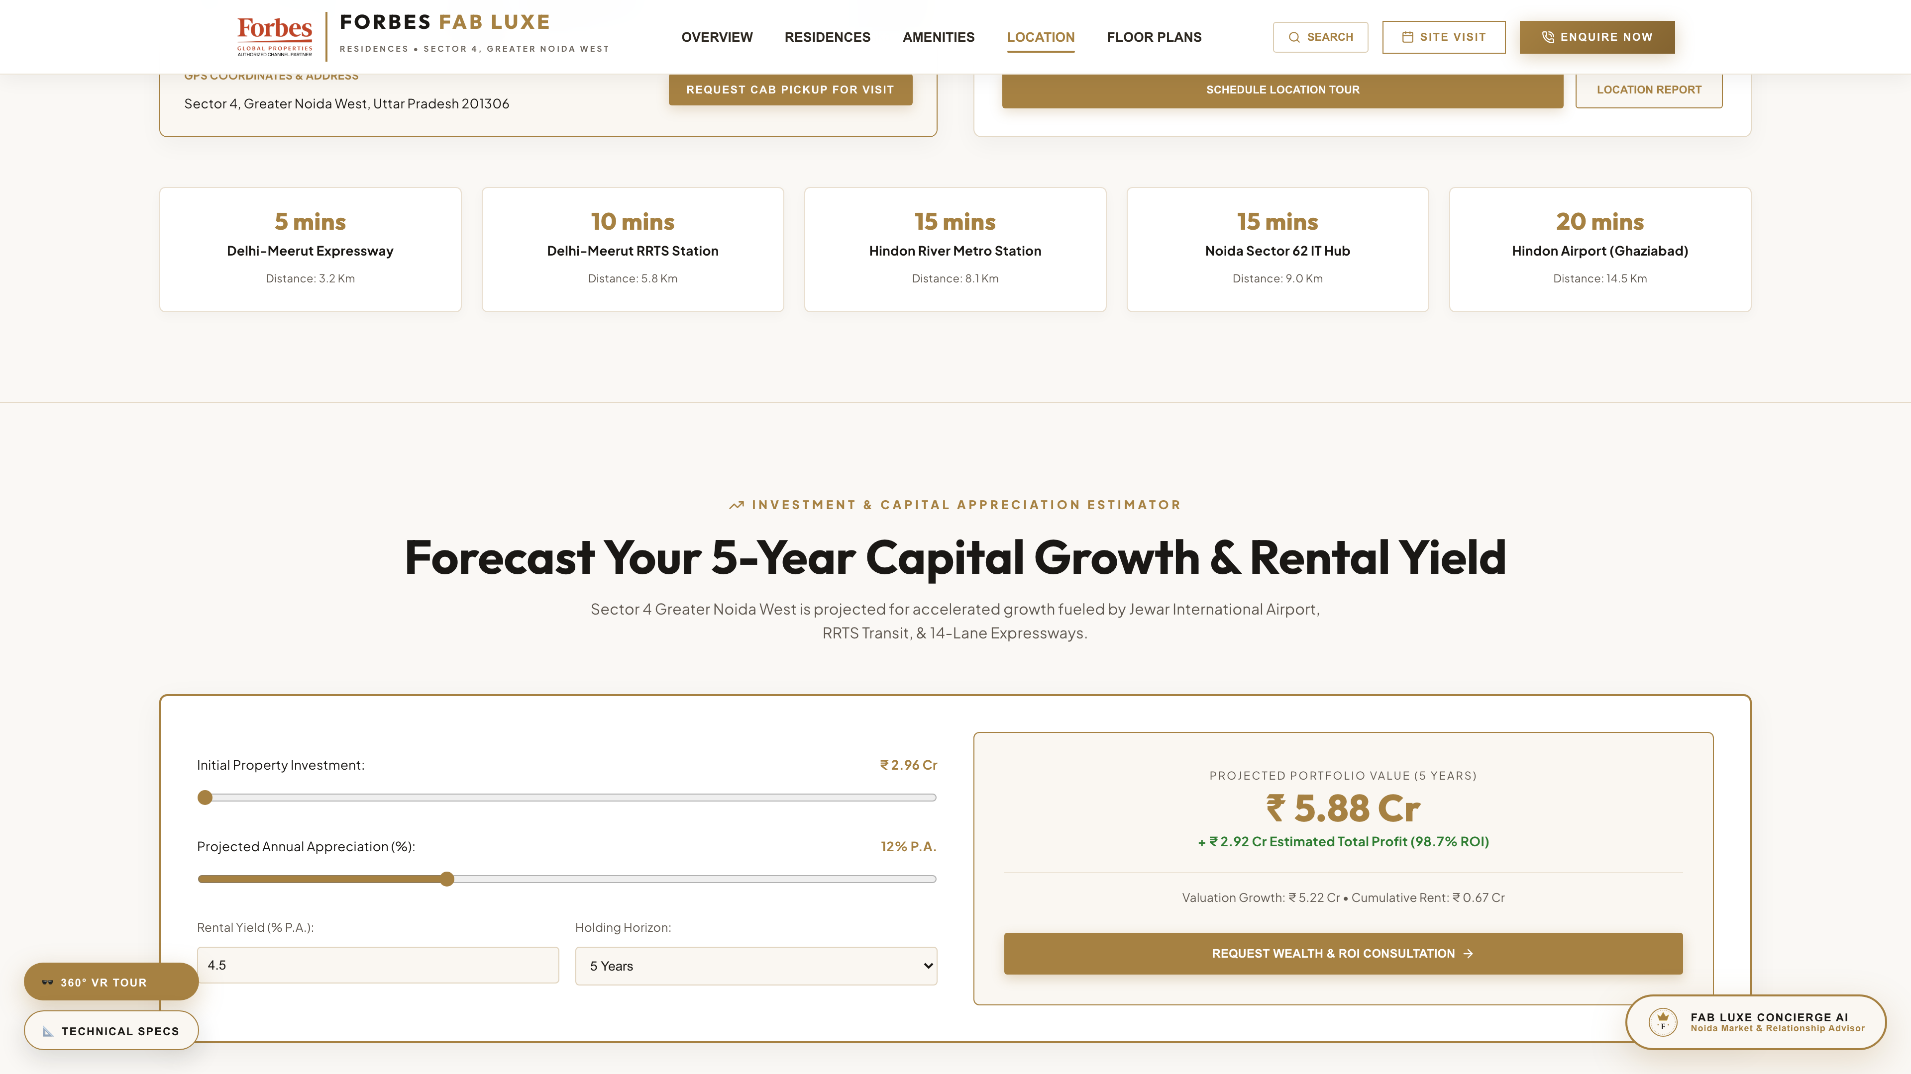
FORBES FAB LUXE • WEBSITE LOOK & FEEL PRESENTATION
9. Investment & Capital ROI Calculator
✨ Current Look & Feel Highlights
• Projected capital appreciation graphs & rental yield projections
• Highlights Greater Noida West growth trajectory
• Targeted for luxury real estate investors & NRI buyers
🛠️ Recommended Modifications (Client Response)
➔ Add NRI Investment Concierge CTA button
➔ Include tax benefit calculator for home loan buyers
➔ Provide downloadable 'Sector 4 Micro-Market Investment Report'

Slide 11
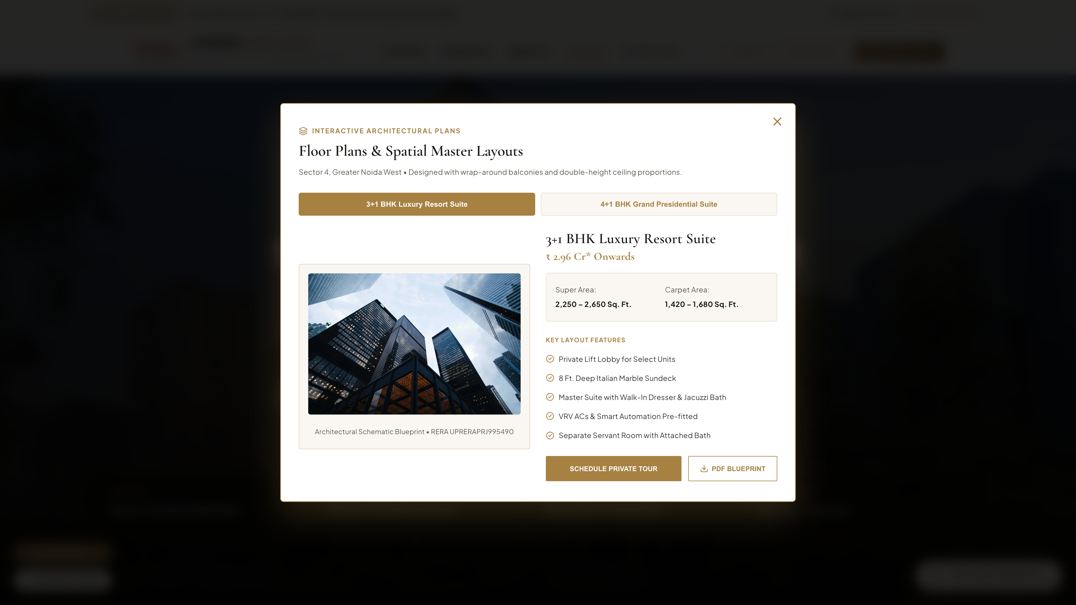
FORBES FAB LUXE • WEBSITE LOOK & FEEL PRESENTATION
10. High-Converting Modals & Lead Funnel
✨ Current Look & Feel Highlights
• VIP Site Visit booking form with date/time selector
• Interactive Floor Plan modal with zoom & download options
• Private Concierge & Digital Brochure request modals
🛠️ Recommended Modifications (Client Response)
➔ Add instant OTP phone verification to prevent fake leads
➔ Show lead confirmation with instant WhatsApp brochure delivery
➔ Reduce required form fields to 3 (Name, Phone, Unit Interest) for +25% conversion

Slide 12
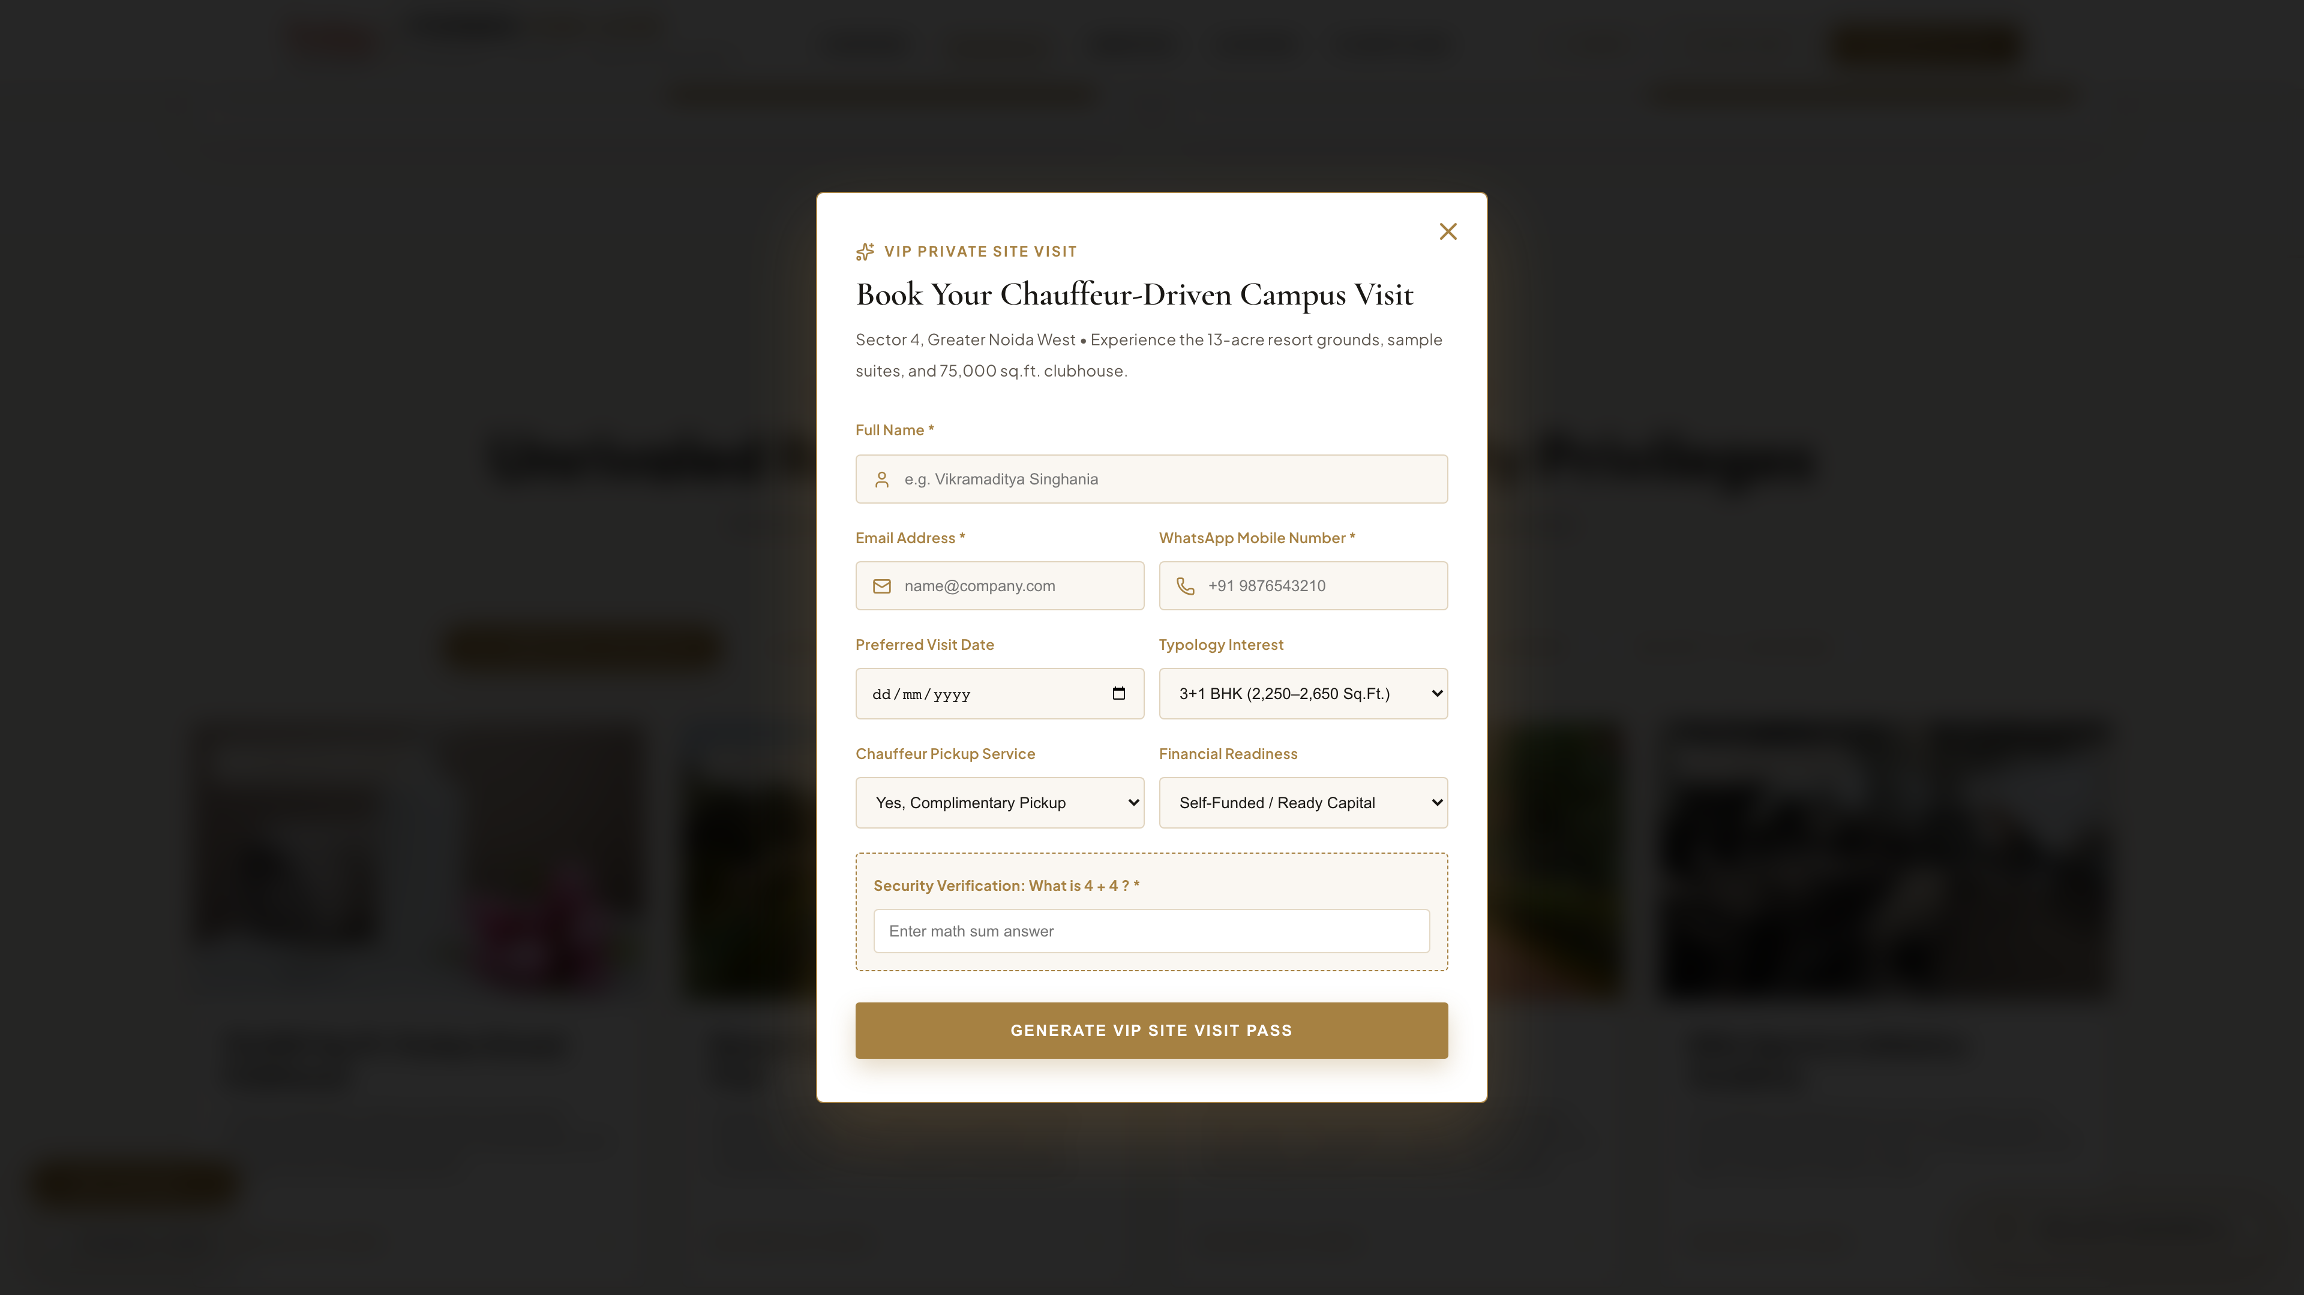
FORBES FAB LUXE • WEBSITE LOOK & FEEL PRESENTATION
11. Forbes AI Assistant & Live Social Proof
✨ Current Look & Feel Highlights
• Floating Forbes AI Chatbot Widget for instant query resolution
• Live Real-Time Buyer Ticker showing recent site visits & bookings
• 24/7 conversational concierge assistance
🛠️ Recommended Modifications (Client Response)
➔ Pre-load AI bot with suggested quick prompts ('Price List', 'Location', 'Amenities')
➔ Allow AI bot to capture user phone number naturally during conversation
➔ Sync buyer ticker with actual real-time CRM updates

Slide 13
FORBES FAB LUXE • WEBSITE LOOK & FEEL PRESENTATION
Recommended Modifications Matrix (Client Review Strategy)
Website Section | Current State | Recommended Modification | Expected Impact
Hero & Header | Static images & standard CTA | Add video background option & WhatsApp quick chat button | +30% Engagement
Property Finder & EMI | Basic sliders | Integrate Bank Partner logos & 'Send Plan to WhatsApp' CTA | +40% Lead Retention
Floor Plans & Modals | Standard popup forms | Reduce form fields to 3 & add instant OTP verification | +25% Form Submissions
Location & Connectivity | Static map graphic | Interactive Google Map with filter tabs (Airport/Schools/Malls) | Improved UX Clarity
Forbes AI Assistant | Standard chat drawer | Pre-loaded quick prompt chips & natural phone lead capture | 24/7 Automated Leads

Slide 14
FORBES FAB LUXE RESIDENCES
Ready for Client Review & Implementation
The Forbes Fab Luxe website delivers a world-class luxury feel matching Sector 4's premium positioning. Implementing these recommended modifications will maximize lead conversion rates, enhance user trust, and deliver an unmatched digital experience.

