Slide 1
SHREE KUNJ BIHARIJI REALTY PVT. LTD. • RERA APPROVED
KB WEST WALK
Commercial High-Street Master Portal & Visual Section Presentation
📍 Address: Plot No. C-3, Ecotech-12, Greater Noida West, Uttar Pradesh 201318
📜 RERA Registration No: UPRERAPRJ422027/01/2026 | Promoter ID: UPRERAPRM414706
🏬 Building Scale: 18-Level Mixed-Use Commercial High-Street & Studio Suites Landmark
📸 Visual Presentation: Complete 16-Section Screenshot Walkthrough & Features Breakdown
📞 Commercial Helpline: +91 828 7777 333 | Official WhatsApp: +91 828 7777 333

Slide 2
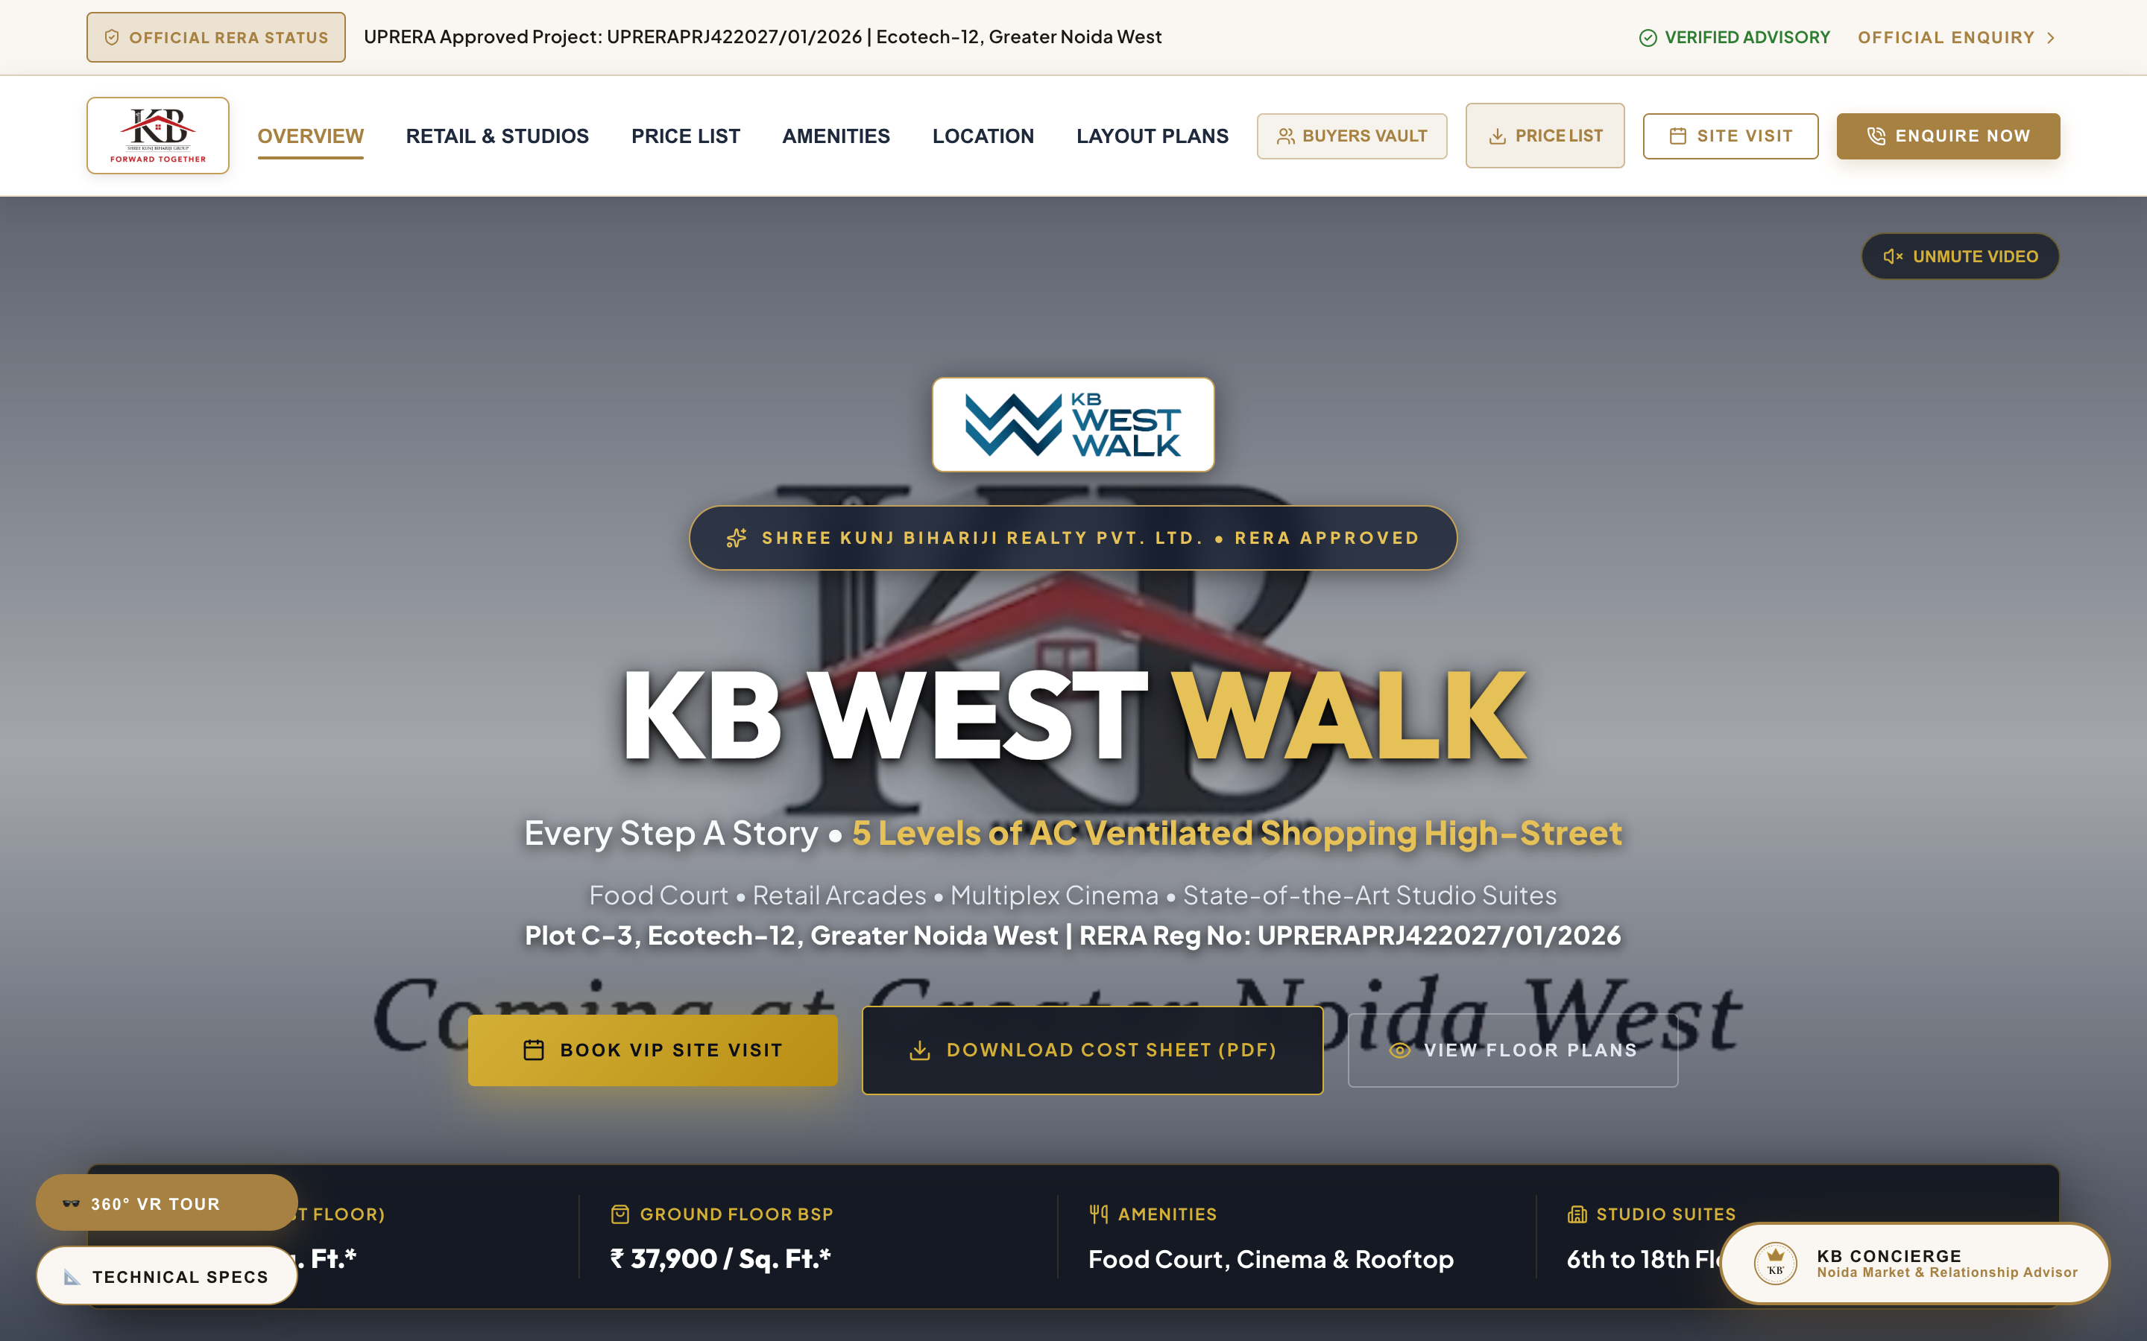
01. HERO CANVAS & NAVIGATION HEADER
Top Header Branding, Live Video Background & Primary Pitch
SECTION DETAILS & FEATURE BREAKDOWN
• Live Announcement Ticker: Top utility bar displaying real-time buyer interest & site visit alerts.
• Builder Company Logo: Official Shree Kunj Bihariji Group Crest (`/shree_kb_logo.png`) anchored in top navigation badge.
• Project Brand Logo: KB West Walk Logo (`/kbww_logo.png`) prominently rendered at the top of the hero fold.
• Background Video Playback: High-contrast high-street footage with quick audio control button.
• Key Tagline: 'Every Step A Story • 5 Levels of AC Ventilated Shopping High-Street'.
• Direct CTAs: Book VIP Site Visit, Download Cost Sheet (PDF), and View Floor Plans.

Slide 3
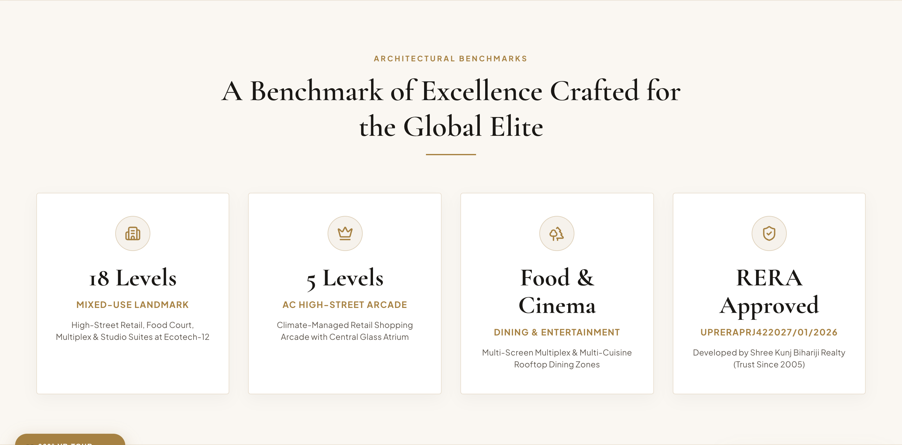
02. LEGACY METRICS & DEVELOPER SCALE
20+ Years Legacy Stats, RERA Approvals & Building Specs
SECTION DETAILS & FEATURE BREAKDOWN
• Developer Track Record: 20+ Years delivering urban commercial landmarks across NCR since 2005.
• Commercial Scale: 18-level mixed-use development with 5 levels of AC retail high-street.
• Verified RERA Approval: Registered under UPRERAPRJ422027/01/2026 with promoter ID UPRERAPRM414706.
• Ecotech-12 Hub: Directly located at Plot C-3 adjacent to proposed metro station.
• Captive Audience: Surrounded by 1,00,000+ occupied residential apartments.

Slide 4
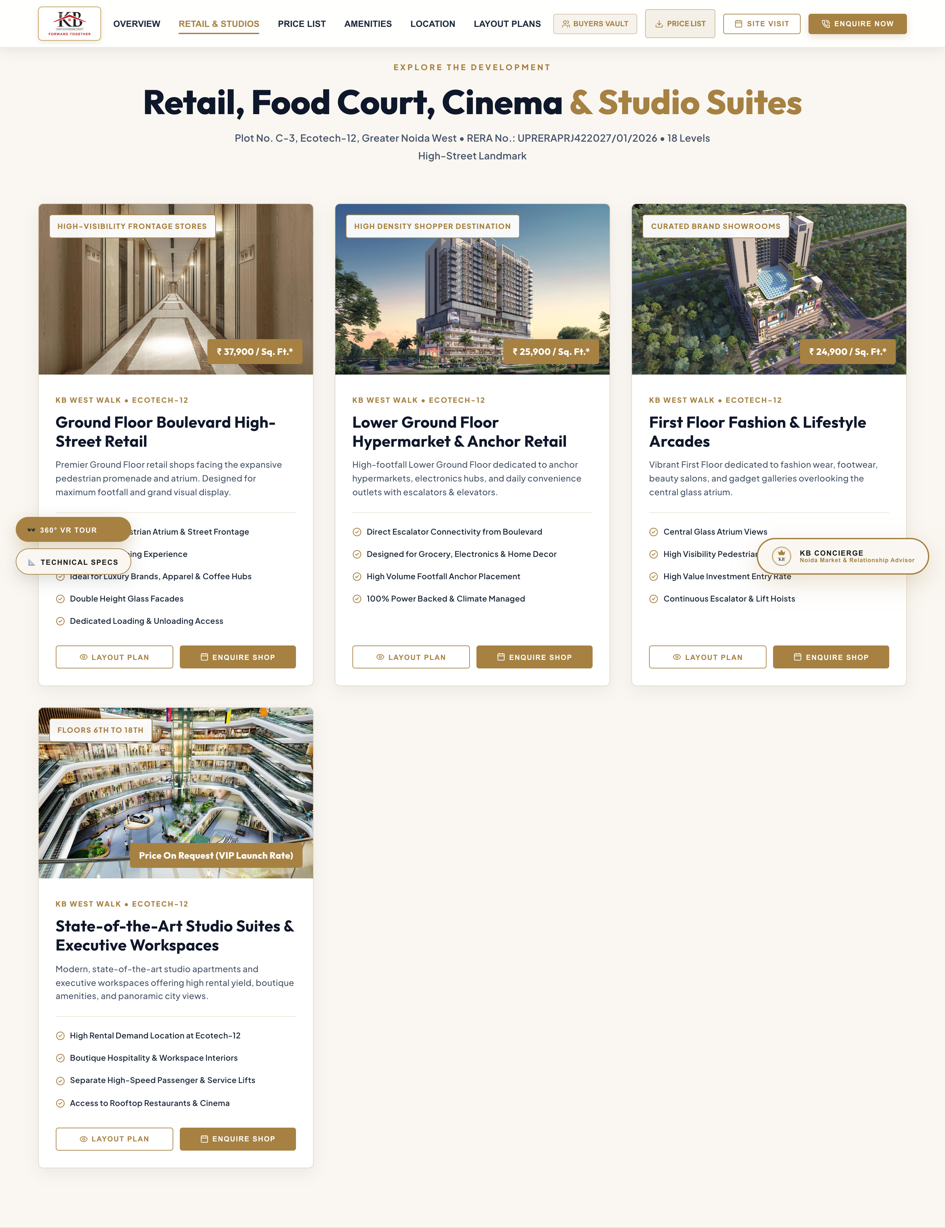
03. COMMERCIAL TYPOLOGIES & SPACES
Retail Shops, Food Court, Multiplex & Studio Suites
SECTION DETAILS & FEATURE BREAKDOWN
• LGF Hypermarket & Retail: ₹25,900 / Sq. Ft. (Hypermarket, electronics & anchor outlets).
• Ground Floor Boulevard Retail: ₹37,900 / Sq. Ft. (Flagship stores facing main pedestrian promenade).
• First Floor Fashion Arcades: ₹24,900 / Sq. Ft. (Apparel, beauty salons & lifestyle showrooms).
• 3rd to 5th Floor Hospitality: Gourmet Food Court, Rooftop Dining & 5-Screen Multiplex Cinema.
• 6th to 18th Floor Studio Suites: Serviced studio apartments & executive workspaces offering high yield.

Slide 5
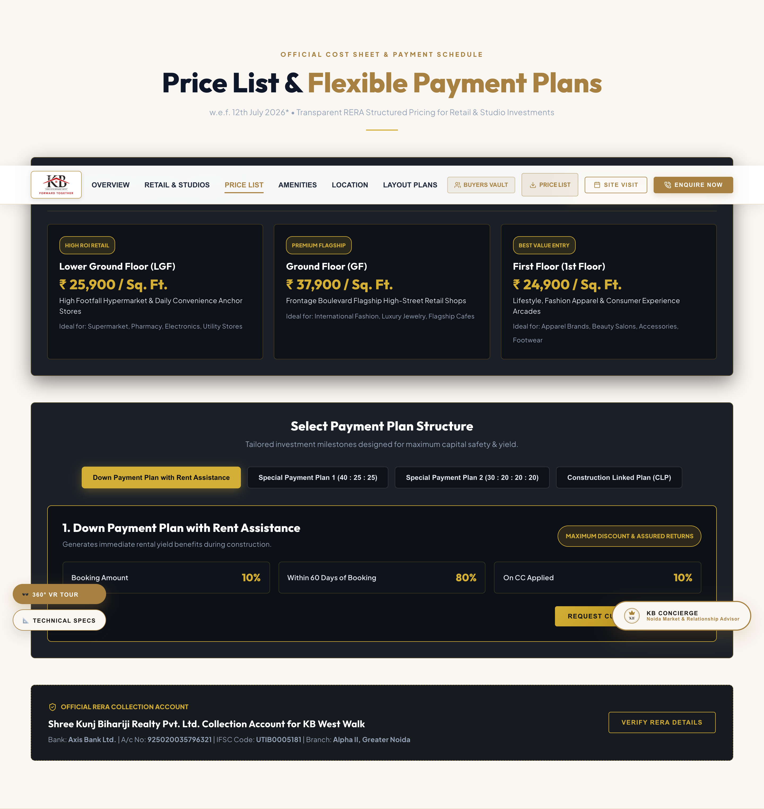
04. OFFICIAL COST SHEET & RERA BANK DETAILS
Transparent BSP Rate Schedule & Axis Bank RERA Account
SECTION DETAILS & FEATURE BREAKDOWN
• Base Selling Price Schedule (w.e.f. July 12, 2026):
- Lower Ground Floor: ₹ 25,900 / Sq. Ft.
- Ground Floor Boulevard: ₹ 37,900 / Sq. Ft.
- First Floor Arcades: ₹ 24,900 / Sq. Ft.
• RERA Collection Bank Account Details:
- Account Name: Shree Kunj Bihariji Realty Pvt. Ltd. Collection Account for KB West Walk
- Bank Name: Axis Bank Ltd.
- Account Number: 925020035796321
- IFSC Code: UTIB0005181 (Alpha II Branch)

Slide 6
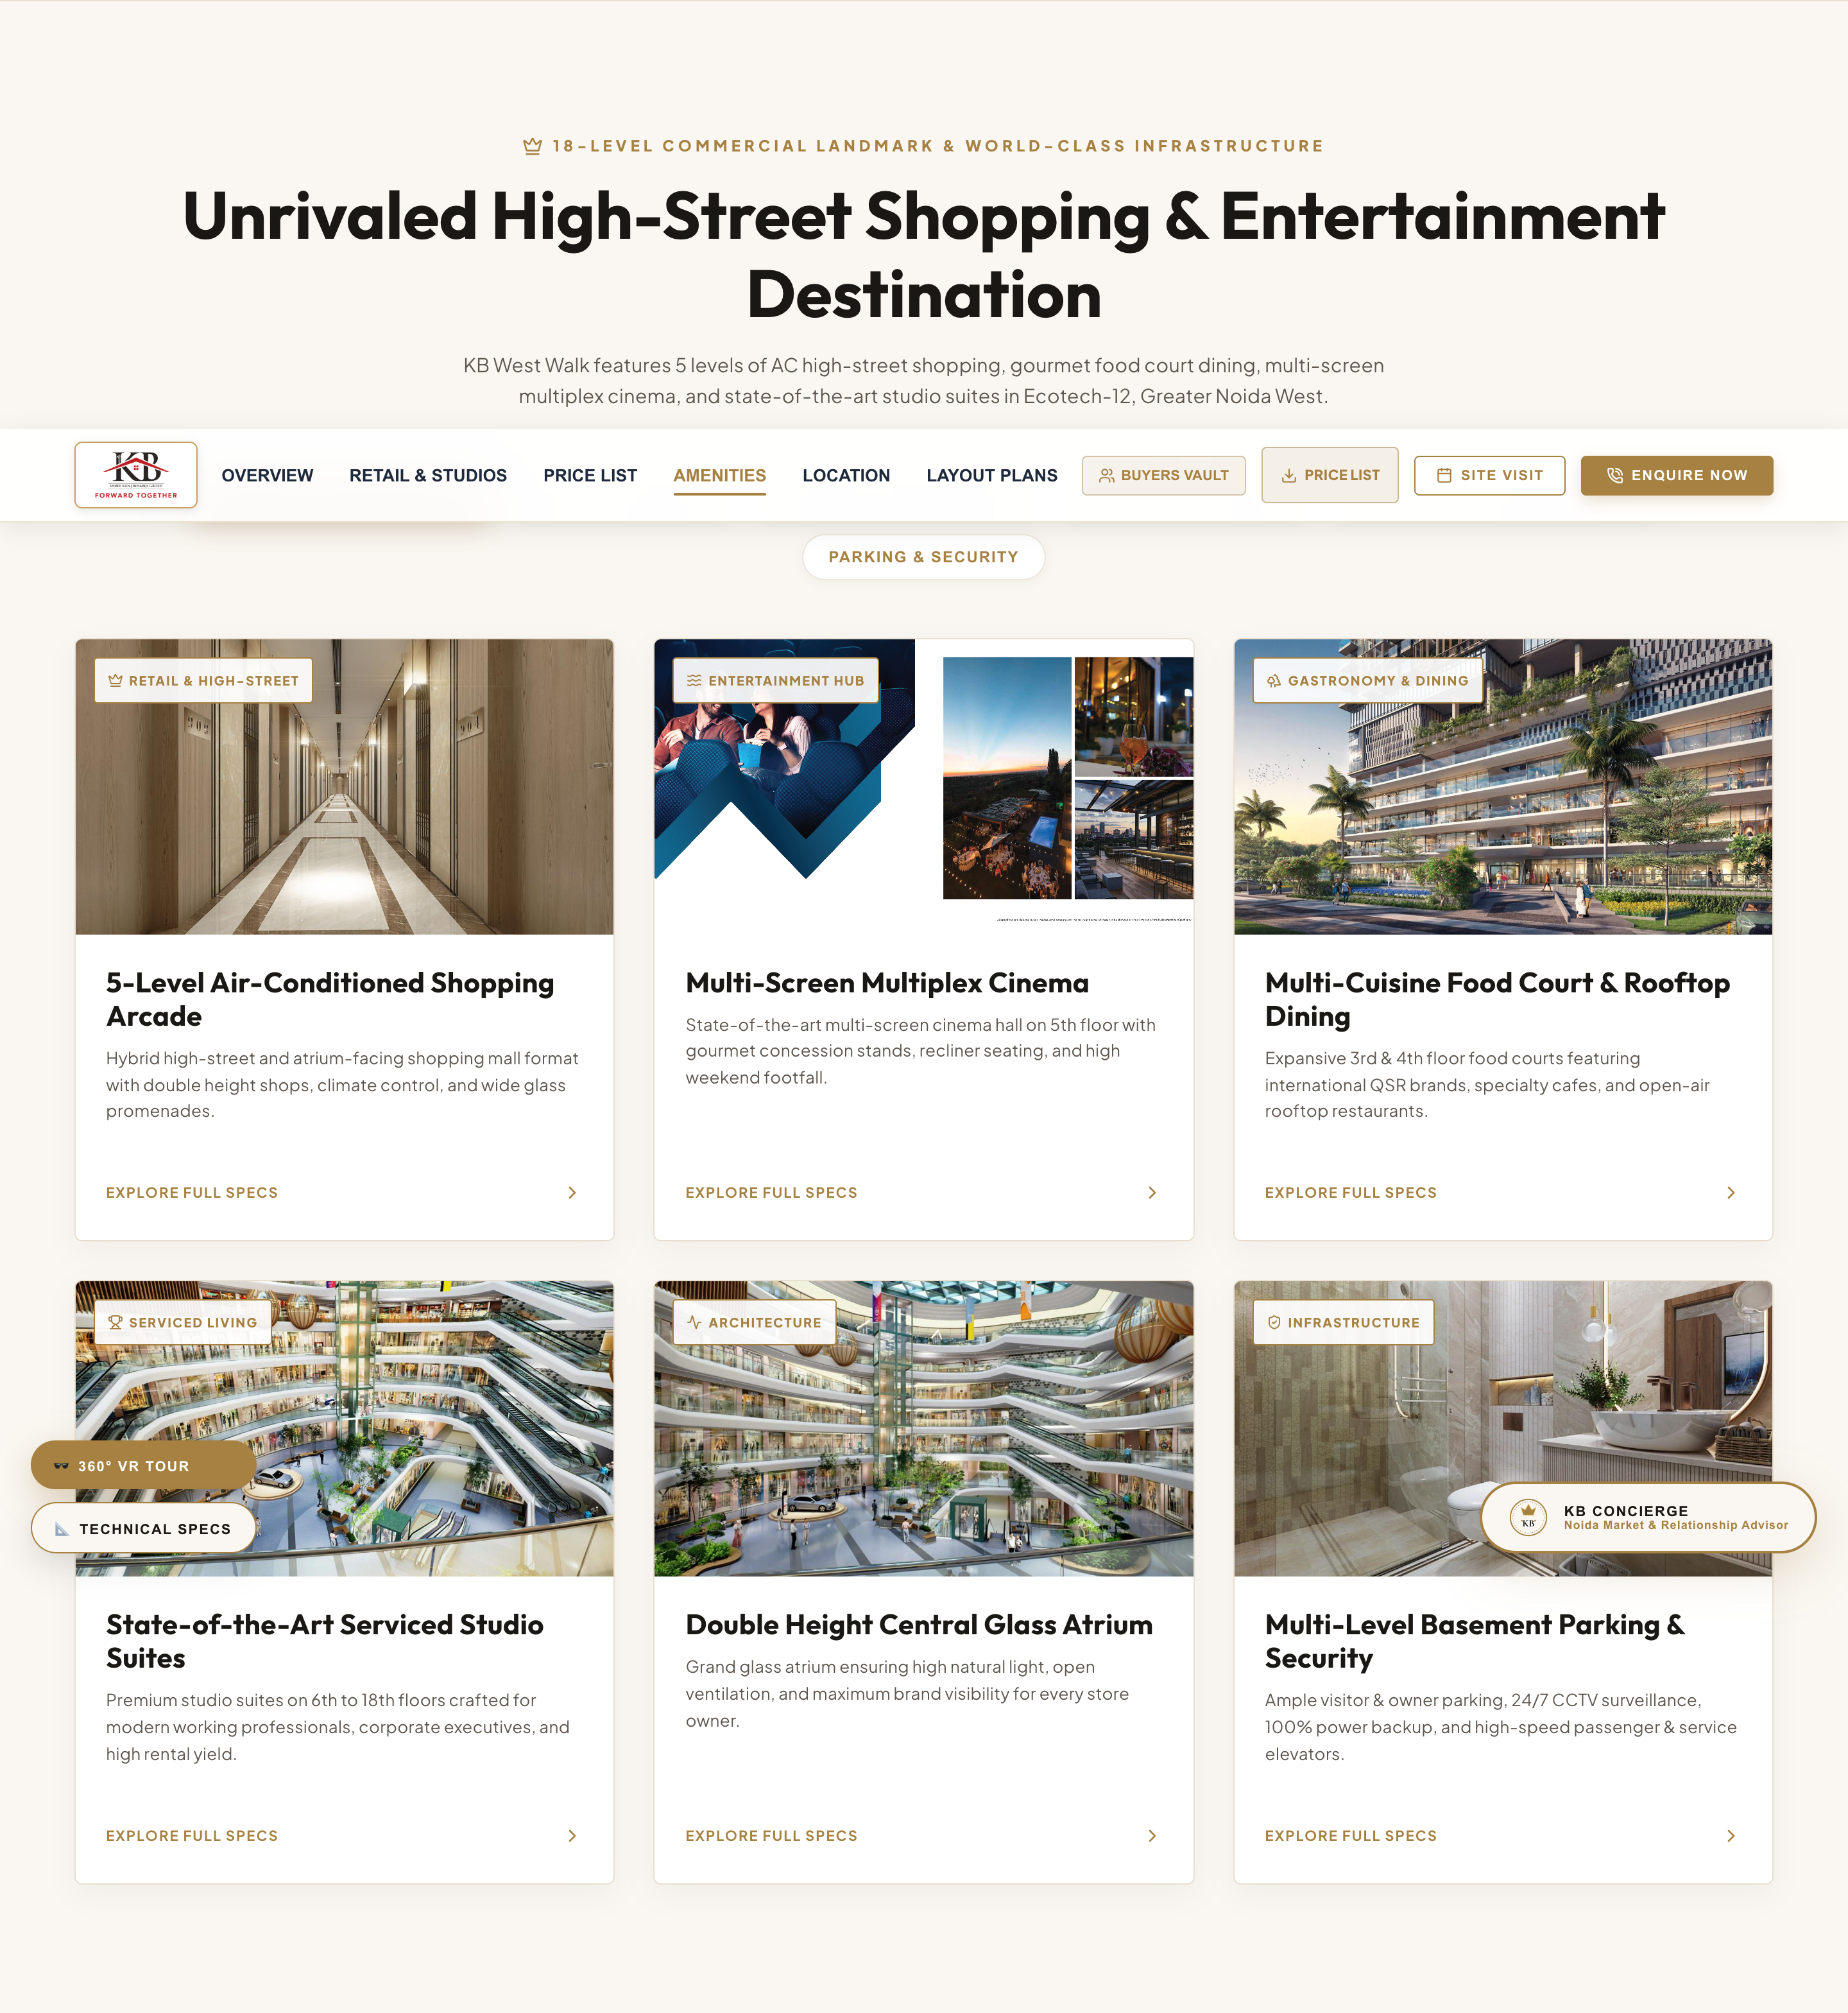
05. COMMERCIAL INFRASTRUCTURE & AMENITIES
6 Pillars of Retail, Entertainment & Working Facilities
SECTION DETAILS & FEATURE BREAKDOWN
• 5-Level AC Shopping High-Street: Hybrid high-street & atrium format with climate control.
• Multi-Screen Multiplex Cinema: Modern cinema hall on 5th floor with gourmet concessions.
• Food Court & Rooftop Dining: Expansive 3rd & 4th floor food courts with QSR brands & rooftop dining.
• Serviced Studio Apartments: Premium studio suites on 6th to 18th floors crafted for high rental yields.
• Double Height Glass Atrium: Skylight atrium ensuring natural light & brand visibility.
• Multi-Level Parking & Security: Multi-level parking, 24/7 CCTV surveillance & 100% power backup.

Slide 7
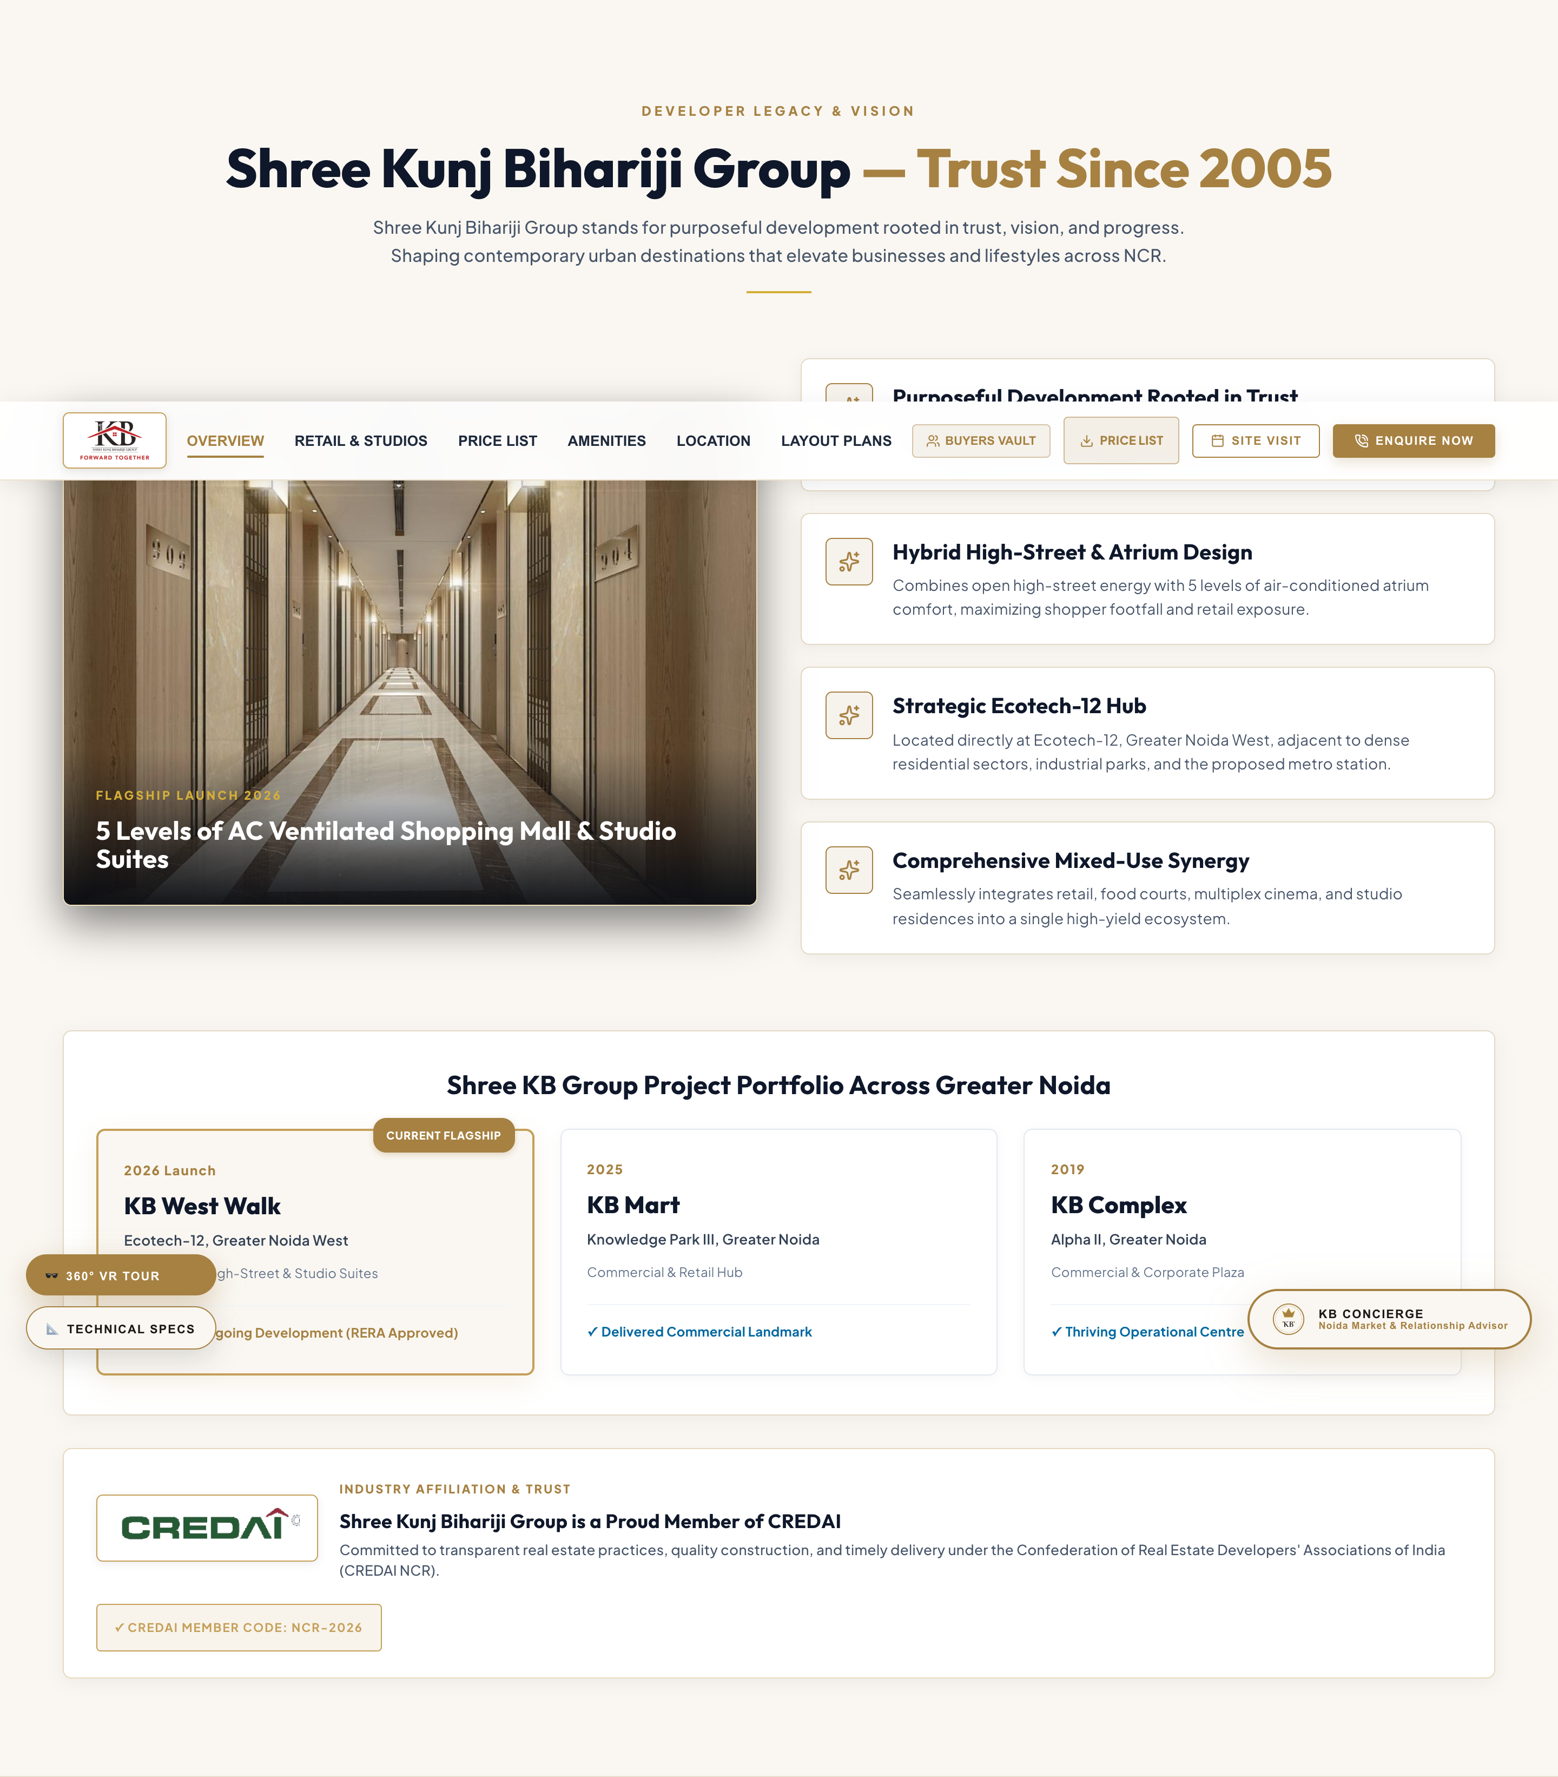
06. BRAND PHILOSOPHY & CREDAI AFFILIATION
Developer Legacy & CREDAI Member Industry Trust
SECTION DETAILS & FEATURE BREAKDOWN
• Developer Lineage: Shree Kunj Bihariji Group shaping urban destinations across NCR since 2005.
• CREDAI NCR Affiliation: Official CREDAI logo badge (`/credai_official_logo.png`) highlighting industry membership.
• Hybrid Architecture: Blends open-air high-street energy with 5 levels of AC atrium comfort.
• Strategic Ecotech-12 Location: Situated directly at Ecotech-12 adjacent to dense residential sectors.
• Delivered Portfolio: KB Mart (Knowledge Park III) and KB Complex (Alpha-2, Greater Noida).

Slide 8
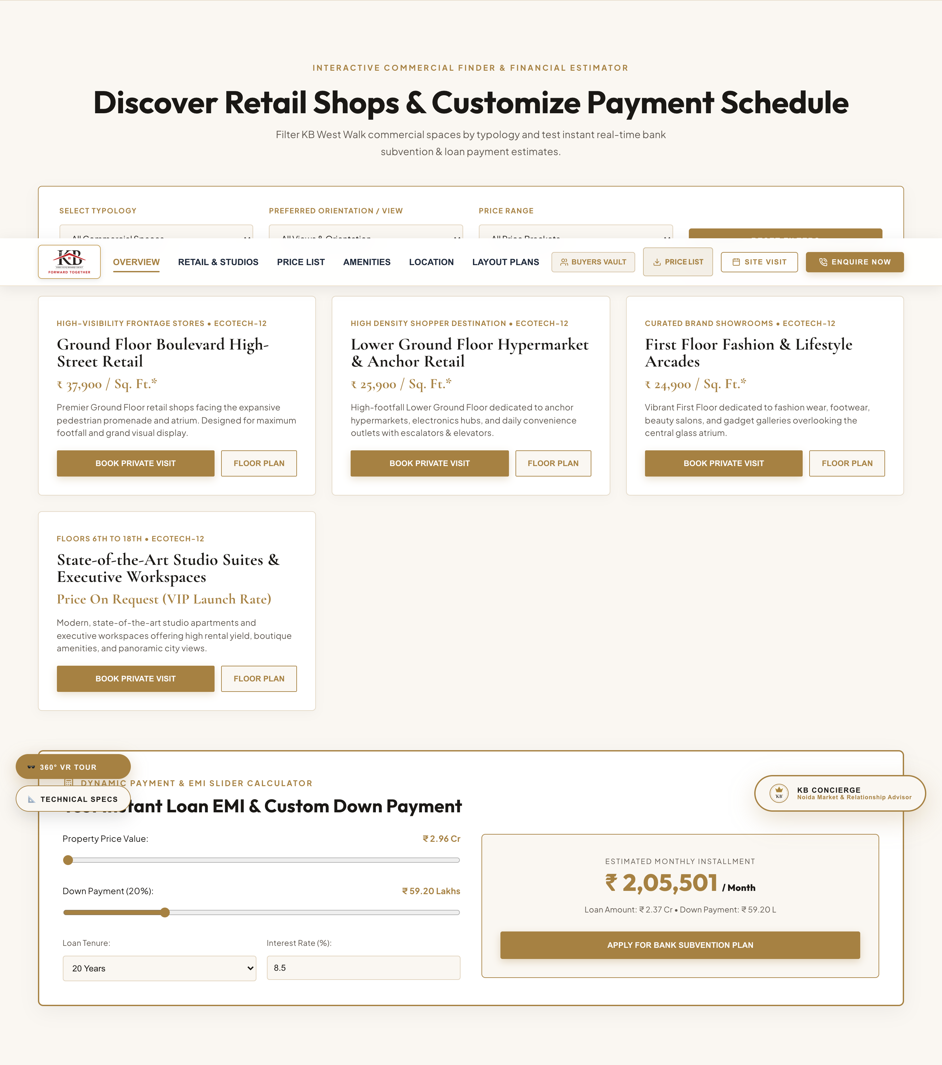
07. PROPERTY FINDER & LOAN EMI CALCULATOR
Interactive Space Search & Bank Loan Slider Tool
SECTION DETAILS & FEATURE BREAKDOWN
• Interactive Property Finder:
- Category Selector: Retail Shops, Food Court/Cinema, Studio Suites
- Budget Range Filter: Up to ₹50L, ₹50L-₹1Cr, ₹1Cr-₹3Cr, ₹3Cr+
- Orientation Filter: Atrium Facing, Boulevard Facing, Main Road View
• Real-Time Loan EMI Calculator:
- Property Price Slider: ₹29.6 L to ₹6.00 Cr
- Down Payment Percentage: 10% to 50%
- Loan Tenure: 10 to 30 Years & Interest Rate Input
- Live Monthly EMI Breakdown

Slide 9
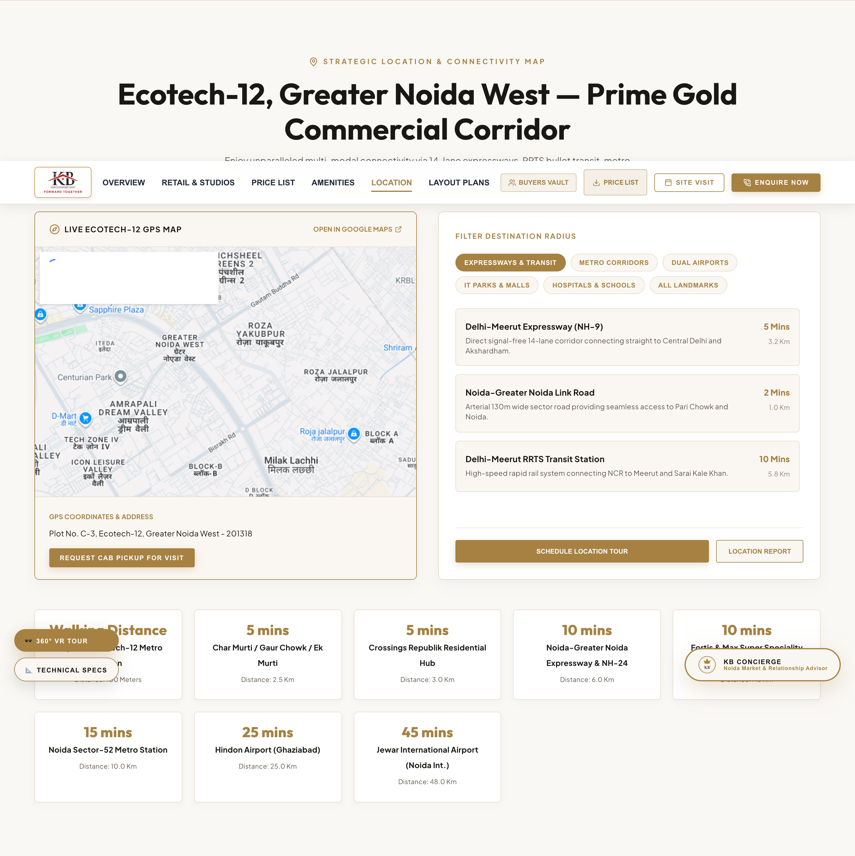
08. LOCATION ADVANTAGE & CONNECTIVITY MAP
Plot C-3, Ecotech-12 Distance Benchmarks & Transit Hubs
SECTION DETAILS & FEATURE BREAKDOWN
• Proposed Ecotech-12 Metro Station: Walking Distance (100 Meters)
• Char Murti / Gaur Chowk / Ek Murti: 5 Mins (2.5 Km)
• Crossings Republik Residential Hub: 5 Mins (3.0 Km)
• Noida-Greater Noida Expressway & NH-24: 10 Mins (6.0 Km)
• Fortis & Max Super Speciality Hospital: 10 Mins (7.5 Km)
• Noida Sector-52 Metro Station: 15 Mins (10.0 Km)
• Hindon Regional Airport: 25 Mins (25.0 Km)
• Jewar International Airport (Noida Int.): 45 Mins (48.0 Km)

Slide 10
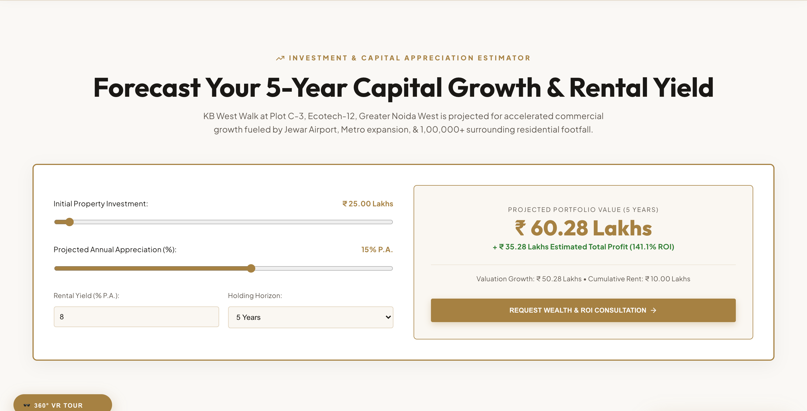
09. INVESTMENT ROI & GROWTH YIELD
Rental Yield Projections & Capital Appreciation Trends
SECTION DETAILS & FEATURE BREAKDOWN
• Commercial Rental Yield: 7.5% – 9.2% P.A. (Top performing retail corridor in Greater Noida West).
• YoY Capital Appreciation: +21.2% YoY Growth in Ecotech-12 commercial property values.
• Cumulative 3-Year Projection: +38% to +48% growth upon metro line & Jewar airport commissioning.
• Locality Benchmark Rating: 92 / 100 (4.9/5 Stars) on leading real estate portals.
• Immediate Footfall Base: Supported by 1,00,000+ nearby residential families.

Slide 11
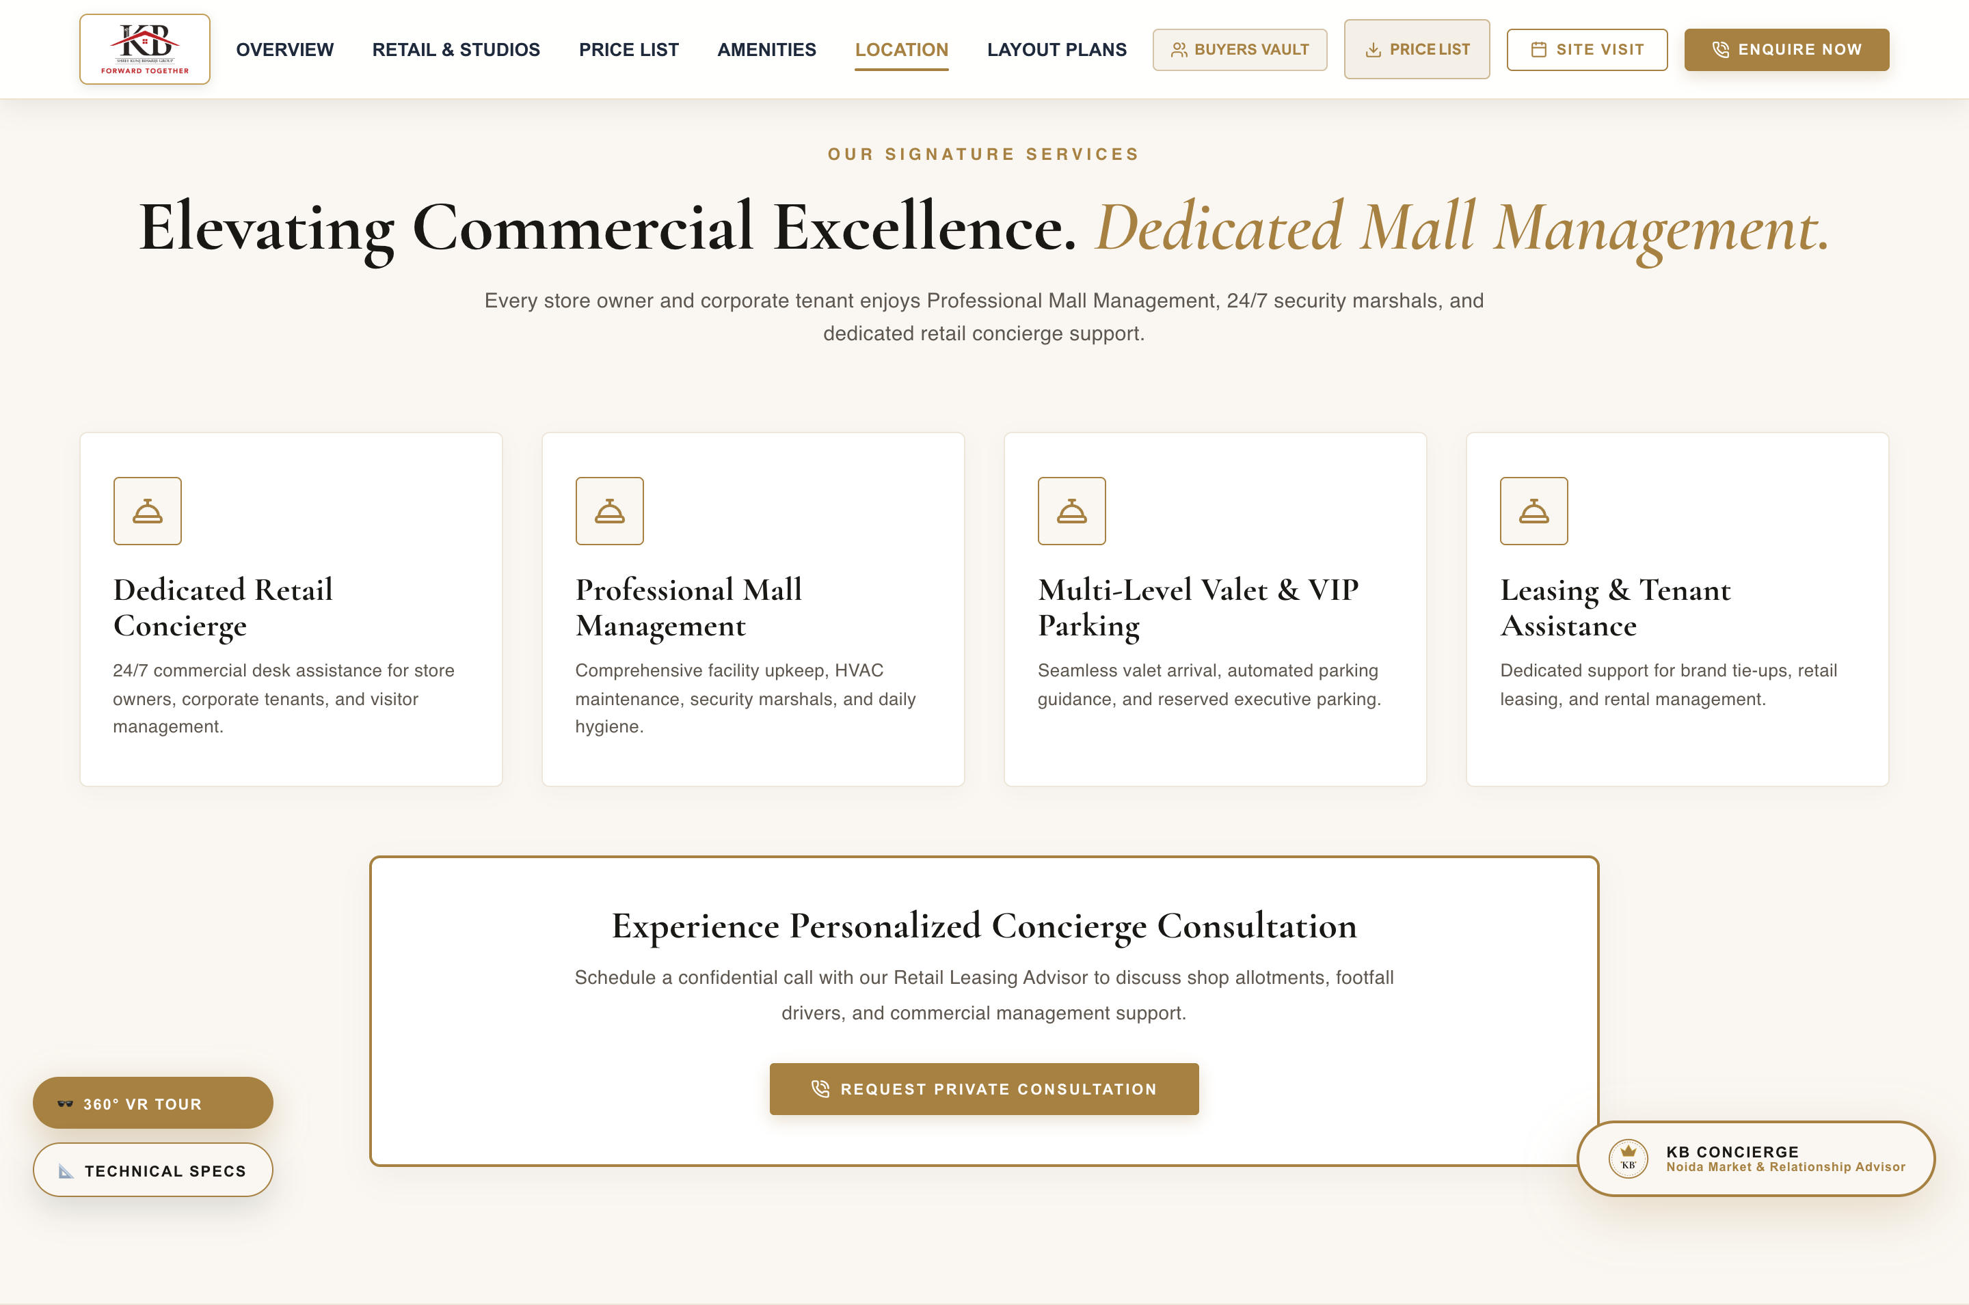
10. DEDICATED MALL & FACILITY SERVICES
4 Pillars of Commercial Mall Management & Support
SECTION DETAILS & FEATURE BREAKDOWN
• Dedicated Retail Concierge: 24/7 commercial desk assistance for store owners & corporate tenants.
• Professional Mall Management: Comprehensive facility upkeep, central HVAC climate maintenance & security.
• Multi-Level Valet & VIP Parking: Smooth valet arrival, automated parking guidance & executive slots.
• Leasing & Brand Support: Dedicated team for brand tie-ups, retail leasing & rental management.

Slide 12
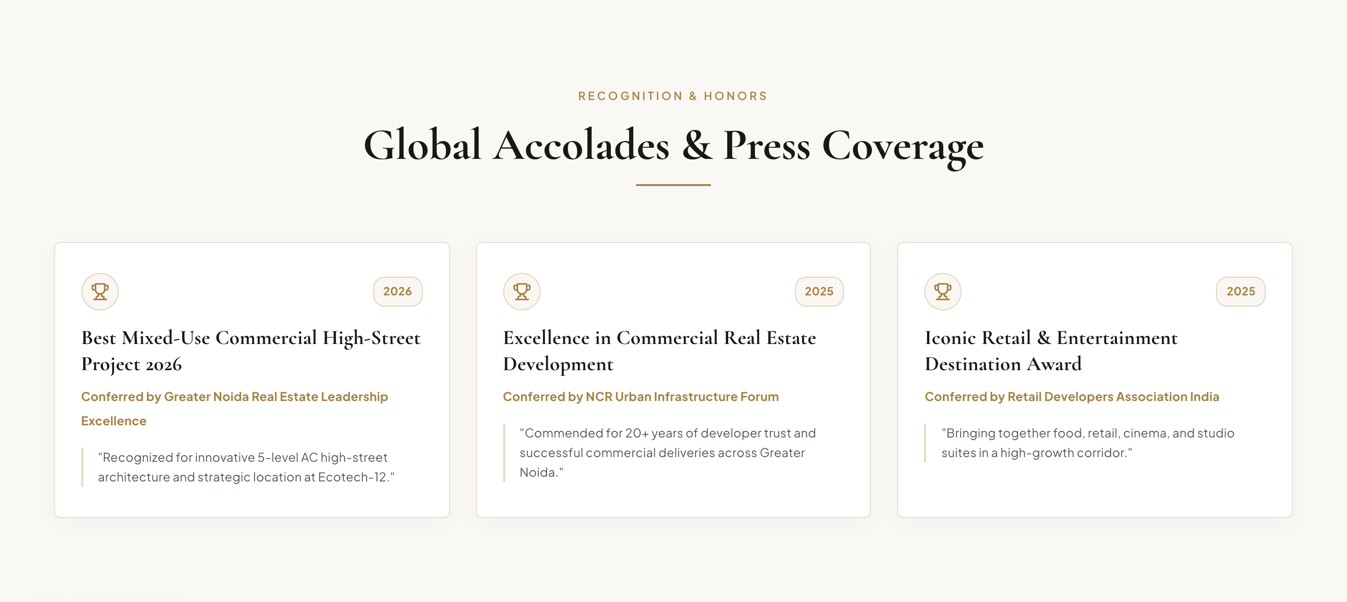
11. PRESS COVERAGE & INDUSTRY ACCOLADES
Media Coverage & Real Estate Excellence Recognitions
SECTION DETAILS & FEATURE BREAKDOWN
• Media Highlights: Featured in Economic Times, Financial Express, and Business Standard.
• Best High-Street Project Award: Recognized for innovative hybrid retail & atrium design in Greater Noida West.
• Investor Confidence Badge: Highlighted as top commercial investment destination for 2026.
• Transparent RERA Governance: Praised for transparent RERA account operations & timely milestone delivery.

Slide 13
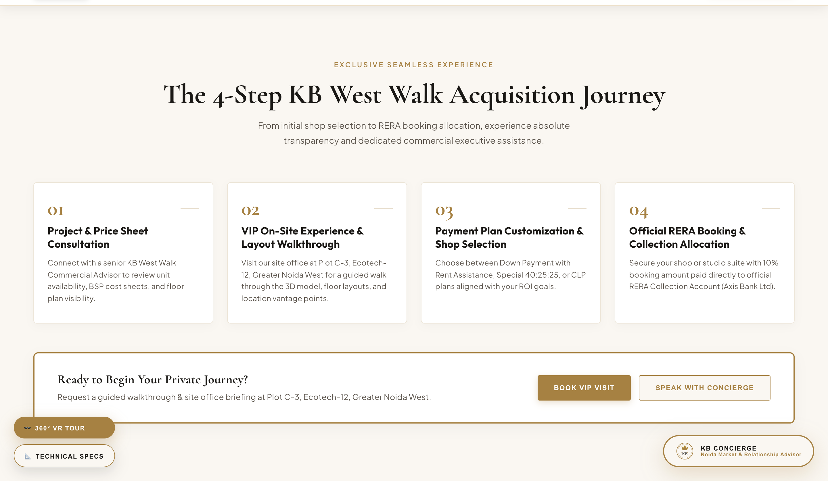
12. 4-STEP BUYER JOURNEY & ASSISTANCE
From Space Discovery to Possession & Rental Yield
SECTION DETAILS & FEATURE BREAKDOWN
• Step 1: Space Discovery & Virtual Tour (Explore floor plans, pricing & 360° VR walkthroughs).
• Step 2: Guided VIP Site Visit (On-site inspection with complimentary luxury AC chauffeur pickup).
• Step 3: Transparent Unit Allotment (Direct booking with Axis Bank RERA Collection account).
• Step 4: Possession & Leasing Support (Handover assistance, tenant onboarding & yield activation).

Slide 14
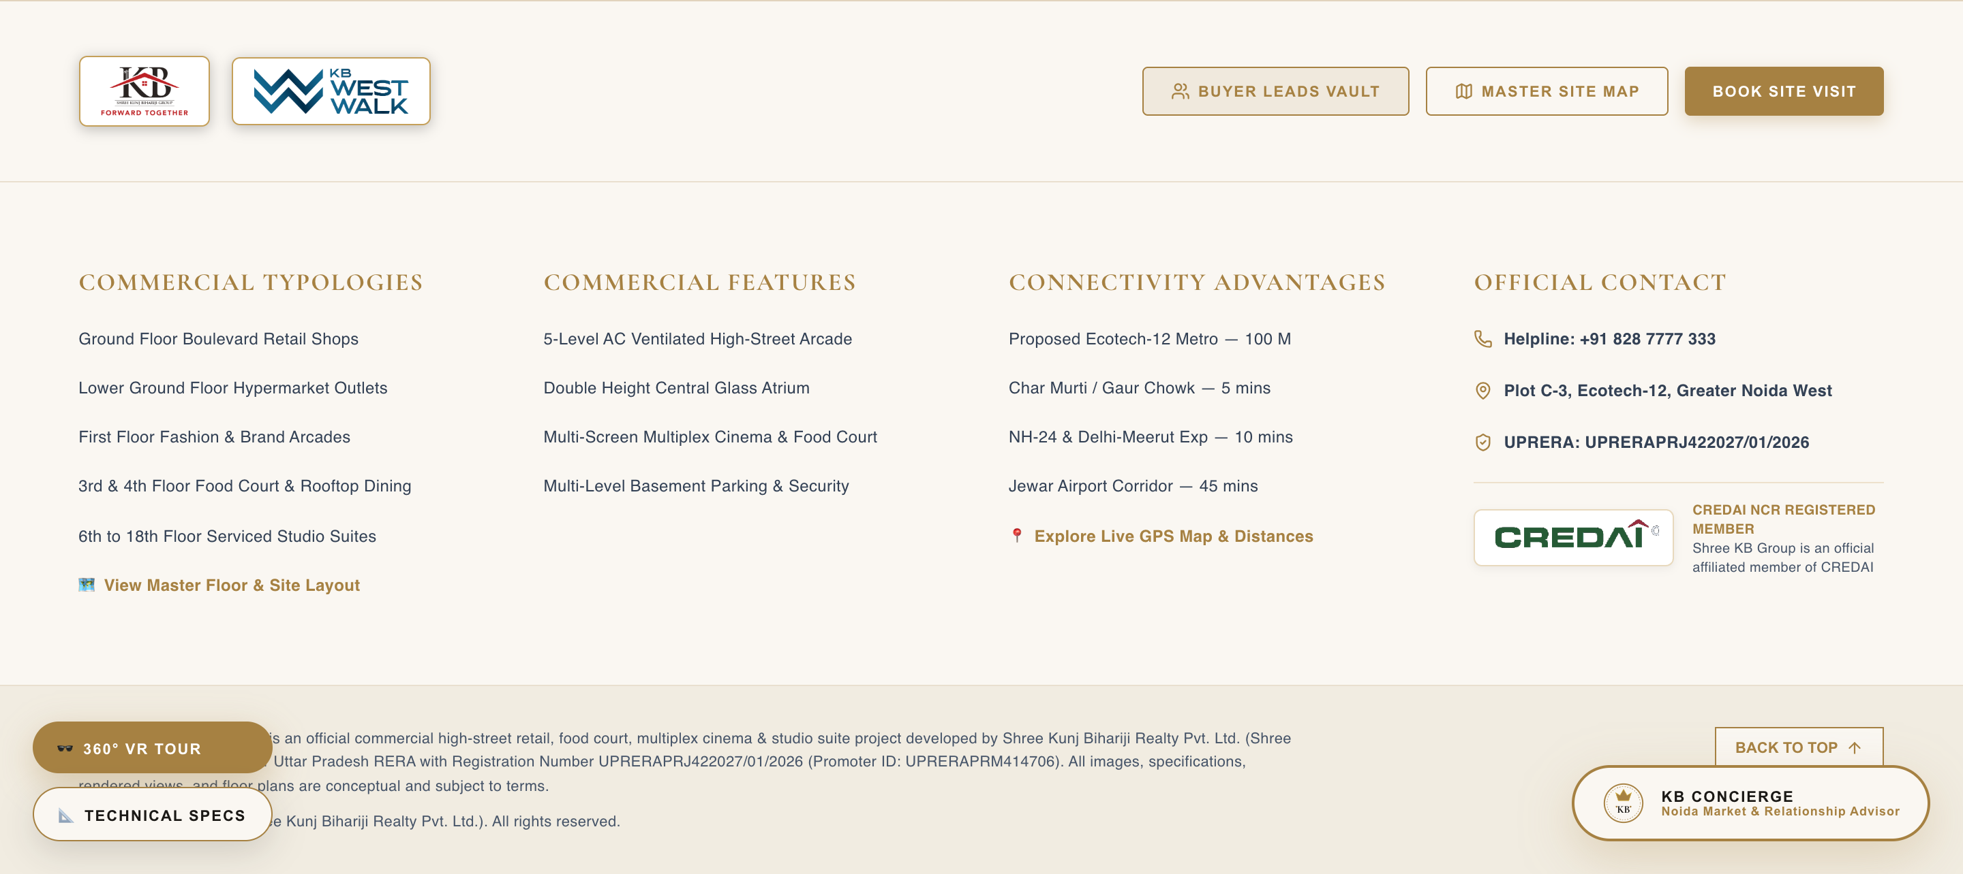
13. COMPREHENSIVE FOOTER & CONTACT DESK
Separate Builder & Project Logos, RERA Badge & Contact Details
SECTION DETAILS & FEATURE BREAKDOWN
• Standalone Logo Cards: Builder Company Logo (`/shree_kb_logo.png`) and Project Logo (`/kbww_logo.png`) displayed separately.
• Official CREDAI Logo Badge: Prominently featured under official details for industry verification.
• Complete Address Details: Site office at Plot C-3, Ecotech-12 & Corporate office at Alpha-2, Greater Noida.
• Direct Helpline: +91 828 7777 333 | Email: sales@shreekunjbihariji.com
• Disclaimers: Full RERA registration details & legal disclaimer text.

Slide 15
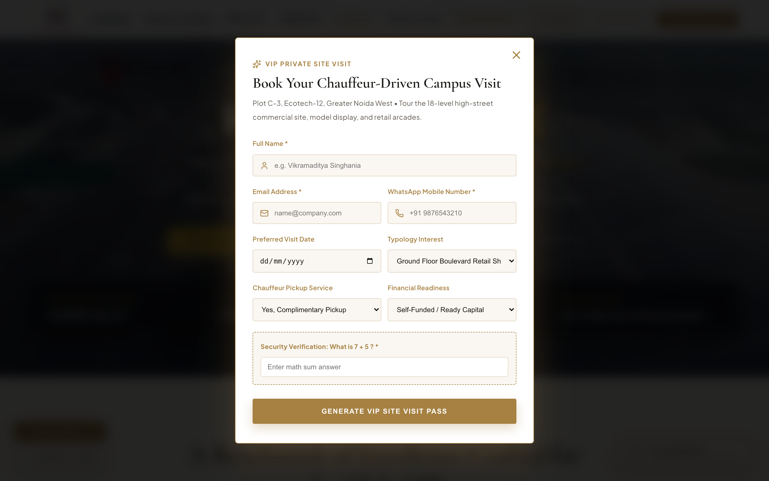
14. VIP SITE VISIT OVERLAY MODAL
On-Site Chauffeur Booking, Math Captcha & VIP Pass Generator
SECTION DETAILS & FEATURE BREAKDOWN
• Interactive Modal Trigger: 'BOOK VIP SITE VISIT' buttons placed across all sections.
• Chauffeur Pickup Option: Request a complimentary luxury AC chauffeur pickup.
• Preferred Slot Selection: Date & time slot picker for guided walkthroughs at Plot C-3, Ecotech-12.
• Captcha Security: Interactive math security challenge ensuring genuine buyer leads.
• Instant VIP Pass Generation: Generates a downloadable digital VIP Pass upon submission.

Slide 16
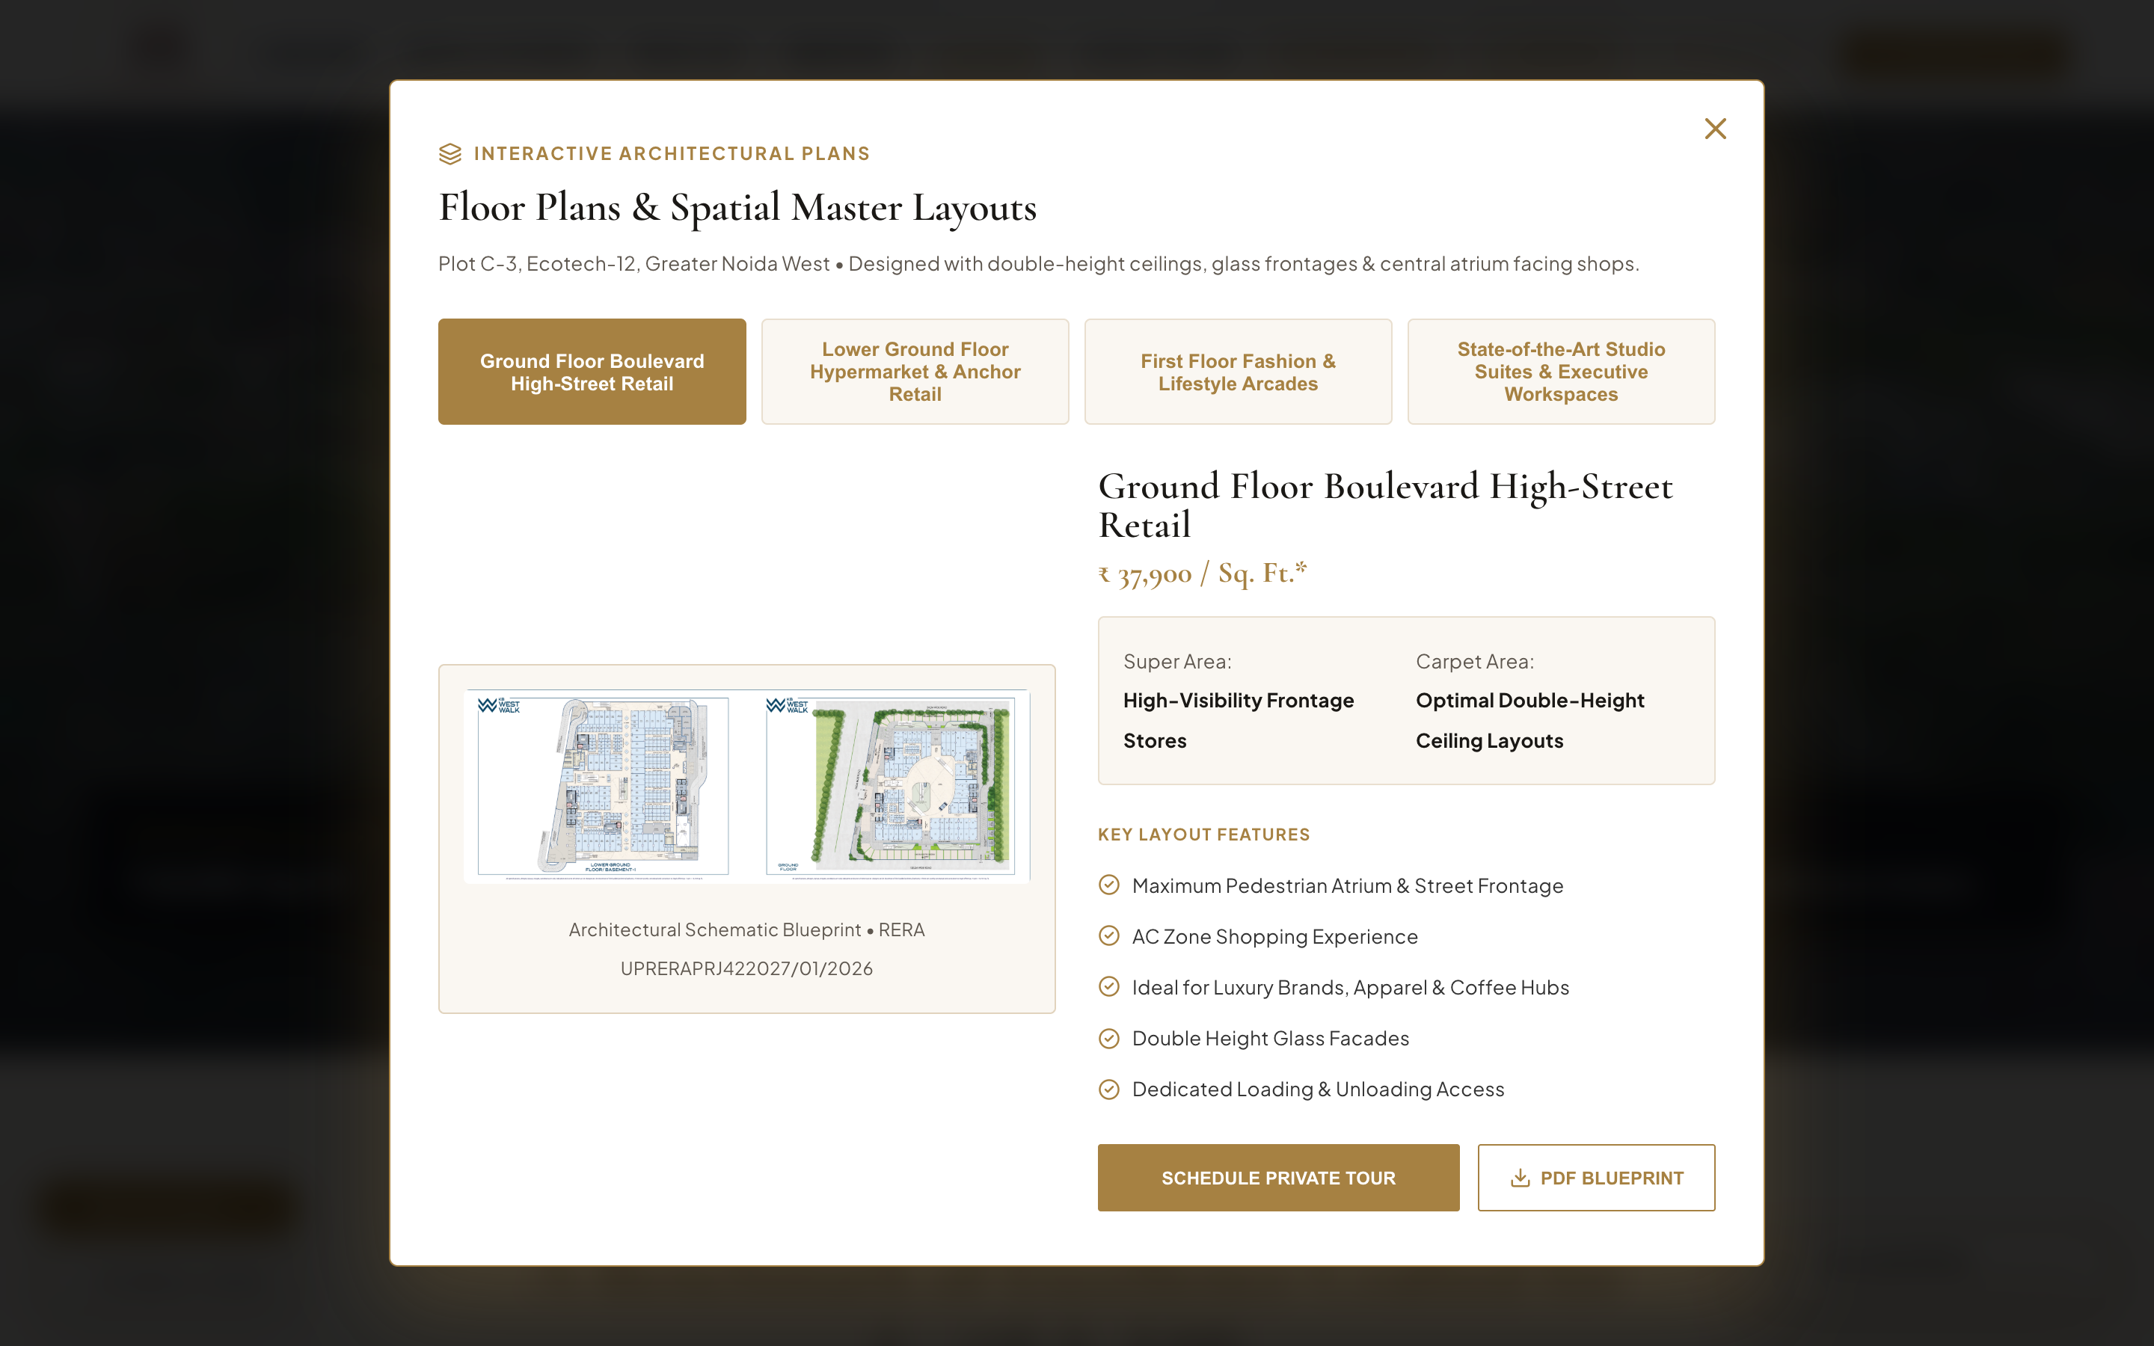
15. ARCHITECTURAL FLOOR PLANS MODAL
Interactive Floor Blueprint Swapper & Technical Unit Specs
SECTION DETAILS & FEATURE BREAKDOWN
• Interactive Modal Trigger: 'VIEW FLOOR PLANS' buttons across typologies.
• Floor Blueprint Tab Swapper: Switch between Lower Ground, Ground Floor, First Floor, and Studio Suites.
• High-Resolution Schematic Renderings: Shows unit dimensions, double height facades & atrium openings.
• Technical Specifications: Highlights super area, carpet area, ceiling heights, and loading hoists.
• Download Blueprint CTA: Instant PDF floor plan download.

Slide 17
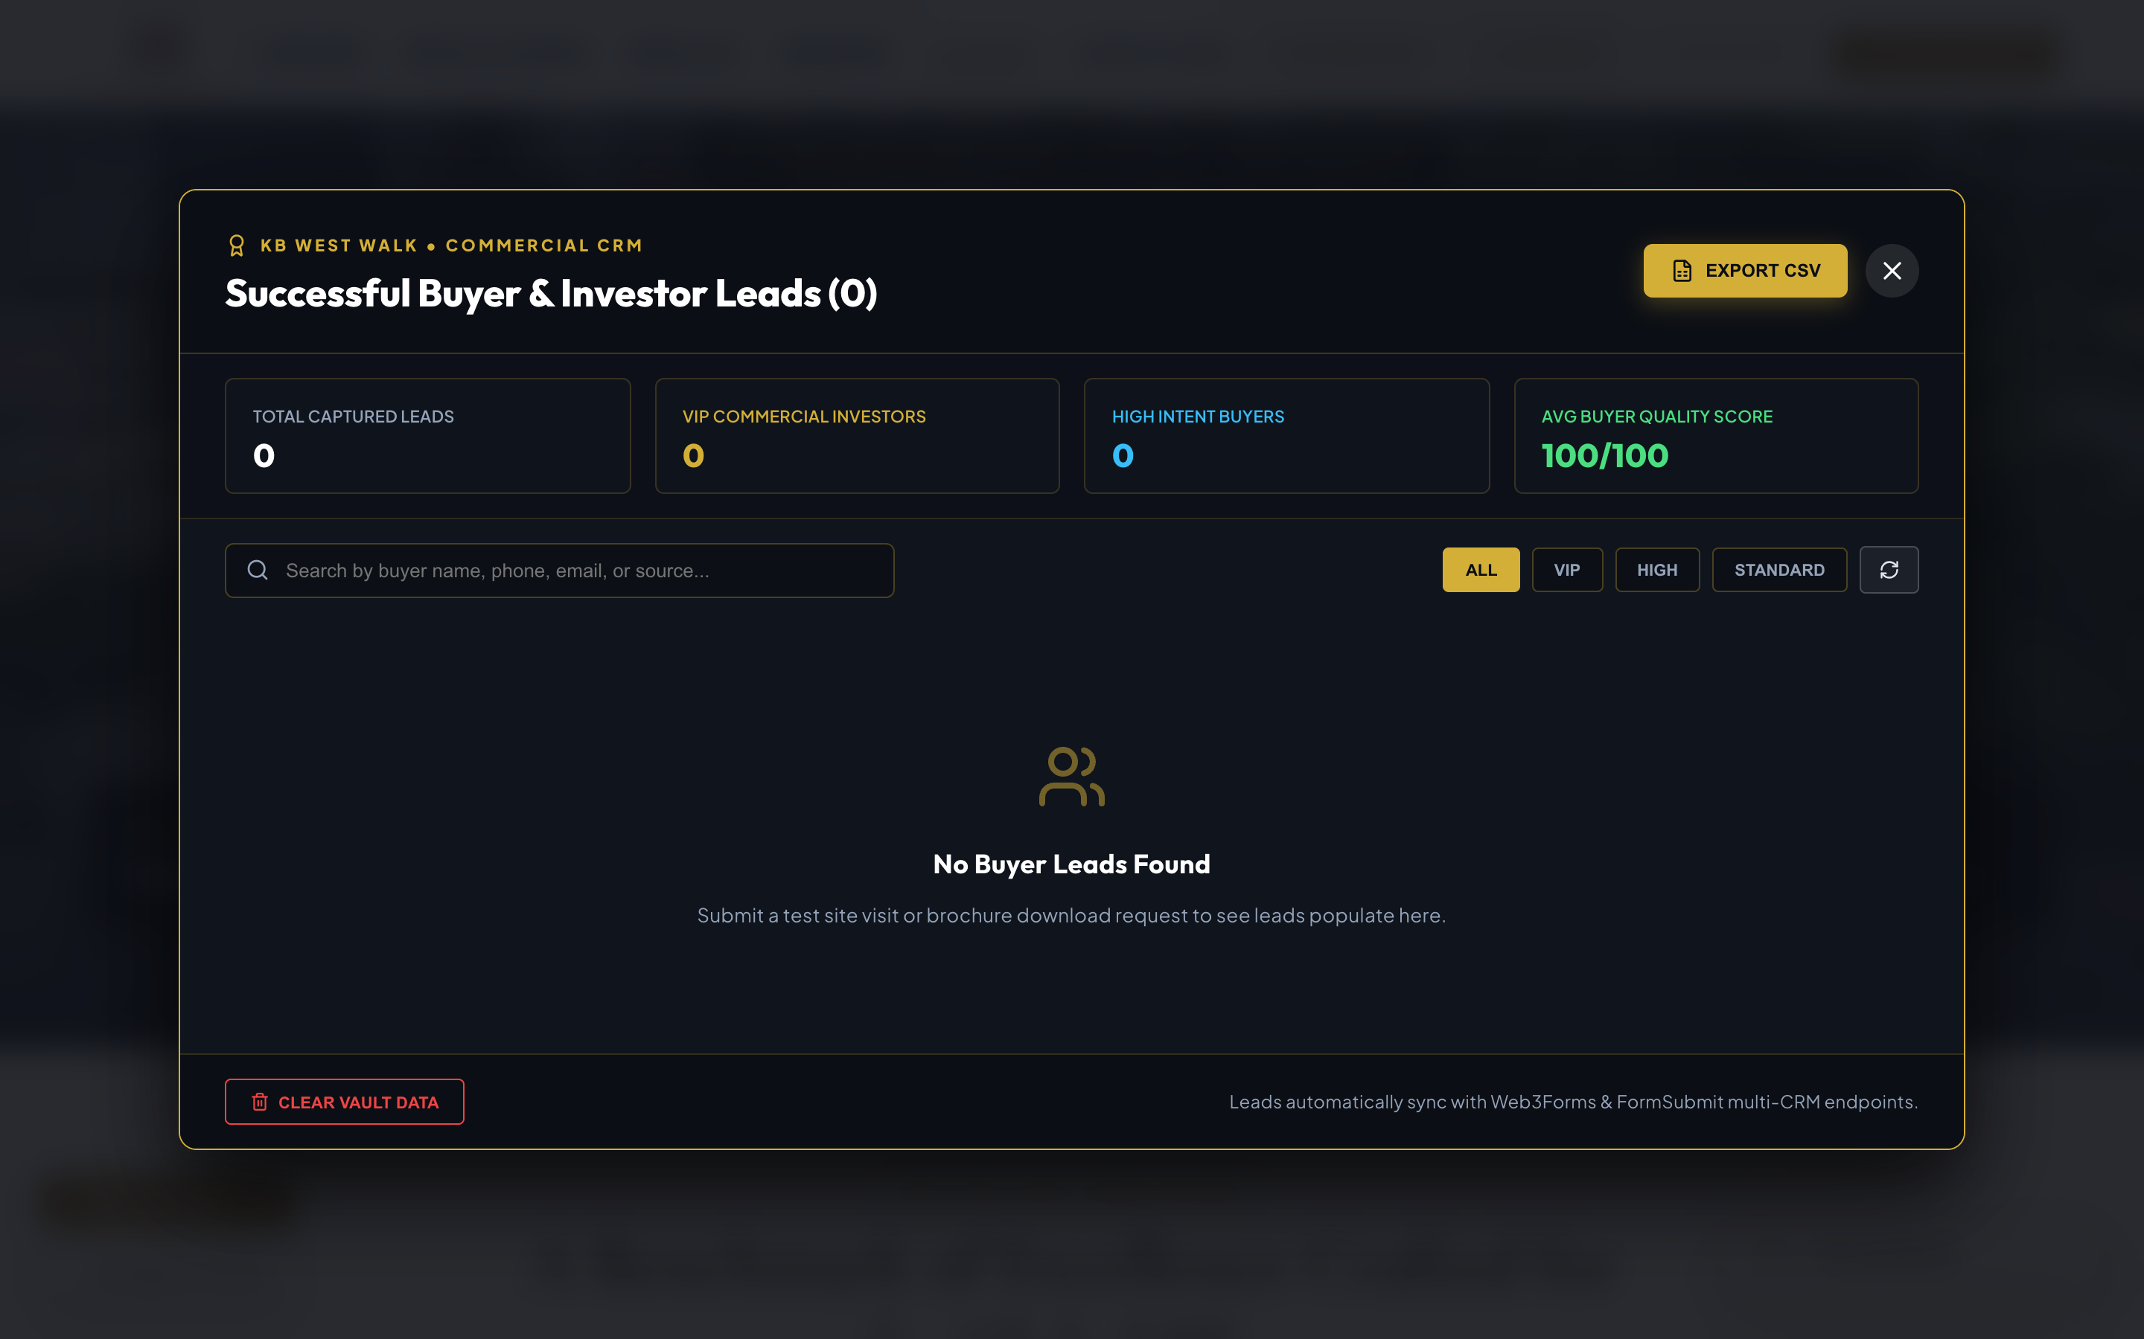
16. BUYER LEADS VAULT & CRM DASHBOARD
100-Point Scoring, Local Storage Vault & CSV Export
SECTION DETAILS & FEATURE BREAKDOWN
• Global Shortcut Trigger: Ctrl + Shift + L or Cmd + Shift + L keyboard shortcut.
• Local Vault Storage: Persistent client-side storage in `localStorage` (`kb_west_walk_leads_vault`).
• 100-Point Quality Scoring: Deducts 50 pts for temp emails/phones; adds 15 pts for chauffeur requests.
• Buyer Tiering: VIP Commercial Investor (90+), High Intent Buyer (70+), Standard Prospect (<70).
• One-Click CSV Export: Instant CSV download via `exportLeadsToCSV()` for sales team dispatch.

Slide 18
PORTAL AUDIT & VISUAL PRESENTATION COMPLETE
✔ 16 High-Resolution Section Screenshots: All website sections & modal overlays captured and embedded.
✔ Official KB Branding: Fixed company logo using official Shree KB Group Crest & KB West Walk brand logos.
✔ Official CREDAI Logo: Integrated official dark green & red CREDAI crest badge in Philosophy & Footer.
✔ RERA Compliance Verified: Registration No UPRERAPRJ422027/01/2026 & Axis Bank Collection Account details.
✔ Live Interactive Server: Running smoothly at http://localhost:3000/ with React 19 & Vite 8.
📍 SITE OFFICE: Plot No. C-3, Ecotech-12, Greater Noida West - 201318
🏢 CORPORATE OFFICE: FF-39, First Floor, KB Complex, Plot No. LS-1, Alpha-2, Greater Noida, U.P. 201310
📞 HELPLINE: +91 828 7777 333 | WHATSAPP: +91 828 7777 333

