Slide 1
SHREE KUNJ BIHARIJI REALTY PVT. LTD. • RERA APPROVED
KB WEST WALK
Complete Website Screen Captures & Visual Layout Audit Presentation
📍 Address: Plot No. C-3, Ecotech-12, Greater Noida West, Uttar Pradesh 201318
📜 RERA Registration No: UPRERAPRJ422027/01/2026 | Promoter ID: UPRERAPRM414706
🏬 Building Scale: 18-Level Mixed-Use High-Street Commercial Landmark
📸 Visual Features: Embedded PNG Screenshots of All 14 Website Sections & Modals
📞 Commercial Helpline: +91 828 7777 333 | WhatsApp: +91 828 7777 333

Slide 2
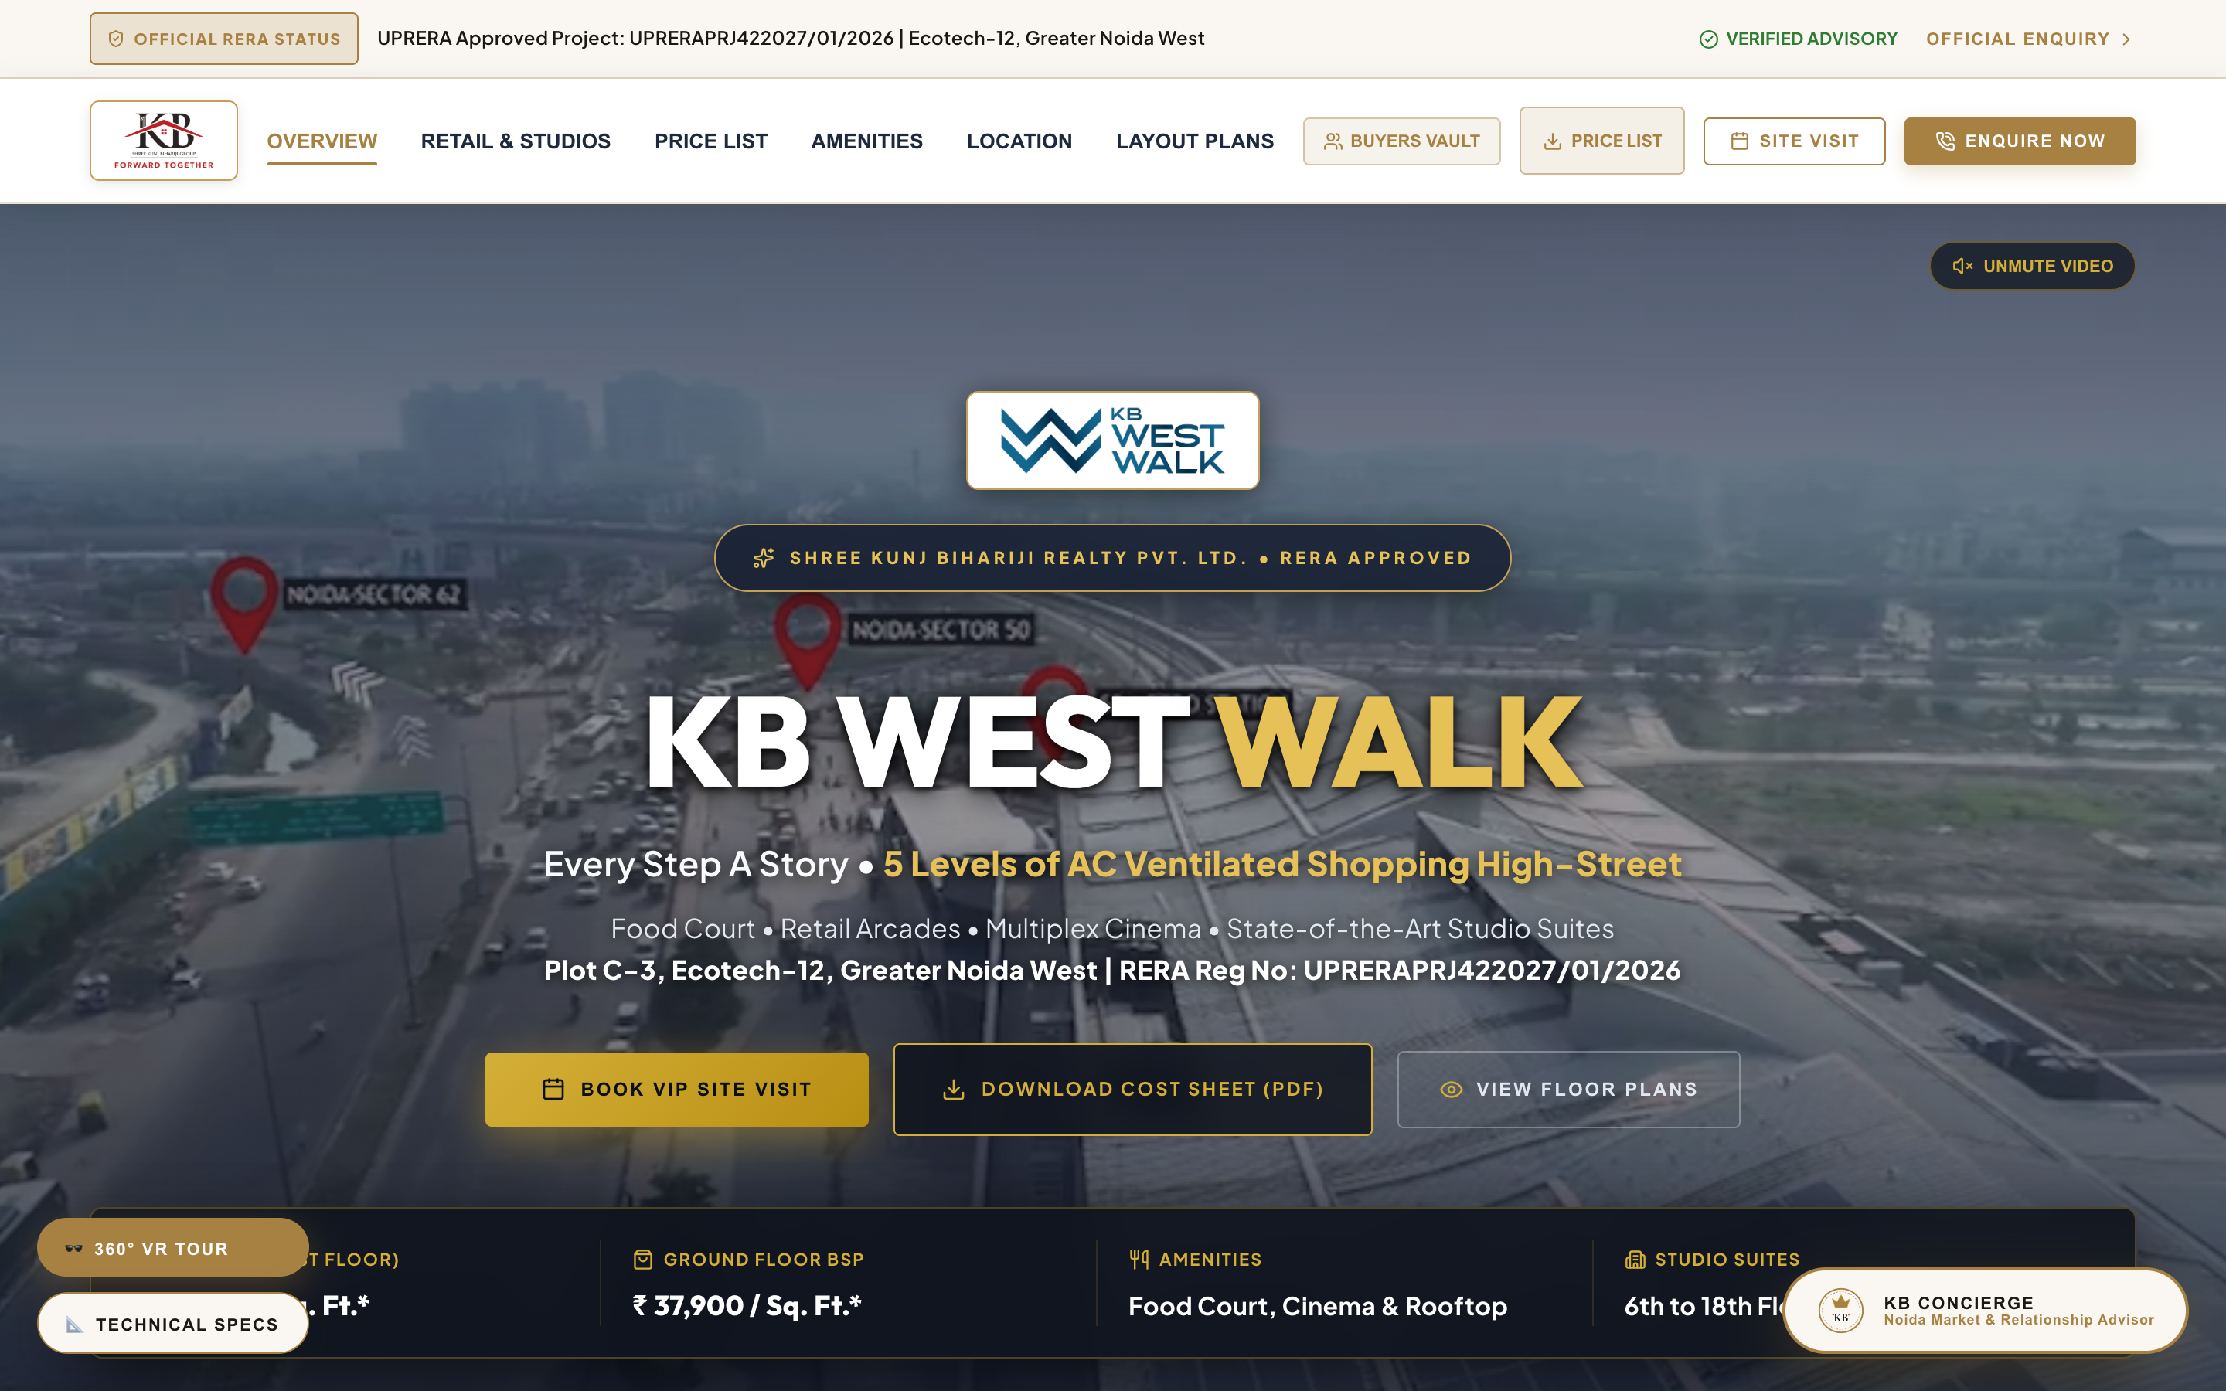
01. HERO CANVAS & NAVIGATION HEADER
Utility Ticker Bar, Official KB Logos & First Fold Impact
SECTION ANALYSIS & DELINEATED CONTENT
• Animated Live Buyer Ticker Bar at the top of the header.
• Brand Logos: Official Shree KB Group Crest (`/shree_kb_logo.png`) paired with KB West Walk Logo (`/kbww_logo.png`).
• Section Anchors: Smooth scroll to Overview, Shops, Pricing, Amenities, Location, ROI, and Management.
• Primary Hero Pitch: 'Every Step A Story • 5 Levels of AC Ventilated Shopping High-Street'.
• Immediate CTAs: 'Book VIP Site Visit', 'Download Cost Sheet (PDF)', and 'View Floor Plans'.

Slide 3
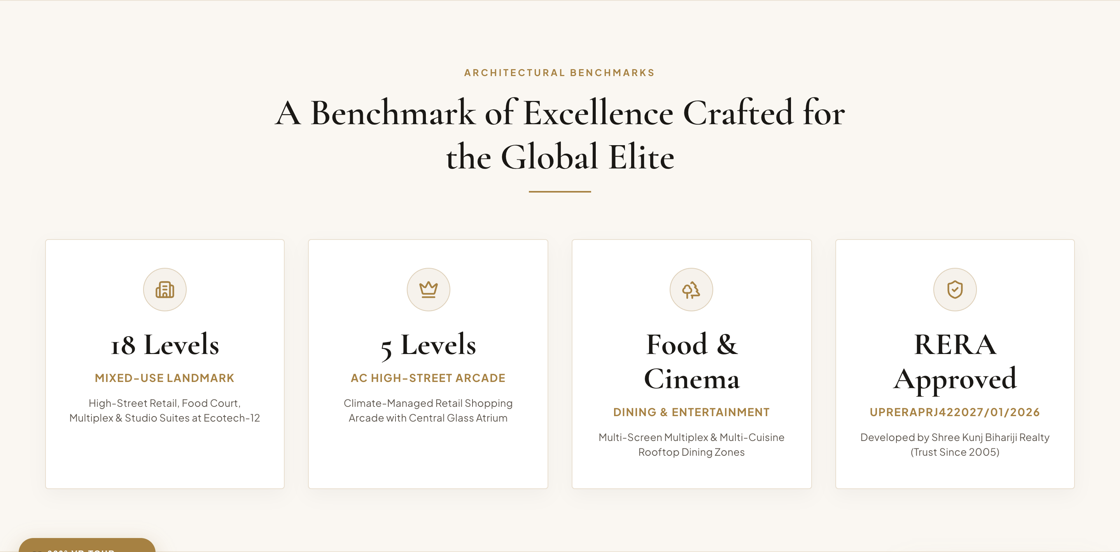
02. LEGACY METRICS COUNTER
Developer Trust & Landmark Commercial Scale Stats
SECTION ANALYSIS & DELINEATED CONTENT
• Developer Trust: 20+ Years shaping urban commercial landmarks across NCR since 2005.
• Building Scale: 18 Levels mixed-use development with 5 levels of AC retail high-street.
• RERA Approval: Registered under UPRERAPRJ422027/01/2026 with promoter ID UPRERAPRM414706.
• Strategic Location: Directly at Ecotech-12, Greater Noida West, adjacent to proposed metro station.
• Captive Base: Surrounded by 1,00,000+ occupied residential apartments.

Slide 4
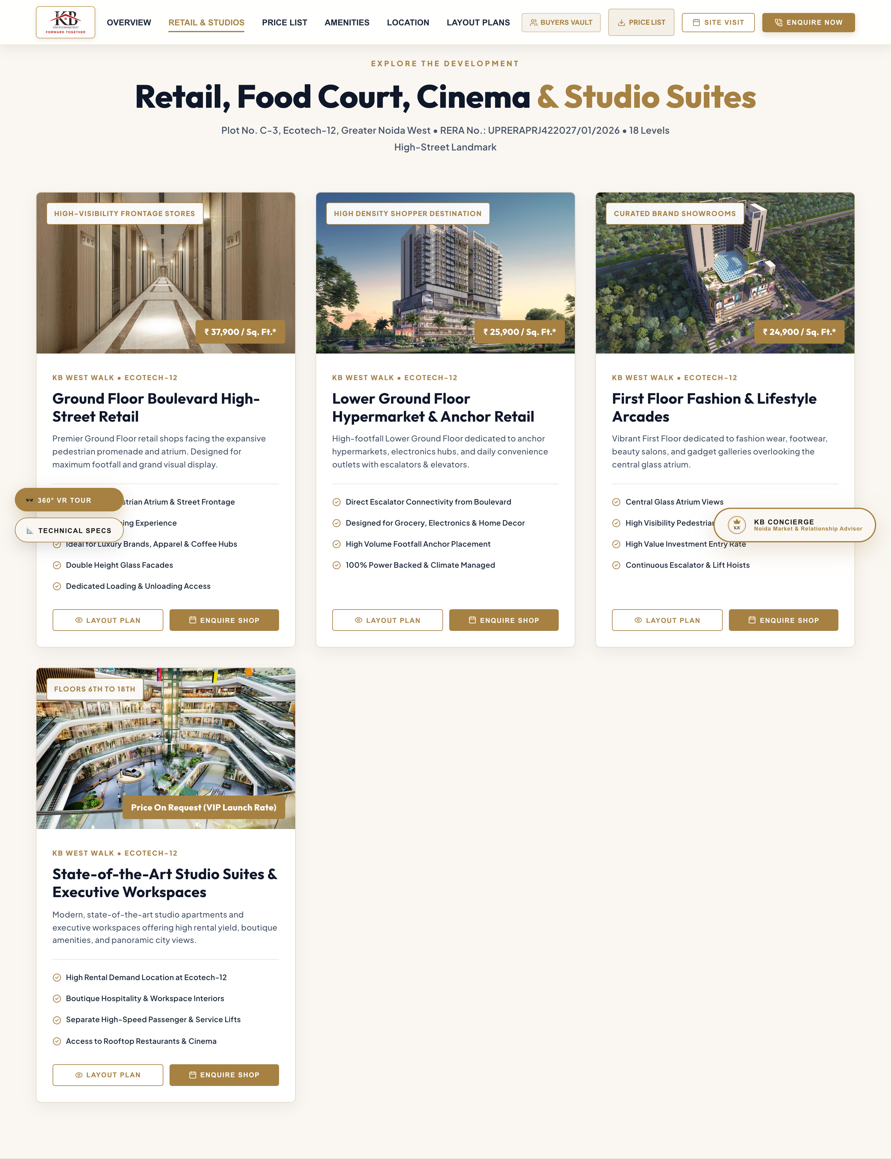
03. COMMERCIAL TYPOLOGIES & SPACES
Floor-Wise Retail Shops, Anchor Outlets & Studio Suites
SECTION ANALYSIS & DELINEATED CONTENT
• Ground Floor Boulevard Retail: ₹37,900 / Sq. Ft. (Flagship stores facing pedestrian promenade).
• Lower Ground Floor: ₹25,900 / Sq. Ft. (Hypermarket, electronics & convenience anchor stores).
• First Floor Fashion Arcades: ₹24,900 / Sq. Ft. (Apparel, beauty salons & lifestyle showrooms).
• 3rd to 5th Floor Hospitality: Gourmet Food Court, Rooftop Dining & 5-Screen Multiplex Cinema.
• 6th to 18th Floor Studio Suites: Serviced studio apartments & executive workspaces offering high yield.

Slide 5
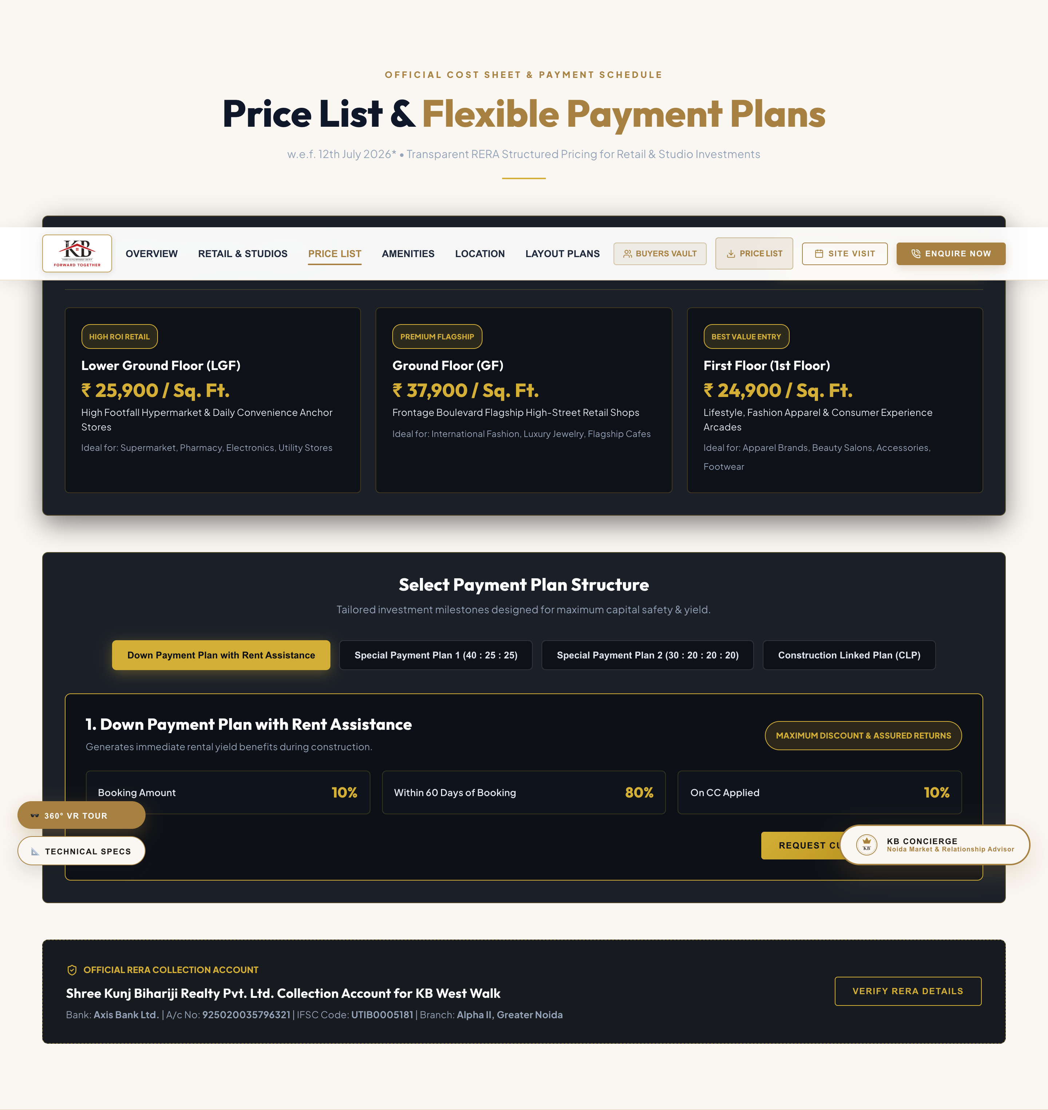
04. OFFICIAL COST SHEET & RERA BANK DETAILS
Transparent BSP Rate Table & Axis Bank Collection Account
SECTION ANALYSIS & DELINEATED CONTENT
• Base Selling Price Schedule w.e.f. July 12, 2026*:
- LGF: ₹ 25,900 / Sq. Ft.
- GF Boulevard: ₹ 37,900 / Sq. Ft.
- 1st Floor: ₹ 24,900 / Sq. Ft.
• RERA Collection Bank Account Details:
- Account Name: Shree Kunj Bihariji Realty Pvt. Ltd. Collection Account for KB West Walk
- Bank Name: Axis Bank Ltd.
- Account Number: 925020035796321
- IFSC Code: UTIB0005181 (Alpha II Branch)

Slide 6
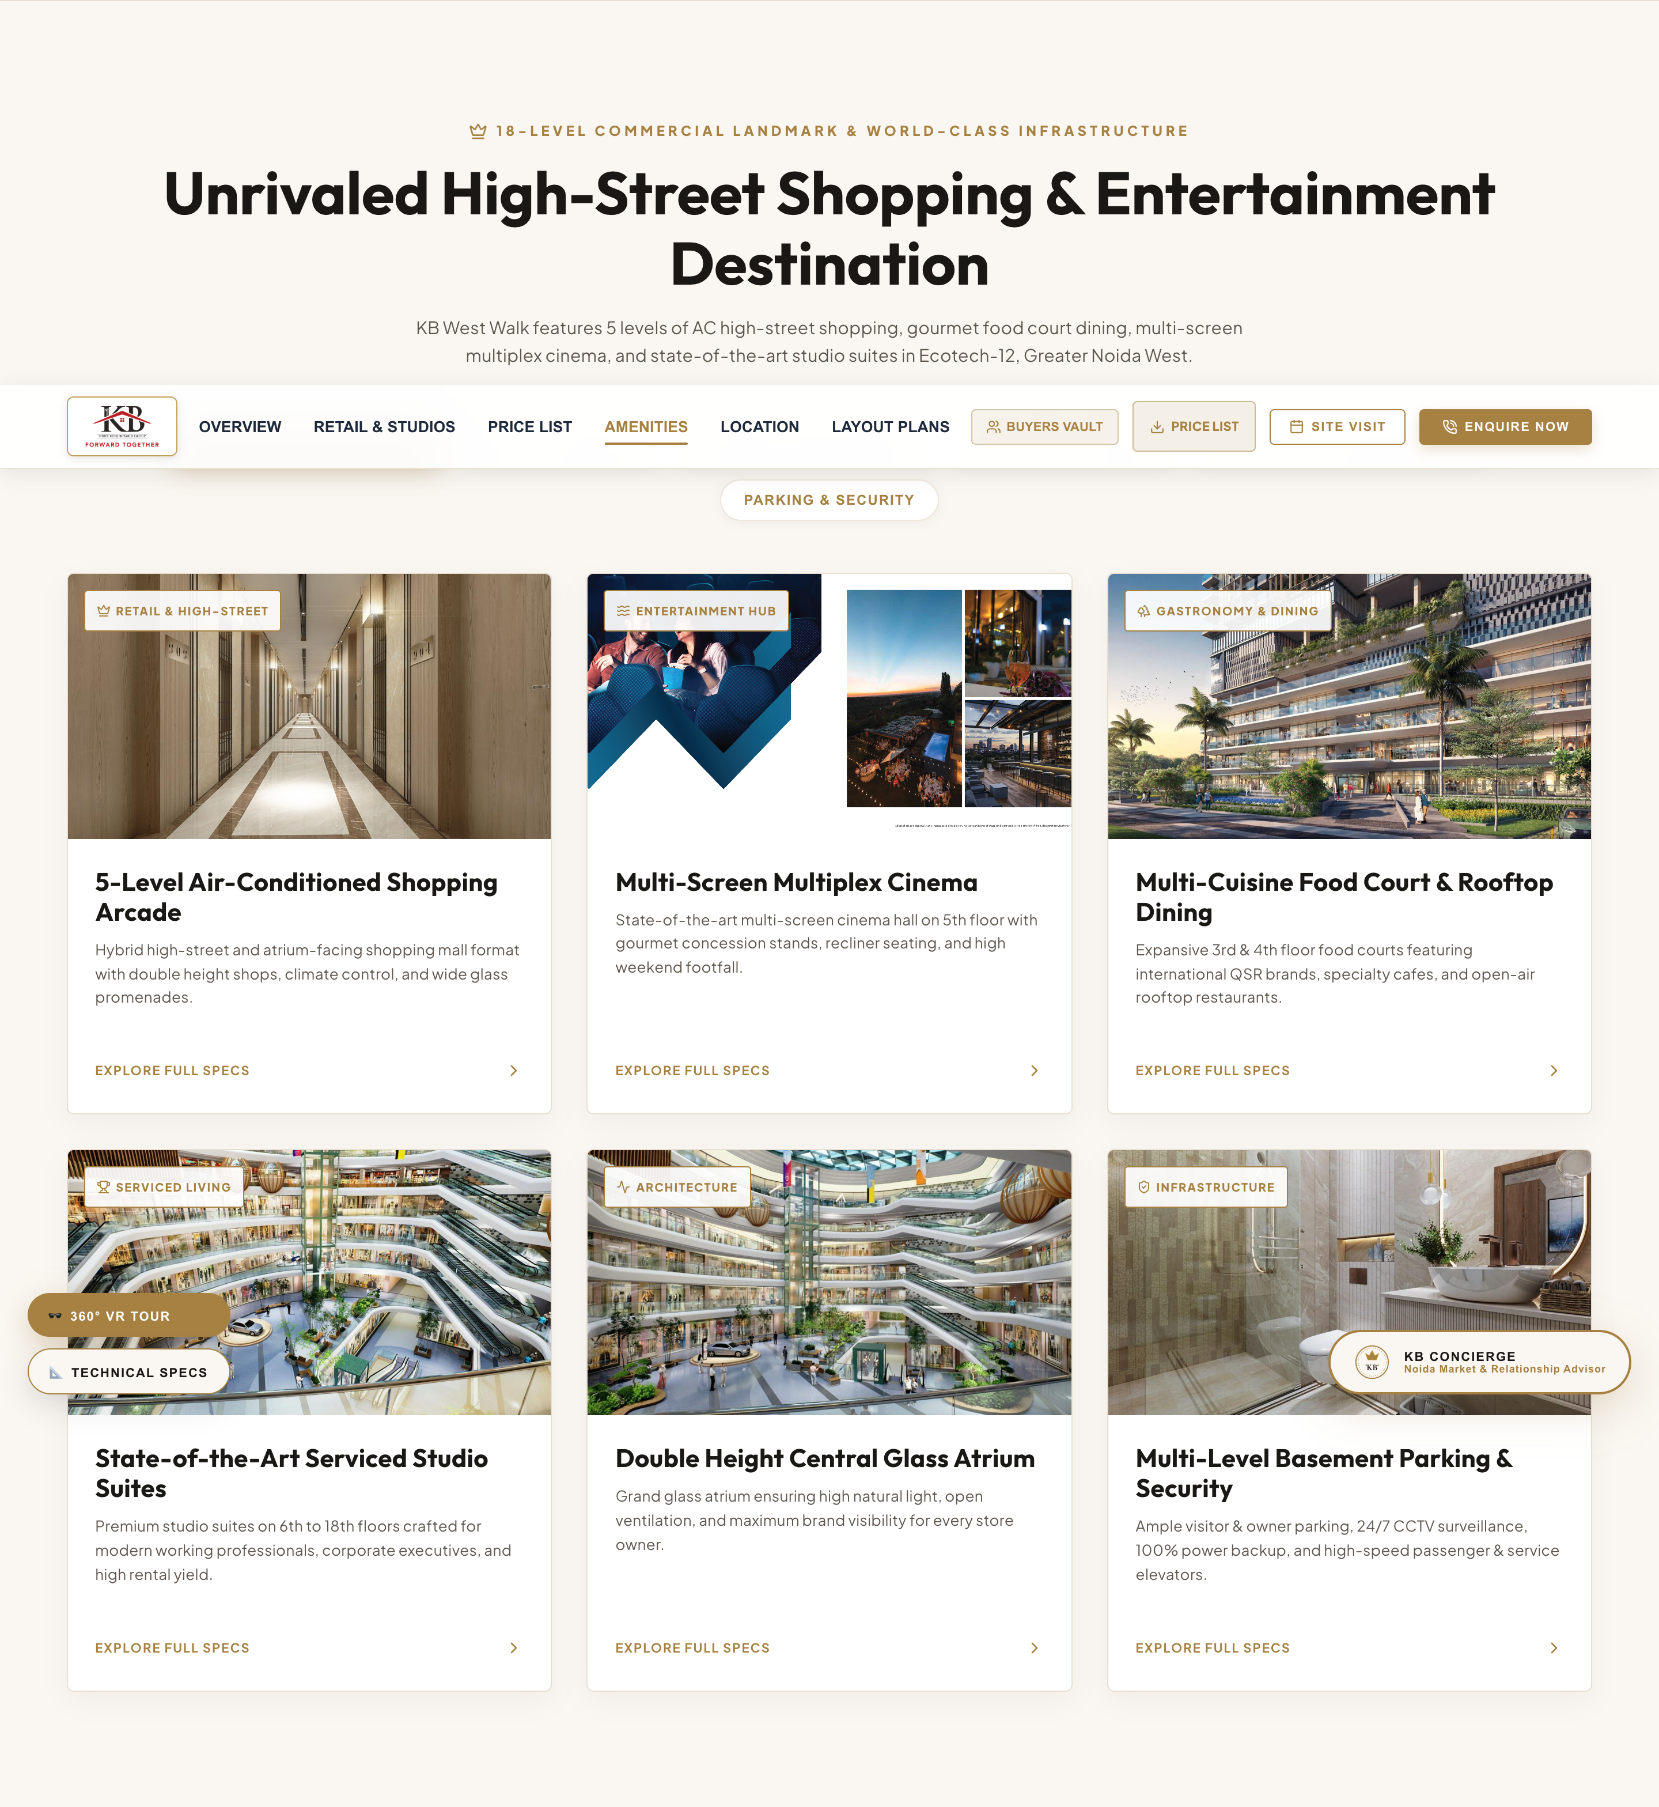
05. COMMERCIAL INFRASTRUCTURE & AMENITIES
6 Core Pillars of Retail, Entertainment & Working Infrastructure
SECTION ANALYSIS & DELINEATED CONTENT
• 5-Level AC Shopping Arcade: Hybrid high-street & atrium format with climate management.
• Multi-Screen Multiplex Cinema: State-of-the-art cinema hall on 5th floor with gourmet concessions.
• Food Court & Rooftop Dining: Expansive 3rd & 4th floor food courts with QSR brands & rooftop dining.
• Serviced Studio Apartments: Premium studio suites on 6th to 18th floors crafted for high rental yields.
• Double Height Glass Atrium: Skylight atrium ensuring natural light, open ventilation & brand display.
• Basement Parking & Security: Multi-level visitor parking, 24/7 CCTV surveillance & 100% power backup.

Slide 7
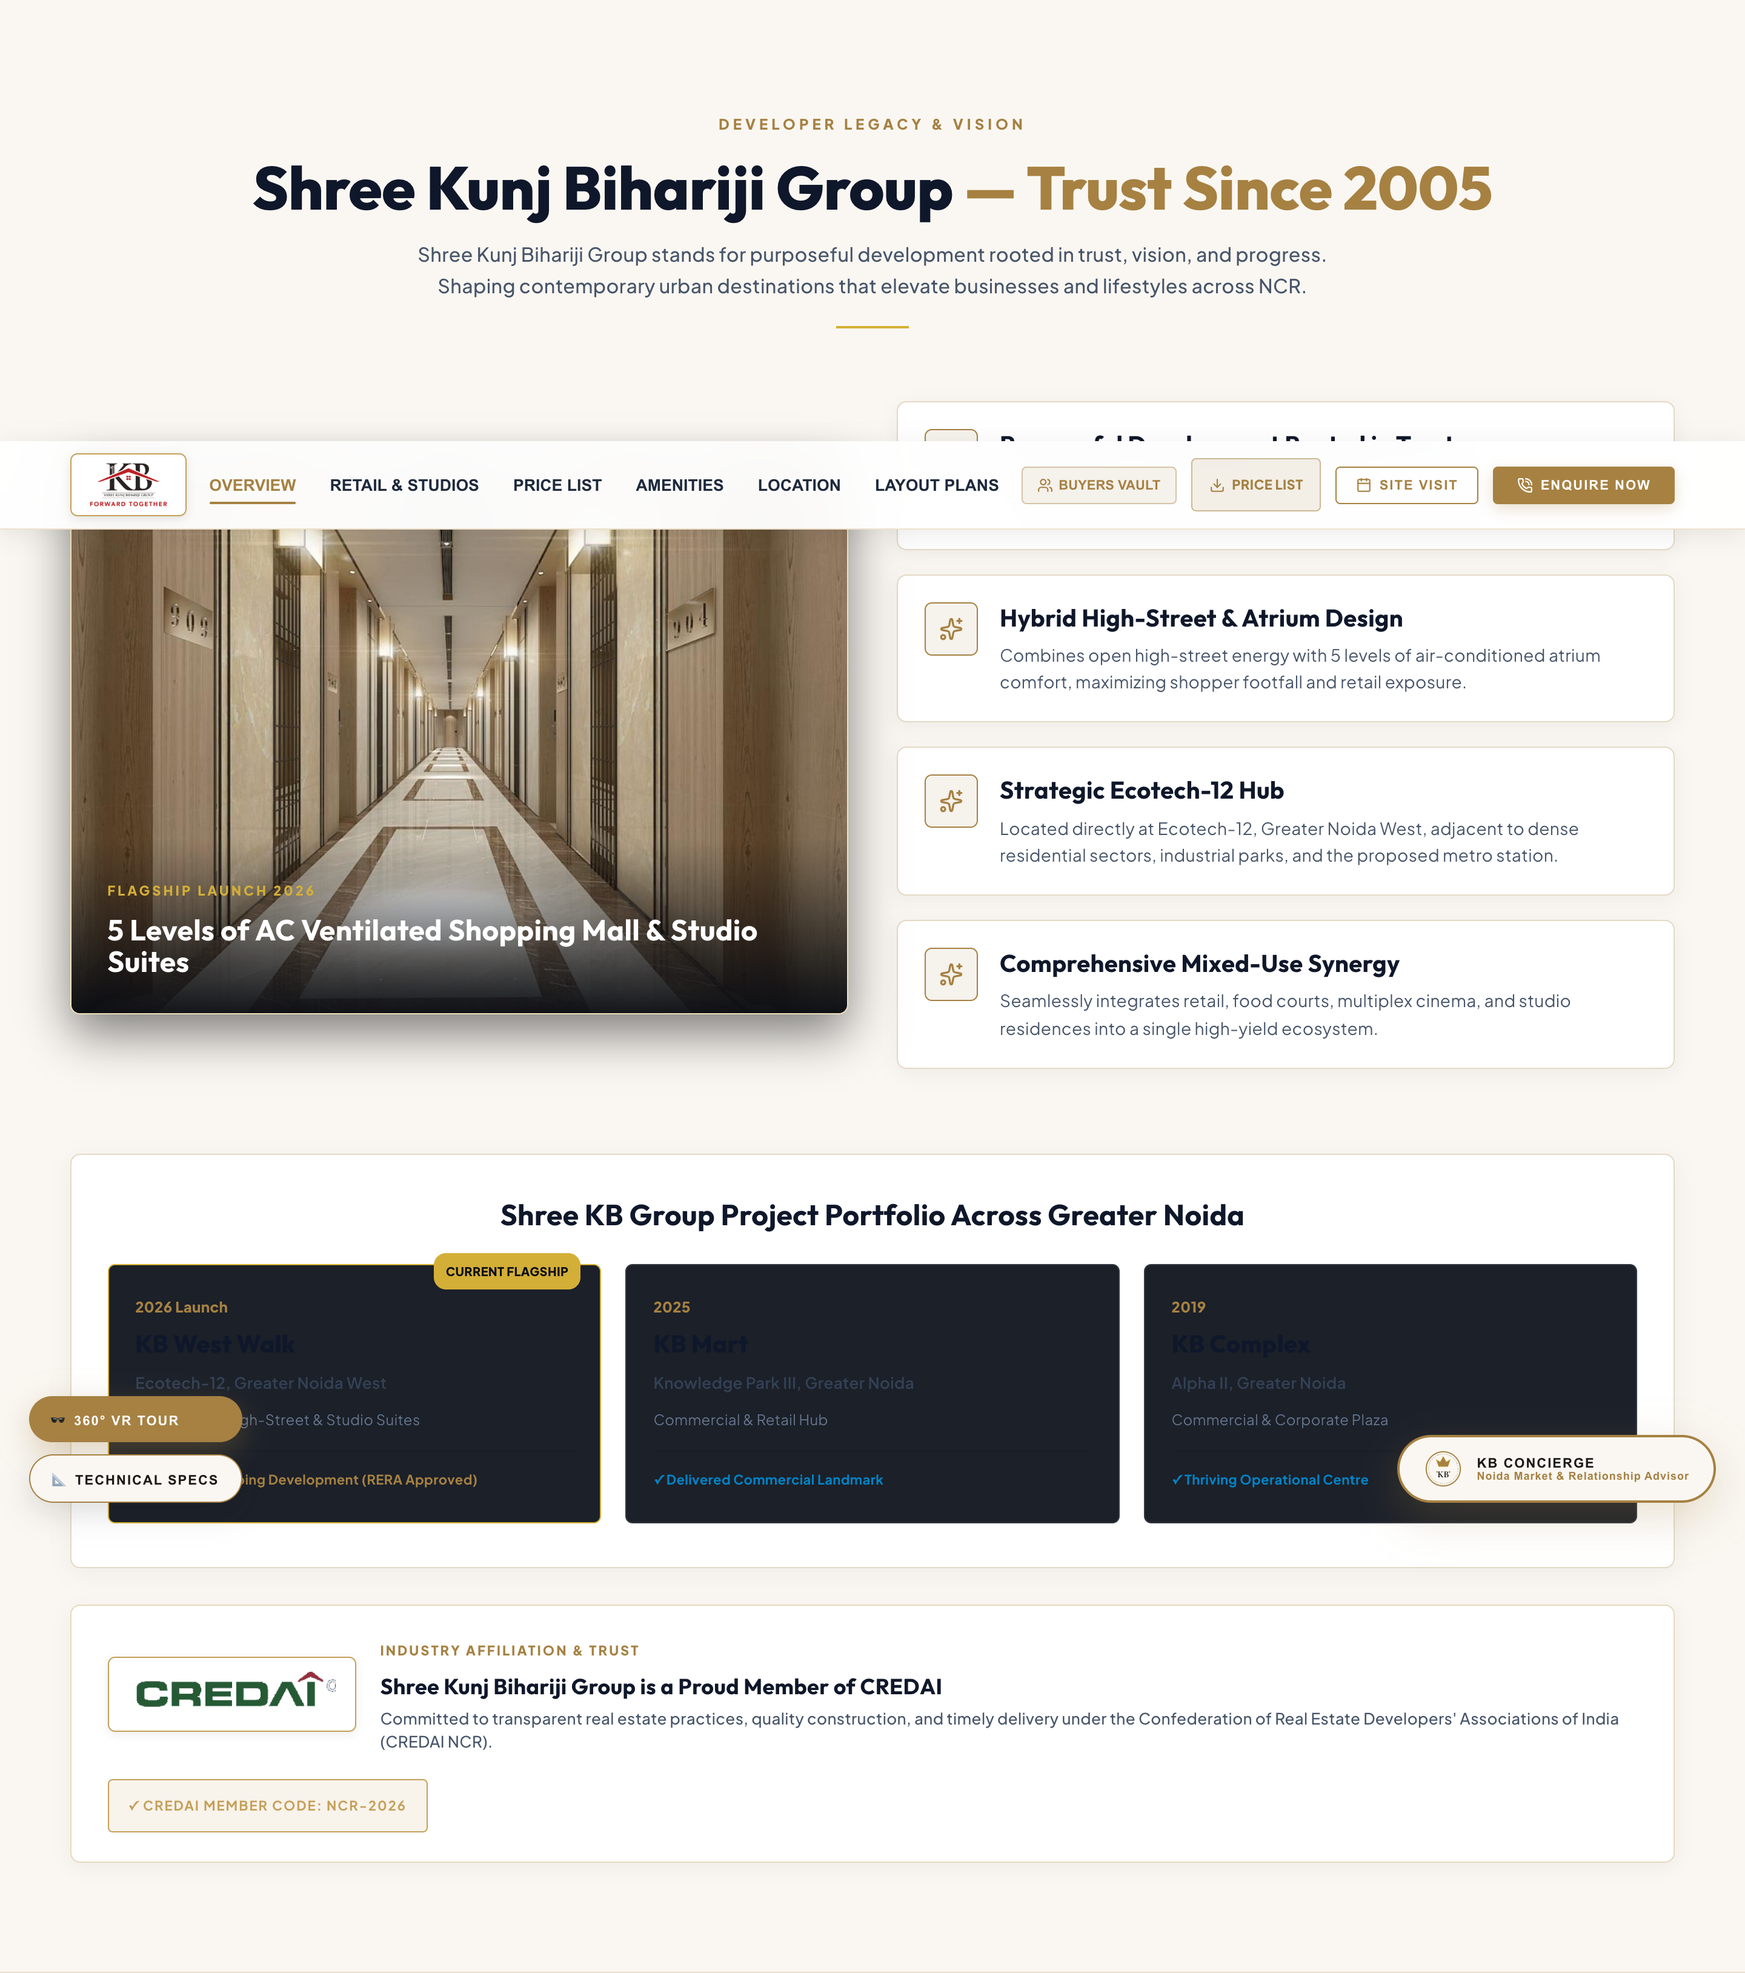
06. BRAND PHILOSOPHY & ETHOS
Purposeful Urban Development Rooted in Developer Trust
SECTION ANALYSIS & DELINEATED CONTENT
• Developer Lineage: Shree Kunj Bihariji Group shaping urban destinations across NCR since 2005.
• Hybrid High-Street & Atrium Design: Combines open high-street energy with 5 levels of AC atrium comfort.
• Strategic Ecotech-12 Corridor: Located directly at Ecotech-12 adjacent to dense residential sectors.
• Mixed-Use Synergy: Seamlessly integrates retail, food courts, multiplex cinema, and studio residences.
• Delivered Track Record: KB Mart (Knowledge Park III) and KB Complex (Alpha-2, Greater Noida).

Slide 8
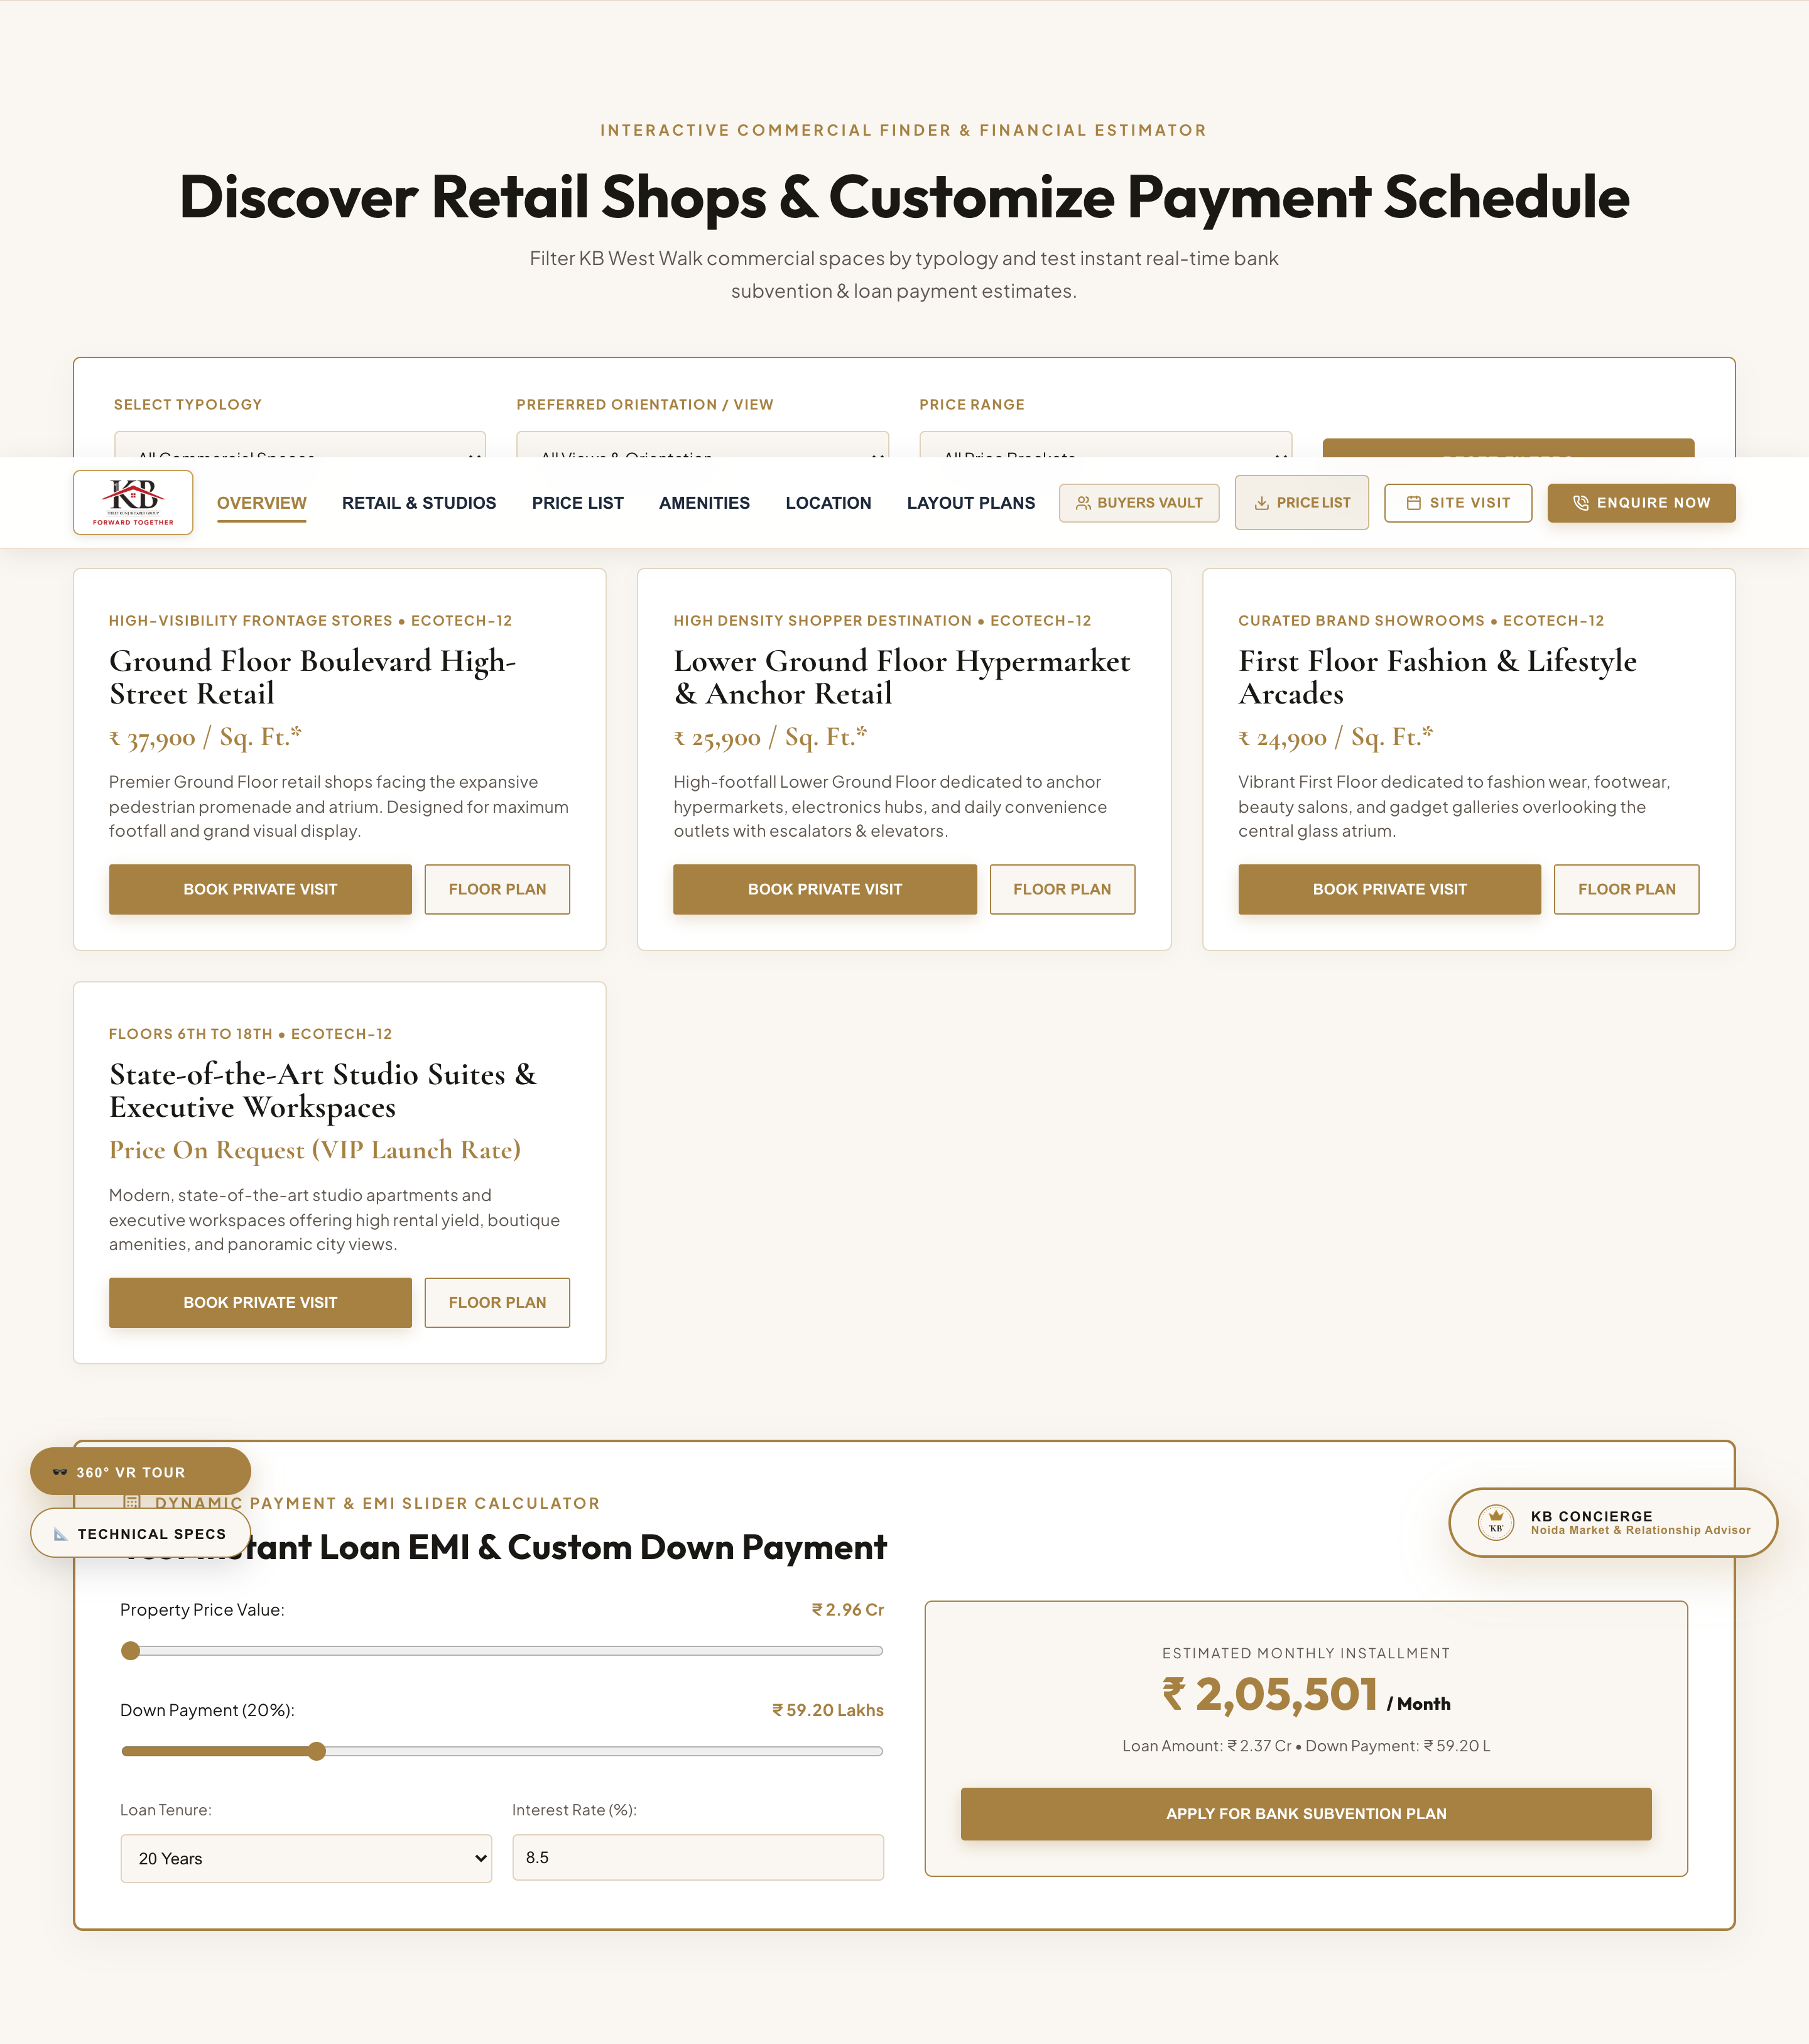
07. PROPERTY FINDER & EMI CALCULATOR
Interactive Commercial Space Search & Bank Loan Slider
SECTION ANALYSIS & DELINEATED CONTENT
• Property Finder Component:
- Category Selector: Retail Shops, Food Court/Cinema, Studio Suites
- Budget Range Selector: Up to ₹50L, ₹50L-₹1Cr, ₹1Cr-₹3Cr, ₹3Cr+
- View Orientation Selector: Atrium Facing, Boulevard Facing, Promenade View
• Real-Time Loan EMI Calculator:
- Property Price Range Slider (₹29.6 L to ₹6.00 Cr)
- Down Payment Percentage Selector (10% to 50%)
- Tenure Selector (10, 15, 20, 25, 30 Years) & Interest Rate Input
- Live Monthly EMI Output Calculation

Slide 9
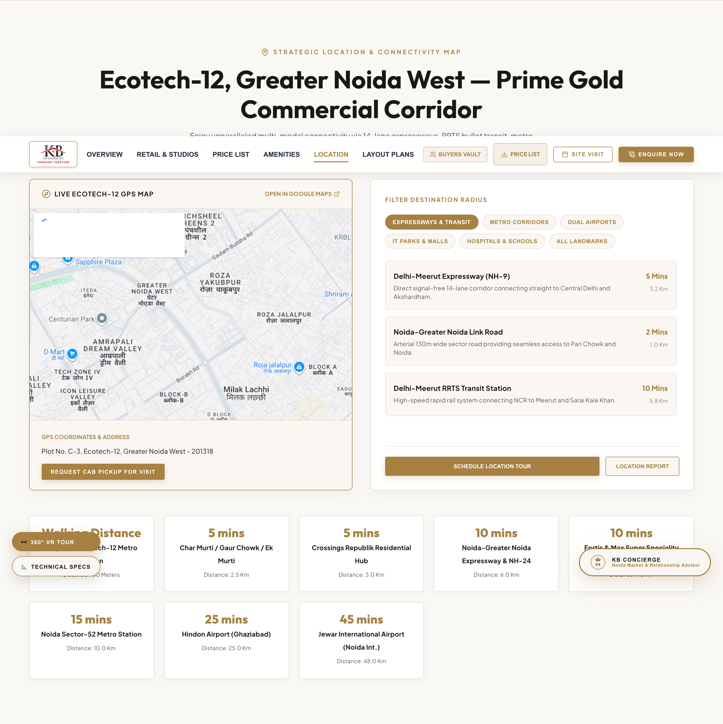
08. LOCATION ADVANTAGE & CONNECTIVITY MAP
Plot C-3, Ecotech-12 Distance Benchmarks & Transit Hubs
SECTION ANALYSIS & DELINEATED CONTENT
• Proposed Ecotech-12 Metro Station: Walking Distance (100 Meters)
• Char Murti / Gaur Chowk / Ek Murti: 5 Mins (2.5 Km)
• Crossings Republik Residential Hub: 5 Mins (3.0 Km)
• Noida-Greater Noida Expressway & NH-24: 10 Mins (6.0 Km)
• Fortis & Max Super Speciality Hospital: 10 Mins (7.5 Km)
• Noida Sector-52 Metro Station: 15 Mins (10.0 Km)
• Hindon Regional Airport: 25 Mins (25.0 Km)
• Jewar International Airport (Noida Int.): 45 Mins (48.0 Km)

Slide 10
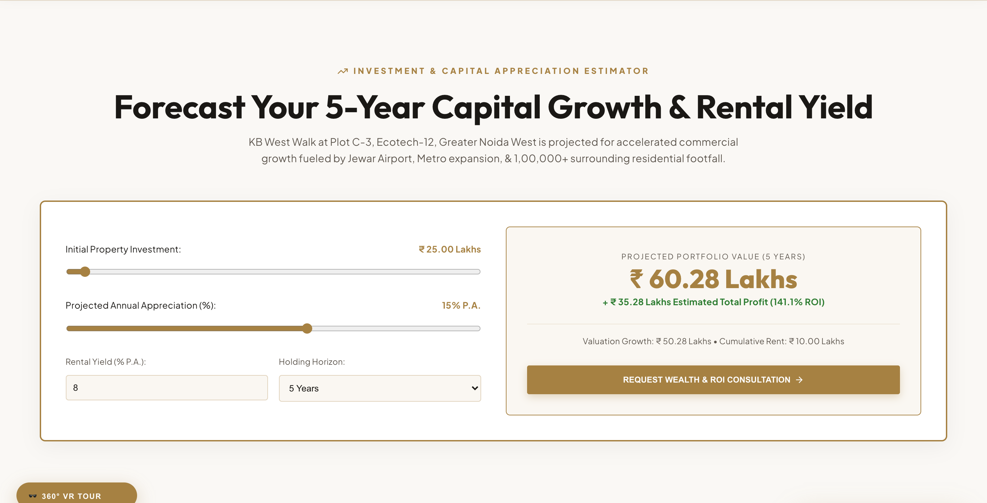
09. INVESTMENT ROI & GROWTH YIELD
Capital Appreciation Benchmarks & Rental Yield Projections
SECTION ANALYSIS & DELINEATED CONTENT
• Commercial Rental Yield: 7.5% – 9.2% P.A. (High yield corridor in Greater Noida West).
• YoY Capital Appreciation: +21.2% YoY Growth (Ranked among top 3 retail appreciation hubs).
• Cumulative 3-Year Appreciation: +38% to +48% projected growth upon metro & Jewar airport launch.
• Ecotech-12 Locality Rating: 92 / 100 (4.9/5 Stars) by leading real estate portals.
• Captive Footfall: Surrounded by 1,00,000+ occupied residential apartments.

Slide 11
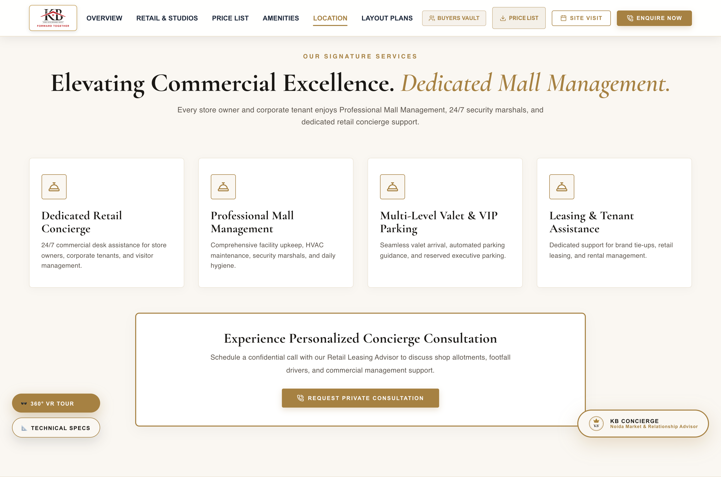
10. DEDICATED MALL & FACILITY SERVICES
4 Pillars of Commercial Mall Management & Tenant Support
SECTION ANALYSIS & DELINEATED CONTENT
• Dedicated Retail Concierge: 24/7 commercial desk assistance for store owners & corporate tenants.
• Professional Mall Management: Comprehensive facility upkeep, central HVAC climate maintenance & security.
• Multi-Level Valet & VIP Parking: Seamless valet arrival, automated parking guidance & executive slots.
• Leasing & Brand Support: Dedicated assistance for brand tie-ups, retail leasing & rental management.

Slide 12
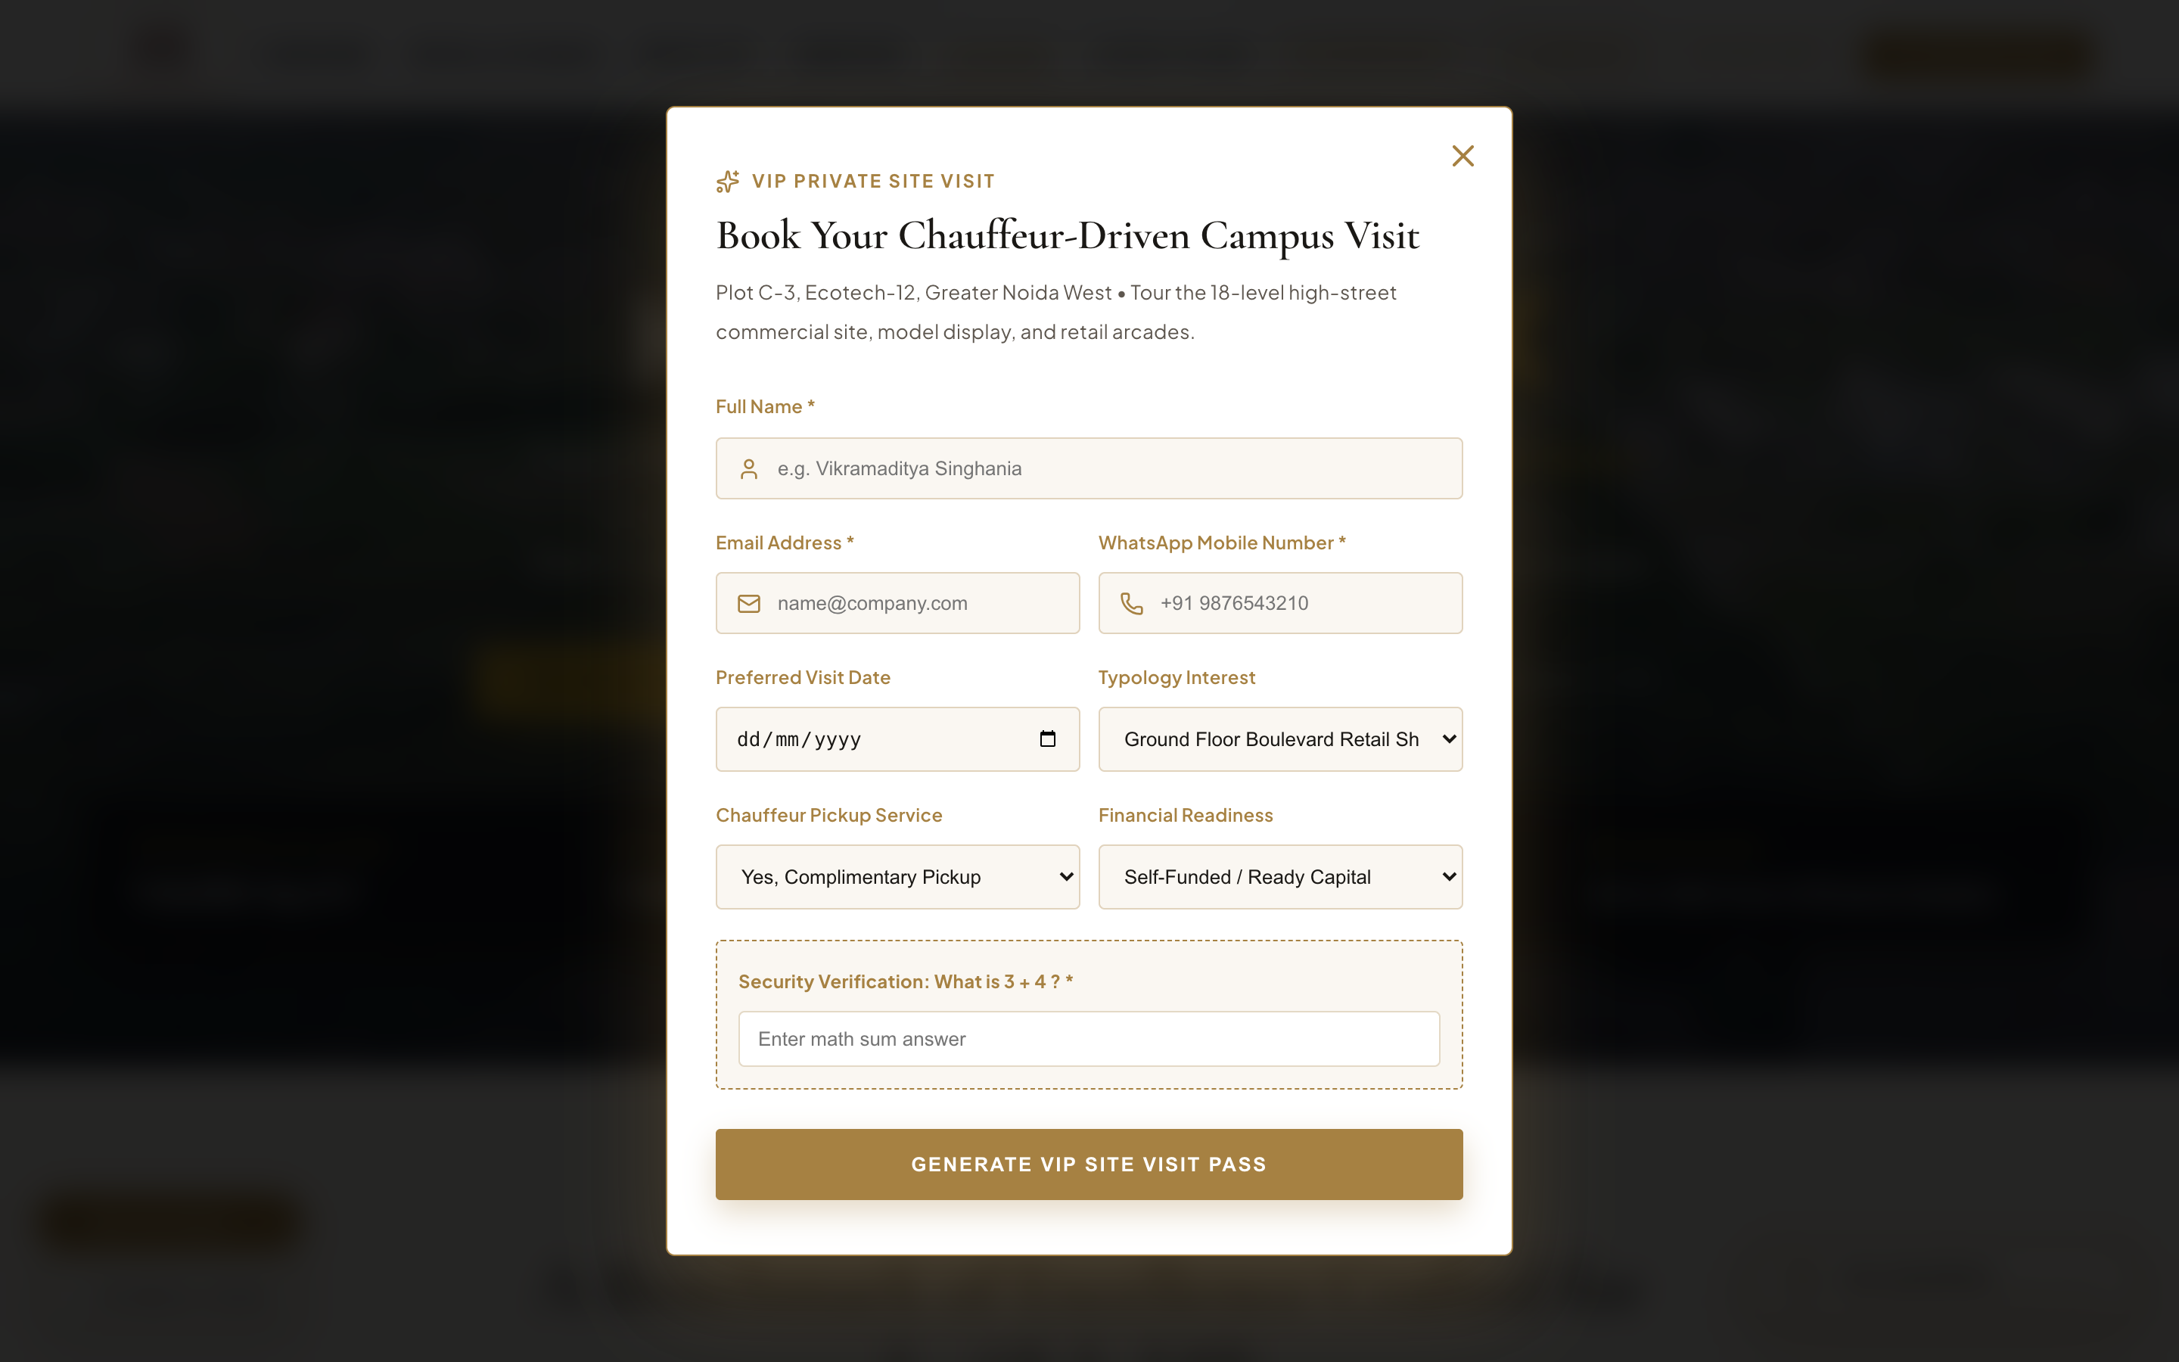
11. VIP SITE VISIT OVERLAY MODAL
On-Site Chauffeur Booking, Security Captcha & VIP Pass Generator
SECTION ANALYSIS & DELINEATED CONTENT
• Interactive Modal Trigger: 'BOOK VIP SITE VISIT' buttons across the site.
• Chauffeur Pickup Option: Option to request a complimentary luxury AC chauffeur pickup.
• Preferred Slot Selection: Date & time slot picker for guided walkthroughs at Plot C-3, Ecotech-12.
• Captcha Security: Interactive math security challenge ensuring real buyer leads.
• Instant VIP Pass Generation: Generates downloadable VIP Pass upon submission.

Slide 13
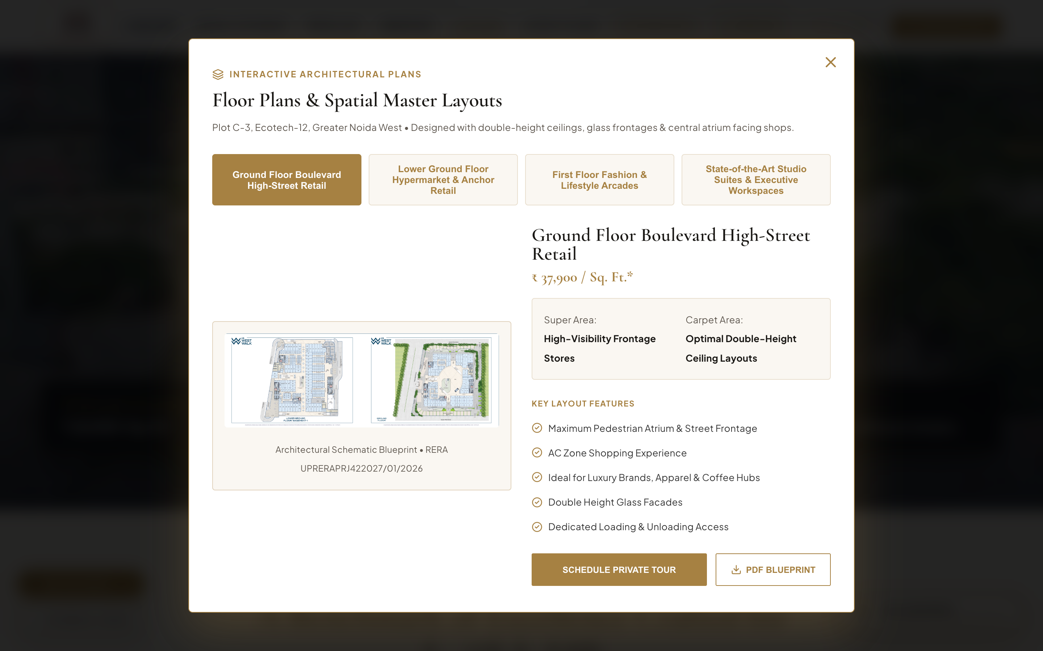
12. ARCHITECTURAL FLOOR PLANS MODAL
Interactive Floor Blueprint Swapper & Technical Unit Specs
SECTION ANALYSIS & DELINEATED CONTENT
• Interactive Modal Trigger: 'VIEW FLOOR PLANS' buttons across typologies.
• Floor Blueprint Tab Swapper: Switch between Lower Ground, Ground Floor, First Floor, and Studio Suites.
• High-Resolution Schematic Renderings: Shows unit dimensions, double height facades & atrium openings.
• Technical Specifications: Highlights super area, carpet area, ceiling heights, and loading hoists.
• Download Blueprint CTA: Instant PDF floor plan download.

Slide 14
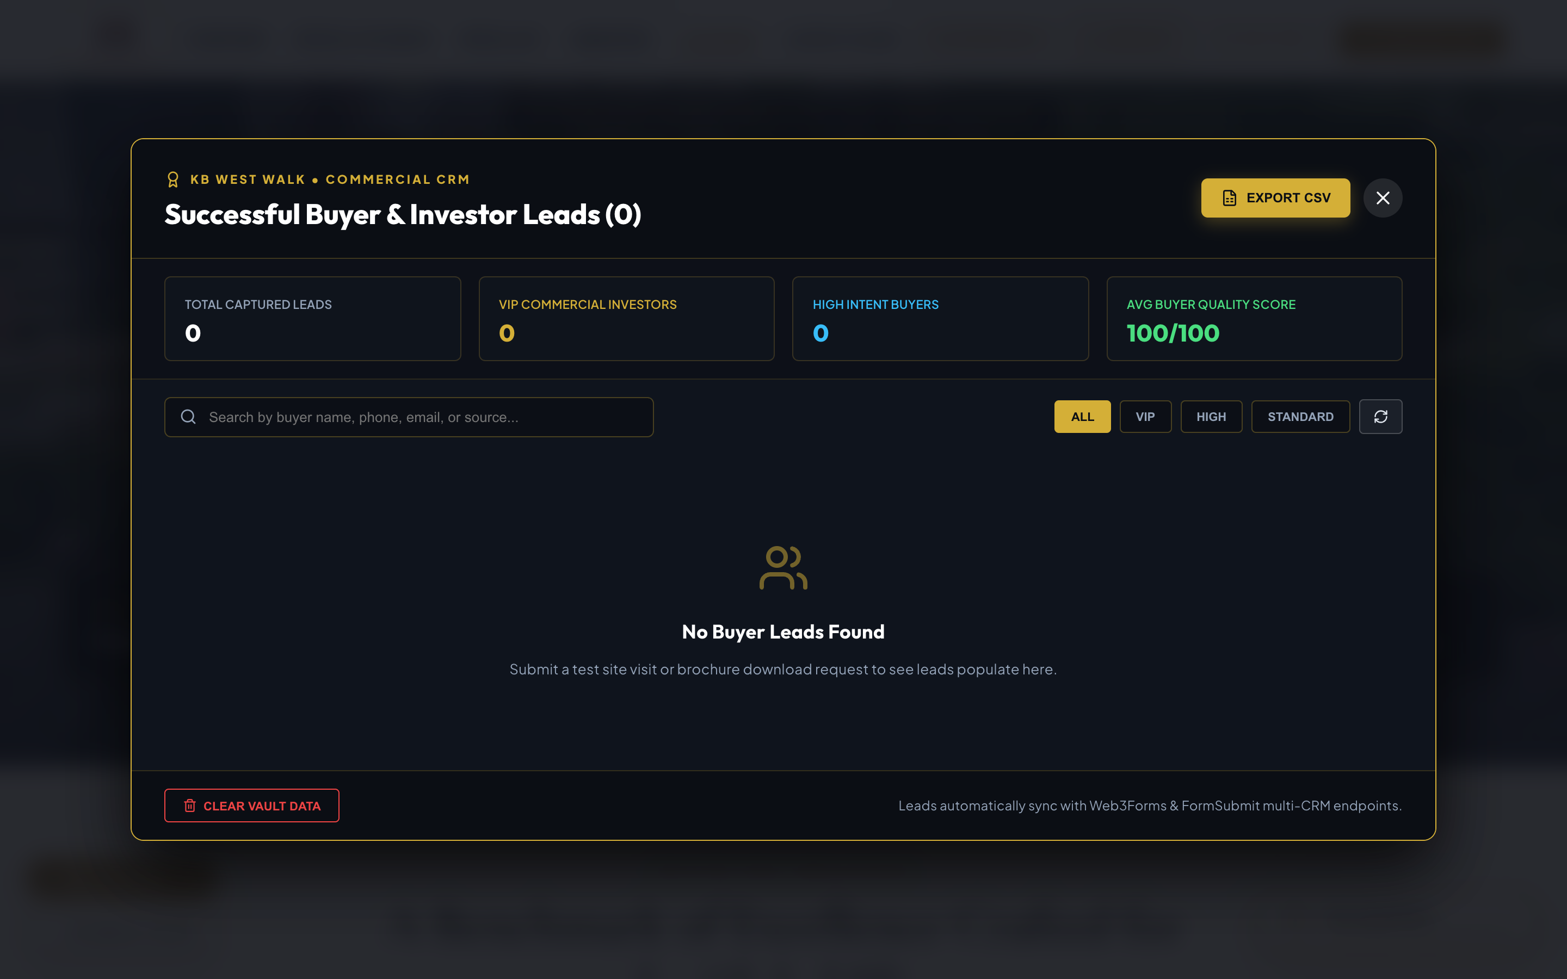
13. BUYER LEADS VAULT & CRM DASHBOARD
100-Point Scoring, Local Vault Storage & One-Click CSV Export
SECTION ANALYSIS & DELINEATED CONTENT
• Global Shortcut Trigger: Ctrl + Shift + L or Cmd + Shift + L shortcut.
• Local Vault Persistence: Secure lead persistence in `localStorage` (`kb_west_walk_leads_vault`).
• 100-Point Quality Scoring: Deducts 50 pts for temp emails/dummy phones; adds 15 pts for chauffeur requests.
• Buyer Tiering: VIP Commercial Investor (90+), High Intent Buyer (70+), Standard Prospect (<70).
• One-Click CSV Export: Instant CSV download via `exportLeadsToCSV()` for sales team dispatch.

Slide 15
PORTAL AUDIT & VISUAL PRESENTATION COMPLETE
✔ Embedded High-Res Screenshots: All 14 website sections & modal overlays captured and embedded.
✔ Official KB Branding: Fixed logo presentation using official Shree KB Group Crest & KB West Walk brand logos.
✔ RERA Compliance Verified: Registration No UPRERAPRJ422027/01/2026 & Axis Bank Collection Account details.
✔ Live Interactive Server: Accessible at http://localhost:3000/ with Vite 8 & React 19.
📍 SITE OFFICE: Plot No. C-3, Ecotech-12, Greater Noida West - 201318
🏢 CORPORATE OFFICE: FF-39, First Floor, KB Complex, Plot No. LS-1, Alpha-2, Greater Noida, U.P. 201310
📞 HELPLINE: +91 828 7777 333 | WHATSAPP: +91 828 7777 333

