Slide 1
Generating Ultra-Concise Summaries of Product Reviews

Slide 2
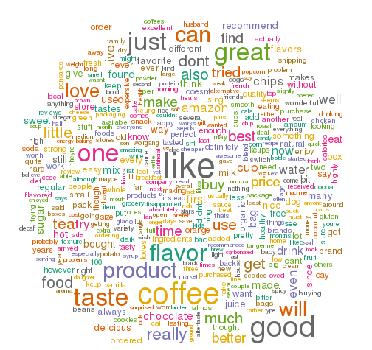
Dataset
We have done the project on "Amazon Fine Food Reviews"
It consists of 568,454 food reviews
We have clubbed all the review of a particular product
together and then generated the micro-opinions on them

Slide 3
Motivation
Micro-opinions generates the key-opinions of whole review about a particular product in set of few words
Conciseness or compactness: Particularly important with the increased use of small sized hand-held devices like phone,tablets
Shopping Sites: Concise pro-cons summary consisting of list of few opinion words would help convey critical information
Tweets: Concise summaries are also suitable for tweets

Slide 4
Methodology
We have implemented the method which is weakly-semi supervised
Opinion Mining
Opinion lexicon expansion
List of opinion words which indicates positive or negative sentiments
e.g. "good", "excellent", "poor", "tasty"
Opinion target extraction
Topics on which opinions are expressed. e.g. tasty chocolate

Slide 5
Relation between opinion words and targets
There exist a natural relation between opinion words and targets because opinion words are used to modify targets.
These relations can be seen via dependency parser based on dependency grammar
And, these dependencies can be used to extract new opinion words and targets
We have extracted new opinion words using existing opinion words and targets and in a similar way we have extracted new target words. Because of this, it is also called double propagation algorithm

Slide 6
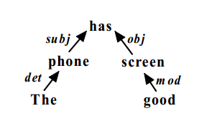
Relational Identification
Relation between opinion word and targets are of three types
OO-Rel: Relation between one opinion word on another opinion word
OT-Rel:
TT-Rel:
Syntactic Relation:
Two words A and B are directly or indirectly dependent on each other through syntactic relations

Slide 7

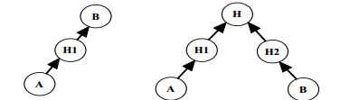
Direct and Indirect Dependency
Direct Dependency: Indicates that one word depends on the other word without any additional words in their dependency path (i.e., directly) or they both depend on a third word directly
Indirect Dependency: An indirect dependency indicates that one word depends on the other word through some additional words (i.e., indirectly) or they both depend on a third word through additional words.

Slide 8
Formulation of OT-Rel, OO-Rel or TT-Rel
DDs and IDDs decribes the set of all relations
We put some more constraints like POS of words and potential syntactic relations between them
We have used NLTK POS tagger and standford dependency parser
Opinion words as adjectives ('JJ')
Target words as nouns ('NN')
Dependency relations between opinion words and targets includes- mod, pnmod, subj, s, obj, obj2, desc (MR)
Relations for opinion words and targets includes- conj (CONJ)
So, a quadruple describe OT,OO,TT relation - <POS(wi),DT, R, POS(wj)>

Slide 9
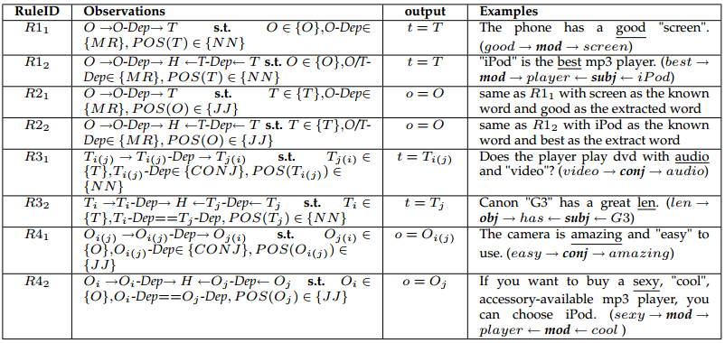
Propagation Rules

Slide 10
Initializing opinion words and targets

Slide 11
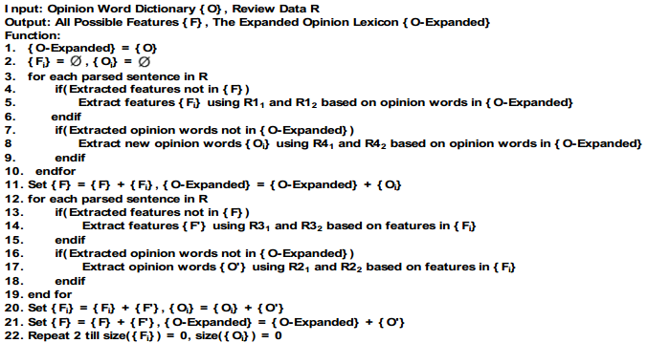
Propagation Algorithm

Slide 12
Prunning of opinion words and targets

Slide 13
Generation of micro-opinions using opinion words and targets

Slide 14
Some micro-opinions on reviews

Slide 15
ROUGE
I will explain it

Slide 16
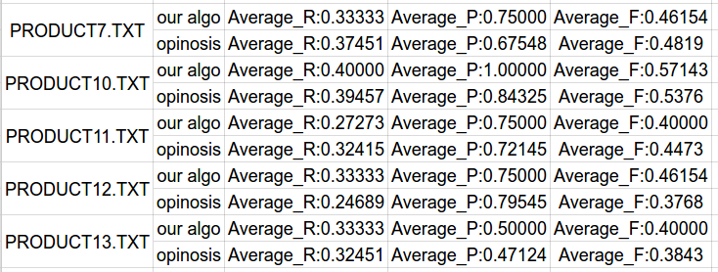
Results and Evaluation
We performed the results using ROUGE-1 and compared the result using state of art method opinosis

Slide 17
Initial attempt
Kavita Ganeshan Paper

Slide 18
Future Work
Quantitative evaluation of generated opinion words and target words, using precision, recall and F-score parameters and comparing it with other state-of-art methods.
Currently, we have generated the micro-opinion consisting of bigrams and trigrams, but it can be easily extended to n-grams (n>3)

Slide 19
References

