Slide 1
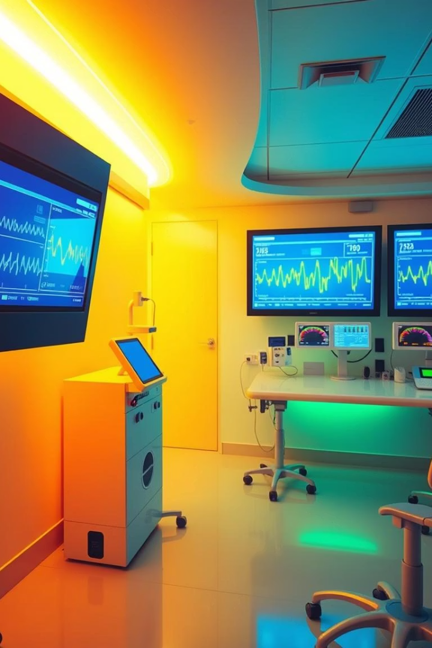
Real-Time Patient Monitoring Using Apache Spark and Kafka
presented by - Tanmesh Singh (MSE2024016)
Neeraj Kumar Kannoujiya (MSE2024003)
Anshuman Moharana (MDE2024006)

Slide 2
Problem Statement
Traditional systems struggle with real-time data processing
Critical care demands timely alerts
Scalability challenges with large sensor data
Need low-latency, scalable processing

Slide 3




System Objectives
Continuous physiological data collection
Abnormal pattern detection
Immediate alert delivery
Data storage for analysis

Slide 4

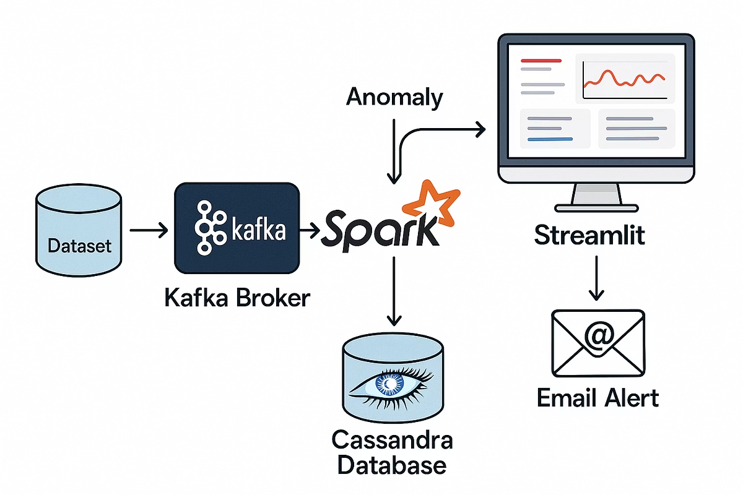
Proposed Methodology
1
Data Ingestion using Kafka
2
Real-Time Processing using spark
3
Alert Generation on Mail
4
Data Storage using Cassandra
5
Visualization using Streamlit
6
Threshold Based Analysis

Slide 5



Frameworks and Tools
Apache Kafka
Apache Spark
Streaming and ingestion
Real-time analytics and processing
Hadoop HDFS / Cassandra
Streamlit
Scalable storage solutions
Visualization and web interface

Slide 6

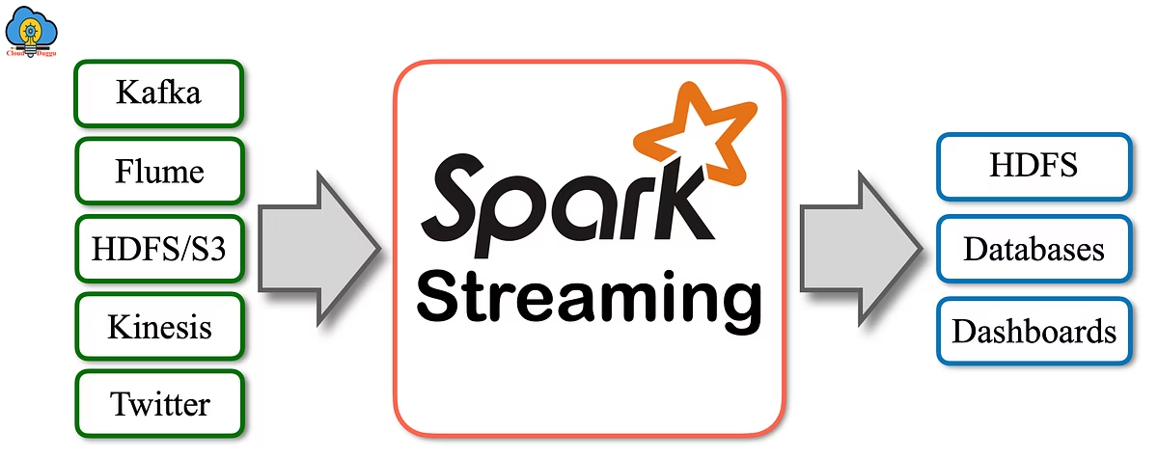


Real-Time Processing with Apache Spark
Batch processing of patient signals in real-time.
Threshold based anomaly detection
Integration with Kafka Streams and the detected anomaly column is appended to the dataset stored on Cassandra.

Slide 7




Anomaly Detection and Alerts
Threshold based analysis
Abnormal pattern recognition
Real-time alerts on mail
Dashboard visualization with alerts

Slide 8
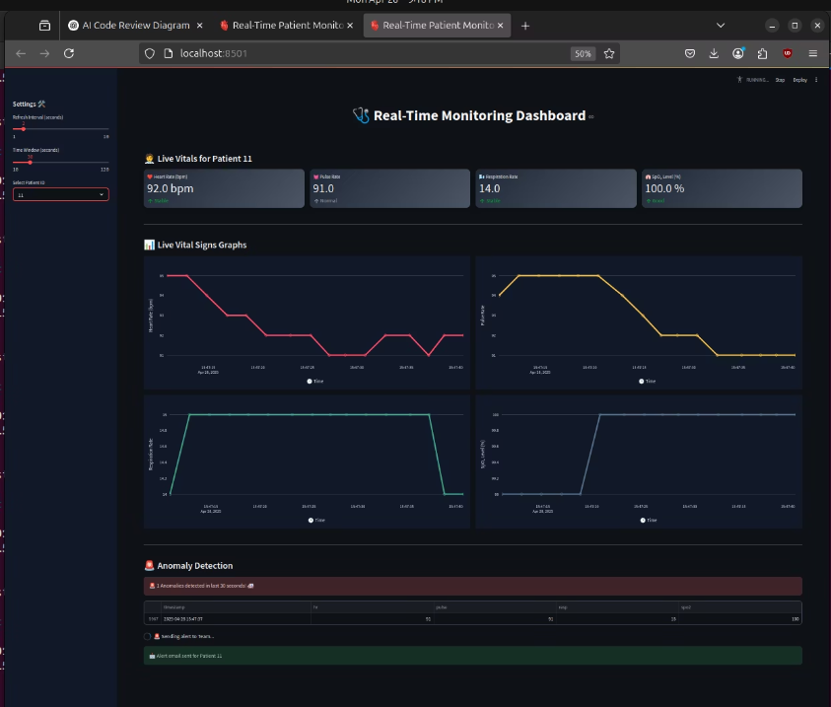
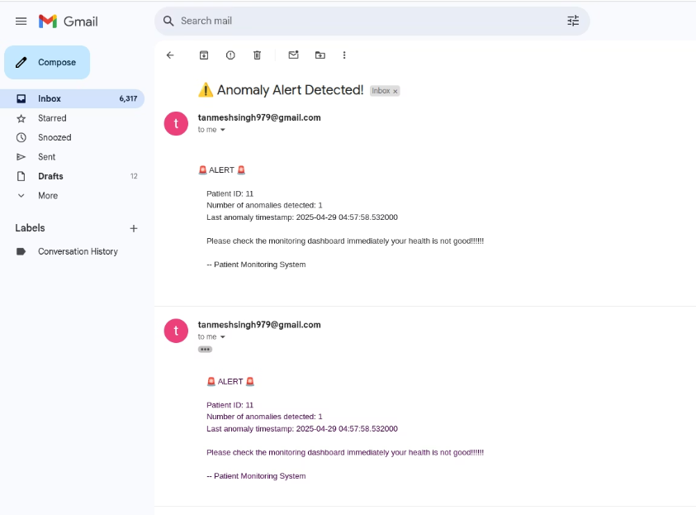
Screenshots
Alert Notification
Email alert generated for detected abnormal patient condition.
Dashboard Overview
Real-time display of patient vital signs and anomaly alerts.

Slide 9



Conclusion
A real-time patient monitoring system using Apache Spark and Kafka offers a scalable, low-latency, and reliable solution for critical healthcare needs.
The system ensures continuous monitoring, quick anomaly detection, and instant alerts, enabling faster interventions and potentially saving lives.
By combining big data frameworks with machine learning, healthcare providers can not only respond faster but also analyze historical trends for better future diagnosis.
This project highlights how modern data engineering tools can revolutionize healthcare monitoring in real-world scenarios.

